Slide 1
God’s Design for Marriage – Man and Woman –
Husband and Wife in Christ”
-God’s good gifts for his people modeled on the relationship
of Christ the Bridegroom and the Church the Bride-
Pastor David Nehrenz
Trinity Lutheran Church Norman, OK. www.tlcnorman.org
Dates: August 9,16,23,30, 2015 - A Four Week Study

Slide 2
THE ORDER OF CREATION and THE FALL OF MAN
Gen 2:18-25; 3:1-24;
Mt 19:3-9;
Mk 10:4-12;
1 Cor 11:3; Eph 5:22-33;
Col 3:18-21

Slide 3
B. THE ORDER OF SALVATION Gal 3:22-29; Rom 8:11-25; 1 Pet 3:1-7

Slide 4
C. THE GOD-GIVEN GIFT OF SEXUALITY
1 Cor 7:1-17;
Rom 7:1-3;
Lk 20:27-38

Slide 5
D. THE MISUSE OF GOD’S GIFT OF SEXUALTIY Gen 19:1-25; Ex 20:14; Lev 18:20-30; Mt 5:27-32; 15:19; Mk 10:17-21; Rom 1:18-30

Slide 6
E. LAW AND GOSPEL RESPONSE TO SINS – REPENTANCE, FAITH, FORGIVENESS, CHANGED LIFE
1 Cor 6:9-20;
Gal 5:16-26;
2 Pet 2:4-22;
Jude 1:1-13

Slide 7
F. THE SANCTITY OF MARRIAGE – Dr. Peter Scaer – Professor at Concordia Theological Seminary Ft. Wayne Vicar at Trinity Lutheran Church 1990-91 The following discussion points concerning the sanctity of marriage and the U.S. Supreme Court’s recent decision were prepared by the Rev. Dr. Peter J. Scaer, associate professor of Exegetical Theology, Concordia Theological Seminary (CTSFW), Fort Wayne, Indiana. 1. The Supreme Court decision changes nothing about our Chris.an faith. We believe that there is still a higher court and that Christ will be our final Judge. As Christians, we obey the government (Romans 13), but we recognize that our greatest allegiance is to God and His Word, and that in matters of conscience, “We must obey God rather than men” (Acts 5:29). 2. We therefore will continue to support one man one woman marriage, as it is taught in Genesis 1 and 2, and as it is taught by Christ Himself (Matthew 19:1-9 and Mark 10:1-12). 3. We will continue to preach marriage as a picture of Christ’s sacrificial love for His bride the Church (Ephesians 5), even as celebrate the Lord’s Supper, which is the beginning of the Wedding Feast that has no end (Matthew 22; Revelation 21).

Slide 8
4. The Church will continue to be a place of healing and forgiveness, restoration and mercy. As our Lord has said, “Those who are well have no need of a physician, but those who are sick. I have not come to call the righteous but sinners to repentance” (Luke 5:31-32). 5. We are all called to repentance. As a people, we have not treated marriage with the respect that it deserves. Divorce is far too common among us, and too often we condone and support even our fellow Christians as they live together outside of wedlock. Knowing that we cannot rely upon worldly wisdom, we are called to hear and reflect upon God’s Word and once more come to Him for forgiveness. 6. True love calls us to speak the truth so that all may know the forgiveness and love of Christ. We cannot celebrate that which God calls sin (Romans 1:18-32; 1 Corinthians 6:9). By doing so, we leave people in their sin and apart from Christ. 7. We will also continue to support traditional marriage as an earthly institution, knowing that it is a reflection of natural law and that any law that goes against the natural law will necessarily be harmful and unjust. Written into creation, marriage is good for men, women and children.

Slide 9
8. The Court has been wrong before. In the Dred Scott decision, African Americans were counted as less than human. In Roe v. Wade, the rights of the li/lest children were ignored, leading to the deaths of 57 million children. The Supreme Court, like any human institution, is prone to error. As Christians, we recognize that there is a higher, heavenly court and that God’s Word does not change. We also recognize that unjust decisions must be challenged for the good of our neighbor. 9. The debate over marriage has nothing to do with equality. The pertinent question is, “What is Marriage?” The traditional definition is not arbitrary, but is based upon the fact that every child has a biological mother and father, and should have a reasonable expectation that he/she will be raised by those parents. Traditional marriage discriminates against no one. The real discrimination will come against those who hold fast to God’s Word. 10. Same-sex marriage is not a civil rights issue. Whether you are black or white makes no difference, but men and women are different biologically, psychologically and emotionally. From our differences, new life comes into the world, and with our complementary differences, we are best able to support and nurture the next generation. 11. Marriage is the only institution that binds a man to his wife and to any children that result from that union. Only the union of one man and one woman is able to produce a child, and for that reason there is marriage

Slide 10
12. Mothers and fathers are not interchangeable. For good reason, we celebrate Mother’s Day and Father’s Day. And it is a blessing to have both a mom and a dad, each of whom brings something special to the family. In a fallen world this is not always possible. God salvages difficult situations. Therefore, our congregations will continue to be true families in Christ, as we continue to call upon God as our Father.
13. Some ask, “How will same-sex marriage affect me?” Consider, for instance, the way that no-fault divorce laws have hurt our society and le so many of our children abandoned and unprotected. The values of permanence, exclusivity and monogamy are inherently tied to the fact that only man and one woman can produce a child and have an obligation to care for that child.
14. So called “gay marriage” is not the end of the debate but only the beginning. There is now no consistent logical argument against polygamy, group marriage or temporary marriage. Such arguments, once thought to be extreme, are now commonplace. In the midst of such confusion, the Church must continue to speak the truth in love.

Slide 11
15. Marriage is about more than the relationship of two people. It is the institution that binds the generations together. At the birth of every child, the mother, by the very nature of things, is present. Marriage is the one institution that encourages, incentivizes and obligates the father to be present as well. Marriage then creates a network of aunts and uncles, grandparents and cousins, helping to establish a child’s sense of belonging.
16. As same-sex marriage becomes the law of the land, Christians will be increasingly persecuted for their belief. Already, florists and bakers have come under fire. Businessmen have lost their jobs and reputations. Christian adoption agencies have been forced to close. Pastors have had their sermons subpoenaed. Chris.an schools have already come under assault, having to fight for their accreditation. The free exercise of religion, a constitutionally protect right, is under great assault. We therefore must stand together with people of conscience. We must support those who speak God’s truth in love and are persecuted for living according to their faith in Christ.
17. As Christians, we are called to be faithful to Christ our Bridegroom. The days ahead will be trying and our faith will be tested. The world will call us haters and we will be mocked and ridiculed (John 15:18-25). Yet, even in the midst of persecution, Jesus calls us to rejoice, saying, “Blessed are you when others revile you and persecute you and utter all kinds of evil against you falsely on my account. Rejoice and be glad, for your reward is great in heaven, for so they persecuted the prophets who were before you” (Matthew 5:12). As Christians, we will listen to the Good Shepherd, knowing that His words are faithful and true. Though the world may hate us, we cling to Christ who says, “Be faithful unto death, and I will give you the crown of life” (Revelation 2:10).

Slide 12
Dr. Matthew Harrison – LCMS President responds to SCOTUS same-sex marriage ruling on June 26, 2015 in OFFICIAL STATEMENTS, PRESSROOM35 God is our refuge and strength, a very present help in trouble. Therefore we will not fear though the earth gives way, though the mountains be moved into the heart of the sea, though its waters roar and foam, though the mountains tremble at its swelling. Selah There is a river whose streams make glad the city of God, the holy habitation of the Most High. God is in the midst of her; she shall not be moved; God will help her when morning dawns. The nations rage, the kingdoms totter; he utters his voice, the earth melts. The LORD of hosts is with us; the God of Jacob is our fortress (Psalm 46:1–7).

Slide 13
A one-person majority of the U.S. Supreme Court got it wrong – again. Some 40 years ago, a similarly activist court legalized the killing of children in the womb. That decision has to date left a wake of some 55 million Americans dead. Today, the Court has imposed same-sex marriage upon the whole nation in a similar fashion. Five justices cannot determine natural or divine law. Now shall come the time of testing for Christians faithful to the Scriptures and the divine institution of marriage (Matthew 19:3–6), and indeed, a time of testing much more intense than what followed Roe v. Wade. Like Roe v. Wade, this decision will be followed by a rash of lawsuits. Through coercive litigation, governments and popular culture continue to make the central post-modern value of sexual freedom override “the free exercise of religion” enshrined in the Bill of Rights. The ramifications of this decision are seismic. Proponents will seek to drive Christians and Christian institutions out of education at all levels; they will press laws to force faithful Christian institutions and individuals to violate consciences in work practices and myriad other ways. We will have much more to say about this.

Slide 14
During some of the darkest days of Germany, a faithful Lutheran presciently described how governments lose their claim to legitimate authority according to Romans 13. The Caesar cult in its manifold forms, the deification of the state, is one great form of the defection from the [true] idea of the state. There are also other possibilities of such defection. The government can forget and neglect its tasks. When it no longer distinguishes between right and wrong, when its courts are no longer governed by the strict desire for justice, but by special interests, when government no longer has the courage to exercise its law, fails to exercise its duties, undermines its own legal order, when it weakens through its family law parental authority and the estate of marriage, then it ceases to be governing authority. Raising such a question can lead to heavy conflicts of conscience. But it is fundamentally conceivable, and it has time and again become reality in history, that a governing authority has ceased to be governing authority. In such a case there may indeed exist a submission to a superior power. But the duty of obedience against this power no longer exists. [Hermann Sasse, “What Is the State?”(1932)]

Slide 15
As faithful Christians, we shall continue to be obedient to just laws. We affirm the human rights of all individuals and the inherent and equal value of all people. We respect the divinely given dignity of all people, no matter their sexual preference. We recognize that, under the exacting and demanding laws of God, we are indeed sinners in thought, word and deed, just as are all (Romans 3:9ff.). We confess that the “blood of Jesus Christ, God’s Son, cleanses us from all our sins” (1 John 1:7). We confess that God’s divine law of marriage and the entire Ten Commandments apply to all, and that so also the life-giving sacrifice of Christ on the cross is for all. It is a “righteousness of God through faith in Jesus Christ for all who believe” (Romans 3:22). However, even as we struggle as a church to come to a unified response to this blatant rejection of the entire history of humankind and its practice of marriage, “We shall obey God rather than man” (Acts 5:29). Christians will now begin to learn what it means to be in a state of solemn conscientious objection against the state. We will resist its imposition of falsehood upon us, even as we continue to reach out to those who continue to be harmed by the ethic of radical sexual freedom, detached from God’s blessing of marriage. And we will stand shoulder to shoulder with Christians, churches and people of good will who are resolute on this issue.

Slide 16
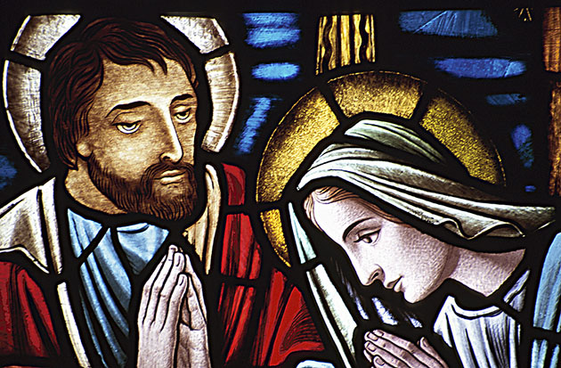

Slide 17
God help us! Amen. Pastor Matthew Harrison President - LCMS

Slide 18
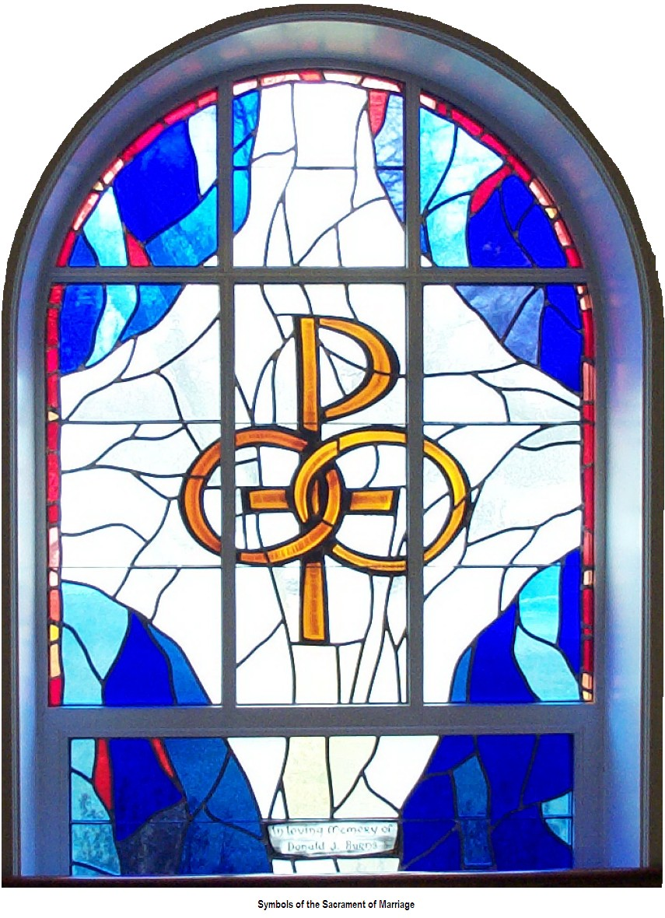

Slide 19
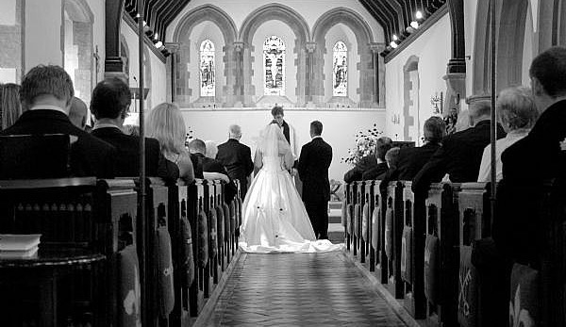

Slide 20
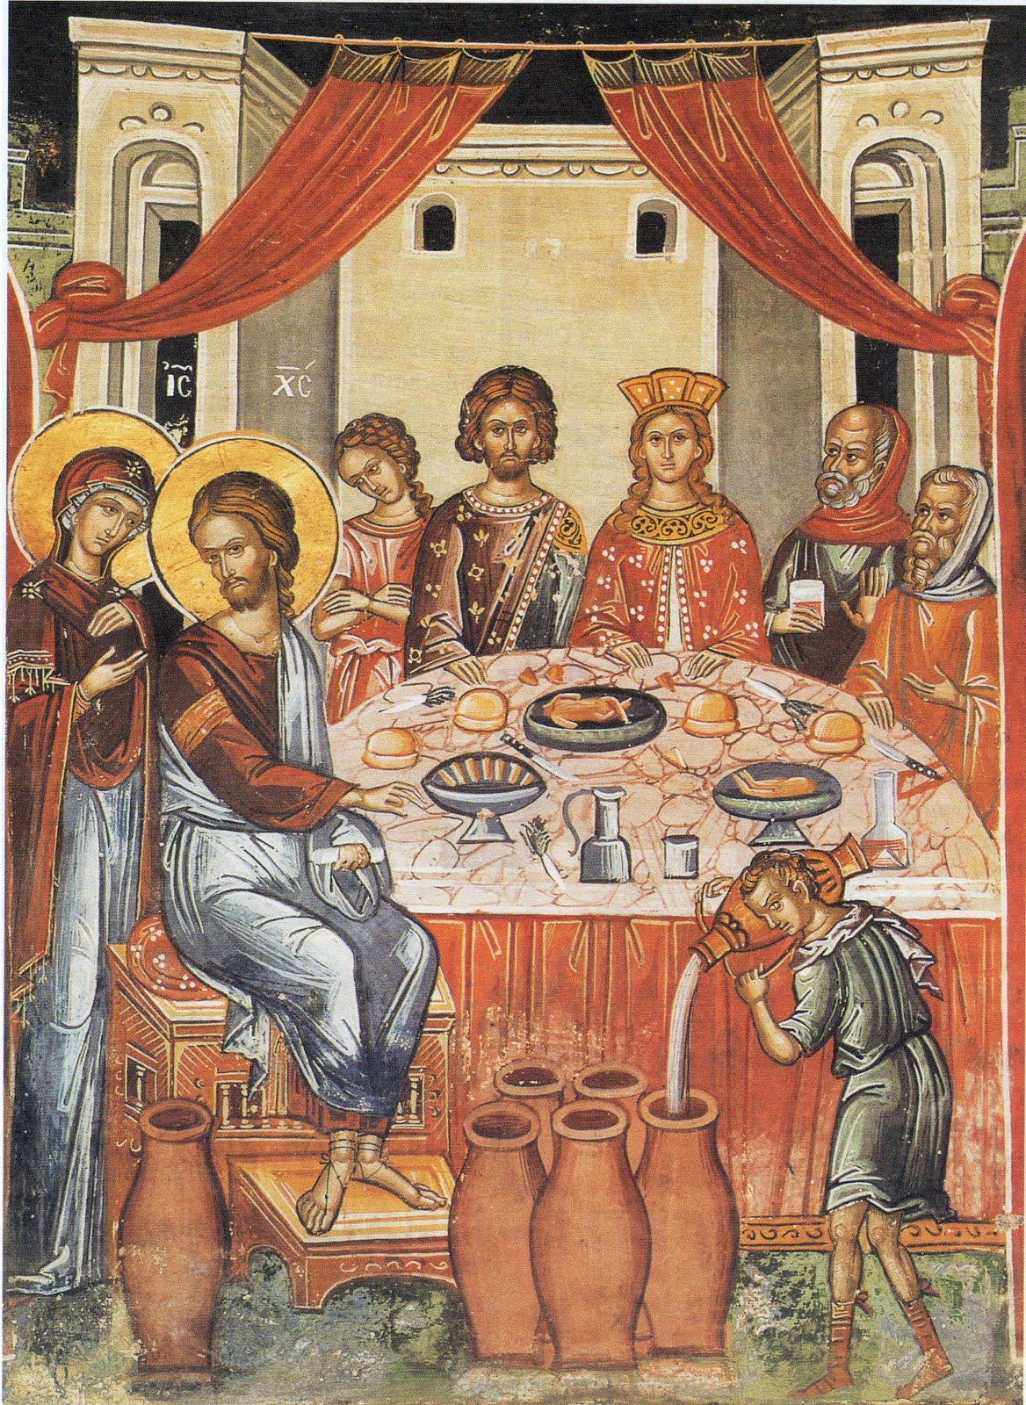

Slide 21
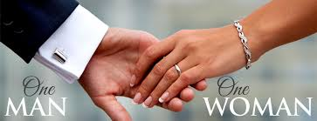

Slide 22
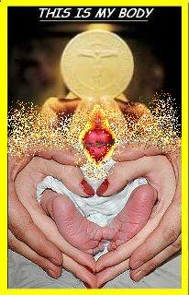

Slide 23
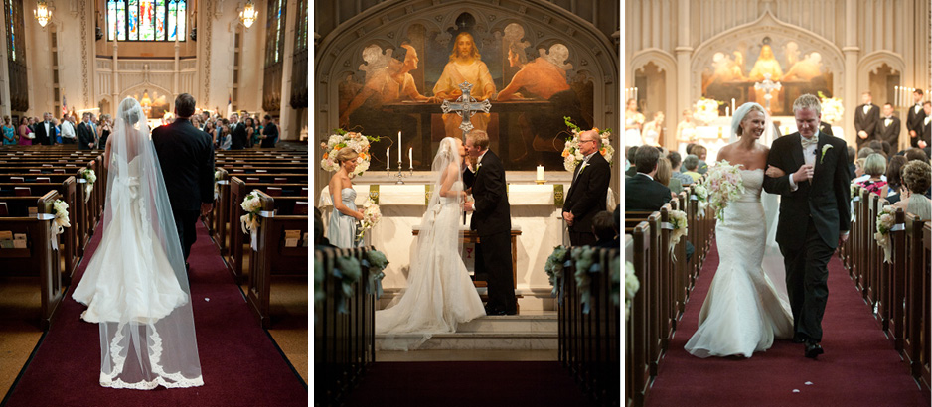

Slide 24
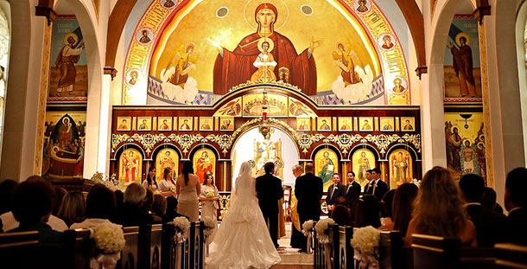

Slide 25
