Slide 1
Begins July 16

Slide 2
“PRAYING LUTHER’S SMALL CATECHISM”
Prof John T. Pless
Lesson 9
Date: 9-10-17
Trinity Lutheran Church Norman, OK
Pastor David Nehrenz
Catechesis =
Teaching with questions and answers
Bible Study:
“Table of Duties – Prayer in Our Callings”

Slide 4
Beginning next Sunday
– “Reformation 500th Anniversary
Bible Study”
– 6 Week Study –
From Sept. 17 to Oct. 22
– Christ, Grace, Faith,
Scripture, Justification, Sacraments along with brief clips from Synodical President Rev. Matt Harrison’s walking tour of Luther sites.

Slide 5
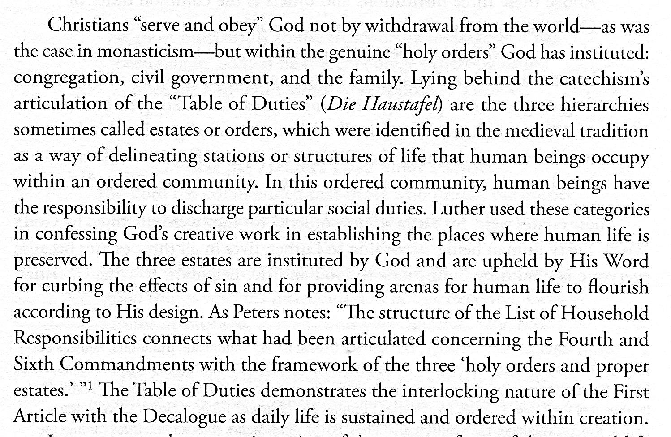

Slide 6
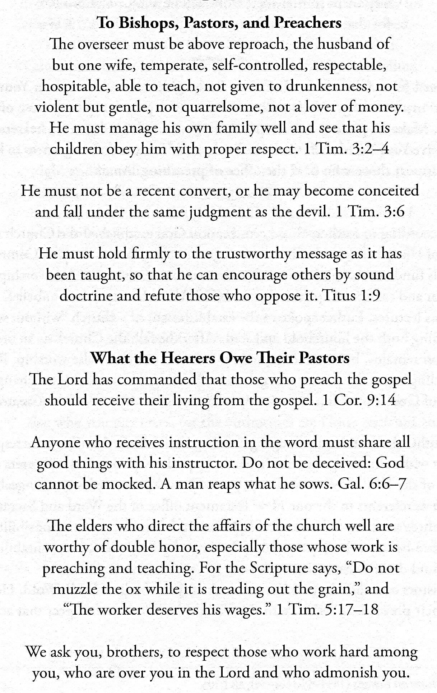
.

Slide 7
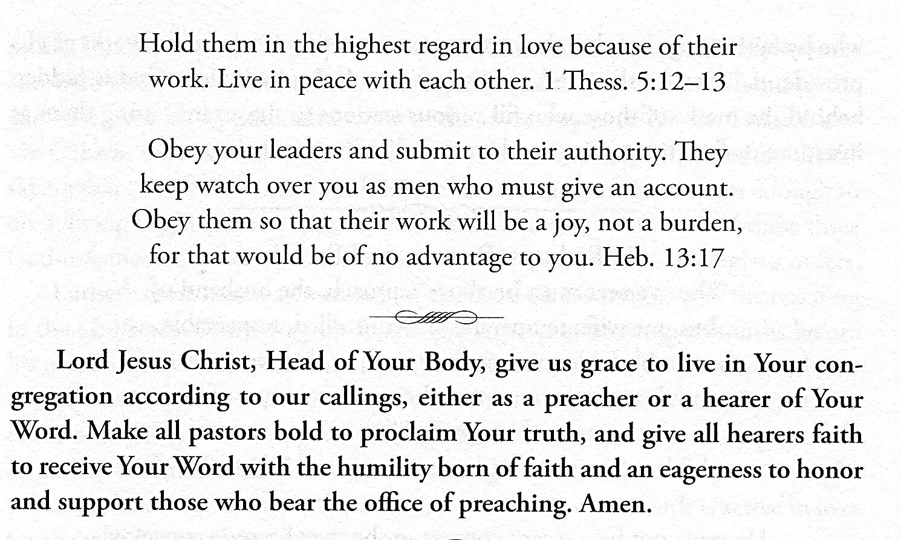

Slide 8
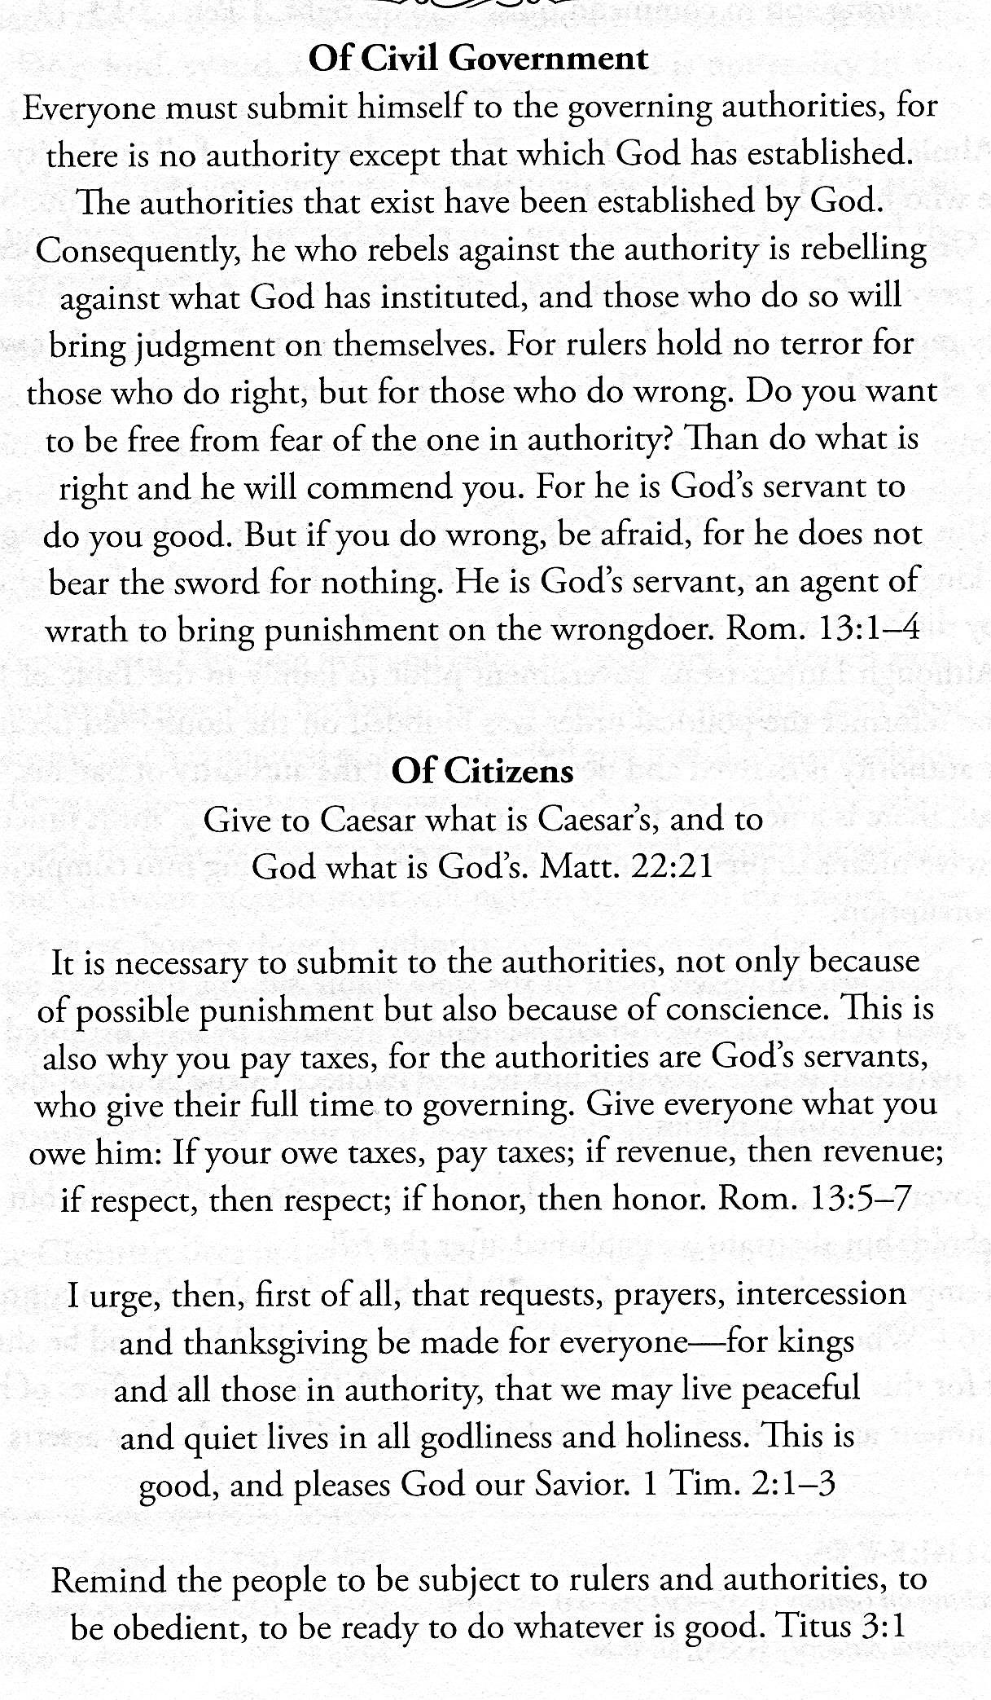

Slide 9
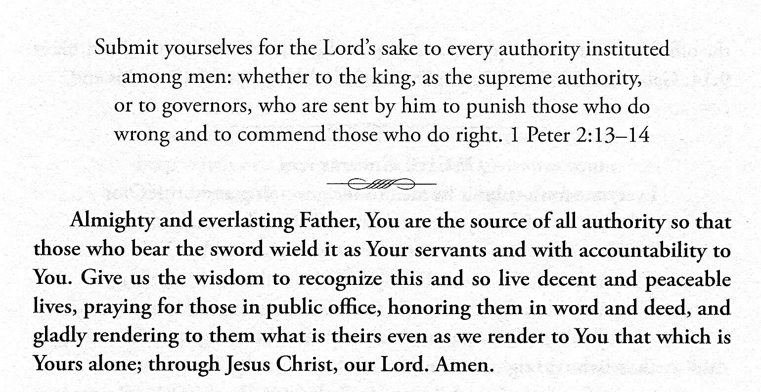

Slide 10
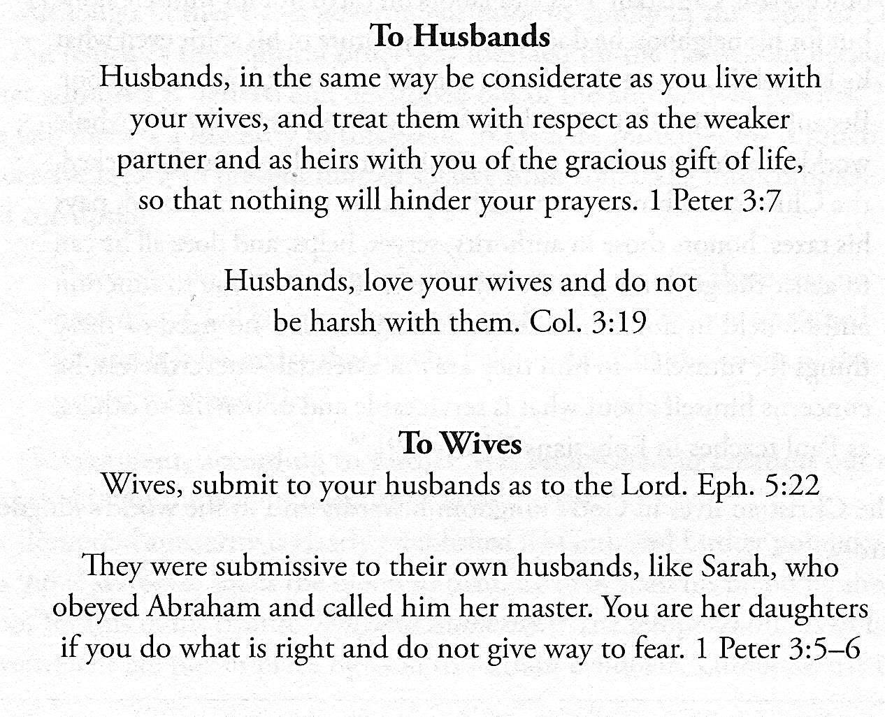

Slide 11
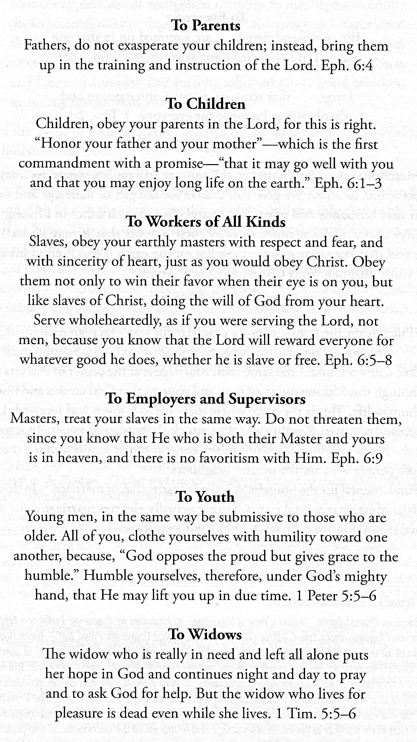

Slide 12
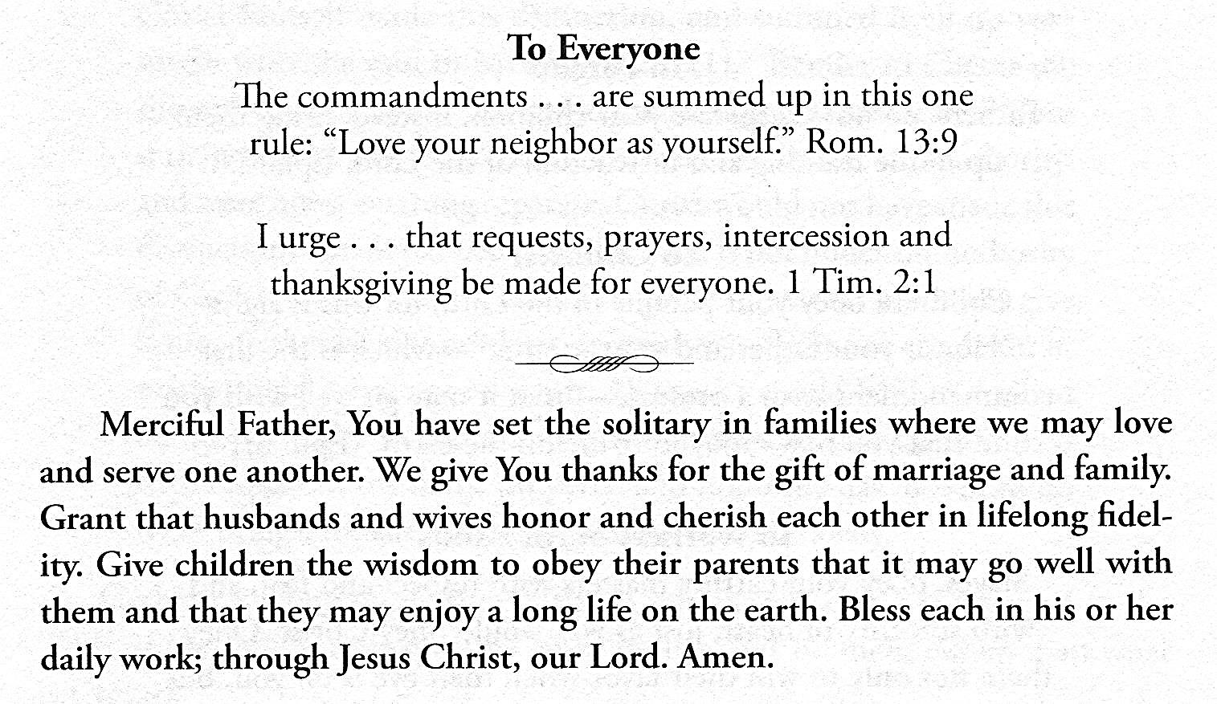

Slide 13
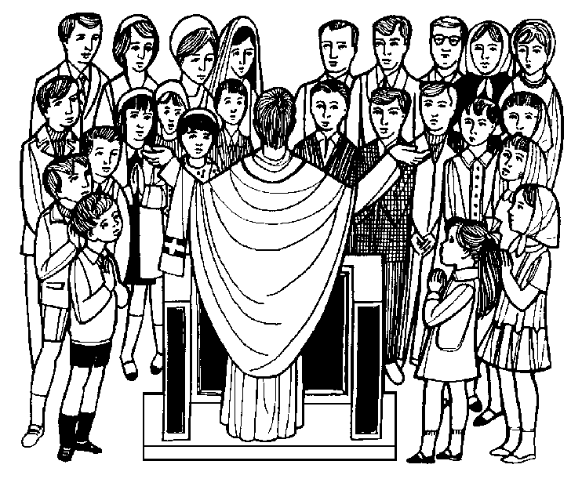

Slide 19
