Slide 1
Begins July 16

Slide 2
“PRAYING LUTHER’S SMALL CATECHISM”
Prof John T. Pless
Lesson 8
Date: 9-3-17
Trinity Lutheran Church Norman, OK
Pastor David Nehrenz
Catechesis =
Teaching with questions and answers
Bible Study: “Give Us Our Daily Bread – Morning, Evening, Mealtime”

Slide 4
Scripture Texts:
Ps. 4:8;
Ps 31:5;
Ps. 50:12,13;
Ps 91:11;
Ps. 121:3,4;
Ps. 136:1,25;
Ps 147:9-16;
Rom 12:12;
2 Cor 1:11;
Eph 6:18;
Php 4:5-7;
Col 4:2;
1 Tim 4:4,5;
1 Pet 3:12;

Slide 5
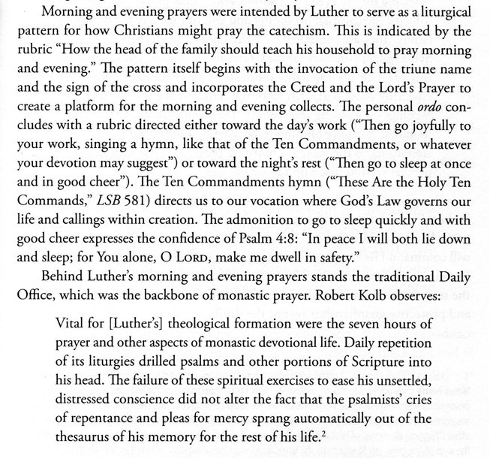

Slide 6
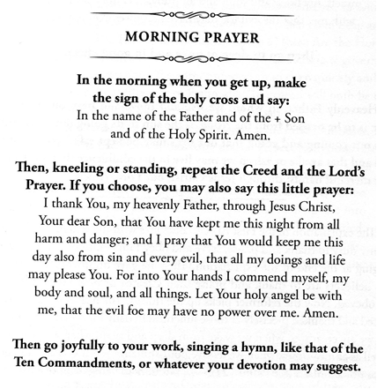
.

Slide 7
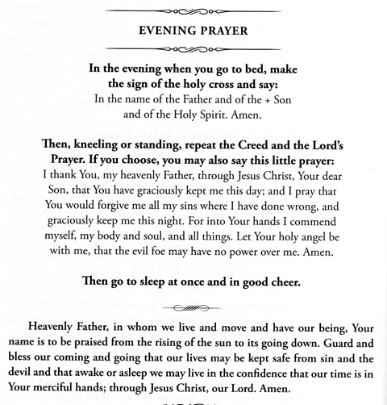

Slide 9
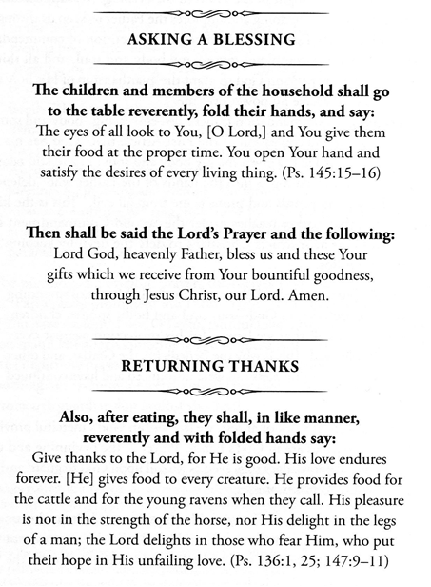

Slide 11
