Slide 1
Begins July 16

Slide 2
“PRAYING LUTHER’S SMALL CATECHISM”
Prof John T. Pless
Lesson 7
Date: 8-27-17
Trinity Lutheran Church Norman, OK
Pastor David Nehrenz
Catechesis =
Teaching with questions and answers
Bible Study: The Sacrament of the Altar

Slide 4
Scripture Texts:
Matt 26:26-30;
Mark 14:22-26;
Luke 22:13-20;
John 6:32-35, 41-43, 48-60;
1 Cor 5:7,8;
1 Cor 10:16-21;
1 Cor 11:17-34;

Slide 5
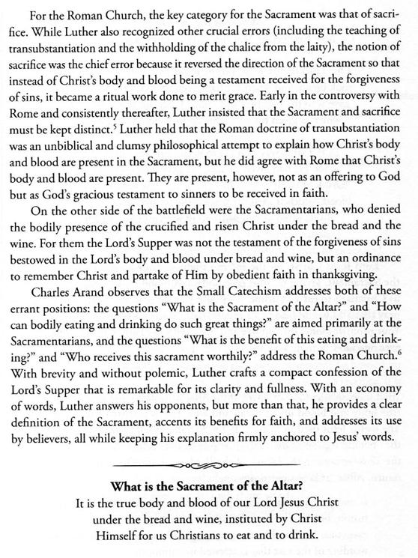

Slide 6
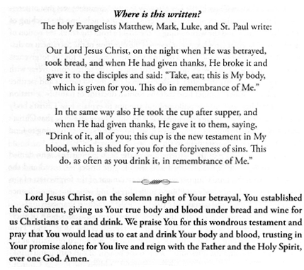
.

Slide 7
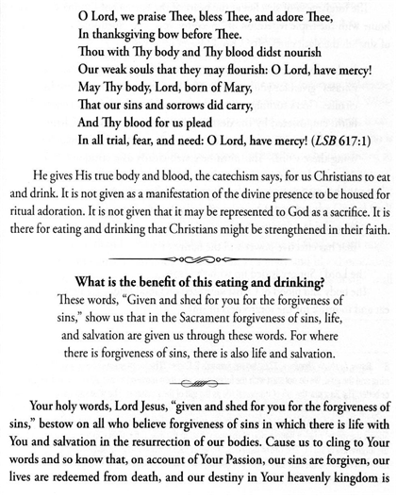

Slide 8
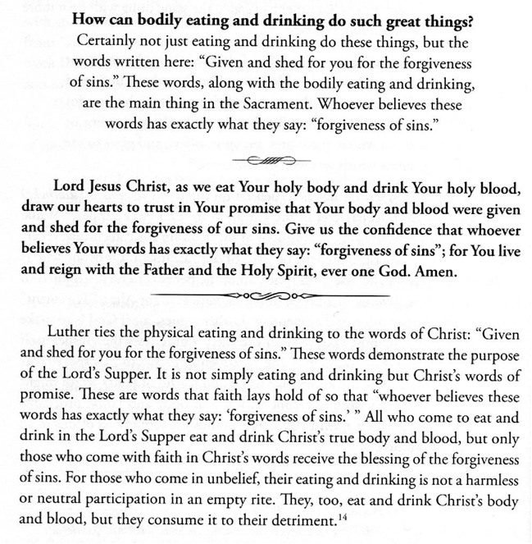

Slide 9
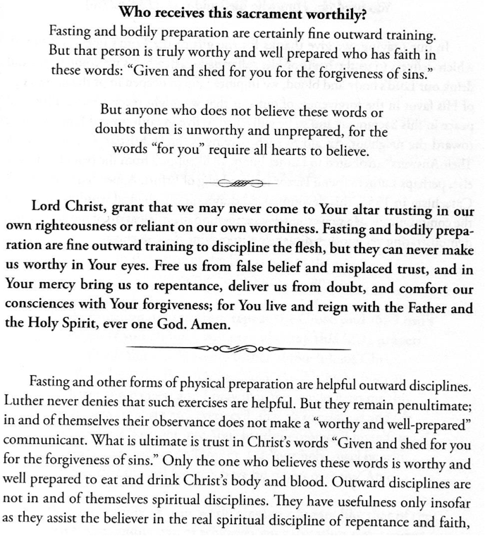

Slide 10
