Slide 1
Begins July 16

Slide 2
“PRAYING LUTHER’S SMALL CATECHISM”
Prof John T. Pless
Lesson 5
Date: 8-13-17
Trinity Lutheran Church Norman, OK
Pastor David Nehrenz
Catechesis =
Teaching with questions and answers
Bible Study: Holy Baptism

Slide 4
Scripture Texts:
Matt 28:16-20;
Rom 6:1-11;
Eph 4:1-6;
Col 2:9-17;
1 Pet 3:18-22

Slide 5
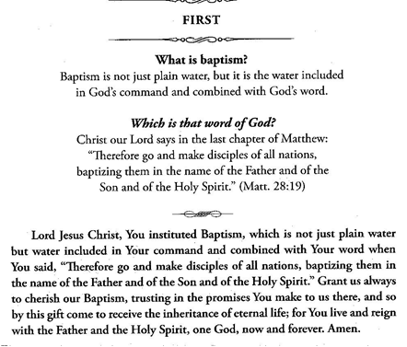

Slide 6
.

Slide 8
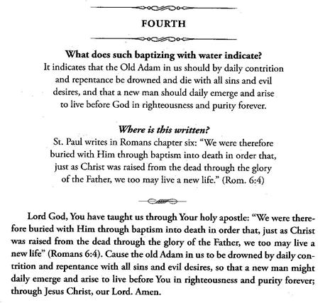

Slide 9
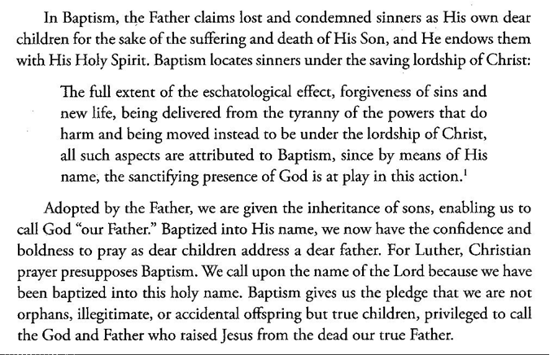

Slide 10
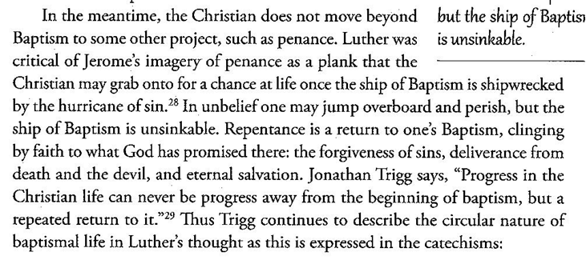

Slide 11
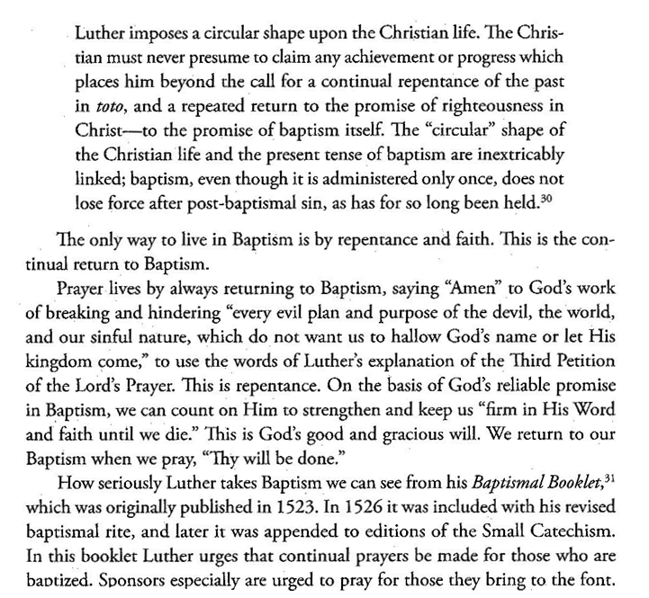

Slide 12
