Slide 1
Begins July 16

Slide 2
“PRAYING LUTHER’S SMALL CATECHISM”
Prof John T. Pless
Lesson 3
Date: 7-30-17
Trinity Lutheran Church Norman, OK
Pastor David Nehrenz
Catechesis =
Teaching with questions and answers
Bible Study: The Apostles’ Creed

Slide 4
Scripture Texts:
Matthew 16:13-17;
Mark 8:27-31; Luke 9:18-22; John 20:26-31;
1 Cor 12:3; 15:1-8;
Php 2:5-11; 1 Tim 3:16;
Titus 3:4-7; Jude 3;

Slide 5
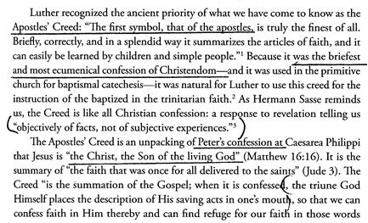
\

Slide 6
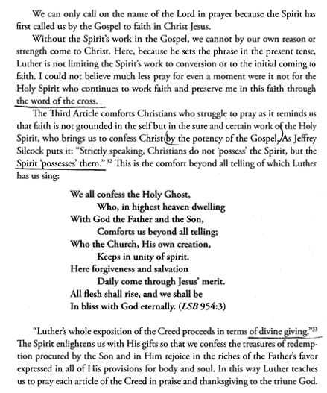
.

Slide 7
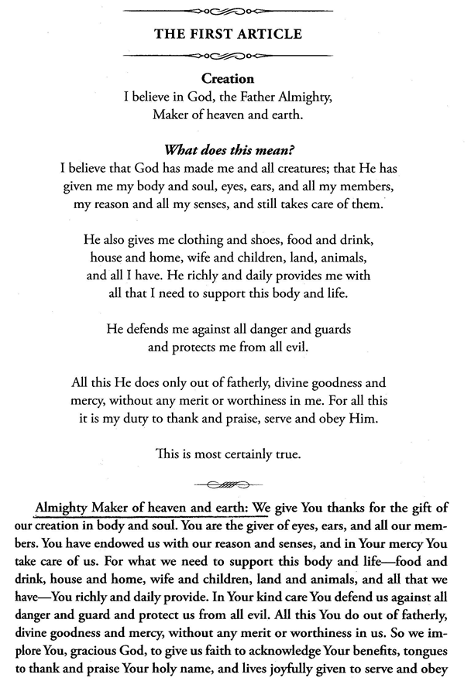

Slide 8
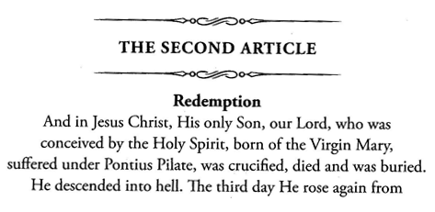
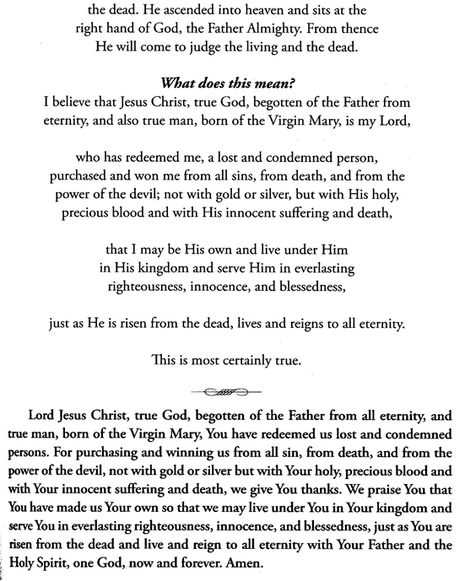

Slide 9
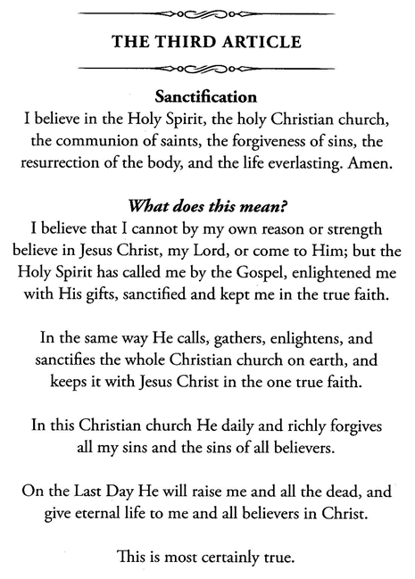
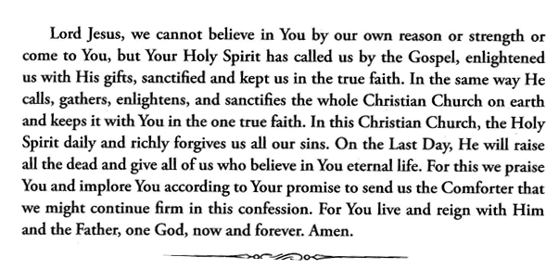

Slide 10
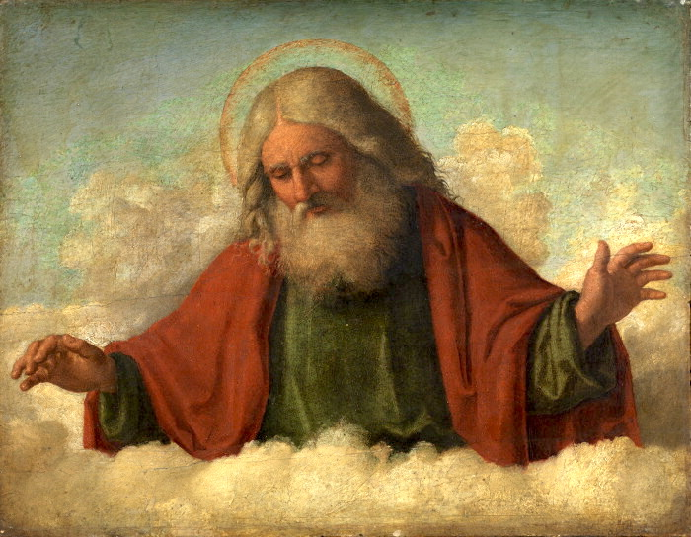

Slide 12
