Slide 1
Begins July 16

Slide 2
“PRAYING LUTHER’S SMALL CATECHISM”
Prof John T. Pless
Lesson 2
Date: 7-23-17
Trinity Lutheran Church Norman, OK
Pastor David Nehrenz
Catechesis =
Teaching with questions and answers
Bible Study: The Ten Commandments

Slide 4
Scripture Texts:
Exodus 19: 16 – 20:21
Matthew 22:36-40;
Mark 12:28-31;
Luke 10:26,27; Rom 13:9,10;
Gal 5:14; James 2:8

Slide 5
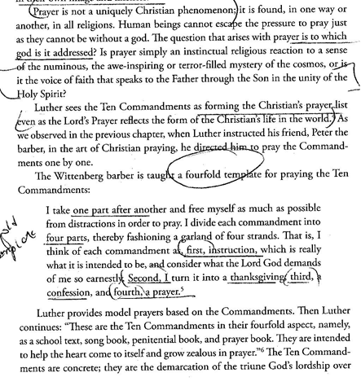
\

Slide 6
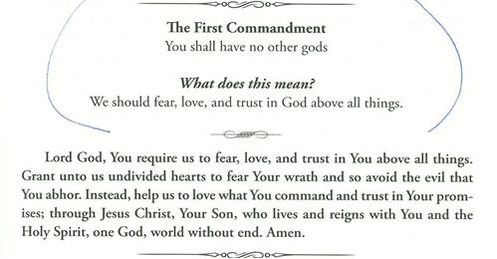
.

Slide 7
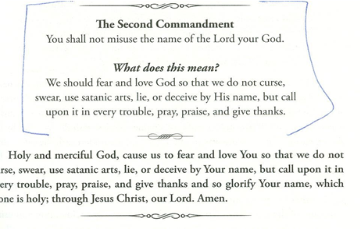

Slide 8
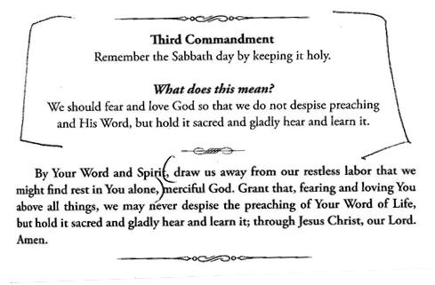

Slide 9
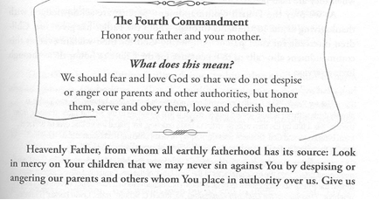

Slide 10
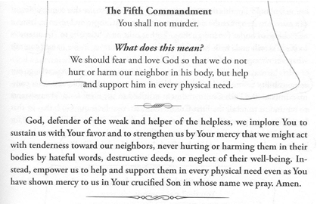

Slide 11
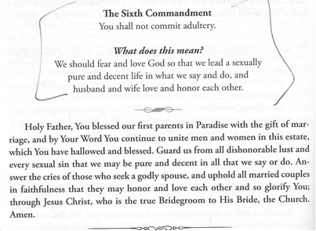

Slide 12
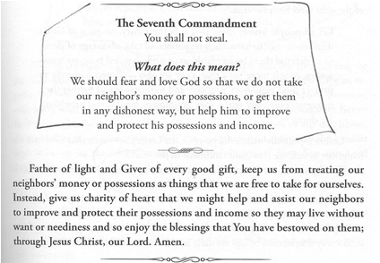

Slide 13
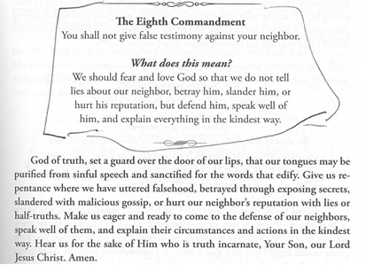

Slide 14
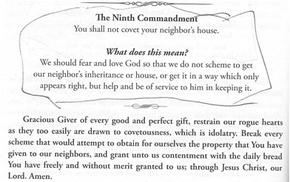

Slide 15
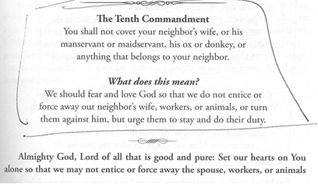

Slide 16
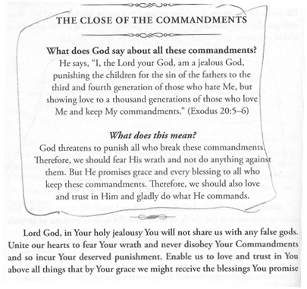

Slide 17
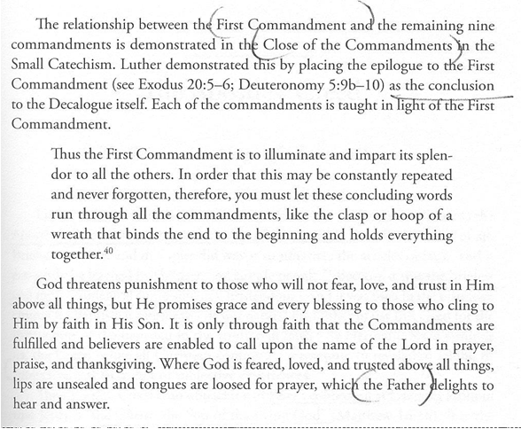

Slide 18
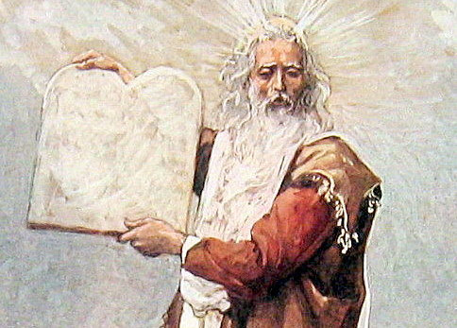

Slide 19
