Slide 1
Begins July 16

Slide 2
“PRAYING LUTHER’S SMALL CATECHISM”
Prof John T. Pless
Lesson 1
Date: 7-16-17
Trinity Lutheran Church Norman, OK
Pastor David Nehrenz
Catechesis =
Teaching with questions and answers
Bible Study: 2 Timothy 1:1-14
2 Cor 3:1-11

Slide 4
Luther's Preface to the Small Catechism
Martin Luther, to all faithful and godly pastors and preachers; grace, mercy, and peace be yours in Jesus Christ, our Lord.
The deplorable, miserable conditions which I recently observed when visiting the parishes have constrained and pressed me to put this catechism of Christian doctrine into this brief, plain, and simple form. How pitiable, so help me God, were the things I saw; the common man, especially in the villages, knows practically nothing of Christian doctrine, and many of the pastors are almost entirely incompetent and unable to teach. Yet all the people are supposed to be Christians, have been baptized, and receive the Holy Sacrament even though they do not know the Lord's Prayer, the Creed, or the Ten Commandments and live like poor animals of the barnyard and pigpen. What these people have mastered, however, is the fine art of tearing all Christian liberty to shreds.
Oh, you bishops! How will you ever answer to Christ for letting the people carry on so disgracefully and not attending to the duties of your office even for a moment? One can only hope judgment does not strike you! You command the Sacrament in one kind only, insist on the observance of your human ways, and yet are unconcerned whether the people know the Lord's Prayer, the Creed, the Ten Commandments, or indeed any of God's Word. Woe, woe to you forever!
Therefore dear brothers, for God's sake, I beg all of you who are pastors and preachers to devote yourselves sincerely to the duties of your office, that you feel compassion for the people entrusted to your care, and that you help us accordingly to inculcate this catechism in the people, especially the young. If you cannot do more, at least take the tables and charts for catechism instruction and drill the people in them word for word, in the following way:
First, the pastor should most carefully avoid teaching the Ten Commandments, the Lord's Prayer, the Creed, the sacraments, etc., according to various texts and differing forms. Let him adopt one version, stay with it, and from one year to the next keep using it unchanged. Young and inexperienced persons must be taught a single fixed form or they will easily become confused, and the result will be that all previous effort and labor will be lost. There should be no change, even though one may wish to improve the text.

Slide 5
The honored fathers understood this well, and therefore they all consistently used one form of the Lord's Prayer, the Creed, and the Ten Commandments. We should do as they did by teaching these materials to the young and the common man without altering a single syllable and by never varying their wording when presenting or quoting them year after year. So adopt whatever form you wish and then stick with it at all times. If, however, you happen to be preaching to some sophisticated, learned audience, then you certainly may demonstrate your skill with words by turning phrases as colorfully and masterfully as you can. But with young persons keep to a single, fixed, and permanent form and wording, and teach them first of all the Ten Commandments, the Creed, the Lord's Prayer, etc. according to the text, word for word, so that can repeat it after you and commit it to memory. But those who refuse to learn are to be told that they are denying Christ and do not belong to Him. They are not to be admitted to the Sacrament, accepted as sponsors at Baptism, or allowed to exercise Christian liberty in any way. They should instead be simply directed back to the pope and his functionaries, yes, even to Satan himself. Moreover, their parents and superiors should refuse them food and drink, telling them that the prince is of a mind to expel such rude persons from his realm, and so on. Of course we cannot, and we should not try to, force the Christian faith on anyone. Yet we should steadily keep on urging people toward it and help them know what is considered right and wrong in the society in which they want to live and earn their living. A person who wants to live in a certain city and enjoy its privileges should know and observe its laws, no matter whether he believes in them or is at heart a rogue or scoundrel. Second, after they have well memorized the text (of the catechism), then explain the meaning so that they understand what they are saying. Do so again with the help of these charts or some other brief uniform method of your choosing; adhere to it and do not change a single syllable, as said above concerning the text, taking your time with it. For it is not necessary to teach everything at once, but one thing after the other. After they understand well the meaning of the First Commandment, proceed to the Second, and so on, otherwise they will be too overwhelmed to the point of remembering nothing.

Slide 6
Third, after you have so taught them this short catechism, take up the Large Catechism and use it to give them a broader and richer understanding. Here enlarge on every individual commandment, petition, segment, explaining in each case the various words, uses, benefits, dangers, and hurts involved, as you will find them amply described in many a book dealing with these topics. Stress especially that commandment or any other specific part of the catechism doctrine which your people neglect most. For example, among craftsmen and merchants, farmers and employees, you must powerfully stress the Seventh Commandment, which forbids stealing, because among such people many kinds of dishonesty and thievery occur. Also, for young persons and the common man you must stress the Fourth Commandment, urging them to be orderly, faithful, obedient, and peaceable, always bringing in many Bible examples of how God punished or blessed such people. You should particularly urge those in authority and parents to govern the young well and to send them to school. Show them why it is their duty to do this and explain what a damnable sin it is if they fail to do so. For by such neglect they ruin and destroy both the kingdom of God and that of this world and prove themselves to be the worst enemies of both God and man. Thoroughly underscore what terrible harm they do by not helping train children to become pastors, preachers, writers, and the like, and how God will punish them for it. There is a great need to preach about these things. For parents and those in authority are guilty beyond words in this regard, and the devil has horrible things in mind. Finally, now that the pope's tyranny is over, people no longer want to go to the Sacrament but despise it. Here again urging is necessary, however, with the understanding that we are not to force anyone into the faith or to the Sacrament, nor set any law, time, or place for it. Our preaching should instead be such that of their own accord and without our command, people feel constrained themselves and press us pastors to serve the Sacrament. The way to go about this is to tell them that if anyone does not seek or desire the Lord's Supper at the very least four times a year, it is to be feared that he despises the Sacrament and is not Christian, just as no one is a Christian who does not believe or hear the Gospel. For Christ did not say, "Omit this" or "Despise this," but "This do, as often as you drink it," etc. He most certainly wants it done and does not want it left undone and despised. "This do," he says.

Slide 7
For a person not to prize highly the Sacrament is tantamount to saying that he has no sin, no flesh, no devil, no world, no death, no danger, no hell. That is to say, he believes in none of these although he is overwhelmed by them and is the devil's possession twice over. On the other hand, he needs no grace, life, paradise, kingdom of heaven, Christ, God, or any good thing. Surely, if he recognized how much evil is in him and how much he needs all the good things he lacks, he would not neglect the Sacrament, which gives help against such evil and bestows so much goodness. He will not need to be forced by law to the Sacrament but will himself come running in a hurry to the Lord's Table, constrained within himself and pressing you to give him the Sacrament. Therefore do not set up any law concerning it, as the pope does. Only emphasize clearly the benefit, need, usefulness, and blessing connected with the Sacrament, and also the harm and danger of neglecting it. The people will then come of themselves without your using compulsion. But if they still do not come, then let them go their way and tell them that all who are insensitive or unaware of their great need and God's gracious help belong to the devil. But if you fail to urge these things or if you make it into law and bitterness, then the fault will be yours if they despise the Sacrament. Why should they not be lazy if you are asleep and silent? So look to it, you pastors and preachers. Our ministry today is something else than it was under the pope. It has become a serious and saving responsibility. Consequently it now involves much more trouble and labor, danger and trial, and in addition it brings you little of the world's gratitude and rewards. But Christ Himself will be our reward if we labor faithfully. The Father of all grace help us to do just that. To Him be praise and thanks forever through Christ our Lord. Amen.

Slide 8
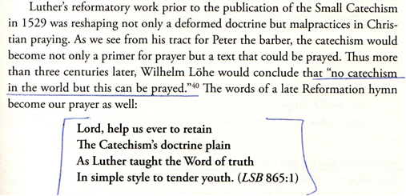

Slide 9
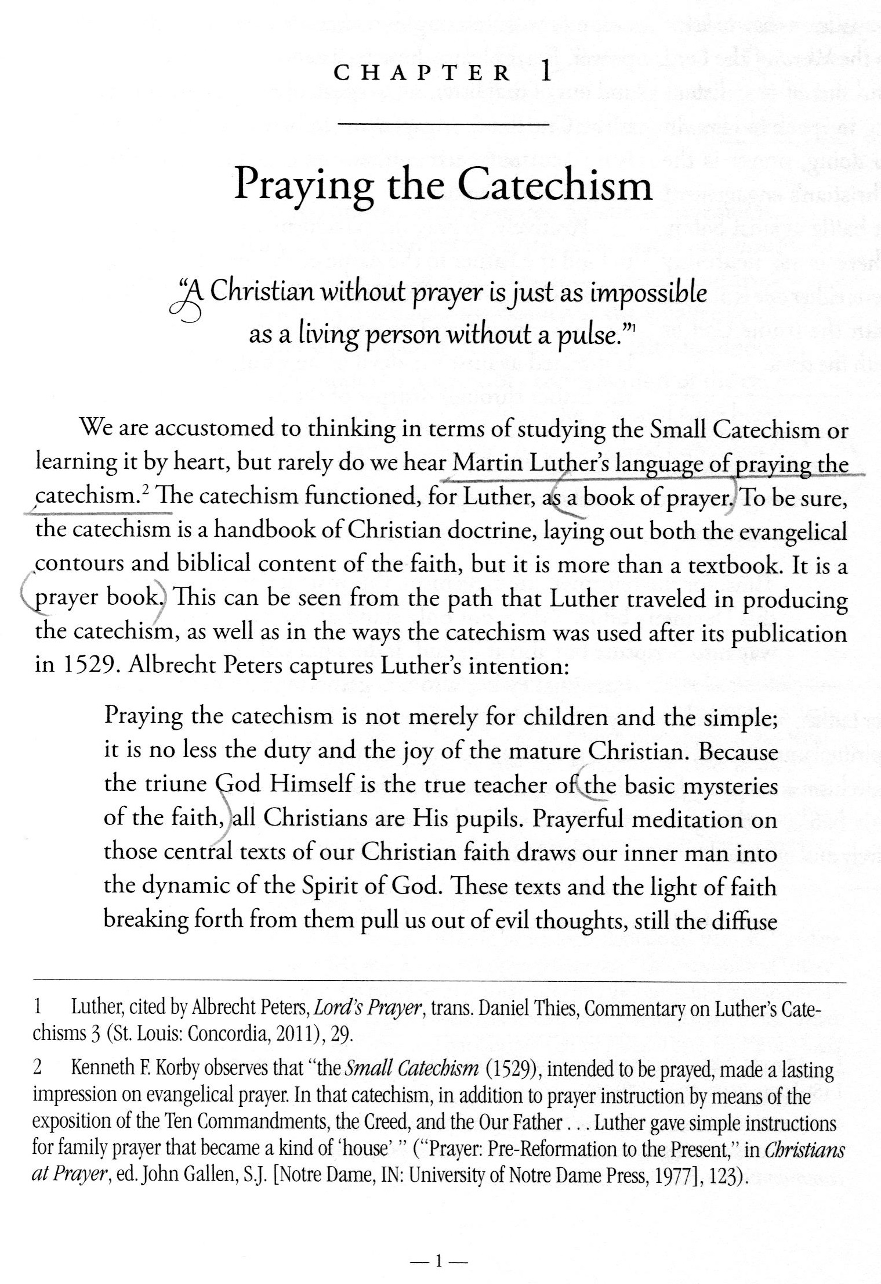

Slide 10
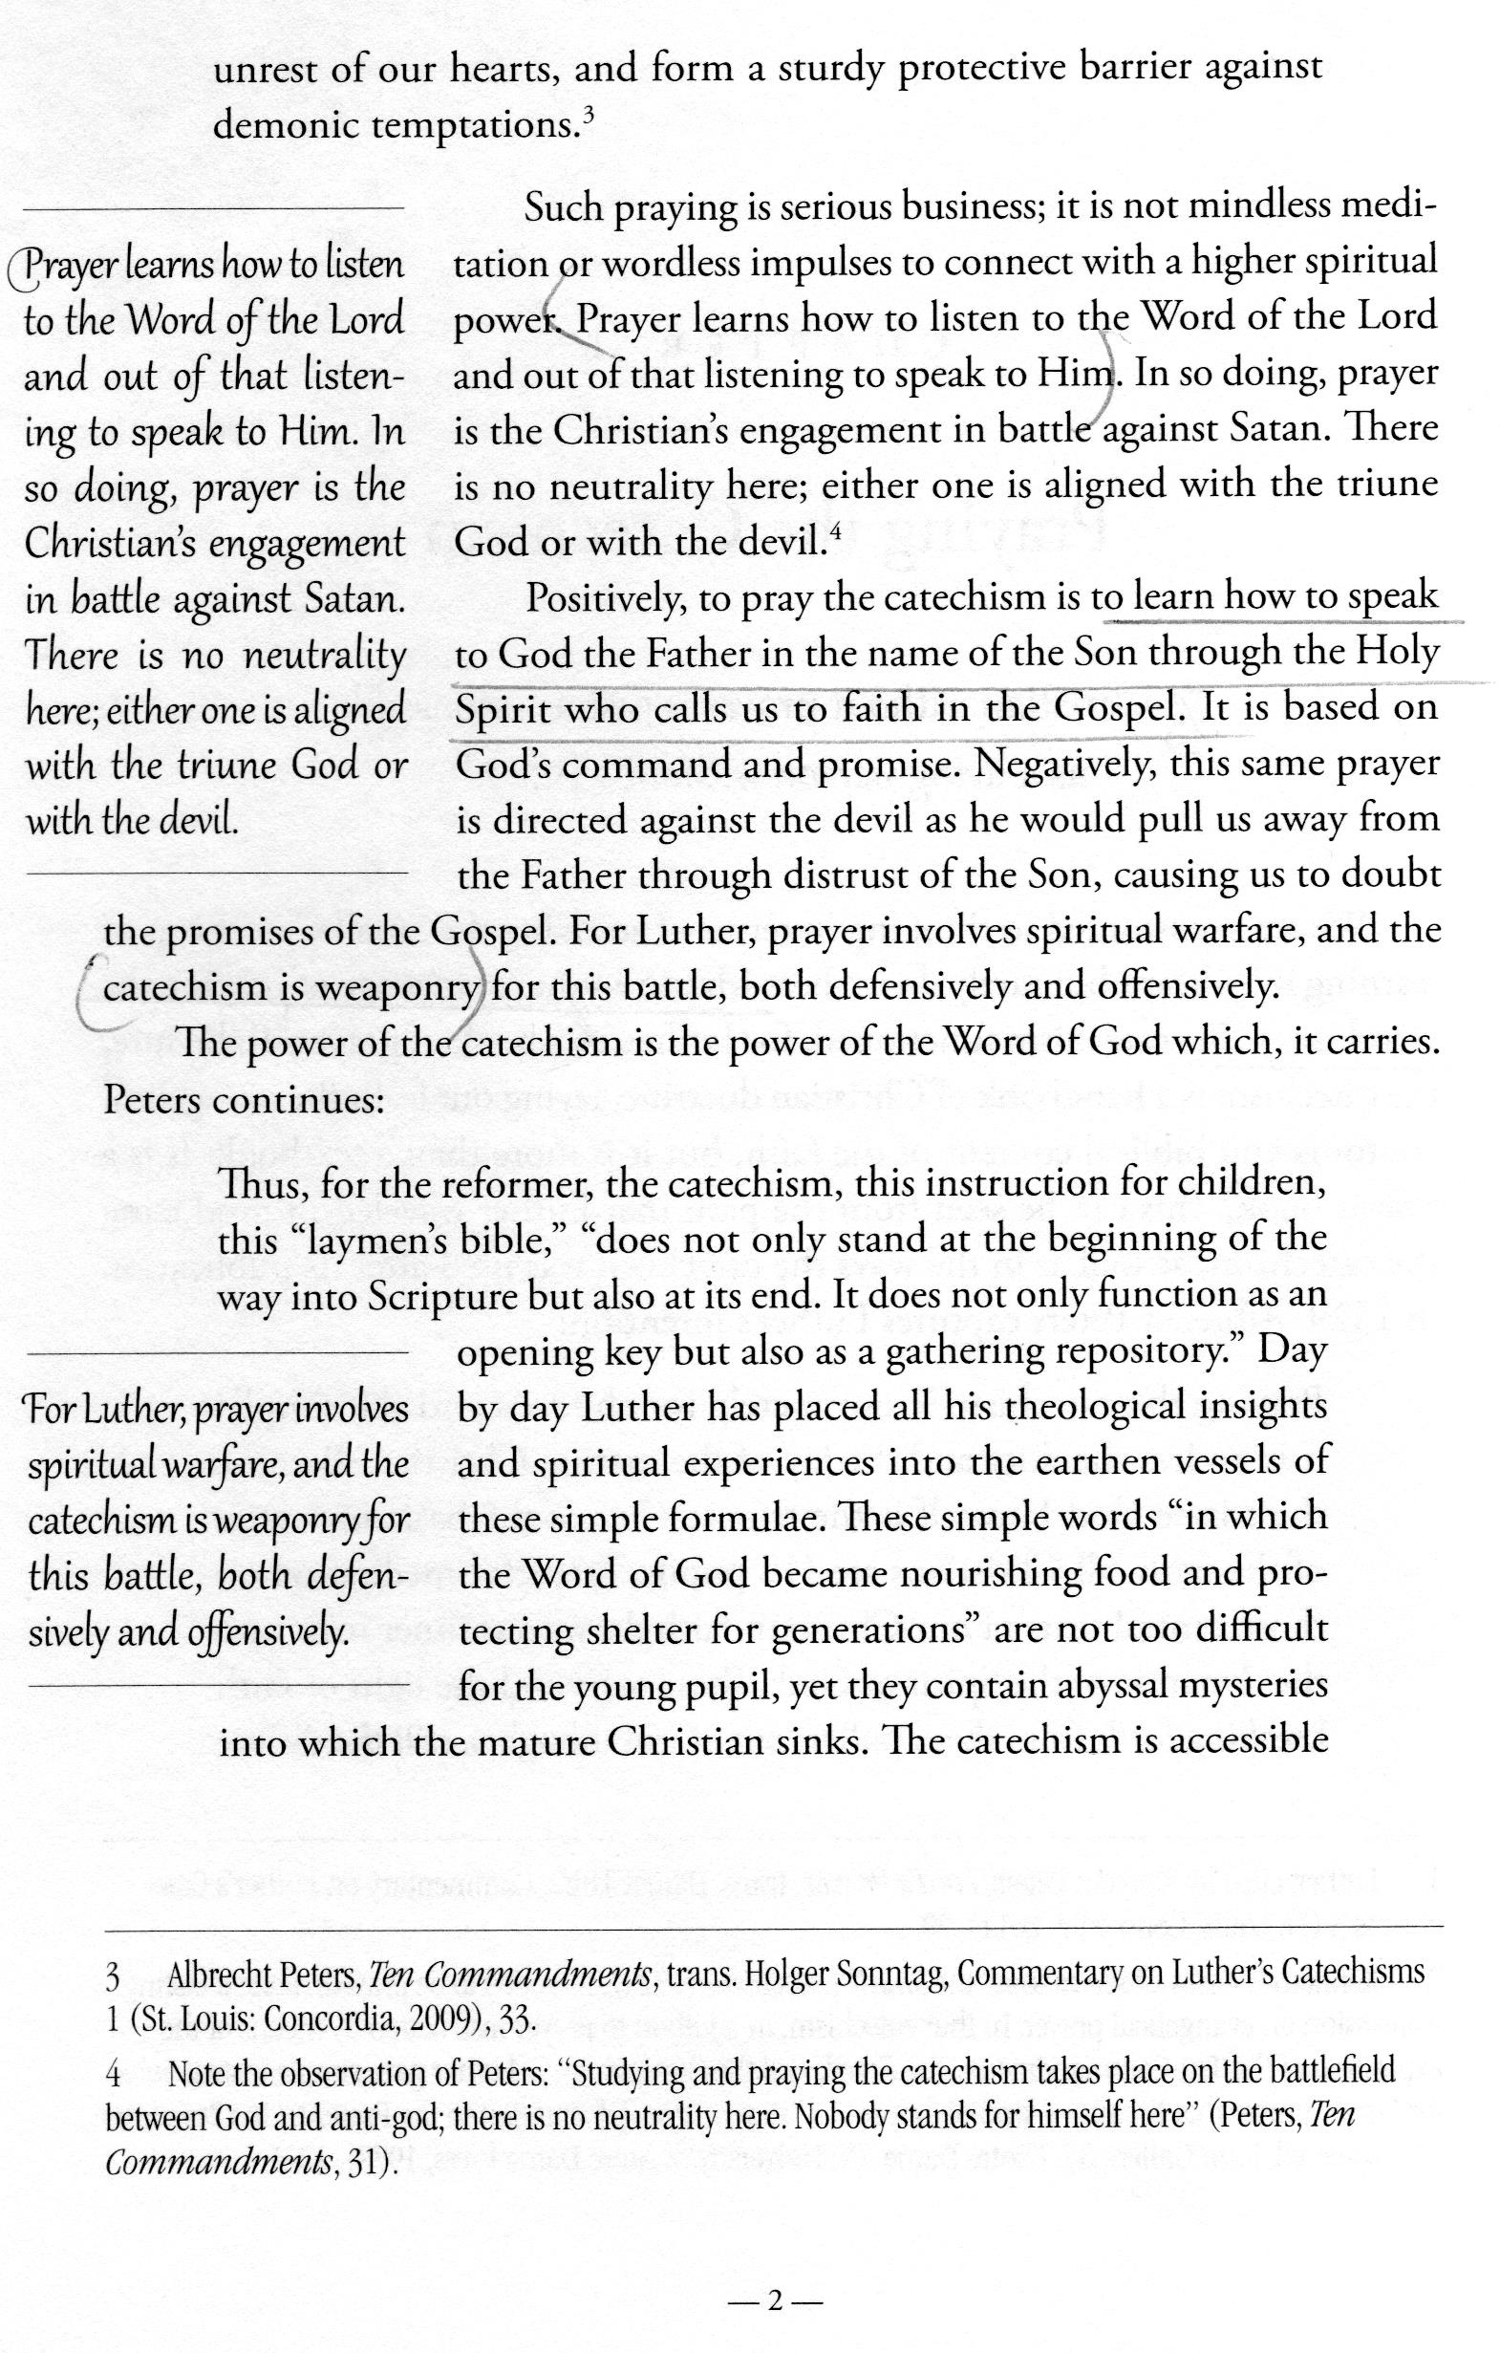

Slide 11
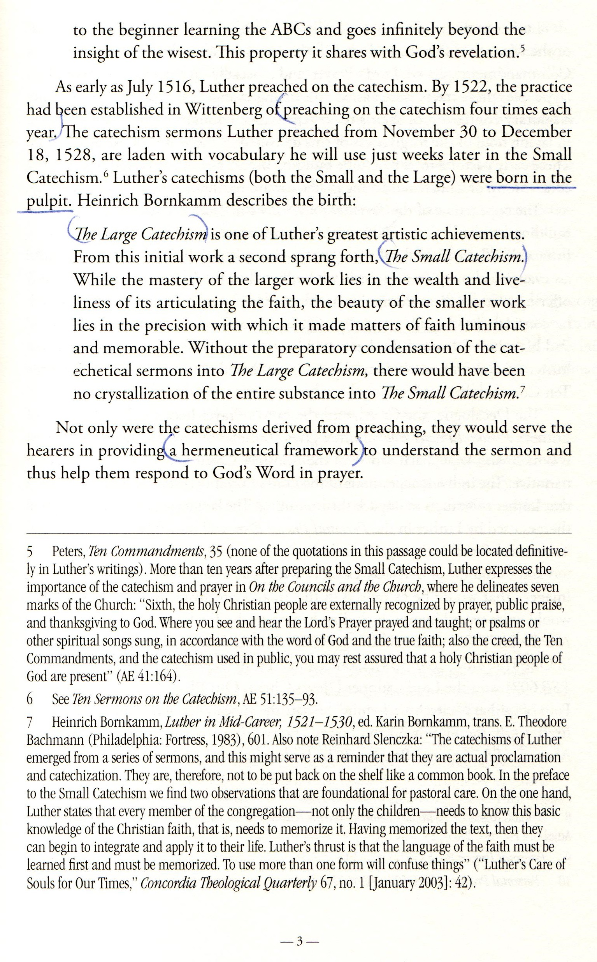

Slide 12
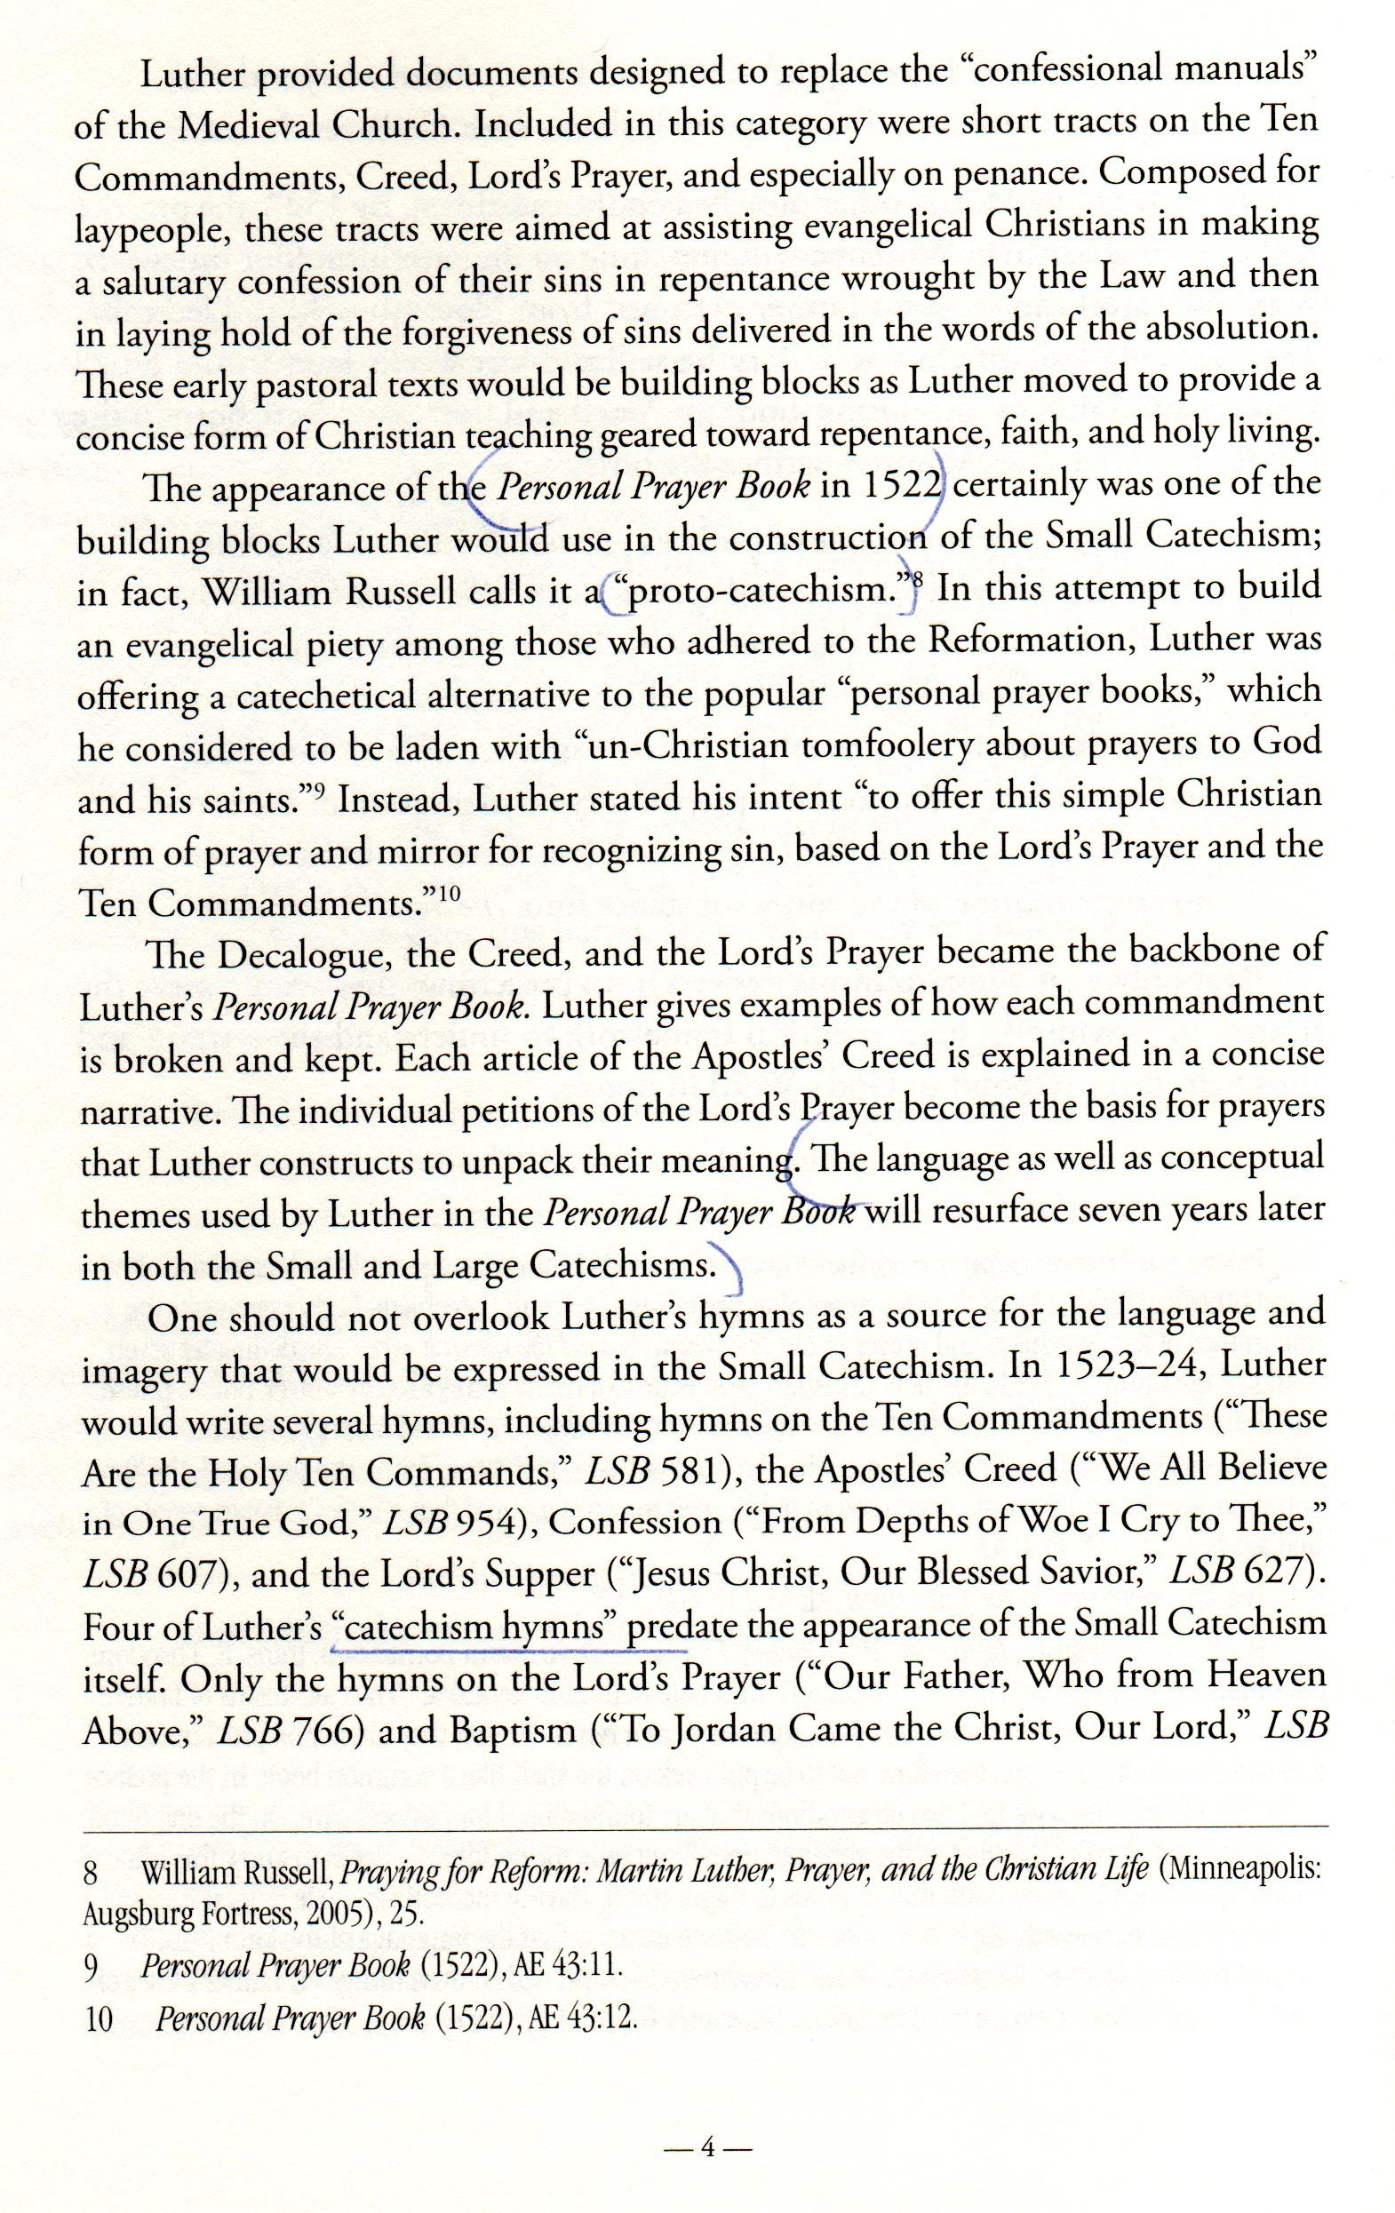

Slide 13
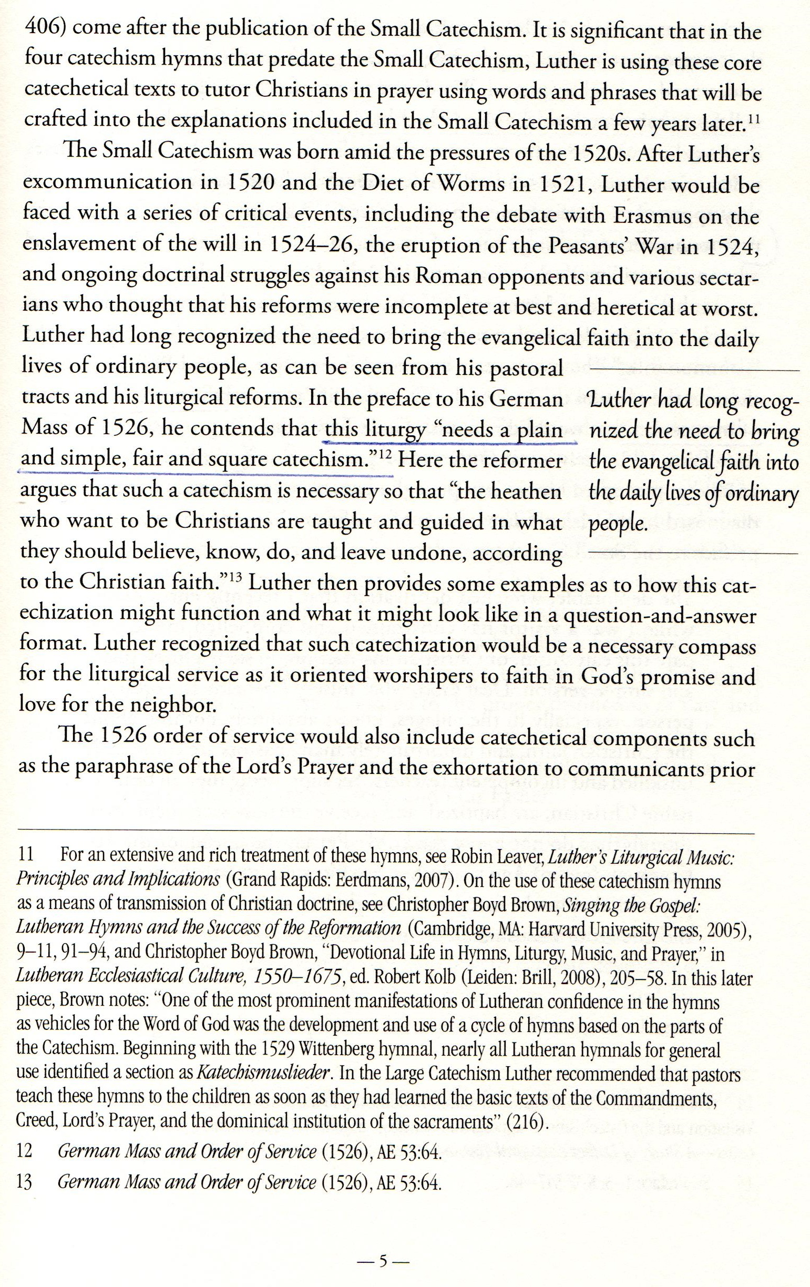

Slide 14
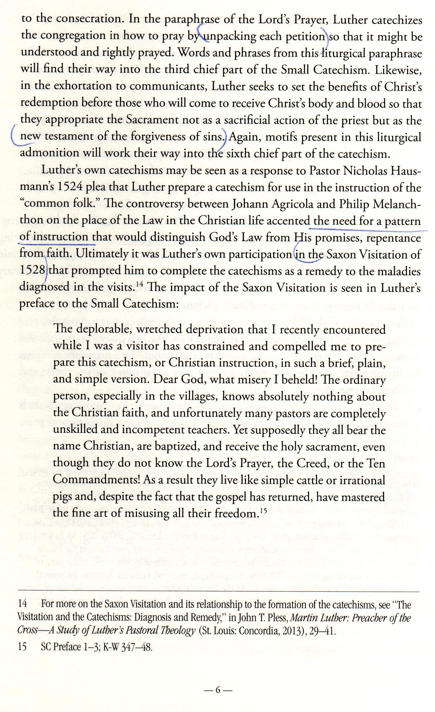

Slide 15
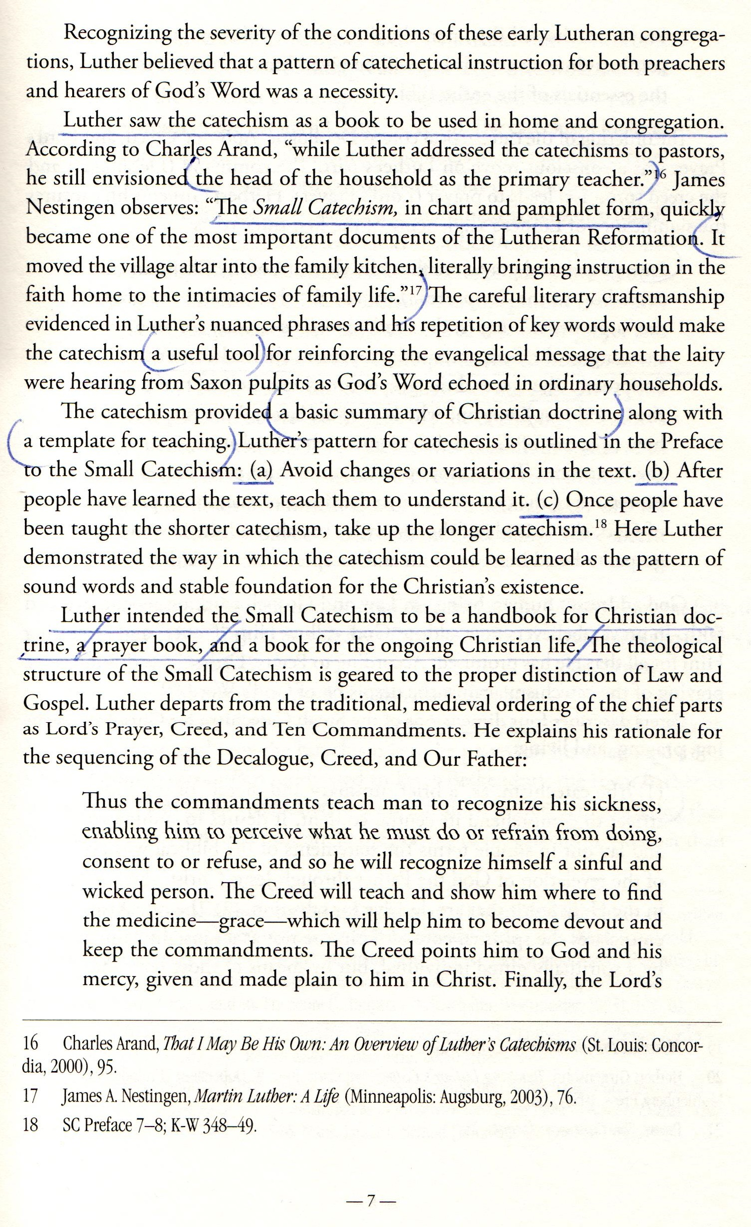

Slide 16
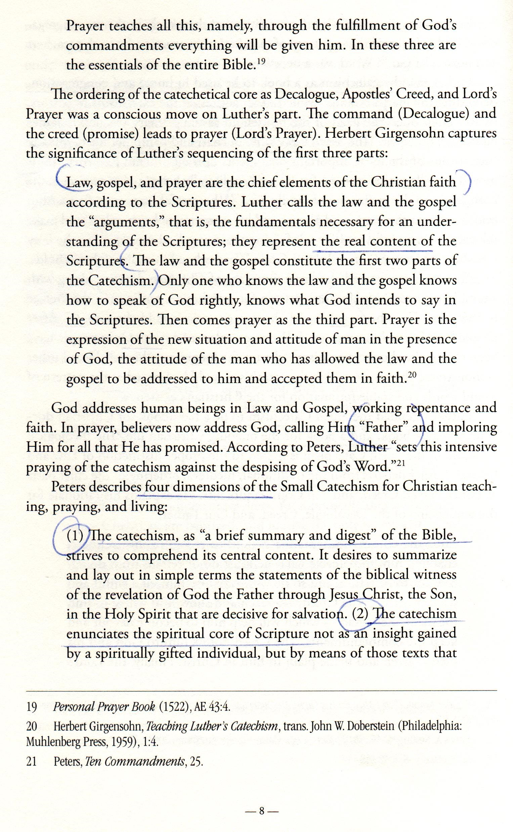

Slide 17
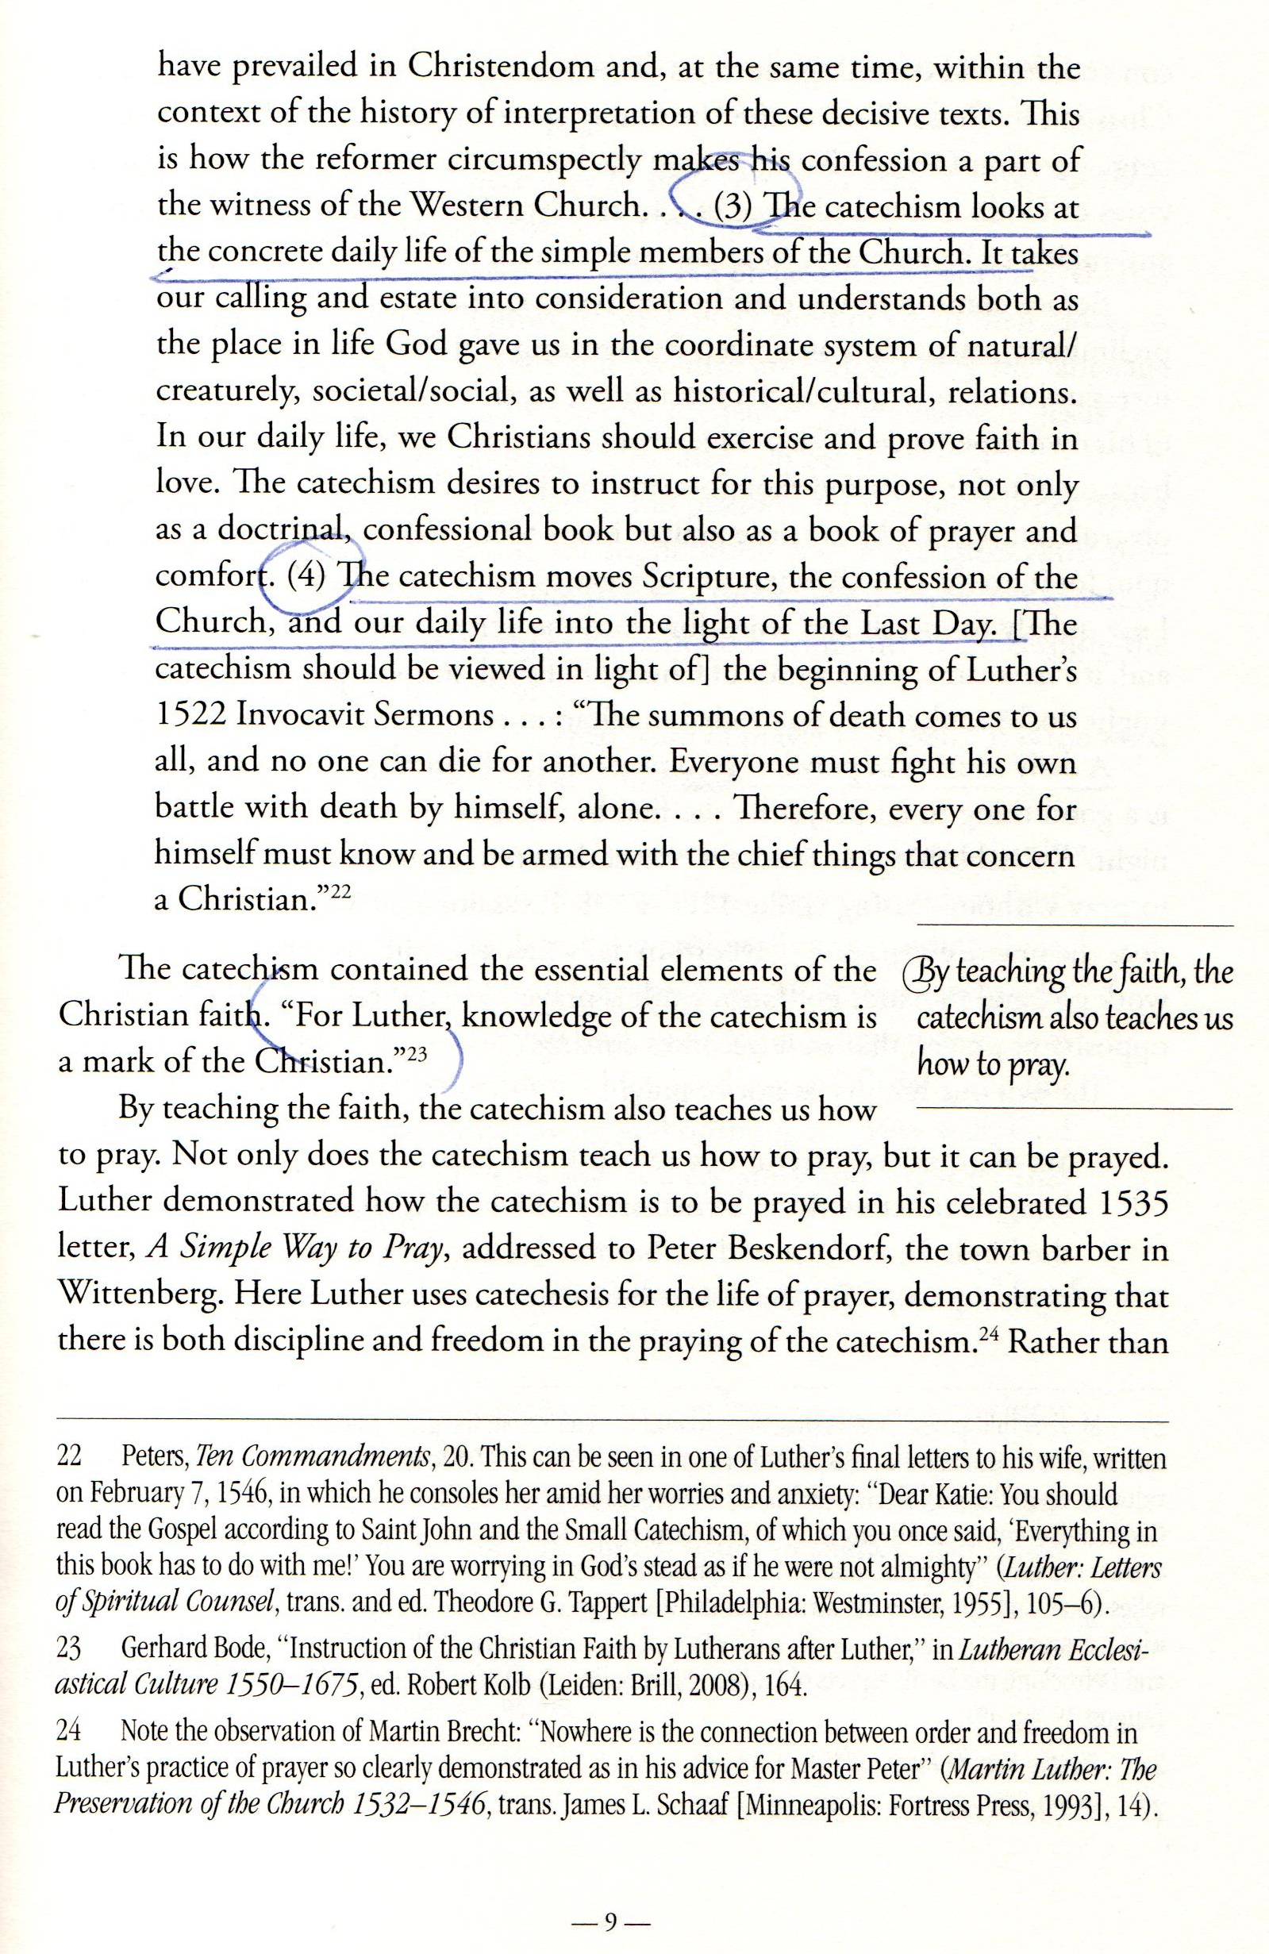

Slide 18
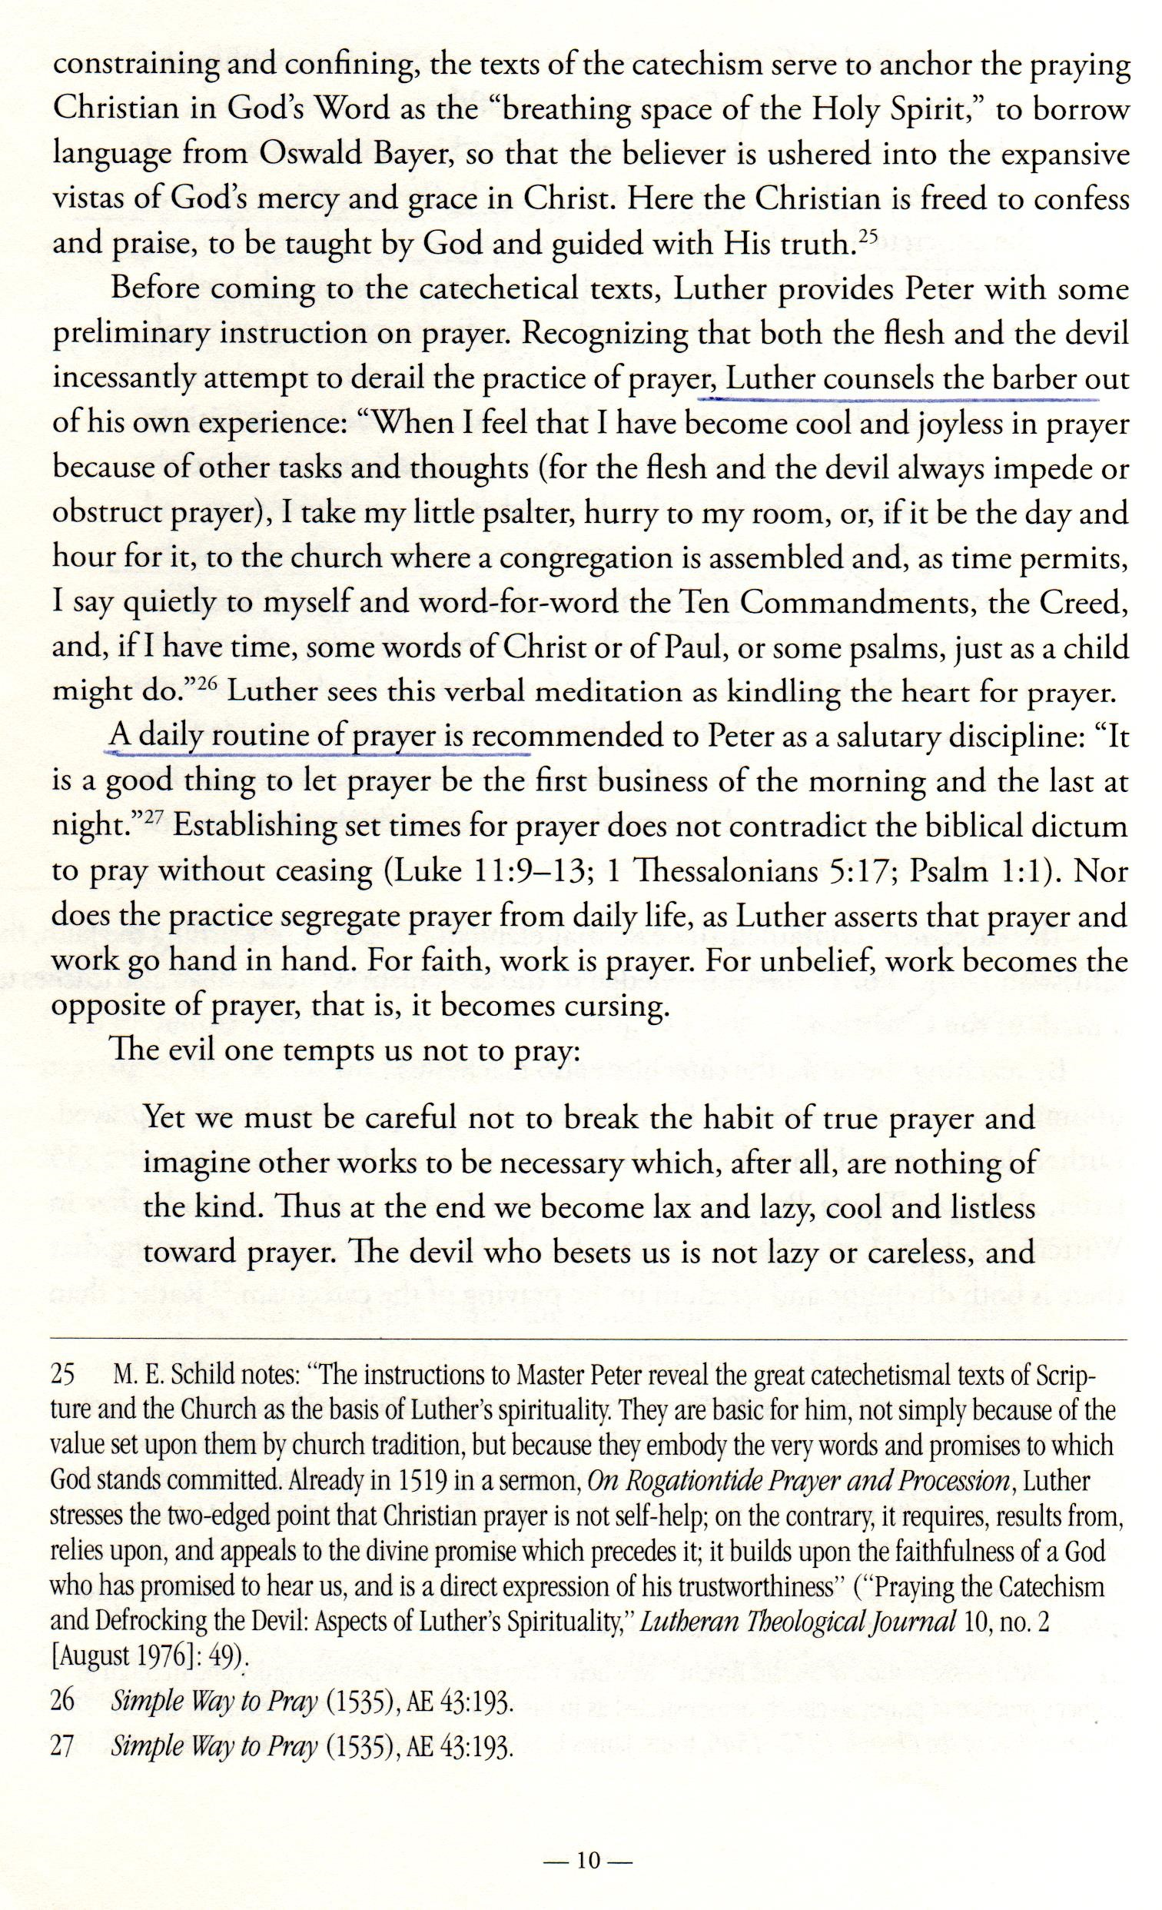

Slide 19
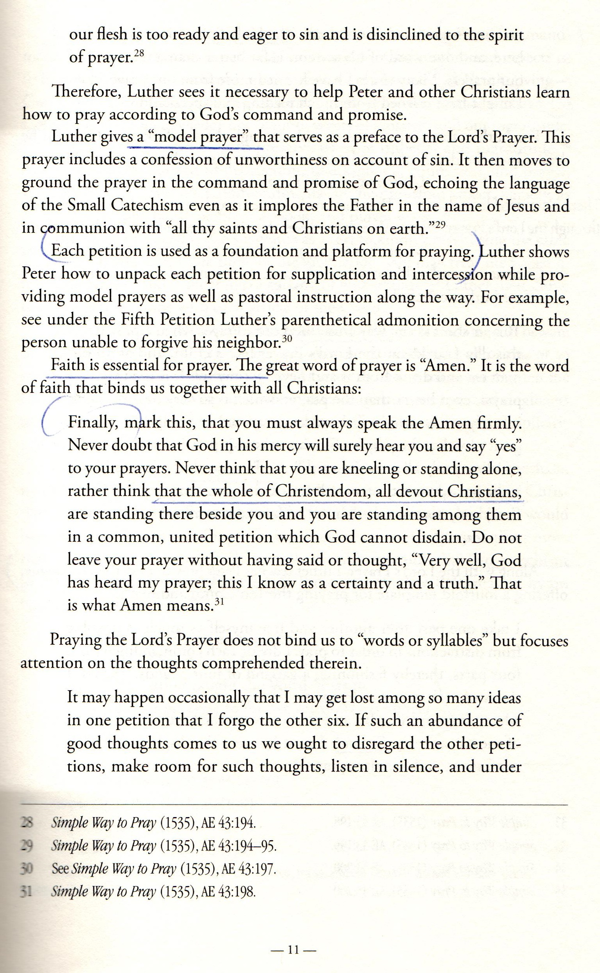

Slide 20
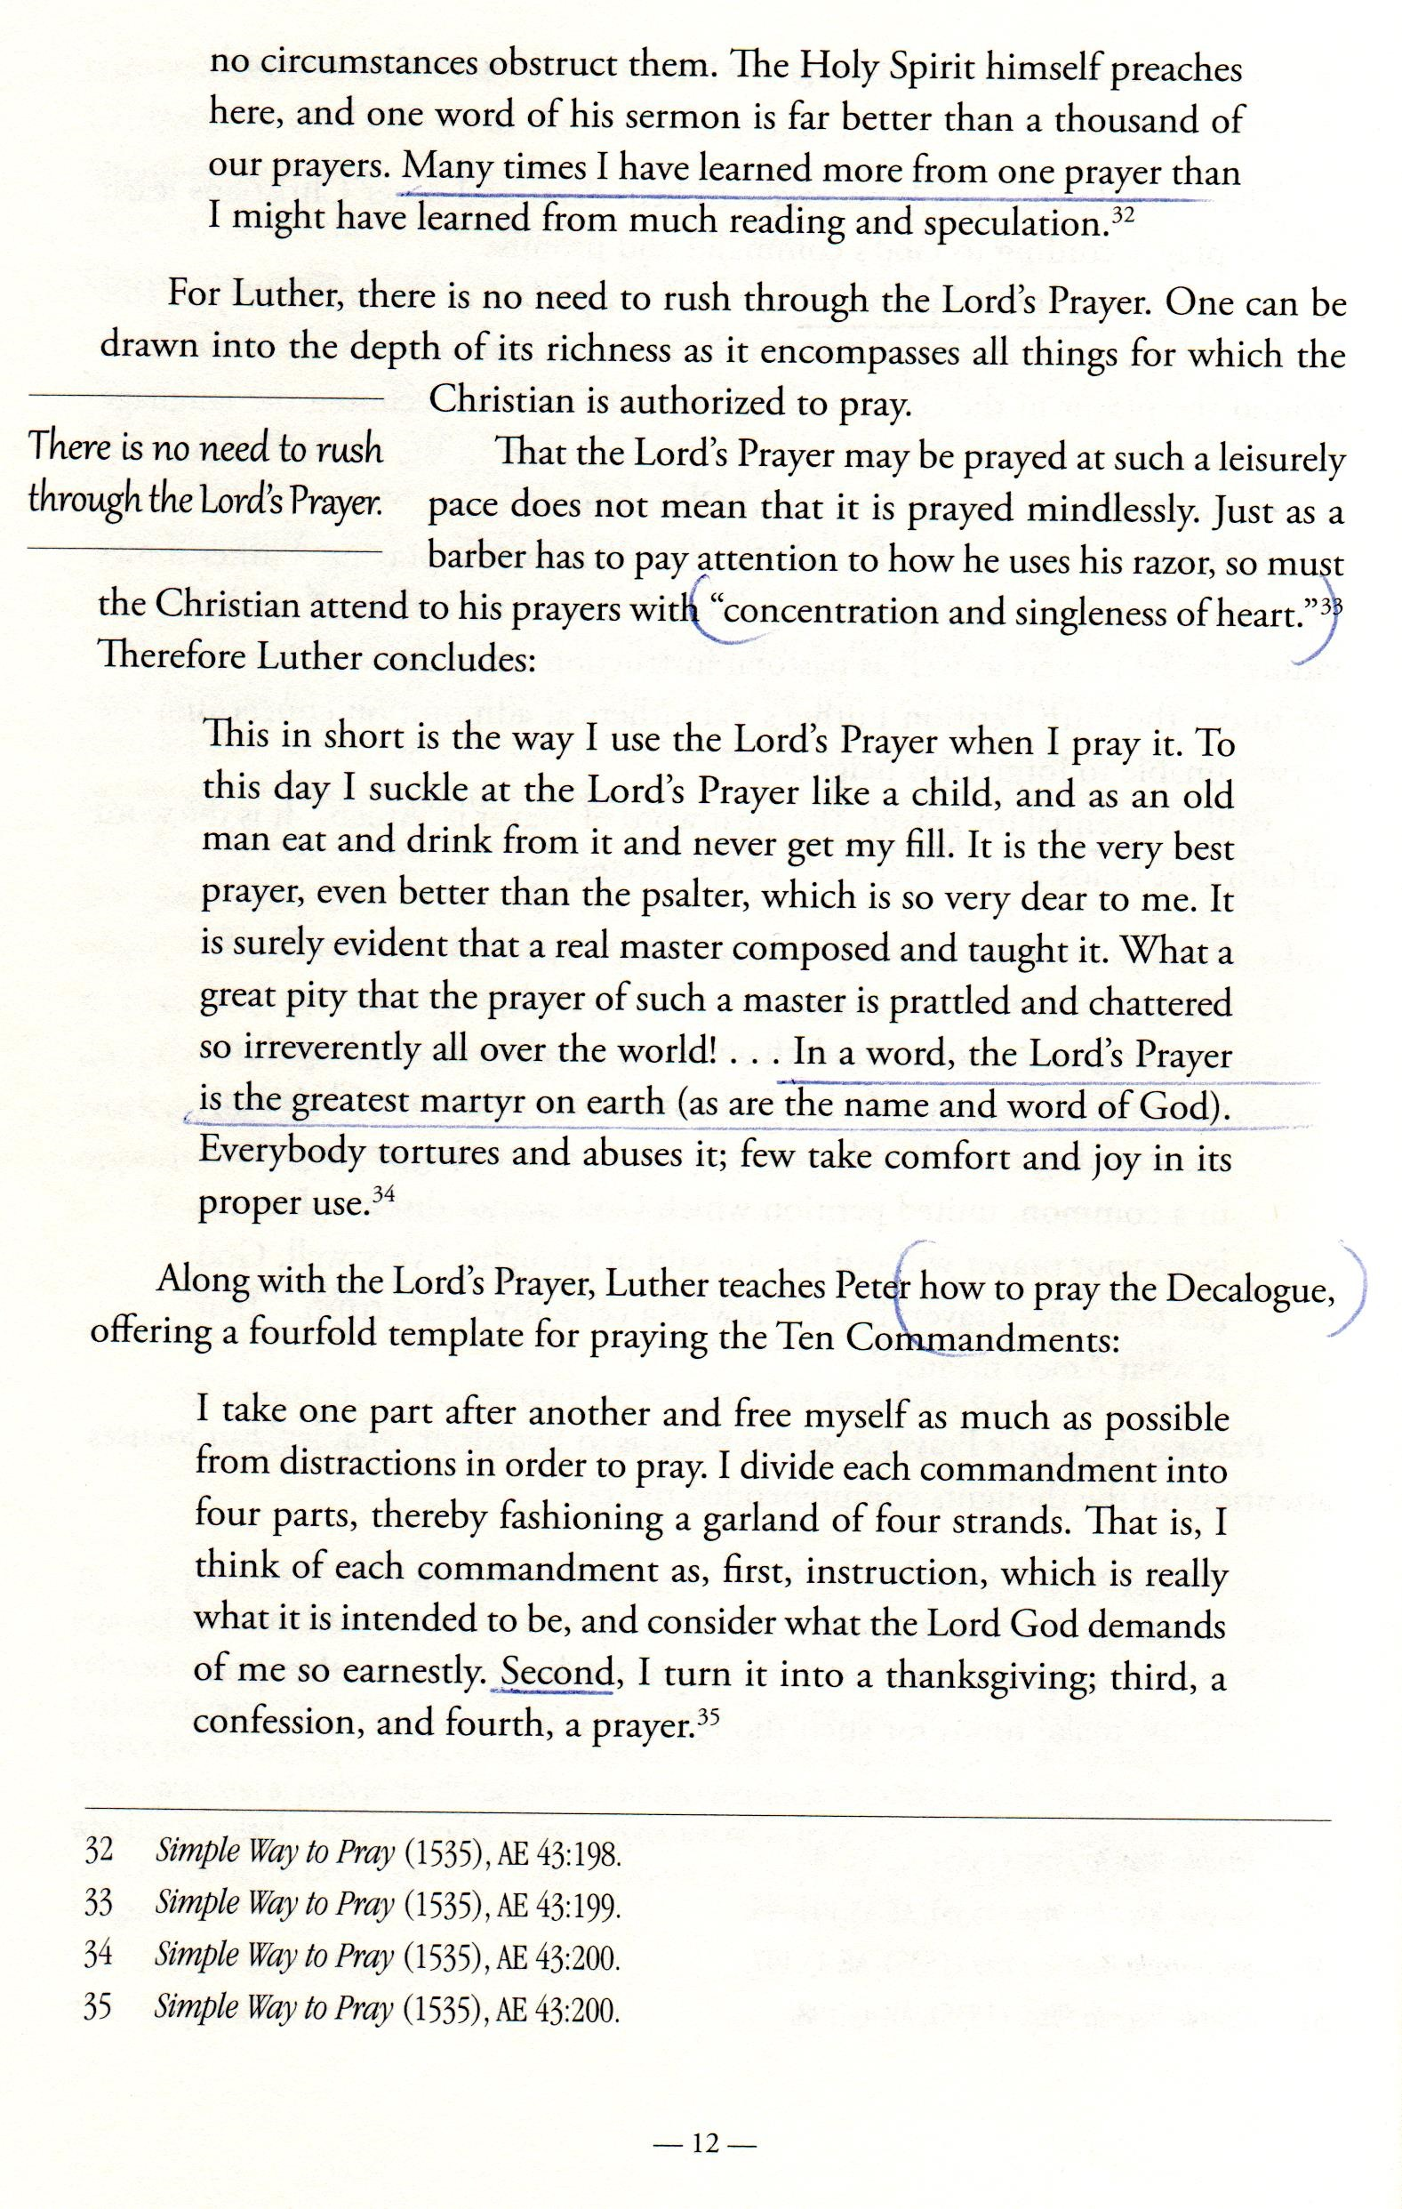

Slide 21
