Slide 1
THE BOOK OF JOSHUA
“Be Strong and Courageous!”
-Joshua in the Old Testament
-Jesus in the New Testament
Date: 3-29-15 Lesson: 8

Slide 2
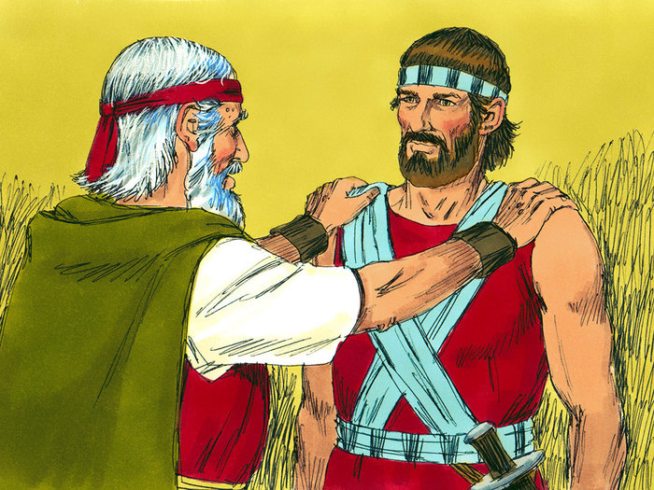

Slide 3
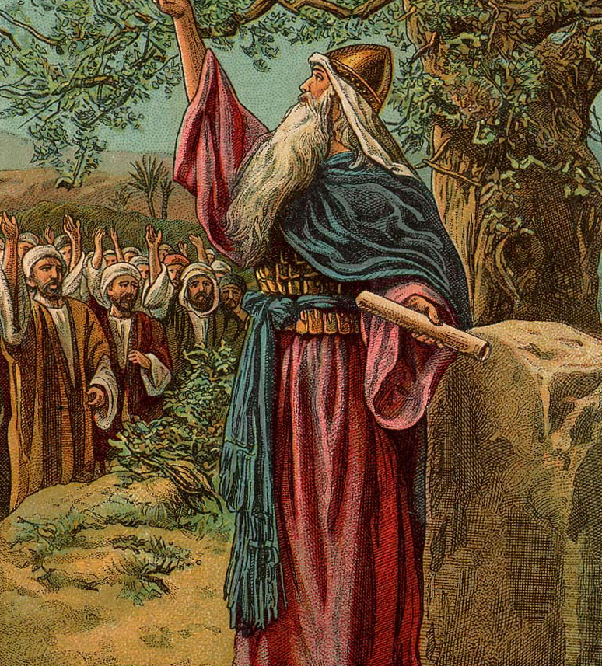

Slide 4
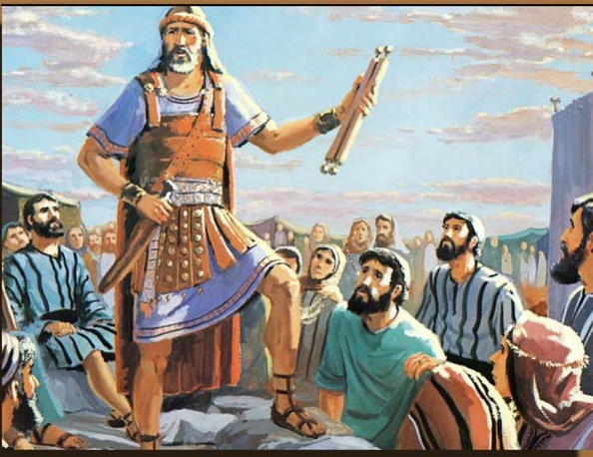

Slide 5
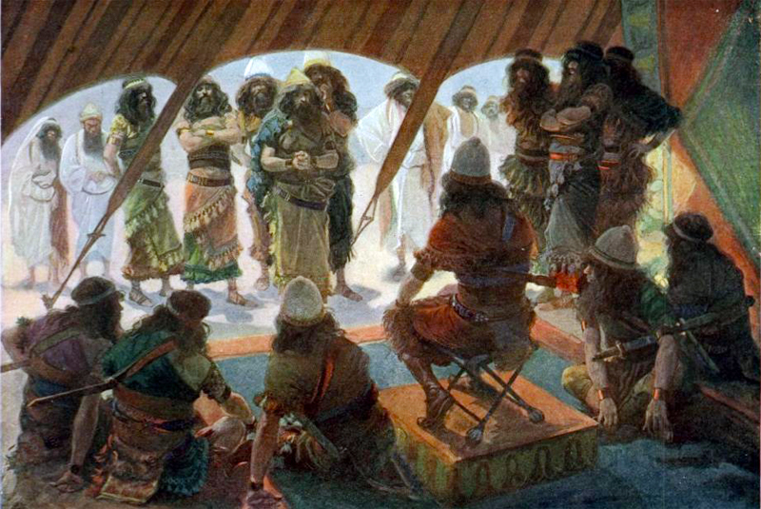

Slide 6
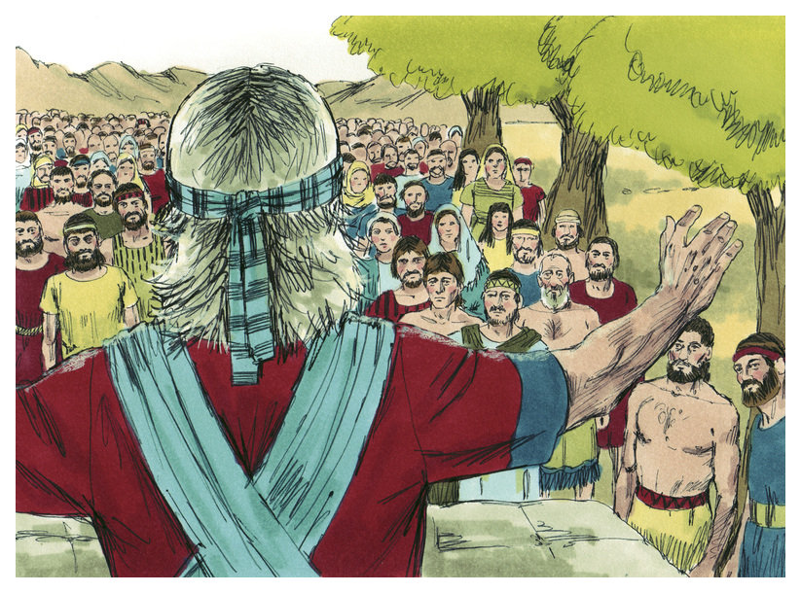

Slide 7
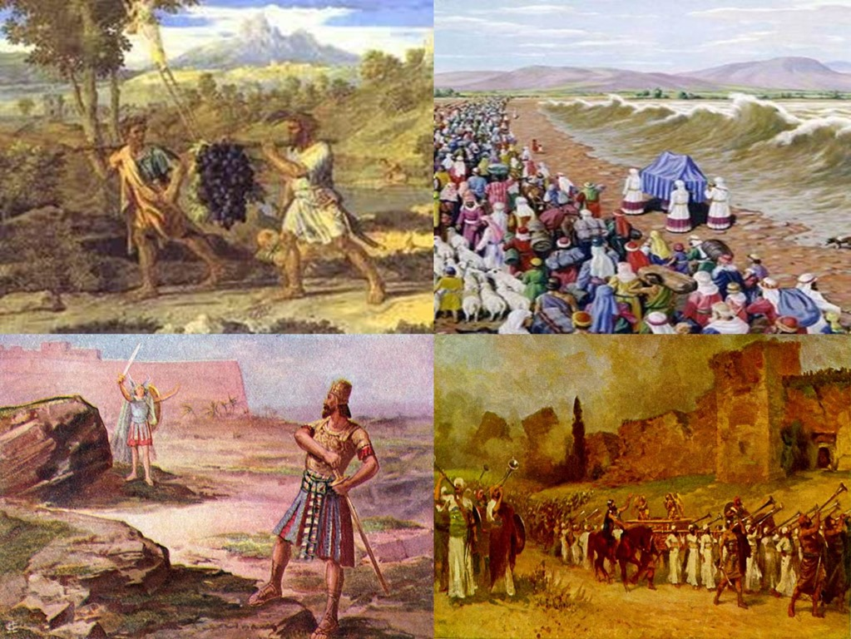

Slide 8
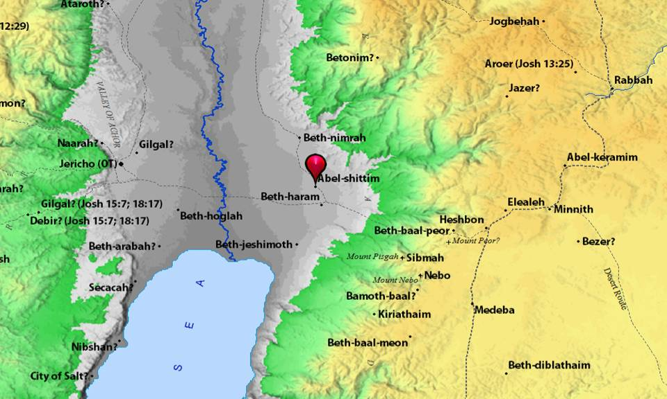

Slide 9
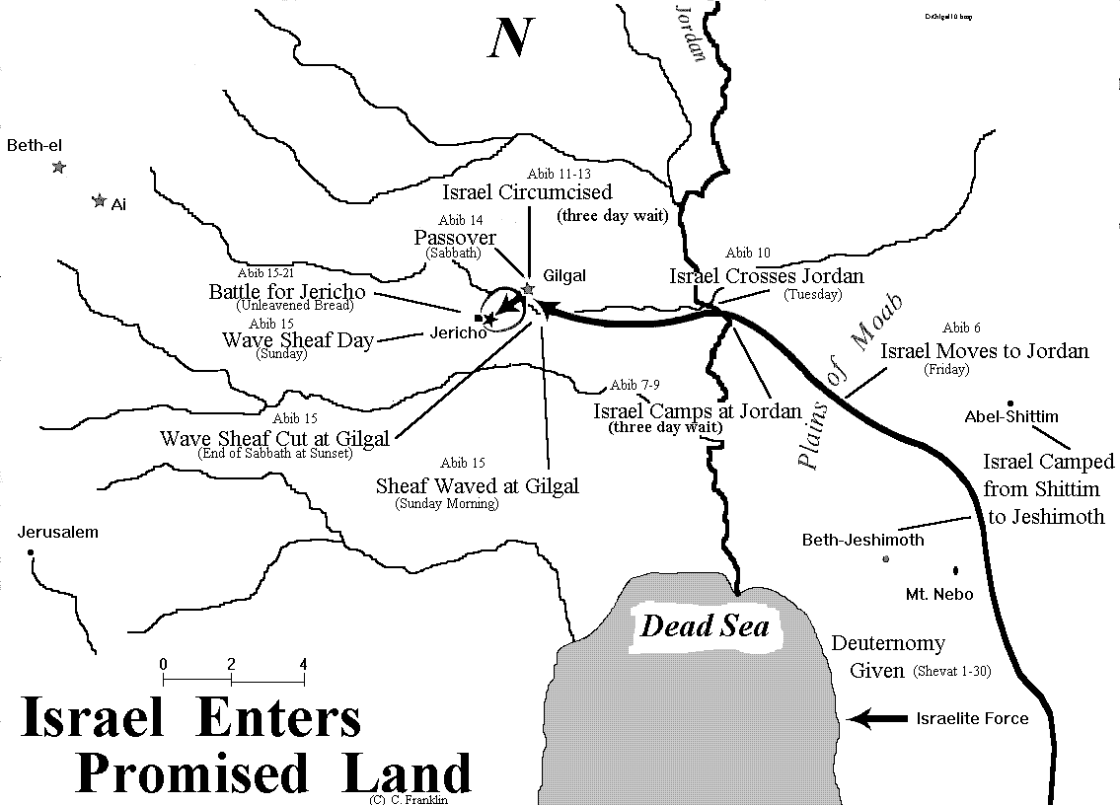

Slide 11
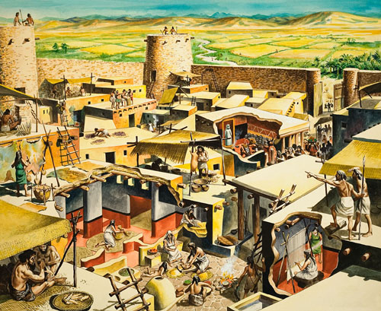

Slide 12
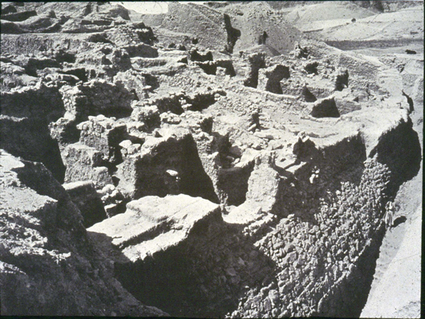

Slide 14
A. TEXT – Chapter 6
(1) Now Jericho was shut up inside and outside because of the people of Israel. None went out, and none came in. (2) And the Lord said to Joshua, "See, I have given Jericho into your hand, with its king and mighty men of valor. (3) You shall march around the city, all the men of war going around the city once. Thus shall you do for six days. (4) Seven priests shall bear seven trumpets of rams' horns before the ark. On the seventh day you shall march around the city seven times, and the priests shall blow the trumpets. (5) And when they make a long blast with the ram's horn, when you hear the sound of the trumpet, then all the people shall shout with a great shout, and the wall of the city will fall down flat, and the people shall go up, everyone straight before him."
(6) So Joshua the son of Nun called the priests and said to them, "Take up the ark of the covenant and let seven priests bear seven trumpets of rams' horns before the ark of the Lord." (7) And he said to the people, "Go forward. March around the city and let the armed men pass on before the ark of the Lord."
(8) And just as Joshua had commanded the people, the seven priests bearing the seven trumpets of rams' horns before the Lord went forward, blowing the trumpets, with the ark of the covenant of the Lord following them. (9) The armed men were walking before the priests who were blowing the trumpets, and the rear guard was walking after the ark, while the trumpets blew continually.

Slide 15
(10) But Joshua commanded the people, "You shall not shout or make your voice heard, neither shall any word go out of your mouth, until the day I tell you to shout. Then you shall shout." (11) So he caused the ark of the Lord to circle the city, going about it once. And they came into the camp and spent the night in the camp. (12) Then Joshua rose early in the morning, and the priests took up the ark of the Lord. (13) And the seven priests bearing the seven trumpets of rams' horns before the ark of the Lord walked on, and they blew the trumpets continually. And the armed men were walking before them, and the rear guard was walking after the ark of the Lord, while the trumpets blew continually. (14) And the second day they marched around the city once, and returned into the camp. So they did for six days. (15) On the seventh day they rose early, at the dawn of day, and marched around the city in the same manner seven times. It was only on that day that they marched around the city seven times. (16) And at the seventh time, when the priests had blown the trumpets, Joshua said to the people, "Shout, for the Lord has given you the city. (17) And the city and all that is within it shall be devoted to the Lord for destruction. Only Rahab the prostitute and all who are with her in her house shall live, because she hid the messengers whom we sent. (18) But you, keep yourselves from the things devoted to destruction, lest when you have devoted them you take any of the devoted things and make the camp of Israel a thing for destruction and bring trouble upon it. (19) But all silver and gold, and every vessel of bronze and iron, are holy to the Lord; they shall go into the treasury of the Lord."

Slide 16
(20) So the people shouted, and the trumpets were blown. As soon as the people heard the sound of the trumpet, the people shouted a great shout, and the wall fell down flat, so that the people went up into the city, every man straight before him, and they captured the city. (21) Then they devoted all in the city to destruction, both men and women, young and old, oxen, sheep, and donkeys, with the edge of the sword. (22) But to the two men who had spied out the land, Joshua said, "Go into the prostitute's house and bring out from there the woman and all who belong to her, as you swore to her." (23) So the young men who had been spies went in and brought out Rahab and her father and mother and brothers and all who belonged to her. And they brought all her relatives and put them outside the camp of Israel. (24) And they burned the city with fire, and everything in it. Only the silver and gold, and the vessels of bronze and of iron, they put into the treasury of the house of the Lord. (25) But Rahab the prostitute and her father's household and all who belonged to her, Joshua saved alive. And she has lived in Israel to this day, because she hid the messengers whom Joshua sent to spy out Jericho. (26) Joshua laid an oath on them at that time, saying, "Cursed before the Lord be the man who rises up and rebuilds this city, Jericho. "At the cost of his firstborn shall he lay its foundation, and at the cost of his youngest son shall he set up its gates."

Slide 17
B. STUDY NOTES
1. Jericho = Tell es-Sultan = “moon city” It was the center of worship for the moon-god, and so they were to destroy completely this pagan city and its people.
2. The number “seven” connects to the 7th day of the Sabbath rest of the Lord after the 6 day creation and the 3rd commandment of resting on the 7th day. Thus in this account, God is giving rest to the land from pagan idolatry and bringing it back into the worship of the true Lord God (7 priests, 7 trumpets, 7 days, 7 encirclements) (Gen 2:2,3; Ex 20:9-11; Heb 11:30)
3. Long blast and loud shouts would strike terror into the hearts of the enemy, after having observed complete silence from Israel for 6 days. Jericho was about 9-12 acres in size, with a circumference of about 1 mile. The solemn silence is a sign of the impending doom and God’s judgment – the still before the storm.
4. The ARK OF THE LORD is the tangible evidence of the presence of the Lord in their midst, before them and behind them. It shows, that with the walls falling straight down all around, THE LORD is responsible for their victory. (Nu 10:35; 1 Sam 4:3; 7:1)

Slide 18
5. Devoted to the ban – the curse of death upon all people and property, except the gold and silver, bronze and iron, which are to be placed into the treasury of the Lord’s house – to be used to support the service of the tabernacle which was set up at Gilgal. (Lev 27:28-31; Num 31:22; Dt. 2:34; 13:16; 20:16-18; Micah 4:13) God is utterly removing Jericho’s idolatry and moral corruption. 6. The faith of Rahab - who at the time of the writing of this book still lived among the Israelites (Mt 1:5; Heb 11:31; Jas 2:25-26). In the midst of judgment there is mercy for those who live by faith in the only true God. Rahab was the mother of Boaz who married Ruth and from them would be the line of Jesse and David – the line of Joseph and Mary – the line of Jesus. 7. The curse on the one who would rebuild Jericho fulfilled in the days of rebellion under King Ahab (1 Ki 16:34). 8. The destruction of all the citizens, men, women and children is total. God’s righteous judgment came upon them for not repenting of their unbelief, child sacrifice, ritual prostitution – though they had been given abundant time to do so (Gen 15:16; Dt. 20:18; Ezek 33:11; 2 Pet 3:9)

Slide 19
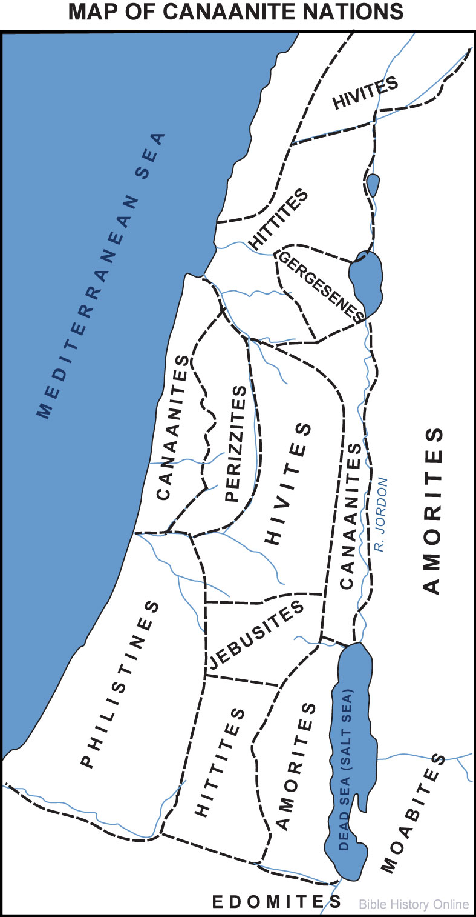

Slide 20
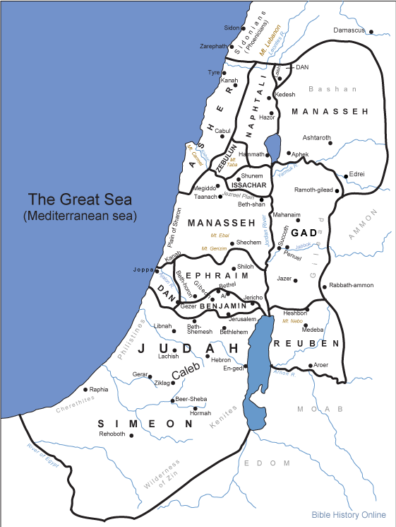

Slide 21
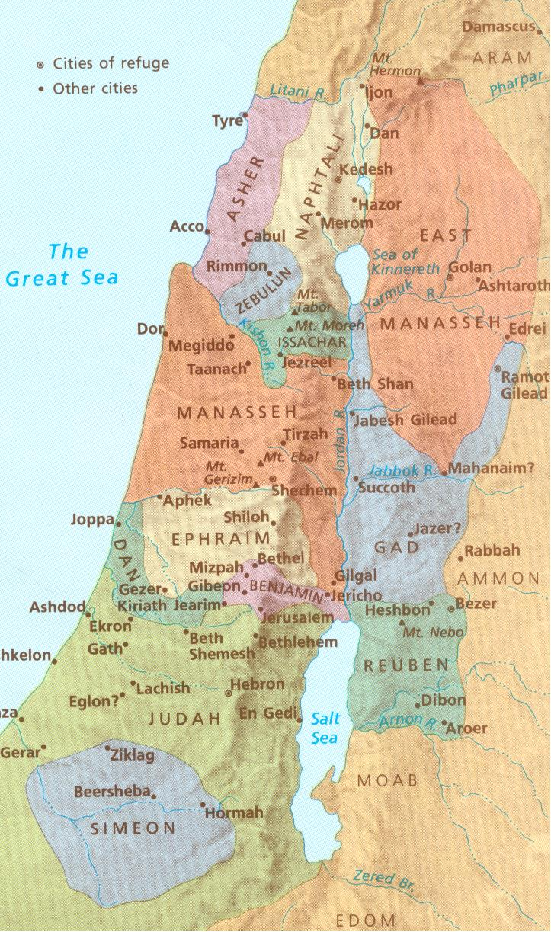

Slide 22
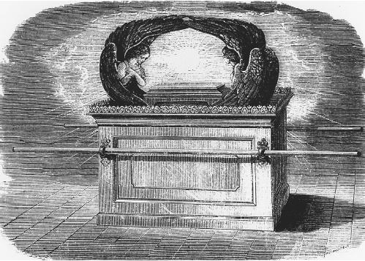

Slide 23
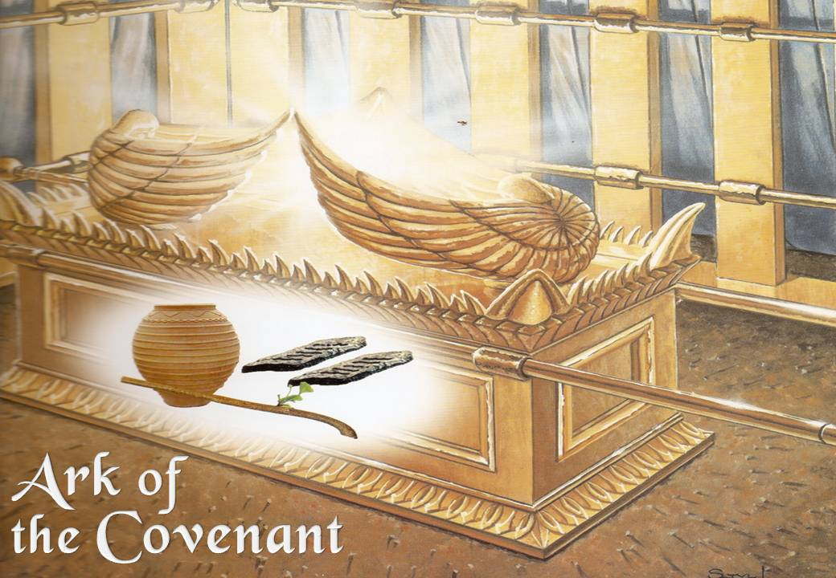

Slide 24
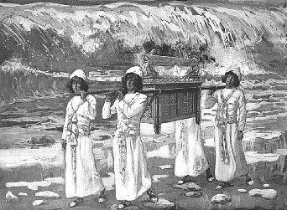

Slide 25
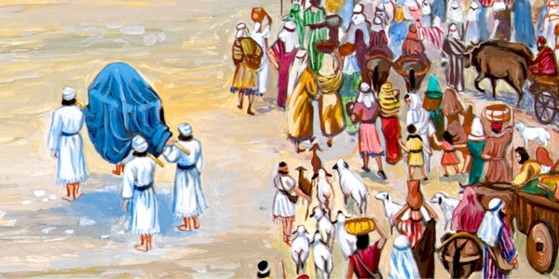

Slide 26
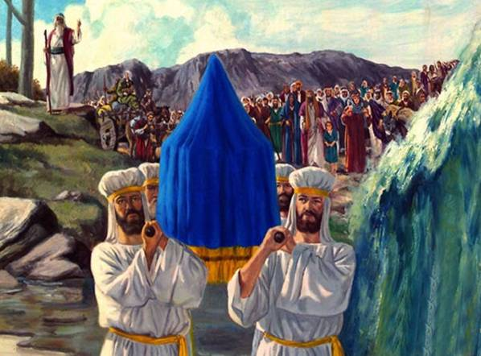

Slide 27
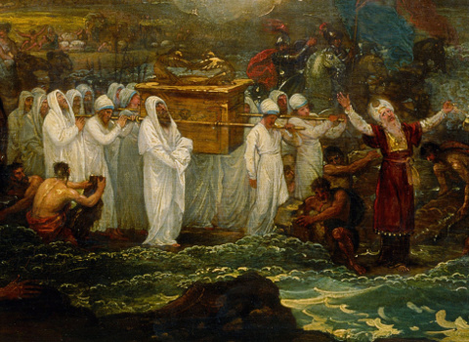

Slide 28
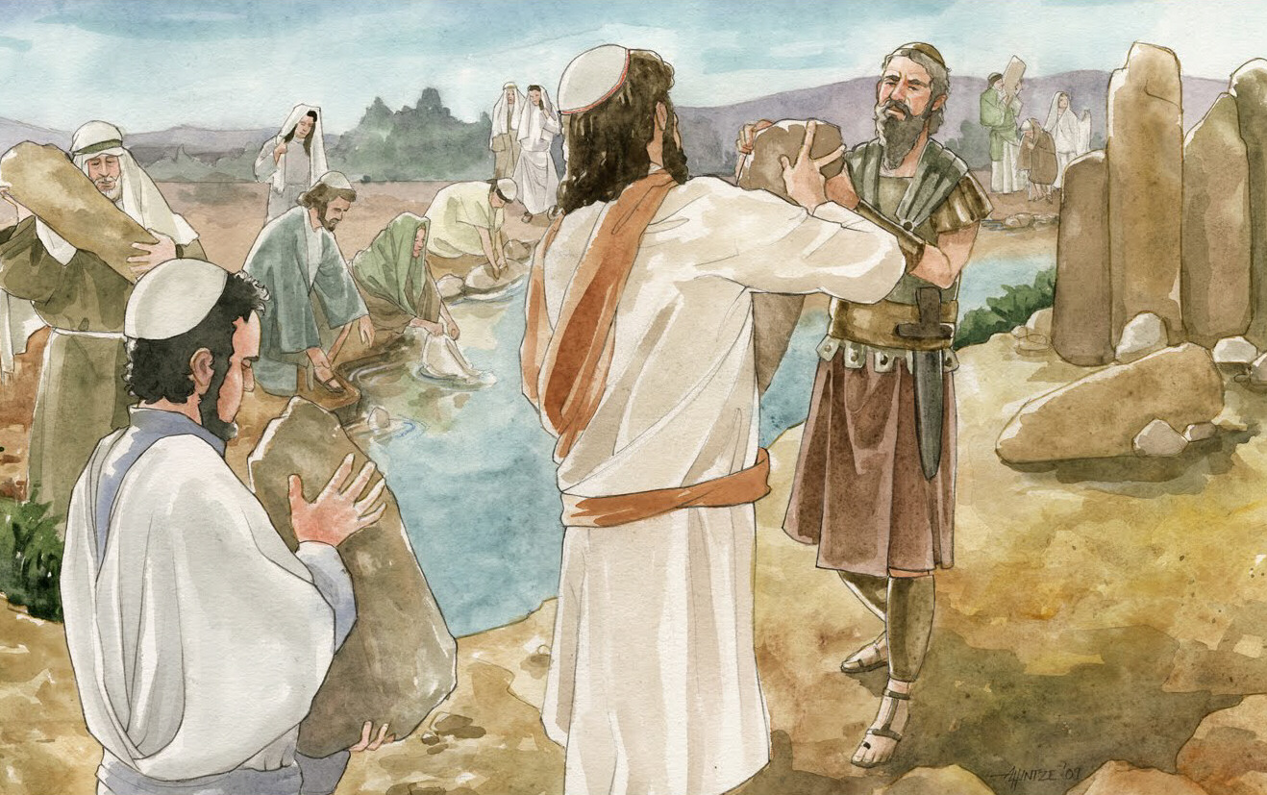

Slide 29
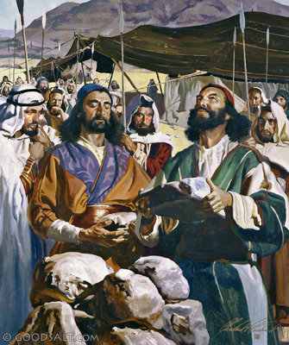

Slide 30
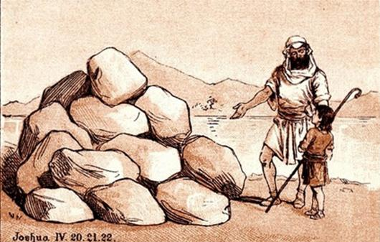

Slide 31
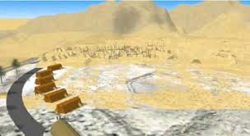

Slide 32
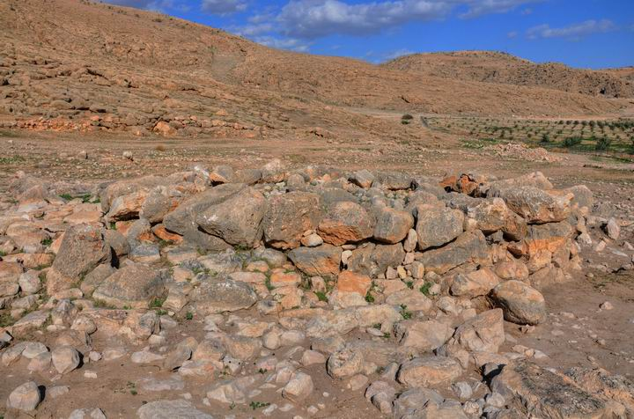

Slide 33
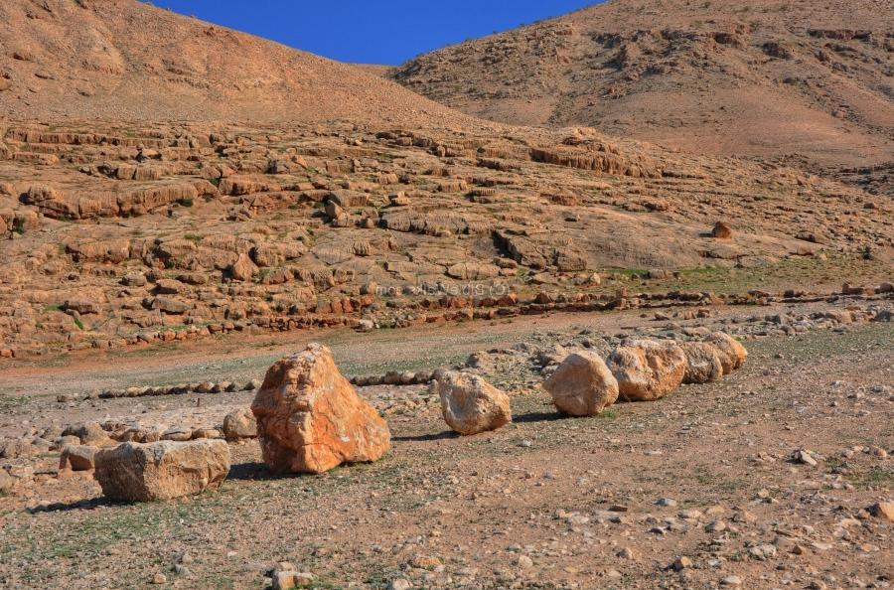

Slide 34
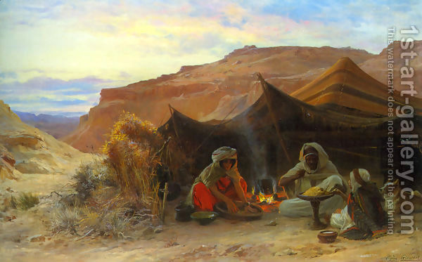

Slide 35
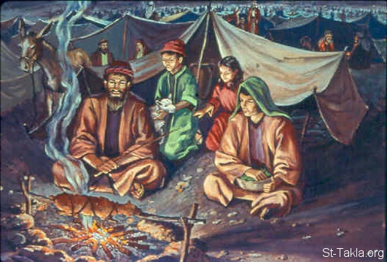

Slide 36
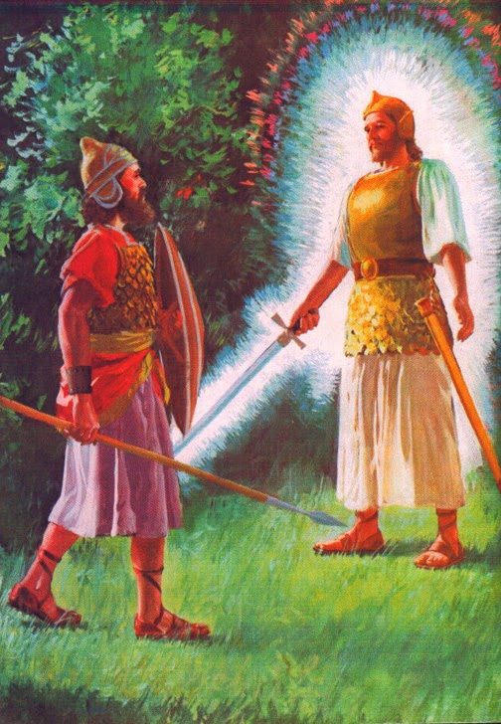

Slide 37
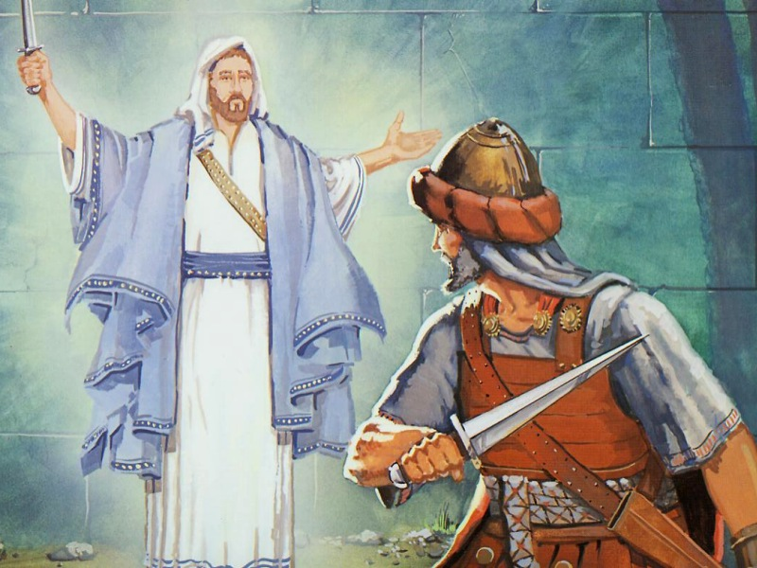

Slide 39
C. LIFE APPLICATION: 1. One shudders at the generation alive today –give examples of the idolatry, abominations, debauchery, evils and child sacrifice today. 2. There is silence in present history, making people think God will not punish anyone in his righteous wrath. This time of silence however will end when and in what way? (Mt 24:37-42; Lk 17:26-35; 1 Pet 3:20; 2 Pet 2:5-12) 3. -Therefore, where do we see the “ark of God’s presence” going before us? -In what ways has God “brought down the walls” of the world for us? - How has he spared us like Rahab and the Israelites through the line of Rahab – the line of the Christ?

Slide 40
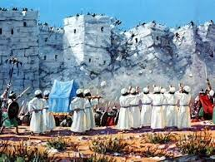

Slide 41
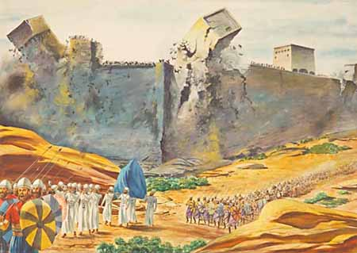

Slide 42
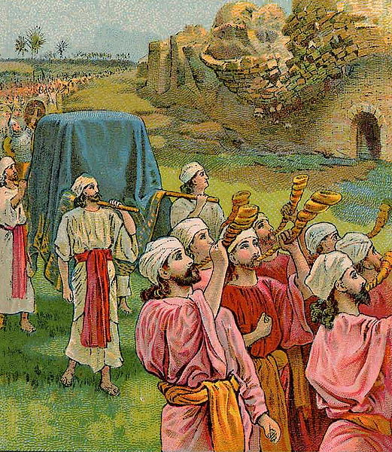

Slide 43
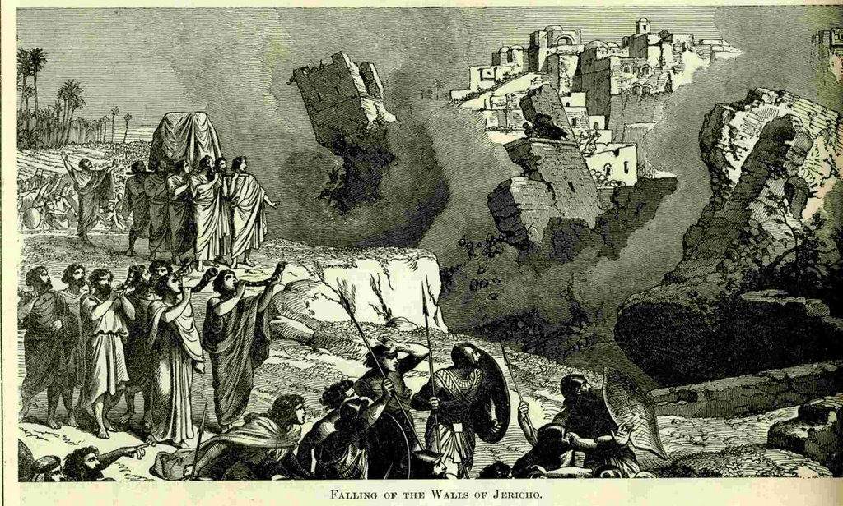

Slide 44
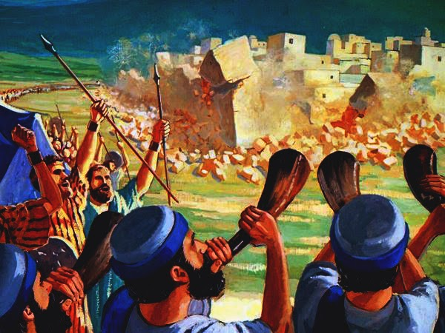

Slide 45
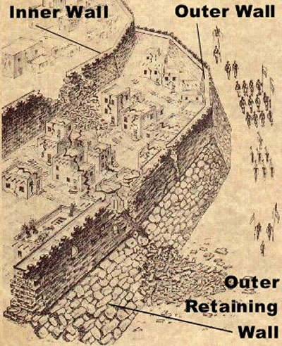

Slide 46
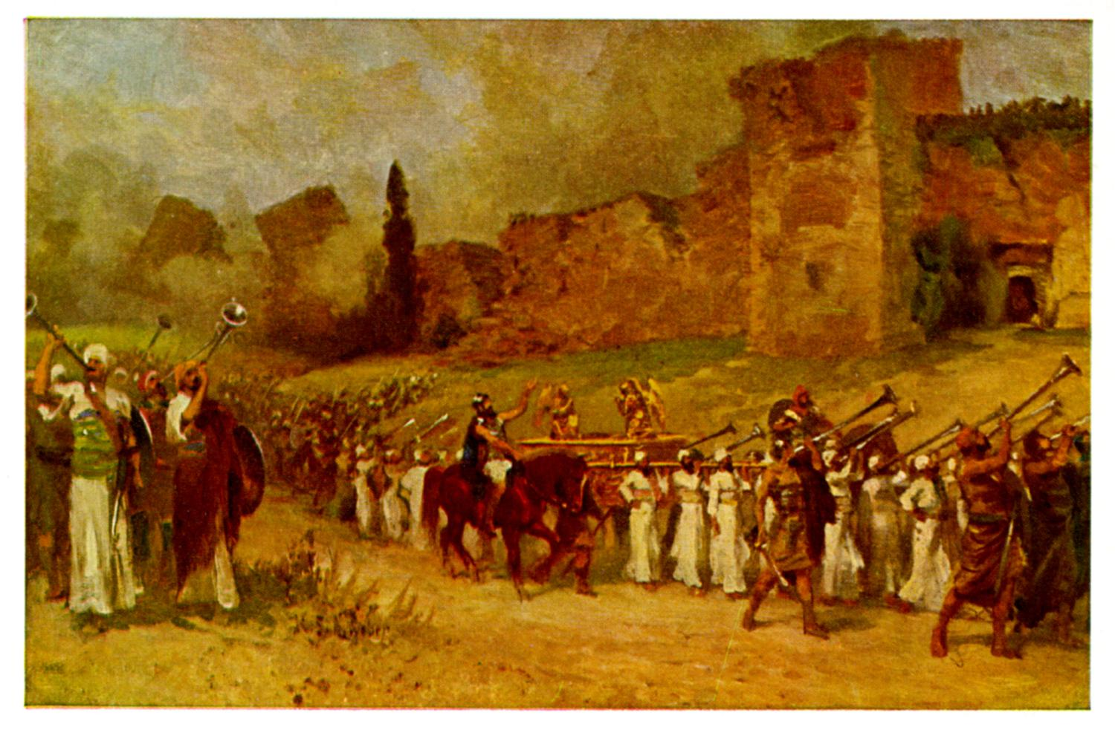

Slide 47
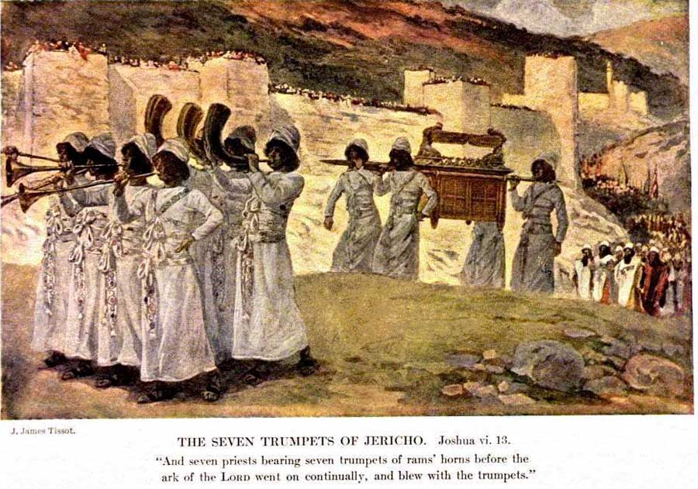

Slide 48
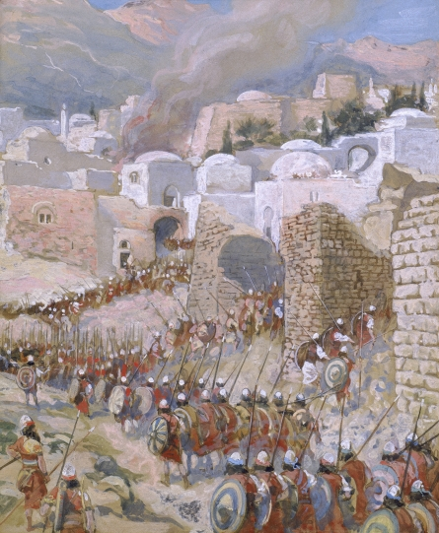

Slide 49
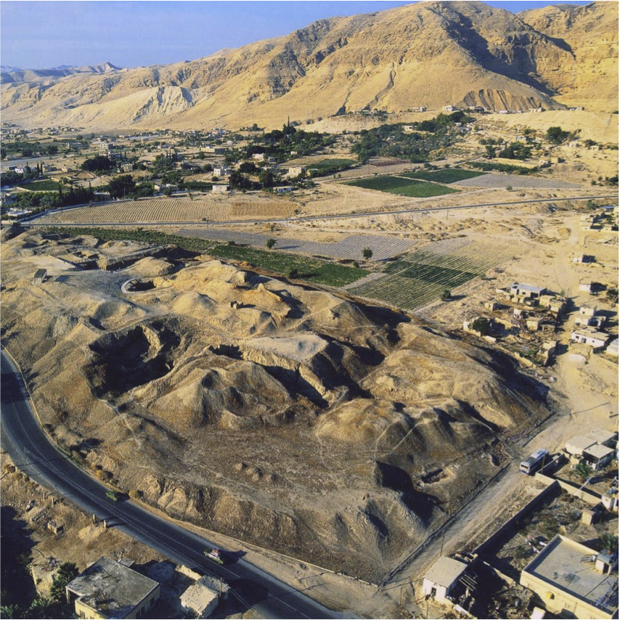

Slide 51
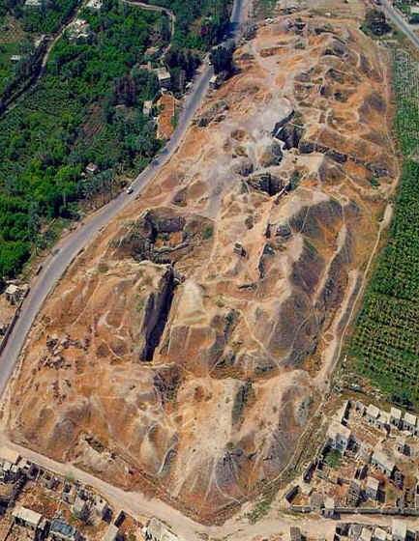

Slide 52
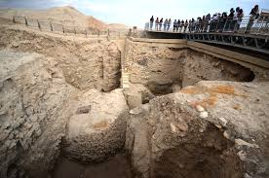

Slide 53
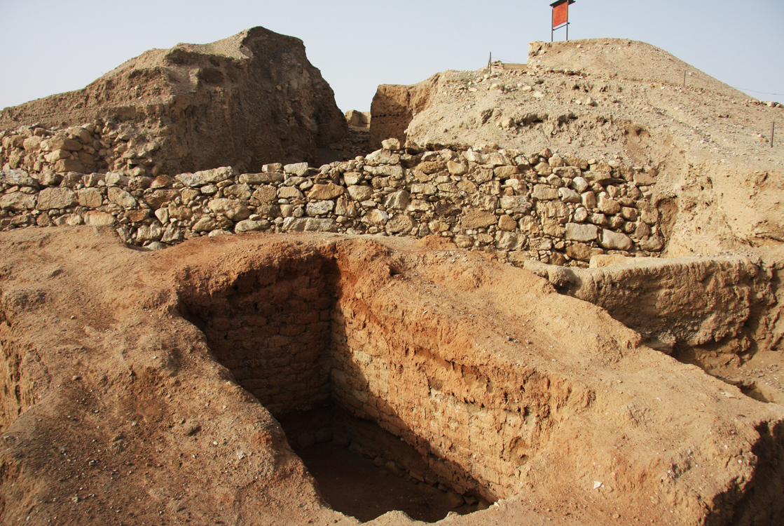

Slide 54
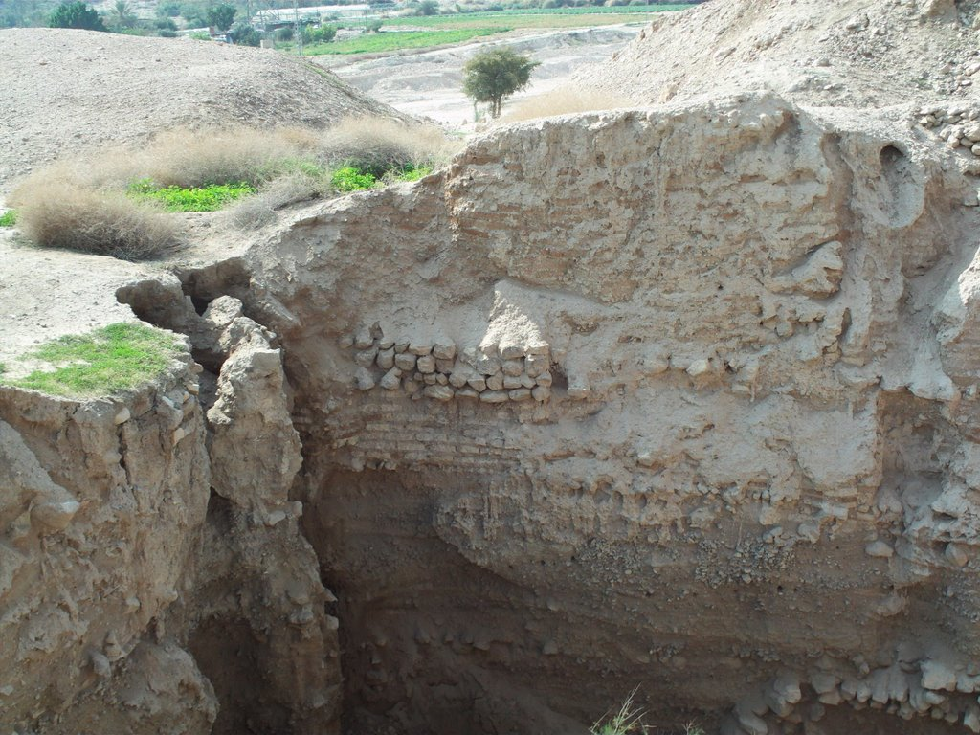

Slide 55
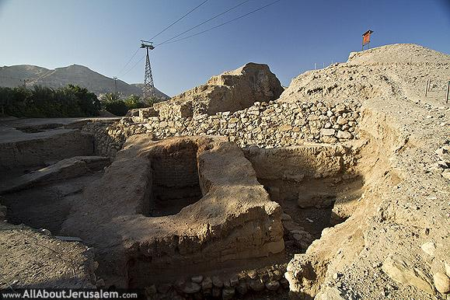

Slide 56
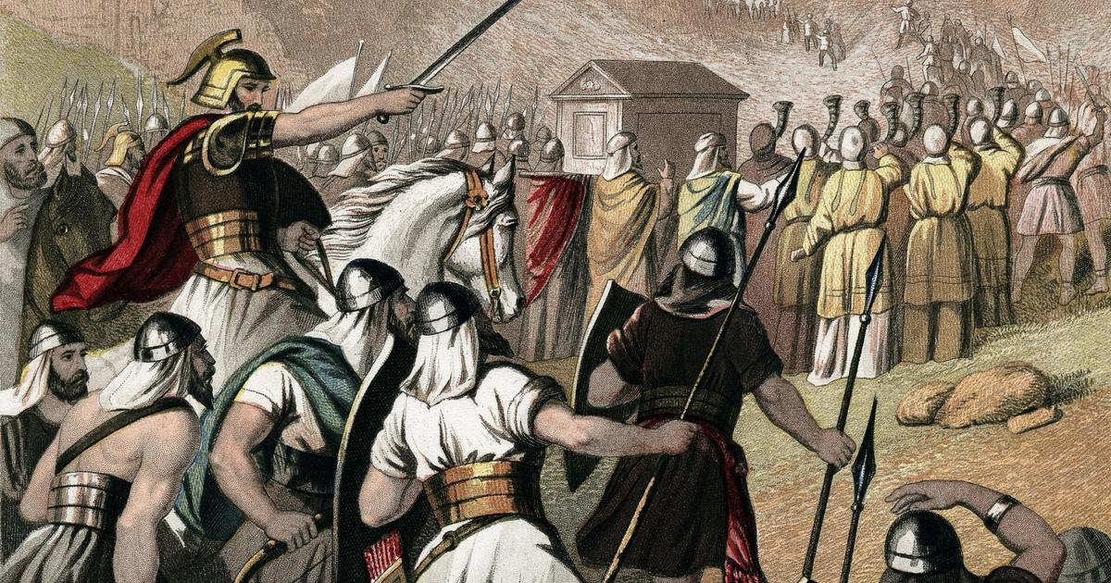

Slide 57
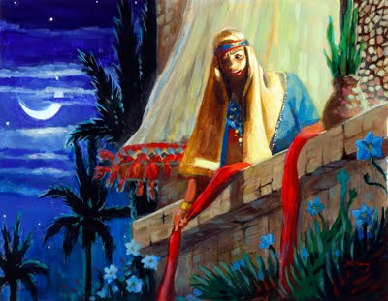

Slide 62
