Slide 1
THE BOOK OF JOSHUA
“Be Strong and Courageous!”
-Joshua in the Old Testament
-Jesus in the New Testament
Date: 3-22-15 Lesson: 7

Slide 2
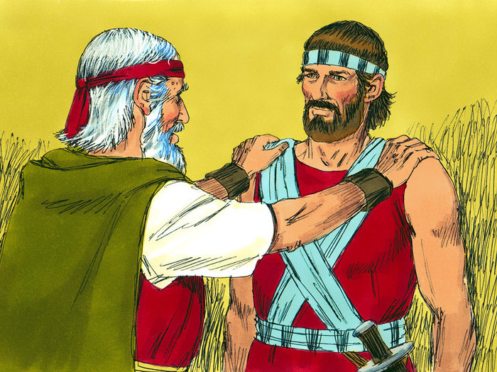

Slide 3
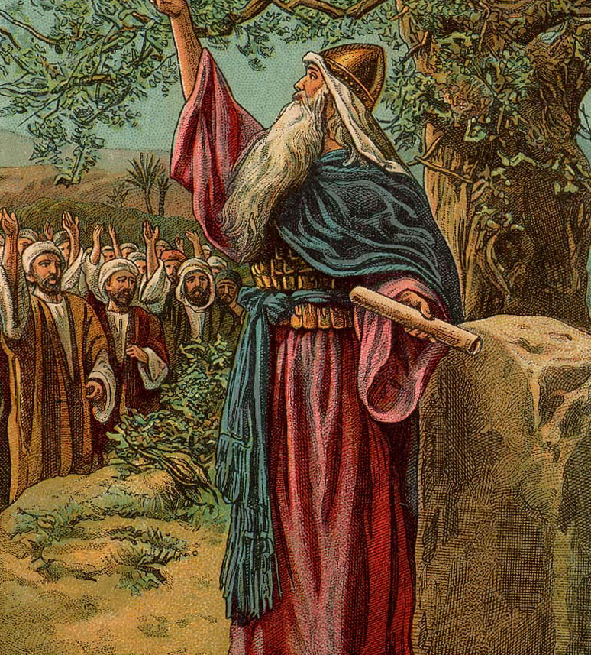

Slide 4
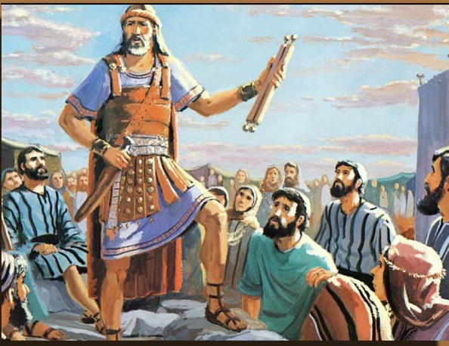

Slide 5
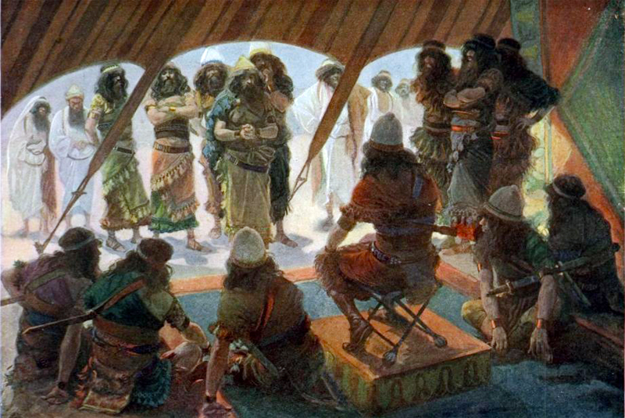

Slide 6
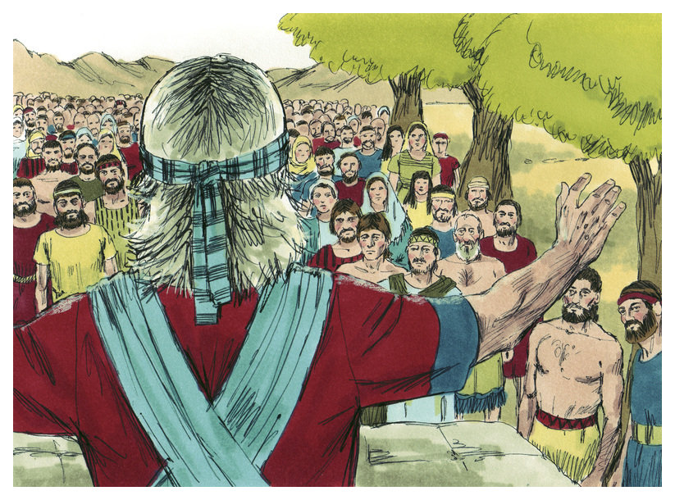

Slide 7
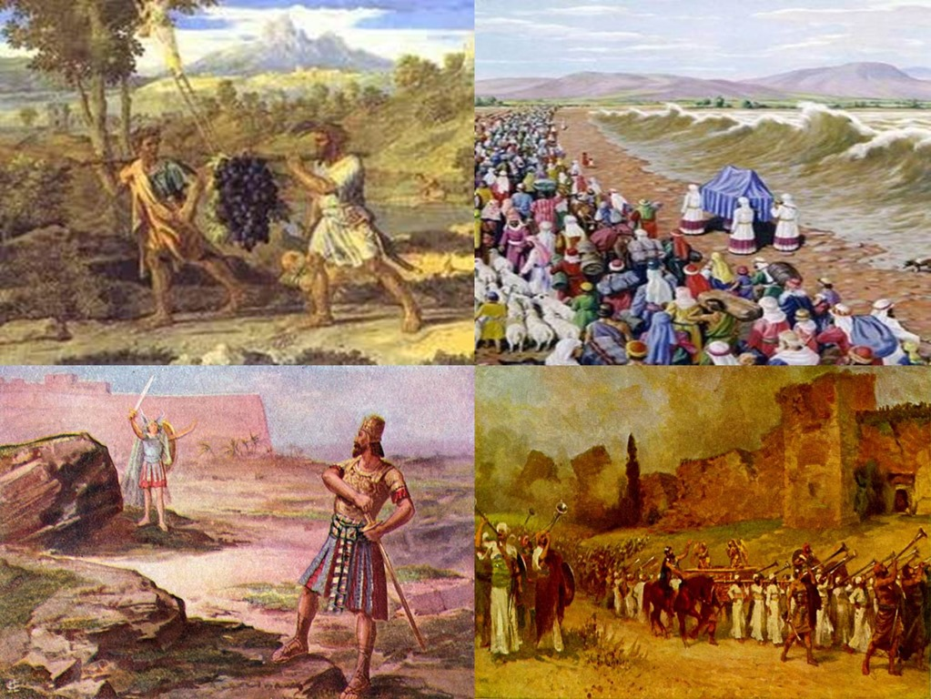

Slide 8
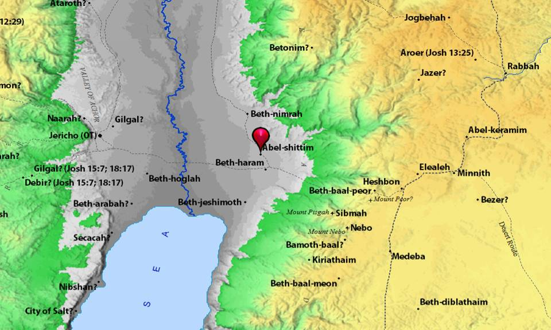

Slide 9
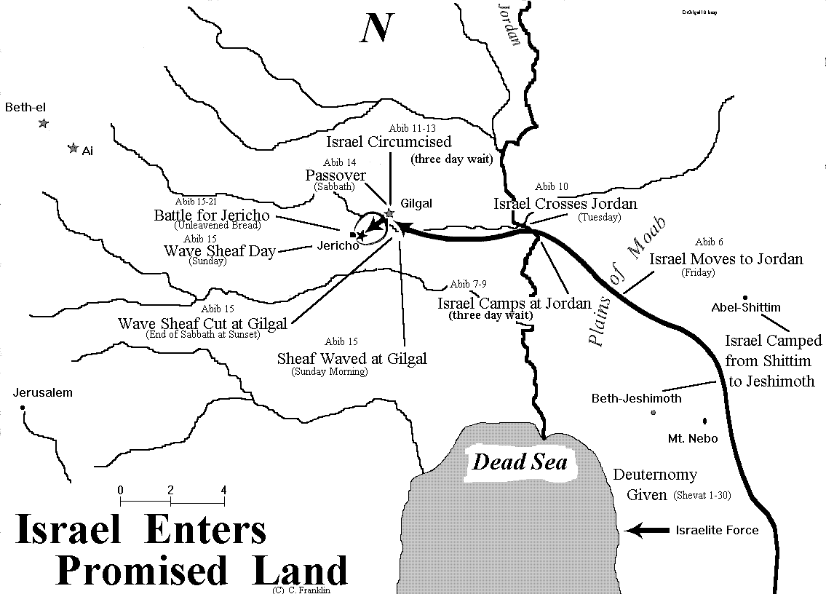

Slide 11
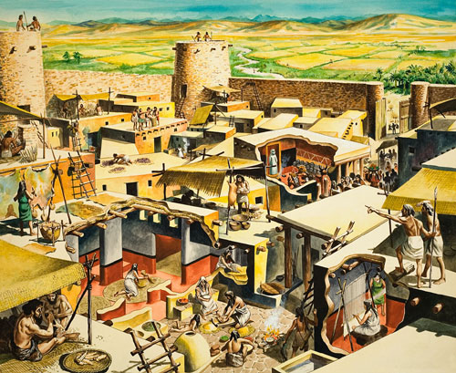

Slide 12
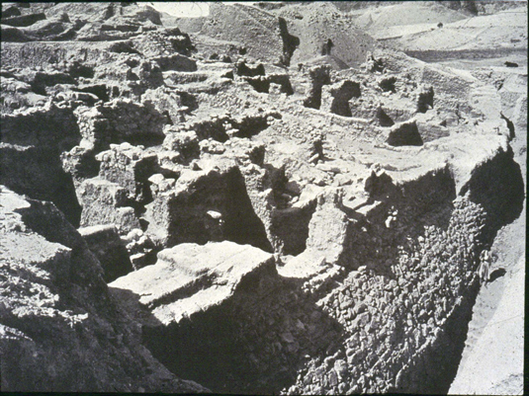

Slide 14
A. TEXT – Chapter 5
(1) As soon as all the kings of the Amorites who were beyond the Jordan to the west, and all the kings of the Canaanites who were by the sea, heard that the Lord had dried up the waters of the Jordan for the people of Israel until they had crossed over, their hearts melted and there was no longer any spirit in them because of the people of Israel.
(2) At that time the Lord said to Joshua, "Make flint knives and circumcise the sons of Israel a second time." (3) So Joshua made flint knives and circumcised the sons of Israel at Gibeath-haaraloth. (4) And this is the reason why Joshua circumcised them: all the males of the people who came out of Egypt, all the men of war, had died in the wilderness on the way after they had come out of Egypt.
(5) Though all the people who came out had been circumcised, yet all the people who were born on the way in the wilderness after they had come out of Egypt had not been circumcised. (6) For the people of Israel walked forty years in the wilderness, until all the nation, the men of war who came out of Egypt, perished, because they did not obey the voice of the Lord; the Lord swore to them that he would not let them see the land that the Lord had sworn to their fathers to give to us, a land flowing with milk and honey.
(7) So it was their children, whom he raised up in their place, that Joshua circumcised. For they were uncircumcised, because they had not been circumcised on the way. (8) When the circumcising of the whole nation was finished, they remained in their places in the camp until they were healed.

Slide 15
(9) And the Lord said to Joshua, "Today I have rolled away the reproach of Egypt from you." And so the name of that place is called Gilgal to this day. (10) While the people of Israel were encamped at Gilgal, they kept the Passover on the fourteenth day of the month in the evening on the plains of Jericho. (11) And the day after the Passover, on that very day, they ate of the produce of the land, unleavened cakes and parched grain. (12) And the manna ceased the day after they ate of the produce of the land. And there was no longer manna for the people of Israel, but they ate of the fruit of the land of Canaan that year. (13) When Joshua was by Jericho, he lifted up his eyes and looked, and behold, a man was standing before him with his drawn sword in his hand. And Joshua went to him and said to him, "Are you for us, or for our adversaries?" (14) And he said, "No; but I am the commander of the army of the Lord. Now I have come." And Joshua fell on his face to the earth and worshiped and said to him, "What does my lord say to his servant?" (15) And the commander of the Lord's army said to Joshua, "Take off your sandals from your feet, for the place where you are standing is holy." And Joshua did so.

Slide 16
B. STUDY NOTES
1. At Gilgal, the two covenantal ceremonies were revived – circumcision and the Passover, before they could enter the promised land. They ate unleavened bread for the 7 feast days.
(Gen 17:10-11; Ex 4:24-26; 12:2-8,15,48; Lev 23:6;
Num 9:1-5; 14:21-23,26-35)
In the New Testament – communion and baptism replace Passover and circumcision
(Lk 22:15; Col 2:11,12)
2. The reproach of Egypt – that the Israelites would all die in the desert – was removed
(Ex 32:12; Nu 14:13-16; Dt 9:28)
3. The manna stopped after 40 years - no more desert food, now the food of the promised land
(Dt. 6:10-12)

Slide 17
4. The sudden appearance of a heavenly being is most likely a Christophany in human form. He is the commander of the Lord’s army with the sword of God. God will send heavenly armies to assist them in their battles. He is called “my Lord” and the place where he stands is “holy ground.” Just like Moses took off his sandals before the burning bush, because God the “I AM” was present, now also Joshua takes his sandals off because the same “I AM” is present in the person of this man – commander – Lord before him. This is one of the many appearance of the Son of God, the 2nd Person of the Holy Trinity, on earth before he was incarnate and became Man through the virgin Mary. (Gen 3:8-24; 18:1-33; 32:22-32; 34:29-35; Ex 3:1-4:17; Dt 34:1-12; Is 9:6; Dan 8:11) Fulfillment in heaven where God walks among us again in the new Garden – Paradise – Tree of Life (Rev. 21:1-7; 22:12-21)

Slide 18
Hymn – “A Mighty Fortress” LSB 656:2
2 | With might of ours can naught be done, Soon were our loss effected; But for us fights the valiant One, Whom God Himself elected. Ask ye, Who is this? Jesus Christ it is, Of Sabaoth Lord, And there’s none other God; He holds the field forever.

Slide 19
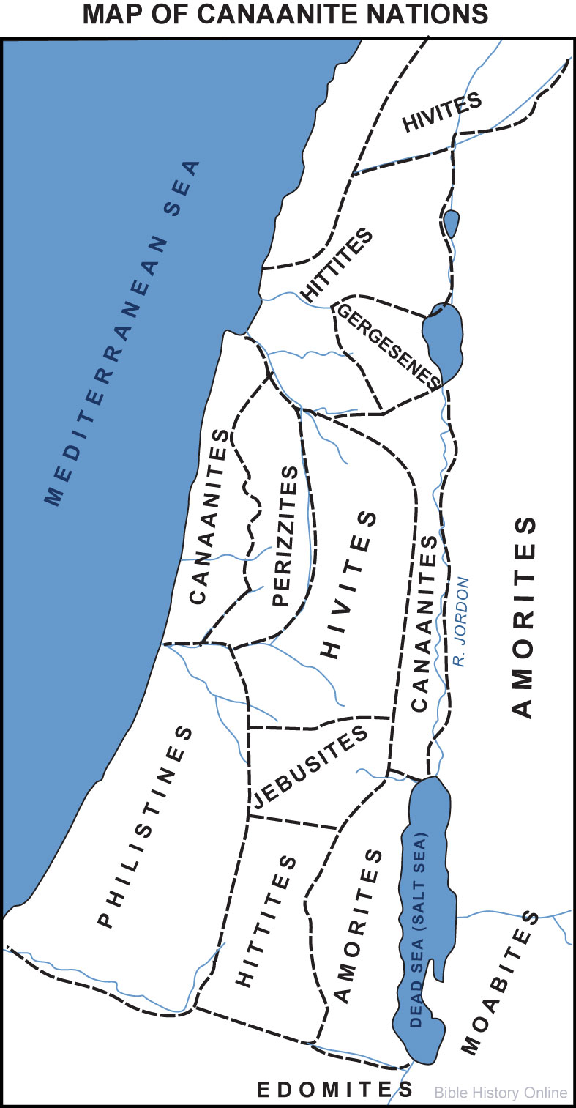

Slide 20
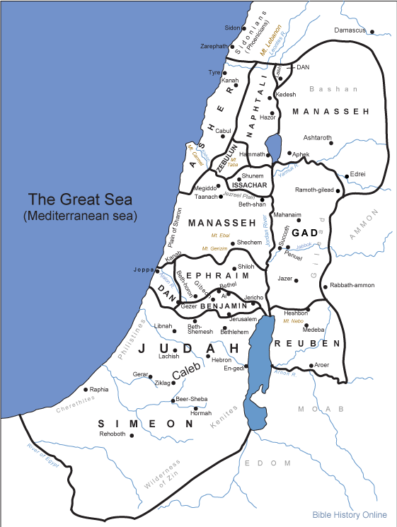

Slide 21
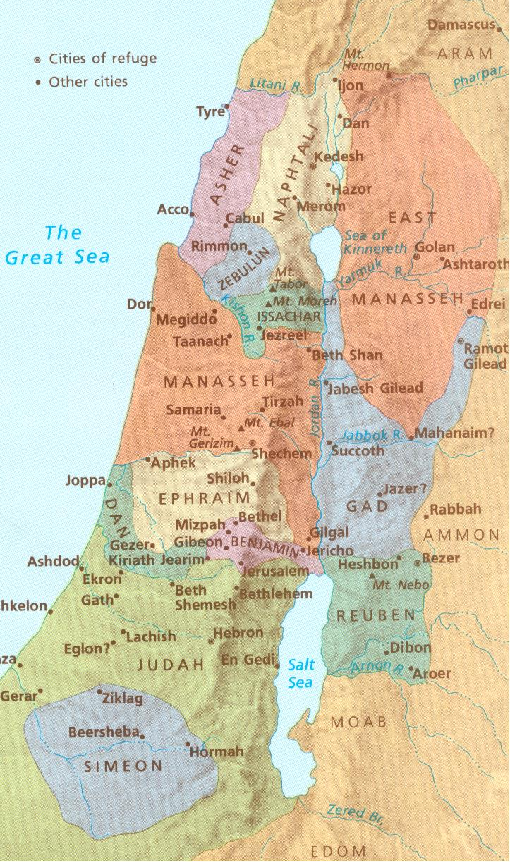

Slide 22
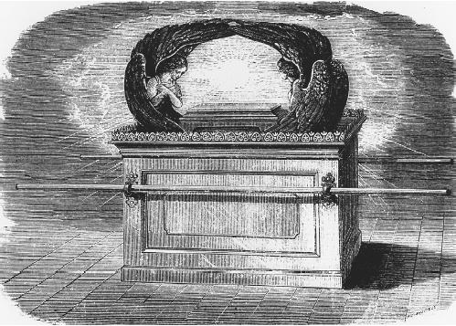

Slide 23
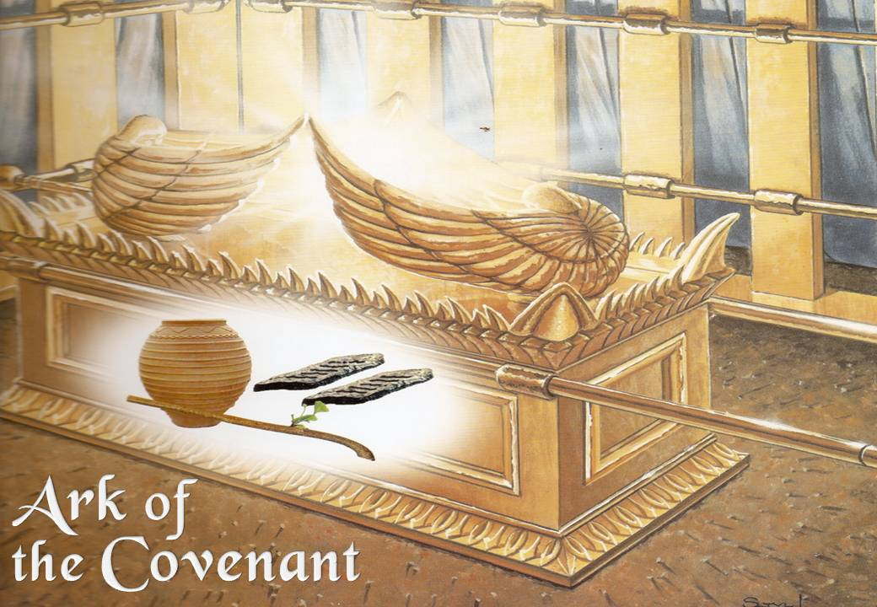

Slide 24
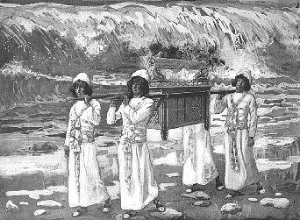

Slide 25
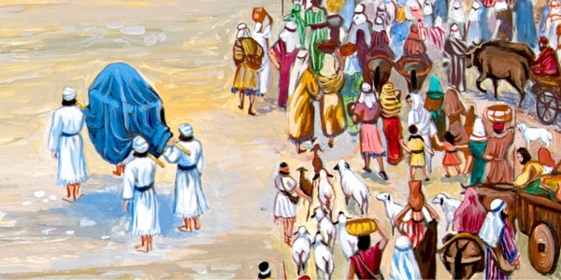

Slide 26
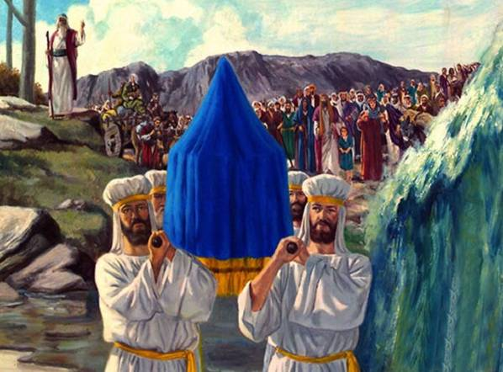

Slide 27
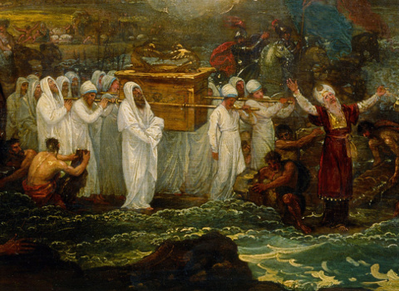

Slide 28
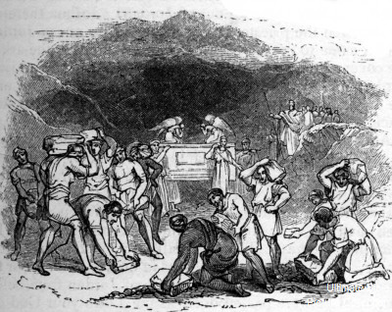

Slide 29
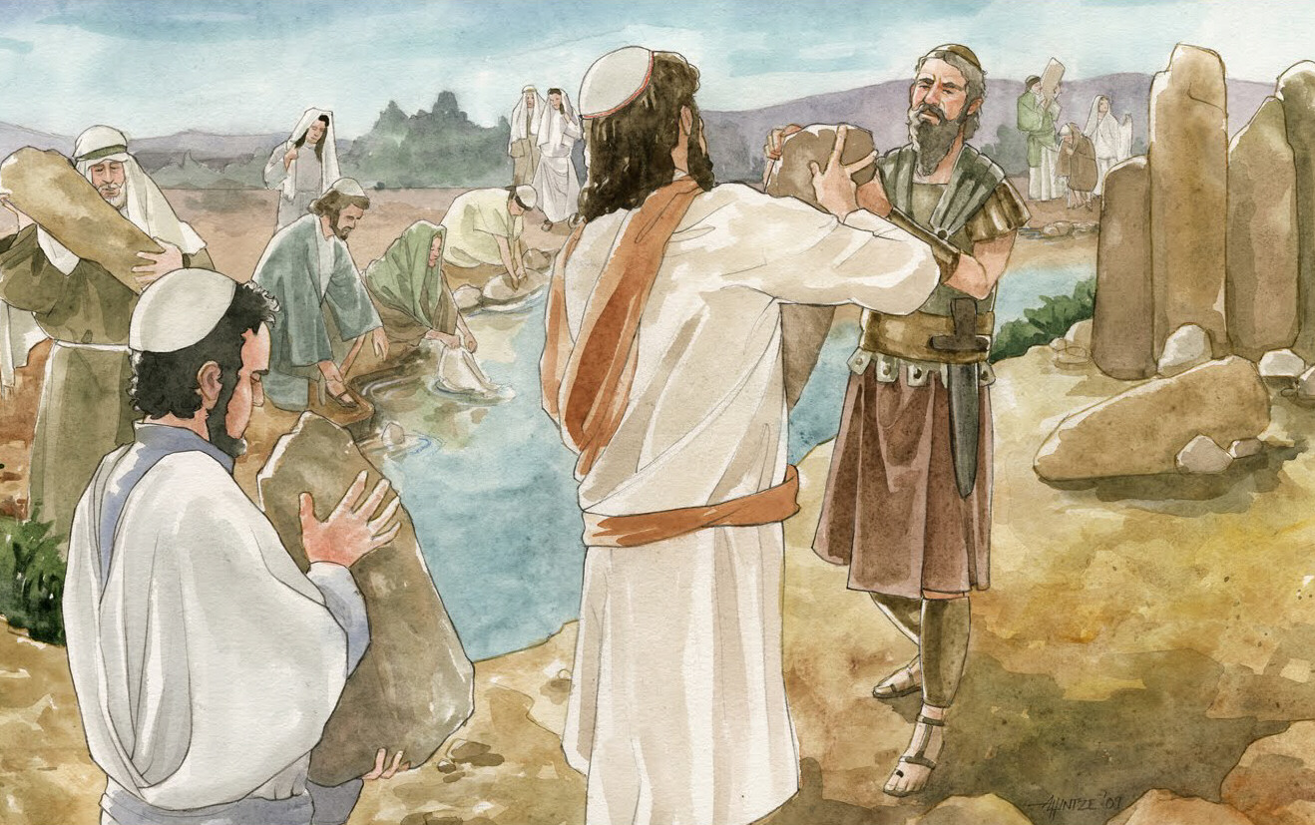

Slide 30
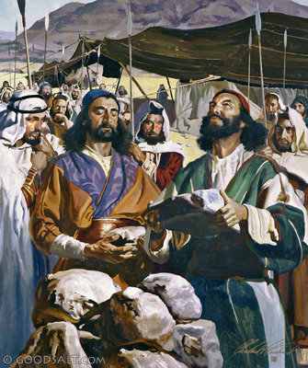

Slide 31
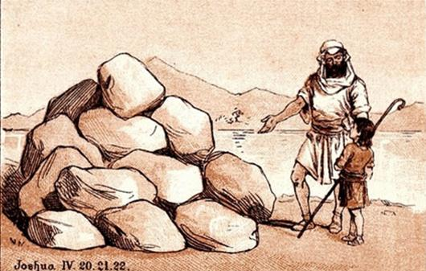

Slide 32
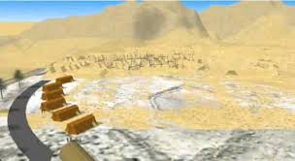

Slide 33
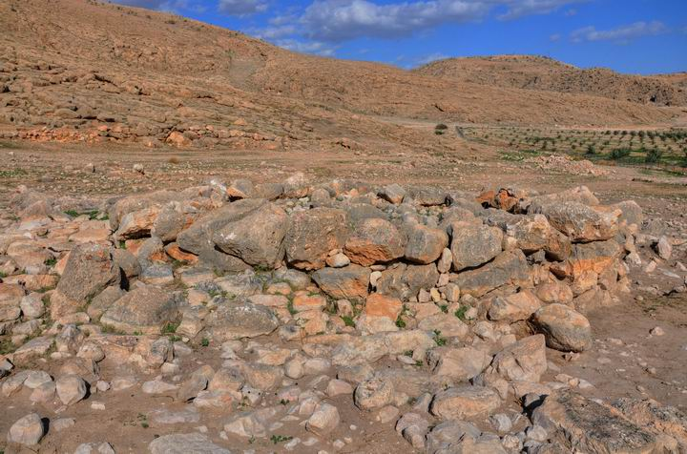

Slide 34
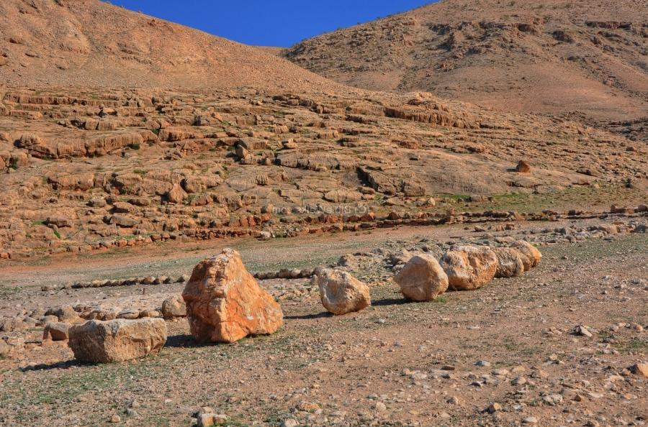

Slide 35
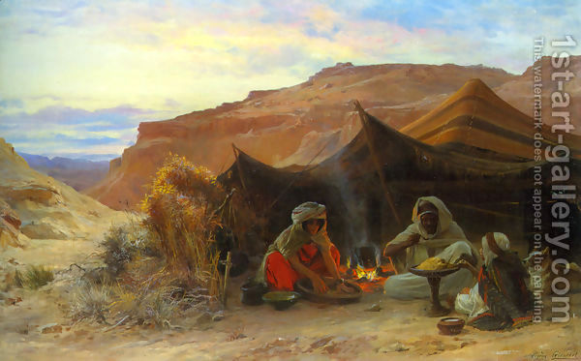

Slide 36
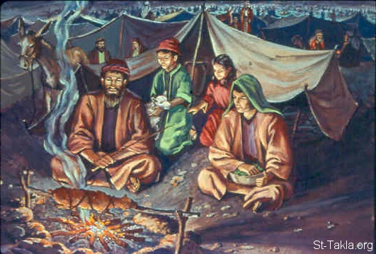

Slide 37
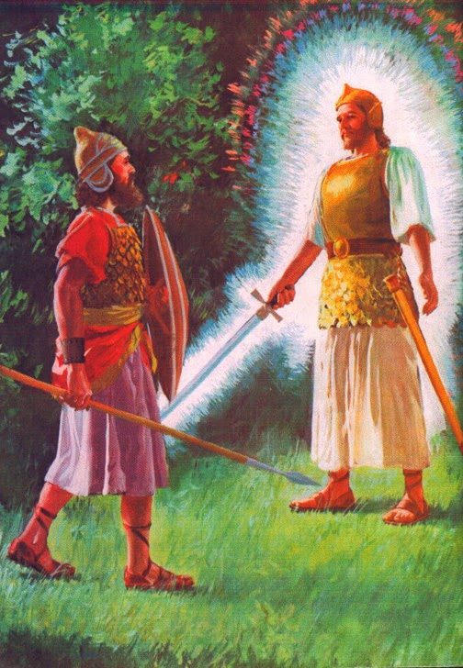

Slide 38
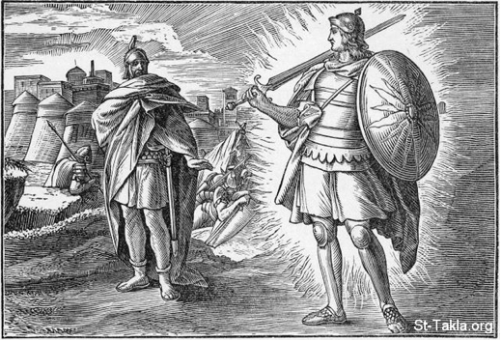

Slide 39
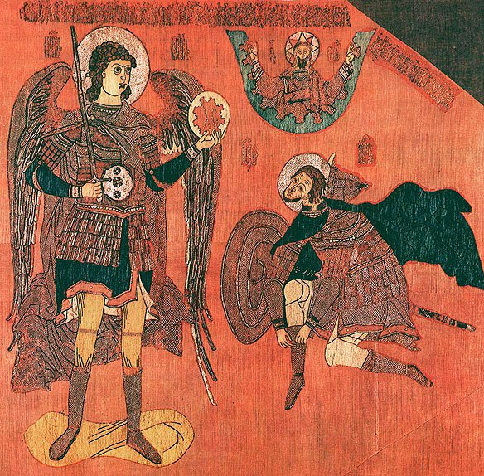

Slide 40
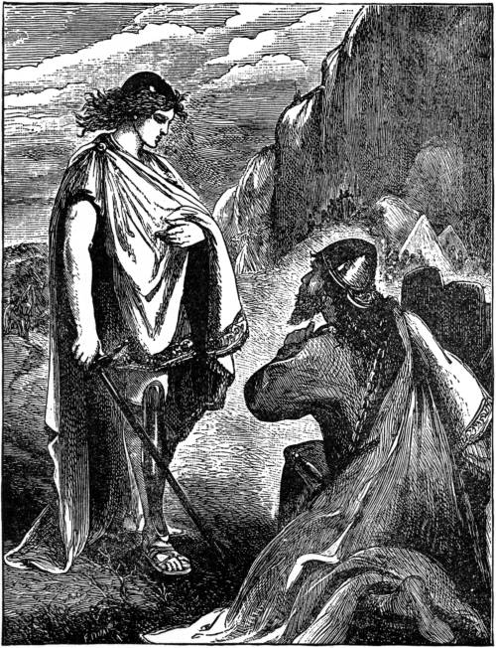

Slide 41
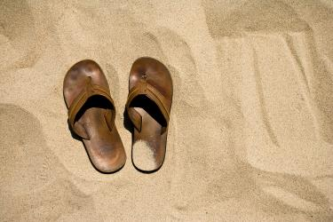

Slide 42
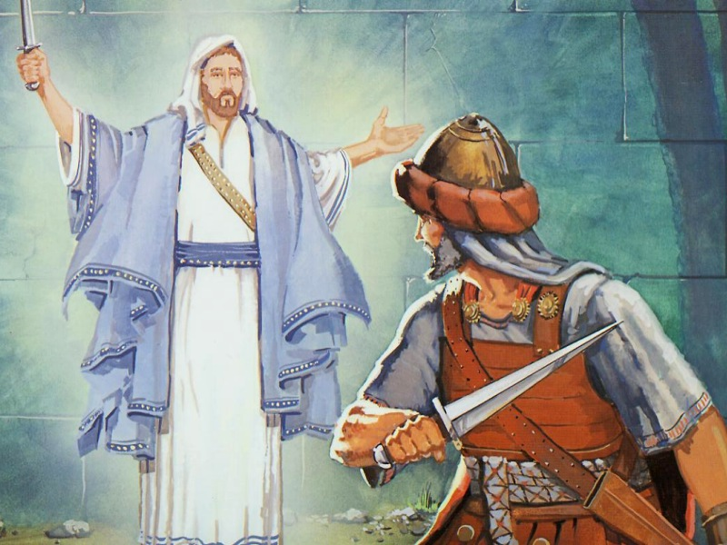

Slide 43
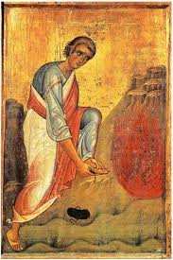

Slide 45
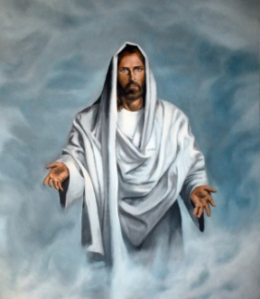

Slide 46
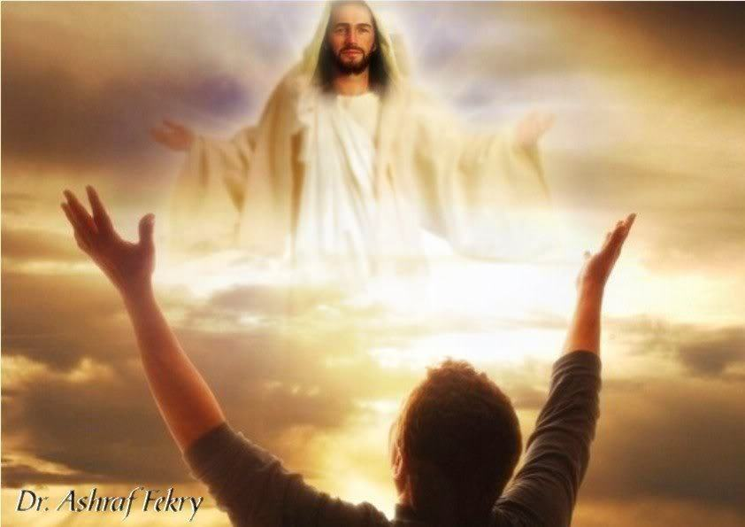

Slide 47
C. LIFE APPLICATION 1. Explain how the Old Covenant was fulfilled in Jesus Christ and the New Covenant now comes to us. 2. How do we confess Jesus as the great “I AM” along with the Father and the Holy Spirit in the creeds? 3. Where do we receive our food and daily bread which has taken the place of the manna? (John 6:32-59) 4. When will we enter the true Promised Land? (Hebrews 9:23-28; 11:13-16)

