Slide 1
THE BOOK OF JOSHUA
“Be Strong and Courageous!”
-Joshua in the Old Testament
-Jesus in the New Testament
Date: 2-22-15 Lesson: 4

Slide 2
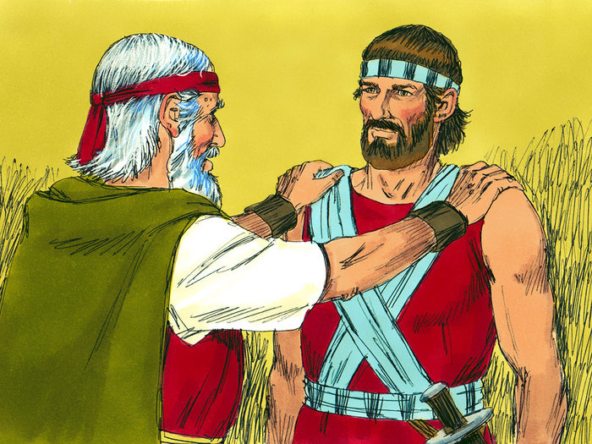

Slide 3
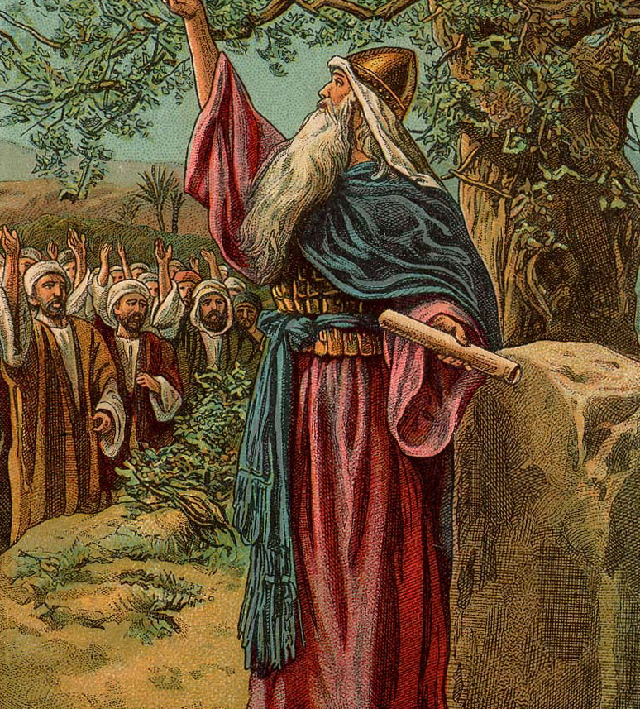

Slide 4
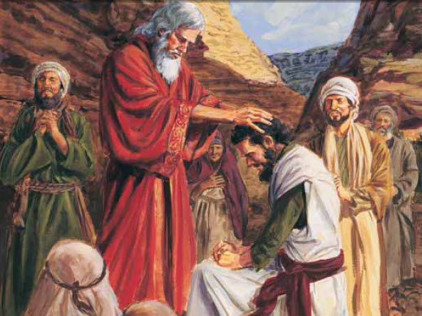

Slide 5
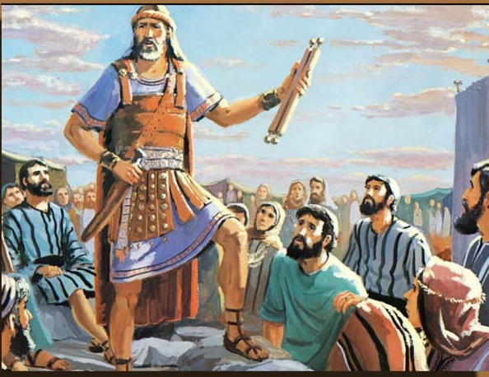

Slide 6
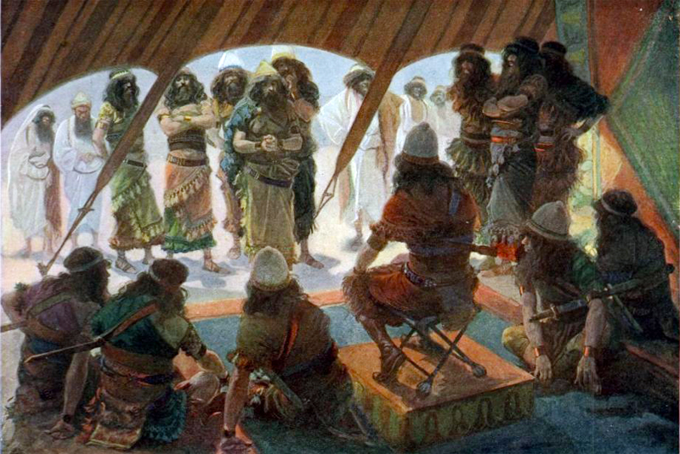

Slide 7
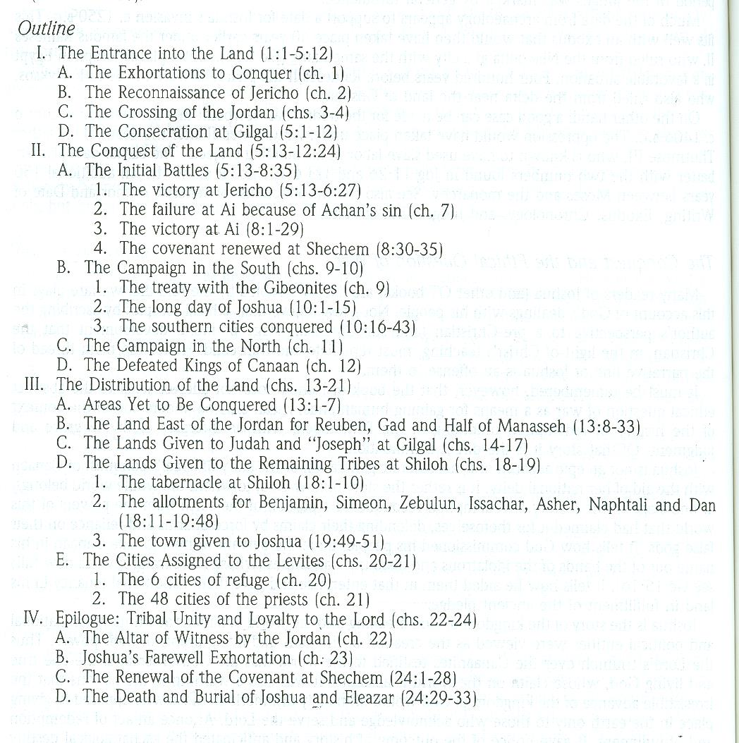

Slide 8
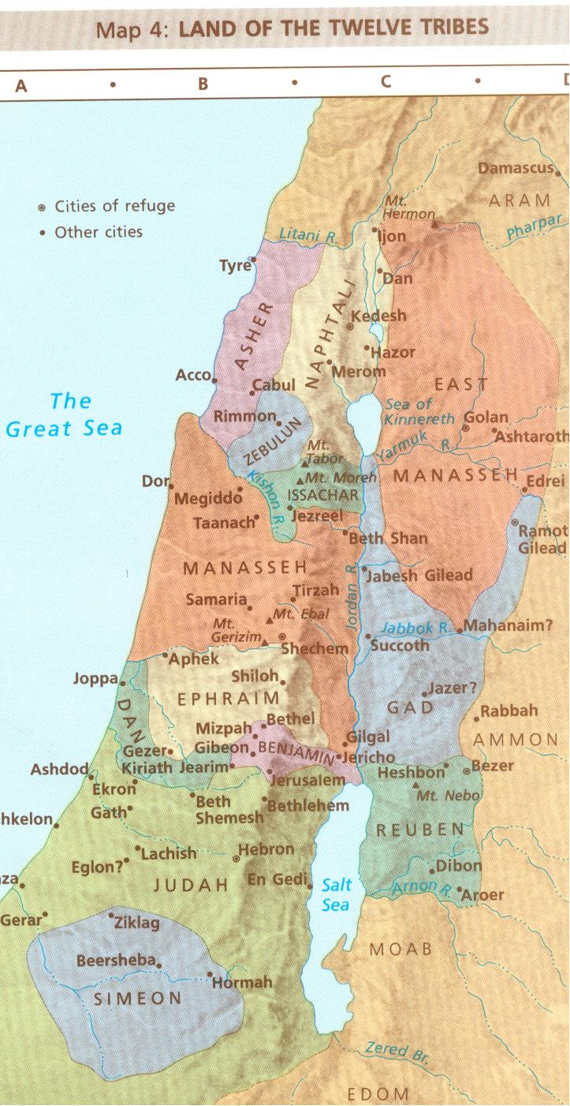

Slide 9
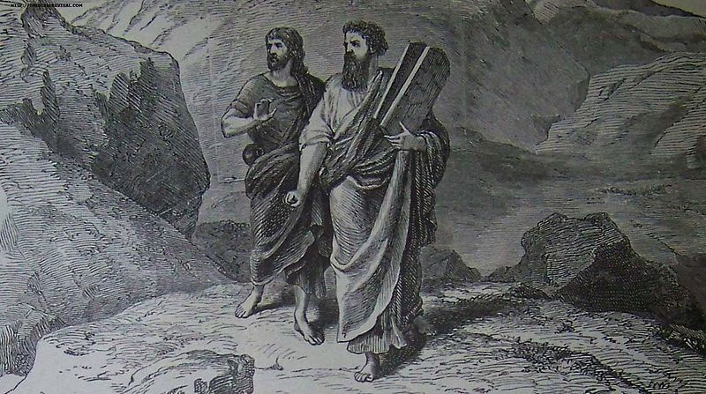

Slide 10
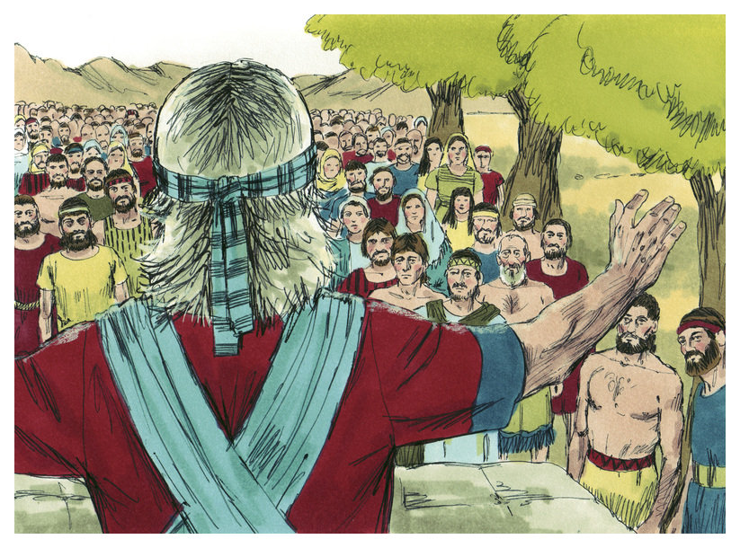

Slide 13
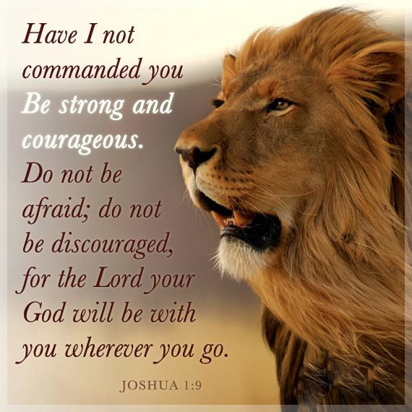

Slide 14
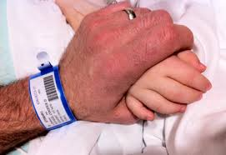

Slide 15
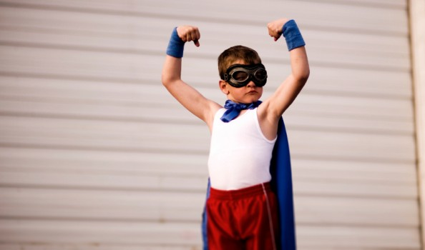

Slide 16
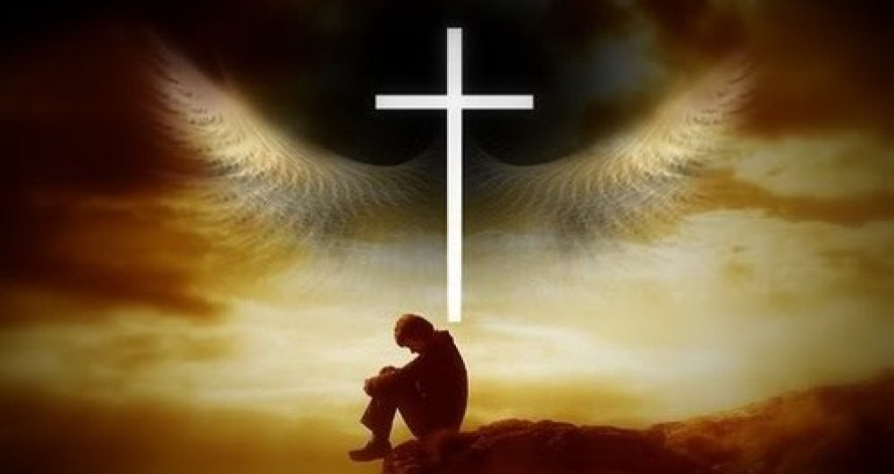

Slide 18
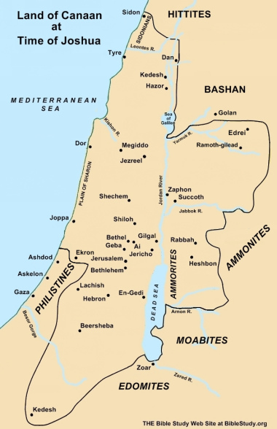

Slide 20
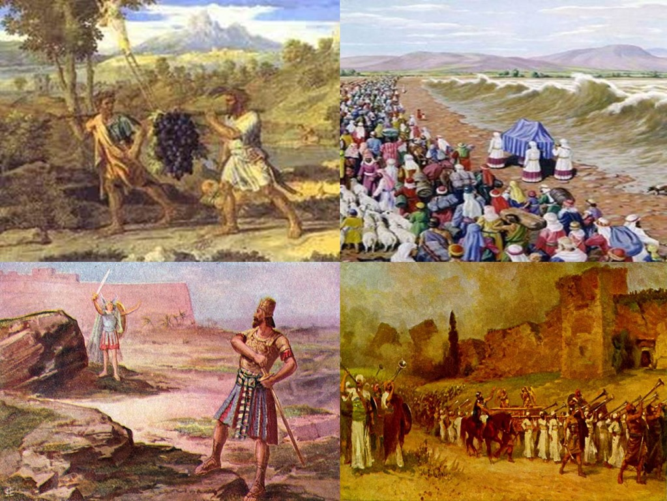

Slide 21
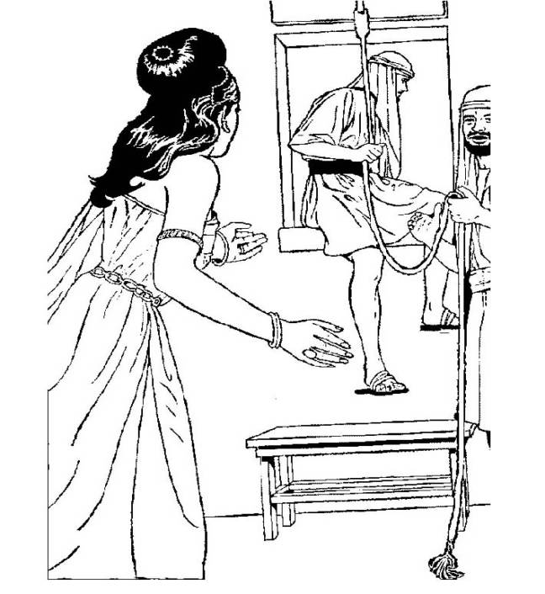

Slide 22
A. TEXT – Chapter 2: (1) And Joshua the son of Nun sent two men secretly from Shittim as spies, saying, "Go, view the land, especially Jericho." And they went and came into the house of a prostitute whose name was Rahab and lodged there. (2) And it was told to the king of Jericho, "Behold, men of Israel have come here tonight to search out the land." (3) Then the king of Jericho sent to Rahab, saying, "Bring out the men who have come to you, who entered your house, for they have come to search out all the land." (4) But the woman had taken the two men and hidden them. And she said, "True, the men came to me, but I did not know where they were from. (5) And when the gate was about to be closed at dark, the men went out. I do not know where the men went. Pursue them quickly, for you will overtake them." (6) But she had brought them up to the roof and hid them with the stalks of flax that she had laid in order on the roof. (7) So the men pursued after them on the way to the Jordan as far as the fords. And the gate was shut as soon as the pursuers had gone out. (8) Before the men lay down, she came up to them on the roof (9) and said to the men, "I know that the Lord has given you the land, and that the fear of you has fallen upon us, and that all the inhabitants of the land melt away before you. (10) For we have heard how the Lord dried up the water of the Red Sea before you when you came out of Egypt, and what you did to the two kings of the Amorites who were beyond the Jordan, to Sihon and Og, whom you devoted to destruction. (11) And as soon as we heard it, our hearts melted, and there was no spirit left in any man because of you, for the Lord your God, he is God in the heavens above and on the earth beneath. (12) Now then, please swear to me by the Lord that, as I have dealt kindly with you, you also will deal kindly with my father's house, and give me a sure sign (13) that you will save alive my father and mother, my brothers and sisters, and all who belong to them, and deliver our lives from death."

Slide 23
(14) And the men said to her, "Our life for yours even to death! If you do not tell this business of ours, then when the Lord gives us the land we will deal kindly and faithfully with you." (15) Then she let them down by a rope through the window, for her house was built into the city wall, so that she lived in the wall. (16) And she said to them, "Go into the hills, or the pursuers will encounter you, and hide there three days until the pursuers have returned. Then afterward you may go your way." (17) The men said to her, "We will be guiltless with respect to this oath of yours that you have made us swear. (18) Behold, when we come into the land, you shall tie this scarlet cord in the window through which you let us down, and you shall gather into your house your father and mother, your brothers, and all your father's household. (19) Then if anyone goes out of the doors of your house into the street, his blood shall be on his own head, and we shall be guiltless. But if a hand is laid on anyone who is with you in the house, his blood shall be on our head. (20) But if you tell this business of ours, then we shall be guiltless with respect to your oath that you have made us swear." (21) And she said, "According to your words, so be it." Then she sent them away, and they departed. And she tied the scarlet cord in the window. (22) They departed and went into the hills and remained there three days until the pursuers returned, and the pursuers searched all along the way and found nothing. (23) Then the two men returned. They came down from the hills and passed over and came to Joshua the son of Nun, and they told him all that had happened to them. (24) And they said to Joshua, "Truly the Lord has given all the land into our hands. And also, all the inhabitants of the land melt away because of us."

Slide 24
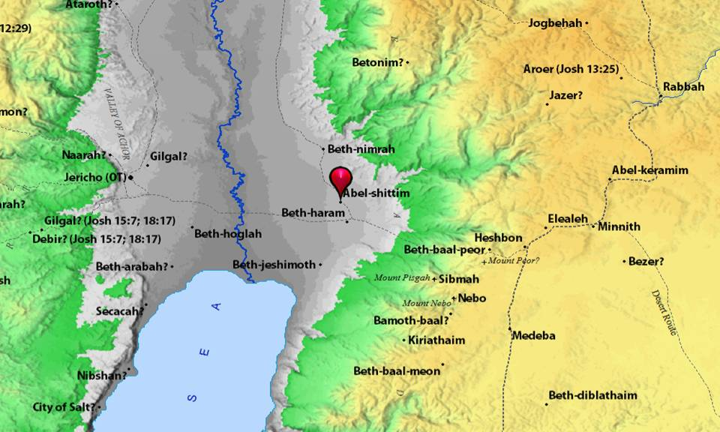

Slide 25
B. STUDY NOTES
-Jericho “moon city”, five miles east of the Jordan River, fortified city, with good water springs, an oasis, fertile land, has been occupied since 7000 B.C. This city would be the gate into the rest of Canaan (Nu 13:18-20)
-Rahab- a prostitute, “innkeeper,” lived by the city wall, no one would be surprised that unknown men would visit her house
- Rooftops of the flat house were used to dry grain, stalks and flax
- Fords across the river where the low points only had 3 feet of water (2 Sam 19:16-19)

Slide 27
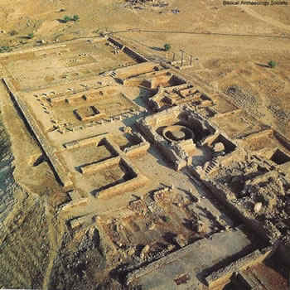

Slide 28
-Rahab’s personal confession of faith: I know/great fear/we have heard/our hearts sank/ the Lord your God is God! -She makes an accurate confession based on correct information about the God of Israel, for she has abandoned the gods of Canaan and come to believe in the Lord who made the heavens and the earth. (Gen 1:1-3; 14:19; Nu 20:14; 2 Ki 5:15; 19:15; Dan 6:26) -She knew about exodus out of Egypt and the crossing of the Red Sea, (Ex 13:17-14:31) what they had done to Sihon and Og the kings of the Amorities (Num 21:21-35) She was giving them valuable information when she told them that the Canaanites’ hearts were melting in fear of the Israelites. The Amarna letters show that the Canaanites considered the Egyptians pharaohs their overlords and protectors. Israel must be great to have prevailed over the Egyptians! -She also understands the concepts from the true God of kindness / love / mercy – she already is thinking like an Israelite. She and the spies were confident that the Lord was about to give them victory.

Slide 29
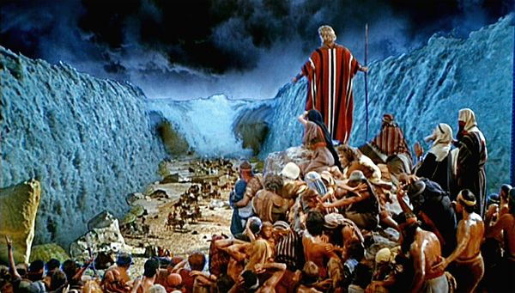

Slide 30
-Rahab is a shrewd and intelligent woman: she hid the spies / she admits they had been there / she tricks them to believe that the spies had fled already / then even orders them to go quickly and catch them (Note: “We do not owe the truth to people who will use it for evil”) / she knows all about God’s people / she bargains with the spies about how they could save her in exchange for her daring act / she is a defender and protector of her entire family / she makes them swear by an oath that they will not kill her or her family / she bravely lets them down by the rope to escape / she even gives them the advice to flee to the hills for 3 days and then return – Rahab is one of the most amazing women in the Old Testament (Mt. 1:5,6; Heb 11:31; Jas 2:25-26)

Slide 31
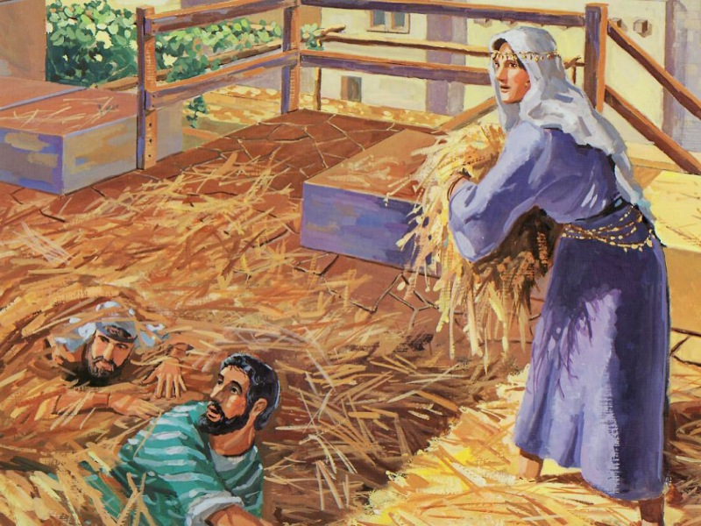

Slide 32
-The scarlet cord in the window – this red marker reminds us of the scarlet red mark on the doors of the Israelites during the Passover in Egypt where God spared them from death also (Ex 12:13,22,23) The blood colored cord was a type and symbol of the red-purple-scarlet blood from Christ as the atoning sacrifice: (Mt 27:28; Mk 15:17-20; John 19:2-5; Heb 9:19-22) -Blood on our heads is a vow that accepts responsibility for the death of another, so that because of guilt, the other party could make retribution (Mt 27:22-26) -They go into the hills to hide for 3 days and then return (“3 days” is everywhere in the Bible – Job and Jesus) -Joshua assures them that the Lord has given the whole land into their hands

Slide 33
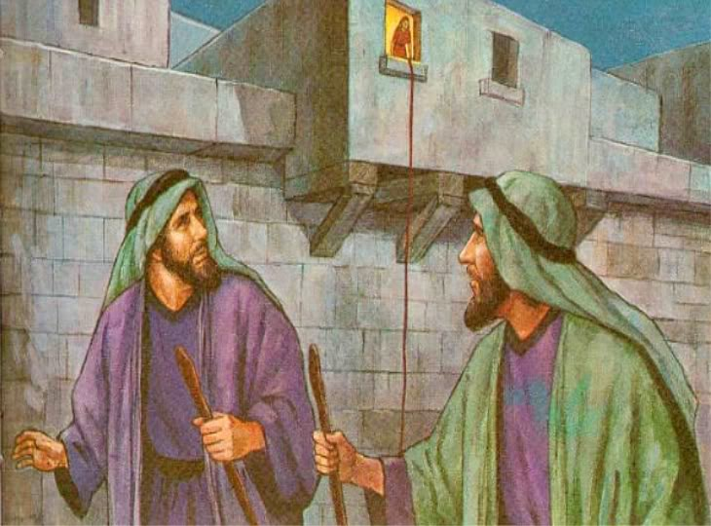

Slide 34
THOUGHTS FROM THE EARLY CHURCH FATHERS – The Lord works his miracles among sinners and prostitutes: the prophet Hosea was told to marry a prostitute; Jesus sat down by the well in Samaria and talked to a harlot; a harlot washed Jesus’ feet with her tears, the church is people who have been called out of prostitution to idols and gods and turned into the virgin bride of the bridegroom Jesus (Mt 21:31,32; Jn 3:29; Eph 5:25-27; Rev 19:7; 21:2,9,17)

Slide 36
C. LIFE APPLICATION 1. In what part of the creeds each Sunday do we also confess that the Lord our God, he is God in the heavens above and on the earth beneath? 2. Why is it such a comfort for you and me that God loves and calls sinners and prostitutes to repentance and faith? 3. How can we be like Rahab, when Jesus calls us to be “as wise as serpents but as innocent as doves?” (Mt 10:16)

Slide 37
