Slide 1
THE BOOK OF JOSHUA
“Be Strong and Courageous!”
-Joshua in the Old Testament
-Jesus in the New Testament
Date: 2-15-15 Lesson: 3

Slide 2
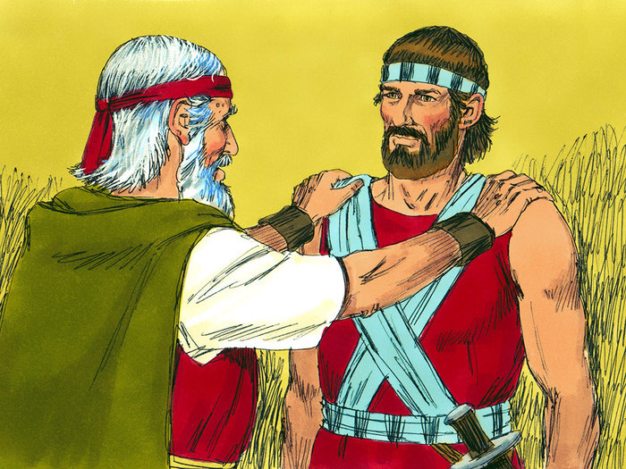

Slide 3
THE NAME OF JOSHUA – the name “Yeshua” = The Lord saves = “Jesus” (Mt 1:21)

Slide 4
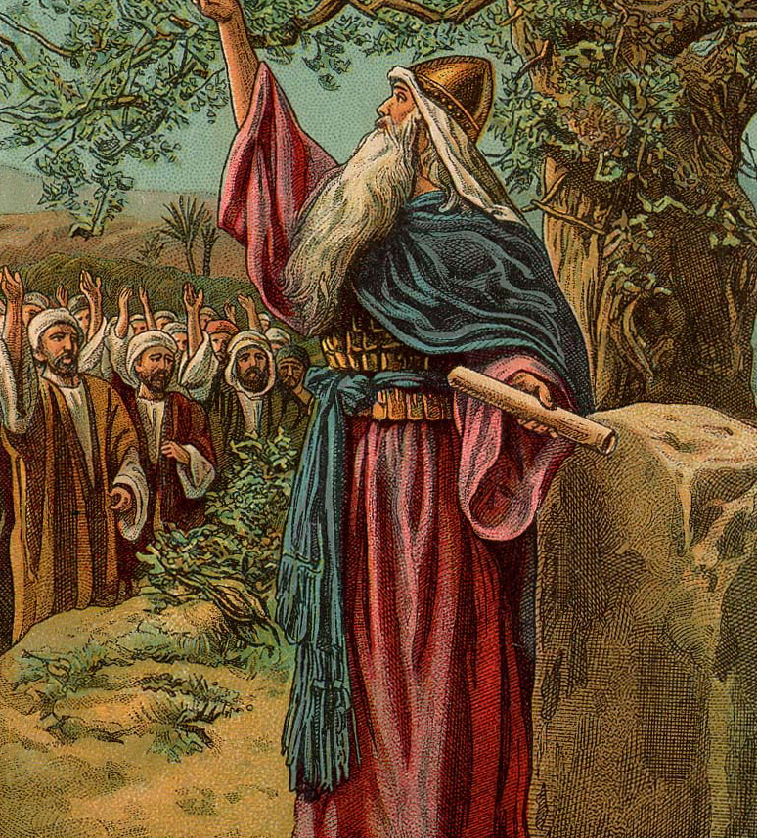

Slide 5
JOSHUA AND JESUS – TYPE AND FULFILLMENT i. The triumphant leader of Israel brings God’s people into the promised land of Canaan The triumphant leader of the new Israel brings God’s people into the promised land of Heaven (2 Cor 2:14; Heb 2:10; 4:1,6-8) ii. Joshua succeeds Moses and wins the victory Jesus succeeds the Mosaic law and wins the eternal victory (Jn 1:17; Rom 8:2-4; Gal 3:23-25; Heb 7:18,19) iii. The Commander of the army of the Lord is a pre-incarnate appearance of Jesus (Josh 5:13-15; Gen 3:8-24; 32:22-32; Ex 3:2,5) iv. The scarlet cord of Rahab, who is part of Jesus’ ancestry, illustrates safety through the blood (Josh 2:18; Mt 1:5; Heb 9:19-22) v. Moses and Israel wander in the desert for 40 years, then Joshua leads them into the Promised Land Jesus fulfills the Law of Moses, leads the new Israel, after his 40 days in the desert, into Heaven

Slide 6
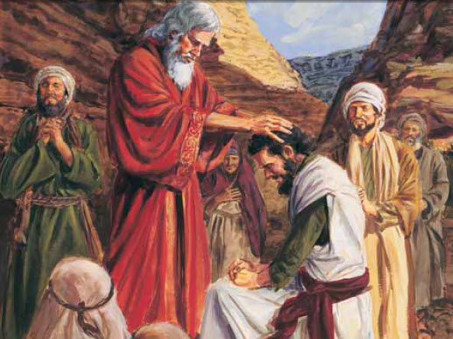

Slide 7
HISTORICAL BACKGROUND i. The Person of Joshua: Ex 17:9-16; 24:13-18; 32:17; 33:11; Num 11:28; 13:16; 14:6-38; 26:65; 27:18-22; 32:12,28; 34:17; Dt. 1:38; 3:21-28; 31:3-23; 34:5,9; Judges 1:1; 2:6-23; 1 Kings 1:34; 1 Chr 7:27; Acts 7:45 ii. The Author – a combination of Joshua and Eleazar, son of Aaron. iii. Dates: Joshua lived from 1485 – 1375 B.C. He lived to be 110.

Slide 8
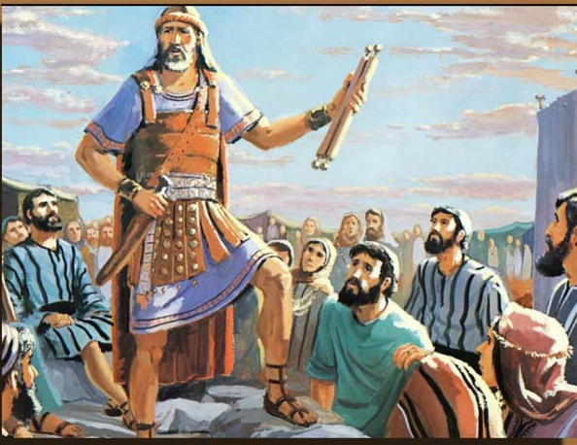

Slide 9
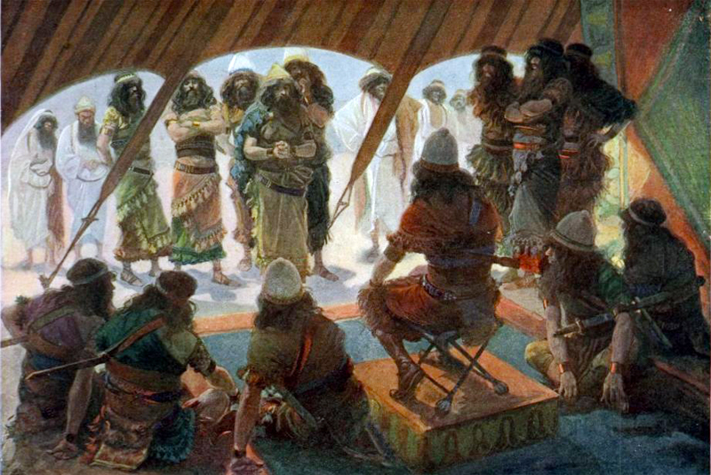

Slide 10
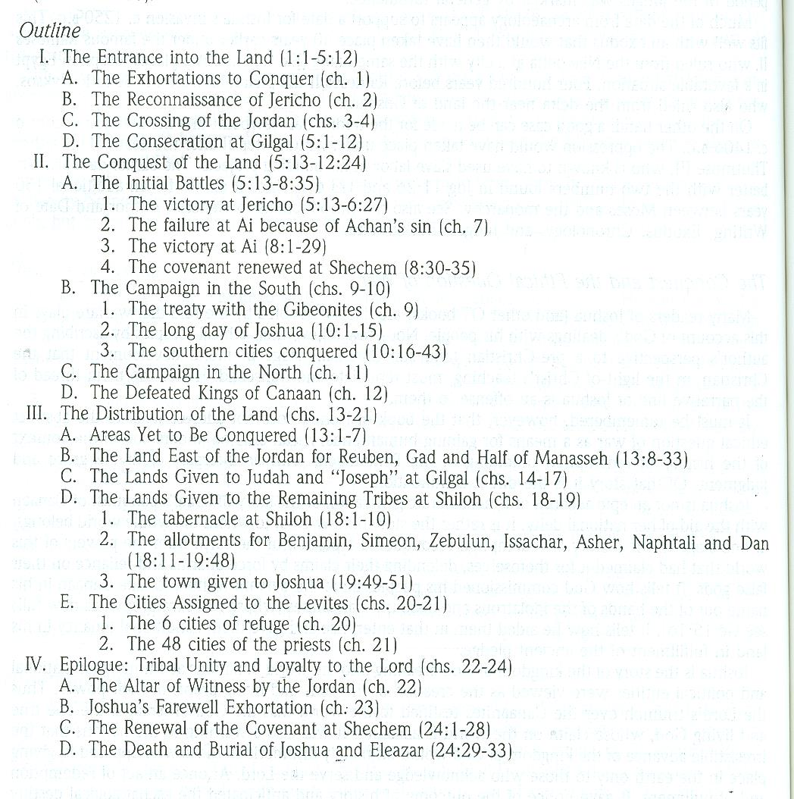

Slide 11
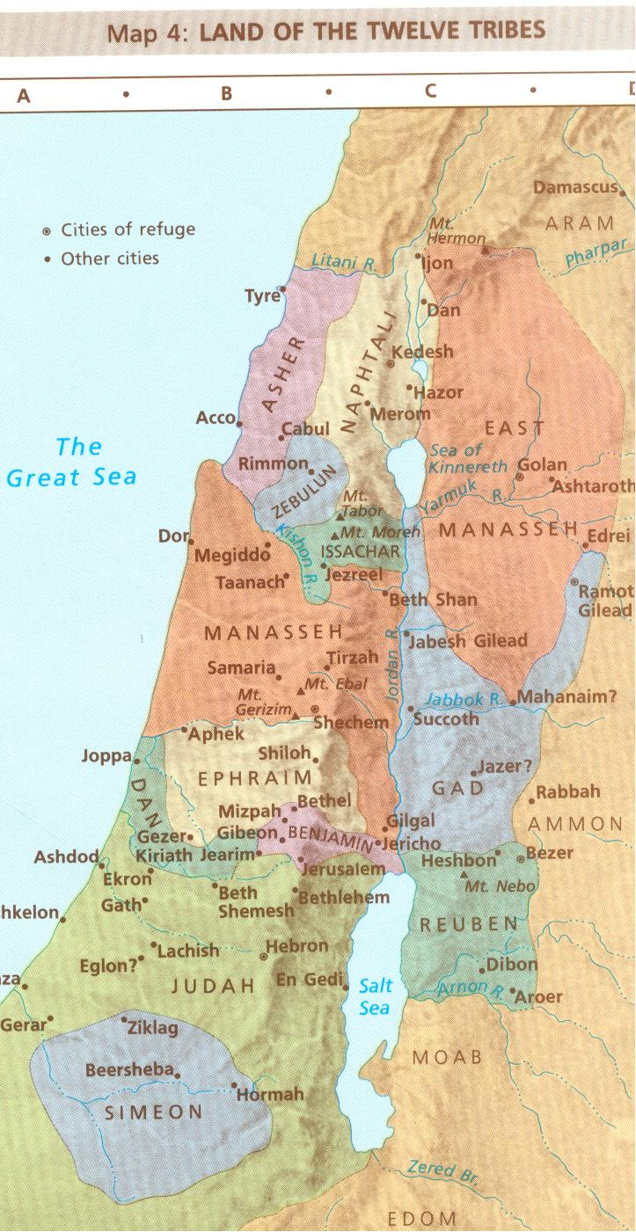

Slide 12
1. Getting Israel into the Holy Land, finally fulfills the promise made to Abraham in (Gen. 15: 1-21; 28:13-15; Dt. 34:1-4) 2. Moses – Joshua same promise (Dt. 11:24-25) 3. The Book of the Law to be read out loud and meditated upon (Dt. 4:9,10; 6:6,7; 11:19; 30:9-14; Acts 8:30) 4. Rest – Sabbath – for the land and the people (Dt 3:20; 2 Sam 7:1,11; 1 Ki 5:4) 5. Strong and courageous (Dt 1:21: 31:6; 2 Sam 2:7; 1 Ki 2:2; Is 41:6; Joel 3:9-10; Jdg 5:21; Jer 3:18; 7:7; )

Slide 13
1. There were 12 sons/tribes of Jacob/Israel – but Joseph split his inheritance between his sons Ephraim/Manasseh (1) Levi, the priests were allowed no land, they served in the tabernacle (9 ½) Simeon, Judah, Dan, Benjamin, Ephraim, (½)W. Manasseh, Issachar, Zebulun, Asher, Naphtali - west of the Jordan (2 ½) Reuben, Gad, (½) E. Manasseh – east of the Jordan 2. The Messianic promise had to be carried out and God chose the nation Israel through which to do this. The line of the Messiah was thus: ADAM – SETH – NOAH – SHEM – ABRAHAM – ISAAC – JACOB – JUDAH - DAVID – SOLOMON - JOSEPH/MARY - JESUS 3. There were two truths for Joshua and Israel to constantly remember: i. God’s PROMISE, that He will be with them and they will inherit the land, must be BELIEVED ii. God’s written LAW, given by the Lord through the 5 Books of Moses, must be OBEYED 4. The destruction to come of the lands and people of the pagan world may seem barbaric to modern sensibilities. But God is intent on clearing out and cleaning up the land. He is ridding it of the idolatrous, filthy and horrific religions of the Canaanites which featured gross immorality, child-sacrifice, prostitution and wickedness – God is the Righteous Judge. 5. The concept of the “means of grace” has always been in the Bible. Through the words and covenants given to real people like Abraham and Moses and Joshua– God is working – so when we listen to them we are listening to God.

Slide 14
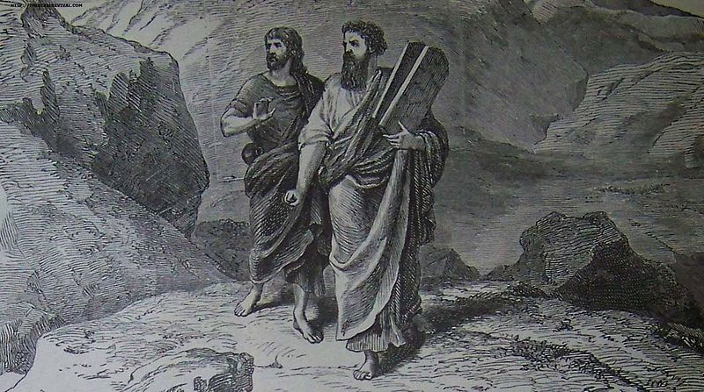

Slide 15
A. TEXT (Joshua 1:1-18) After the death of Moses the servant of the Lord, the Lord said to Joshua the son of Nun, Moses' assistant, (2) "Moses my servant is dead. Now therefore arise, go over this Jordan, you and all this people, into the land that I am giving to them, to the people of Israel. (3) Every place that the sole of your foot will tread upon I have given to you, just as I promised to Moses. (4) From the wilderness and this Lebanon as far as the great river, the river Euphrates, all the land of the Hittites to the Great Sea toward the going down of the sun shall be your territory. (5) No man shall be able to stand before you all the days of your life. Just as I was with Moses, so I will be with you. I will not leave you or forsake you. (6) Be strong and courageous, for you shall cause this people to inherit the land that I swore to their fathers to give them. (7) Only be strong and very courageous, being careful to do according to all the law that Moses my servant commanded you. Do not turn from it to the right hand or to the left, that you may have good success wherever you go. (8) This Book of the Law shall not depart from your mouth, but you shall meditate on it day and night, so that you may be careful to do according to all that is written in it. For then you will make your way prosperous, and then you will have good success. (9) Have I not commanded you? Be strong and courageous. Do not be frightened, and do not be dismayed, for the Lord your God is with you wherever you go." (10) And Joshua commanded the officers of the people, (11) "Pass through the midst of the camp and command the people, 'Prepare your provisions, for within three days you are to pass over this Jordan to go in to take possession of the land that the Lord your God is giving you to possess.'" (12) And to the Reubenites, the Gadites, and the half-tribe of Manasseh Joshua said, (13) "Remember the word that Moses the servant of the Lord commanded you, saying, 'The Lord your God is providing you a place of rest and will give you this land.' (14) Your wives, your little ones, and your livestock shall remain in the land that Moses gave you beyond the Jordan, but all the men of valor among you shall pass over armed before your brothers and shall help them, (15) until the Lord gives rest to your brothers as he has to you, and they also take possession of the land that the Lord your God is giving them. Then you shall return to the land of your possession and shall possess it, the land that Moses the servant of the Lord gave you beyond the Jordan toward the sunrise.“ (16) And they answered Joshua, "All that you have commanded us we will do, and wherever you send us we will go. (17) Just as we obeyed Moses in all things, so we will obey you. Only may the Lord your God be with you, as he was with Moses! (18) Whoever rebels against your commandment and disobeys your words, whatever you command him, shall be put to death. Only be strong and courageous."

Slide 16
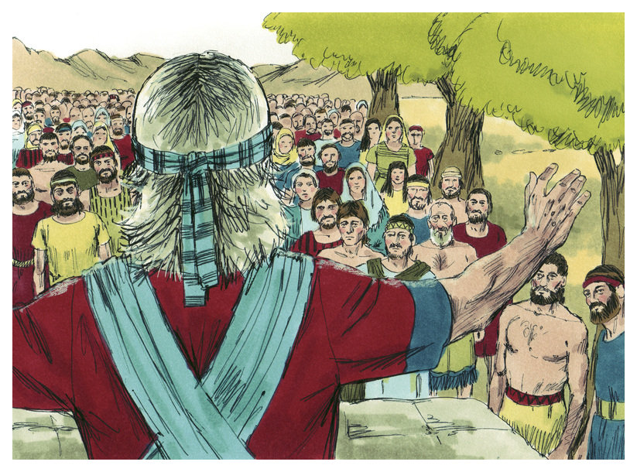

Slide 17
B. STUDY NOTES 1. Rest – Sabbath – for the land and the people Dt 3:18-20 2 Sam 7:1,11 1 Ki 5:4 Hebrews 4:1-11 2. Strong and courageous Dt 1:19-25; 31:1-6 2 Sam 2:7 1 Ki 2:2-4 Is 41:6,8-10 2 Cor 5:1-9 Philippians 1:17-24

Slide 19
C. LIFE APPLICATION 1. Describe how our lives are filled with doubts in God’s Promise and disobedience of God’s Law. 2. How then can we heed God’s exhortation to instead, be strong and courageous?

Slide 21
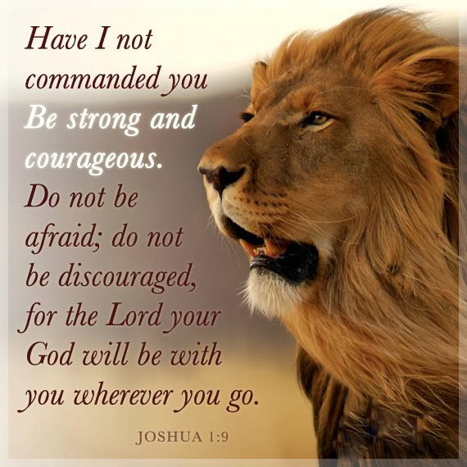

Slide 22
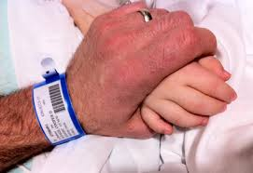

Slide 24
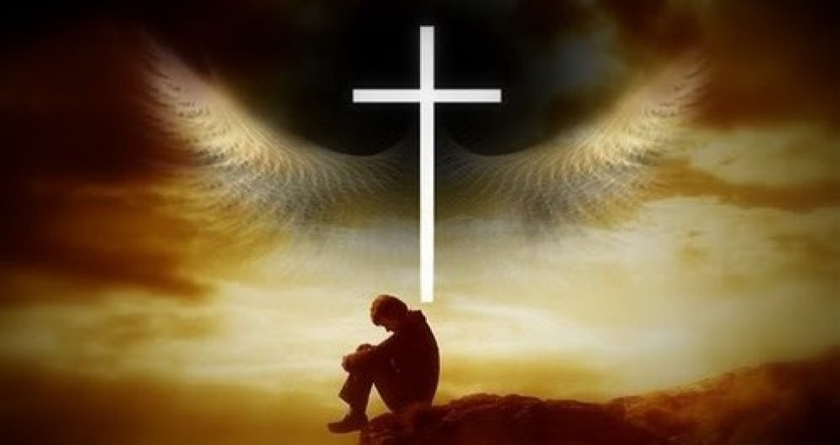

Slide 27
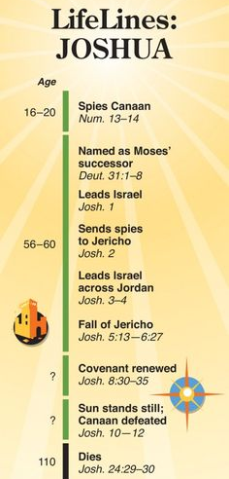

Slide 28
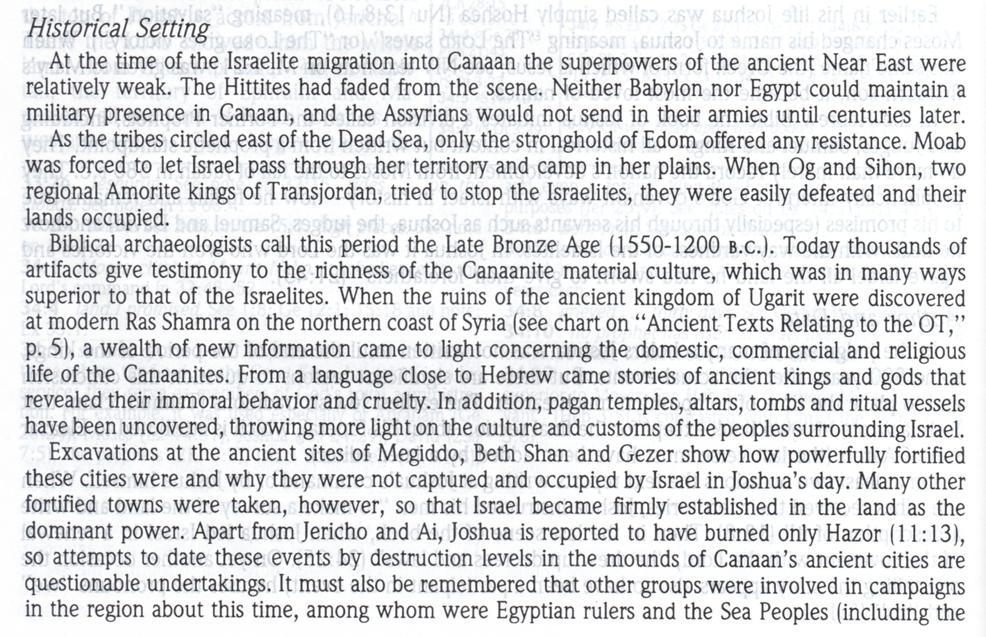

Slide 29
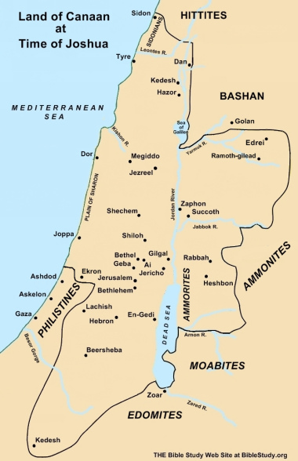

Slide 30
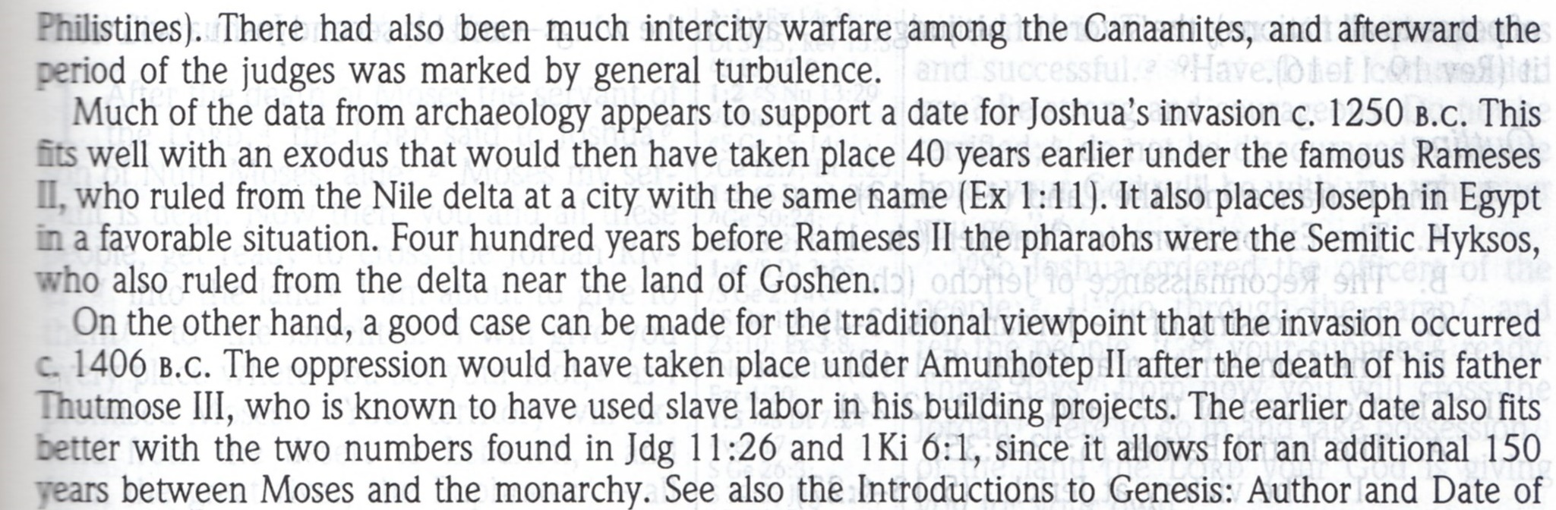

Slide 32
