Slide 1
THE BOOK OF JOSHUA
“Be Strong and Courageous!”
-Joshua in the Old Testament
-Jesus in the New Testament
Date: 7-26-15 Lesson: 21

Slide 2
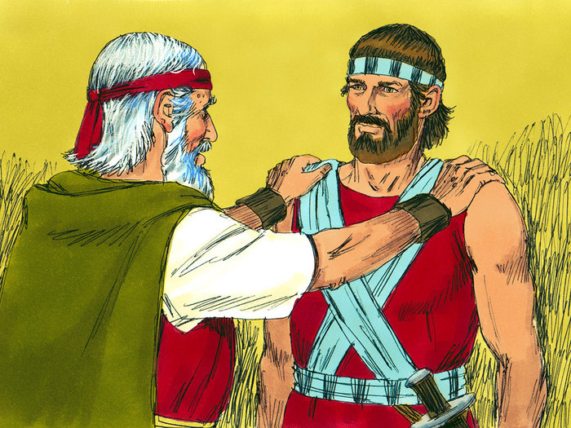

Slide 3
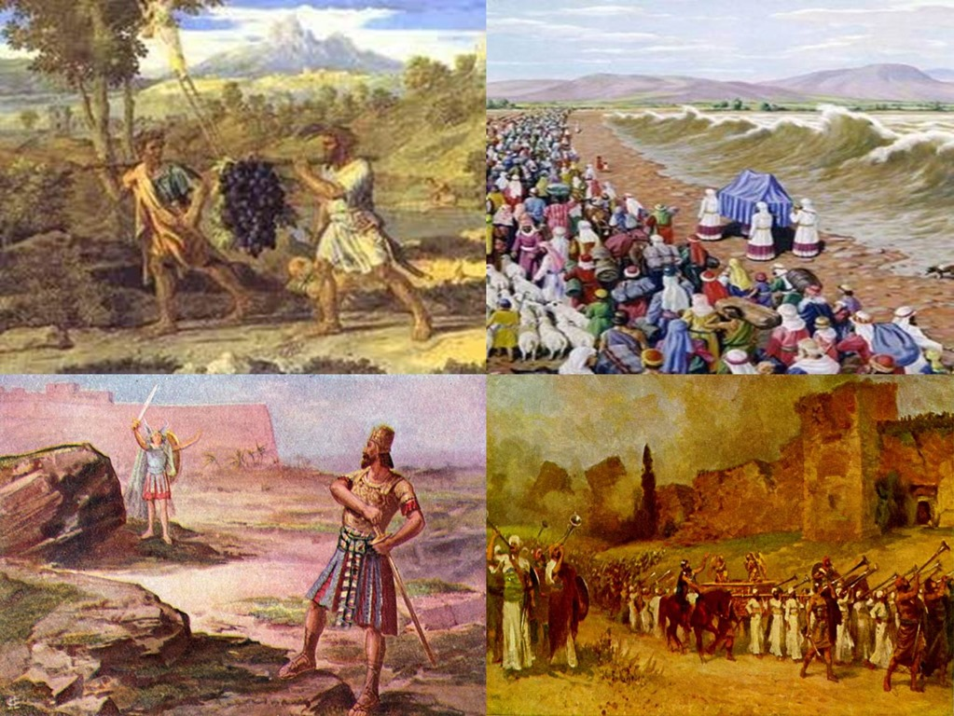

Slide 4
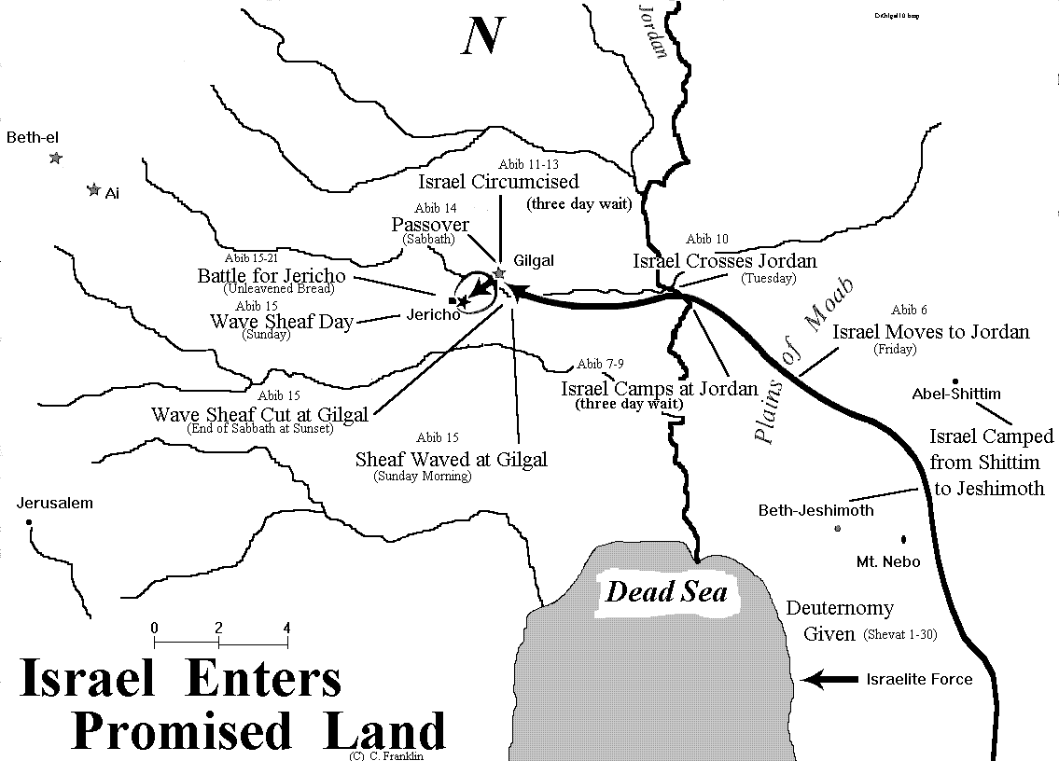

Slide 6
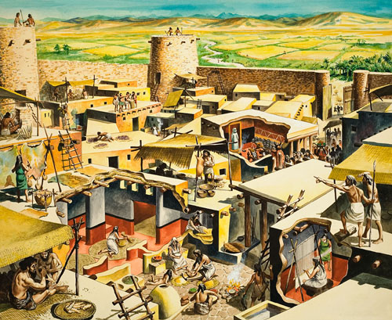

Slide 8
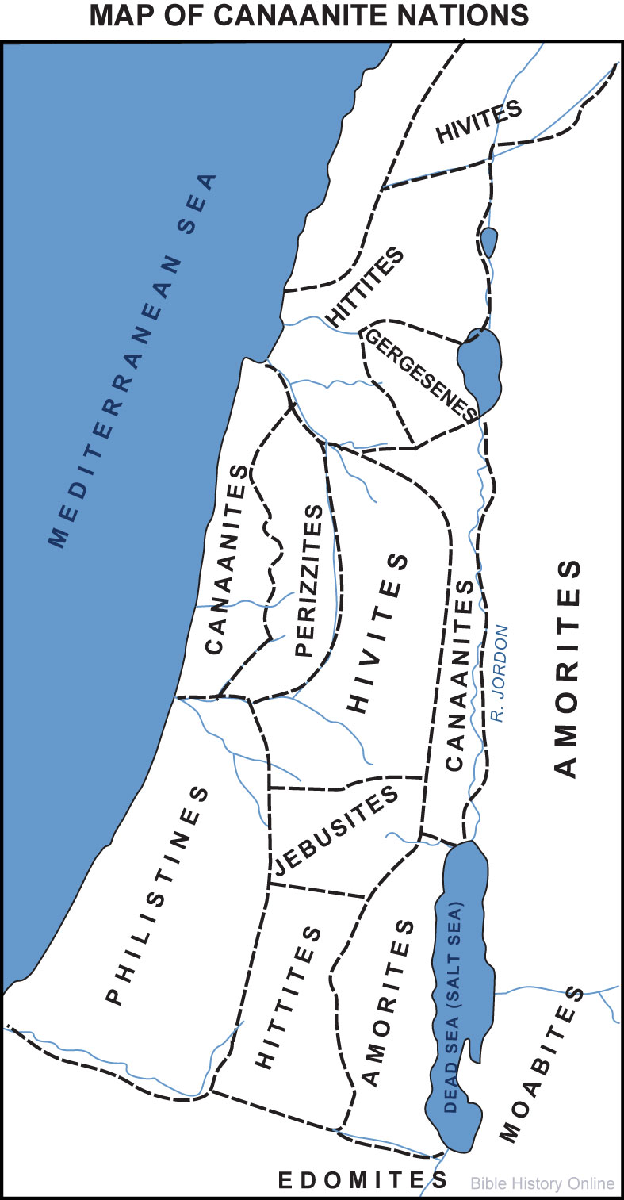

Slide 9
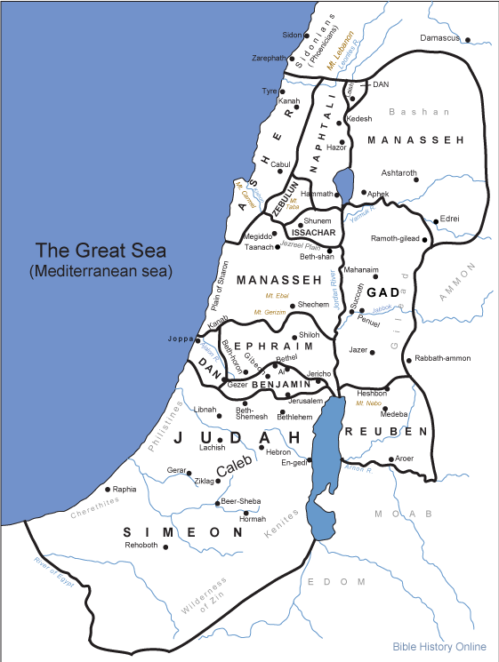

Slide 10
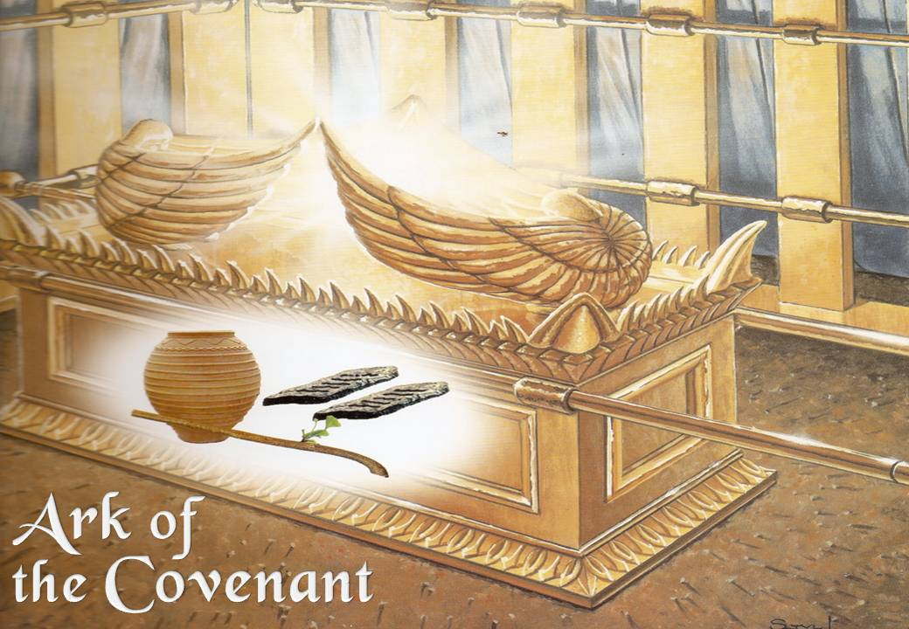

Slide 11
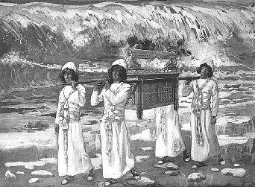

Slide 12
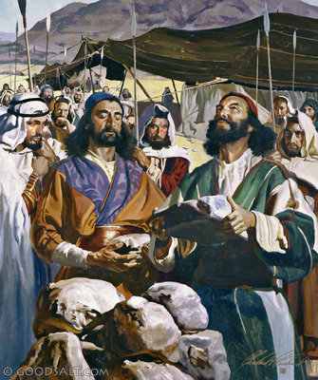

Slide 13
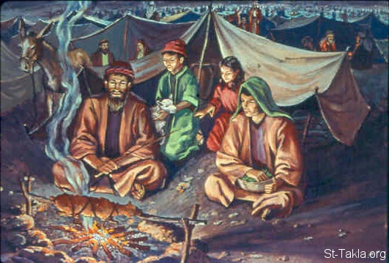

Slide 14
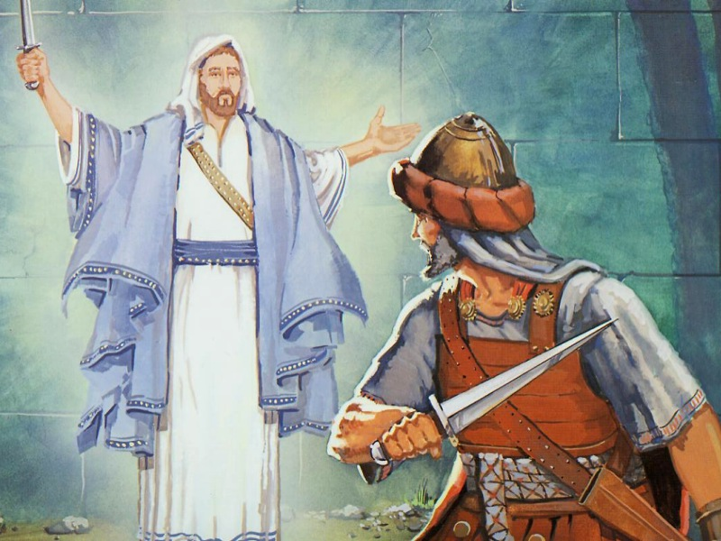

Slide 15
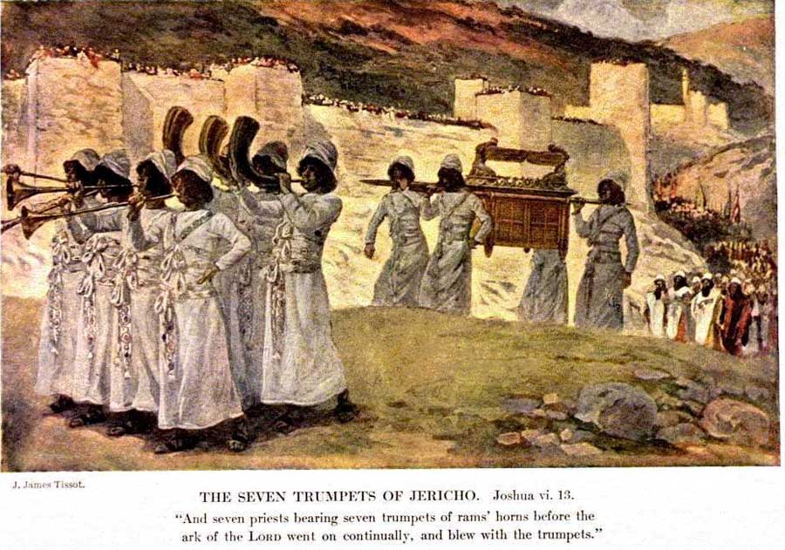

Slide 19
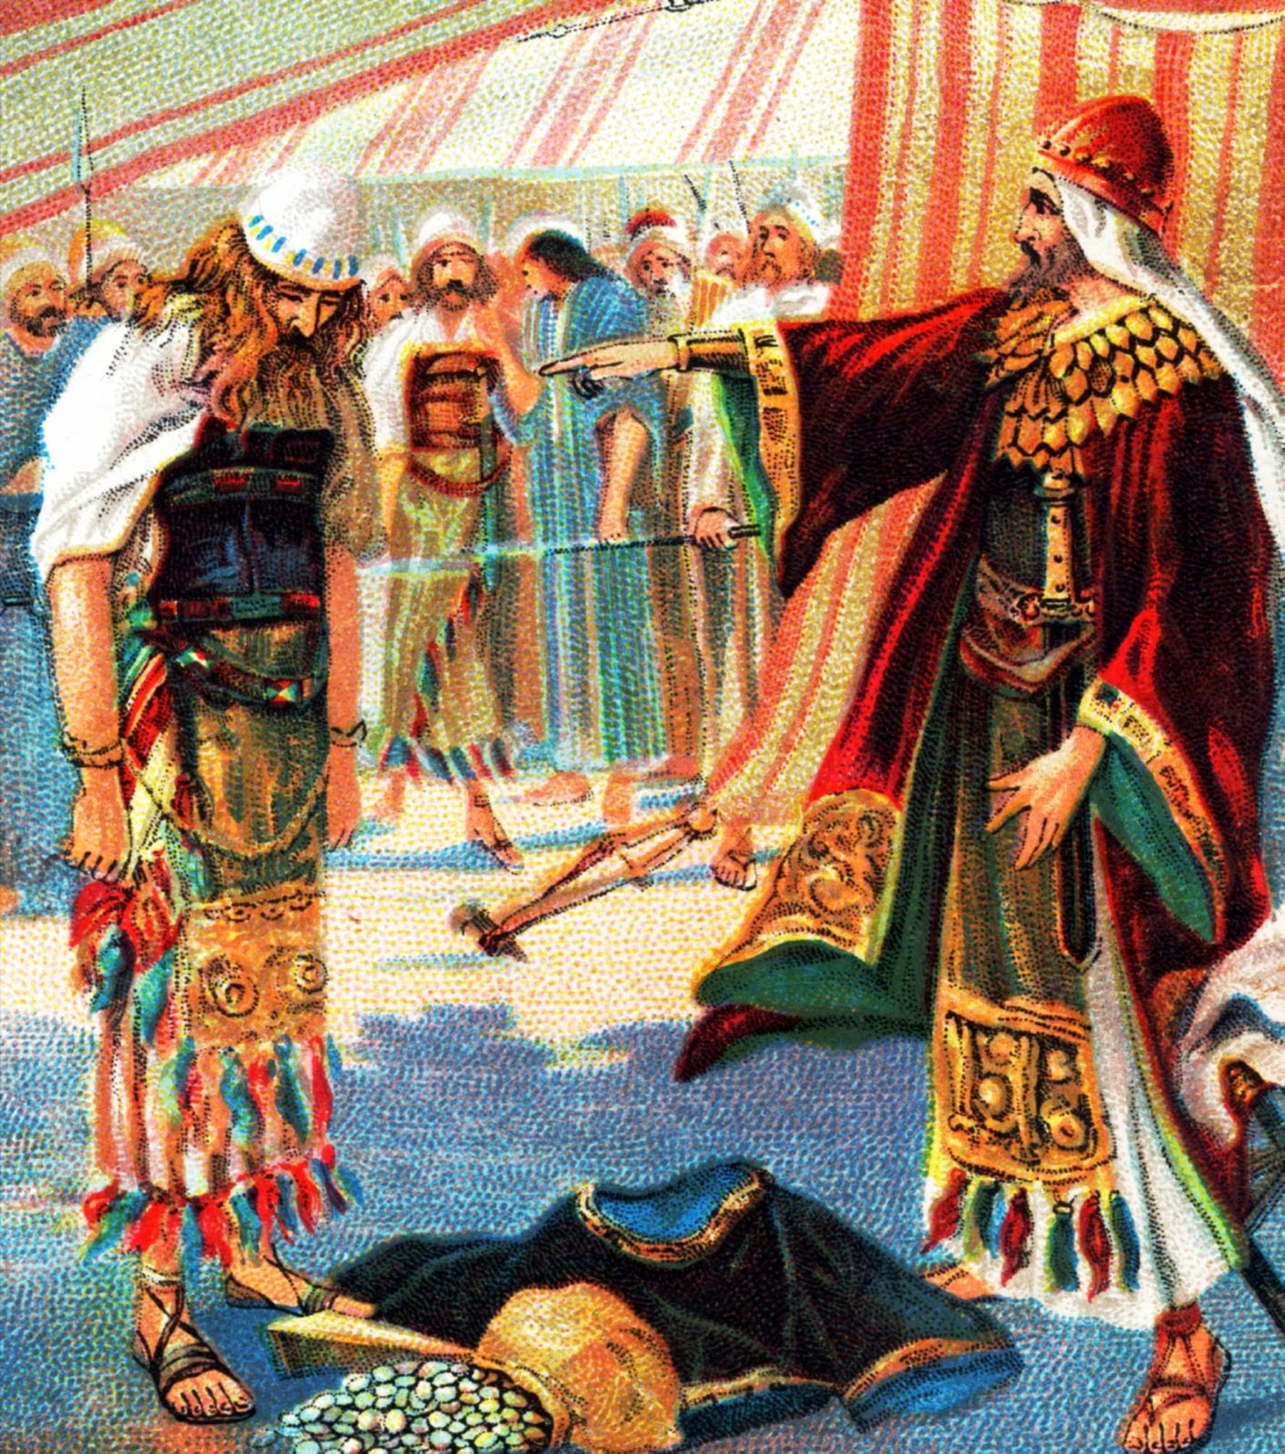

Slide 21
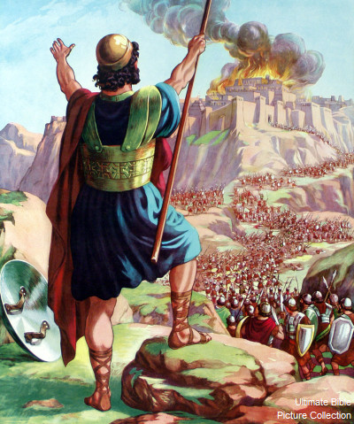

Slide 22
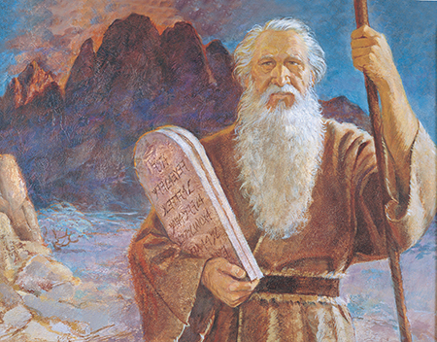

Slide 23
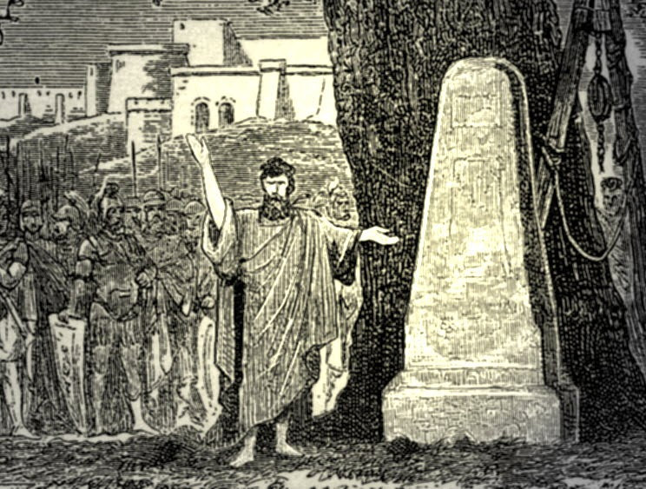

Slide 24
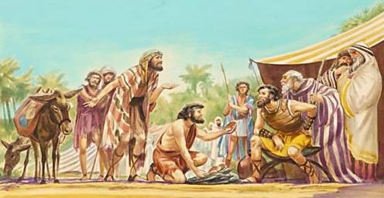

Slide 25
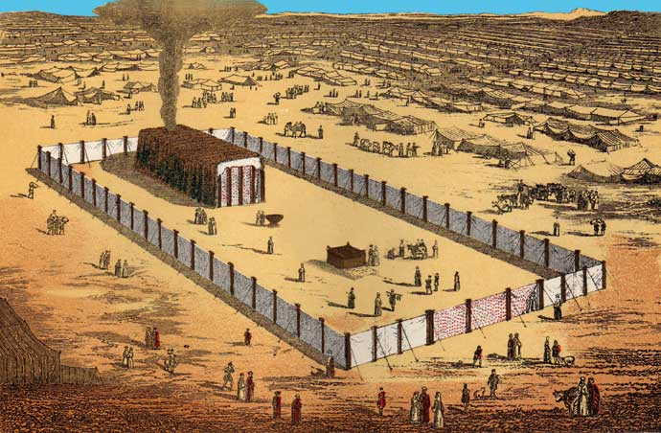

Slide 26
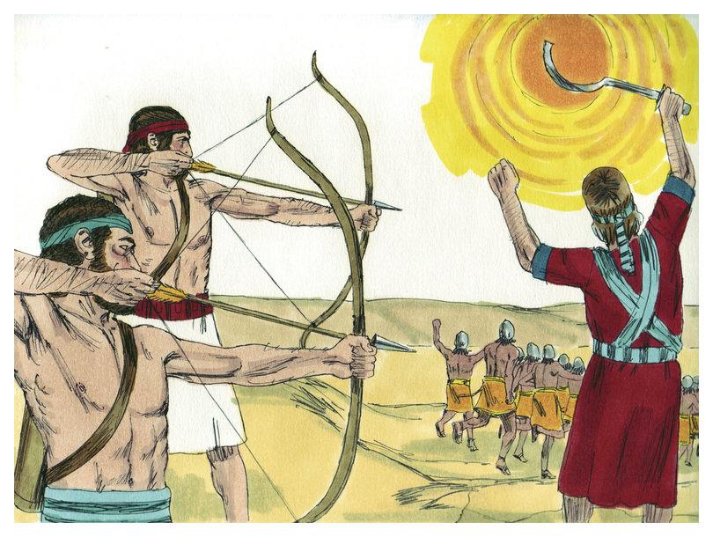

Slide 27
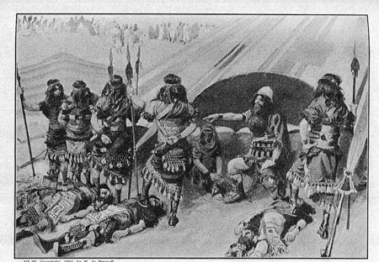

Slide 28
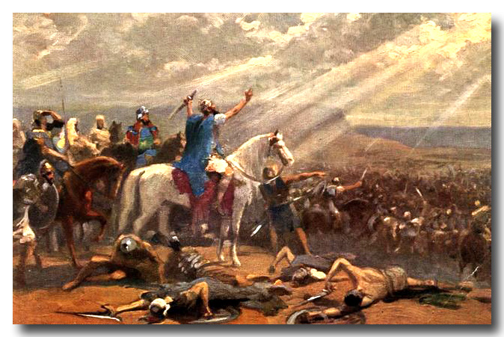

Slide 29
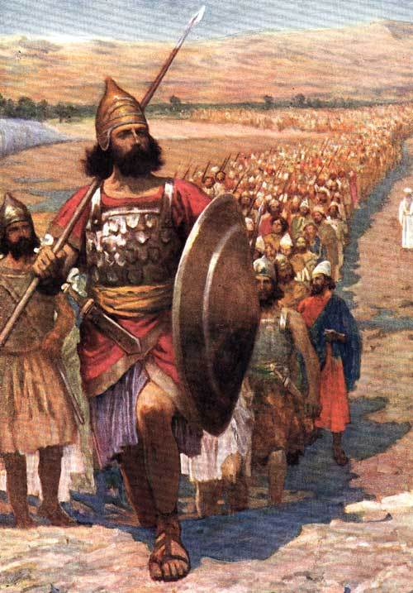

Slide 30
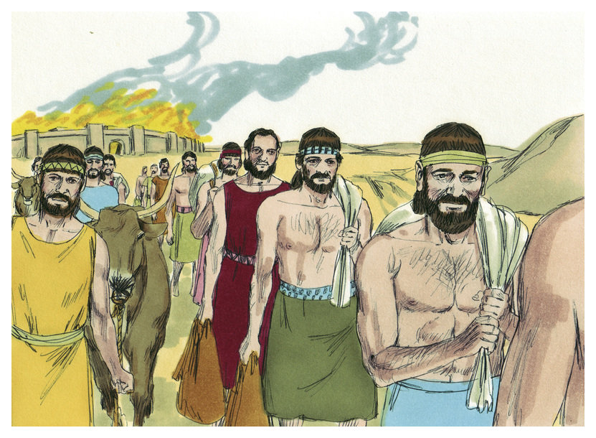

Slide 32
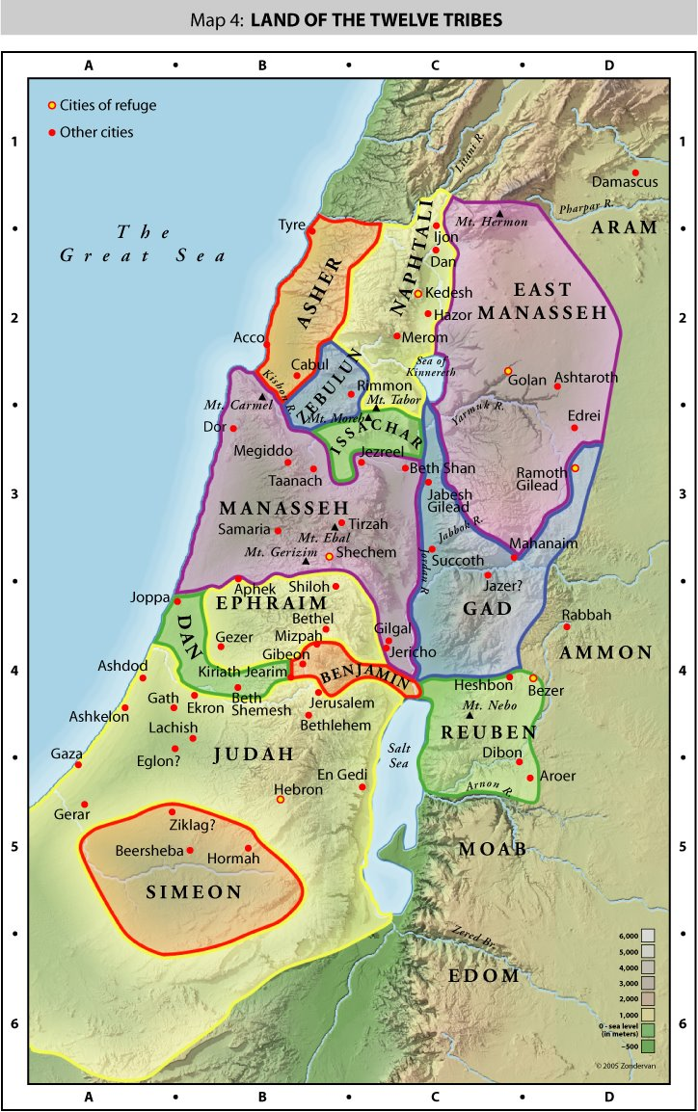

Slide 33
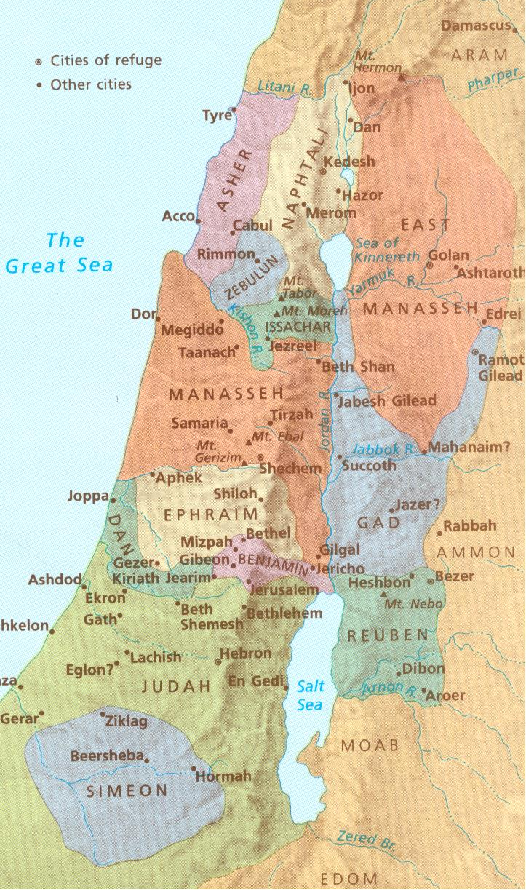

Slide 34
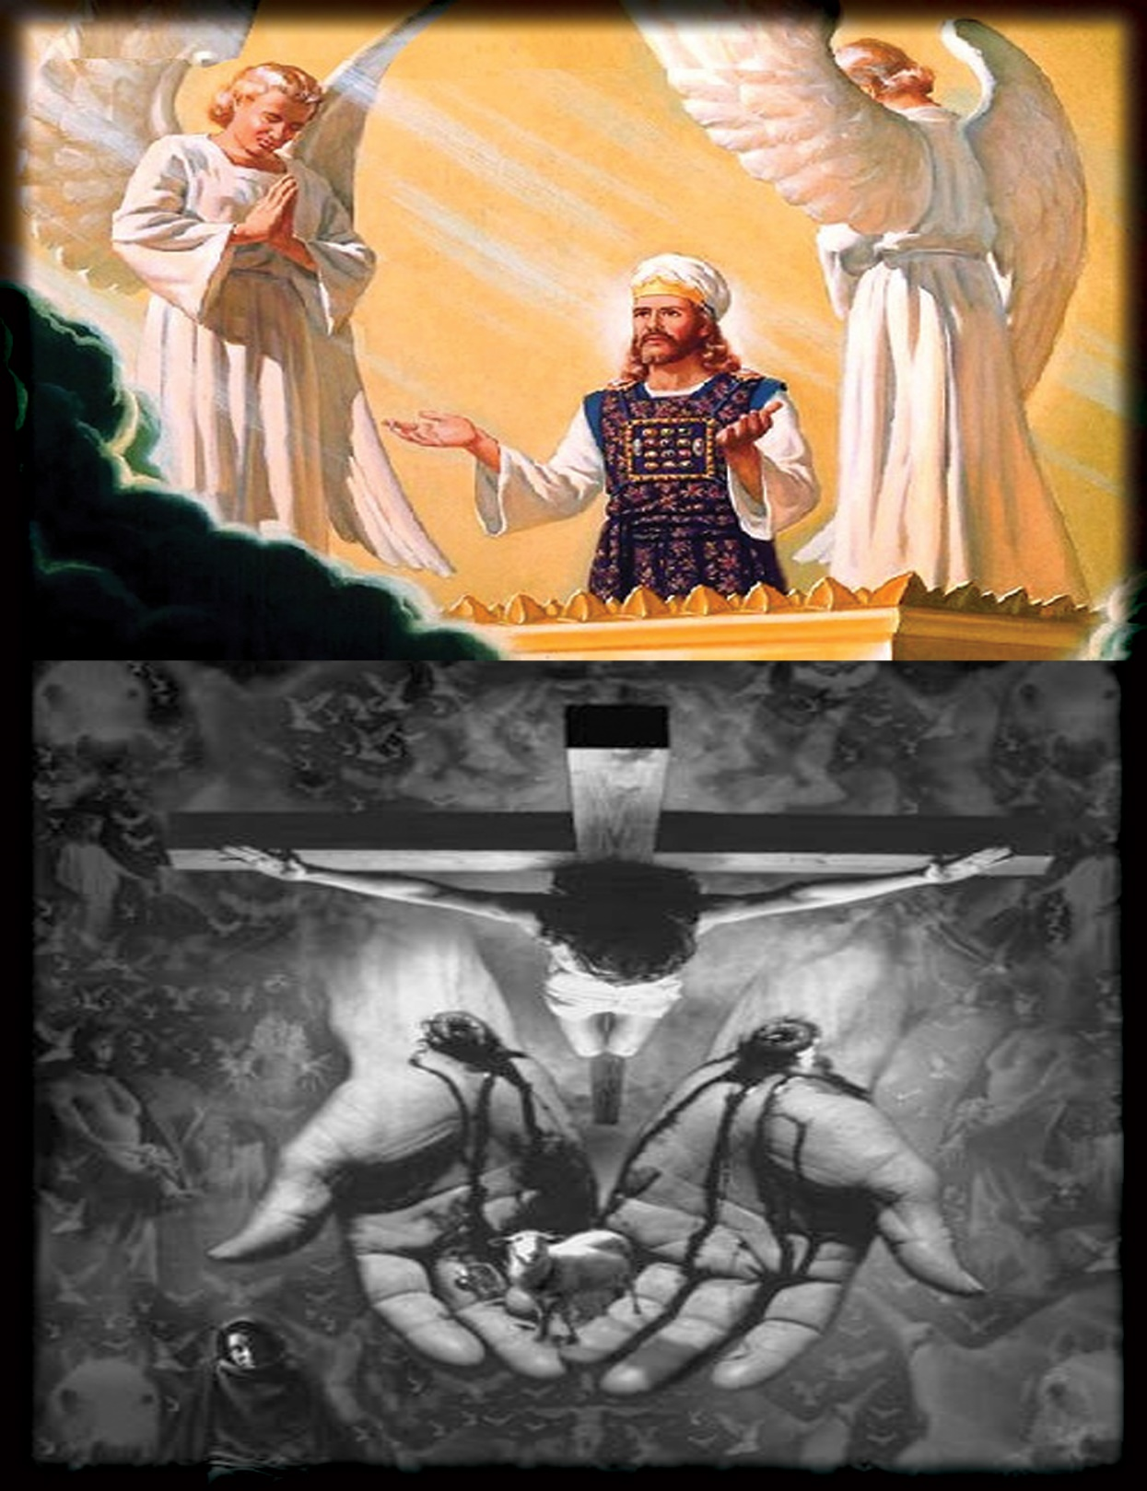

Slide 35
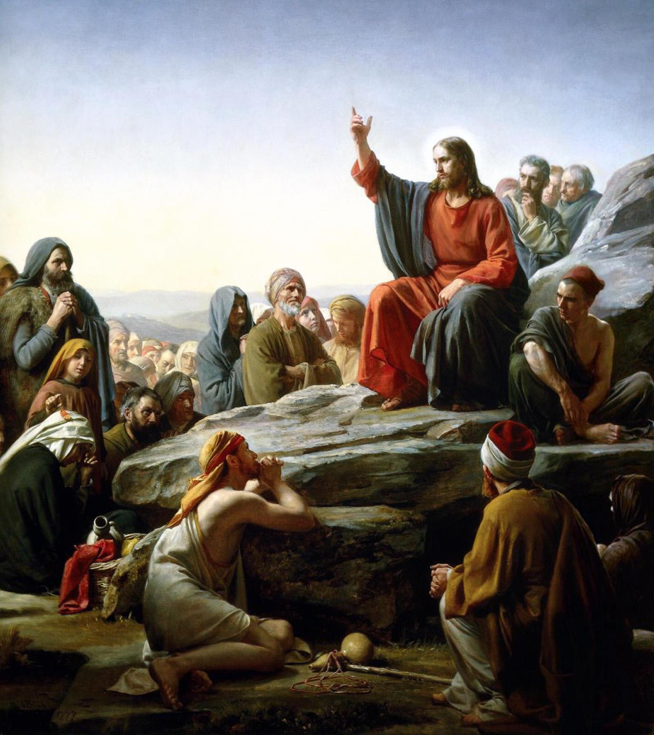

Slide 36
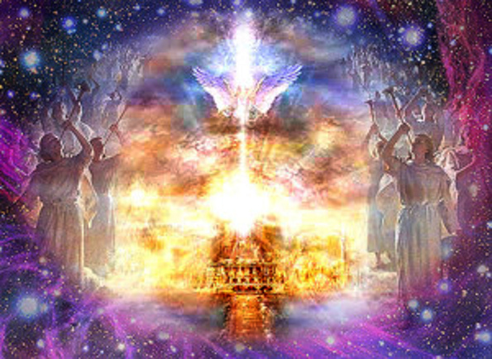

Slide 37
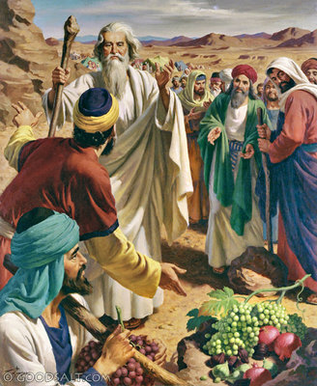

Slide 38
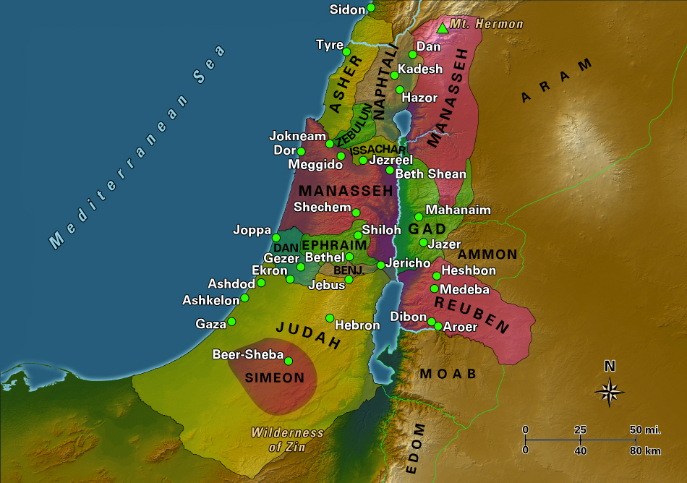

Slide 40
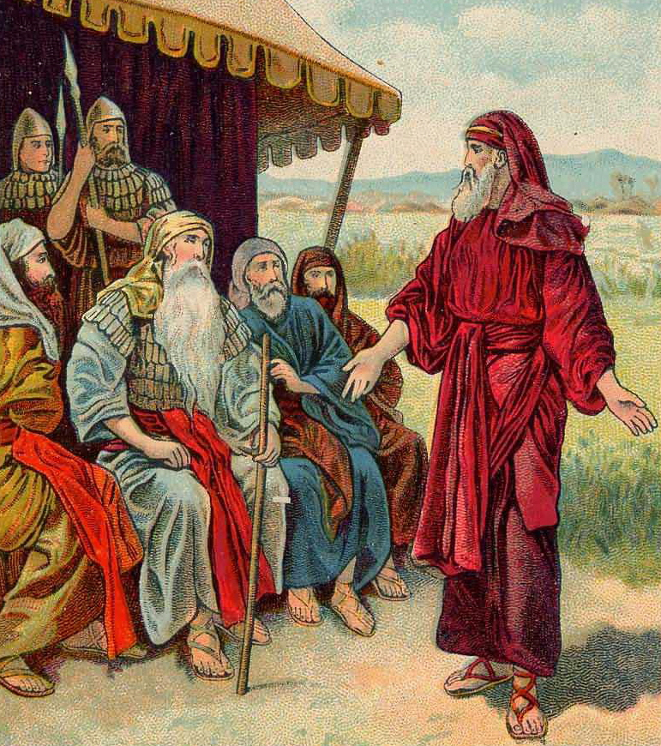

Slide 41
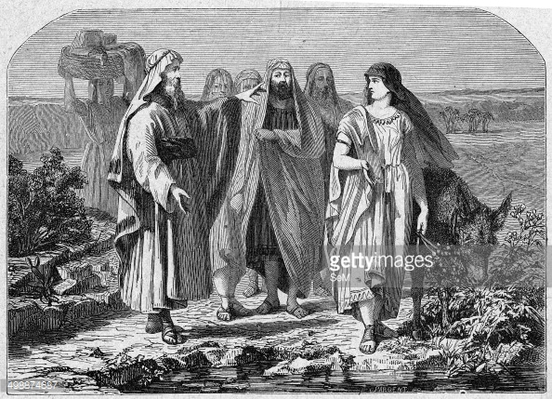

Slide 42
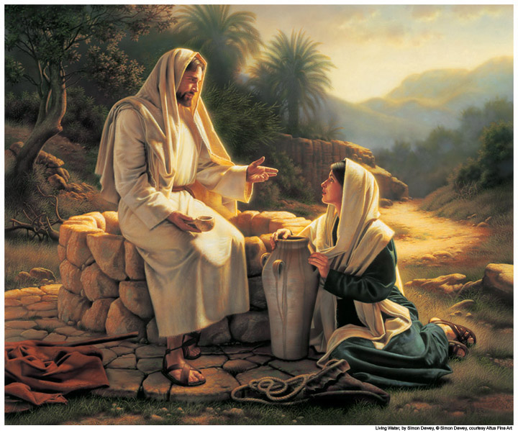

Slide 43
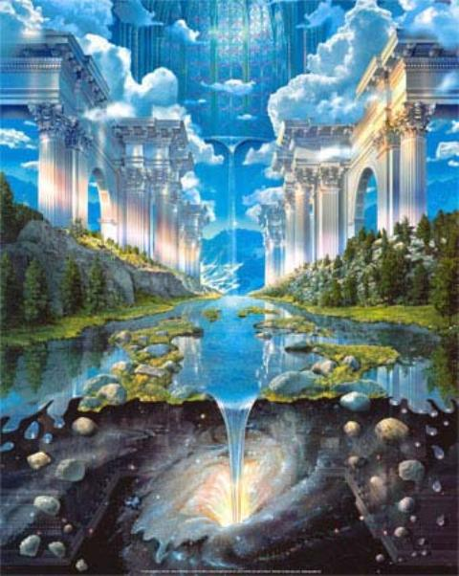

Slide 44
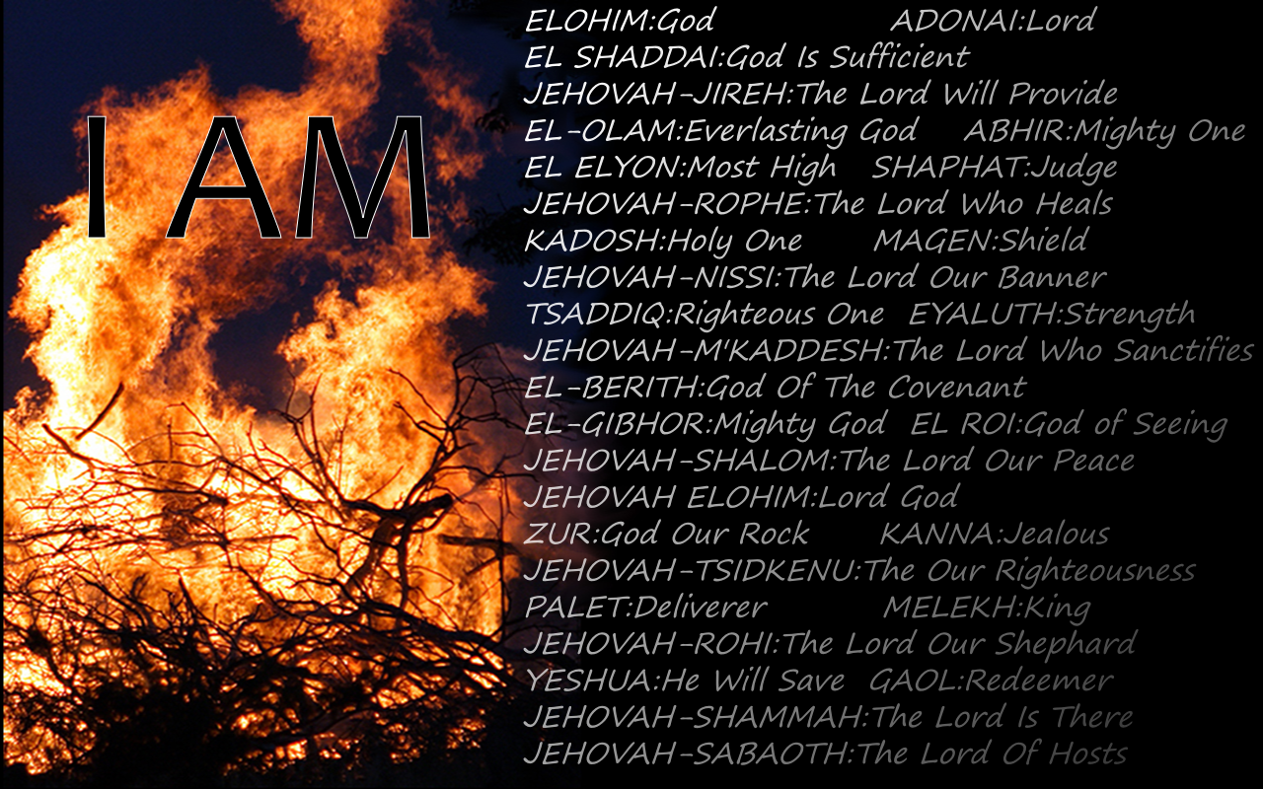

Slide 45
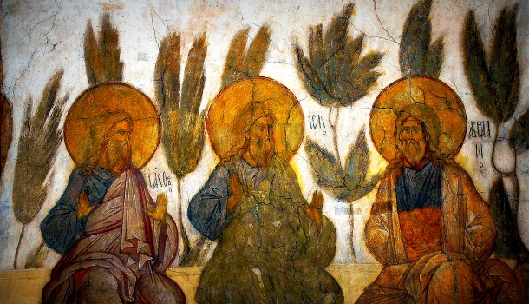

Slide 46
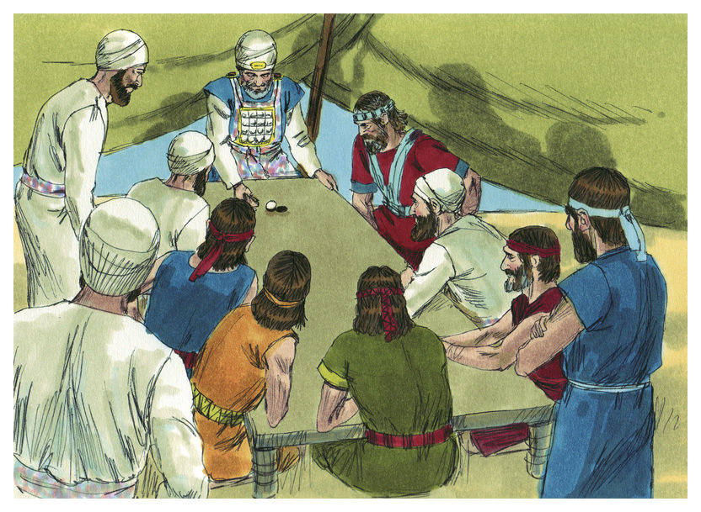

Slide 47
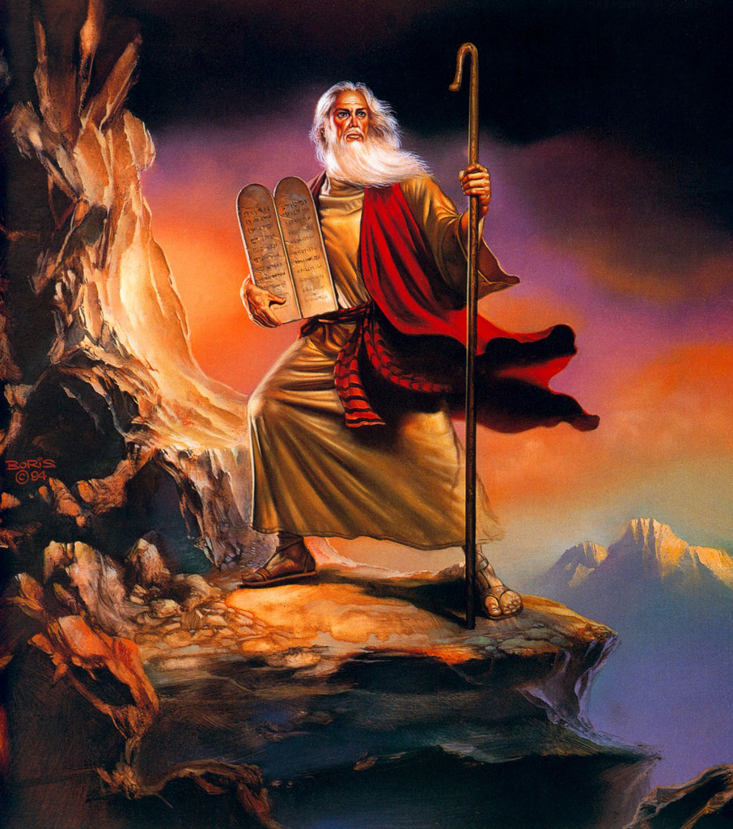

Slide 48
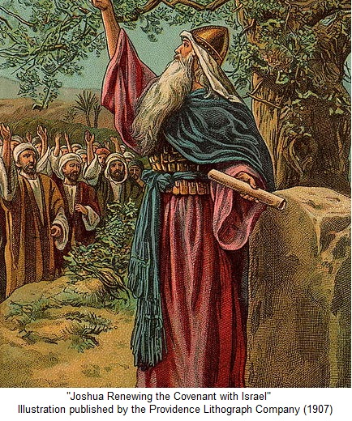

Slide 49
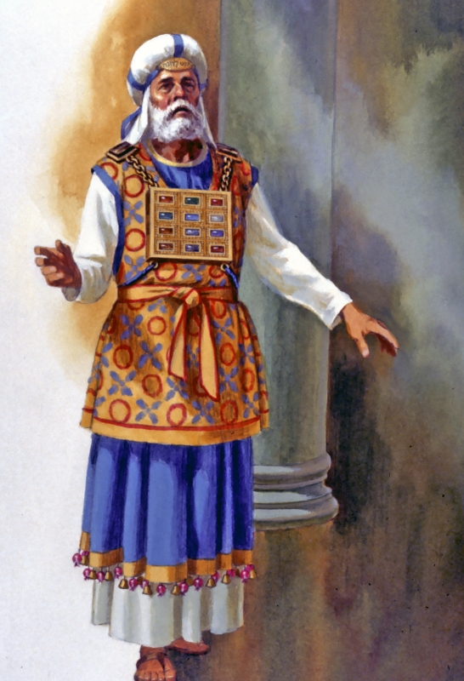

Slide 50
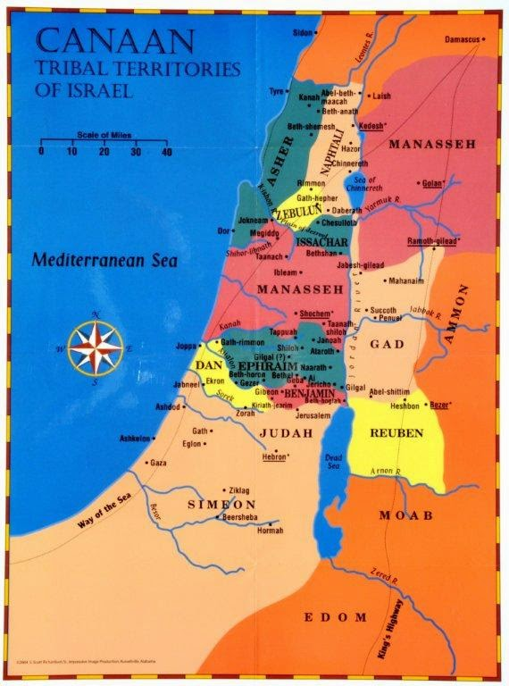

Slide 51
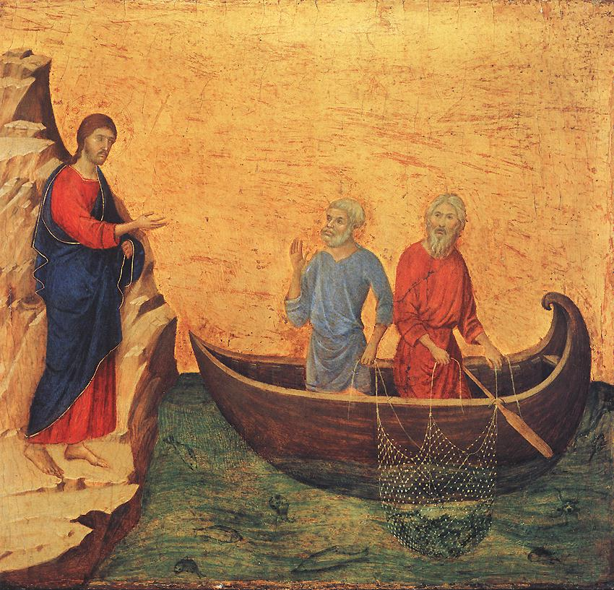

Slide 52
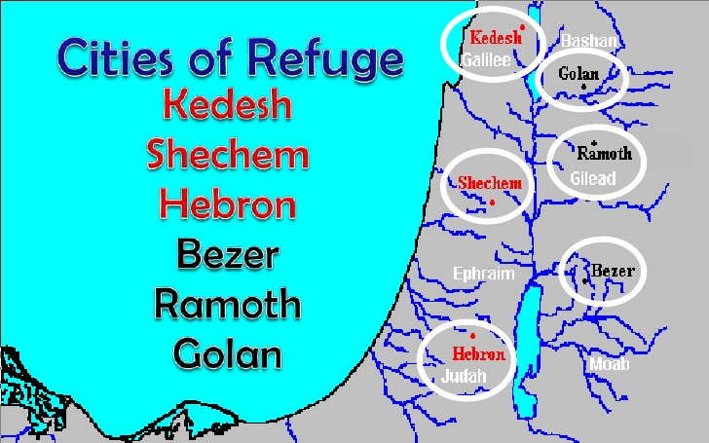

Slide 53
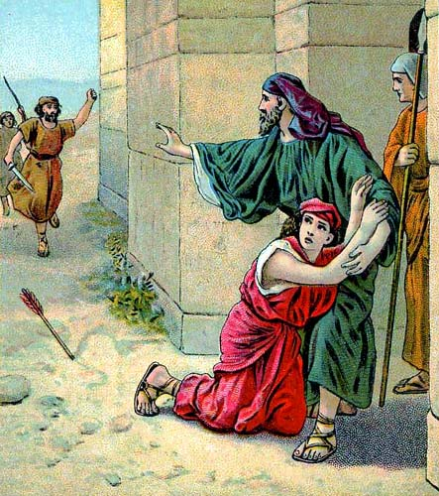

Slide 54
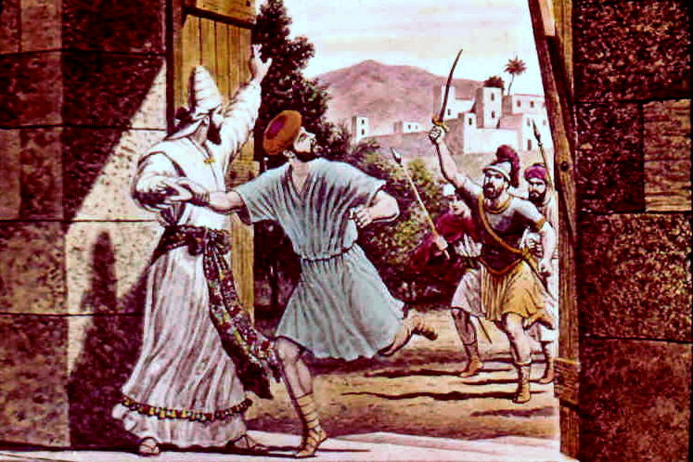

Slide 56
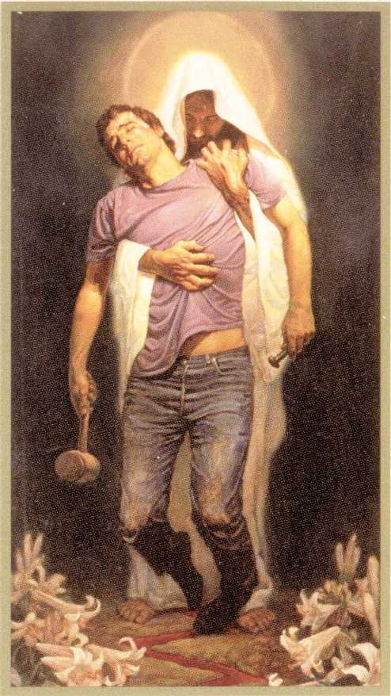

Slide 58
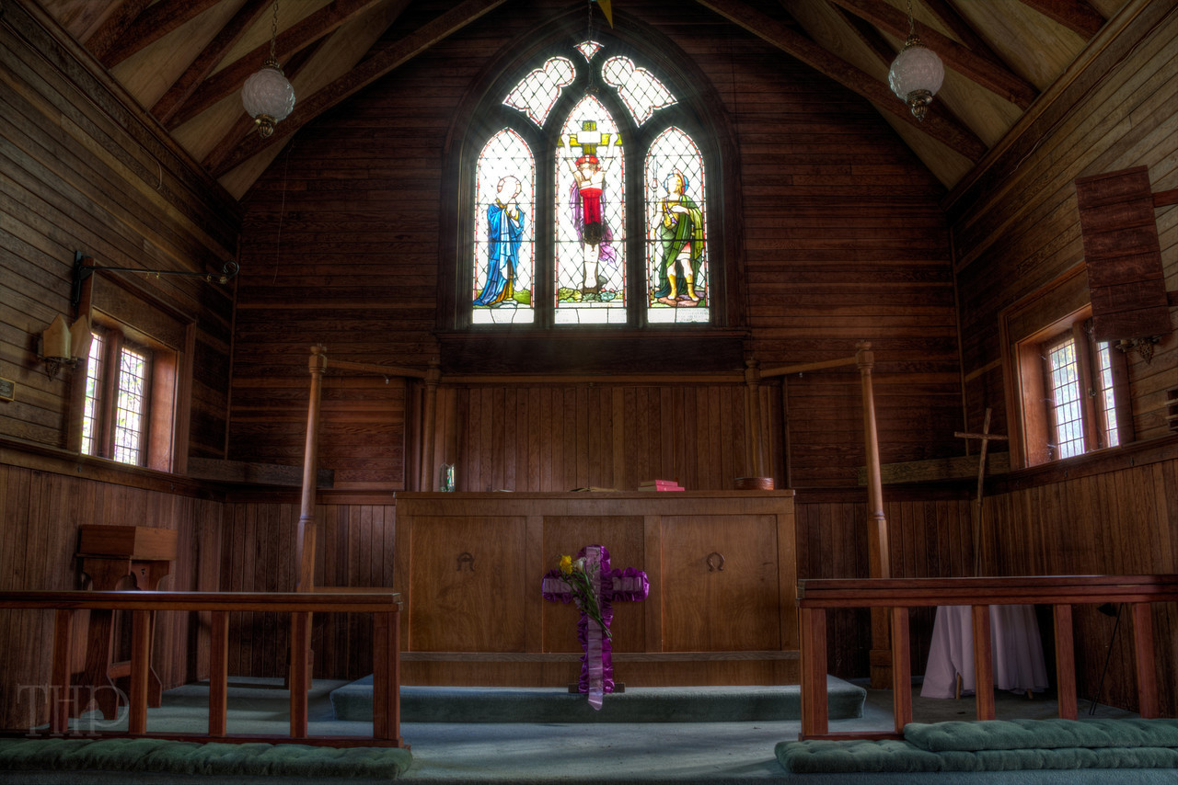

Slide 59
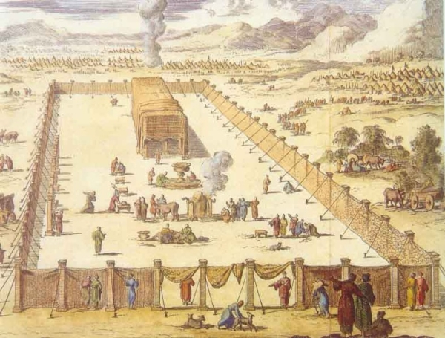

Slide 60
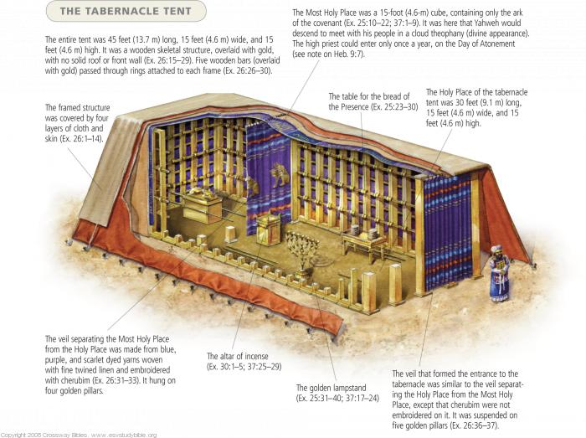

Slide 61
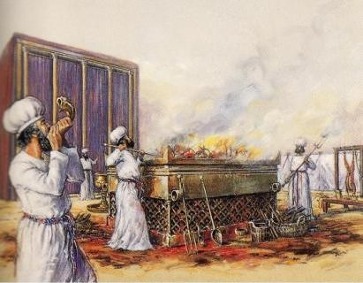

Slide 68
C. LIFE APPLICATION: 1. How do we love the Lord our God, and walk in all his ways and keep his commandments and cling to him and serve him with all our heart and with all our soul? 2. In what ways do we affirm the omniscience of the Lord every day, since: the Mighty One, God, the Lord! The Mighty One, God, the Lord! He knows everything… 3. Explain how we today handle allegations of false teaching or wrong practice in the midst of our congregations? 4. Why is the goal of the church always to bring a peaceful resolution to any issue, if it is possible?

Slide 79
TEXT: Chapter 23 (1) A long time afterward, when the Lord had given rest to Israel from all their surrounding enemies, and Joshua was old and well advanced in years, (2) Joshua summoned all Israel, its elders and heads, its judges and officers, and said to them, "I am now old and well advanced in years. (3) And you have seen all that the Lord your God has done to all these nations for your sake, for it is the Lord your God who has fought for you. (4) Behold, I have allotted to you as an inheritance for your tribes those nations that remain, along with all the nations that I have already cut off, from the Jordan to the Great Sea in the west. (5) The Lord your God will push them back before you and drive them out of your sight. And you shall possess their land, just as the Lord your God promised you.

Slide 80
(6) Therefore, be very strong to keep and to do all that is written in the Book of the Law of Moses, turning aside from it neither to the right hand nor to the left, (7) that you may not mix with these nations remaining among you or make mention of the names of their gods or swear by them or serve them or bow down to them, (8) but you shall cling to the Lord your God just as you have done to this day. (9) For the Lord has driven out before you great and strong nations. And as for you, no man has been able to stand before you to this day. (10) One man of you puts to flight a thousand, since it is the Lord your God who fights for you, just as he promised you. .

Slide 81
(11) Be very careful, therefore, to love the Lord your God. (12) For if you turn back and cling to the remnant of these nations remaining among you and make marriages with them, so that you associate with them and they with you, (13) know for certain that the Lord your God will no longer drive out these nations before you, but they shall be a snare and a trap for you, a whip on your sides and thorns in your eyes, until you perish from off this good ground that the Lord your God has given you. (14) "And now I am about to go the way of all the earth, and you know in your hearts and souls, all of you, that not one word has failed of all the good things that the Lord your God promised concerning you. All have come to pass for you; not one of them has failed.

Slide 82
(15) But just as all the good things that the Lord your God promised concerning you have been fulfilled for you, so the Lord will bring upon you all the evil things, until he has destroyed you from off this good land that the Lord your God has given you, (16) if you transgress the covenant of the Lord your God, which he commanded you, and go and serve other gods and bow down to them. Then the anger of the Lord will be kindled against you, and you shall perish quickly from off the good land that he has given to you."

Slide 83
STUDY NOTES: 1. The farewell address of Joshua (who is almost 110 years old in about 1375 B.C.), like Moses, recalls the victories God has given Israel, but comes with the warning that if the people forget the Lord and serve other gods, they will lose it all and God would punish them. This is classic Law and Gospel theology. 2. The Book of the Law includes all five books of the Torah, the five books of Moses (Gen., Ex., Lev., Num., Deut.) called the Penteteuch, and since it was written down, it could not be changed (Dt 30:10,19; 31:9,24,26) 3. Love the Lord your God is the first commandment and most important of all (Ex 20:1-11). The first table of the Law includes Commandments 1-3. It is the relationship between God and us.

Slide 84
4. For the Old Israel, to break the first table of the Law includes: a. turning away to the worship of false gods (idolatry) (2 Ki 17:7,8; 2 Ch 7:14-20; 34:12) b. ally yourselves with pagans and intermarry with them (Ex 34:13-16; Dt 7:2-4) c. falling into snares and traps of evil and wickedness (Ex 23:33; 34:12; Dt 7:16) 5. Since the Church is the New Israel, this is also a warning to the Christian Church to not: a. turn away to the worship of false gods (idolatry) (Gal 4:1-9; 1 Cor 12:1-7; 1 Jn 5:18-21) b. ally yourselves with pagans and intermarry with them (1 Cor 7:12-16; 2 Cor 6:14-18) c. fall into snares and traps of evil and wickedness (1 Cor 8:3-7; 1 Thess 1:9-10; Rev 9:20,21)

Slide 85
6. We need strength to carry out the will of God in our lives (Php 2:13; 1 Jn 4:19) 7. Blessings and curses upon the old Israel - the Jewish nation (Lev 26:14-39; Dt. 28:15-68; 29:18-28) This all came to pass in 722 B.C. when the idolatrous northern Israel was destroyed, and in 587 B.C. when the northern Judah was defeated and exiled to Babylon. 8. Blessings and curses upon the new Israel – the Church (1 Cor 9:19-27; Heb 3:12-19; 4:11-16) The heresies, false doctrines and blasphemies within the modern Christian denominations also fall under God’s judgment. These include: the denial of the inerrancy of the Bible, teaching that Jesus is not the only way to heaven, denying that the miracles happened – including Jesus’ resurrection, the allowing of abortion, adopting the world’s view of sexuality and thus allowing women pastors, homosexual pastors, and nowsame-sex marriage. The list goes on and on. The LCMS, our denomination, teaches the truth of God’s Word and does not sanction any of these. God’s judgment will begin with the Church (1 Pet 4:17-19)

Slide 86
LIFE APPLICATION: 1. How have you have seen all that the Lord your God has done for your sake, and how has the Lord your God fought for you? 2. Why must we hold to all that is written in the Book of the Bible, and not turn from it neither to the right hand nor to the left? 3. When is the anger of the Lord kindled against you, and you shall perish unless you repent? 4. Where do we see all the good things that the Lord your God promised concerning you, which have been and will be fulfilled for you?

