Slide 1
THE BOOK OF JOSHUA
“Be Strong and Courageous!”
-Joshua in the Old Testament
-Jesus in the New Testament
Date: 7-19-15 Lesson: 20

Slide 2
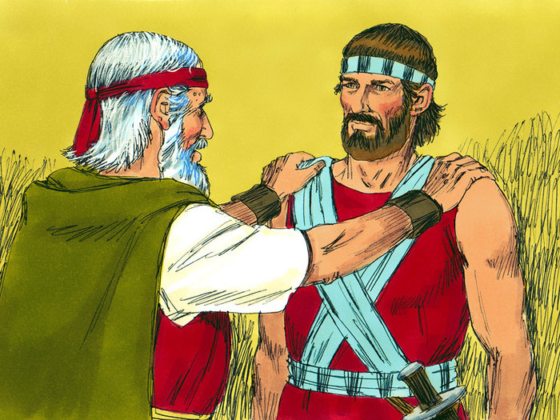

Slide 3
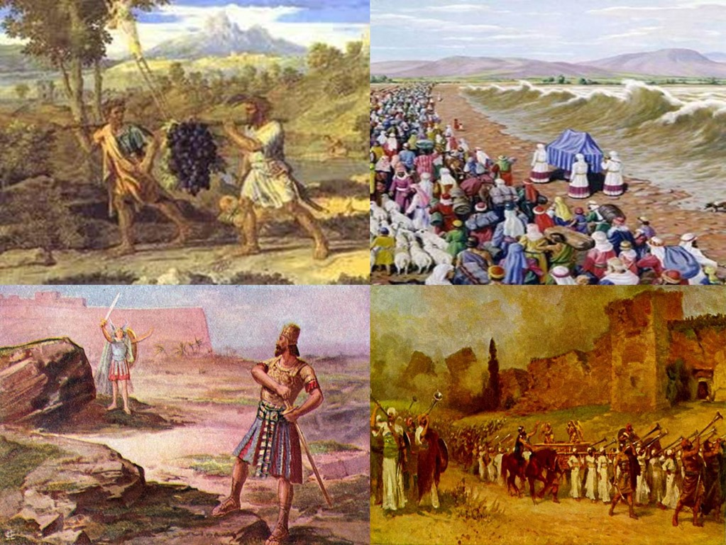

Slide 4
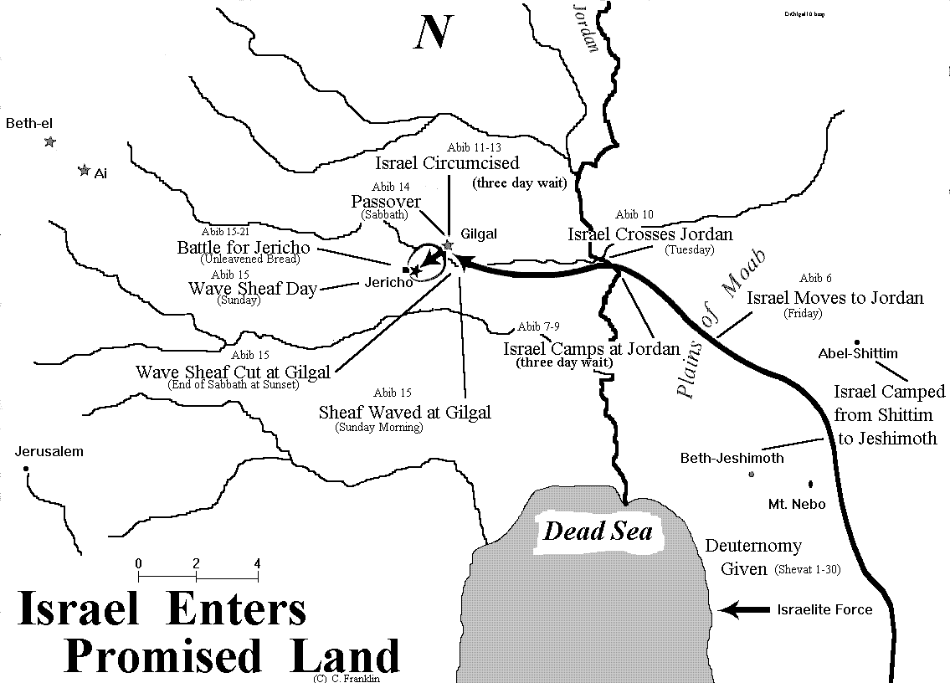

Slide 6
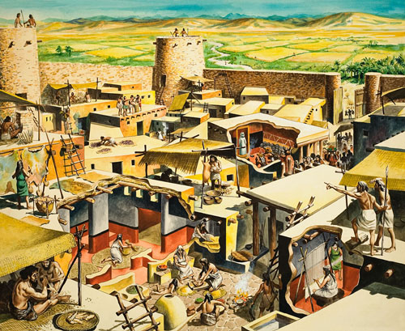

Slide 8
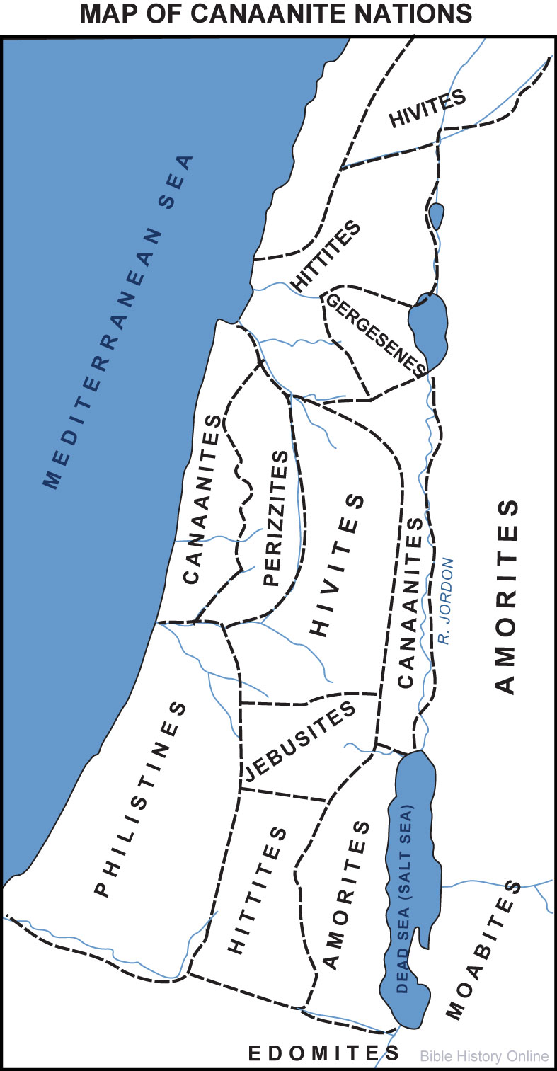

Slide 9
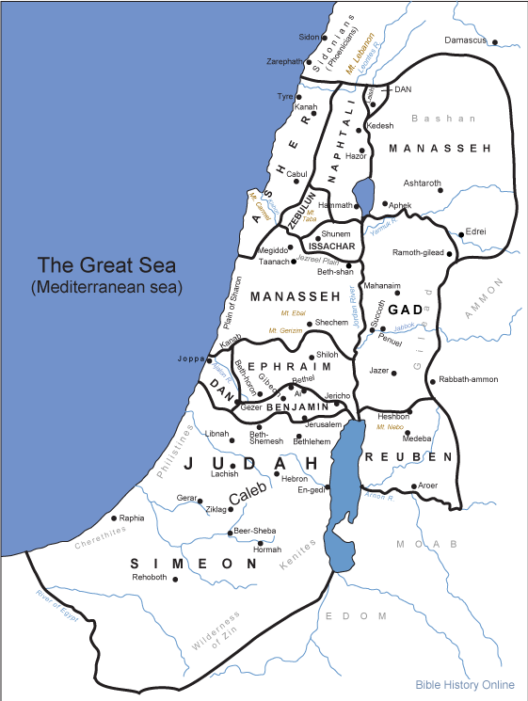

Slide 10
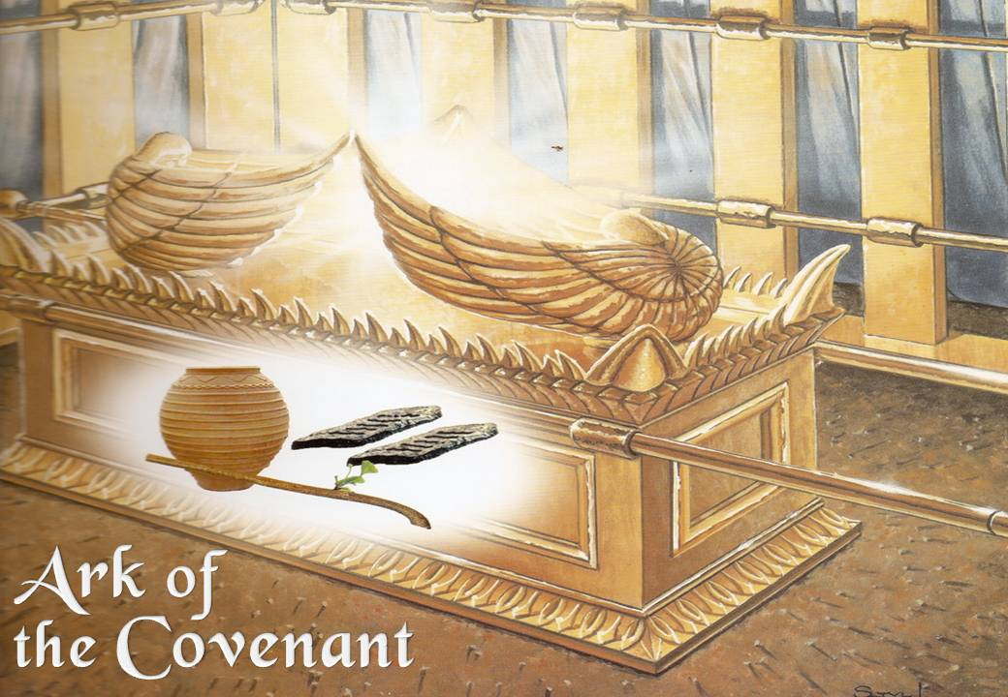

Slide 11
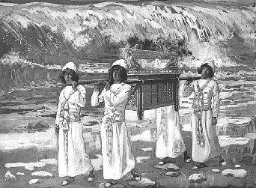

Slide 12
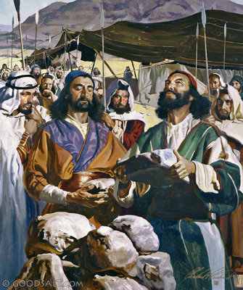

Slide 13
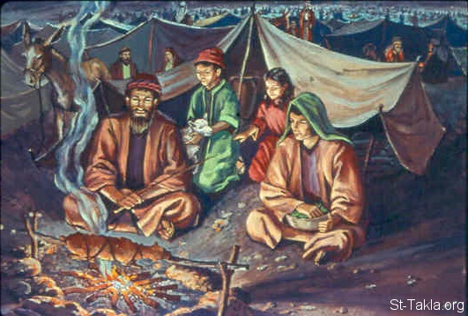

Slide 14
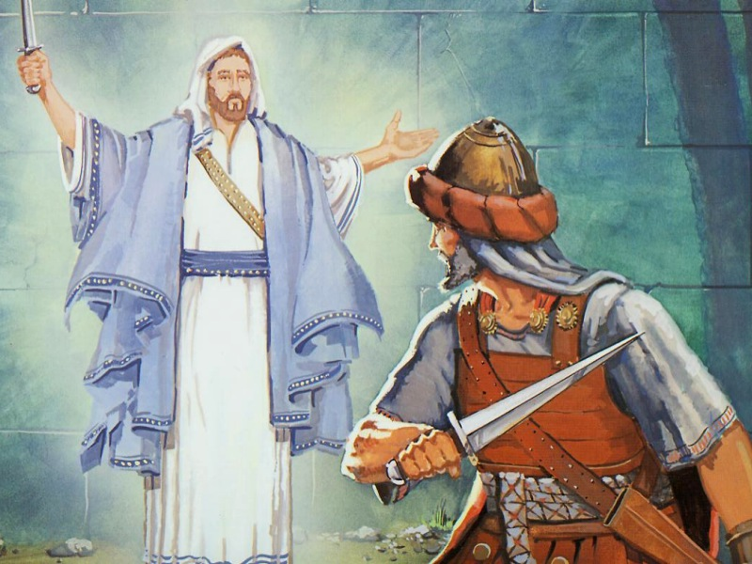

Slide 15
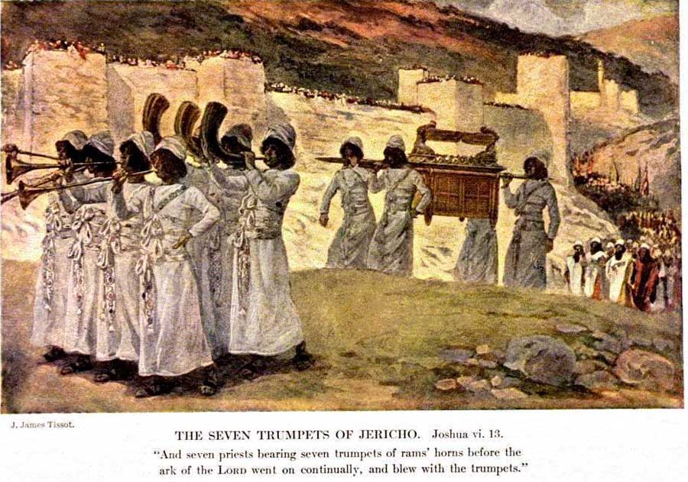

Slide 19
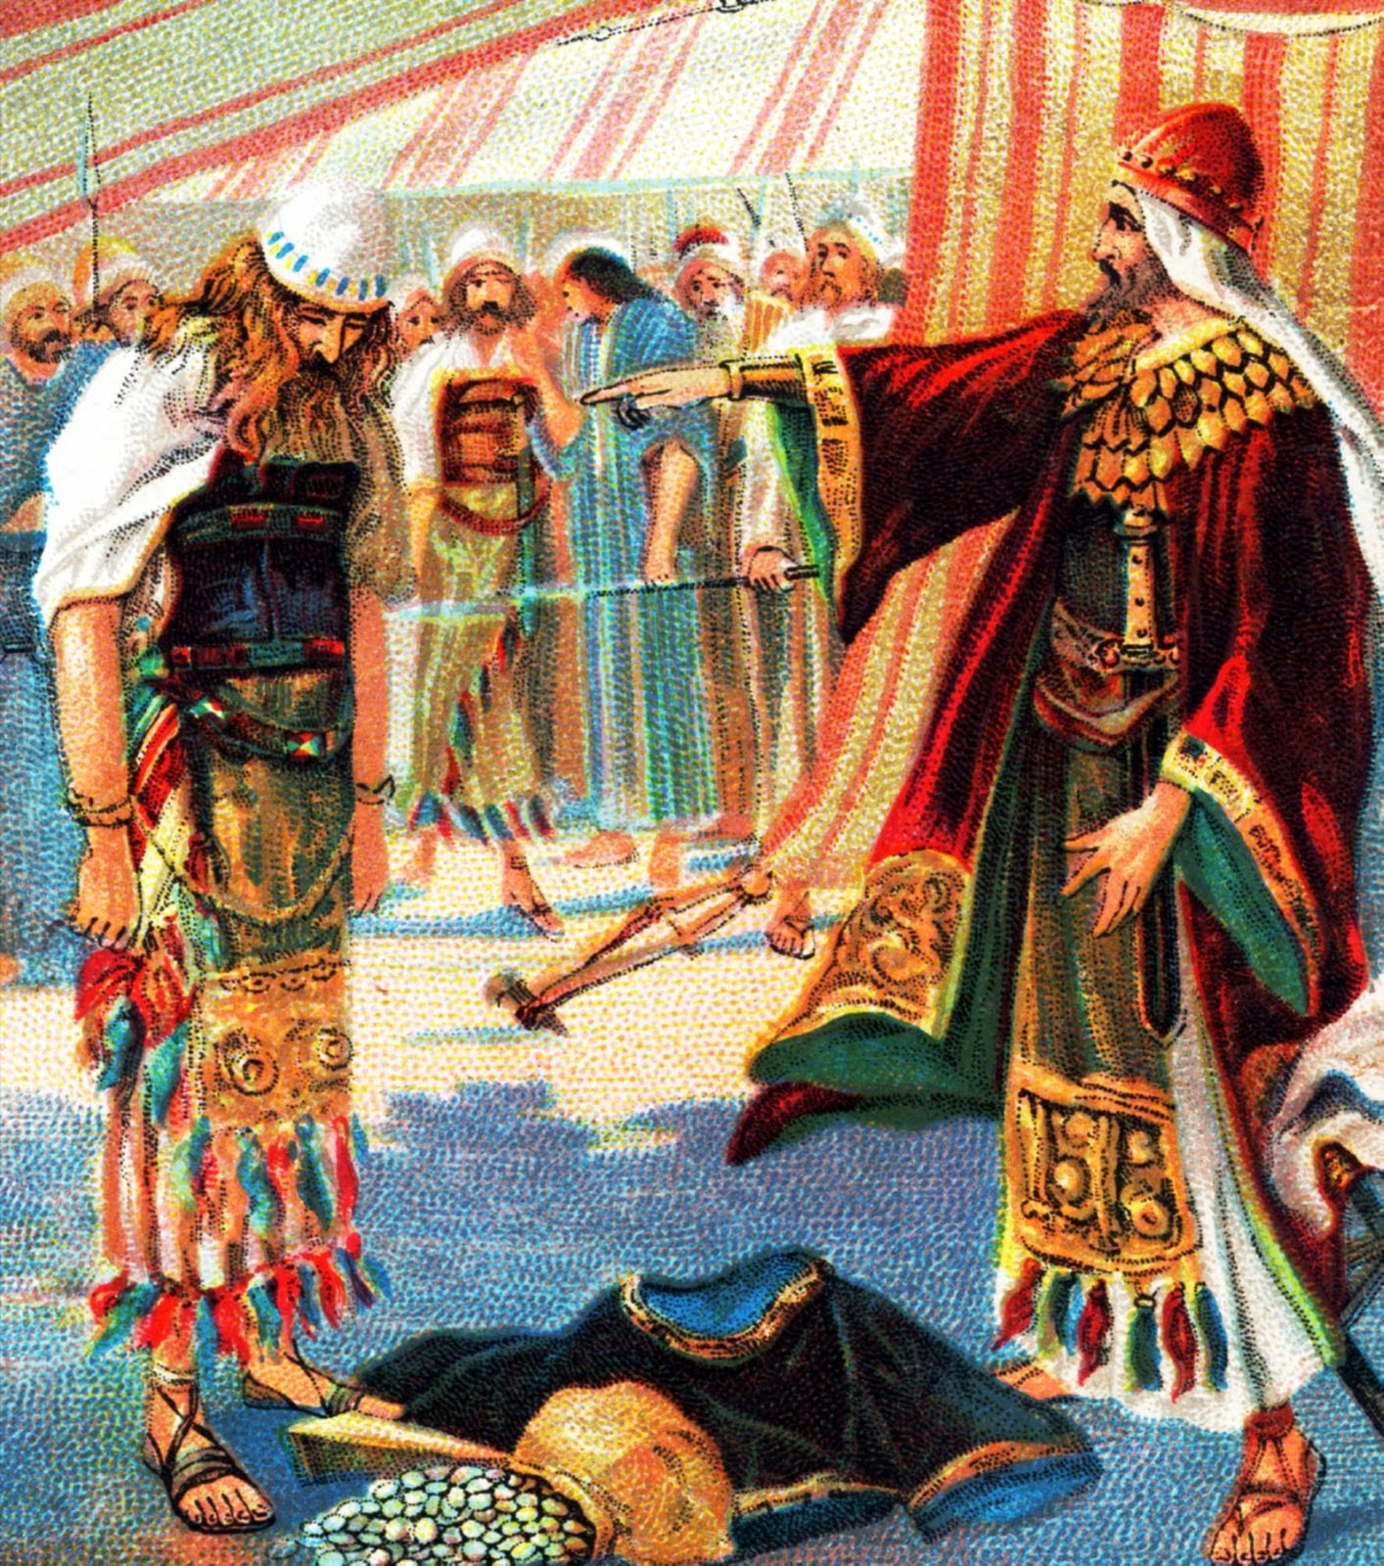

Slide 21
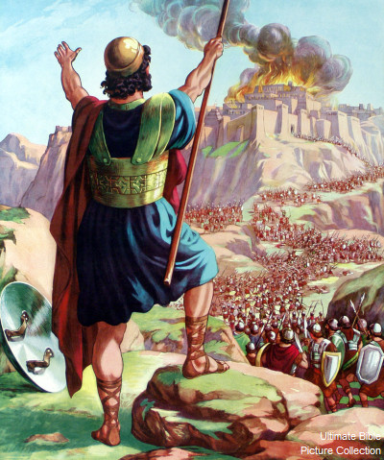

Slide 22
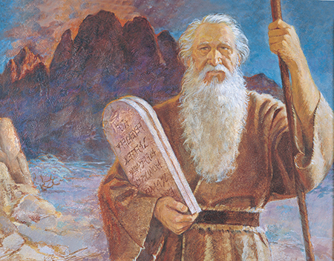

Slide 23
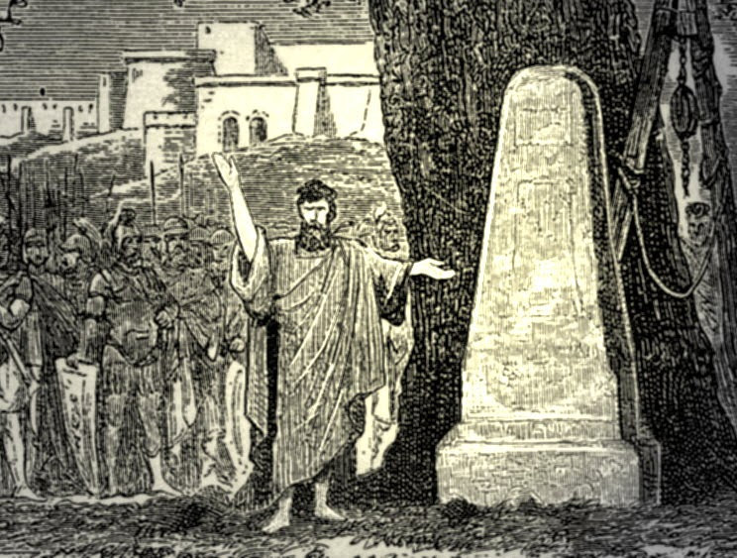

Slide 24
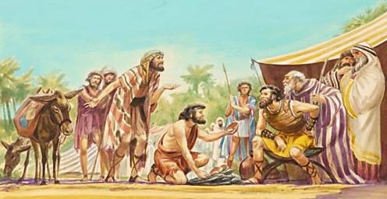

Slide 25
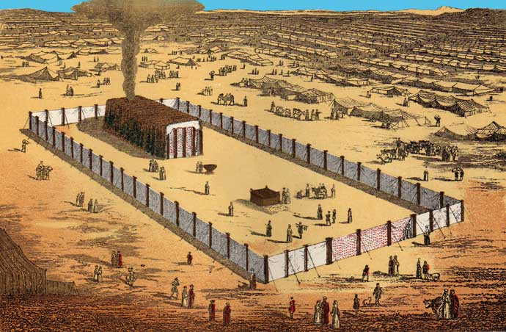

Slide 26
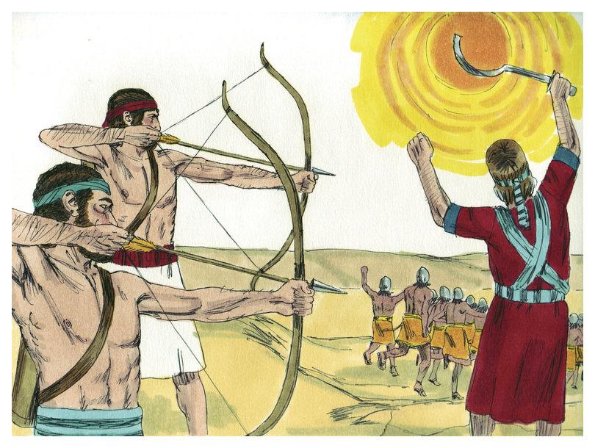

Slide 27
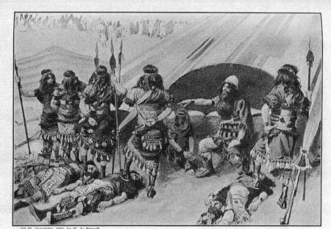

Slide 28
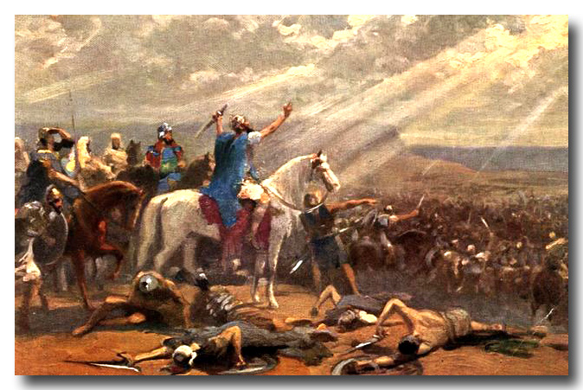

Slide 29
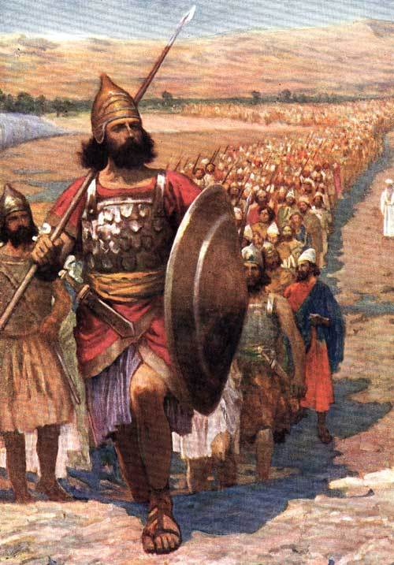

Slide 30
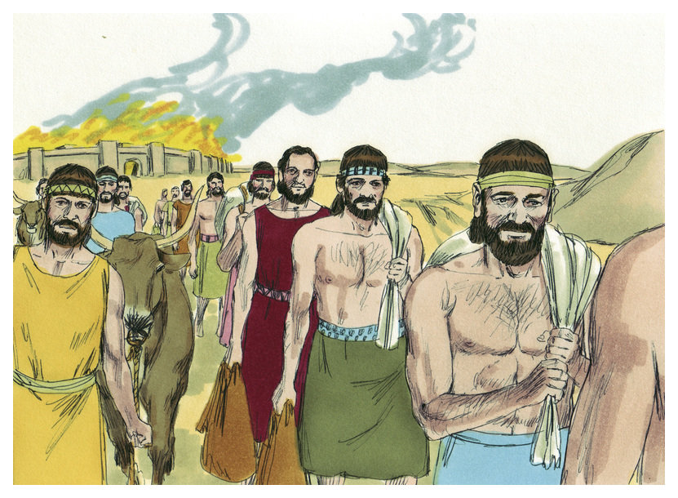

Slide 32
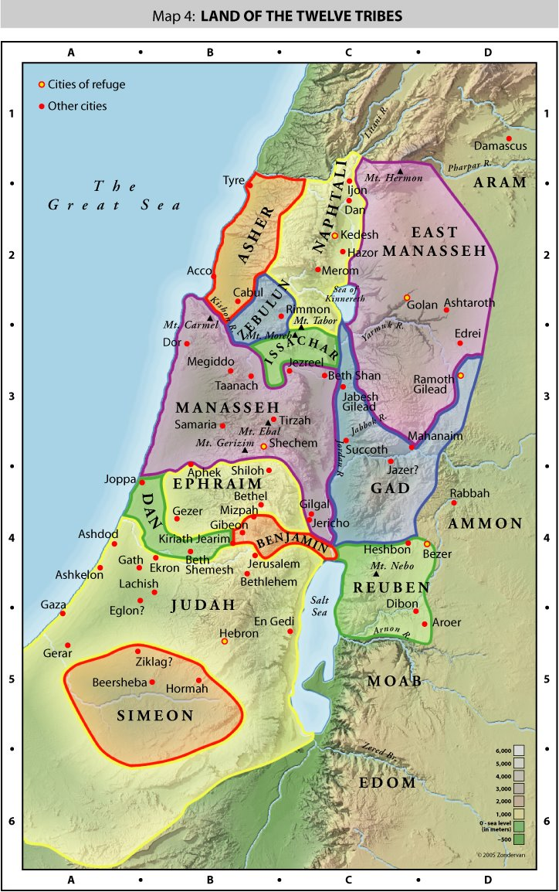

Slide 33
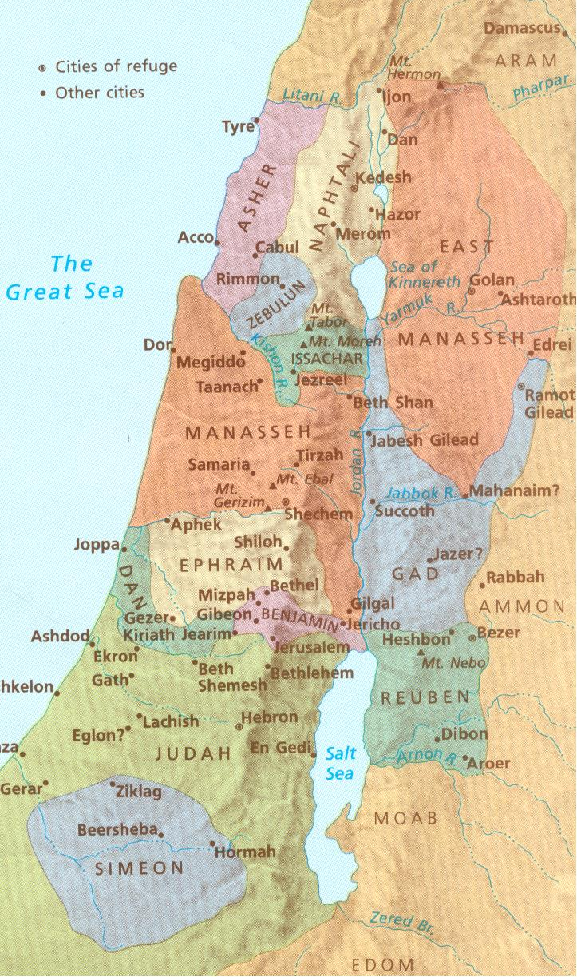

Slide 34
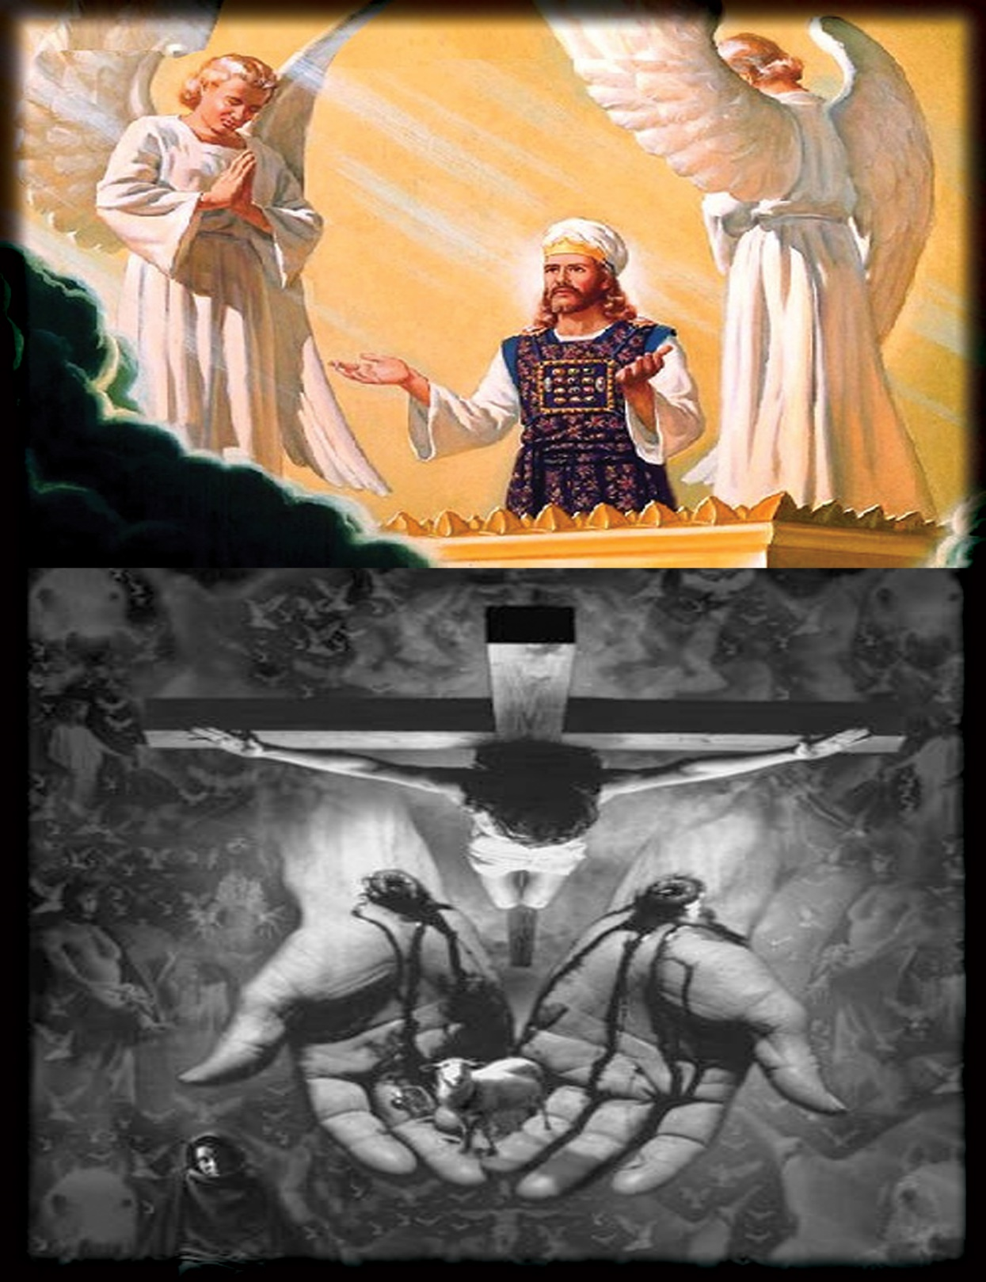

Slide 35
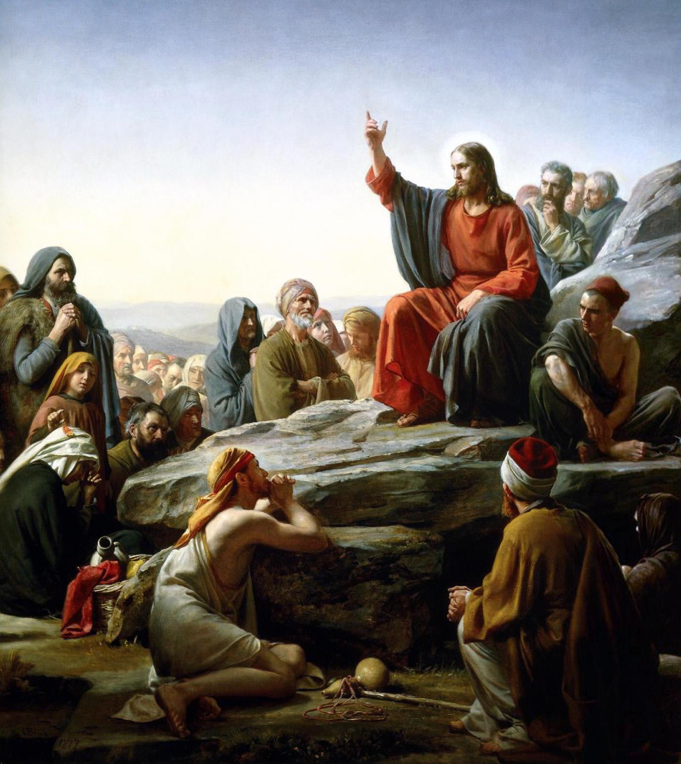

Slide 36
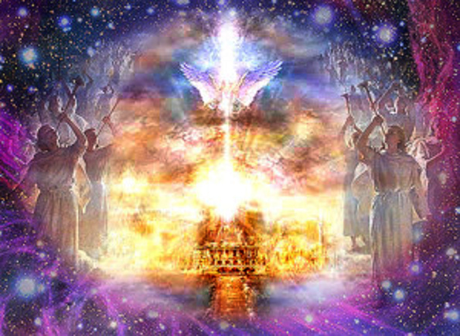

Slide 37
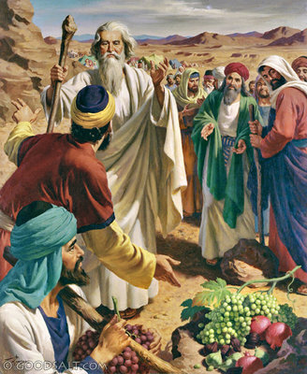

Slide 38
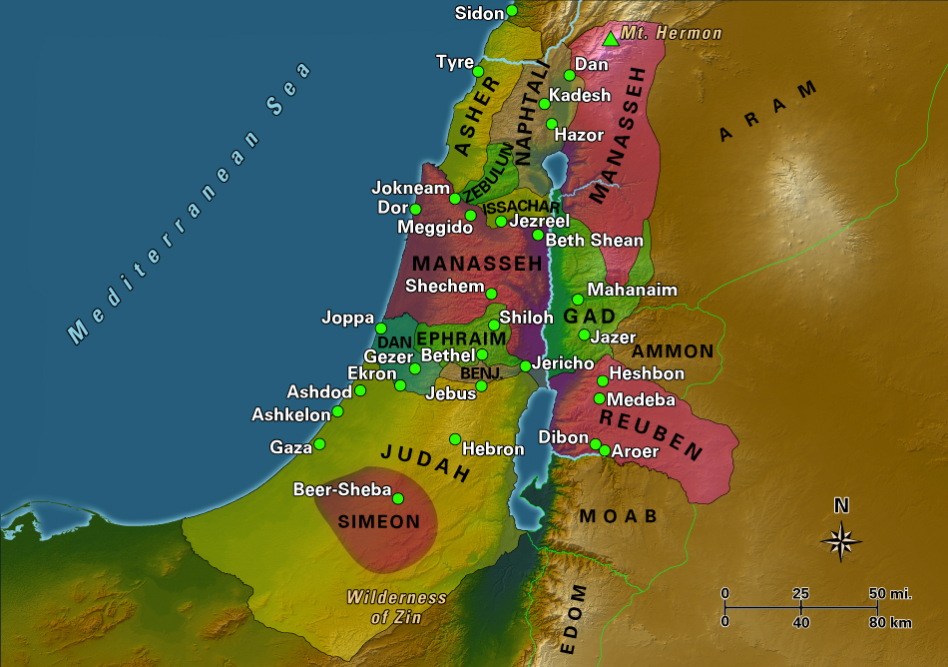

Slide 40
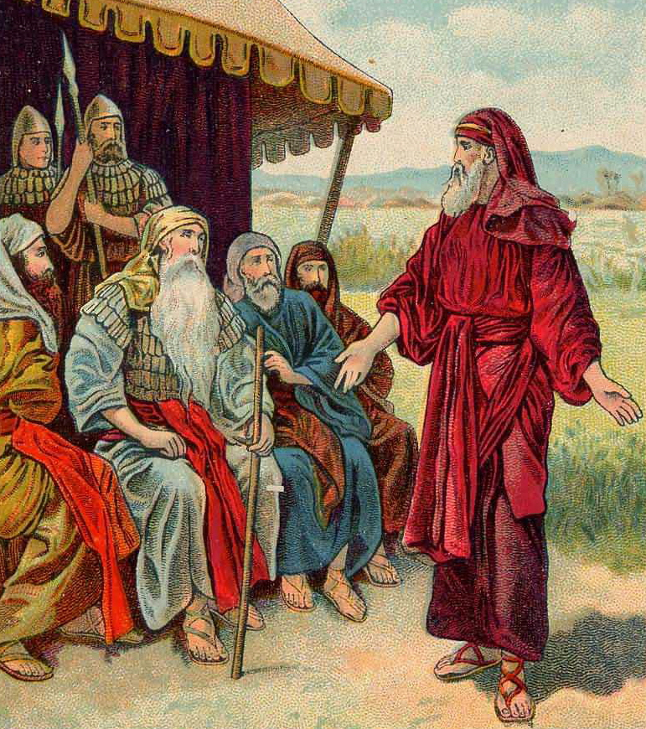

Slide 41
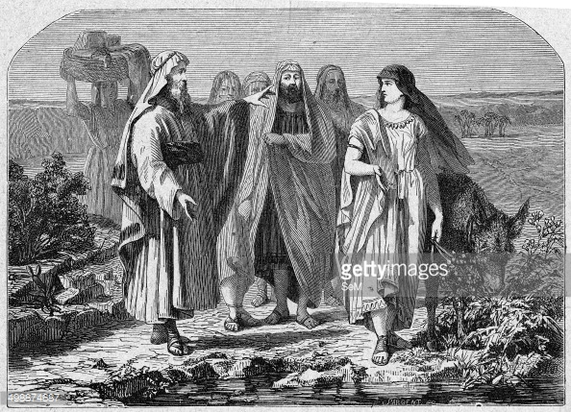

Slide 42
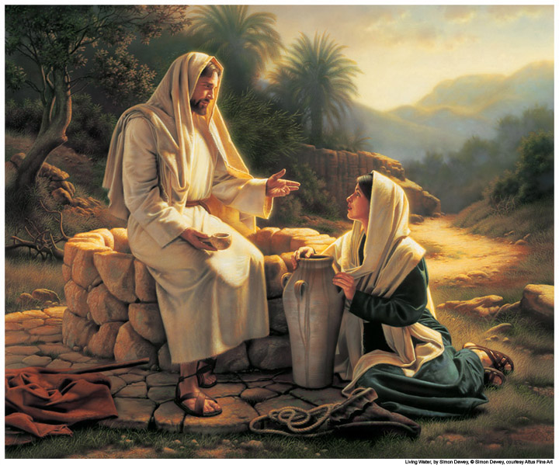

Slide 43
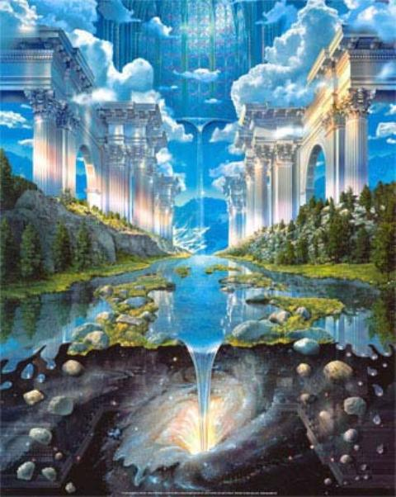

Slide 44
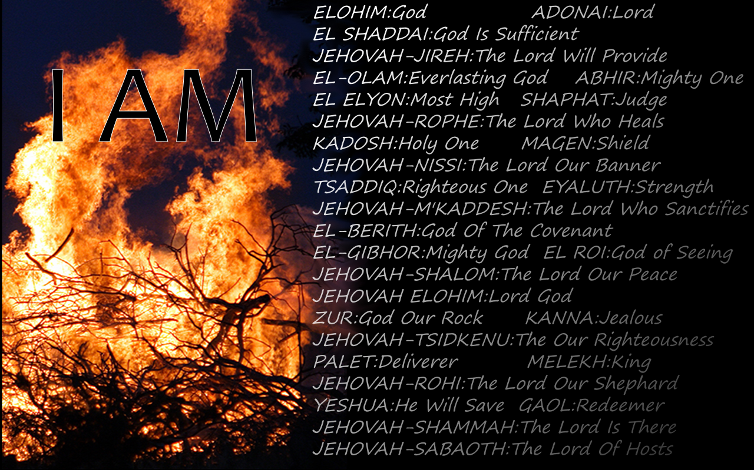

Slide 45
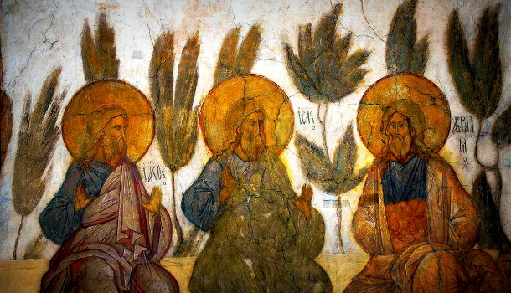

Slide 46
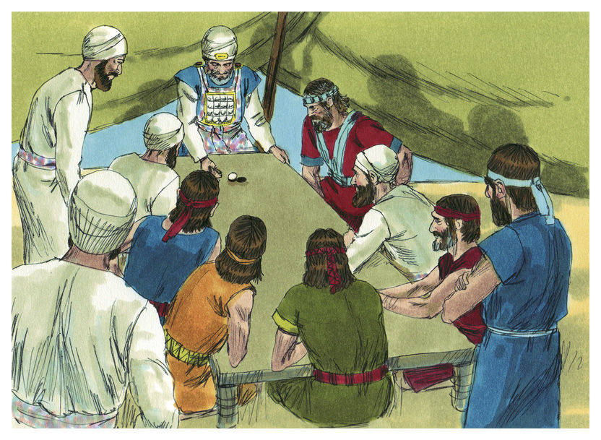

Slide 47
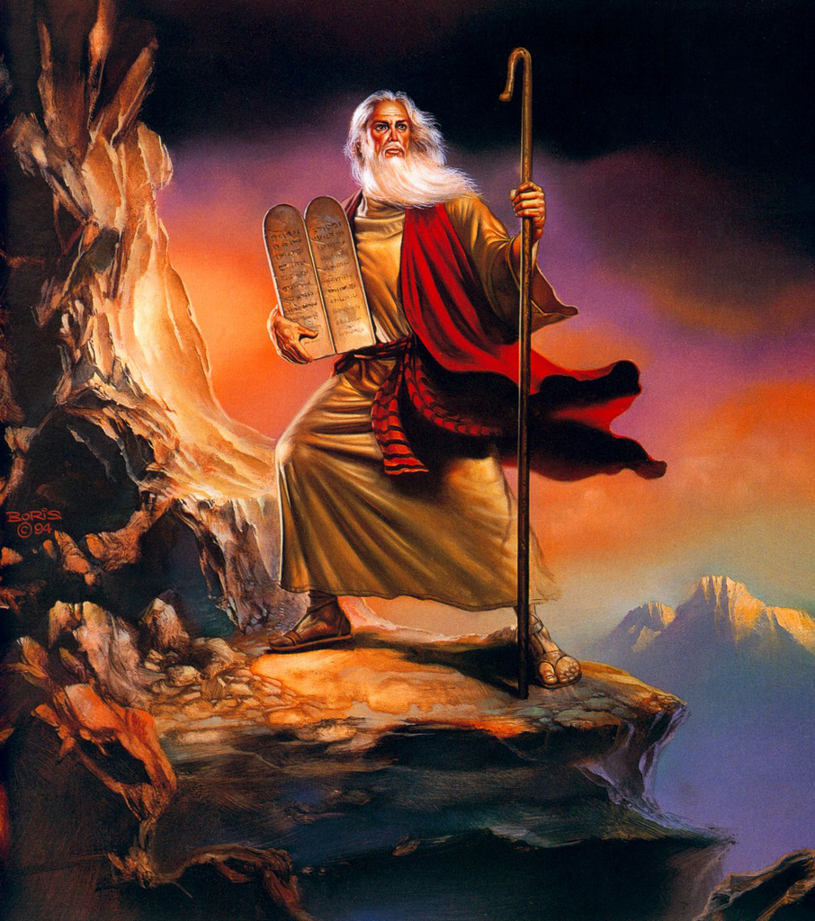

Slide 48
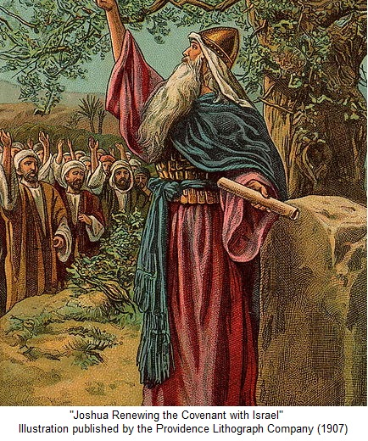

Slide 49
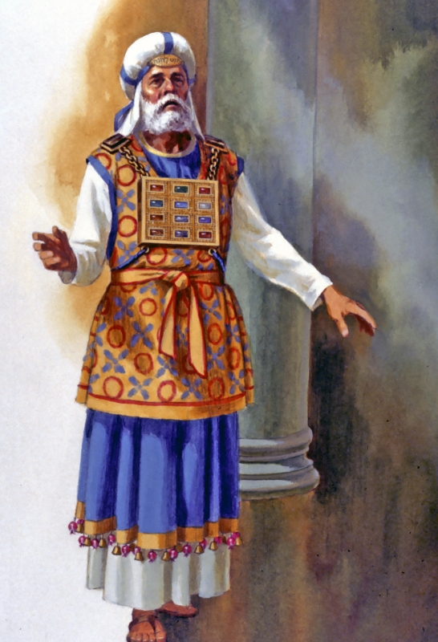

Slide 50
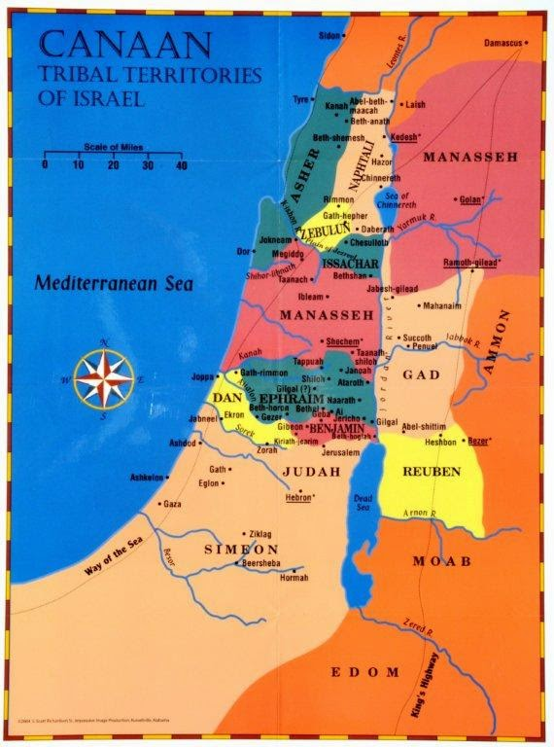

Slide 51
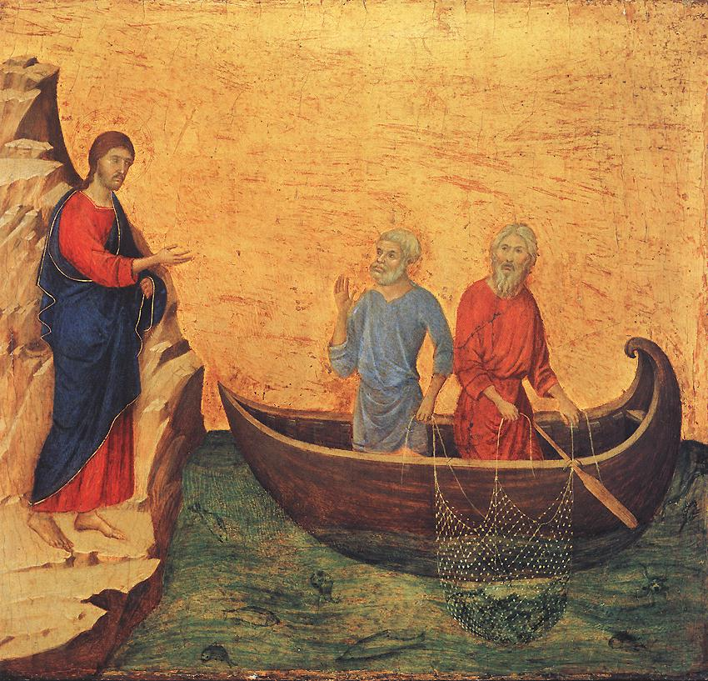

Slide 52
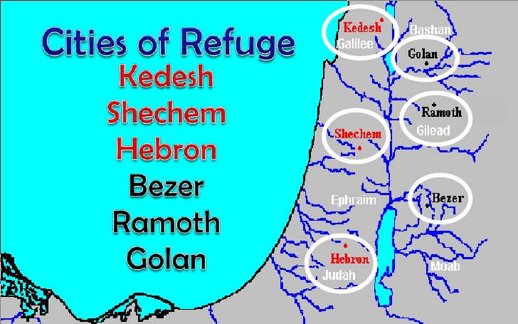

Slide 53
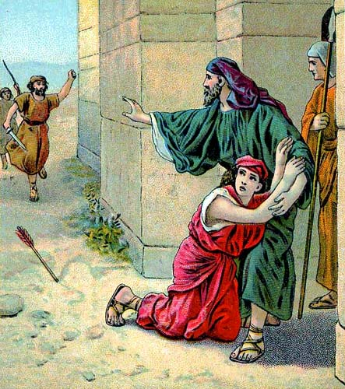

Slide 54
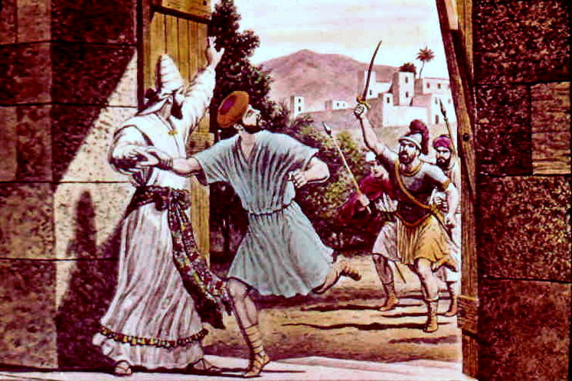

Slide 56
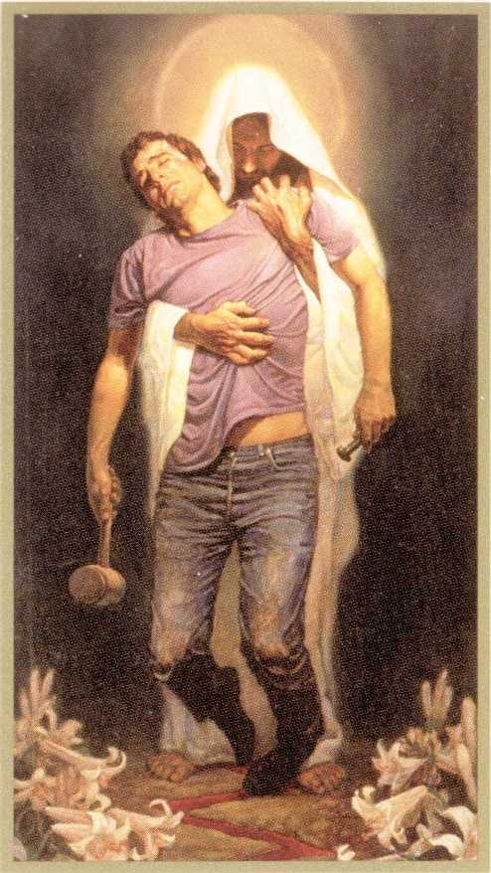

Slide 58
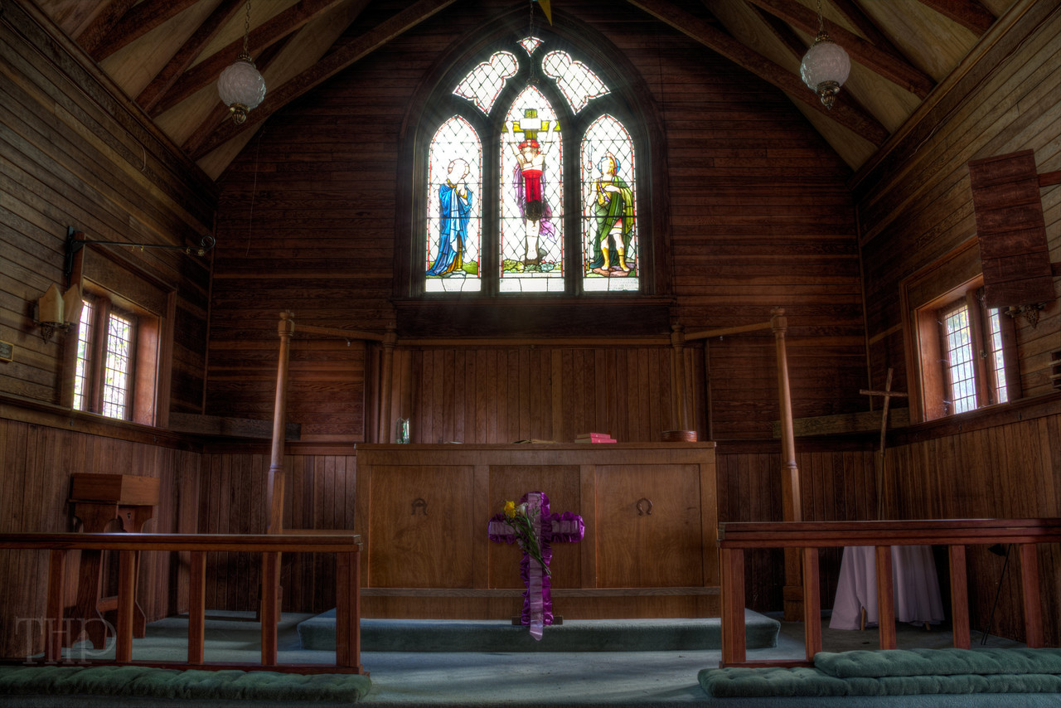

Slide 59
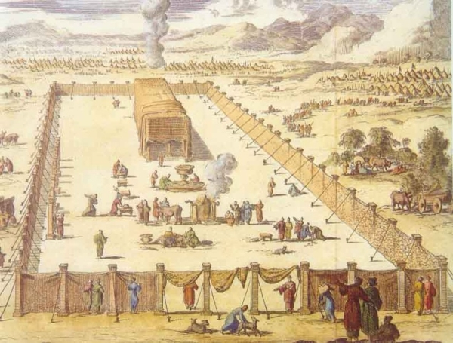

Slide 60
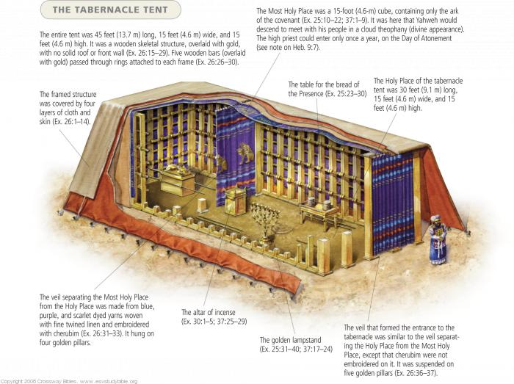

Slide 61
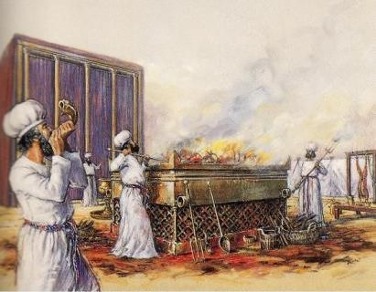

Slide 68
TEXT: Chapter 22 (1) At that time Joshua summoned the Reubenites and the Gadites and the half-tribe of Manasseh, (2) and said to them, "You have kept all that Moses the servant of the Lord commanded you and have obeyed my voice in all that I have commanded you. (3) You have not forsaken your brothers these many days, down to this day, but have been careful to keep the charge of the Lord your God. (4) And now the Lord your God has given rest to your brothers, as he promised them. Therefore turn and go to your tents in the land where your possession lies, which Moses the servant of the Lord gave you on the other side of the Jordan. (5) Only be very careful to observe the commandment and the law that Moses the servant of the Lord commanded you, to love the Lord your God, and to walk in all his ways and to keep his commandments and to cling to him and to serve him with all your heart and with all your soul." (6) So Joshua blessed them and sent them away, and they went to their tents. (7) Now to the one half of the tribe of Manasseh Moses had given a possession in Bashan, but to the other half Joshua had given a possession beside their brothers in the land west of the Jordan. And when Joshua sent them away to their homes and blessed them, (8) he said to them, "Go back to your tents with much wealth and with very much livestock, with silver, gold, bronze, and iron, and with much clothing. Divide the spoil of your enemies with your brothers." (9) So the people of Reuben and the people of Gad and the half-tribe of Manasseh returned home, parting from the people of Israel at Shiloh, which is in the land of Canaan, to go to the land of Gilead, their own land of which they had possessed themselves by command of the Lord through Moses. (10) And when they came to the region of the Jordan that is in the land of Canaan, the people of Reuben and the people of Gad and the half-tribe of Manasseh built there an altar by the Jordan, an altar of imposing size.

Slide 69
(11) And the people of Israel heard it said, "Behold, the people of Reuben and the people of Gad and the half-tribe of Manasseh have built the altar at the frontier of the land of Canaan, in the region about the Jordan, on the side that belongs to the people of Israel." (12) And when the people of Israel heard of it, the whole assembly of the people of Israel gathered at Shiloh to make war against them. (13) Then the people of Israel sent to the people of Reuben and the people of Gad and the half-tribe of Manasseh, in the land of Gilead, Phinehas the son of Eleazar the priest, (14) and with him ten chiefs, one from each of the tribal families of Israel, every one of them the head of a family among the clans of Israel. (15) And they came to the people of Reuben, the people of Gad, and the half-tribe of Manasseh, in the land of Gilead, and they said to them, (16) "Thus says the whole congregation of the Lord, 'What is this breach of faith that you have committed against the God of Israel in turning away this day from following the Lord by building yourselves an altar this day in rebellion against the Lord? (17) Have we not had enough of the sin at Peor from which even yet we have not cleansed ourselves, and for which there came a plague upon the congregation of the Lord, (18) that you too must turn away this day from following the Lord? And if you too rebel against the Lord today then tomorrow he will be angry with the whole congregation of Israel. (19) But now, if the land of your possession is unclean, pass over into the Lord's land where the Lord's tabernacle stands, and take for yourselves a possession among us. Only do not rebel against the Lord or make us as rebels by building for yourselves an altar other than the altar of the Lord our God. (20) Did not Achan the son of Zerah break faith in the matter of the devoted things, and wrath fell upon all the congregation of Israel? And he did not perish alone for his iniquity.'" .

Slide 70
(21) Then the people of Reuben, the people of Gad, and the half-tribe of Manasseh said in answer to the heads of the families of Israel, (22) "The Mighty One, God, the Lord! The Mighty One, God, the Lord! He knows; and let Israel itself know! If it was in rebellion or in breach of faith against the Lord, do not spare us today (23) for building an altar to turn away from following the Lord. Or if we did so to offer burnt offerings or grain offerings or peace offerings on it, may the Lord himself take vengeance. (24) No, but we did it from fear that in time to come your children might say to our children, 'What have you to do with the Lord, the God of Israel? (25) For the Lord has made the Jordan a boundary between us and you, you people of Reuben and people of Gad. You have no portion in the Lord.' So your children might make our children cease to worship the Lord. (26) Therefore we said, 'Let us now build an altar, not for burnt offering, nor for sacrifice, (27) but to be a witness between us and you, and between our generations after us, that we do perform the service of the Lord in his presence with our burnt offerings and sacrifices and peace offerings, so your children will not say to our children in time to come, "You have no portion in the Lord."' (28) And we thought, If this should be said to us or to our descendants in time to come, we should say, 'Behold, the copy of the altar of the Lord, which our fathers made, not for burnt offerings, nor for sacrifice, but to be a witness between us and you.' (29) Far be it from us that we should rebel against the Lord and turn away this day from following the Lord by building an altar for burnt offering, grain offering, or sacrifice, other than the altar of the Lord our God that stands before his tabernacle!"

Slide 71
(41) The cities of the Levites in the midst of the possession of the people of Israel were in all forty-eight cities with their pasturelands. (42) These cities each had its pasturelands around it. So it was with all these cities. (43) Thus the Lord gave to Israel all the land that he swore to give to their fathers. And they took possession of it, and they settled there. (44) And the Lord gave them rest on every side just as he had sworn to their fathers. Not one of all their enemies had withstood them, for the Lord had given all their enemies into their hands. (45) Not one word of all the good promises that the Lord had made to the house of Israel had failed; all came to pass.

Slide 72
(30) When Phinehas the priest and the chiefs of the congregation, the heads of the families of Israel who were with him, heard the words that the people of Reuben and the people of Gad and the people of Manasseh spoke, it was good in their eyes. (31) And Phinehas the son of Eleazar the priest said to the people of Reuben and the people of Gad and the people of Manasseh, "Today we know that the Lord is in our midst, because you have not committed this breach of faith against the Lord. Now you have delivered the people of Israel from the hand of the Lord." (32) Then Phinehas the son of Eleazar the priest, and the chiefs, returned from the people of Reuben and the people of Gad in the land of Gilead to the land of Canaan, to the people of Israel, and brought back word to them. (33) And the report was good in the eyes of the people of Israel. And the people of Israel blessed God and spoke no more of making war against them to destroy the land where the people of Reuben and the people of Gad were settled. (34) The people of Reuben and the people of Gad called the altar Witness, "For," they said, "it is a witness between us that the Lord is God."

Slide 73
STUDY NOTES: 1. Moses had ordered the three tribes east of the Jordan to assist the other tribes in the conquest of Canaan (Nu 32:16-27; Dt. 3:12-20). They all needed to have a fair sharing of the land (Nu 31:25-27). 2. To love the Lord your God, and to walk in all his ways and to keep his commandments and to cling to him and to serve him with all your heart and with all your soul – this was the role of Israel and is the role of the new Israel- the Church. (Dt 5:29; 6:5; Is 43:22; Mal 3:14; 1Jn 4:19) 3. When Israel heard that the three tribes had built their own large altar, they assumed this was apostasy and and rebellion against the true altar of the Lord, which was with the tabernacle and ark of the covenant at Shiloh. (Lev 1:3-3:17; 6:14-23; 7:11-18; Dt. 12:5-14) If this was so, it had to be punished and removed from among them (Dt 13:12-18; Jdg ch. 20). This reminded them of Peor where Israel was involved in Moabite worship of Baal (Nu 25:1-5). Such defilement could not be allowed in Israel. 4. The tribe of Levi is represented by Phineas (the son of Eleazar the priest, who was the son of Aaron, and was the high priest at the time of Joshua). After his father dies, he would become the priest and he is known for his faithful and righteous acts (Ex 6:23; Nu 25:10-13; Ps 106:28-31)

Slide 74
5. The Mighty One, God the Lord was the only true God (Dt 10:17; Ps 11:4; 40:9; 44:21; 50:1; 139:4; Jer 17:10) 6. In reality, the three tribes had set up an altar as a 6th memorial monument, and NOT as a place for the tabernacle sacrifices. Since they lived far away on the other side of the Jordan River, this altar of uncut stone(Gen 31:43-52; Ex 20:25) was a testimony that they would remain loyal to the true Lord at the tabernacle, and affirmed their right to continue to worship the Lord, when they did come up to Shiloh and the tabernacle. 7. When this reasonable meeting with godly counsel and a peaceful resolution took place, a terrible and incorrect punishment was averted. This would have been based upon a misunderstanding and would have devastated the 12 tribes’ unity around the Lord God. We recall the way Jesus and the apostles calls us to handle all perceived or actual sin: (Mt. 18:15-20; Lk 17:3; 1 Tim 5:20; 1 Tim 4:10; Titus 1:9; 2:15; James 5:16) 8. When Joshua blessed them, this reminds us of the liturgical blessings pronounced upon us: (Nu 6:22-27; Acts 20:35; 2 Cor 13:14) 9. Now the true tabernacle and temple and presence of God is in the body of Jesus. (Jn 2:18-22; 1 Cor 11:23-34).

Slide 75
C. LIFE APPLICATION: 1. How do we love the Lord our God, and walk in all his ways and keep his commandments and cling to him and serve him with all our heart and with all our soul? 2. In what ways do we affirm the omniscience of the Lord every day, since: the Mighty One, God, the Lord! The Mighty One, God, the Lord! He knows everything… 3. Explain how we today handle allegations of false teaching or wrong practice in the midst of our congregations? 4. Why is the goal of the church always to bring a peaceful resolution to any issue, if it is possible?

