Slide 1
THE BOOK OF JOSHUA
“Be Strong and Courageous!”
-Joshua in the Old Testament
-Jesus in the New Testament
Date: 6-28-15 Lesson: 18

Slide 2
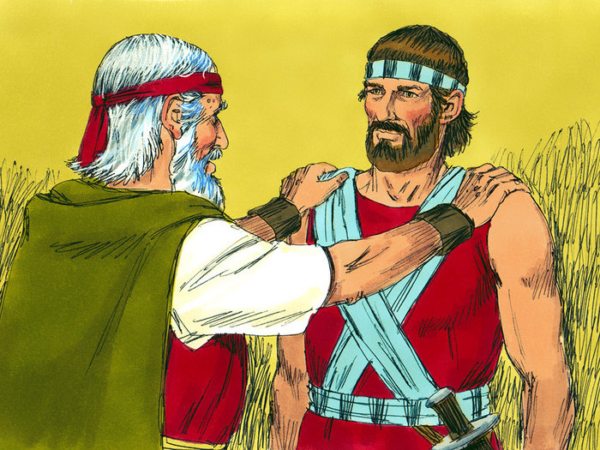

Slide 3
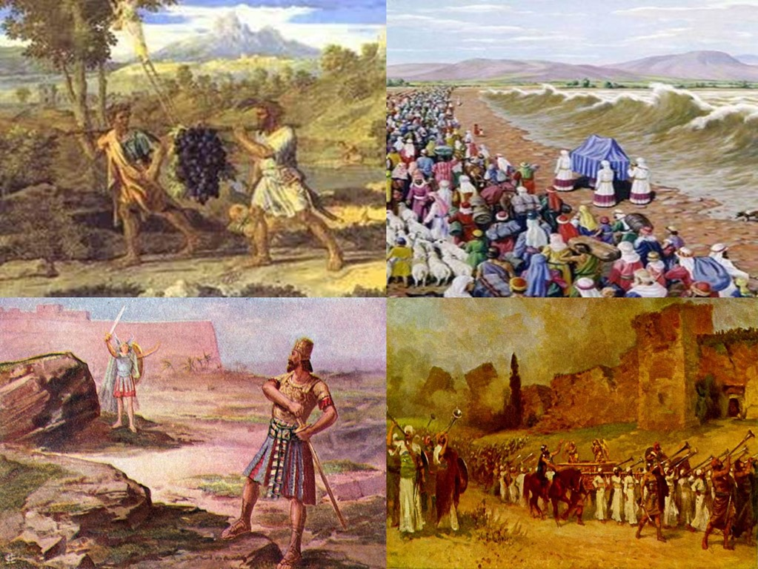

Slide 4
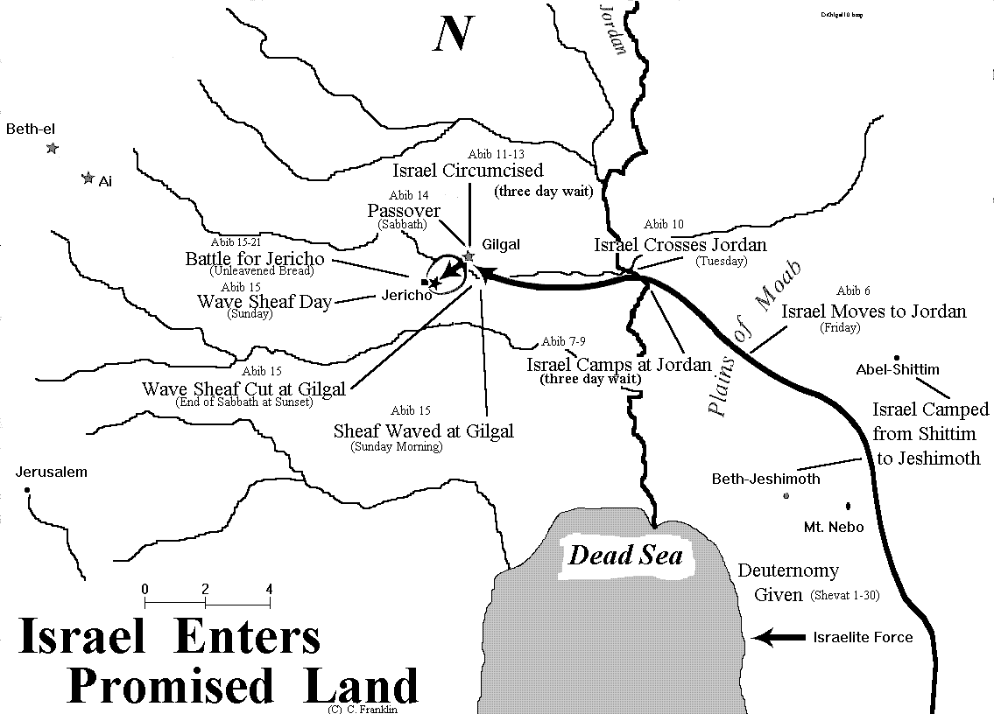

Slide 6
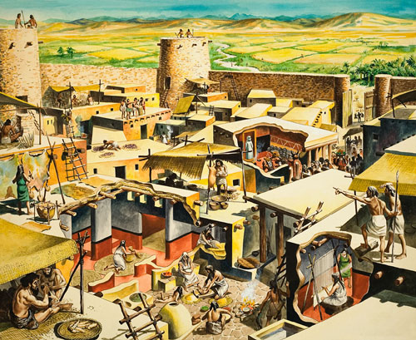

Slide 8
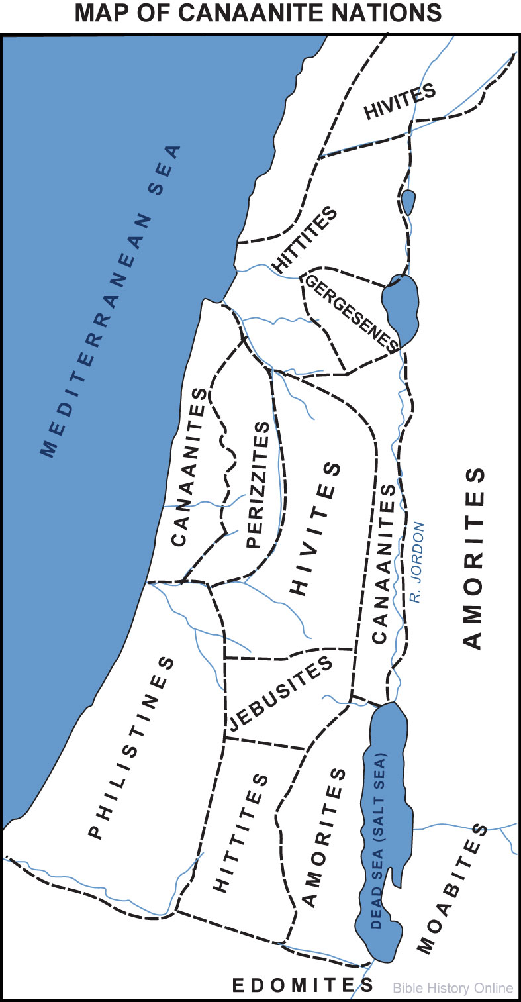

Slide 9
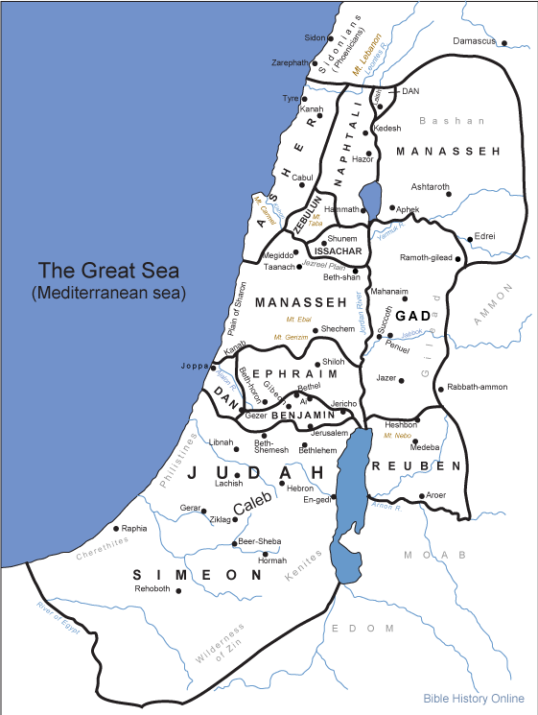

Slide 10
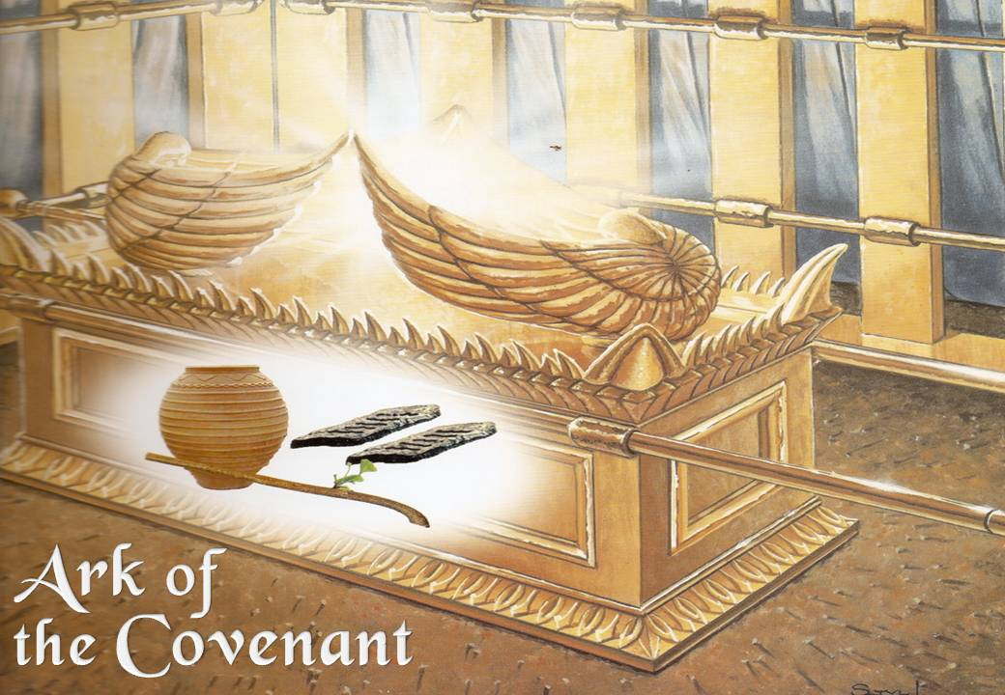

Slide 11
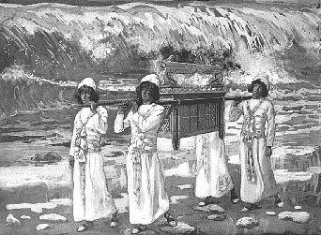

Slide 12
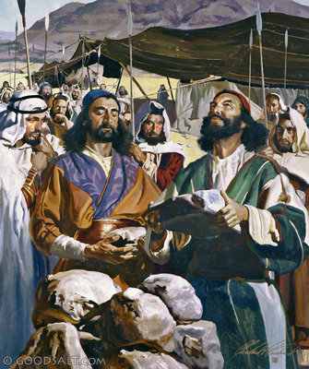

Slide 13
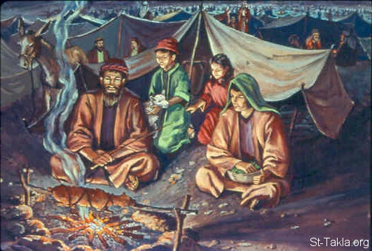

Slide 14
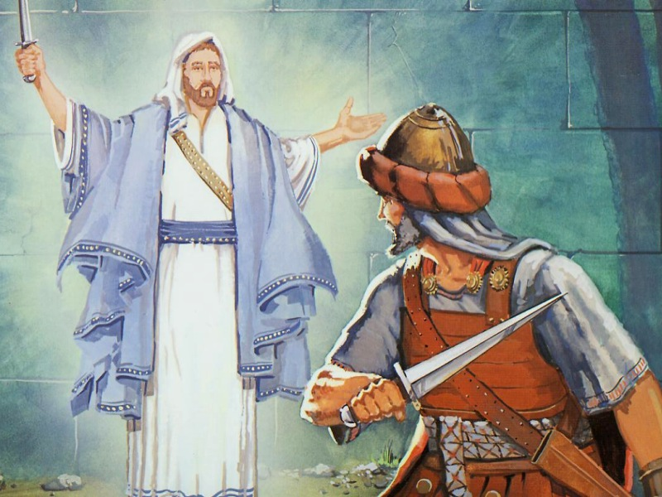

Slide 15
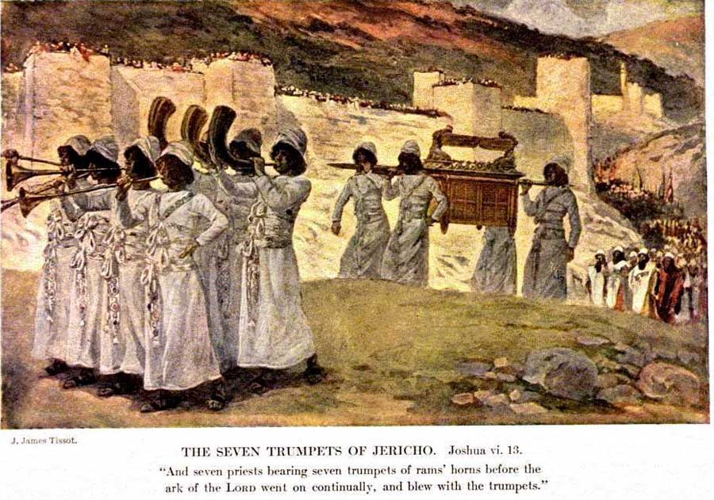

Slide 19
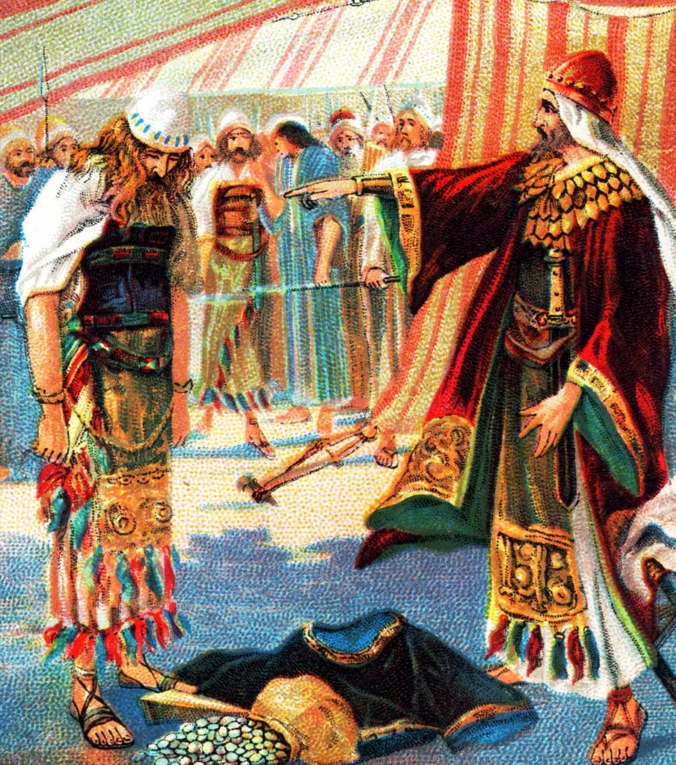

Slide 21
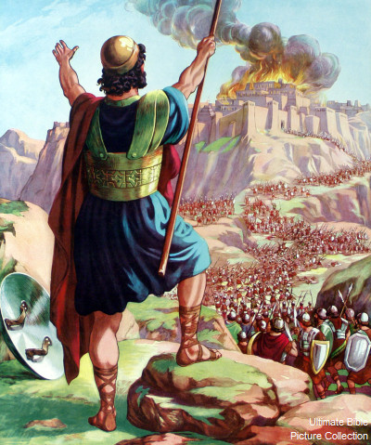

Slide 22
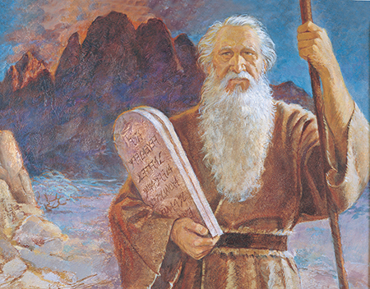

Slide 23
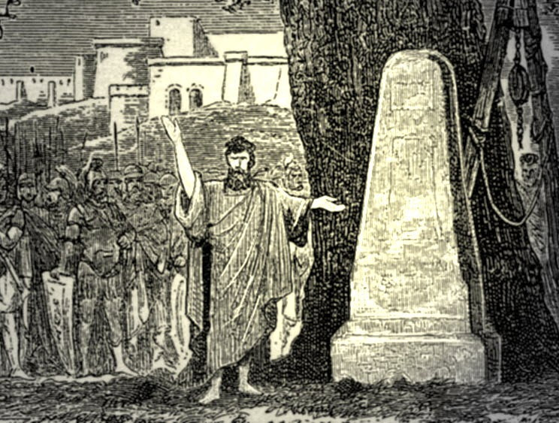

Slide 24
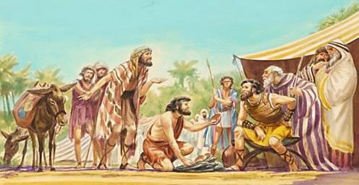

Slide 25
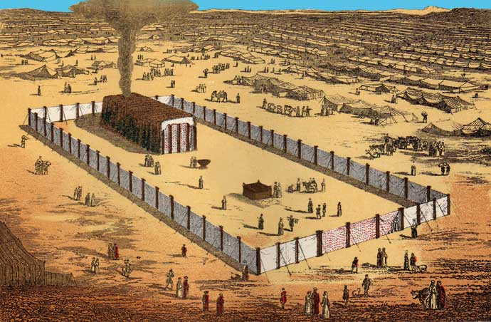

Slide 26
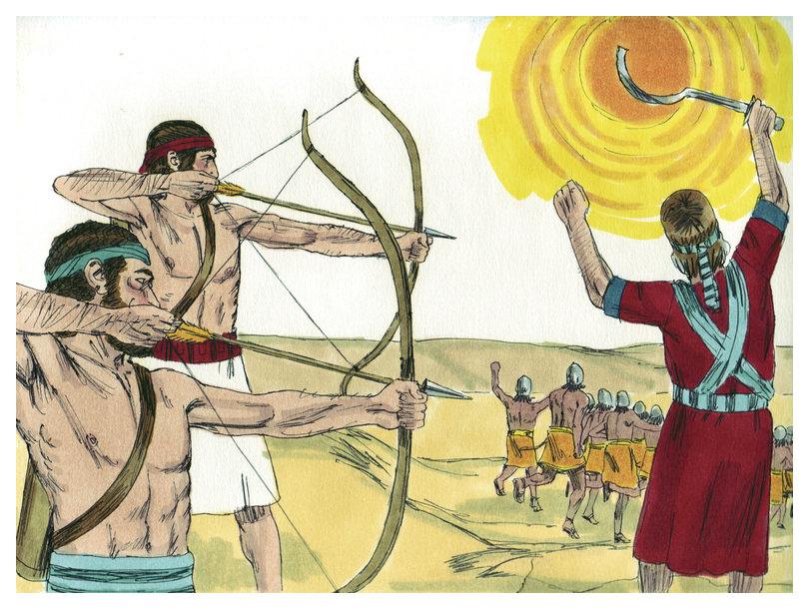

Slide 27
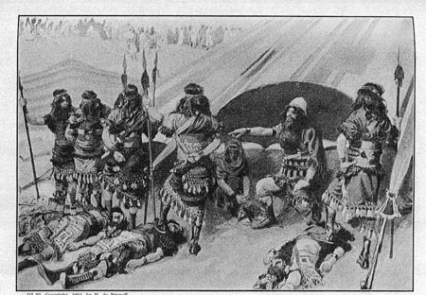

Slide 28
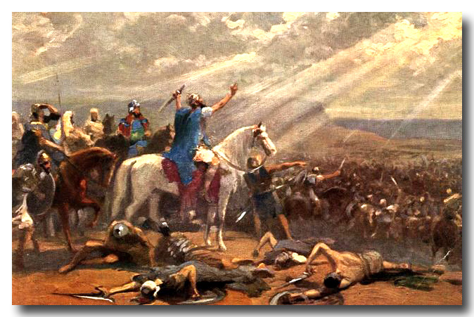

Slide 29
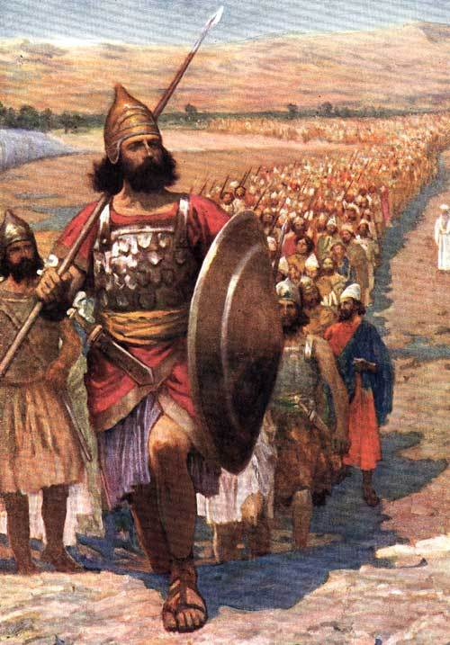

Slide 30
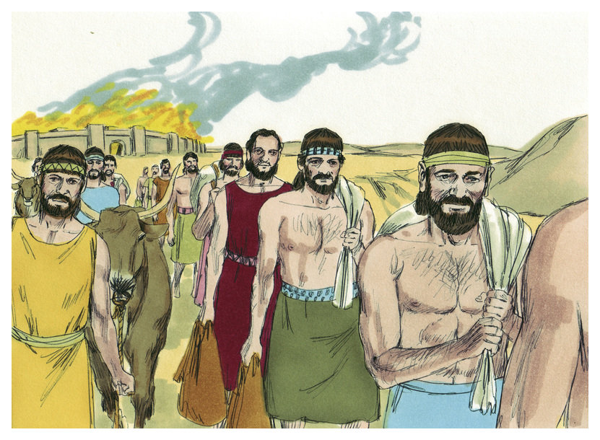

Slide 32
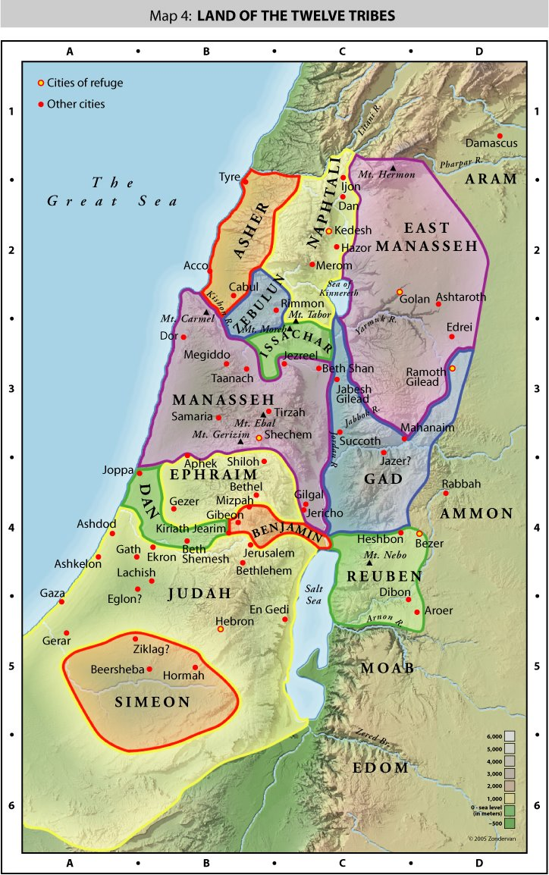

Slide 33
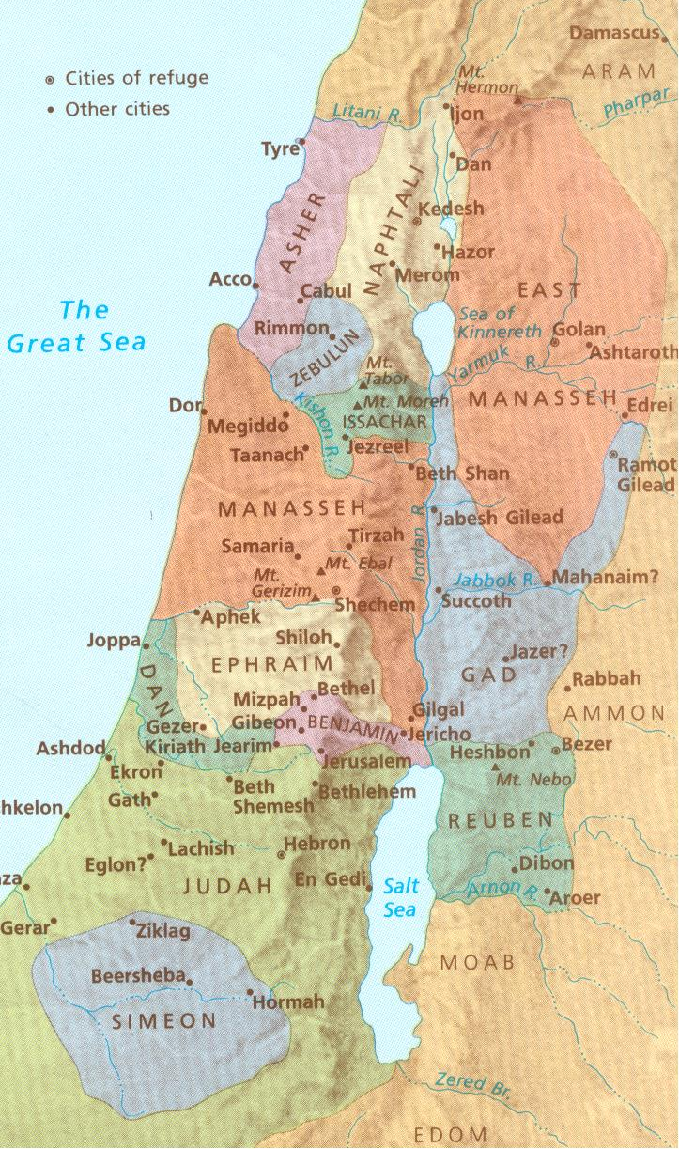

Slide 34
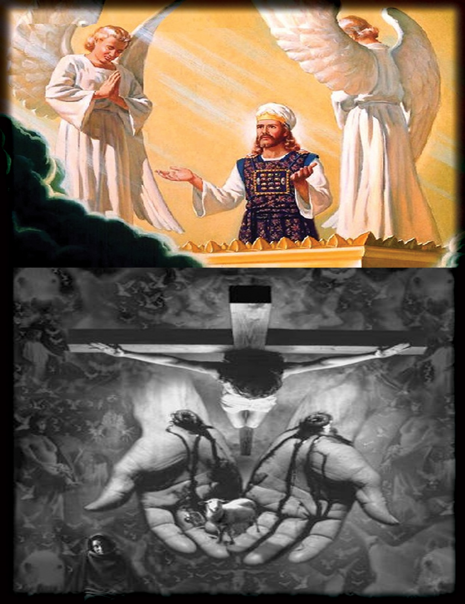

Slide 35
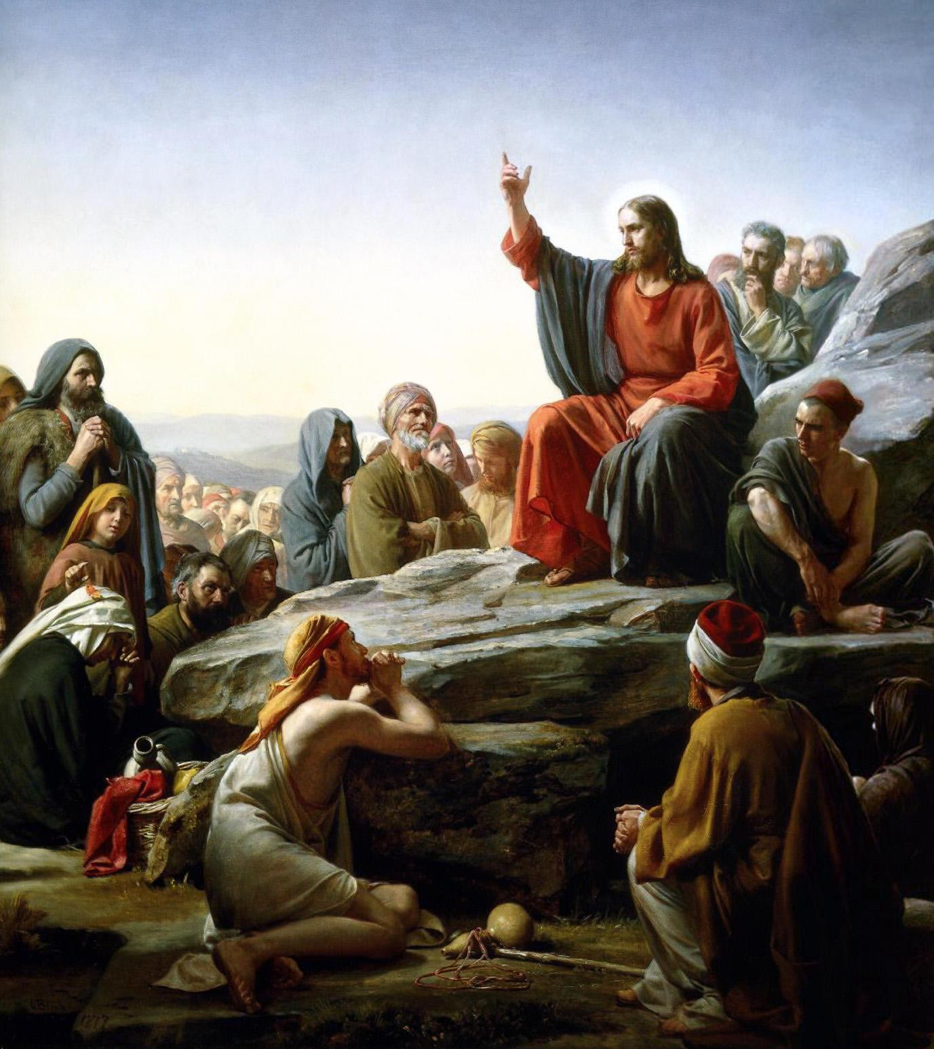

Slide 36
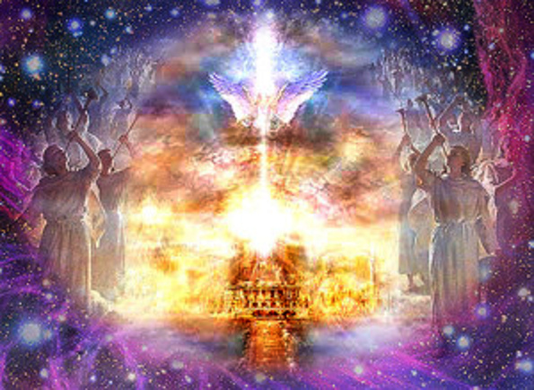

Slide 37
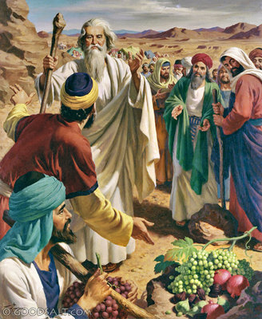

Slide 38
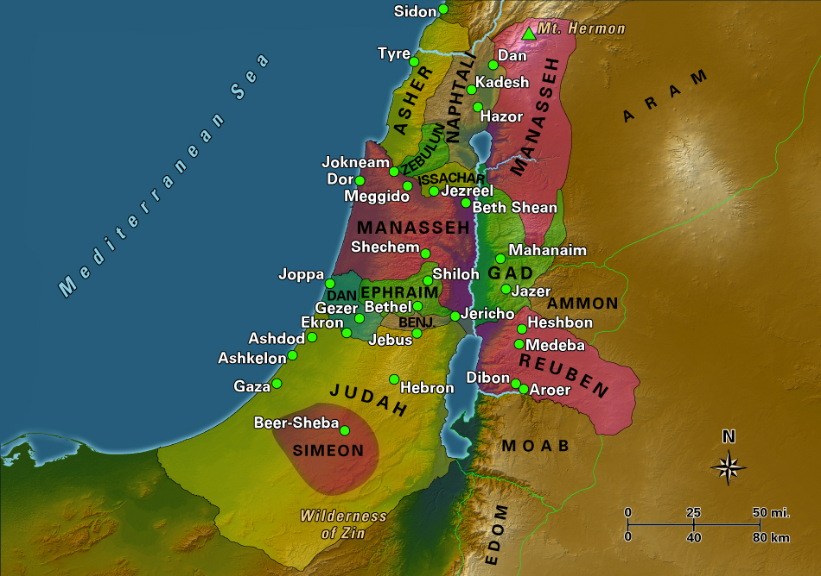

Slide 40
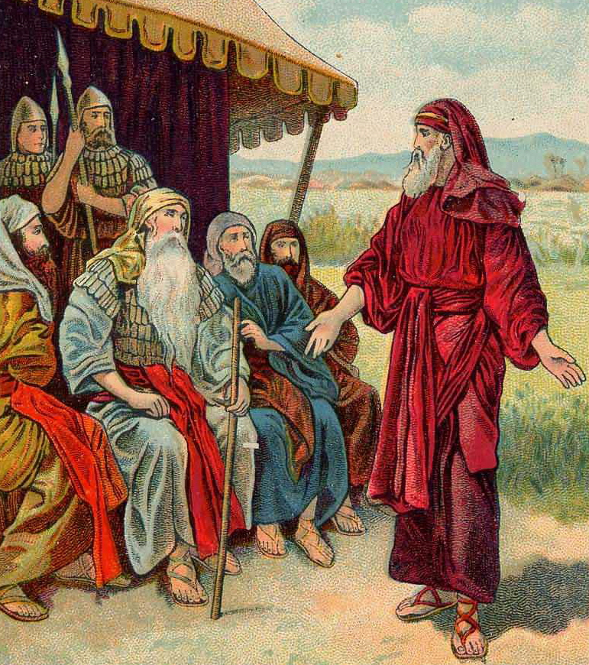

Slide 41
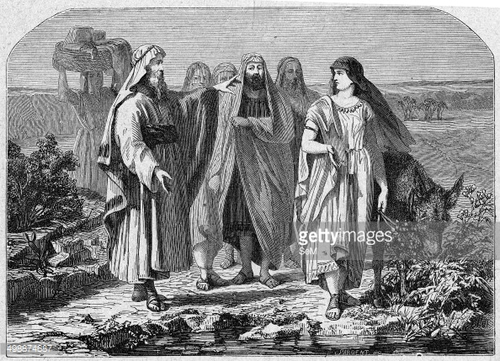

Slide 42
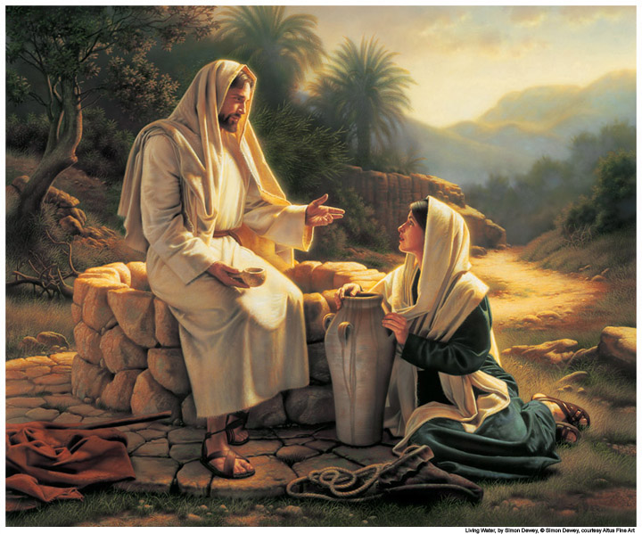

Slide 43
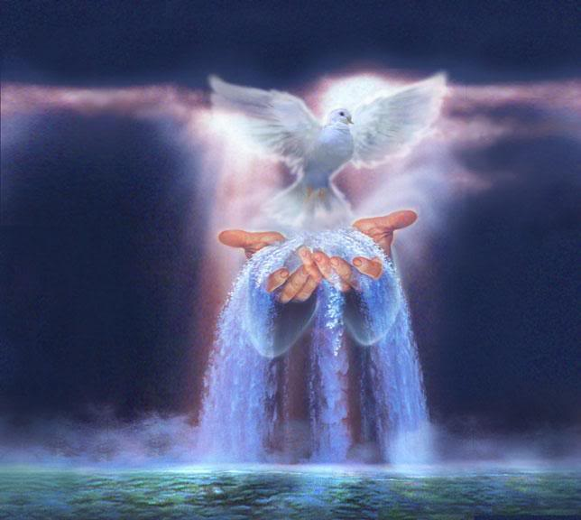

Slide 44
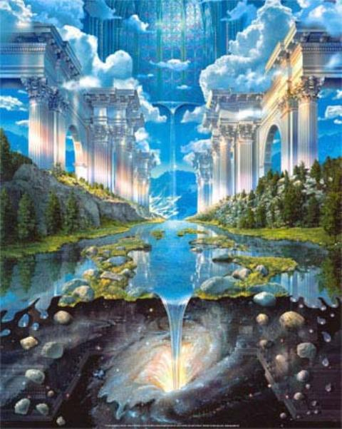

Slide 45
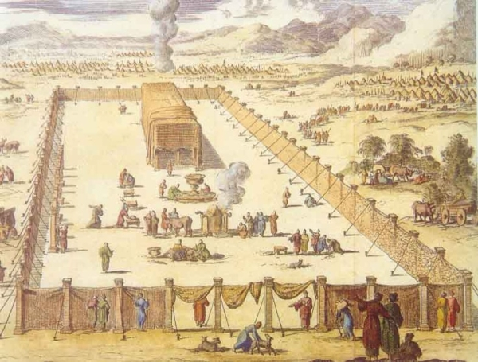

Slide 46
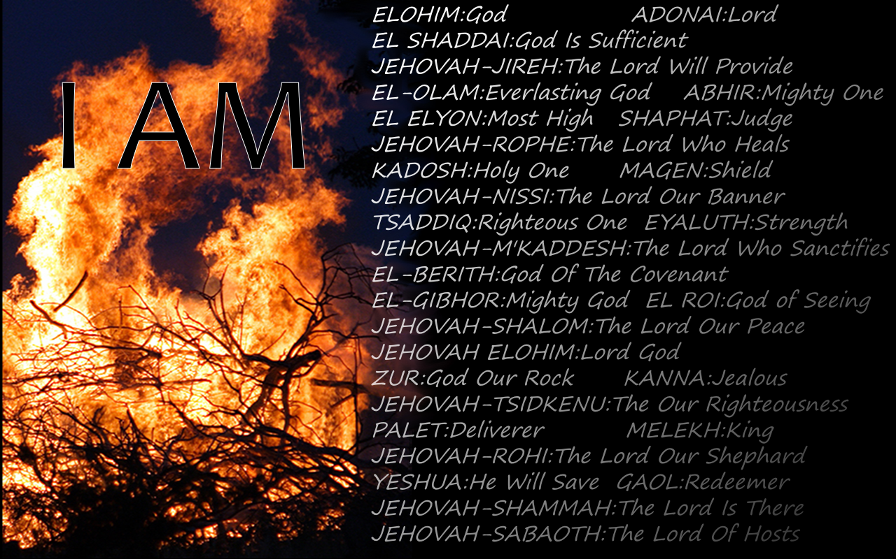

Slide 47
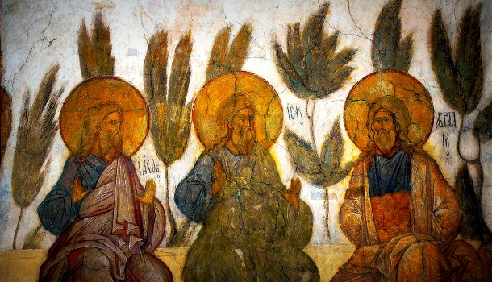

Slide 48
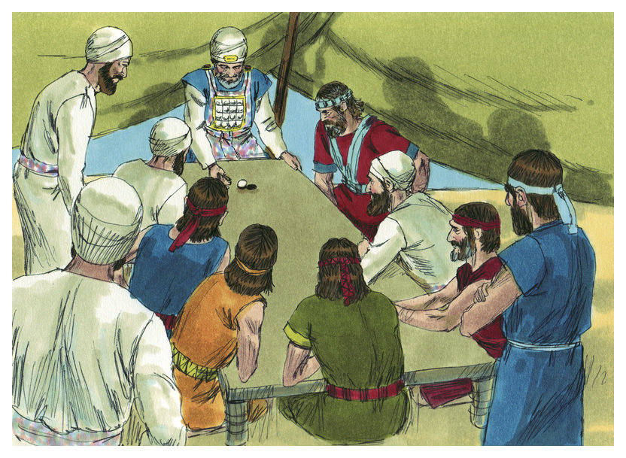

Slide 49
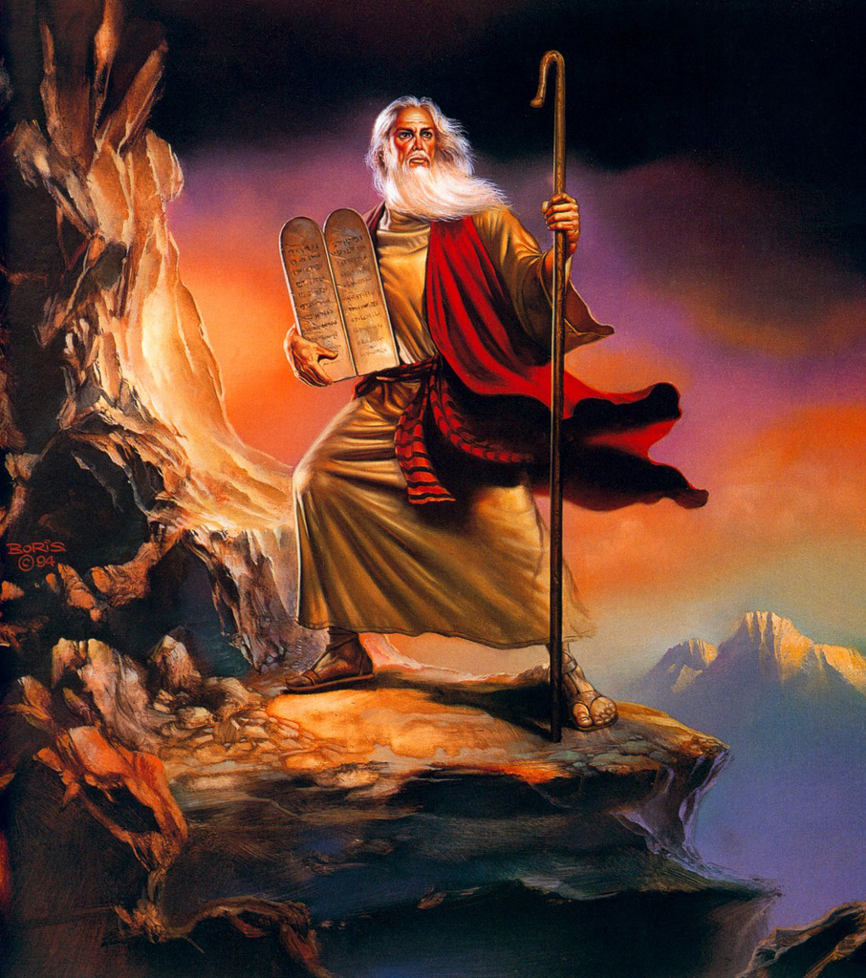

Slide 50
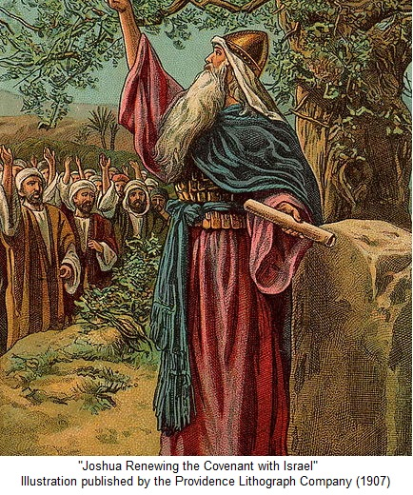

Slide 51
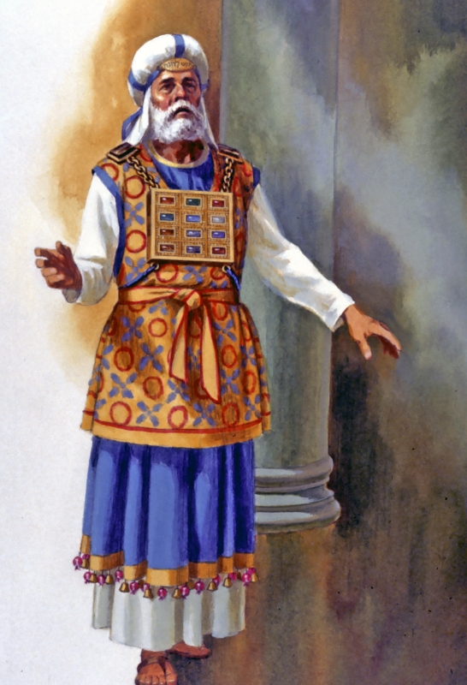

Slide 52
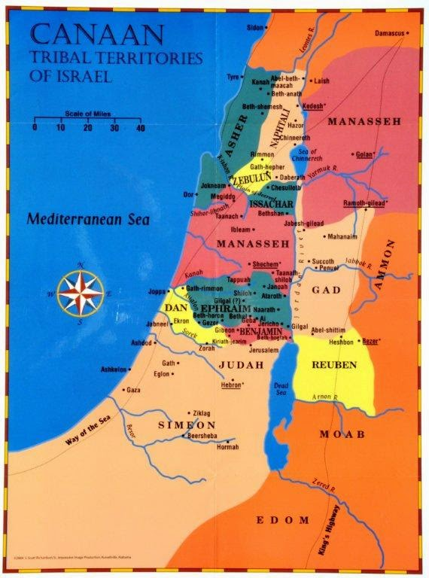

Slide 53
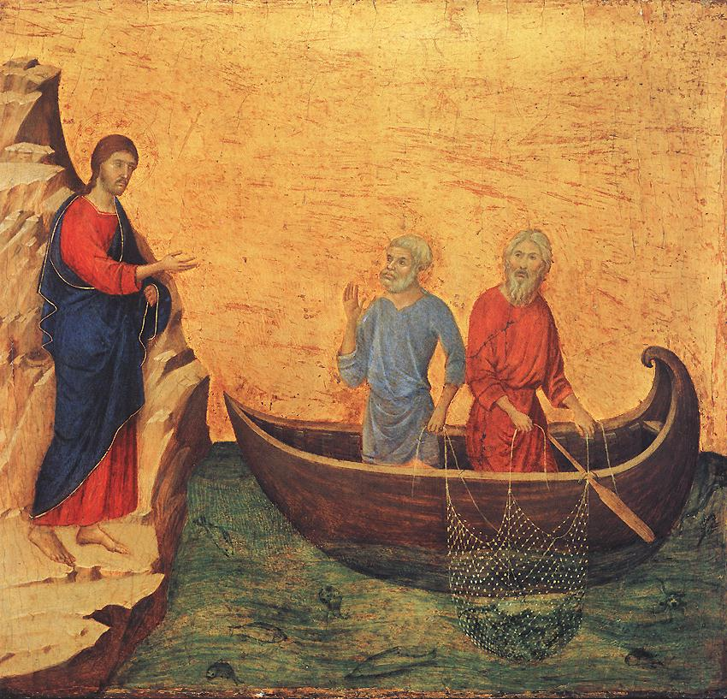

Slide 54
TEXT: Chapter 20 (1) Then the Lord said to Joshua, (2) "Say to the people of Israel, 'Appoint the cities of refuge, of which I spoke to you through Moses, (3) that the manslayer who strikes any person without intent or unknowingly may flee there. They shall be for you a refuge from the avenger of blood. (4) He shall flee to one of these cities and shall stand at the entrance of the gate of the city and explain his case to the elders of that city. Then they shall take him into the city and give him a place, and he shall remain with them. (5) And if the avenger of blood pursues him, they shall not give up the manslayer into his hand, because he struck his neighbor unknowingly, and did not hate him in the past. (6) And he shall remain in that city until he has stood before the congregation for judgment, until the death of him who is high priest at the time. Then the manslayer may return to his own town and his own home, to the town from which he fled.'"

Slide 55
(7) So they set apart Kedesh in Galilee in the hill country of Naphtali, and Shechem in the hill country of Ephraim, and Kiriath-arba (that is, Hebron) in the hill country of Judah. (8) And beyond the Jordan east of Jericho, they appointed Bezer in the wilderness on the tableland, from the tribe of Reuben, and Ramoth in Gilead, from the tribe of Gad, and Golan in Bashan, from the tribe of Manasseh. (9) These were the cities designated for all the people of Israel and for the stranger sojourning among them, that anyone who killed a person without intent could flee there, so that he might not die by the hand of the avenger of blood, till he stood before the congregation. .

Slide 56
B. STUDY NOTES: 1. In the theocratic state of Israel, when someone was guilty of manslaughter or an accidental killing, it could easily have turned into endless blood feuds between tribes. In order to avoid this, a regional system of governmental courts was set up in Levitical cities, where the law of Moses was honored. This was a safeguard against local retribution by family members which could have turned into a miscarriage of justice. 2. Moses had told them about the Lord’s plan to set up cities of refuge in these cases (Nu 35:6-34) 3. The avenger of blood was a near relative whose job was to extract retribution and revenge when a family member had been injured. They were avengers – kinsman- redeemers (Gen 4:10; 9:6; Dt 32:35; Lev 24:17; Nu 35:16-28; Ruth 3:9; Ps 19:14)

Slide 57
4. The city gate was the place for trials where the city elders sat to hold court (Ruth 2:12; 4:1; Job 29:7) 5. A congregation was the assembly of the men in the city who were witnesses to the trial. 6. After the death of the high priest there came a form of atonement or amnesty (Nu 35:25-28). The death of the high priest, the intercessor of Israel, anticipated the death of the great High Priest Jesus Christ, whose blood makes full atonement for the sins of mankind. (Rom 3:25; Heb 2:17; 1 Jn 2:2; 4:10) 7. These regional cities were all from the tribe of Levi, the priests, and they were spread from the north to the midlands to the south so anyone could flee to them. God is the true owner of these cities and thus his justice would prevail (Lev 25:23)

Slide 58
8. Even aliens among them had these rights – equal protection for foreigners (Ex 22:21; 23:9; Lev 19:33,34; Dt 10:17-19). This was also a type of the coming reality that in the new Israel, the Church, there were equal rights for both Jews and Gentiles (1 Cor 1:20-24; Gal 3:8-15; Eph 3:1-6; Col 1:24-28) 9. Note the advanced character of Jewish law, the rights of all are protected for both justice and mercy. People are allowed to have their case heard in an objective and fair court setting. Even Gentiles were accorded this benefit. This is a precursor of the whole Judeo-Christian legal system which we enjoy in the U.S.A. 10. Therefore the whole concept of cities of refuge are a type of all places of refuge we have todayin God, in Jesus, in his Word, in our baptism, absolution and holy communion, in the holy Christian church, in prayers and supplications, in the “rock of ages cleft for, let me hide myself in Thee.” See: (2 Sam 22:1-3,31-33; Ps 2:12; 5:11; 7:1; 18:2; 31:1-4; 46:1; 62:7,8; 91:1-4; 142:4,5; Prov 30:5; Jerem 16:19; Joel 3:16; Nahum 1:7; Hebrews 6:17-20)

Slide 59
C. LIFE APPLICATION: 1. How do we see both justice and mercy in the government – the kingdom of the left? 2. How do we see both justice and mercy in the church – the kingdom of the right? 3. In what ways does our own legal system handle charges of manslaughter? 4. Why do we constantly have to seek refuge in our Lord God through His Son Jesus Christ? 5. When are the times that we become places of refuge for other people?

Slide 60
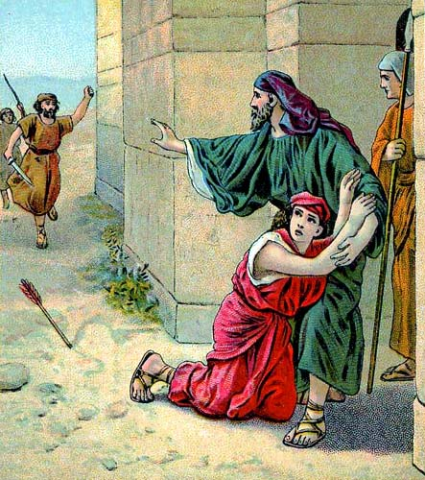

Slide 61
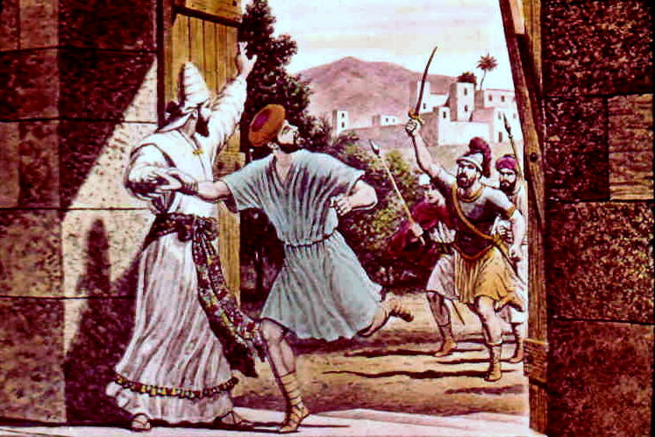

Slide 62
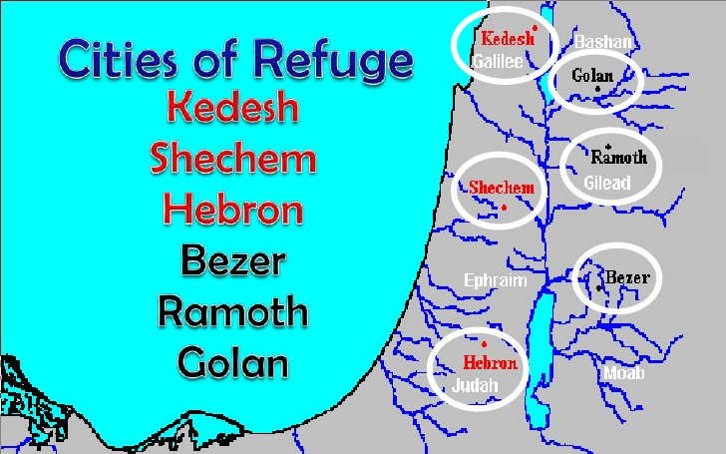

Slide 64
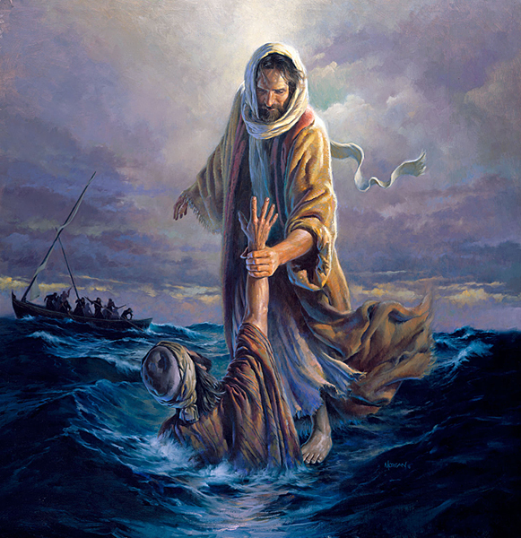

Slide 66
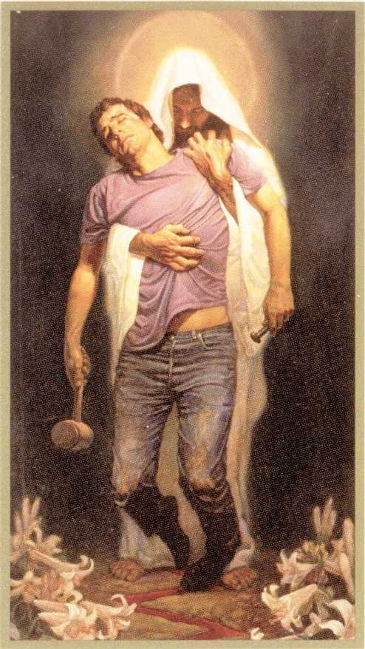

Slide 67
