Slide 1
THE BOOK OF JOSHUA
“Be Strong and Courageous!”
-Joshua in the Old Testament
-Jesus in the New Testament
Date: 6-21-15 Lesson: 17

Slide 2
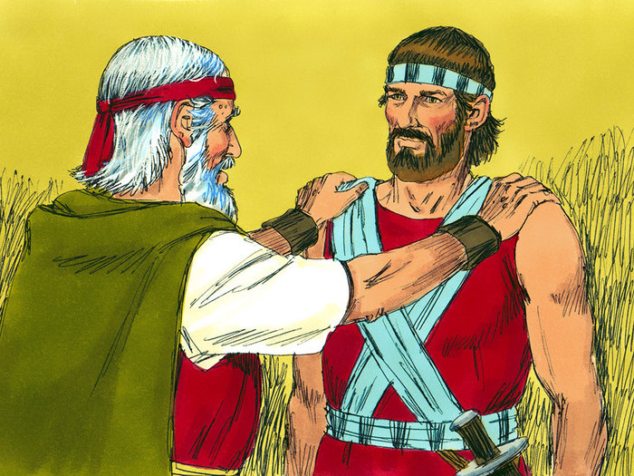

Slide 3
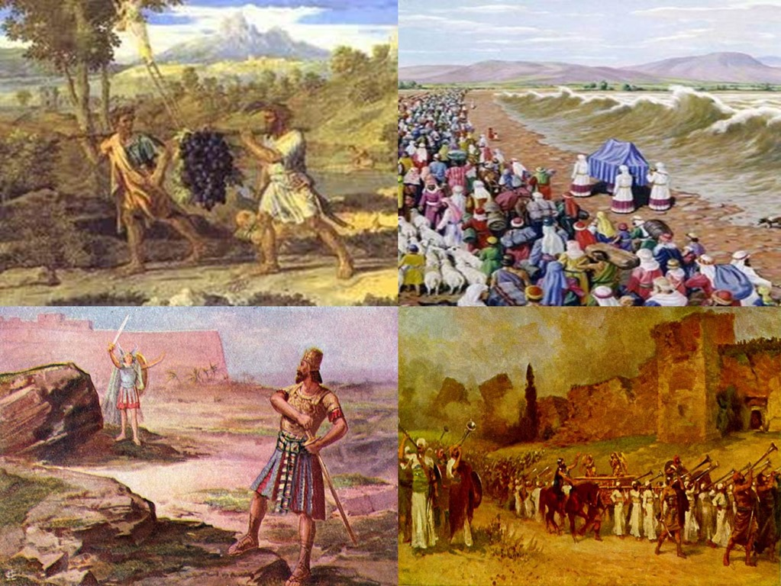

Slide 5
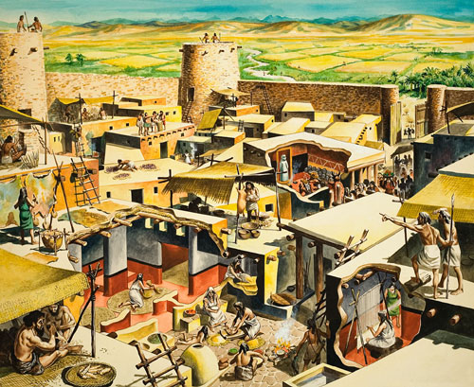

Slide 7
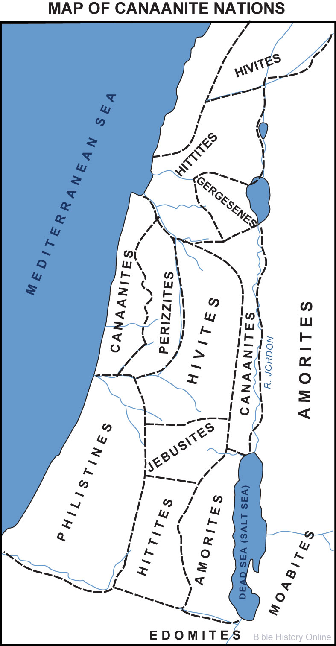

Slide 8
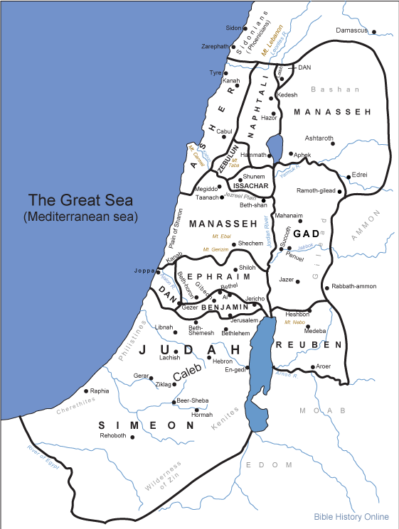

Slide 9
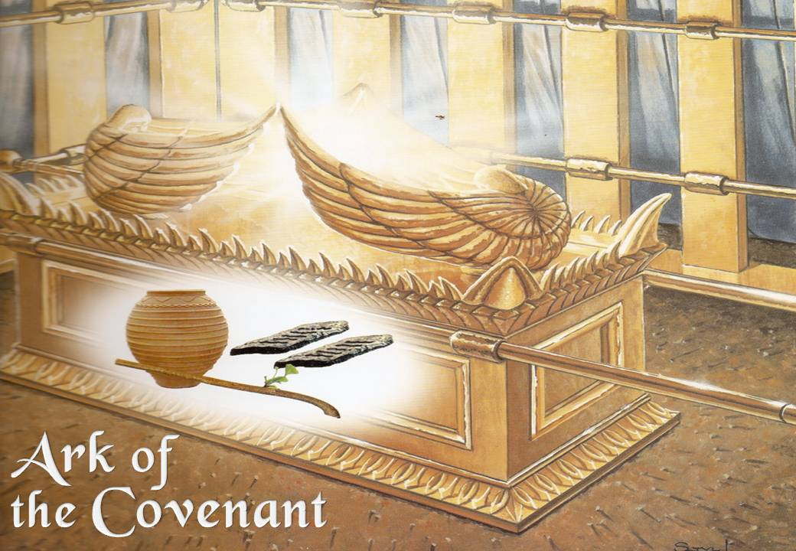

Slide 10
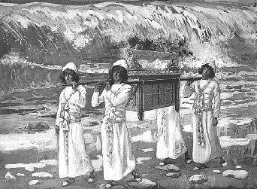

Slide 11
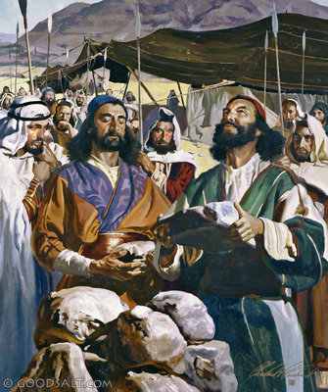

Slide 12
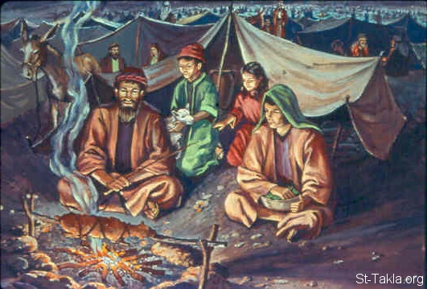

Slide 13
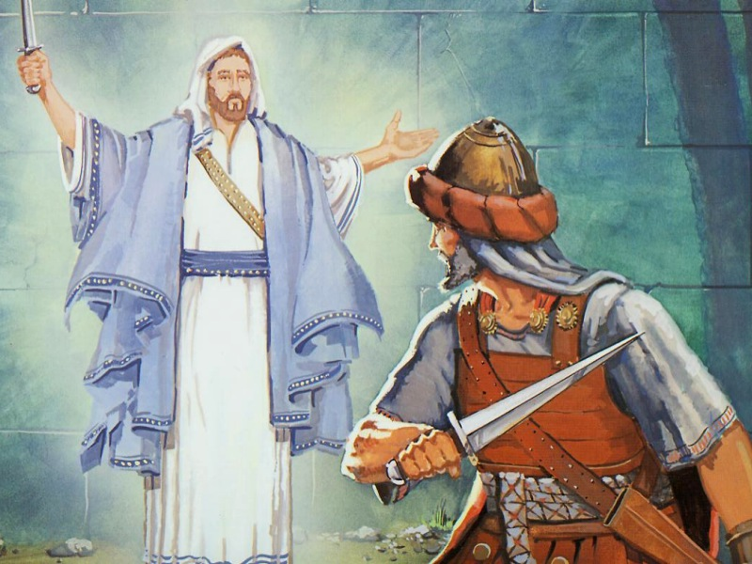

Slide 14
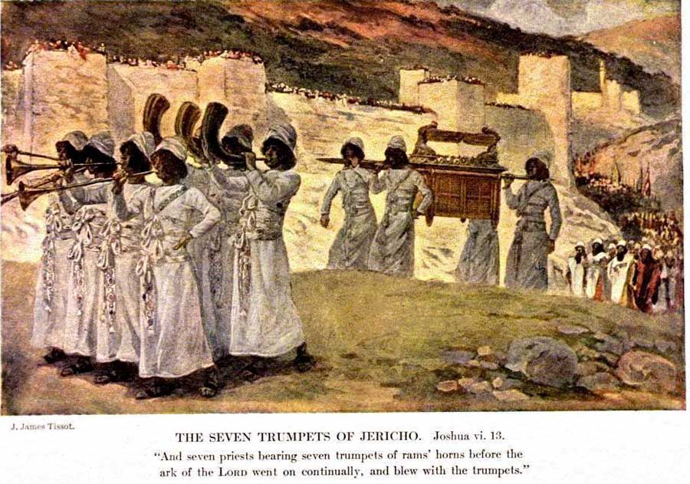

Slide 18
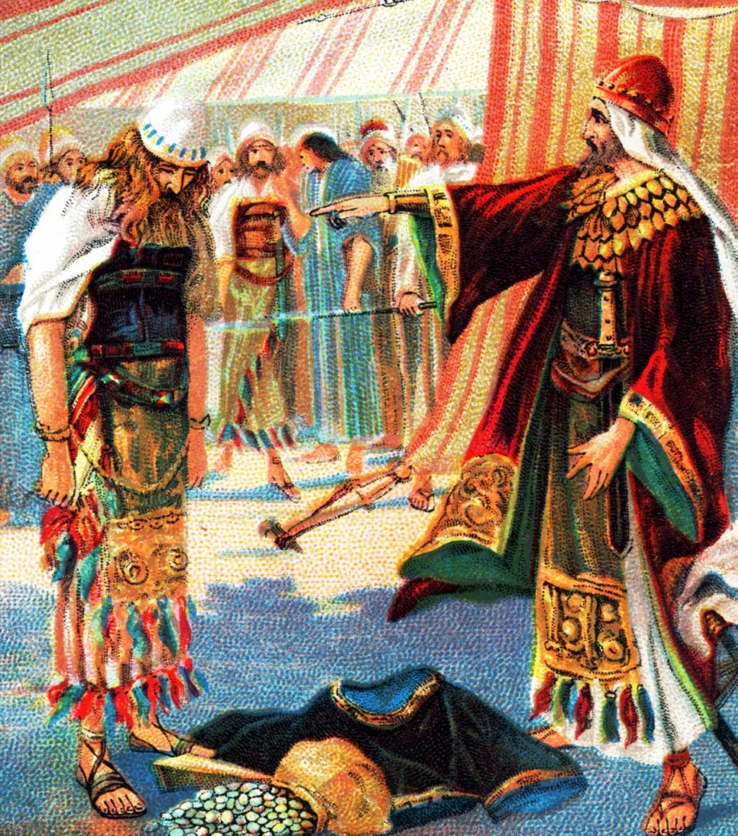

Slide 20
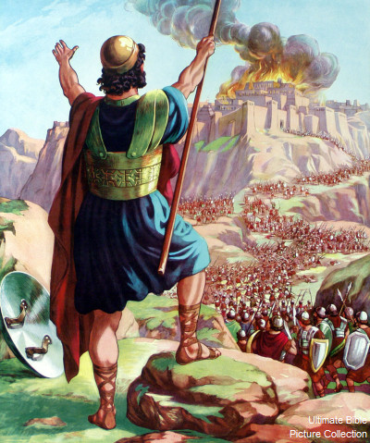

Slide 21
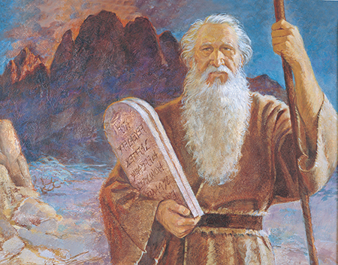

Slide 22
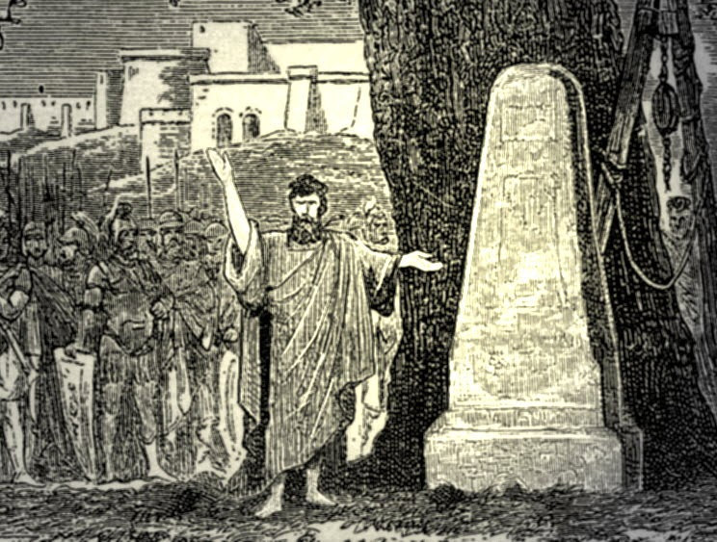

Slide 23
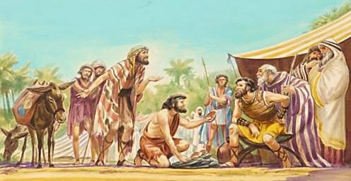

Slide 24
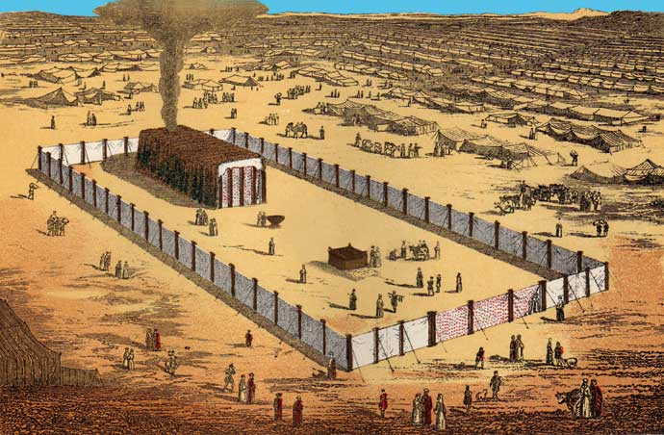

Slide 25
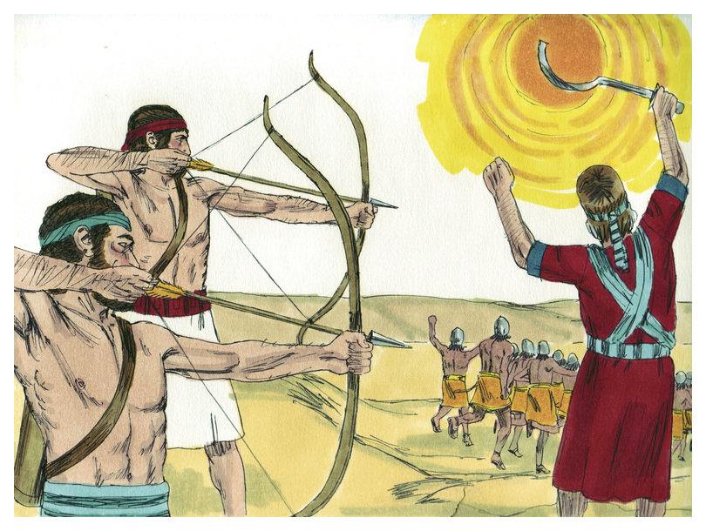

Slide 26
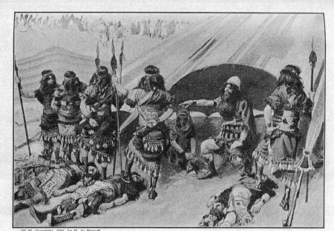

Slide 27
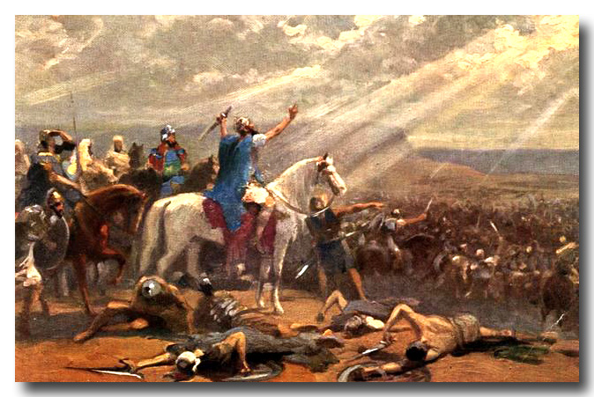

Slide 28
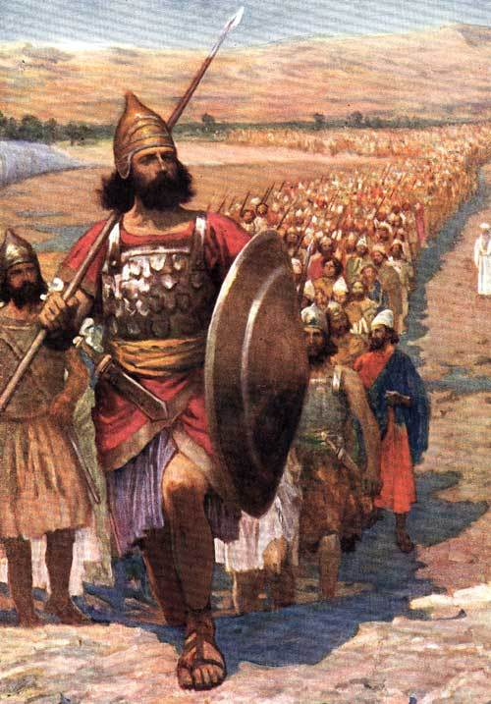

Slide 29
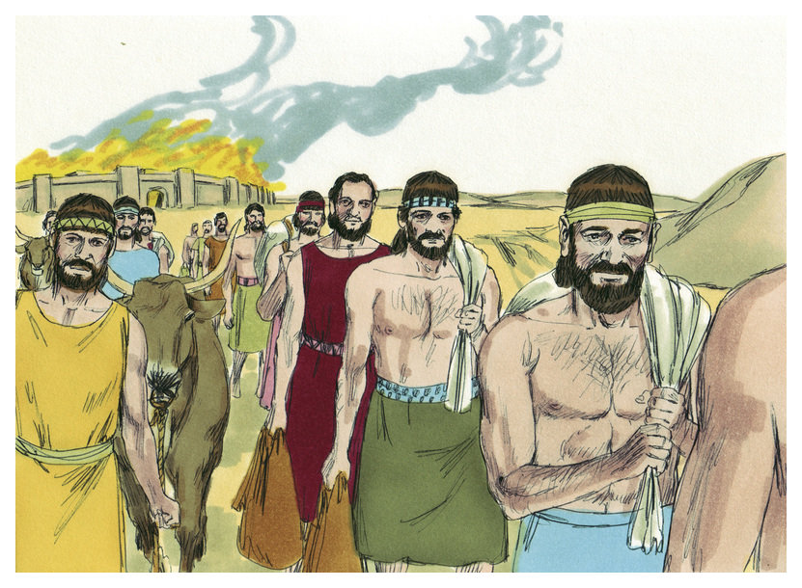

Slide 31
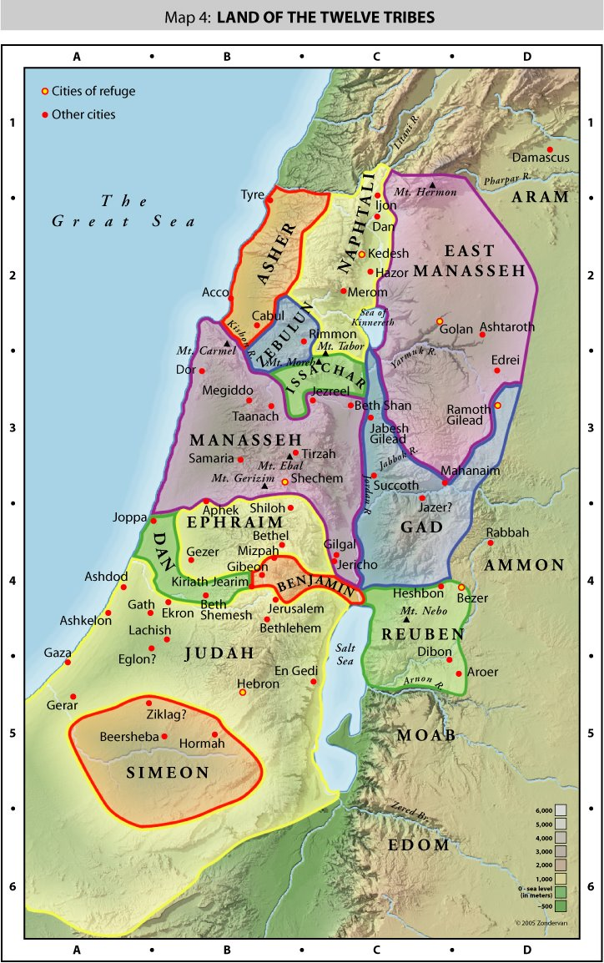

Slide 32
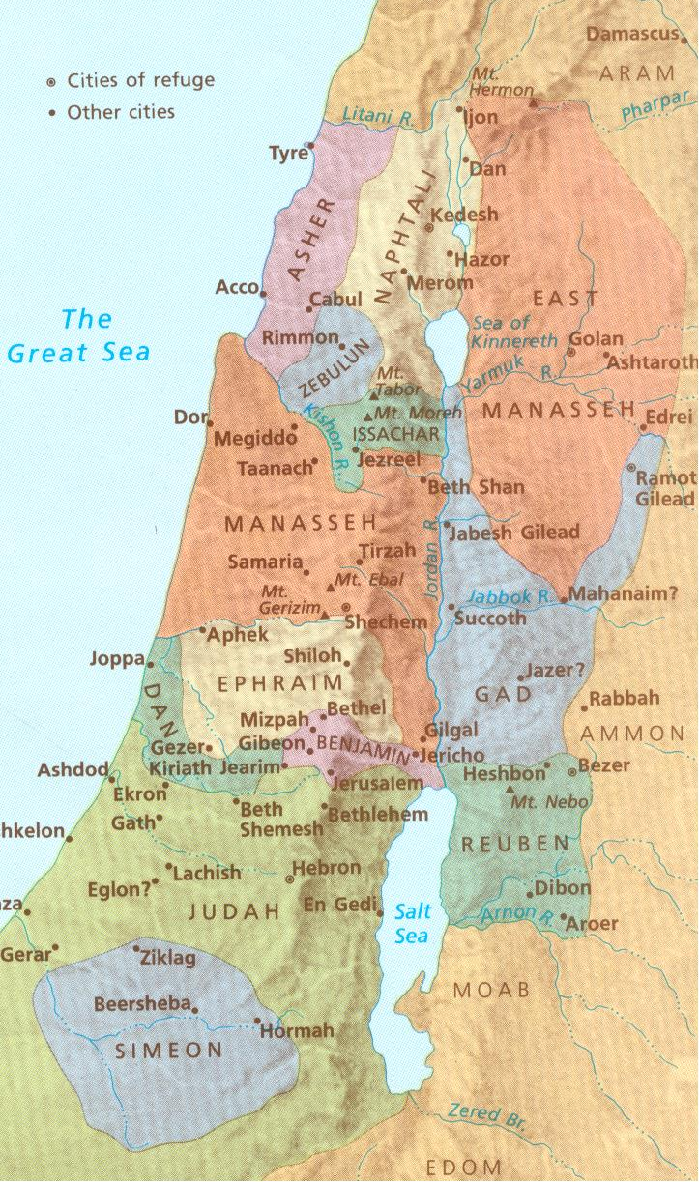

Slide 33
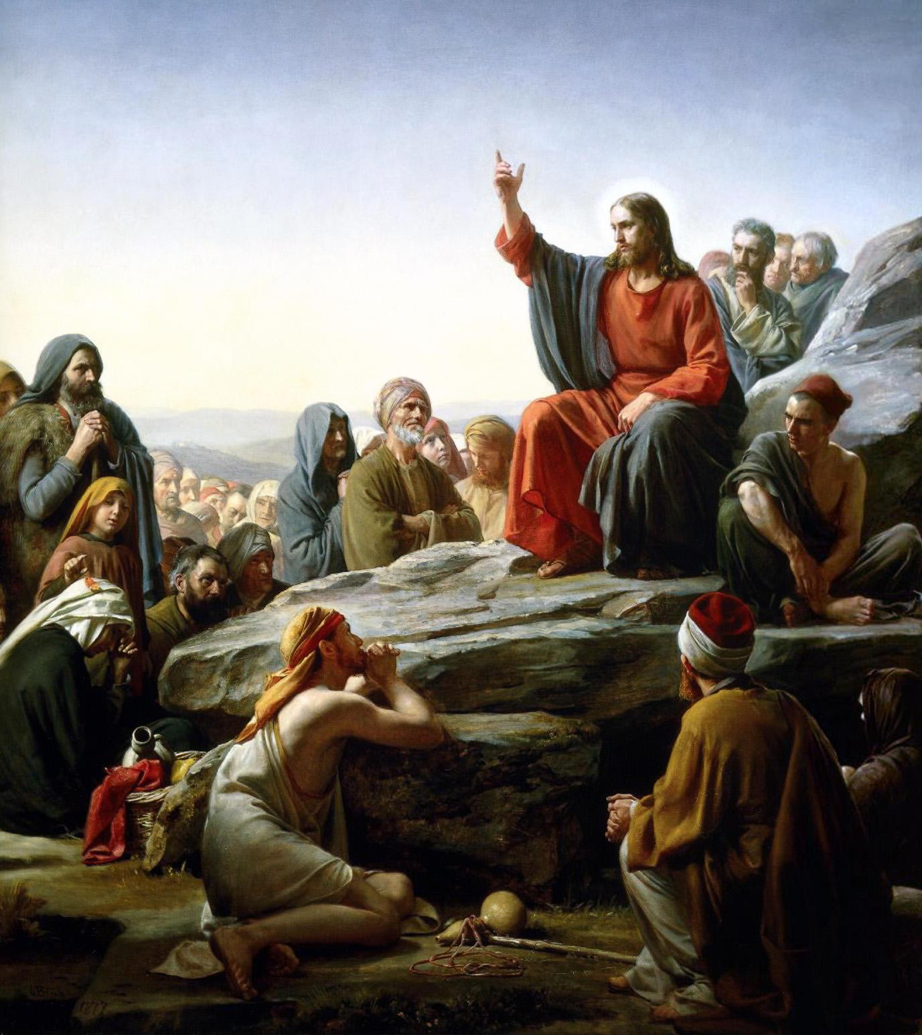

Slide 34
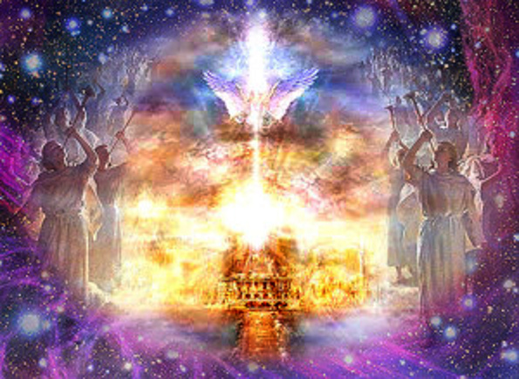

Slide 35
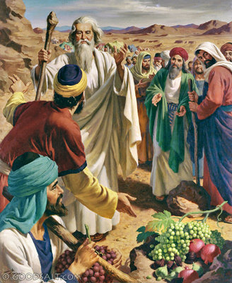

Slide 36
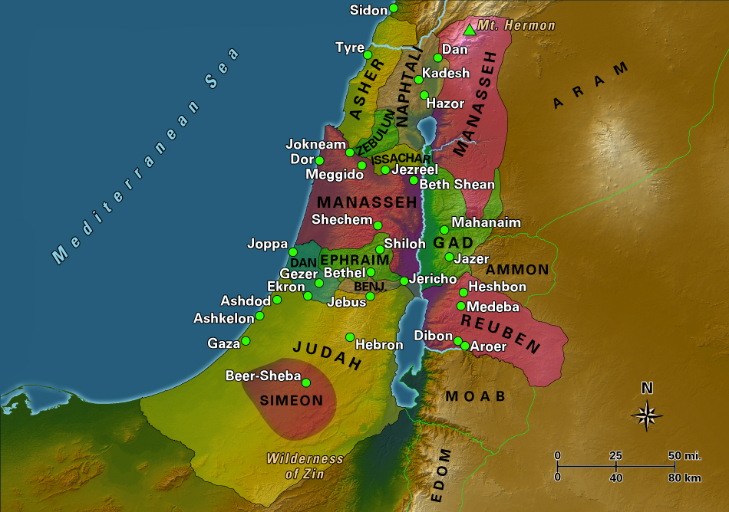

Slide 38
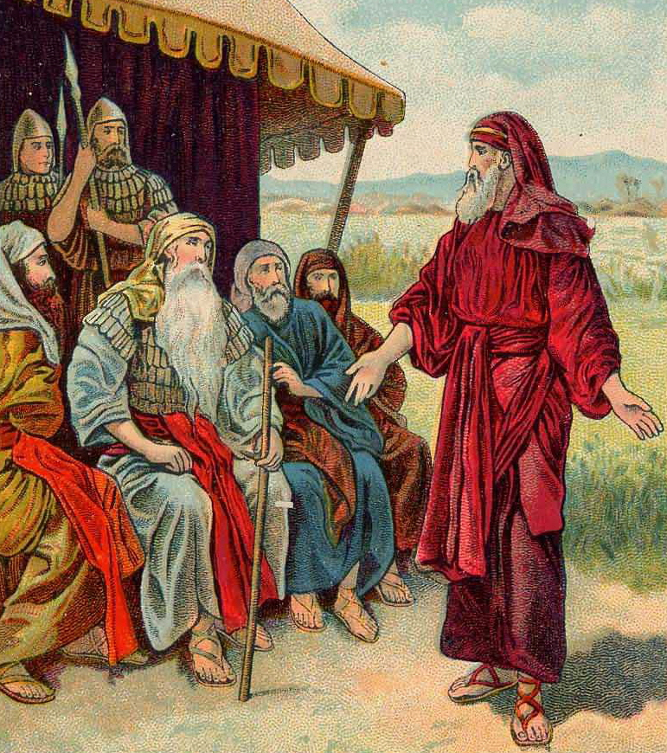

Slide 39
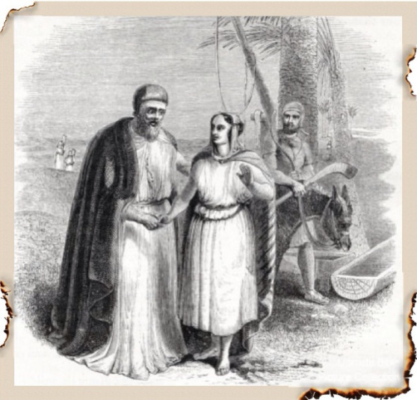

Slide 40
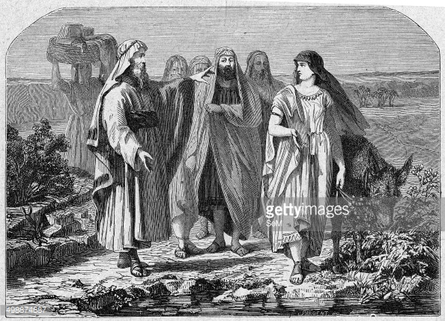

Slide 41
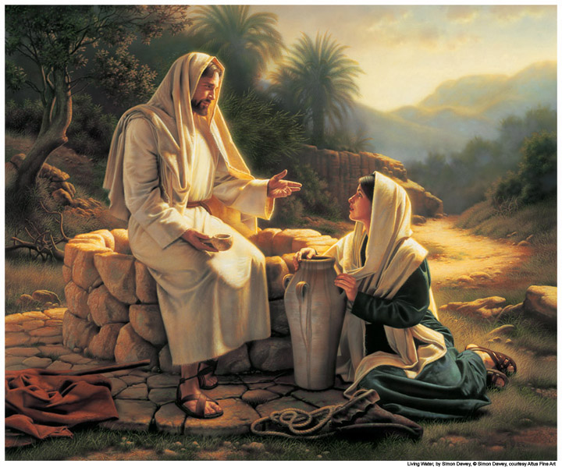

Slide 42
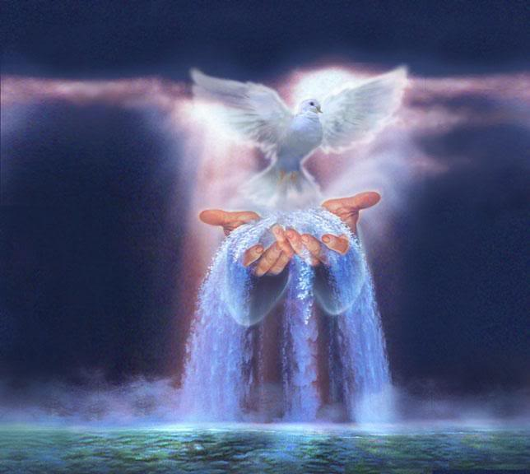

Slide 44
(18:1-28) Then the whole congregation of the people of Israel assembled at Shiloh and set up the tent of meeting there. The land lay subdued before them. (2) There remained among the people of Israel seven tribes whose inheritance had not yet been apportioned. (3) So Joshua said to the people of Israel, "How long will you put off going in to take possession of the land, which the Lord, the God of your fathers, has given you? (4) Provide three men from each tribe, and I will send them out that they may set out and go up and down the land. They shall write a description of it with a view to their inheritances, and then come to me. (5) They shall divide it into seven portions. Judah shall continue in his territory on the south, and the house of Joseph shall continue in their territory on the north. (6) And you shall describe the land in seven divisions and bring the description here to me. And I will cast lots for you here before the Lord our God. (7) The Levites have no portion among you, for the priesthood of the Lord is their heritage. And Gad and Reuben and half the tribe of Manasseh have received their inheritance beyond the Jordan eastward, which Moses the servant of the Lord gave them." (8) So the men arose and went, and Joshua charged those who went to write the description of the land, saying, "Go up and down in the land and write a description and return to me. And I will cast lots for you here before the Lord in Shiloh." (9) So the men went and passed up and down in the land and wrote in a book a description of it by towns in seven divisions. Then they came to Joshua to the camp at Shiloh, (10) and Joshua cast lots for them in Shiloh before the Lord. And there Joshua apportioned the land to the people of Israel, to each his portion.

Slide 45
(11) The lot of the tribe of the people of Benjamin according to its clans came up, and the territory allotted to it fell between the people of Judah and the people of Joseph. (12) On the north side their boundary began at the Jordan. Then the boundary goes up to the shoulder north of Jericho, then up through the hill country westward, and it ends at the wilderness of Beth-aven. (13) From there the boundary passes along southward in the direction of Luz, to the shoulder of Luz (that is, Bethel), then the boundary goes down to Ataroth-addar, on the mountain that lies south of Lower Beth-horon. (14) Then the boundary goes in another direction, turning on the western side southward from the mountain that lies to the south, opposite Beth-horon, and it ends at Kiriath-baal (that is, Kiriath-jearim), a city belonging to the people of Judah. This forms the western side. (15) And the southern side begins at the outskirts of Kiriath-jearim. And the boundary goes from there to Ephron, to the spring of the waters of Nephtoah. (16) Then the boundary goes down to the border of the mountain that overlooks the Valley of the Son of Hinnom, which is at the north end of the Valley of Rephaim. And it then goes down the Valley of Hinnom, south of the shoulder of the Jebusites, and downward to En-rogel. (17) Then it bends in a northerly direction going on to En-shemesh, and from there goes to Geliloth, which is opposite the ascent of Adummim. Then it goes down to the stone of Bohan the son of Reuben, (18) and passing on to the north of the shoulder of Beth-arabah it goes down to the Arabah. (19) Then the boundary passes on to the north of the shoulder of Beth-hoglah. And the boundary ends at the northern bay of the Salt Sea, at the south end of the Jordan: this is the southern border. (20) The Jordan forms its boundary on the eastern side. This is the inheritance of the people of Benjamin, according to their clans, boundary by boundary all around. (21) Now the cities of the tribe of the people of Benjamin according to their clans were Jericho, Beth-hoglah, Emek-keziz, (22) Beth-arabah, Zemaraim, Bethel, (23) Avvim, Parah, Ophrah, (24) Chephar-ammoni, Ophni, Geba--twelve cities with their villages: (25) Gibeon, Ramah, Beeroth, (26) Mizpeh, Chephirah, Mozah, (27) Rekem, Irpeel, Taralah, (28) Zela, Haeleph, Jebus (that is, Jerusalem), Gibeah and Kiriath-jearim--fourteen cities with their villages. This is the inheritance of the people of Benjamin according to its clans.

Slide 46
(19:1-40) The second lot came out for Simeon, for the tribe of the people of Simeon, according to their clans, and their inheritance was in the midst of the inheritance of the people of Judah. (2) And they had for their inheritance Beersheba, Sheba, Moladah, (3) Hazar-shual, Balah, Ezem, (4) Eltolad, Bethul, Hormah, (5) Ziklag, Beth-marcaboth, Hazar-susah, (6) Beth-lebaoth, and Sharuhen--thirteen cities with their villages; (7) Ain, Rimmon, Ether, and Ashan--four cities with their villages, (8) together with all the villages around these cities as far as Baalath-beer, Ramah of the Negeb. This was the inheritance of the tribe of the people of Simeon according to their clans. (9) The inheritance of the people of Simeon formed part of the territory of the people of Judah. Because the portion of the people of Judah was too large for them, the people of Simeon obtained an inheritance in the midst of their inheritance. (10) The third lot came up for the people of Zebulun, according to their clans. And the territory of their inheritance reached as far as Sarid. (11) Then their boundary goes up westward and on to Mareal and touches Dabbesheth, then the brook that is east of Jokneam. (12) From Sarid it goes in the other direction eastward toward the sunrise to the boundary of Chisloth-tabor. From there it goes to Daberath, then up to Japhia. (13) From there it passes along on the east toward the sunrise to Gath-hepher, to Eth-kazin, and going on to Rimmon it bends toward Neah, (14) then on the north the boundary turns about to Hannathon, and it ends at the Valley of Iphtahel; (15) and Kattath, Nahalal, Shimron, Idalah, and Bethlehem--twelve cities with their villages. (16) This is the inheritance of the people of Zebulun, according to their clans--these cities with their villages.

Slide 47
(17) The fourth lot came out for Issachar, for the people of Issachar, according to their clans. (18) Their territory included Jezreel, Chesulloth, Shunem, (19) Hapharaim, Shion, Anaharath, (20) Rabbith, Kishion, Ebez, (21) Remeth, En-gannim, En-haddah, Beth-pazzez. (22) The boundary also touches Tabor, Shahazumah, and Beth-shemesh, and its boundary ends at the Jordan--sixteen cities with their villages. (23) This is the inheritance of the tribe of the people of Issachar, according to their clans--the cities with their villages. (24) The fifth lot came out for the tribe of the people of Asher according to their clans. (25) Their territory included Helkath, Hali, Beten, Achshaph, (26) Allammelech, Amad, and Mishal. On the west it touches Carmel and Shihor-libnath, (27) then it turns eastward, it goes to Beth-dagon, and touches Zebulun and the Valley of Iphtahel northward to Beth-emek and Neiel. Then it continues in the north to Cabul, (28) Ebron, Rehob, Hammon, Kanah, as far as Sidon the Great. (29) Then the boundary turns to Ramah, reaching to the fortified city of Tyre. Then the boundary turns to Hosah, and it ends at the sea; Mahalab, Achzib, (30) Ummah, Aphek and Rehob--twenty-two cities with their villages. (31) This is the inheritance of the tribe of the people of Asher according to their clans--these cities with their villages. (32) The sixth lot came out for the people of Naphtali, for the people of Naphtali, according to their clans. (33) And their boundary ran from Heleph, from the oak in Zaanannim, and Adami-nekeb, and Jabneel, as far as Lakkum, and it ended at the Jordan. (34) Then the boundary turns westward to Aznoth-tabor and goes from there to Hukkok, touching Zebulun at the south and Asher on the west and Judah on the east at the Jordan. (35) The fortified cities are Ziddim, Zer, Hammath, Rakkath, Chinnereth, (36) Adamah, Ramah, Hazor, (37) Kedesh, Edrei, En-hazor, (38) Yiron, Migdal-el, Horem, Beth-anath, and Beth-shemesh--nineteen cities with their villages. (39) This is the inheritance of the tribe of the people of Naphtali according to their clans--the cities with their villages.

Slide 48
(40) The seventh lot came out for the tribe of the people of Dan, according to their clans. (41) And the territory of its inheritance included Zorah, Eshtaol, Ir-shemesh, (42) Shaalabbin, Aijalon, Ithlah, (43) Elon, Timnah, Ekron, (44) Eltekeh, Gibbethon, Baalath, (45) Jehud, Bene-berak, Gath-rimmon, (46) and Me-jarkon and Rakkon with the territory over against Joppa. (47) When the territory of the people of Dan was lost to them, the people of Dan went up and fought against Leshem, and after capturing it and striking it with the sword they took possession of it and settled in it, calling Leshem, Dan, after the name of Dan their ancestor. (48) This is the inheritance of the tribe of the people of Dan, according to their clans--these cities with their villages.

Slide 49
(49) When they had finished distributing the several territories of the land as inheritances, the people of Israel gave an inheritance among them to Joshua the son of Nun. (50) By command of the Lord they gave him the city that he asked, Timnath-serah in the hill country of Ephraim. And he rebuilt the city and settled in it. (51) These are the inheritances that Eleazar the priest and Joshua the son of Nun and the heads of the fathers' houses of the tribes of the people of Israel distributed by lot at Shiloh before the Lord, at the entrance of the tent of meeting. So they finished dividing the land.

Slide 50
B. STUDY NOTES: 1. Shiloh – 10 miles northeast of Bethel – where the tent of meeting / tabernacle with the ark of the covenant would remain till the time of Samuel (Ex 27:21; 1 Sam 1:3-38; 3:21; 4:3,4; Judg 18:31; Ps 78:60) 2. The Lord, the God of your fathers (Ex 3:13-15; Dt 30:20; Jer 34:13; Acts 7:32,33) 3. Cast lots for you here before the Lord our God (Lev 16:8; Ps 22:18; Jonah 1:7) 4. The Levites have no portion among you, for the priesthood of the Lord is their heritage (Gen 34:25-30; 49:5-7; Dt 18:1-8; Heb 7:5,11,12,24) (The New Testament priesthood of all believers: 1 Pet 2:5-9)

Slide 51
5. Moses the servant of the Lord (Ex 4:1-17; 1 Ki 8:53) 6. By command of the Lord, an inheritance among them to Joshua the son of Nun (Nu 13:30; 14:6,24,30) Timnath-serah in the hill country of Ephraim – southwest corner of Ephraim facing out to the sea 7. Eleazar the priest (Nu 3:32; 34:7; Dt 10:6) 8. So they finished dividing the land. (Gen 12:1-8; Acts 13:17-19) 9. The people of Naphtali (this area will be the first to hear the preaching of Jesus) – (Is 9:1; Mt 4:15)

Slide 52
C. LIFE APPLICATION: 1. If the Lord, the God of your fathers is with you, how is this passed down to your own children in Christ Jesus? 2. How does the priesthood of the Lord become our heritage through Jesus our High Priest and King? 3. Define “the priesthood of all believers” – all baptized Christians are priests (office of the keys), some are called to be pastors (office of the ministry) 4. How does Moses stand for the Law and Jesus stand for the Gospel? (John 1:17)

Slide 53
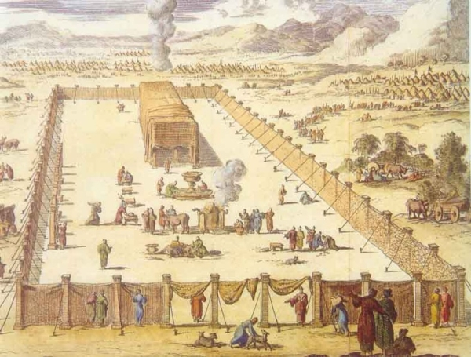

Slide 54
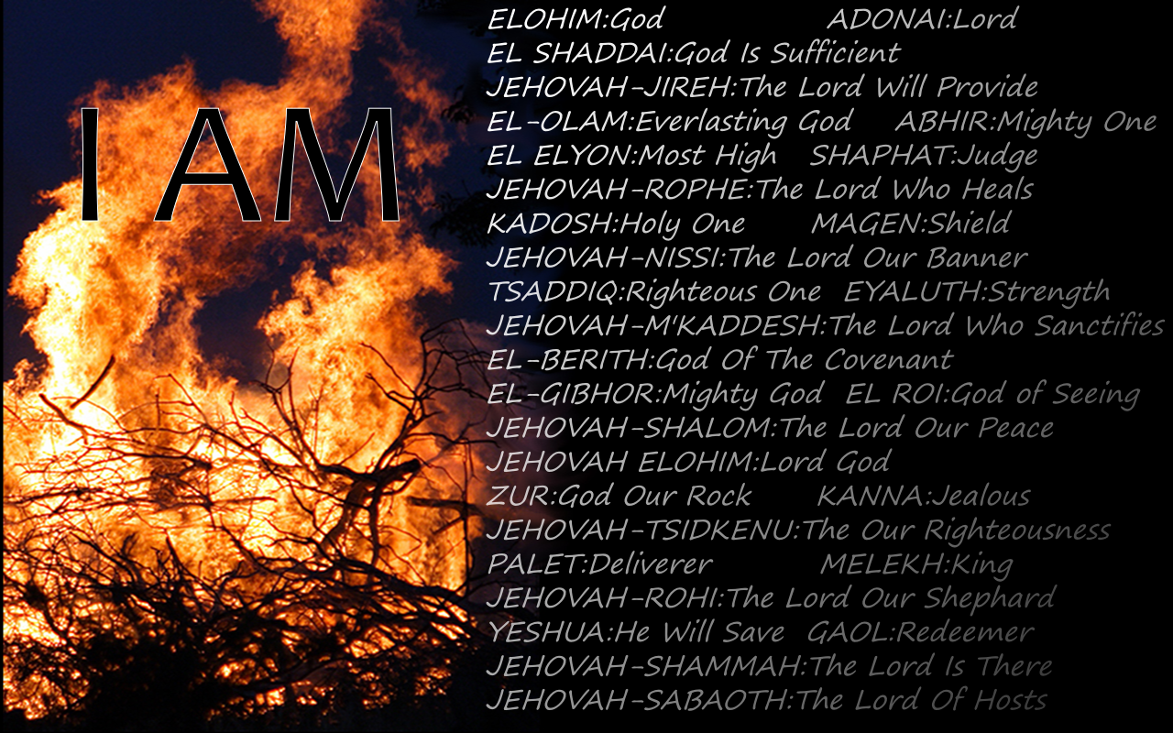

Slide 55
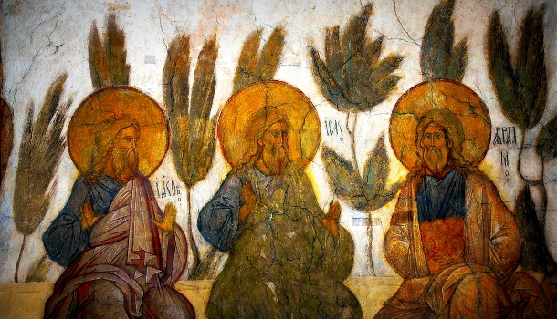

Slide 56
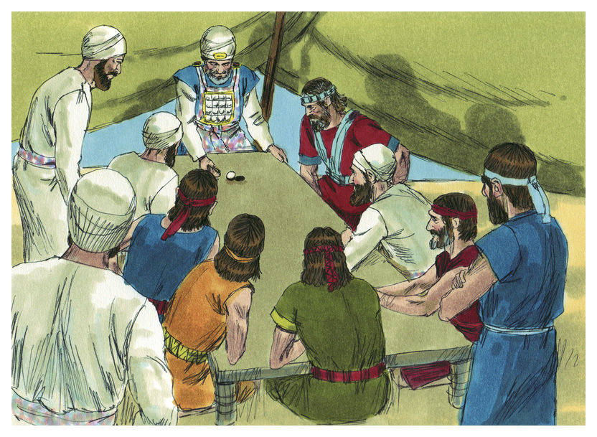

Slide 57
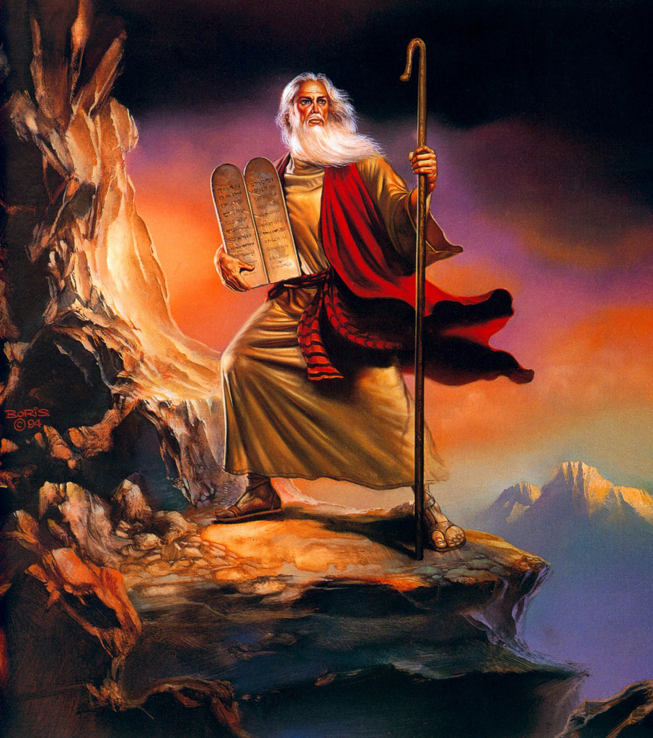

Slide 58
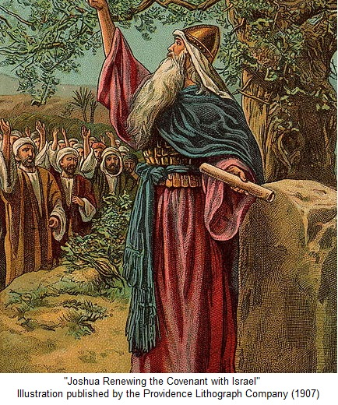

Slide 59
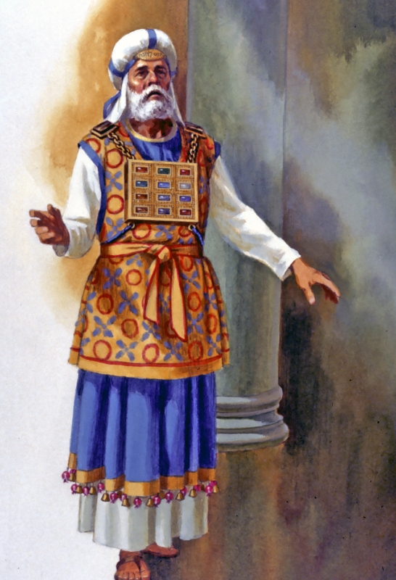

Slide 60
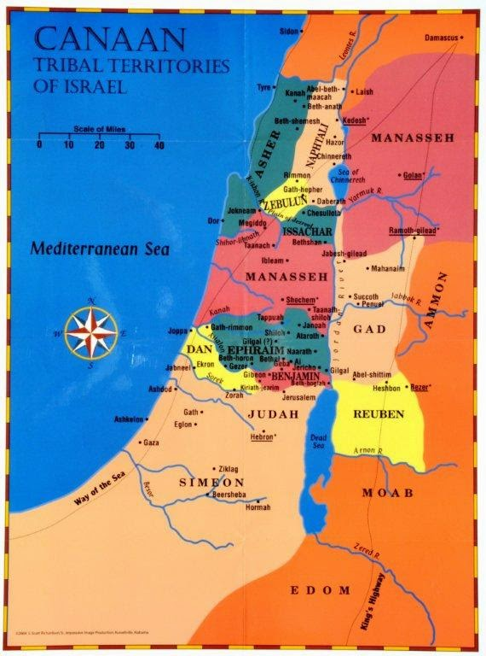

Slide 61
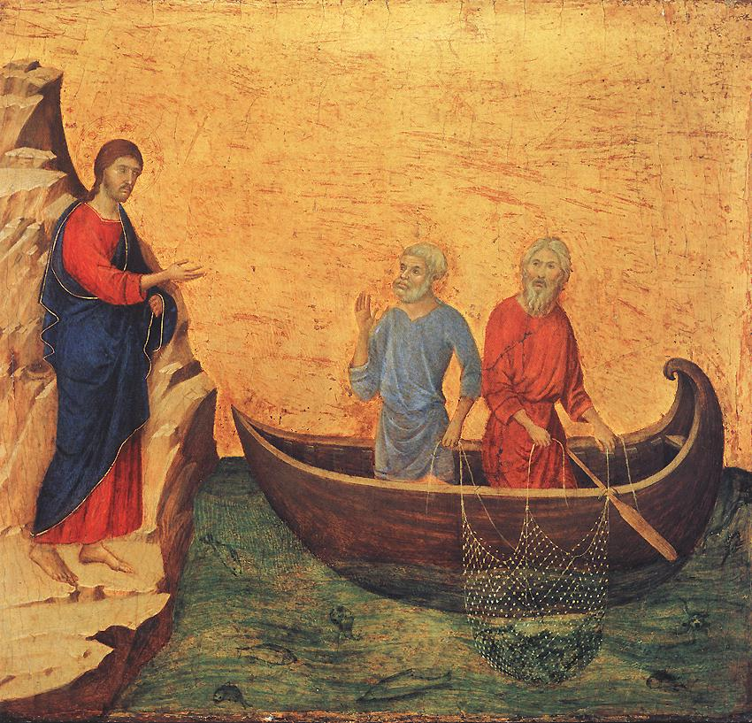

Slide 62
