Slide 1
THE BOOK OF JOSHUA
“Be Strong and Courageous!”
-Joshua in the Old Testament
-Jesus in the New Testament
Date: 6-14-15 Lesson: 16

Slide 2
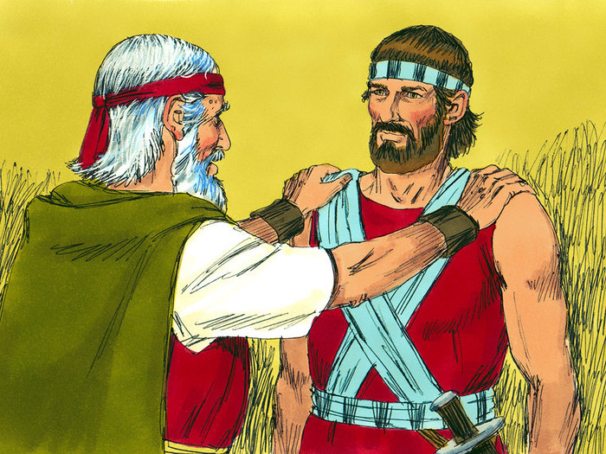

Slide 3
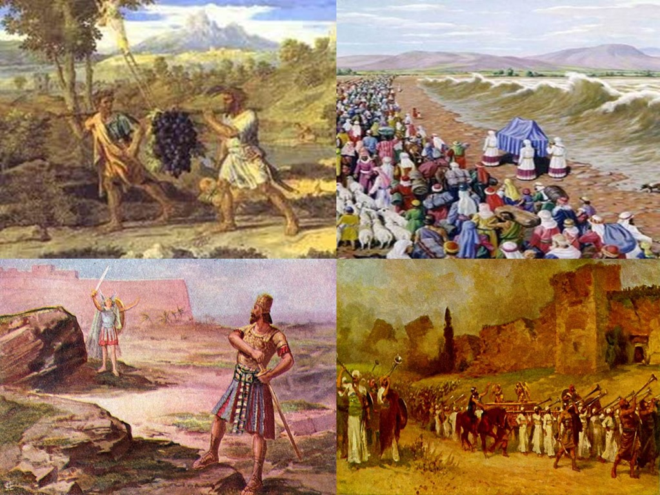

Slide 4
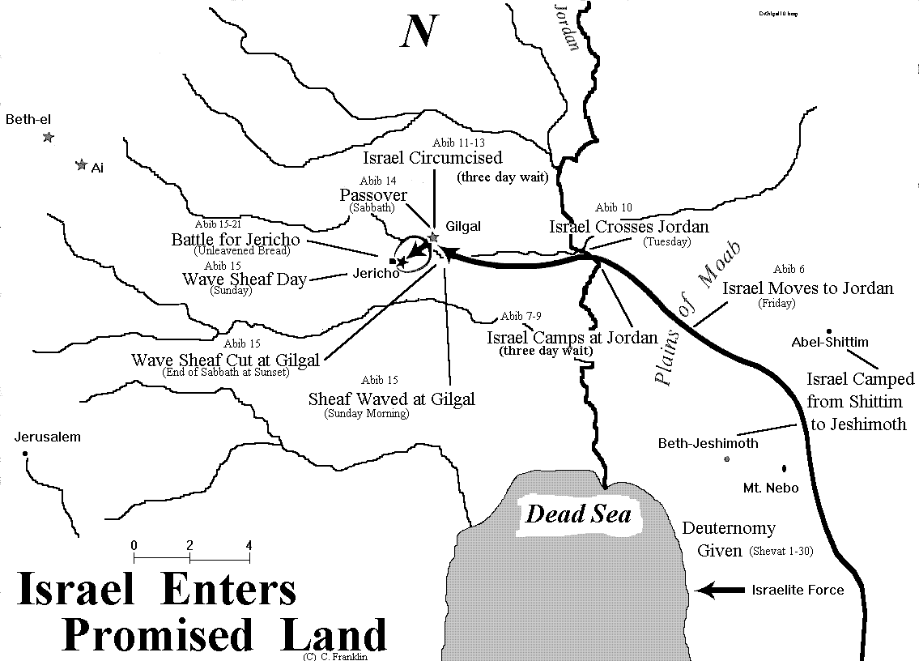

Slide 6
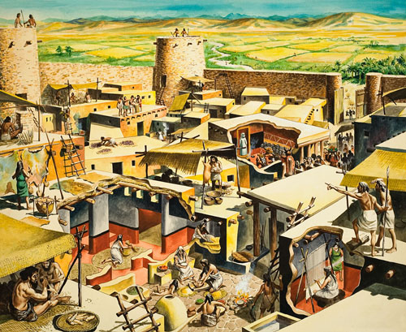

Slide 8
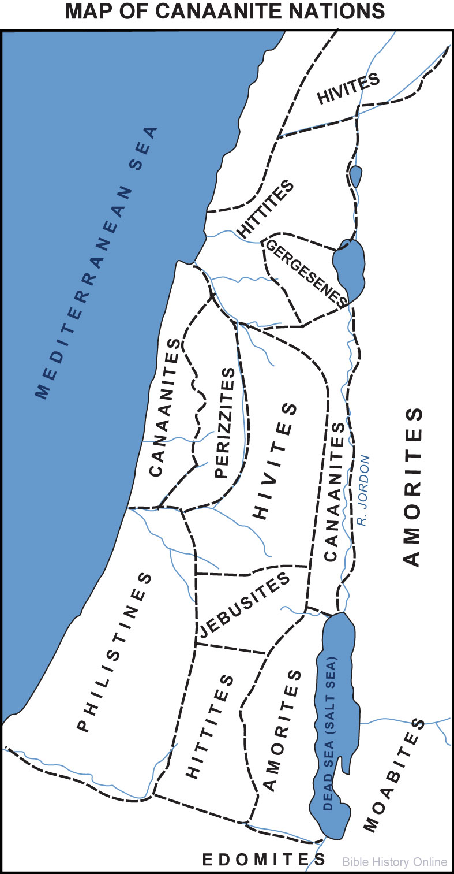

Slide 9
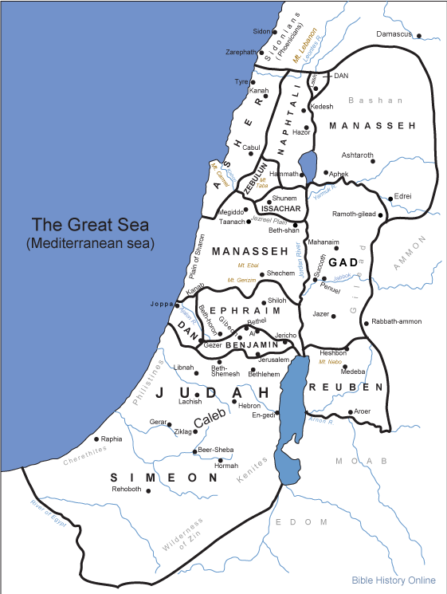

Slide 10
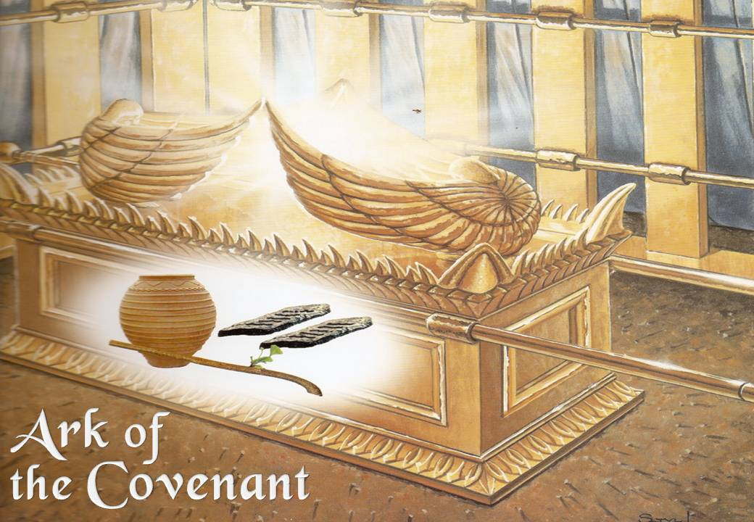

Slide 11
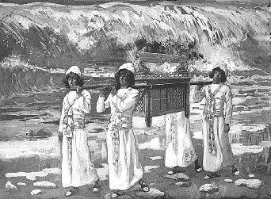

Slide 12
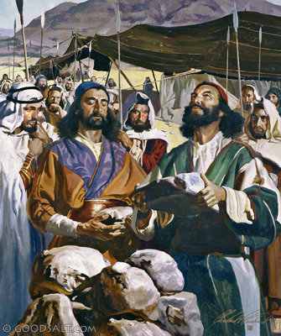

Slide 13
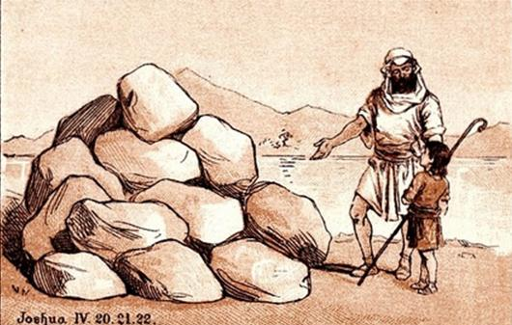

Slide 14
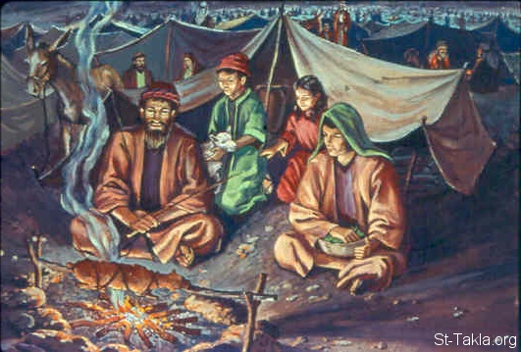

Slide 15
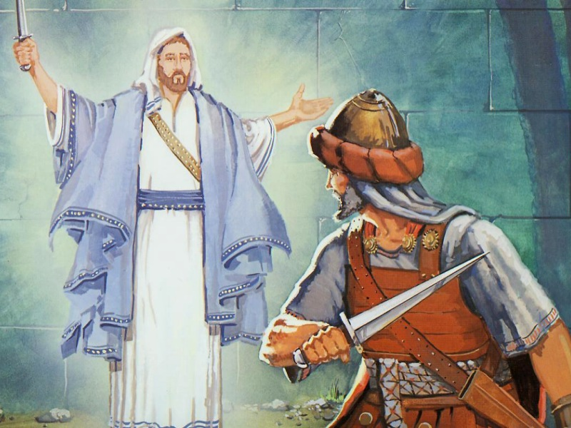

Slide 16
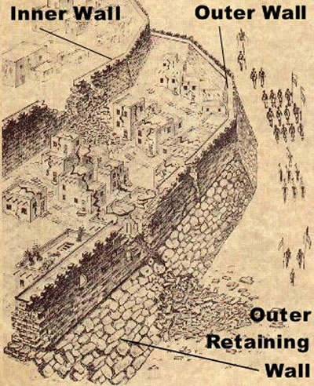

Slide 17
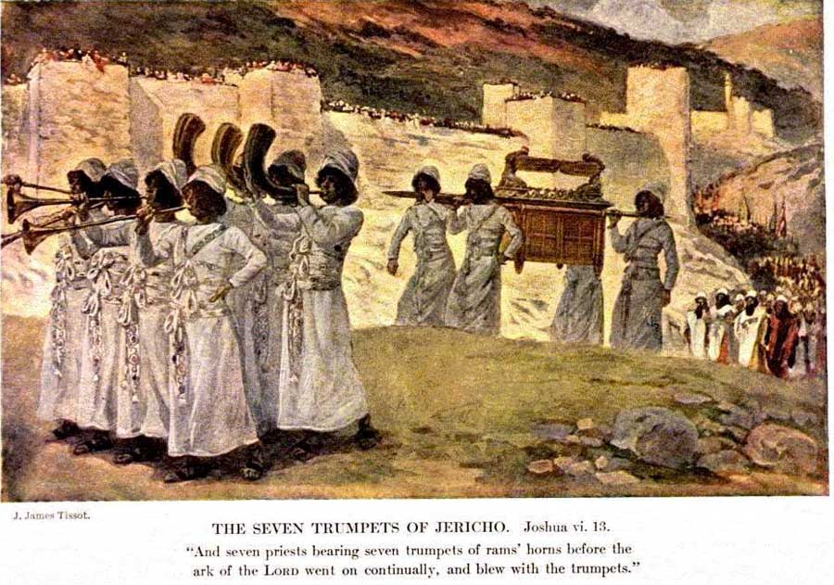

Slide 18
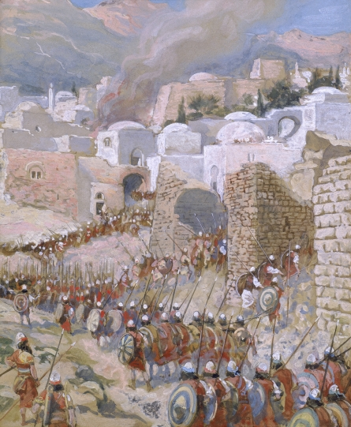

Slide 23
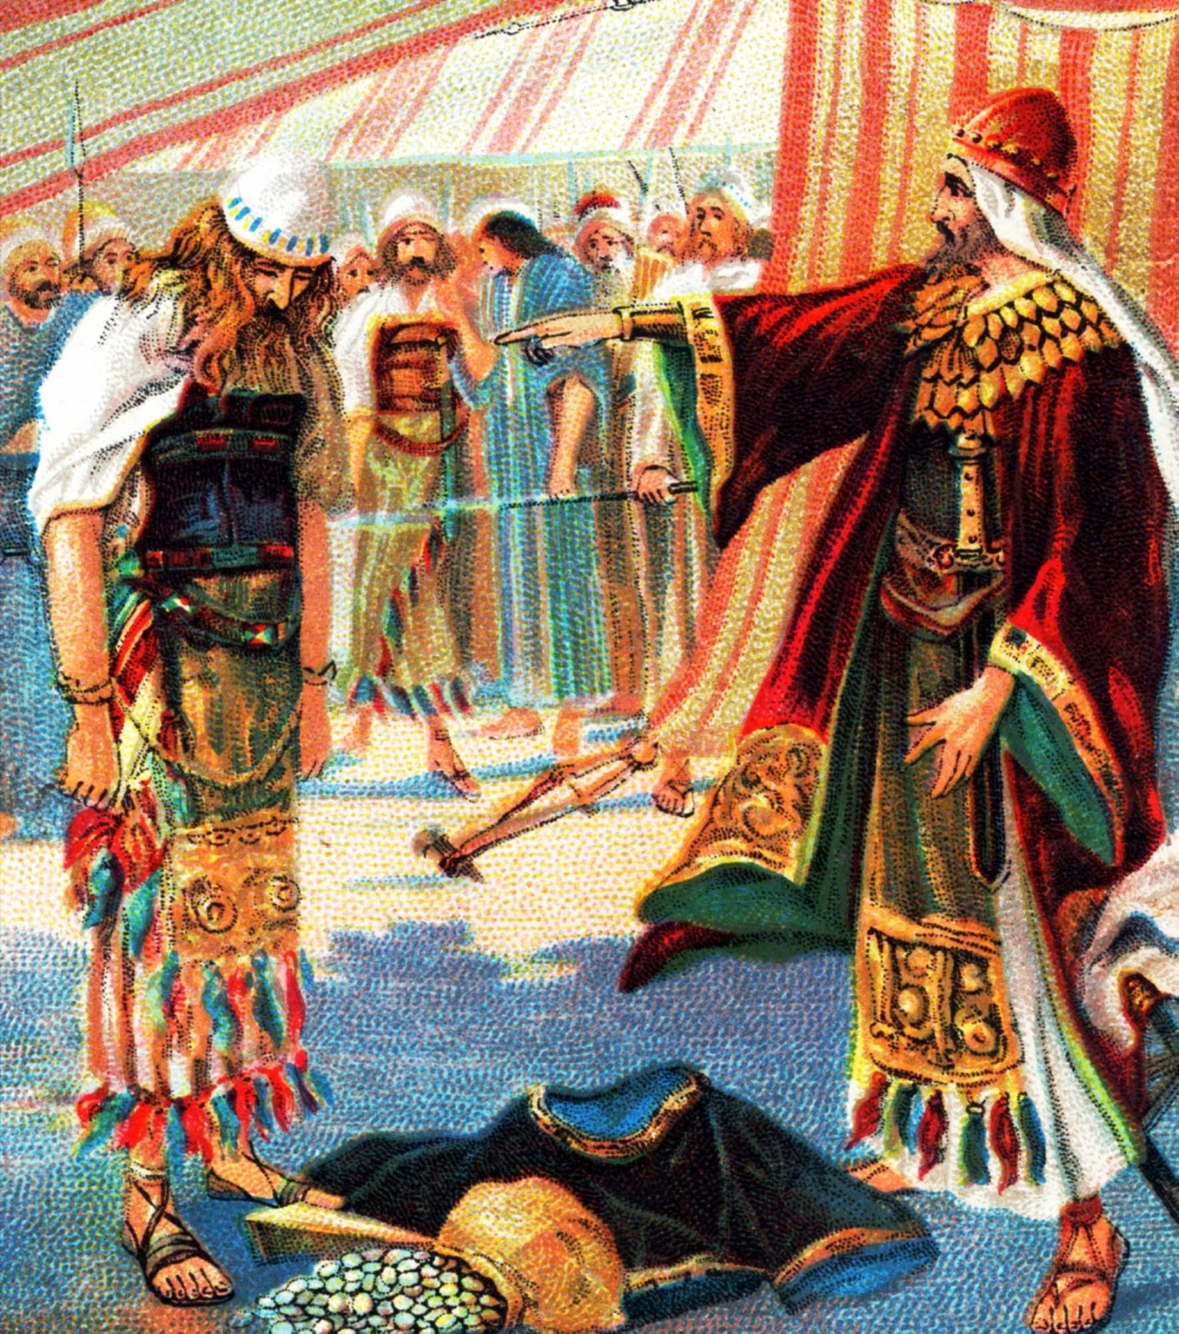

Slide 25
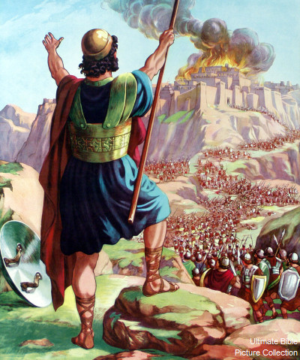

Slide 26
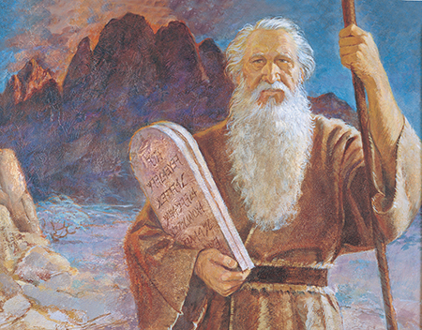

Slide 27
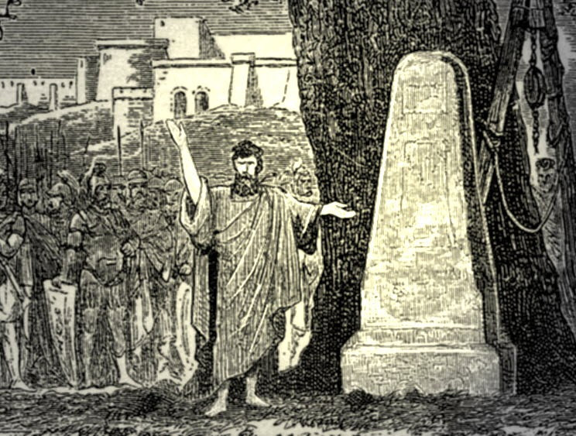

Slide 28
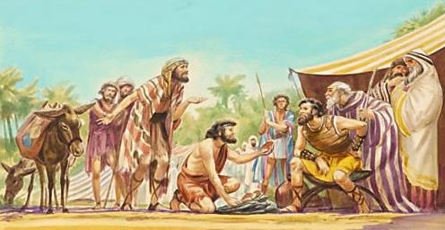

Slide 29
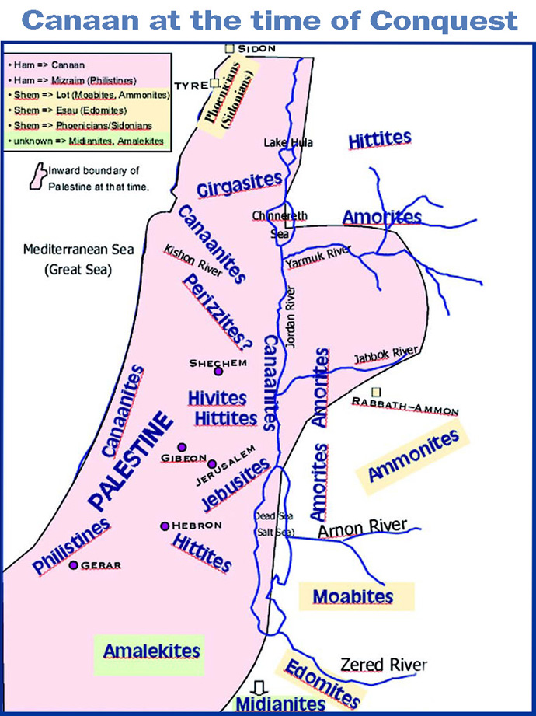

Slide 30
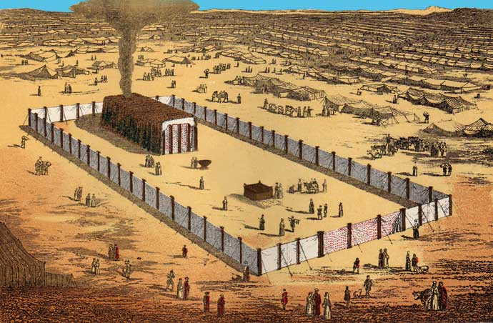

Slide 31
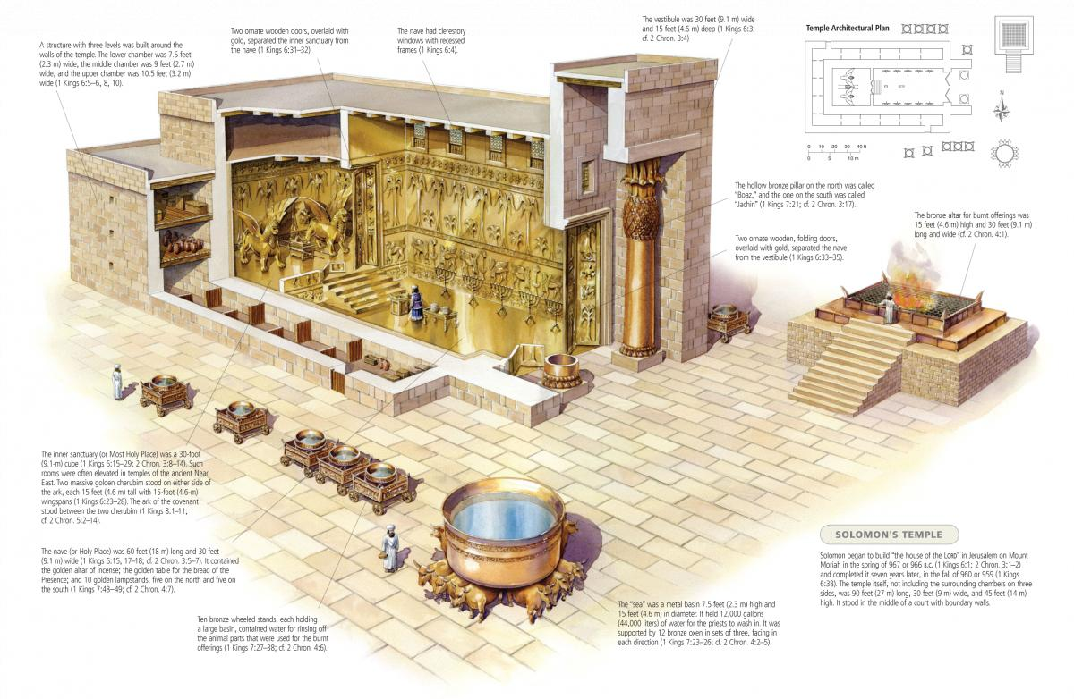

Slide 32
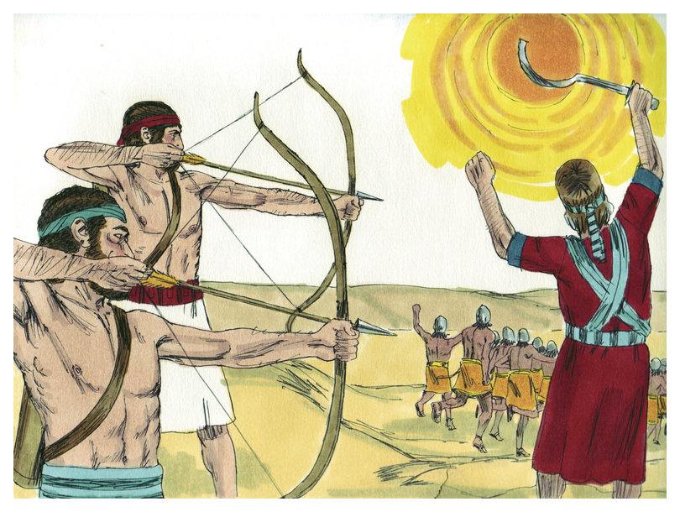

Slide 33
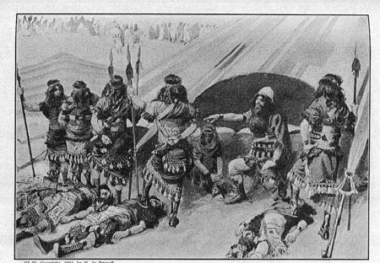

Slide 34
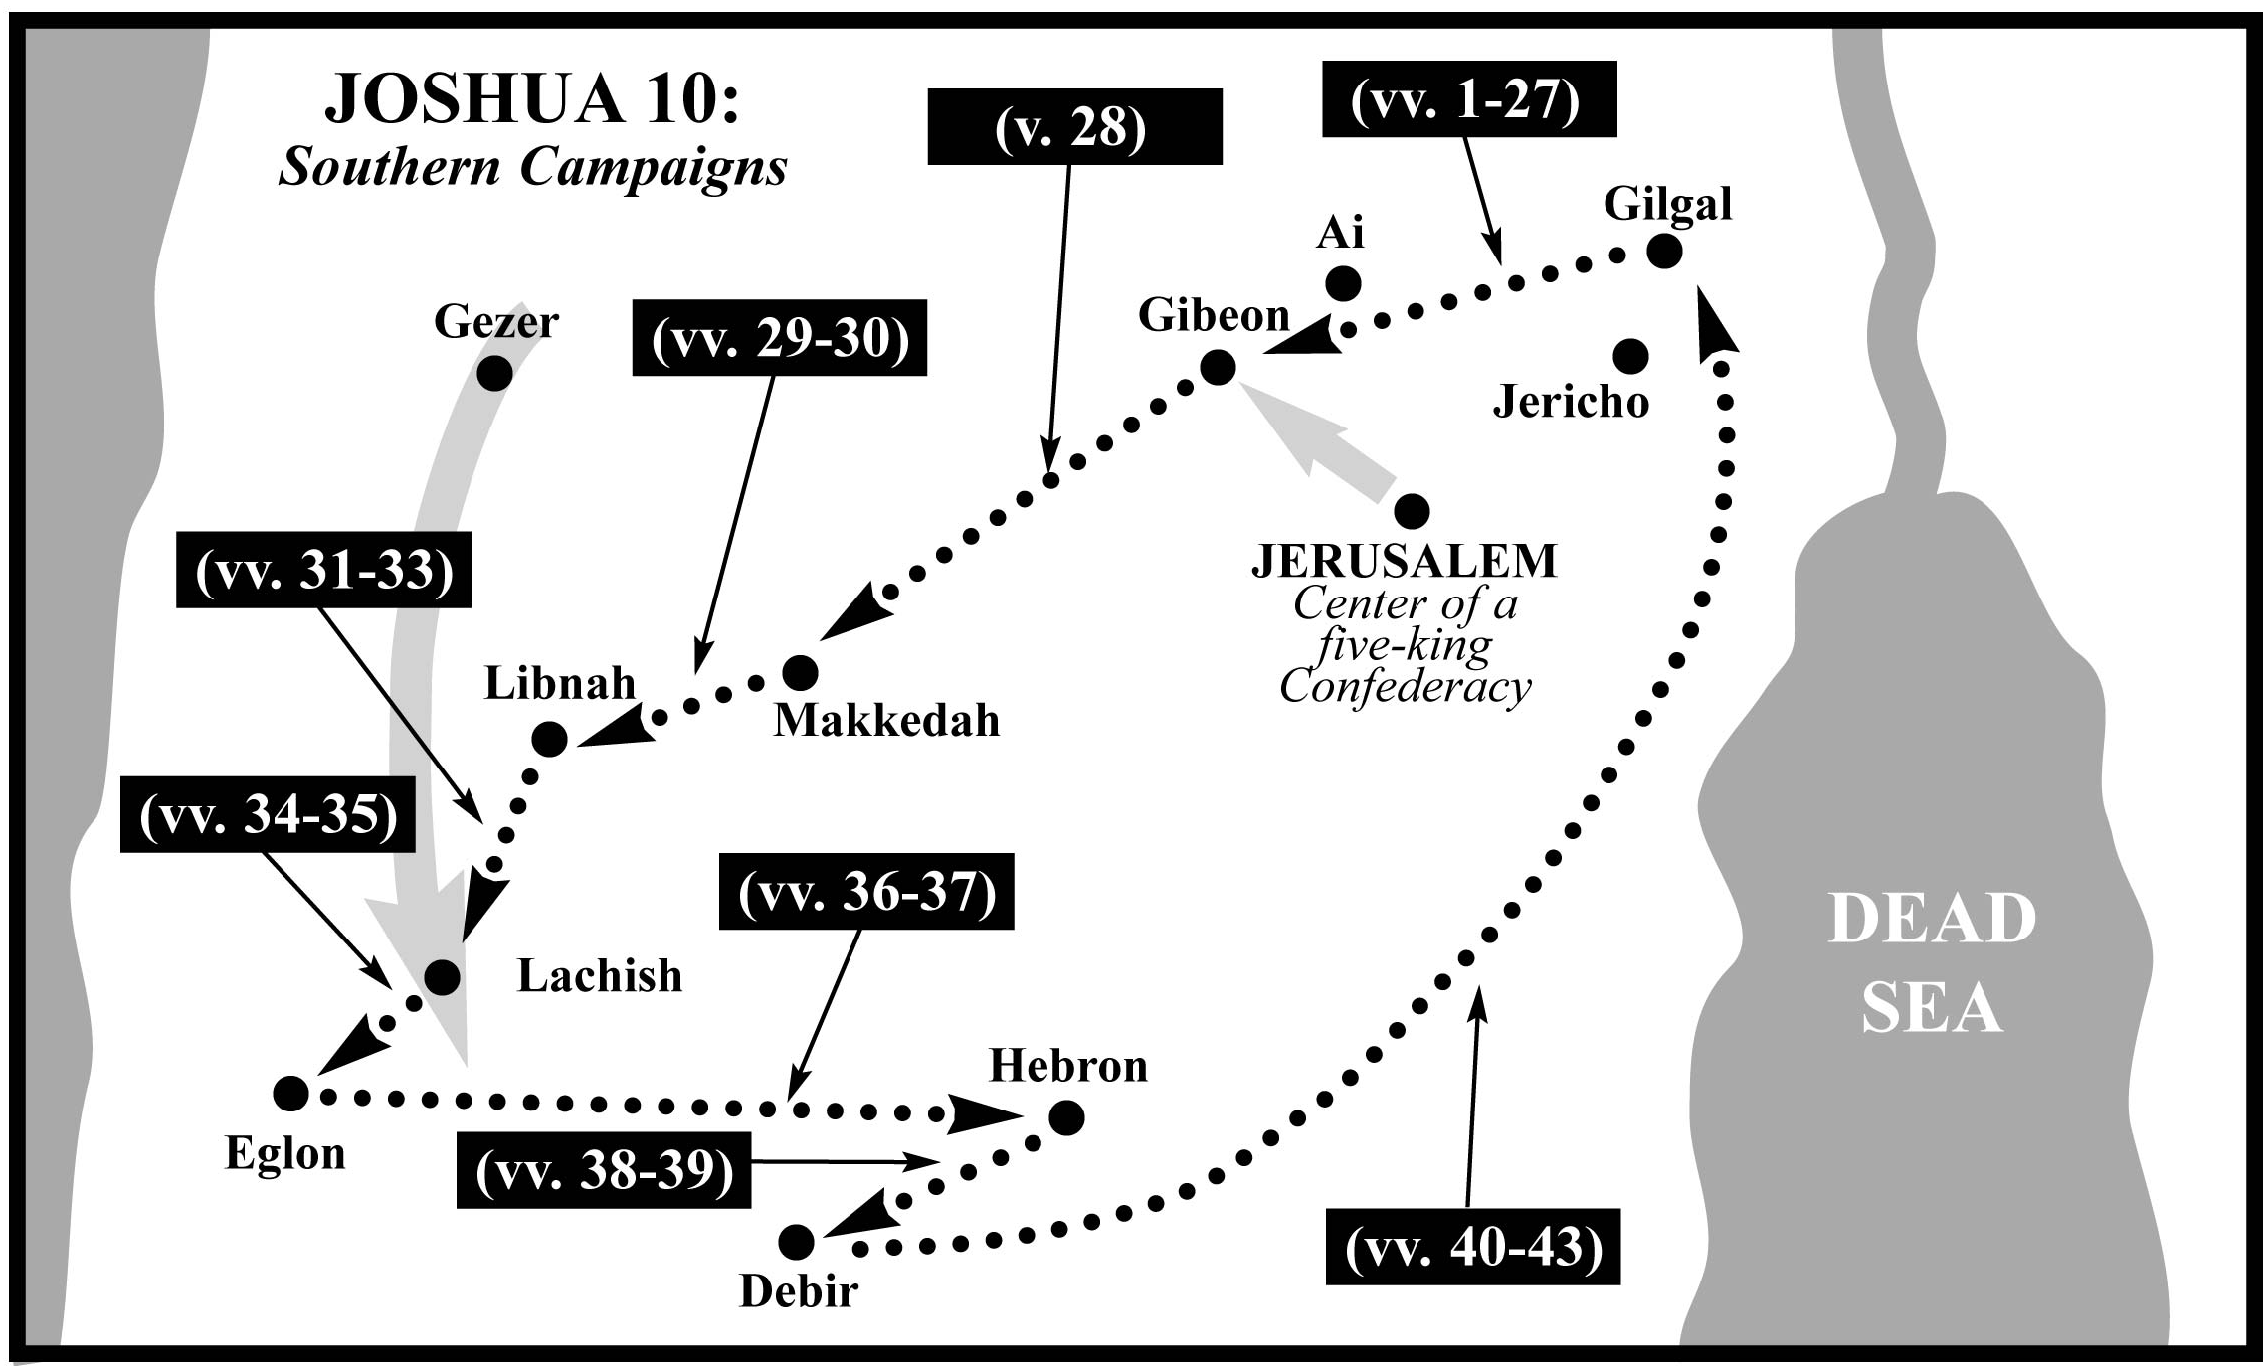

Slide 35
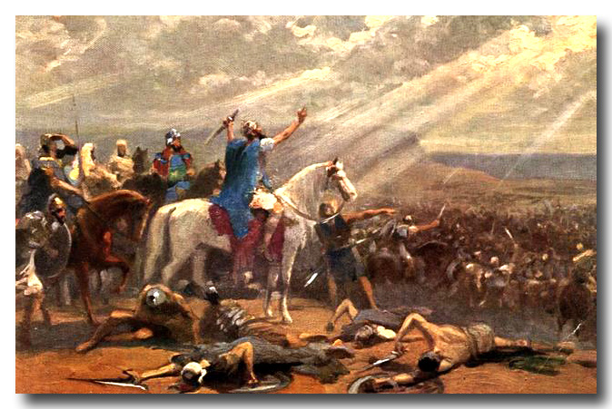

Slide 36
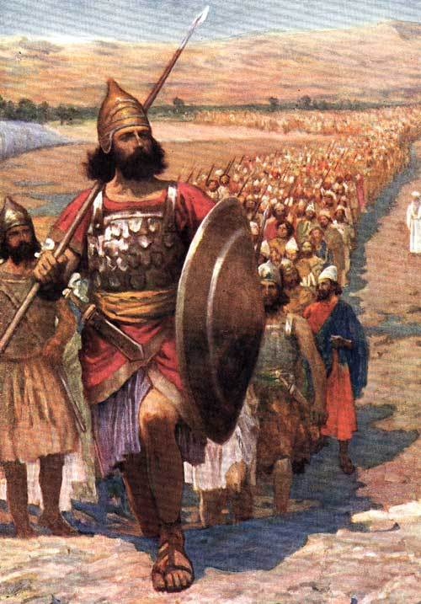

Slide 37
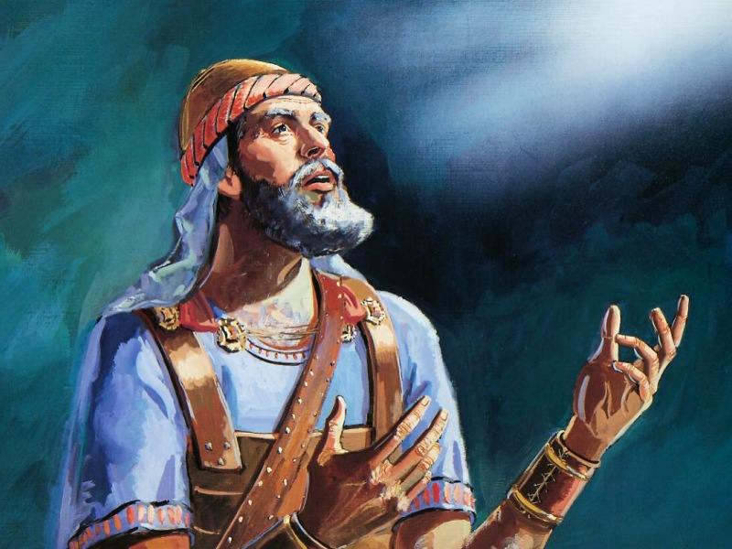

Slide 38
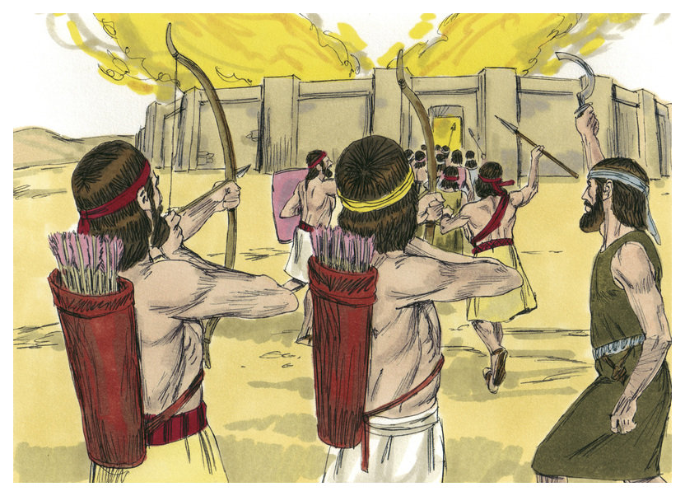

Slide 39
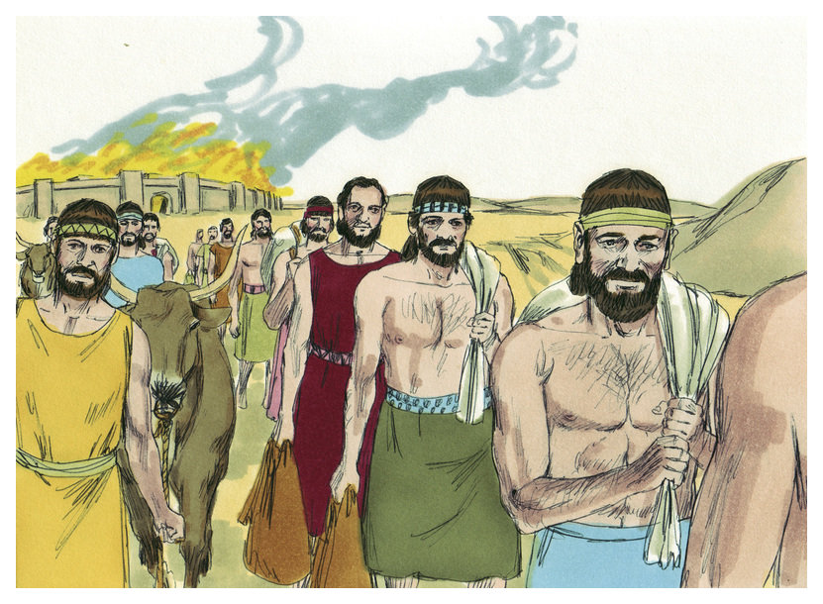

Slide 41
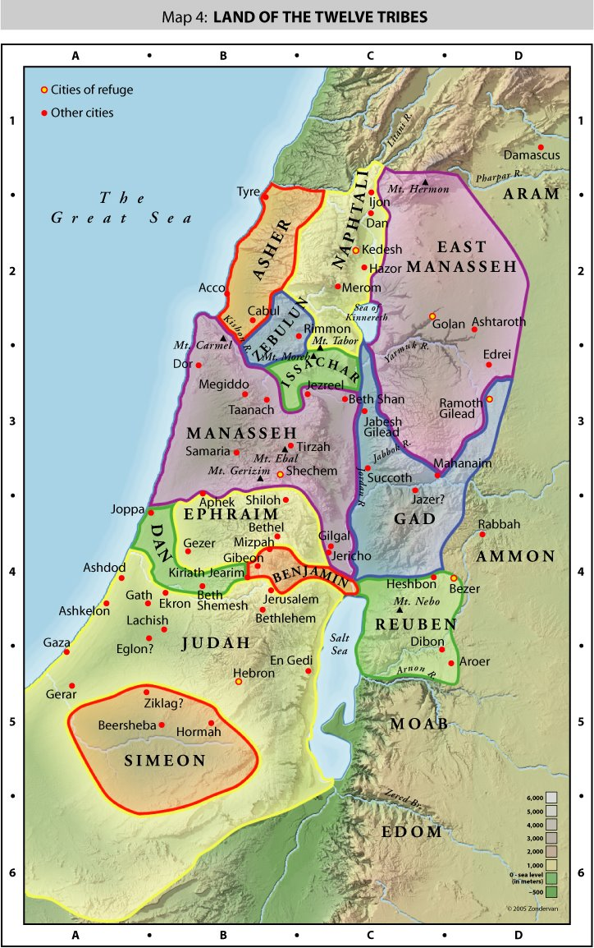

Slide 42
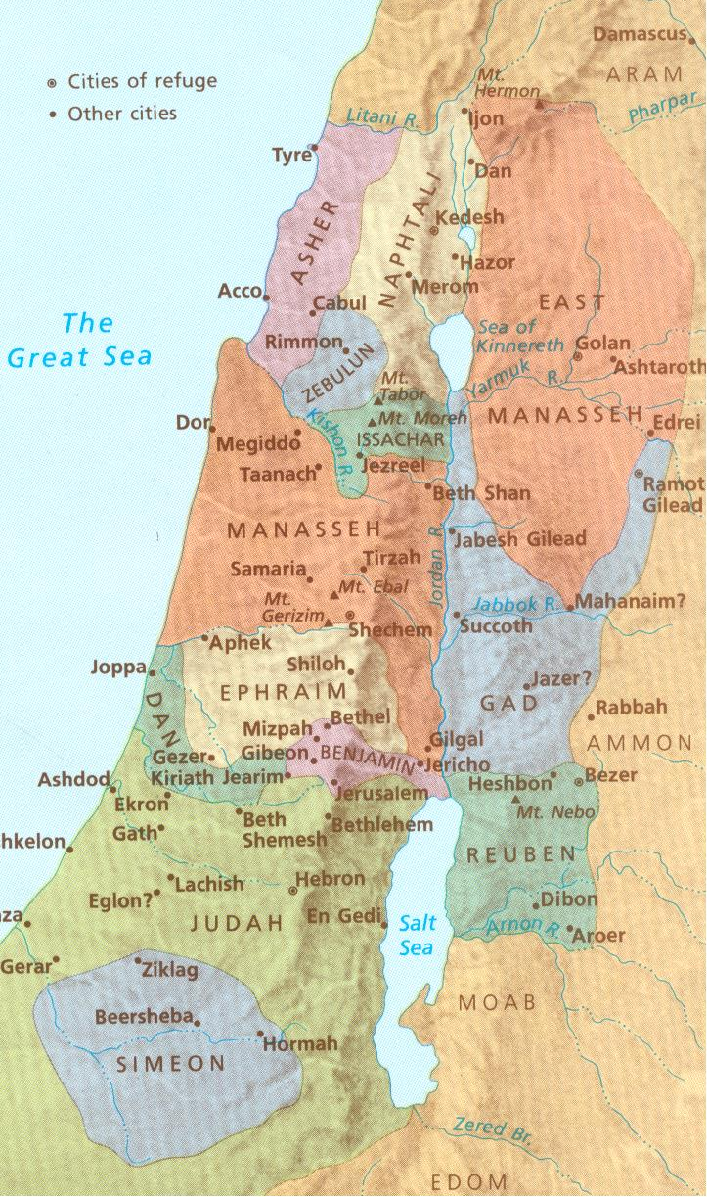

Slide 43
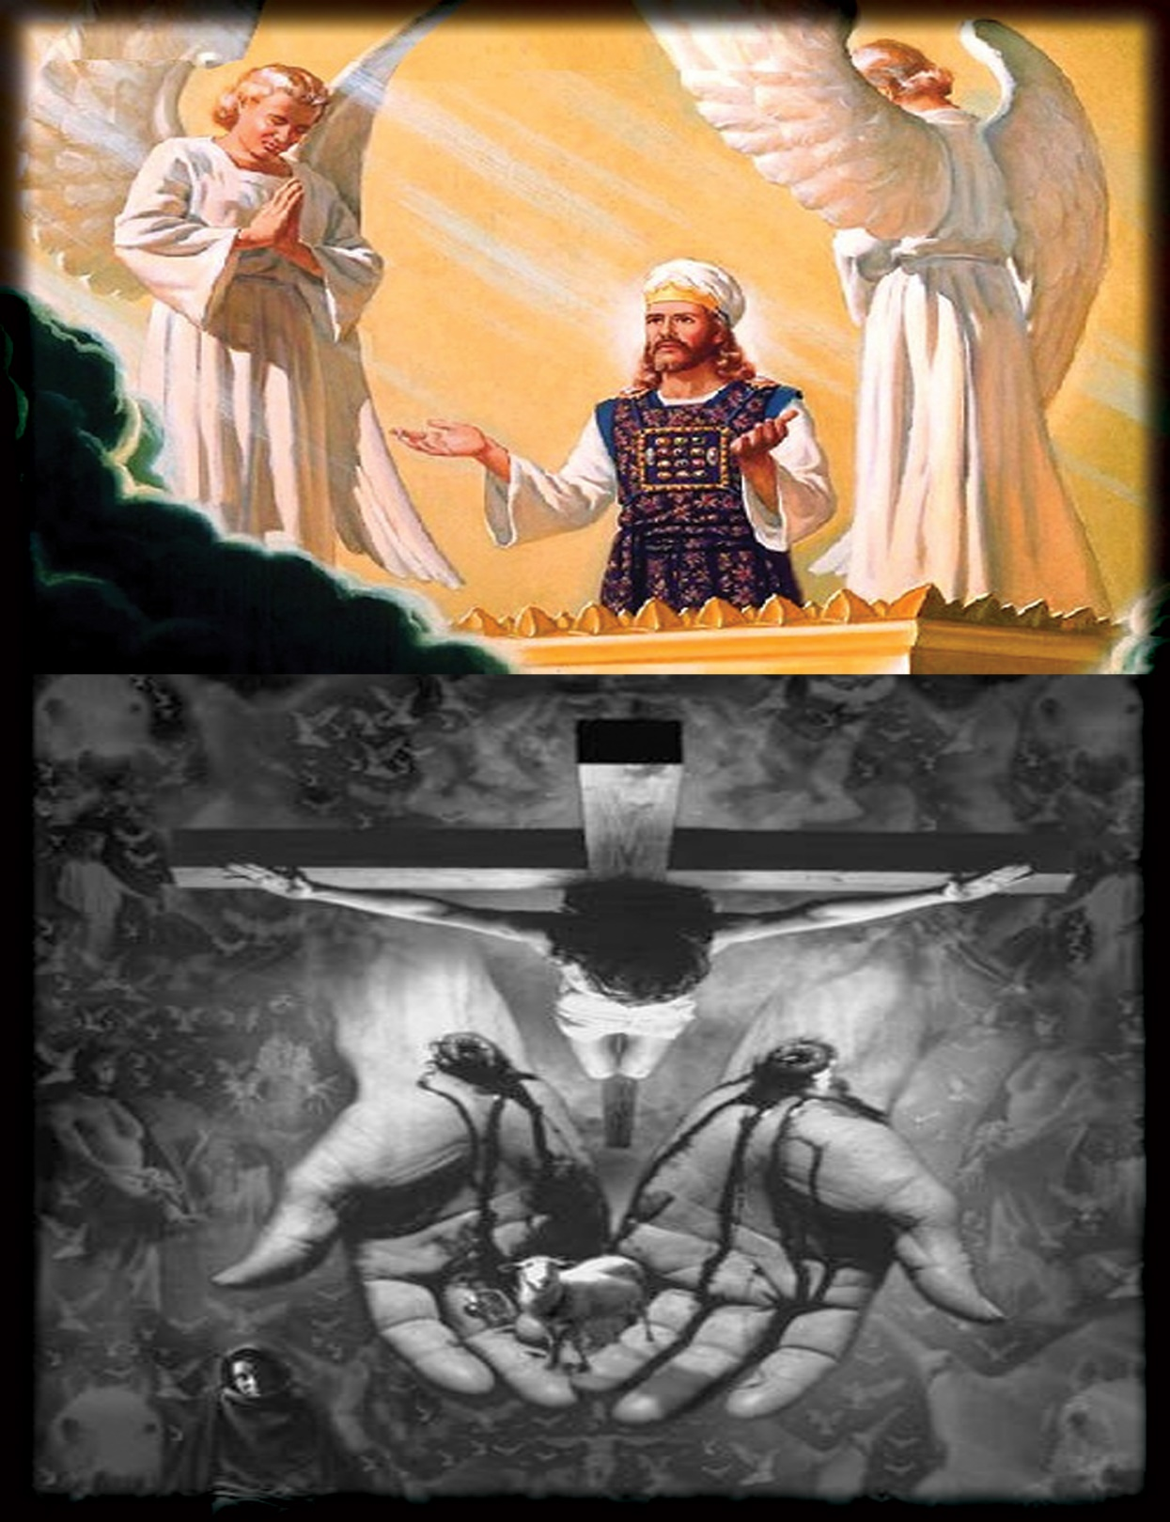

Slide 44
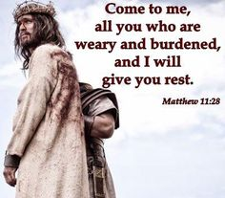

Slide 45
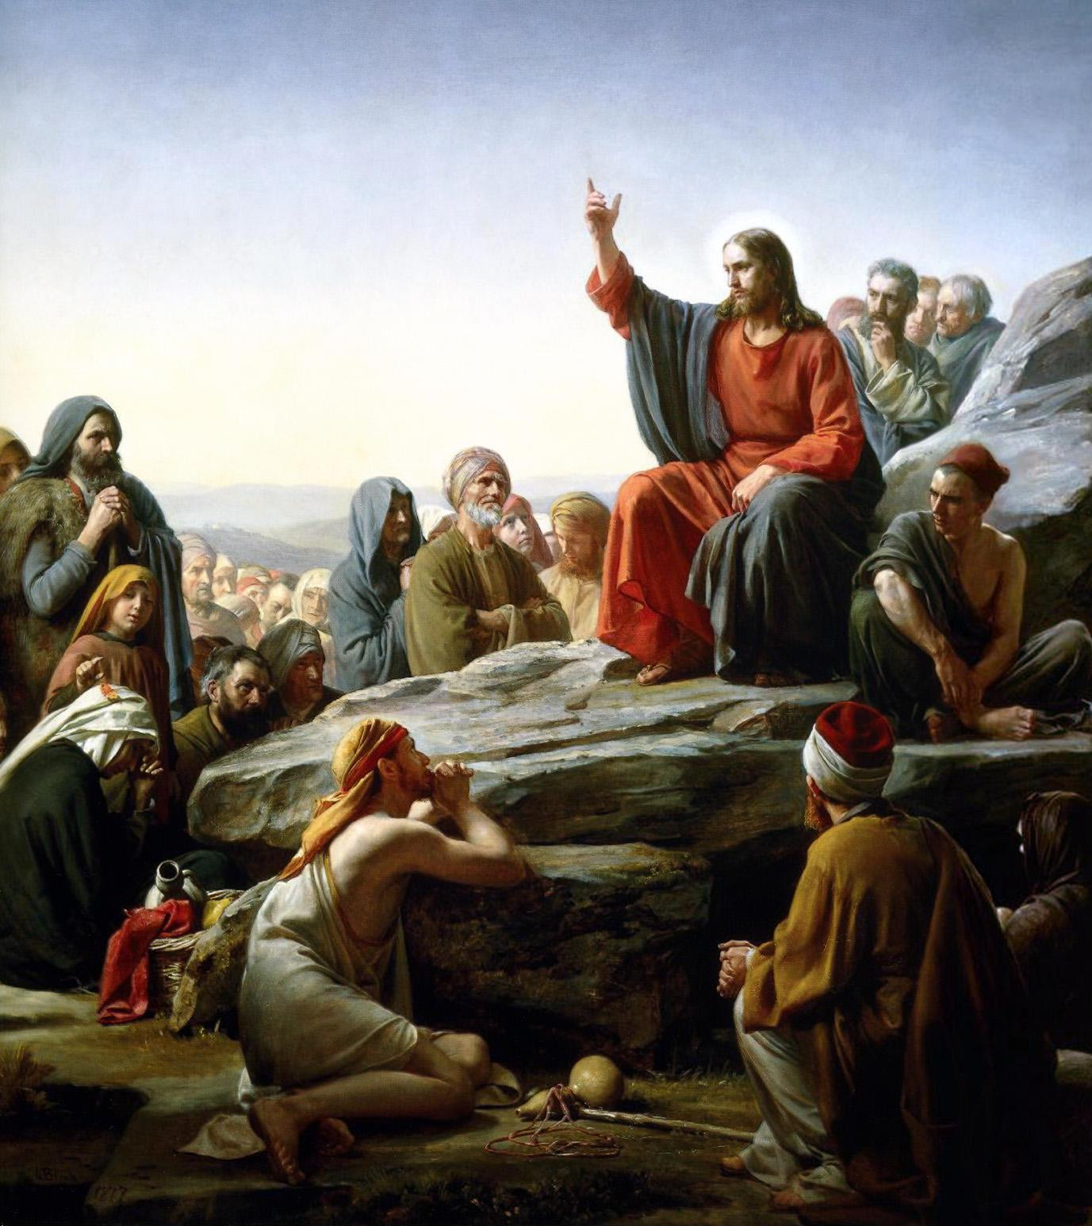

Slide 46
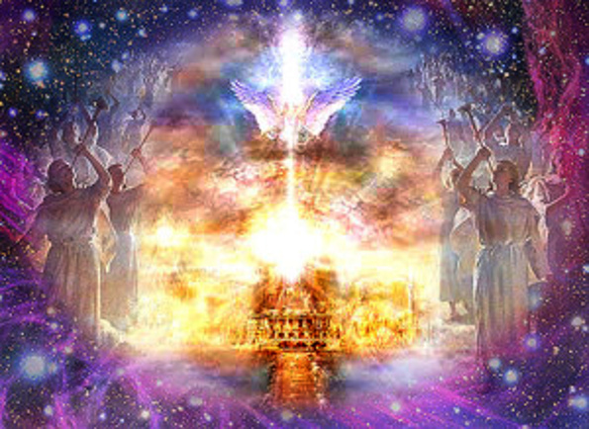

Slide 47
(15:1-63) The allotment for the tribe of the people of Judah according to their clans reached southward to the boundary of Edom, to the wilderness of Zin at the farthest south. (2) And their south boundary ran from the end of the Salt Sea, from the bay that faces southward. (3) It goes out southward of the ascent of Akrabbim, passes along to Zin, and goes up south of Kadesh-barnea, along by Hezron, up to Addar, turns about to Karka, (4) passes along to Azmon, goes out by the Brook of Egypt, and comes to its end at the sea. This shall be your south boundary. (5) And the east boundary is the Salt Sea, to the mouth of the Jordan. And the boundary on the north side runs from the bay of the sea at the mouth of the Jordan. (6) And the boundary goes up to Beth-hoglah and passes along north of Beth-arabah. And the boundary goes up to the stone of Bohan the son of Reuben. (7) And the boundary goes up to Debir from the Valley of Achor, and so northward, turning toward Gilgal, which is opposite the ascent of Adummim, which is on the south side of the valley. And the boundary passes along to the waters of En-shemesh and ends at En-rogel. (8) Then the boundary goes up by the Valley of the Son of Hinnom at the southern shoulder of the Jebusite (that is, Jerusalem). And the boundary goes up to the top of the mountain that lies over against the Valley of Hinnom, on the west, at the northern end of the Valley of Rephaim. (9) Then the boundary extends from the top of the mountain to the spring of the waters of Nephtoah, and from there to the cities of Mount Ephron. Then the boundary bends around to Baalah (that is, Kiriath-jearim). (10) And the boundary circles west of Baalah to Mount Seir, passes along to the northern shoulder of Mount Jearim (that is, Chesalon), and goes down to Beth-shemesh and passes along by Timnah. (11) The boundary goes out to the shoulder of the hill north of Ekron, then the boundary bends around to Shikkeron and passes along to Mount Baalah and goes out to Jabneel. Then the boundary comes to an end at the sea. (12) And the west boundary was the Great Sea with its coastline. This is the boundary around the people of Judah according to their clans.

Slide 48
(13) According to the commandment of the Lord to Joshua, he gave to Caleb the son of Jephunneh a portion among the people of Judah, Kiriath-arba, that is, Hebron (Arba was the father of Anak). (14) And Caleb drove out from there the three sons of Anak, Sheshai and Ahiman and Talmai, the descendants of Anak. (15) And he went up from there against the inhabitants of Debir. Now the name of Debir formerly was Kiriath-sepher. (16) And Caleb said, "Whoever strikes Kiriath-sepher and captures it, to him will I give Achsah my daughter as wife." (17) And Othniel the son of Kenaz, the brother of Caleb, captured it. And he gave him Achsah his daughter as wife. (18) When she came to him, she urged him to ask her father for a field. And she got off her donkey, and Caleb said to her, "What do you want?" (19) She said to him, "Give me a blessing. Since you have given me the land of the Negeb, give me also springs of water." And he gave her the upper springs and the lower springs.

Slide 49
(20) This is the inheritance of the tribe of the people of Judah according to their clans. (21) The cities belonging to the tribe of the people of Judah in the extreme south, toward the boundary of Edom, were Kabzeel, Eder, Jagur, (22) Kinah, Dimonah, Adadah, (23) Kedesh, Hazor, Ithnan, (24) Ziph, Telem, Bealoth, (25) Hazor-hadattah, Kerioth-hezron (that is, Hazor), (26) Amam, Shema, Moladah, (27) Hazar-gaddah, Heshmon, Beth-pelet, (28) Hazar-shual, Beersheba, Biziothiah, (29) Baalah, Iim, Ezem, (30) Eltolad, Chesil, Hormah, (31) Ziklag, Madmannah, Sansannah, (32) Lebaoth, Shilhim, Ain, and Rimmon: in all, twenty-nine cities with their villages. (33) And in the lowland, Eshtaol, Zorah, Ashnah, (34) Zanoah, En-gannim, Tappuah, Enam, (35) Jarmuth, Adullam, Socoh, Azekah, (36) Shaaraim, Adithaim, Gederah, Gederothaim: fourteen cities with their villages. (37) Zenan, Hadashah, Migdal-gad, (38) Dilean, Mizpeh, Joktheel, (39) Lachish, Bozkath, Eglon, (40) Cabbon, Lahmam, Chitlish, (41) Gederoth, Beth-dagon, Naamah, and Makkedah: sixteen cities with their villages. (42) Libnah, Ether, Ashan, (43) Iphtah, Ashnah, Nezib, (44) Keilah, Achzib, and Mareshah: nine cities with their villages. (45) Ekron, with its towns and its villages; (46) from Ekron to the sea, all that were by the side of Ashdod, with their villages. (47) Ashdod, its towns and its villages; Gaza, its towns and its villages; to the Brook of Egypt, and the Great Sea with its coastline. (48) And in the hill country, Shamir, Jattir, Socoh, (49) Dannah, Kiriath-sannah (that is, Debir), (50) Anab, Eshtemoh, Anim, (51) Goshen, Holon, and Giloh: eleven cities with their villages. (52) Arab, Dumah, Eshan, (53) Janim, Beth-tappuah, Aphekah, (54) Humtah, Kiriath-arba (that is, Hebron), and Zior: nine cities with their villages. (55) Maon, Carmel, Ziph, Juttah, (56) Jezreel, Jokdeam, Zanoah, (57) Kain, Gibeah, and Timnah: ten cities with their villages. (58) Halhul, Beth-zur, Gedor, (59) Maarath, Beth-anoth, and Eltekon: six cities with their villages. (60) Kiriath-baal (that is, Kiriath-jearim), and Rabbah: two cities with their villages. (61) In the wilderness, Beth-arabah, Middin, Secacah, (62) Nibshan, the City of Salt, and Engedi: six cities with their villages. (63) But the Jebusites, the inhabitants of Jerusalem, the people of Judah could not drive out, so the Jebusites dwell with the people of Judah at Jerusalem to this day. )

Slide 50
(16:1-10) The allotment of the people of Joseph went from the Jordan by Jericho, east of the waters of Jericho, into the wilderness, going up from Jericho into the hill country to Bethel. (2) Then going from Bethel to Luz, it passes along to Ataroth, the territory of the Archites. (3) Then it goes down westward to the territory of the Japhletites, as far as the territory of Lower Beth-horon, then to Gezer, and it ends at the sea. (4) The people of Joseph, Manasseh and Ephraim, received their inheritance. (5) The territory of the people of Ephraim by their clans was as follows: the boundary of their inheritance on the east was Ataroth-addar as far as Upper Beth-horon, (6) and the boundary goes from there to the sea. On the north is Michmethath. Then on the east the boundary turns around toward Taanath-shiloh and passes along beyond it on the east to Janoah, (7) then it goes down from Janoah to Ataroth and to Naarah, and touches Jericho, ending at the Jordan. (8) From Tappuah the boundary goes westward to the brook Kanah and ends at the sea. Such is the inheritance of the tribe of the people of Ephraim by their clans, (9) together with the towns that were set apart for the people of Ephraim within the inheritance of the Manassites, all those towns with their villages. (10) However, they did not drive out the Canaanites who lived in Gezer, so the Canaanites have lived in the midst of Ephraim to this day but have been made to do forced labor.

Slide 51
(17:1-18) Then allotment was made to the people of Manasseh, for he was the firstborn of Joseph. To Machir the firstborn of Manasseh, the father of Gilead, were allotted Gilead and Bashan, because he was a man of war. (2) And allotments were made to the rest of the people of Manasseh by their clans, Abiezer, Helek, Asriel, Shechem, Hepher, and Shemida. These were the male descendants of Manasseh the son of Joseph, by their clans. (3) Now Zelophehad the son of Hepher, son of Gilead, son of Machir, son of Manasseh, had no sons, but only daughters, and these are the names of his daughters: Mahlah, Noah, Hoglah, Milcah, and Tirzah. (4) They approached Eleazar the priest and Joshua the son of Nun and the leaders and said, "The Lord commanded Moses to give us an inheritance along with our brothers." So according to the mouth of the Lord he gave them an inheritance among the brothers of their father. (5) Thus there fell to Manasseh ten portions, besides the land of Gilead and Bashan, which is on the other side of the Jordan, (6) because the daughters of Manasseh received an inheritance along with his sons. The land of Gilead was allotted to the rest of the people of Manasseh.

Slide 52
(7) The territory of Manasseh reached from Asher to Michmethath, which is east of Shechem. Then the boundary goes along southward to the inhabitants of En-tappuah. (8) The land of Tappuah belonged to Manasseh, but the town of Tappuah on the boundary of Manasseh belonged to the people of Ephraim. (9) Then the boundary went down to the brook Kanah. These cities, to the south of the brook, among the cities of Manasseh, belong to Ephraim. Then the boundary of Manasseh goes on the north side of the brook and ends at the sea, (10) the land to the south being Ephraim's and that to the north being Manasseh's, with the sea forming its boundary. On the north Asher is reached, and on the east Issachar. (11) Also in Issachar and in Asher Manasseh had Beth-shean and its villages, and Ibleam and its villages, and the inhabitants of Dor and its villages, and the inhabitants of En-dor and its villages, and the inhabitants of Taanach and its villages, and the inhabitants of Megiddo and its villages; the third is Naphath. (12) Yet the people of Manasseh could not take possession of those cities, but the Canaanites persisted in dwelling in that land. (13) Now when the people of Israel grew strong, they put the Canaanites to forced labor, but did not utterly drive them out. (14) Then the people of Joseph spoke to Joshua, saying, "Why have you given me but one lot and one portion as an inheritance, although I am a numerous people, since all along the Lord has blessed me?" (15) And Joshua said to them, "If you are a numerous people, go up by yourselves to the forest, and there clear ground for yourselves in the land of the Perizzites and the Rephaim, since the hill country of Ephraim is too narrow for you." (16) The people of Joseph said, "The hill country is not enough for us. Yet all the Canaanites who dwell in the plain have chariots of iron, both those in Beth-shean and its villages and those in the Valley of Jezreel." (17) Then Joshua said to the house of Joseph, to Ephraim and Manasseh, "You are a numerous people and have great power. You shall not have one allotment only, (18) but the hill country shall be yours, for though it is a forest, you shall clear it and possess it to its farthest borders. For you shall drive out the Canaanites, though they have chariots of iron, and though they are strong."

Slide 53
B. STUDY NOTES: 1. The importance of the tribe of Judah. It would become the family line for the coming Messiah: Abraham - Isaac –Jacob –Judah –David –Solomon -Joseph/Mary – JESUS (Gen 37:26; 44:14-18,33,34; 49:8-12; 1 Sam 16:1-13; 2 Ki 17:18; Mt 1:2,3; 2:6; Heb 7:14; 8:8; Rev 5:5) Eventually King David would defeat the Jebusites and take Jerusalem to be his capitol city. (2 Sam 5:6-10) 2. The context for the house of Joseph - Ephraim and Manasseh. (Gen 48: 1-22) 3. When a family had no sons, the daughters had the inheritance rights (Nu 27:8-11) 4. The blessing for the woman Achsah, who requests springs of water, is that she receives a double blessing, getting from Caleb both the upper and lower springs. (Jesus gives us overflowing double portions of living springs of water: John 4:4-14; 7:37-39; Rev 7:17; 21:6; 22:1,17)

Slide 54
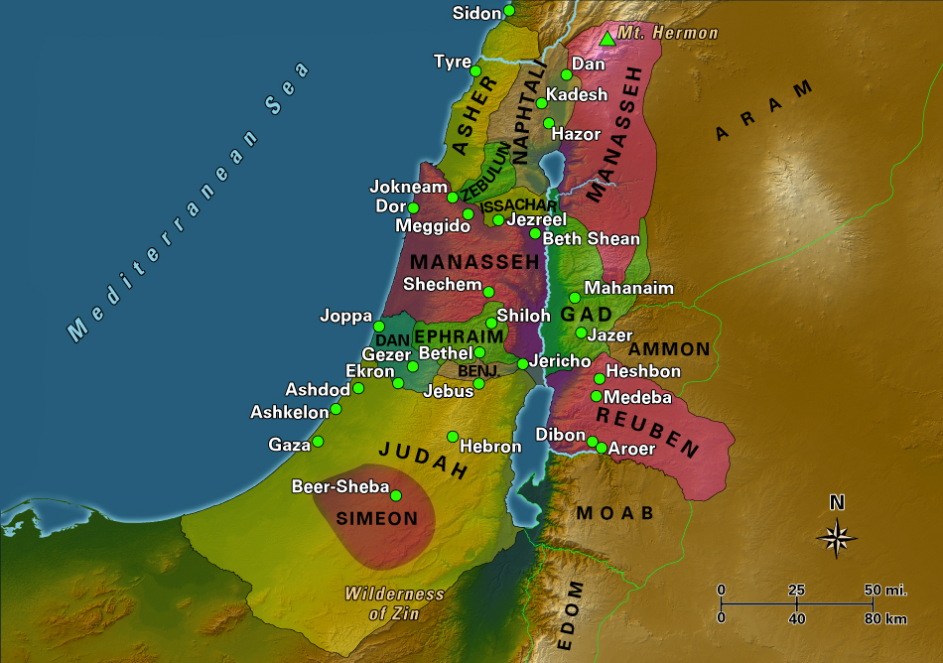

Slide 55
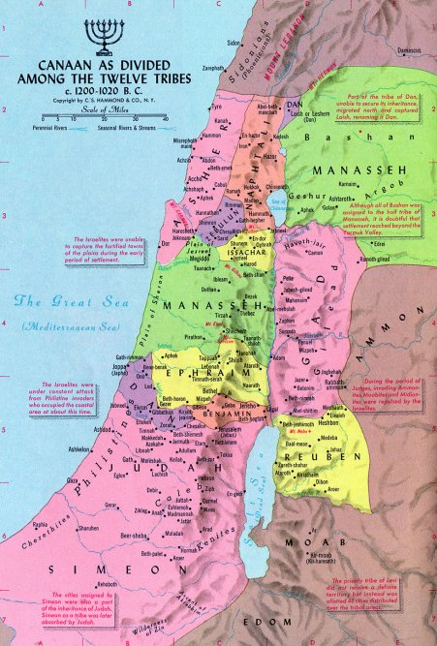

Slide 58
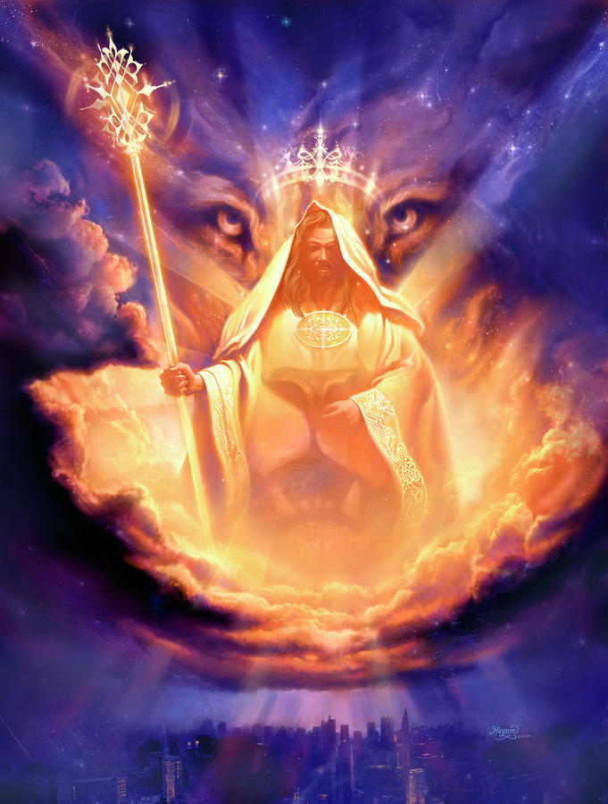

Slide 59
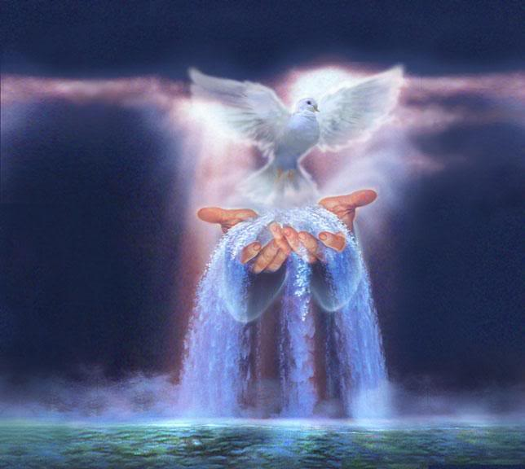

Slide 60
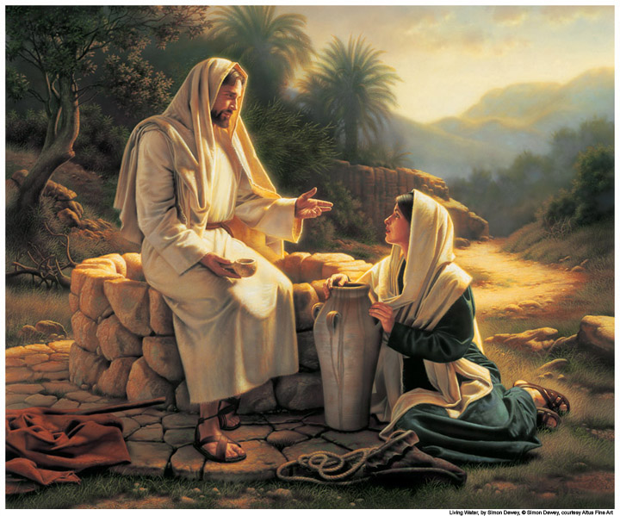

Slide 61
