Slide 1
THE BOOK OF JOSHUA
“Be Strong and Courageous!”
-Joshua in the Old Testament
-Jesus in the New Testament
Date: 5-10-15 Lesson: 13

Slide 2
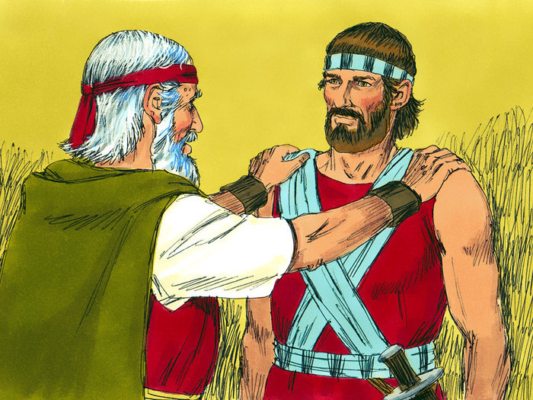

Slide 3
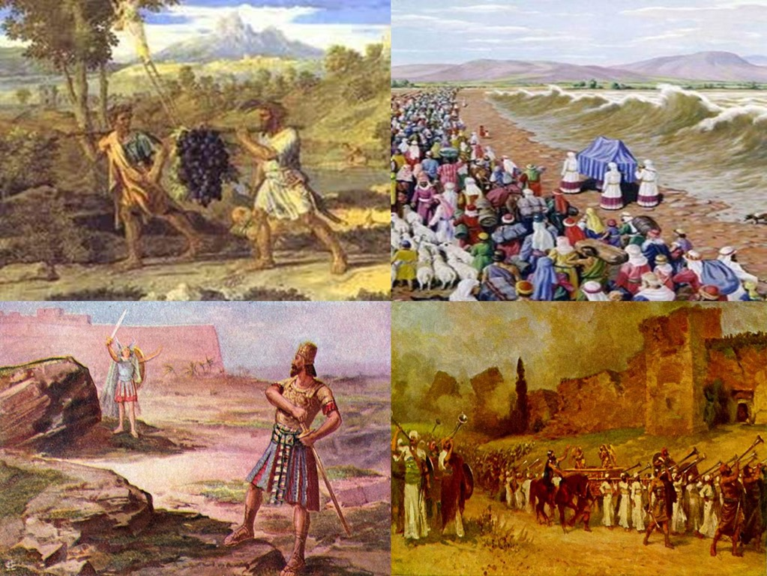

Slide 4
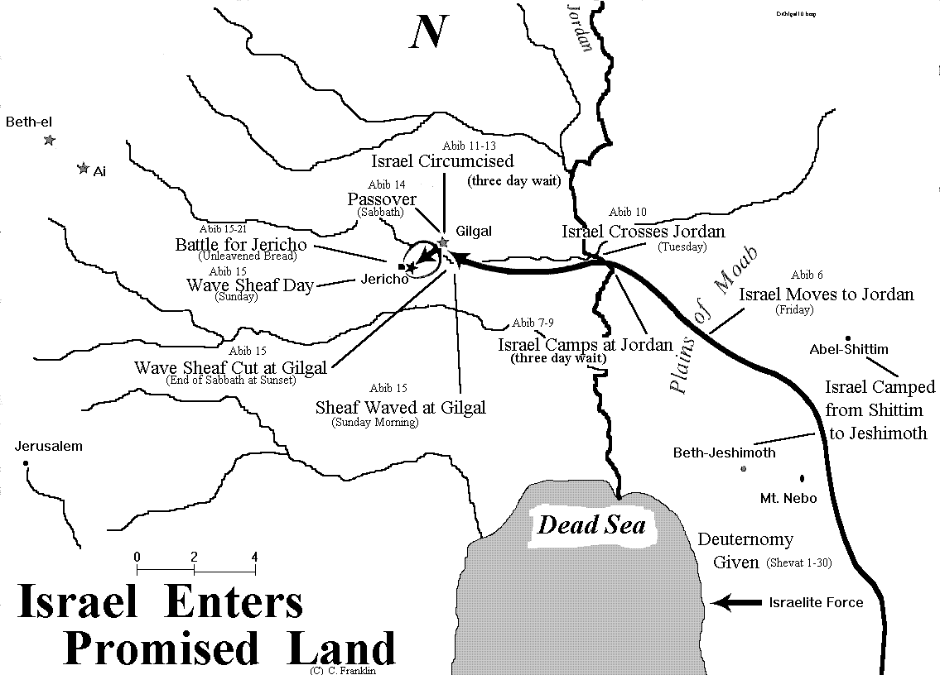

Slide 6
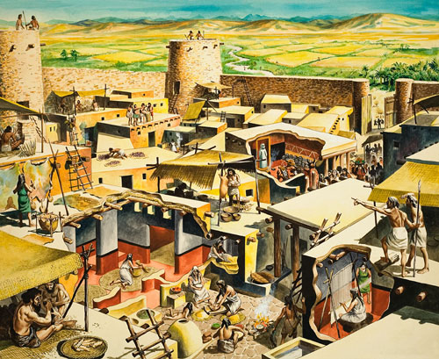

Slide 8
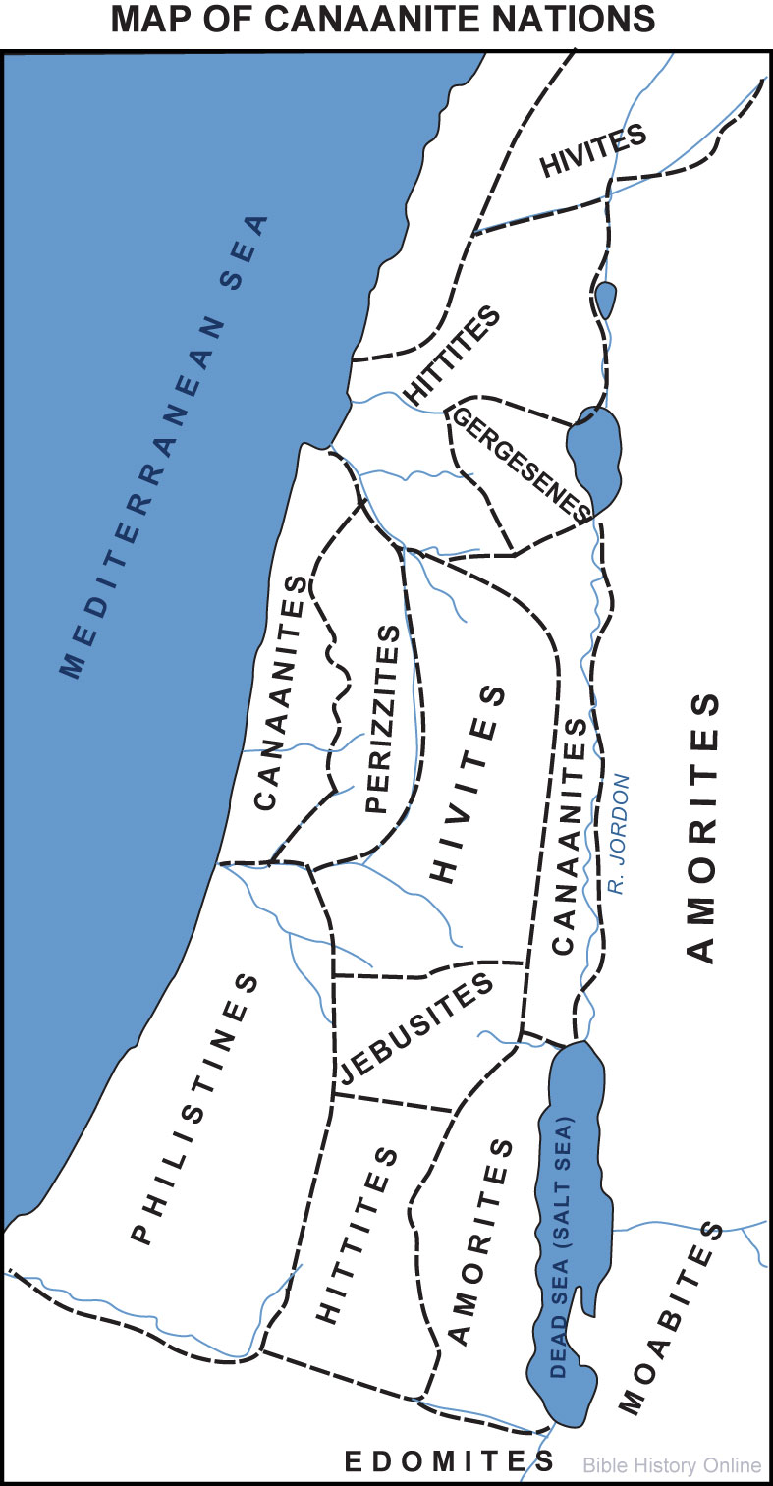

Slide 9
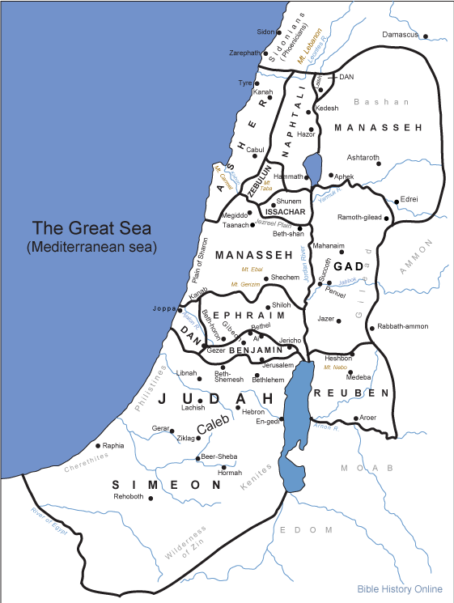

Slide 10
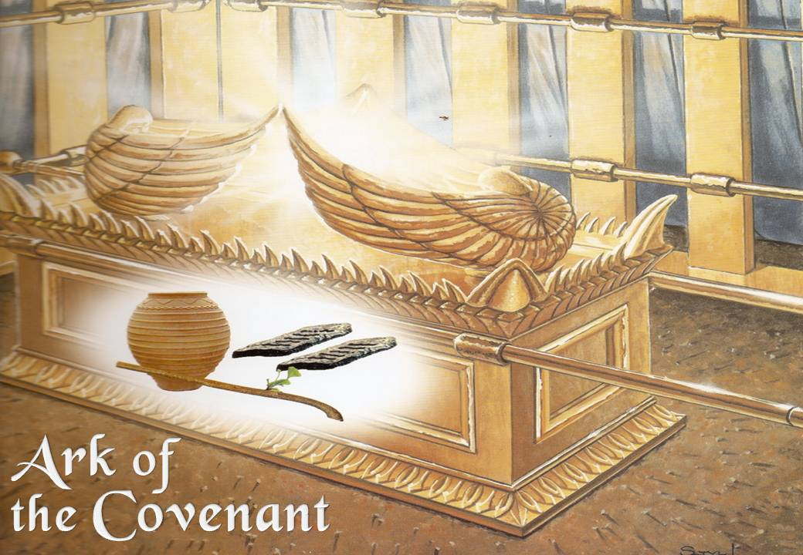

Slide 11
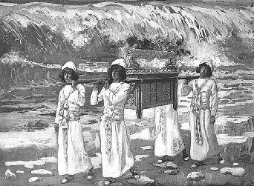

Slide 12
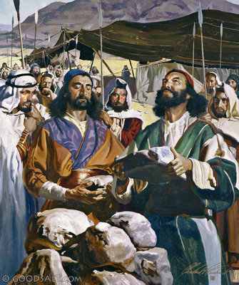

Slide 13
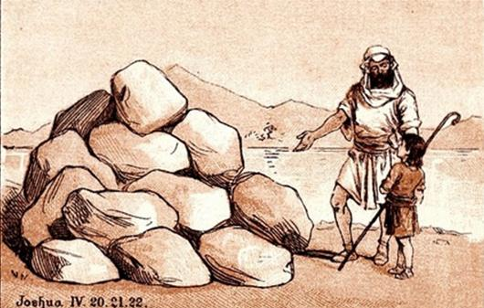

Slide 14
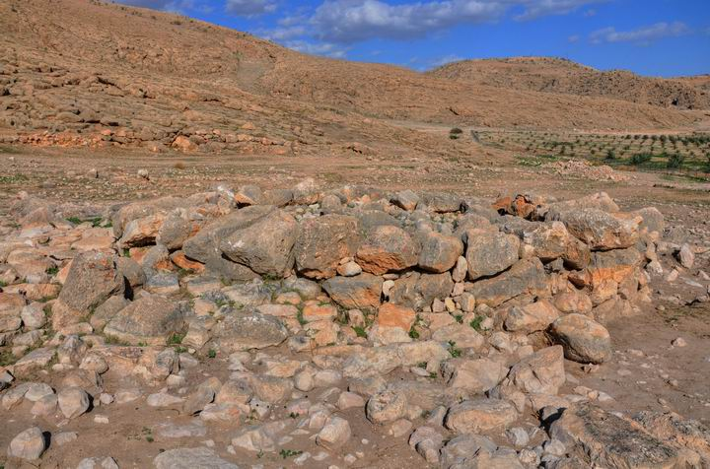

Slide 15
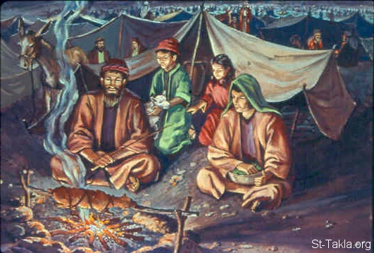

Slide 16
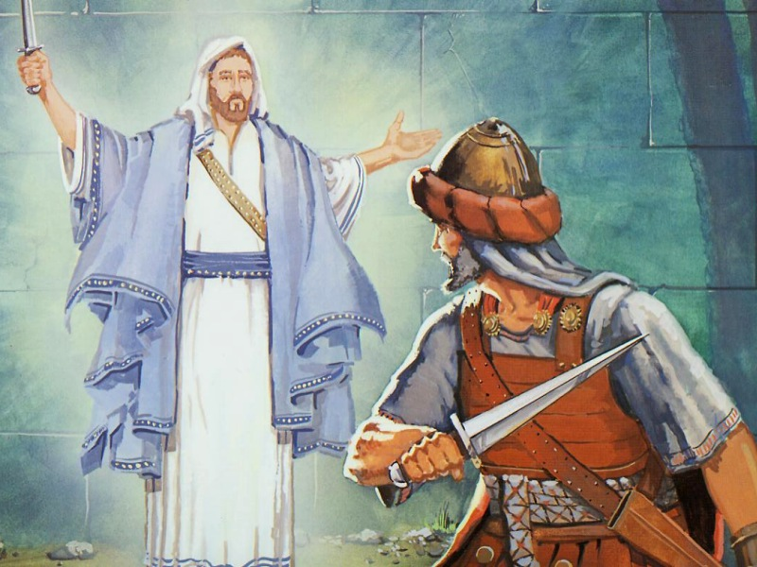

Slide 18
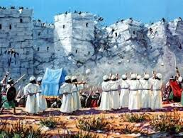

Slide 19
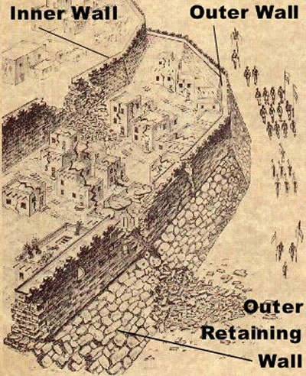

Slide 20
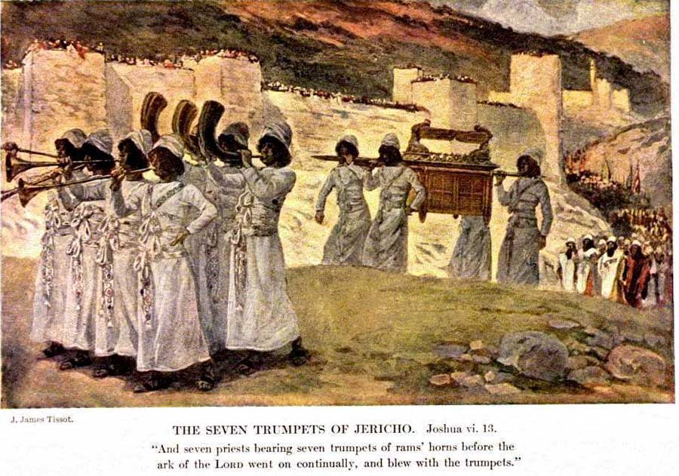

Slide 21
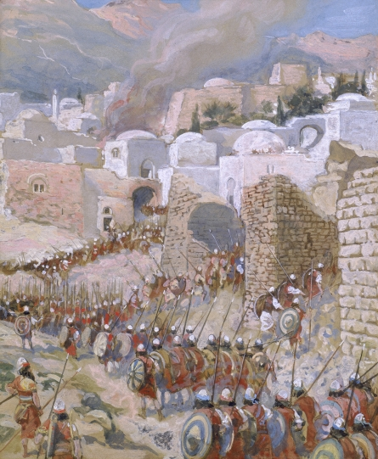

Slide 22
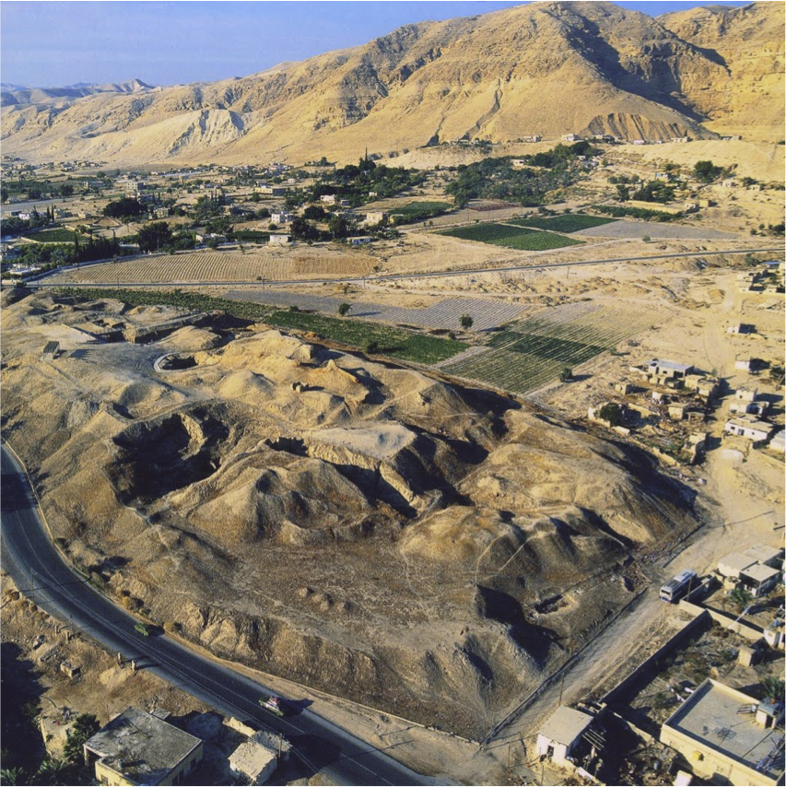

Slide 27
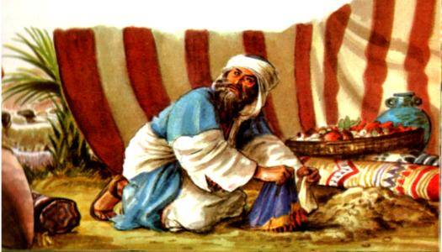

Slide 28
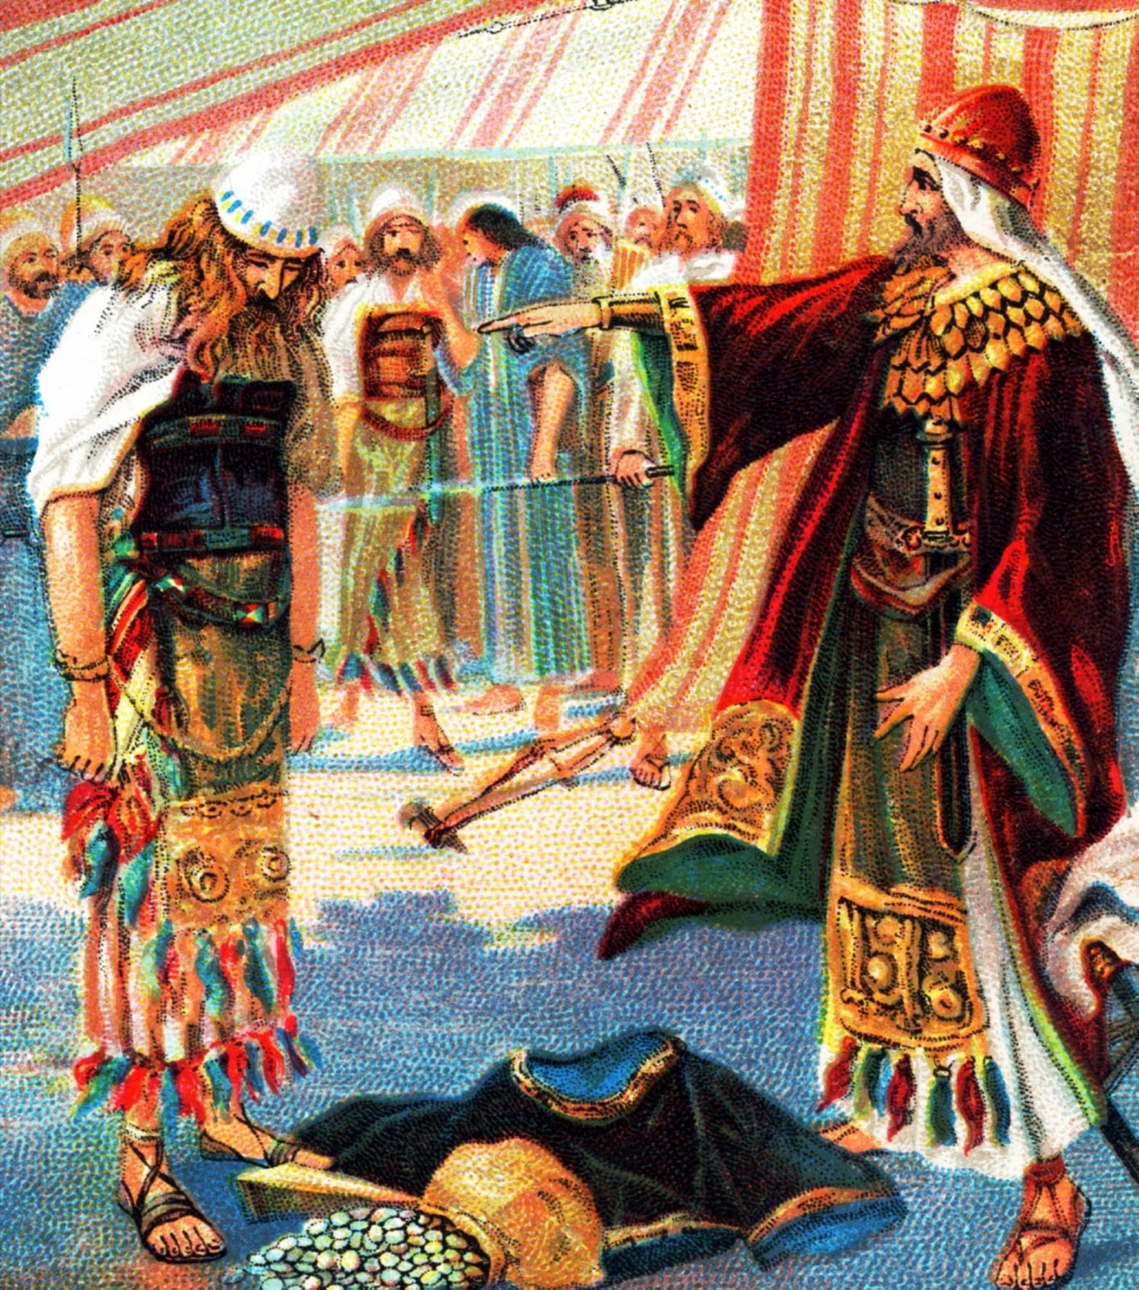

Slide 31
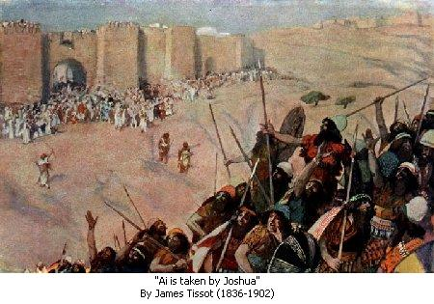

Slide 32
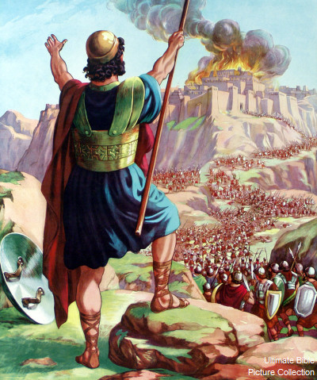

Slide 33
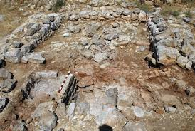

Slide 34
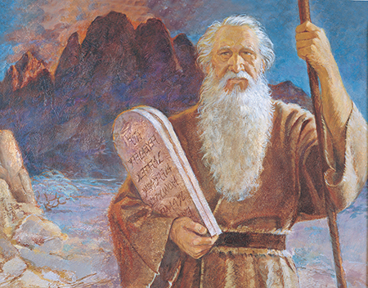

Slide 35
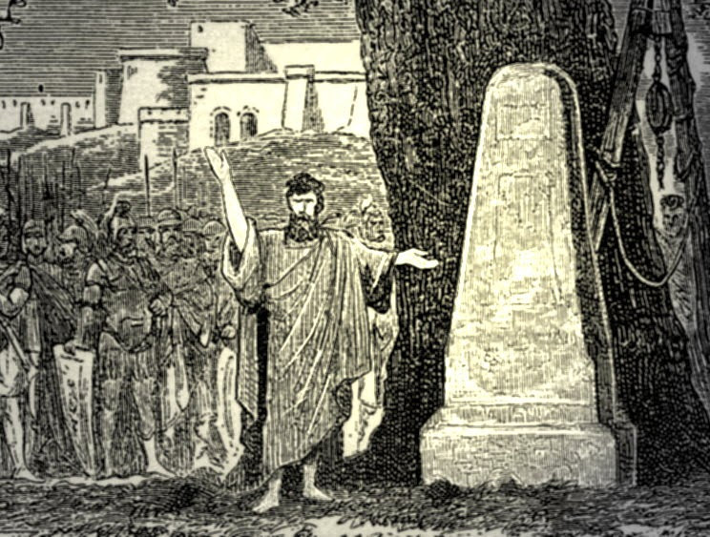

Slide 36
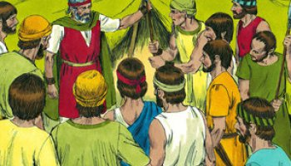

Slide 37
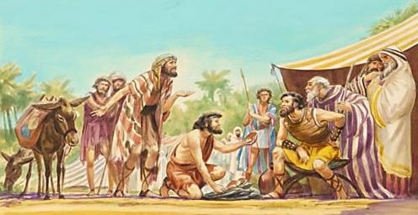

Slide 38
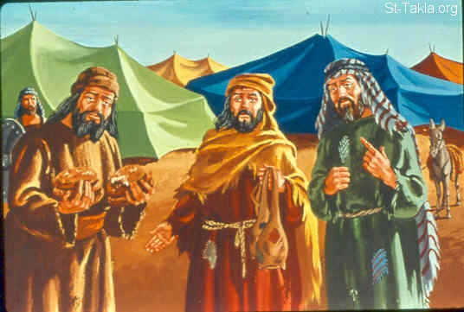

Slide 39
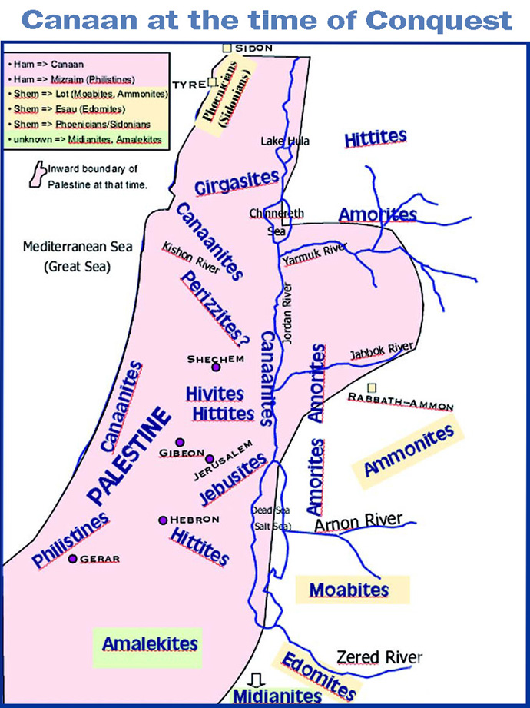

Slide 40
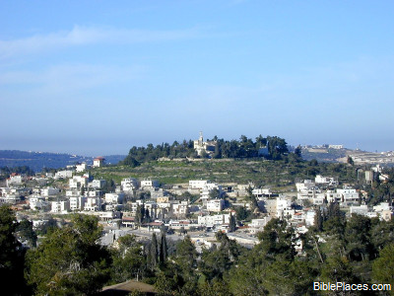

Slide 41
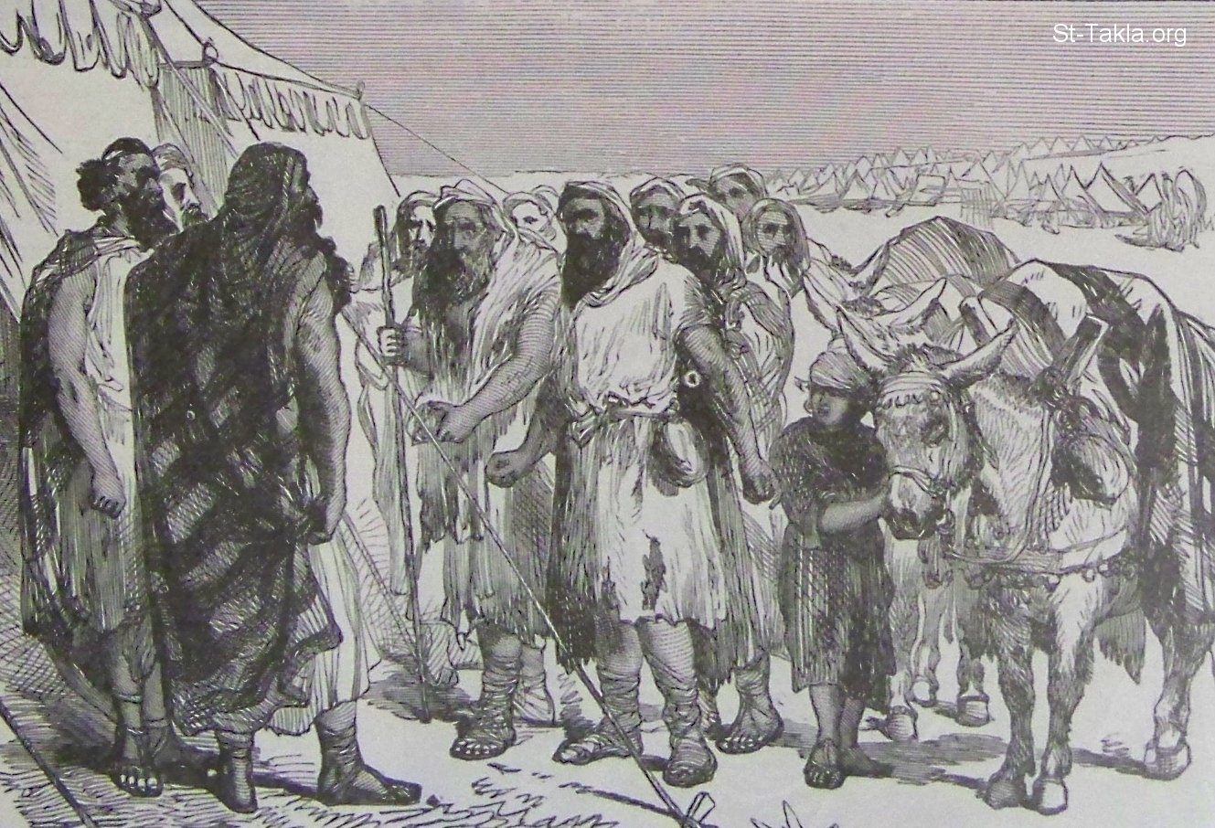

Slide 42
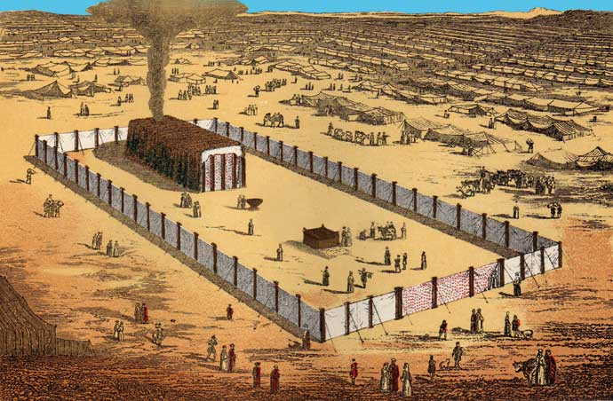

Slide 43
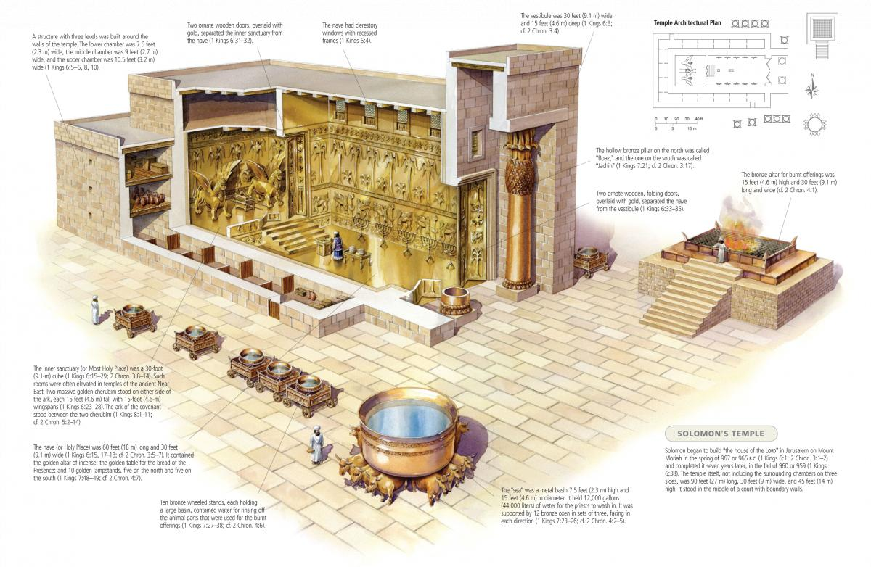

Slide 44
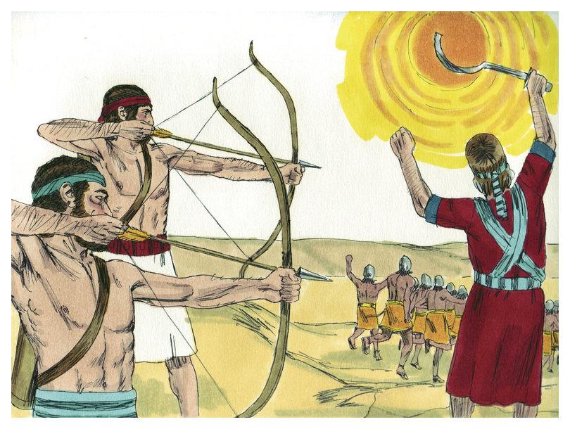

Slide 45
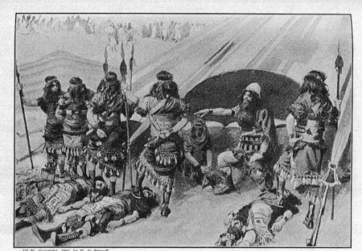

Slide 46
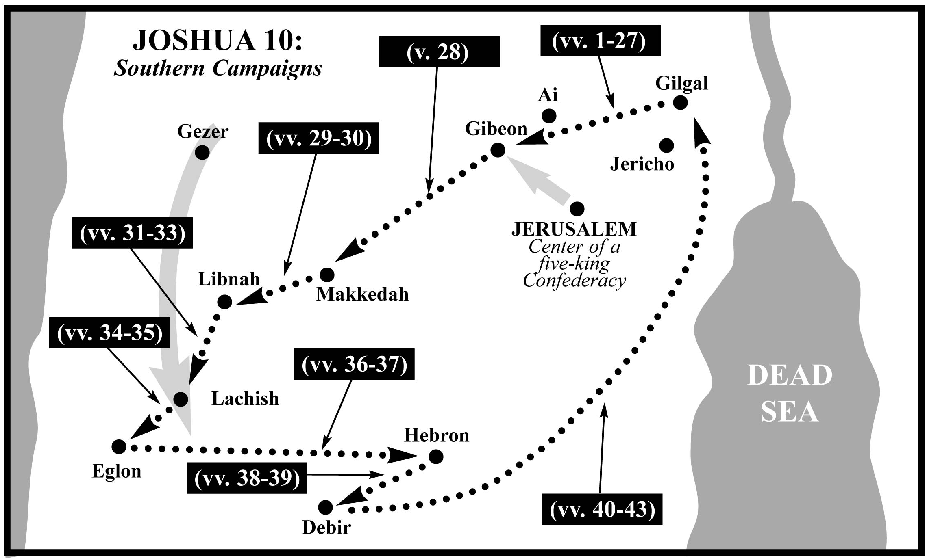

Slide 47
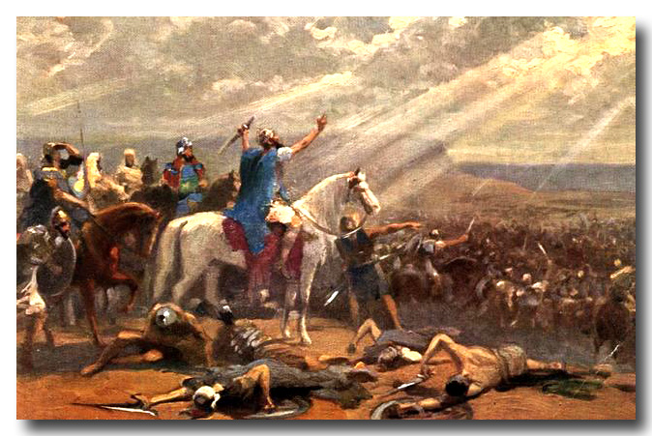

Slide 48
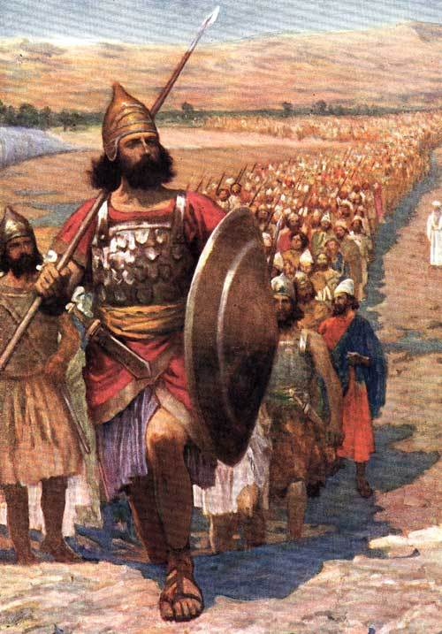

Slide 49
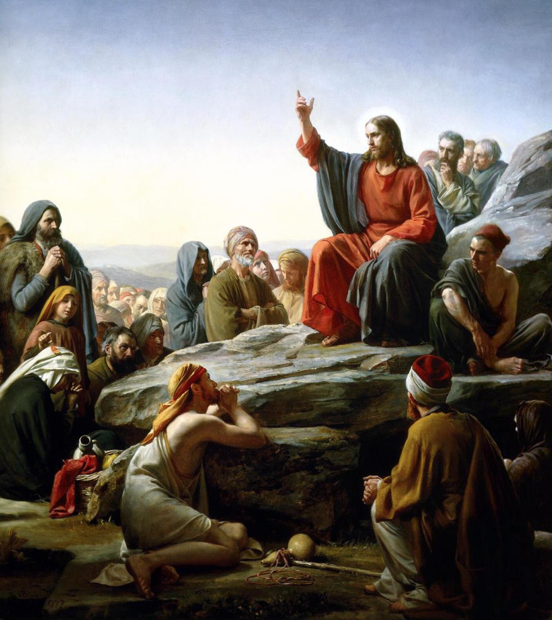

Slide 50
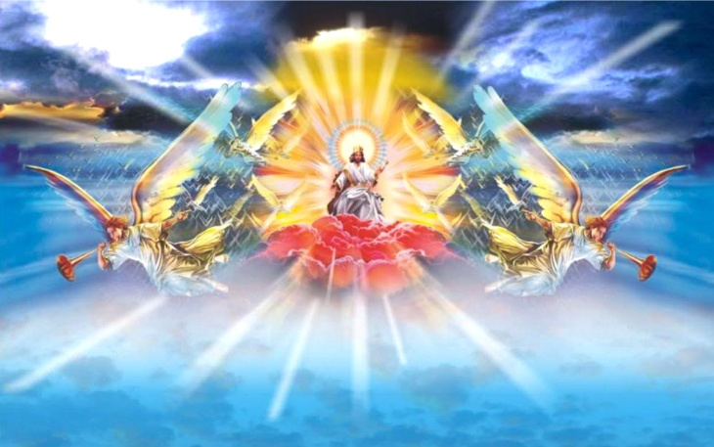

Slide 51
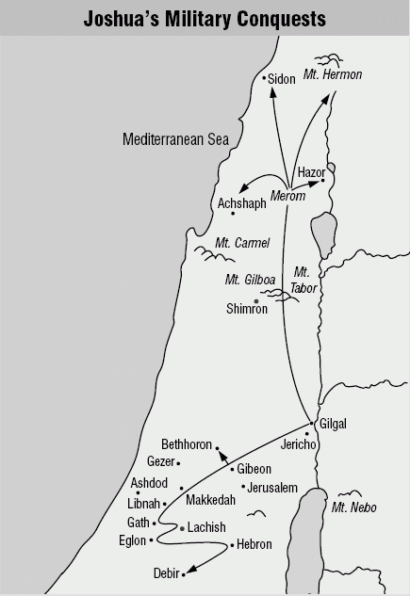

Slide 52
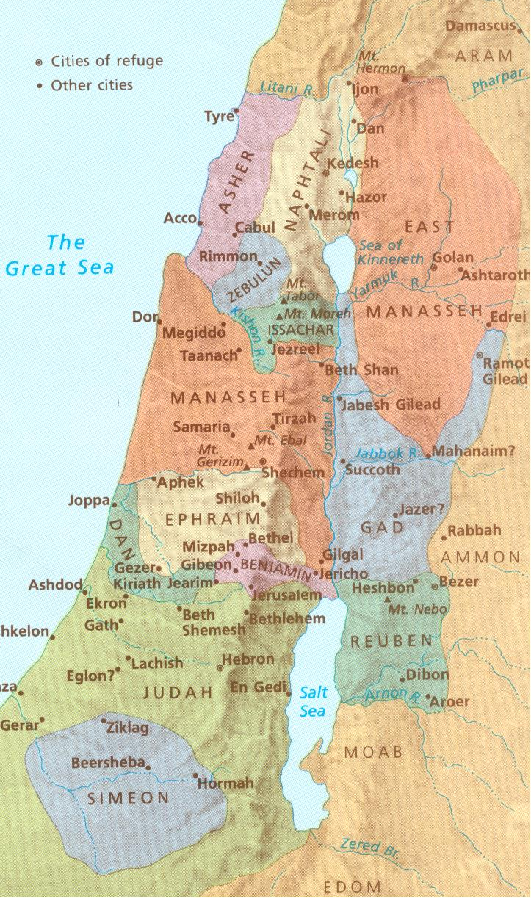

Slide 53
A.TEXT – Chapter 11 (1) When Jabin, king of Hazor, heard of this, he sent to Jobab king of Madon, and to the king of Shimron, and to the king of Achshaph, (2) and to the kings who were in the northern hill country, and in the Arabah south of Chinneroth, and in the lowland, and in Naphoth-dor on the west, (3) to the Canaanites in the east and the west, the Amorites, the Hittites, the Perizzites, and the Jebusites in the hill country, and the Hivites under Hermon in the land of Mizpah. (4) And they came out with all their troops, a great horde, in number like the sand that is on the seashore, with very many horses and chariots. (5) And all these kings joined their forces and came and encamped together at the waters of Merom to fight with Israel. (6) And the Lord said to Joshua, "Do not be afraid of them, for tomorrow at this time I will give over all of them, slain, to Israel. You shall hamstring their horses and burn their chariots with fire." (7) So Joshua and all his warriors came suddenly against them by the waters of Merom and fell upon them. (8) And the Lord gave them into the hand of Israel, who struck them and chased them as far as Great Sidon and Misrephoth-maim, and eastward as far as the Valley of Mizpeh. And they struck them until he left none remaining.

Slide 54
(9) And Joshua did to them just as the Lord said to him: he hamstrung their horses and burned their chariots with fire. (10) And Joshua turned back at that time and captured Hazor and struck its king with the sword, for Hazor formerly was the head of all those kingdoms. (11) And they struck with the sword all who were in it, devoting them to destruction; there was none left that breathed. And he burned Hazor with fire. (12) And all the cities of those kings, and all their kings, Joshua captured, and struck them with the edge of the sword, devoting them to destruction, just as Moses the servant of the Lord had commanded. (13) But none of the cities that stood on mounds did Israel burn, except Hazor alone; that Joshua burned. (14) And all the spoil of these cities and the livestock, the people of Israel took for their plunder. But every man they struck with the edge of the sword until they had destroyed them, and they did not leave any who breathed.

Slide 55
(15) Just as the Lord had commanded Moses his servant, so Moses commanded Joshua, and so Joshua did. He left nothing undone of all that the Lord had commanded Moses. (16) So Joshua took all that land, the hill country and all the Negeb and all the land of Goshen and the lowland and the Arabah and the hill country of Israel and its lowland (17) from Mount Halak, which rises toward Seir, as far as Baal-gad in the Valley of Lebanon below Mount Hermon. And he captured all their kings and struck them and put them to death. (18) Joshua made war a long time with all those kings. (19) There was not a city that made peace with the people of Israel except the Hivites, the inhabitants of Gibeon. They took them all in battle. (20) For it was the Lord's doing to harden their hearts that they should come against Israel in battle, in order that they should be devoted to destruction and should receive no mercy but be destroyed, just as the Lord commanded Moses.

Slide 56
(21) And Joshua came at that time and cut off the Anakim from the hill country, from Hebron, from Debir, from Anab, and from all the hill country of Judah, and from all the hill country of Israel. Joshua devoted them to destruction with their cities. (22) There was none of the Anakim left in the land of the people of Israel. Only in Gaza, in Gath, and in Ashdod did some remain. (23) So Joshua took the whole land, according to all that the Lord had spoken to Moses. And Joshua gave it for an inheritance to Israel according to their tribal allotments. And the land had rest from war.

Slide 57
B. STUDY NOTES: 1. This is now the description of defeating the northern kingdoms also. Hazor was the greatest victory – it was a large fortified city in Canaan, and its lower city was 175 acres. “Jabin” as king was a dynastic name – like “Pharoah.” 2. Mounds were left after the destruction of a city and then a new city was built on it. 3. Joshua left nothing undone, like Moses, he did what the Lord told him to do. (Ex 34:11; Dt 7:2,16; 20:16,17; Jdg 14:4) 4. For a long time = 7 years of battles and conquests. It happened during the life of Caleb from age 78 to 85. (Josh 14:7,10; Dt 2:14)

Slide 58
5. The Lord hardens people’s hearts when they harden theirs against the Lord. (Ex 4:21; 8:32; 9:12; 14:17; Rom 9:14-28; Heb 3:7-19) 6. Anakites = related to the Nephilim (Gen 6:4) = people of great size (Nu 13:28-33) = named after their forefather Anak. They were dreaded and the oldest inhabitants of Canaan, much feared by the nations. They may have been the “Ya’anaq” from Egyptian texts. Some of them fled to Gaza, Gath and Ashdod – and later still caused trouble for Israel – Goliath would come from Gath (1 Sam 17:4) 7. The land given to Israel as God had commanded – according to their tribal divisions – their inheritance - (Dt 1:38; 12:9-10; 25:19; Nu 26:53; Ps 105:44; Heb 9:15-28)

Slide 59
8. The victory was from the Lord – since the enemy had horses, chariots and were in number like the sand on the seashore. It was devoted to destruction as the Lord commanded. (Dt 7:2; 20:16,17; Rev 20:7-15) 9. Then the land had rest from war (Ex 33:14; Jdg 1:27-36; Heb 4:1-11)

Slide 60
C. LIFE APPLICATION:
1. “As the Lord had commanded Moses his servant, so Moses commanded Joshua, and so Joshua did,”
- since the Word of God is passed on through actual
persons – how has this happened for you?
When do people “harden their hearts” against God, Jesus, the Holy Spirit – God’s Word?
In what ways doe the new Joshua, Jesus, “give an inheritance” to the new Israel, the Church, according
to our “allotments” in the new heavens and the new earth?
4. Who enables us to inherit the “eternal land” and have “rest from all war” forever?

Slide 61
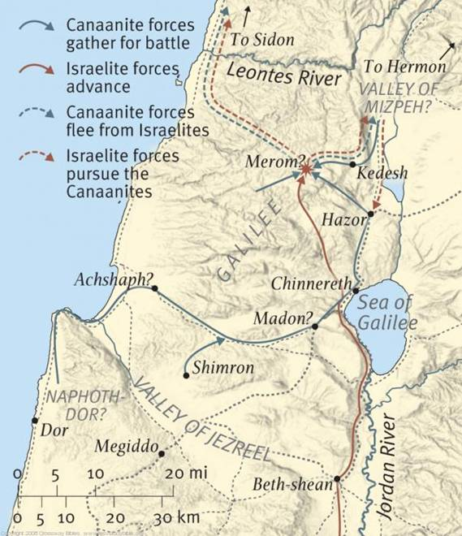

Slide 62
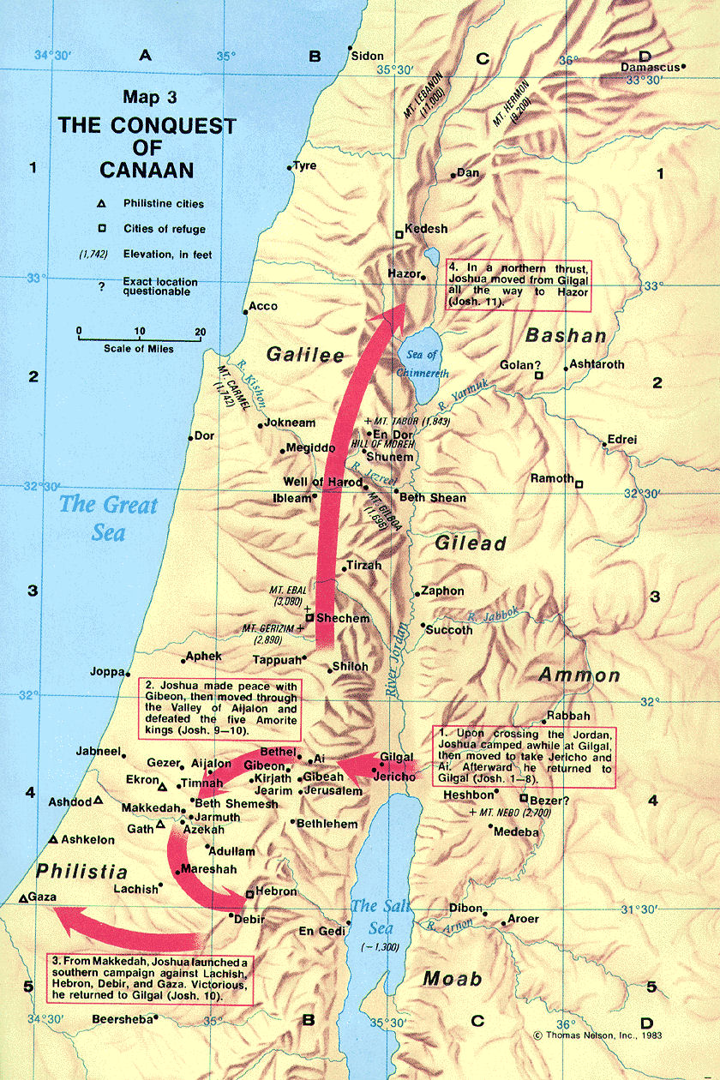

Slide 63
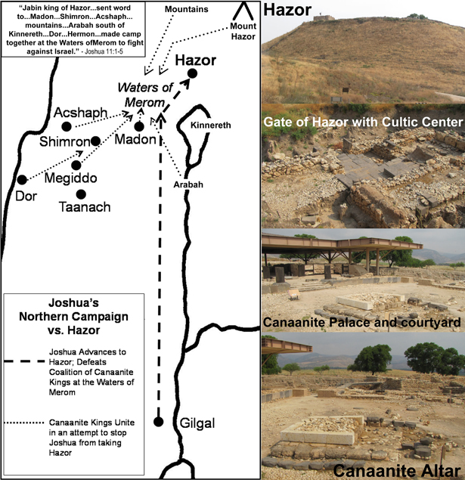

Slide 64
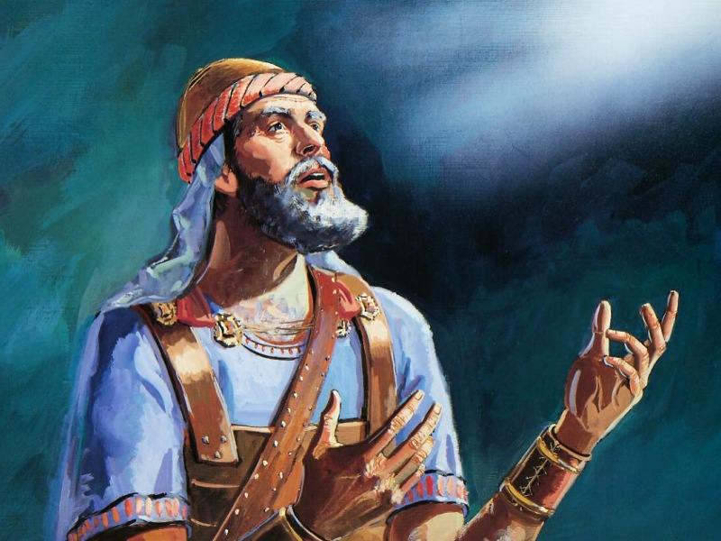

Slide 65
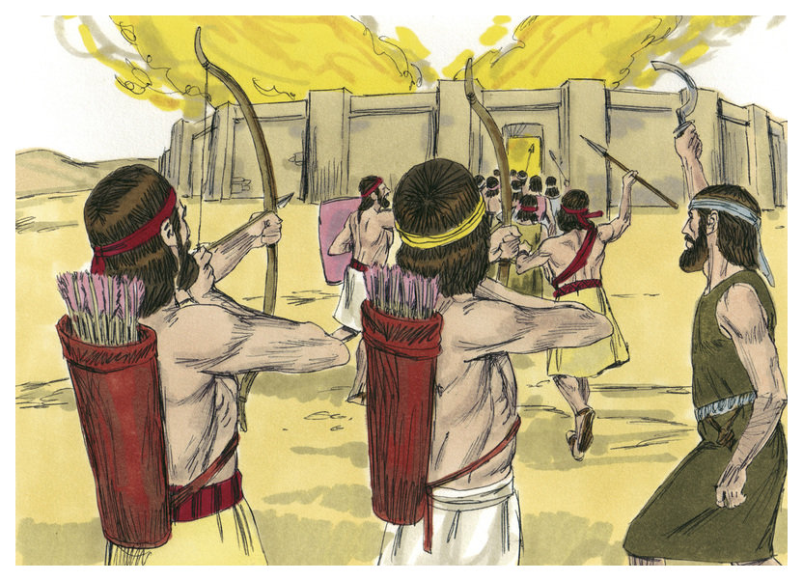

Slide 66
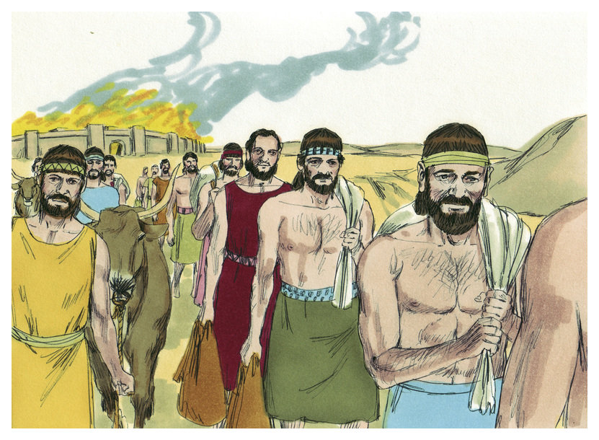

Slide 68
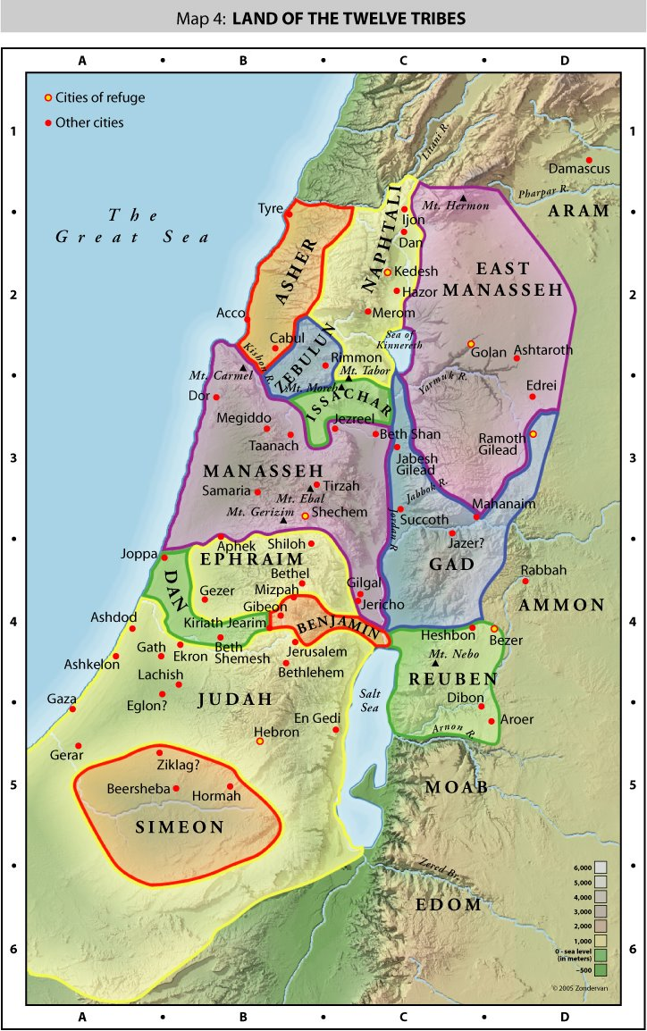

Slide 69
