Slide 1
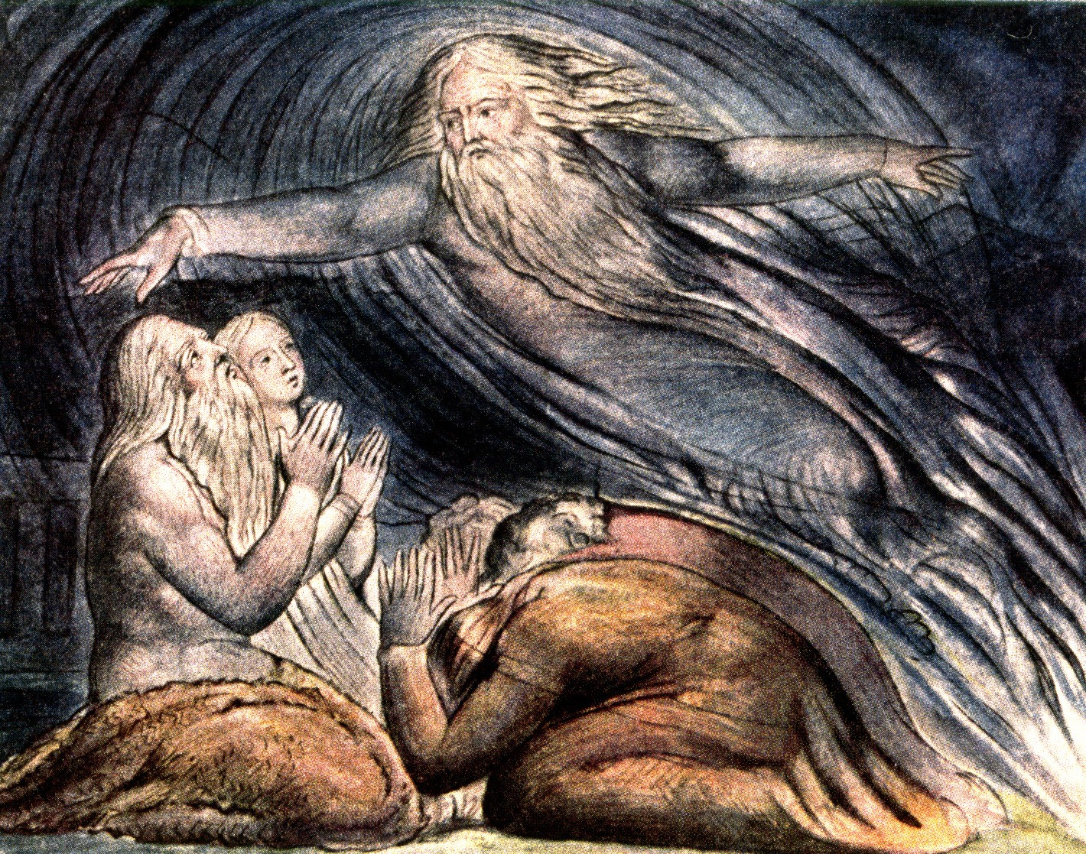
Begins July 16

Slide 2
THE BOOK OF JOB –
“The Suffering and Consolation of the Christian”
Date: 4-22-18 Lesson: 20
Text: Chapters 38, 39
Theme:
“The Lord Answered Job Out of the Whirlwind”

Slide 3
Text: (Job 38:1-41) Then the Lord answered Job out of the whirlwind and said: (2) "Who is this that darkens counsel by words without knowledge? (3) Dress for action like a man; I will question you, and you make it known to me. (4) "Where were you when I laid the foundation of the earth? Tell me, if you have understanding. (5) Who determined its measurements--surely you know! Or who stretched the line upon it? (6) On what were its bases sunk, or who laid its cornerstone, (7) when the morning stars sang together and all the sons of God shouted for joy? (8) "Or who shut in the sea with doors when it burst out from the womb, (9) when I made clouds its garment and thick darkness its swaddling band, (10) and prescribed limits for it and set bars and doors, (11) and said, 'Thus far shall you come, and no farther, and here shall your proud waves be stayed'?
(12) "Have you commanded the morning since your days began, and caused the dawn to know its place, (13) that it might take hold of the skirts of the earth, and the wicked be shaken out of it? (14) It is changed like clay under the seal, and its features stand out like a garment. (15) From the wicked their light is withheld, and their uplifted arm is broken.
(16) "Have you entered into the springs of the sea, or walked in the recesses of the deep? (17) Have the gates of death been revealed to you, or have you seen the gates of deep darkness? (18) Have you comprehended the expanse of the earth? Declare, if you know all this. (19) "Where is the way to the dwelling of light, and where is the place of darkness, (20) that you may take it to its territory and that you may discern the paths to its home? (21) You know, for you were born then, and the number of your days is great!
.

Slide 4
(22) "Have you entered the storehouses of the snow, or have you seen the storehouses of the hail, (23) which I have reserved for the time of trouble, for the day of battle and war? (24) What is the way to the place where the light is distributed, or where the east wind is scattered upon the earth? (25) "Who has cleft a channel for the torrents of rain and a way for the thunderbolt, (26) to bring rain on a land where no man is, on the desert in which there is no man, (27) to satisfy the waste and desolate land, and to make the ground sprout with grass? (28) "Has the rain a father, or who has begotten the drops of dew? (29) From whose womb did the ice come forth, and who has given birth to the frost of heaven? (30) The waters become hard like stone, and the face of the deep is frozen.
(31) "Can you bind the chains of the Pleiades or loose the cords of Orion? (32) Can you lead forth the Mazzaroth in their season, or can you guide the Bear with its children? (33) Do you know the ordinances of the heavens? Can you establish their rule on the earth? (34) "Can you lift up your voice to the clouds, that a flood of waters may cover you? (35) Can you send forth lightnings, that they may go and say to you, 'Here we are'?
(36) Who has put wisdom in the inward parts or given understanding to the mind? (37) Who can number the clouds by wisdom? Or who can tilt the waterskins of the heavens, (38) when the dust runs into a mass and the clods stick fast together? (39) "Can you hunt the prey for the lion, or satisfy the appetite of the young lions, (40) when they crouch in their dens or lie in wait in their thicket? (41) Who provides for the raven its prey, when its young ones cry to God for help, and wander about for lack of food?

Slide 5
(Job 39:1-30) "Do you know when the mountain goats give birth? Do you observe the calving of the does? (2) Can you number the months that they fulfill, and do you know the time when they give birth, (3) when they crouch, bring forth their offspring, and are delivered of their young? (4) Their young ones become strong; they grow up in the open; they go out and do not return to them. (5) "Who has let the wild donkey go free? Who has loosed the bonds of the swift donkey, (6) to whom I have given the arid plain for his home and the salt land for his dwelling place?
(7) He scorns the tumult of the city; he hears not the shouts of the driver. (8) He ranges the mountains as his pasture, and he searches after every green thing. (9) "Is the wild ox willing to serve you? Will he spend the night at your manger? (10) Can you bind him in the furrow with ropes, or will he harrow the valleys after you? (11) Will you depend on him because his strength is great, and will you leave to him your labor? (12) Do you have faith in him that he will return your grain and gather it to your threshing floor?

Slide 6
(13) "The wings of the ostrich wave proudly, but are they the pinions and plumage of love? (14) For she leaves her eggs to the earth and lets them be warmed on the ground, (15) forgetting that a foot may crush them and that the wild beast may trample them. (16) She deals cruelly with her young, as if they were not hers; though her labor be in vain, yet she has no fear, (17) because God has made her forget wisdom and given her no share in understanding. (18) When she rouses herself to flee, she laughs at the horse and his rider.
(19) "Do you give the horse his might? Do you clothe his neck with a mane? (20) Do you make him leap like the locust? His majestic snorting is terrifying. (21) He paws in the valley and exults in his strength; he goes out to meet the weapons. (22) He laughs at fear and is not dismayed; he does not turn back from the sword. (23) Upon him rattle the quiver, the flashing spear and the javelin. (24) With fierceness and rage he swallows the ground; he cannot stand still at the sound of the trumpet. (25) When the trumpet sounds, he says 'Aha!' He smells the battle from afar, the thunder of the captains, and the shouting.
(26) "Is it by your understanding that the hawk soars and spreads his wings toward the south? (27) Is it at your command that the eagle mounts up and makes his nest on high? (28) On the rock he dwells and makes his home, on the rocky crag and stronghold. (29) From there he spies out the prey; his eyes behold it afar off. (30) His young ones suck up blood, and where the slain are, there is he."

Slide 7
STUDY NOTES:
1. The Lord (Yahweh) “I AM” (Ex 3:15) appears in a whirlwind, which is a theophany, an appearance of God on earth.
(Ex 14:21; 19:16; 2 Kings 2:1; Ps 18:12-14; 1 Sam 2:10;
Is 21:1; Zech 9:14; Ezek 1:4)
2. Animate and inanimate creation bears testimony
to God’s creative power.
3. (38:7) “When the morning stars sang together and all the sons of God (angels) (Rev. 19:1-3) shouted for joy”
(Ps 65:13; 148:2,3)
4. (38:10) “And prescribed limits for it and set bars and doors, (11) and said, 'Thus far shall you come, and no
farther, and here shall your proud waves be stayed'
(Ps 33:7; Jer 5:22; Lk 8:24,25)
God the Father speaks and God the Son speaks
and the waters must listen!
5. (38:15) “From the wicked their light is withheld” People walking in darkness (Lk 11:35; Jn 3:19-21)

Slide 8
6. (38:41) “Who provides for the raven its prey, when its young ones cry to God for help,
and wander about for lack of food” (Mt 6:26; Lk 12:24)
7. (39:7-11) “The wild ox… you depend on him because his strength is great.” Strong beasts of burden.
(Num 23:22; 24:8; Dt 33:17; Ps 29:6;
1 Cor 9:9; Rev 4:7)
8. The horse, the only domestic animal referred to here (39:19-25), war horses compared to locusts
(Jer 51:27; Joel 2:4; Rev 9:7; Rev 19:11-19)
9. (38:22-25) The blessing of rain in all its forms – clouds, snow, ice - (Dt. 28:12; Mt 5:45)
10. (38:31-33) Constellations of the stars that God created for signs, seasons, years: Pleiades (the 7 Sisters) -Orion
Mazzaroth – The Bear with its children (the Lion – Ursa Major- Big Bear containing the Big Dipper) (Gen. 1:14-16)

Slide 9
LUTHER’S WORKS – Vol. 1, p. 73 (Gen. 1:31) –
The Creation of the Universe by God is Very Good
“And God saw all things that He had made, and they were very good. And evening and morning became the sixth day.” After God has finished His works, He speaks after the custom of one who has become tired, as if He wanted to say: “Behold, I have prepared all things in the best way. The heaven I have prepared as a roof; the earth is the flooring; the animals—with all the appointments of the earth, the sea, and the air—are the possession and wealth; seeds, roots, and herbs are the food. Moreover, he himself, the lord of these, man, has been created. He is to have knowledge of God; and with the utmost freedom from fear, with justice and wisdom, he is to make use of the creatures as he wishes, according to his will. Nothing is lacking. All things have been created in greatest abundance for physical life. Therefore I shall keep a Sabbath.”

Slide 10
LIFE APPLICATION:
Since the Lord answered Job out of the whirlwind and said: "Who is this that darkens counsel by words without knowledge? Dress for action like a man; I will question you, and you make it known to me.
"Where were you when I laid the foundation of the earth? Tell me, if you have understanding.”
What is our only response to the Lord’s entreaties?

Slide 11
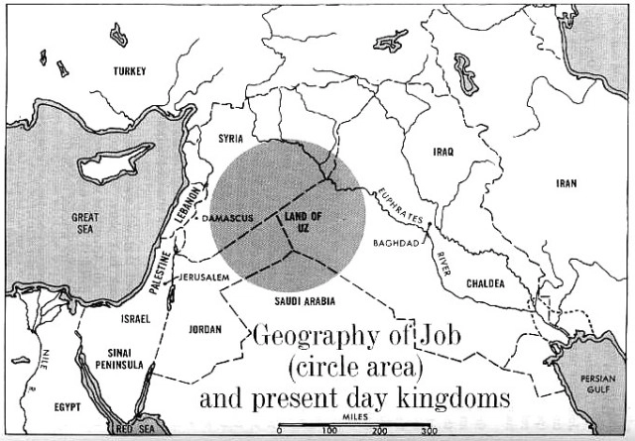

Slide 12
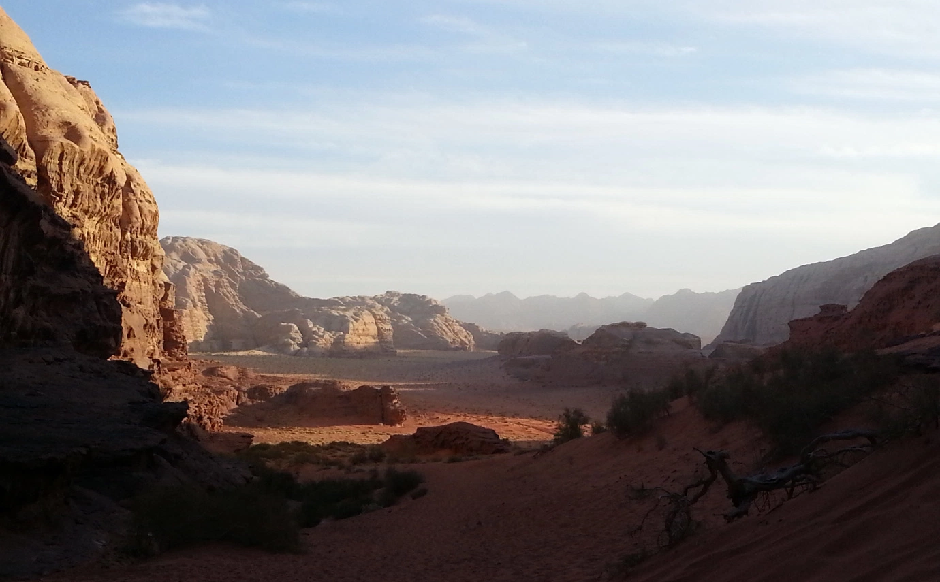

Slide 13
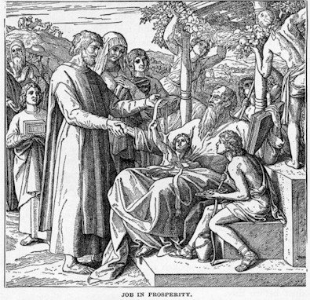

Slide 32
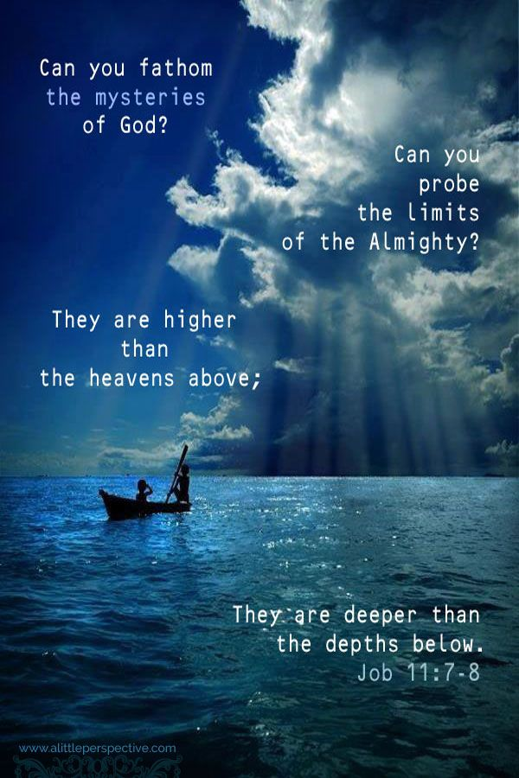

Slide 35
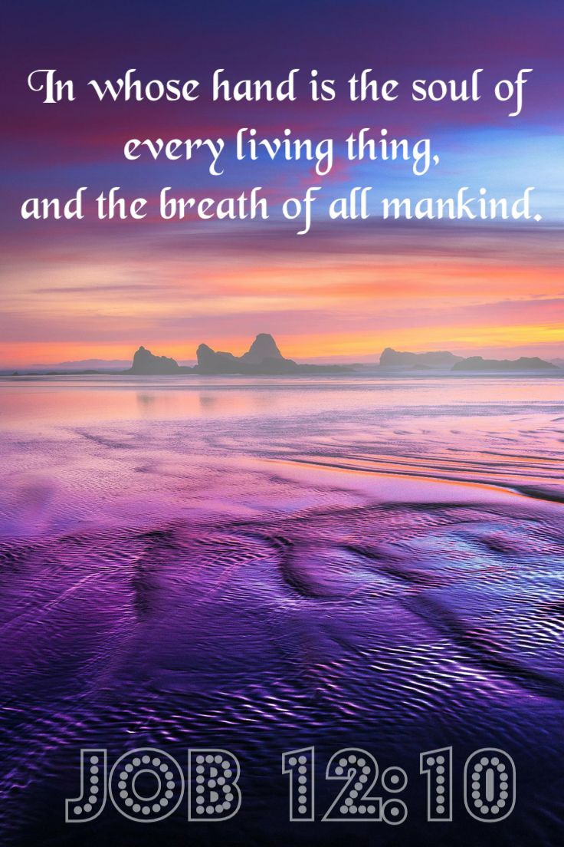

Slide 40
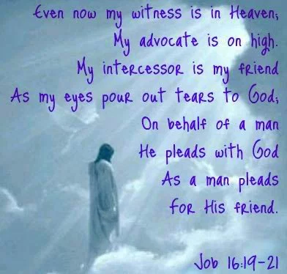

Slide 47
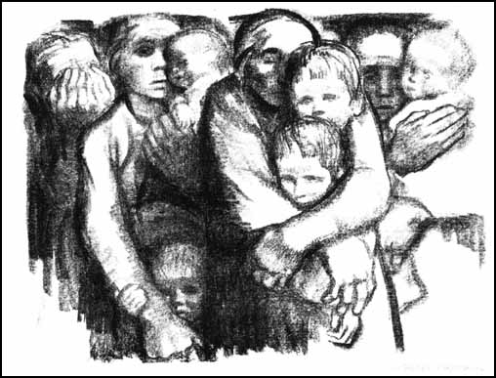

Slide 48
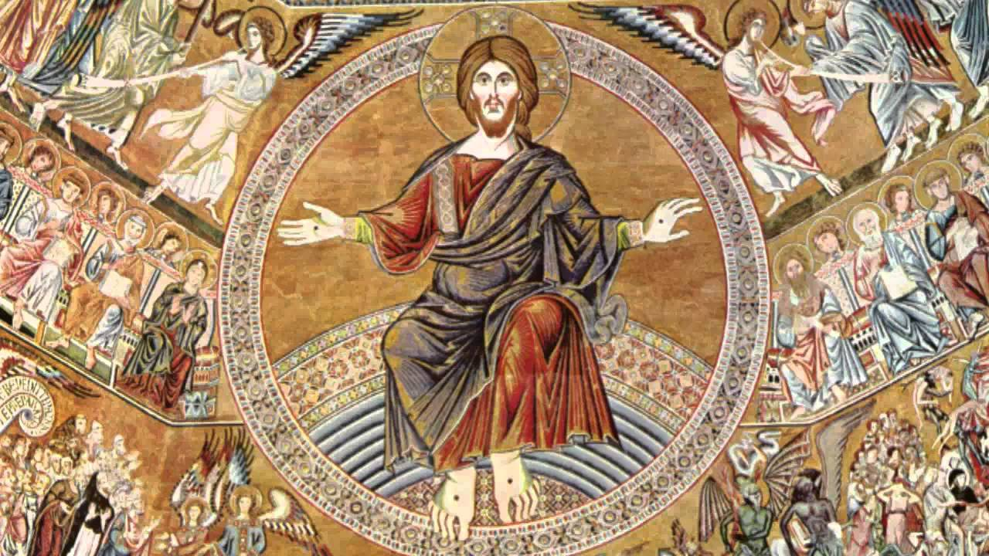

Slide 49
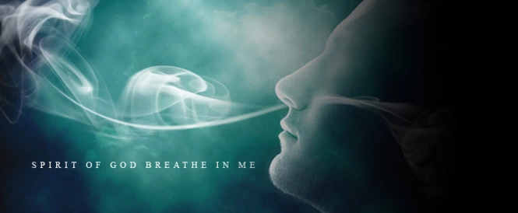

Slide 50
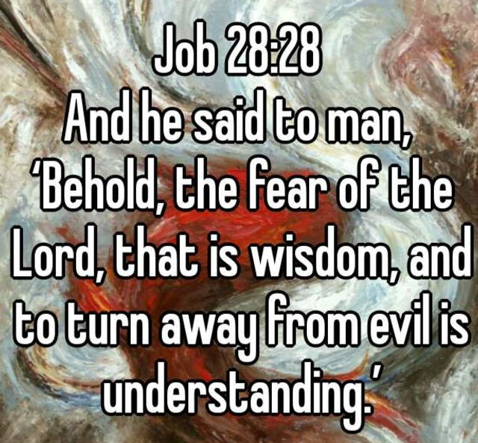

Slide 51
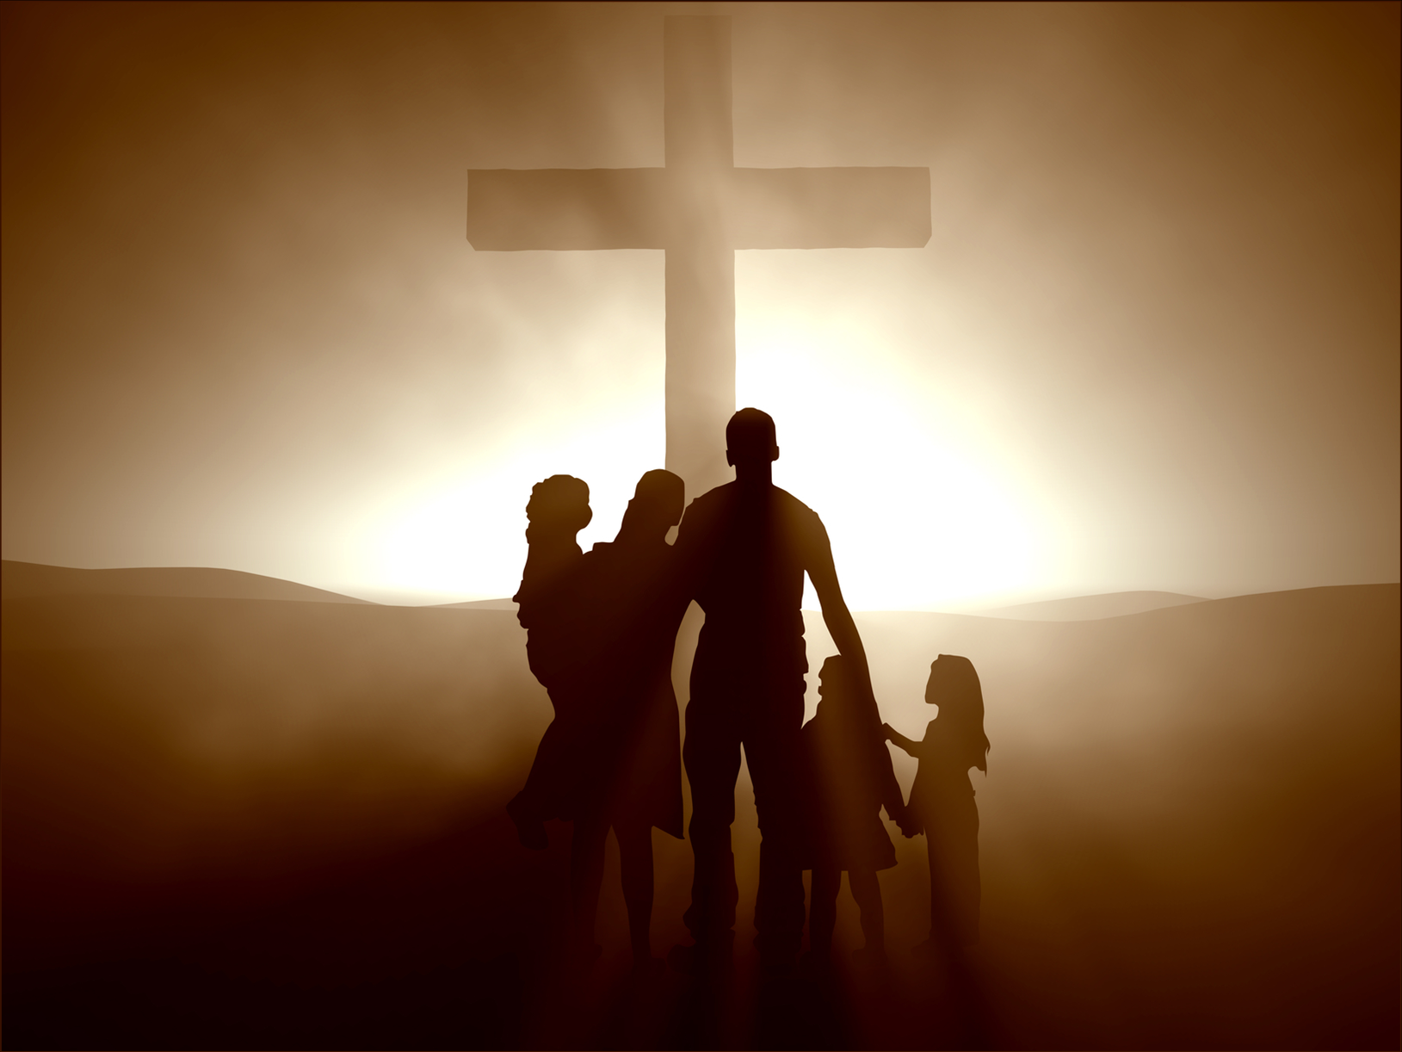

Slide 52
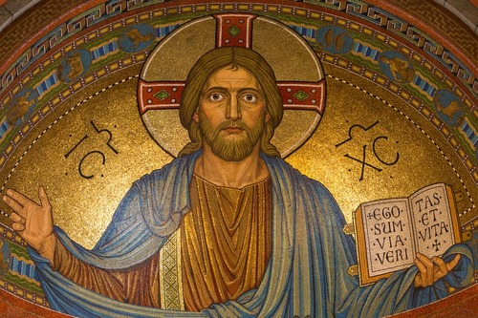

Slide 53
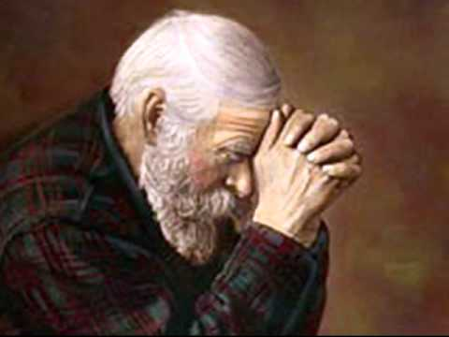

Slide 55
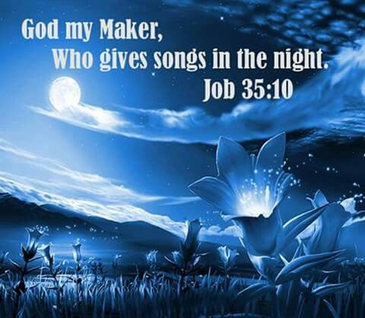

Slide 59
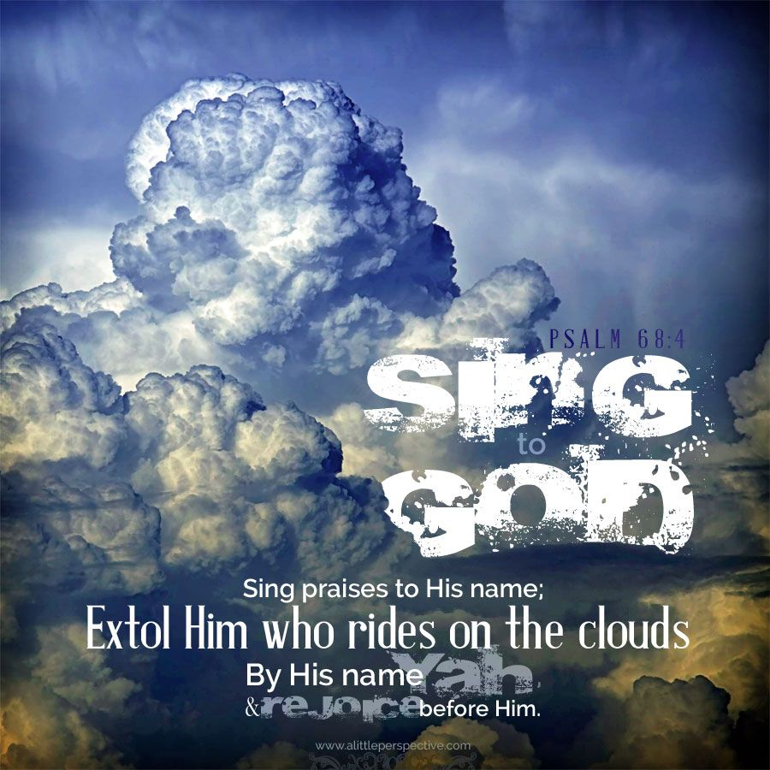

Slide 60
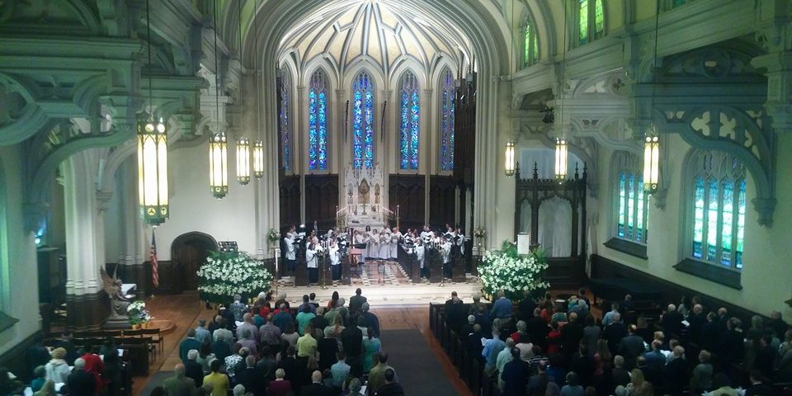

Slide 61
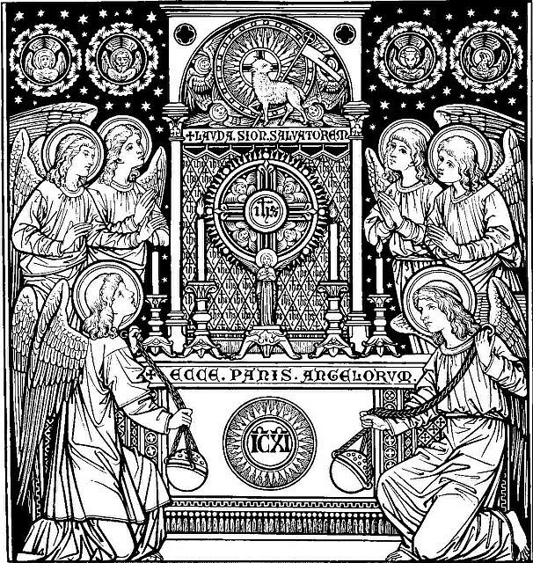

Slide 62
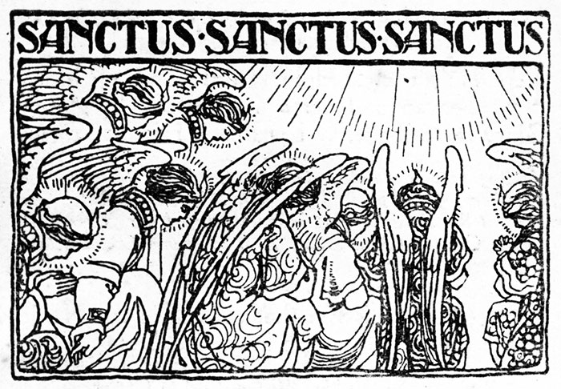

Slide 63
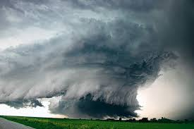

Slide 66
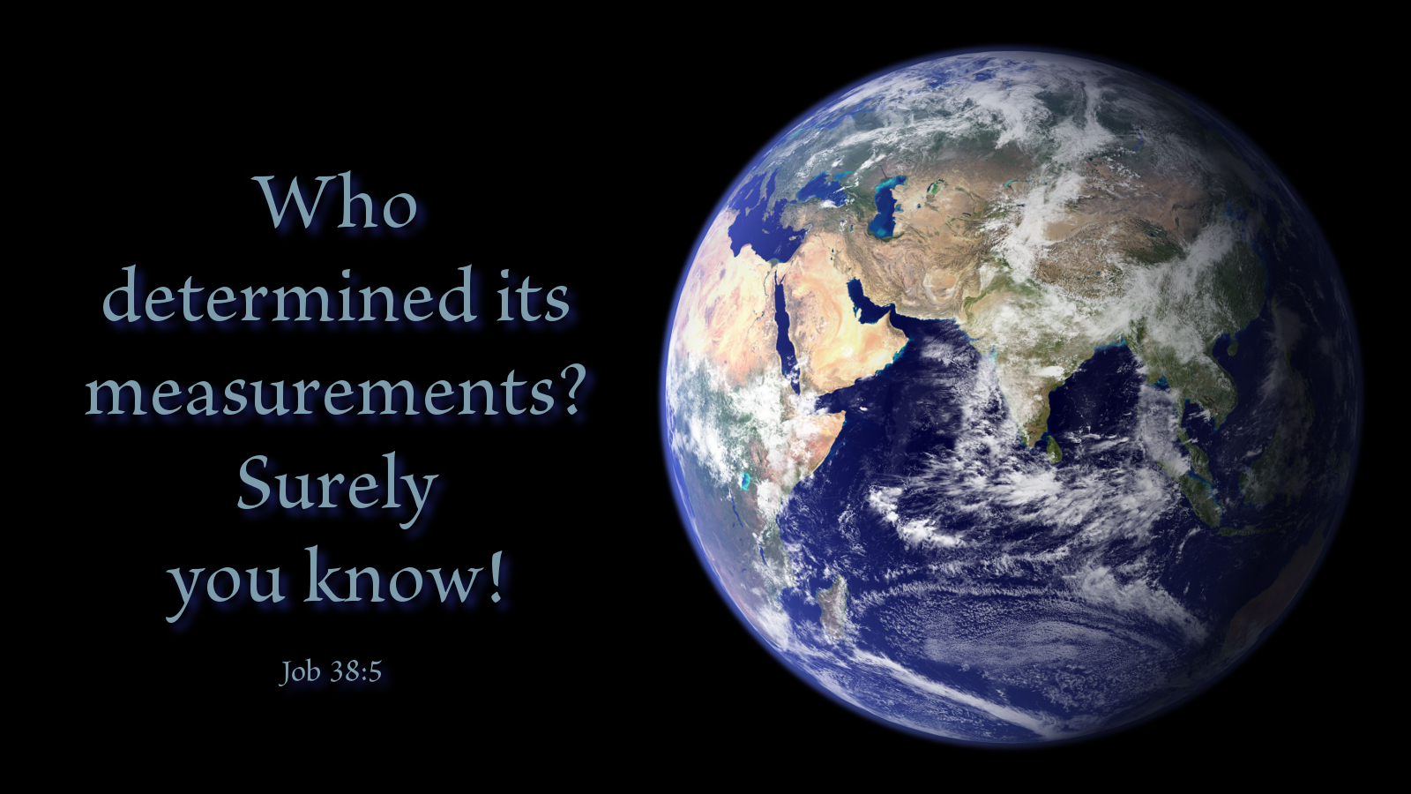

Slide 67
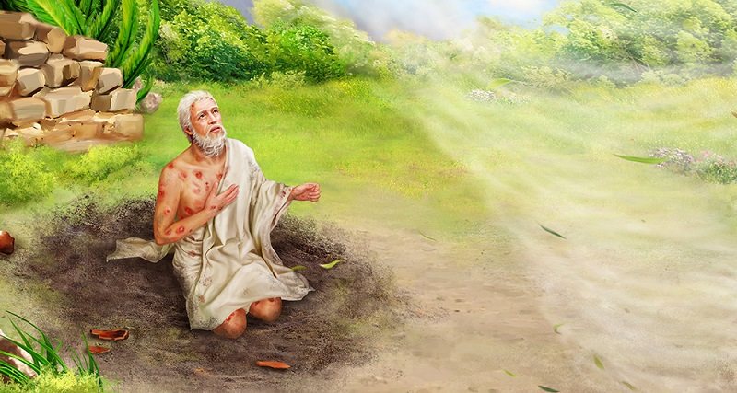

Slide 68
