Slide 1
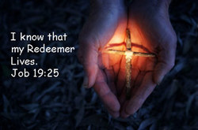
Begins July 16

Slide 2
THE BOOK OF JOB –
“The Suffering and Consolation of the Christian”
Date: 2-4-18 Lesson: 10
Text: Chapters 18,19
Theme:
“I Know that My Redeemer Lives!”

Slide 3
Text: (Job 18:1-21) Then Bildad the Shuhite answered and said: (2) "How long will you hunt for words? Consider, and then we will speak. (3) Why are we counted as cattle? Why are we stupid in your sight? (4) You who tear yourself in your anger, shall the earth be forsaken for you, or the rock be removed out of its place? (5) "Indeed, the light of the wicked is put out, and the flame of his fire does not shine. (6) The light is dark in his tent, and his lamp above him is put out. (7) His strong steps are shortened, and his own schemes throw him down. (8) For he is cast into a net by his own feet, and he walks on its mesh. (9) A trap seizes him by the heel; a snare lays hold of him. (10) A rope is hidden for him in the ground, a trap for him in the path.

Slide 4
(11) Terrors frighten him on every side, and chase him at his heels. (12) His strength is famished, and calamity is ready for his stumbling. (13) It consumes the parts of his skin; the firstborn of death consumes his limbs. (14) He is torn from the tent in which he trusted and is brought to the king of terrors. (15) In his tent dwells that which is none of his; sulfur is scattered over his habitation. (16) His roots dry up beneath, and his branches wither above.
(17) His memory perishes from the earth, and he has no name in the street. (18) He is thrust from light into darkness, and driven out of the world. (19) He has no posterity or progeny among his people, and no survivor where he used to live. (20) They of the west are appalled at his day, and horror seizes them of the east. (21) Surely such are the dwellings of the unrighteous, such is the place of him who knows not God."
.

Slide 5
(Job 19:1-29) Then Job answered and said: (2) "How long will you torment me and break me in pieces with words? (3) These ten times you have cast reproach upon me; are you not ashamed to wrong me? (4) And even if it be true that I have erred, my error remains with myself. (5) If indeed you magnify yourselves against me and make my disgrace an argument against me, (6) know then that God has put me in the wrong and closed his net about me.
(7) Behold, I cry out, 'Violence!' but I am not answered; I call for help, but there is no justice. (8) He has walled up my way, so that I cannot pass, and he has set darkness upon my paths. (9) He has stripped from me my glory and taken the crown from my head. (10) He breaks me down on every side, and I am gone, and my hope has he pulled up like a tree. (11) He has kindled his wrath against me and counts me as his adversary. (12) His troops come on together; they have cast up their siege ramp against me and encamp around my tent. (13) "He has put my brothers far from me, and those who knew me are wholly estranged from me.

Slide 6
.
14) My relatives have failed me, my close friends have forgotten me. (15) The guests in my house and my maidservants count me as a stranger; I have become a foreigner in their eyes. (16) I call to my servant, but he gives me no answer; I must plead with him with my mouth for mercy. (17) My breath is strange to my wife, and I am a stench to the children of my own mother. (18) Even young children despise me; when I rise they talk against me. (19) All my intimate friends abhor me, and those whom I loved have turned against me. (20) My bones stick to my skin and to my flesh, and I have escaped by the skin of my teeth.
(21) Have mercy on me, have mercy on me, O you my friends, for the hand of God has touched me! (22) Why do you, like God, pursue me? Why are you not satisfied with my flesh?
(23) "Oh that my words were written! Oh that they were inscribed in a book! (24) Oh that with an iron pen and lead they were engraved in the rock forever! (25) For I know that my Redeemer lives, and at the last he will stand upon the earth. (26) And after my skin has been thus destroyed, yet in my flesh I shall see God, (27) whom I shall see for myself, and my eyes shall behold, and not another.
My heart faints within me!
(28) If you say, 'How we will pursue him!' and, 'The root of the matter is found in him,' (29) be afraid of the sword, for wrath brings the punishment of the sword, that you may know there is a judgment."

Slide 7
STUDY NOTES:
1. Bildad in ch. 18 is convinced that “what goes ‘round, comes ‘round.”
2. In ch. 19:13-19 nothing is more devastating then rejection by one’s family and friends.
His children are
gone, and his wife, brothers, friends and servants find him repulsive.

Slide 8
3. Ch. 19:25 “I know that my Redeemer lives” forms the basis many hymns and was part of Handel’s
“Messiah.” This is fulfilled in Jesus Christ alone who is the world’s only Redeemer.
The word “redeemer” is the Hebrew word גוֹאֵל
“Goel” = A primitive root, to redeem (according to the Oriental law of kinship), i.e. To be the next of kin (and as such to buy back a relative's property, marry his widow, etc.) avenger, deliver, (perform the part of near, next of kinsfolk), purchase, ransom, redeem. See (Ruth 2:20; 3:6-18; 4:1-13) Boaz, redeemer for Ruth.
Jesus redeemed us and bought us back
(Luke 24:19-27; Gal 4:4-9; Titus 2:11-14)

Slide 9
4. “At the last he will stand upon the earth”
A description of the Last Day, Judgment Day, the Parousia, when Jesus will return on the clouds with all his
angels and sit on his throne and separates the sheep from the goats.
(Matt 25:31-46;
Acts 17:30-32; 2 Tim 4:1,2,8;
Heb 12:22-24; Rev 6:10,11; 20:11-15)

Slide 10
5. “And after my skin has been thus destroyed, yet in my flesh I shall see God, whom I shall see for myself, and my eyes shall behold, and not another”
The Resurrection Day when all people will be raised from the dead.
(Mt 5:8; 1 Cor 13:12; 15:51-58; 1 Jn 3:2)

Slide 11
LUTHER’S WORKS Vol. 26, pp. 287-288
“Therefore we should not imagine Christ as an innocent and private person who is holy and righteous only for Himself; this is what the sophists and nearly all the fathers, Jerome and others, have done. It is, of course, true that Christ is the purest of persons; but this is not the place to stop. For you do not yet have Christ, even though you know that He is God and man.
You truly have Him only when you believe that this altogether pure and innocent Person has been granted to you by the Father as your High Priest and Redeemer, yes, as your Slave. Putting off His innocence and holiness and putting on your sinful person, He bore your sin, death, and curse; He became a sacrifice and a curse for you, in order thus to set you free from the curse of the Law.”

Slide 13
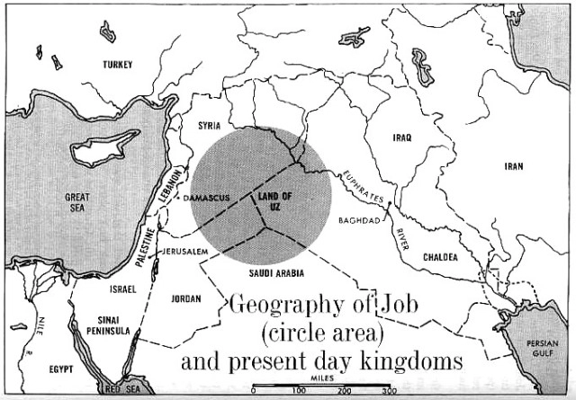

Slide 14
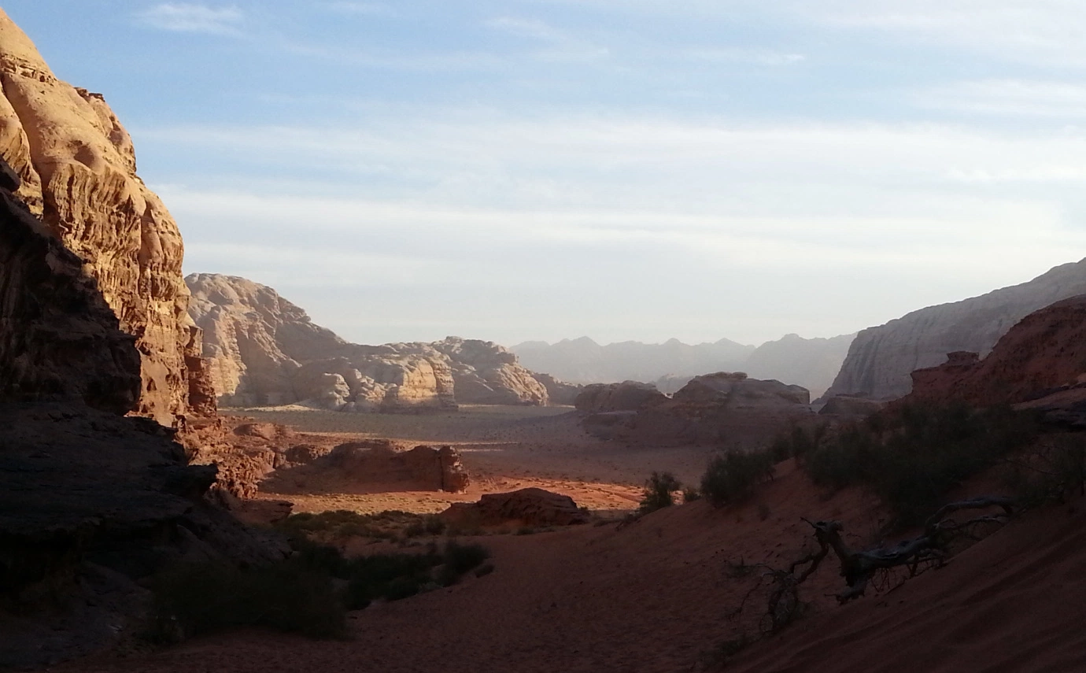

Slide 15
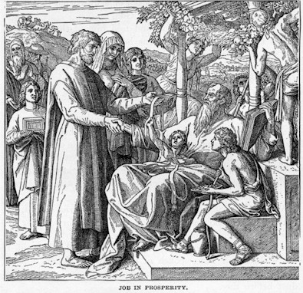

Slide 16
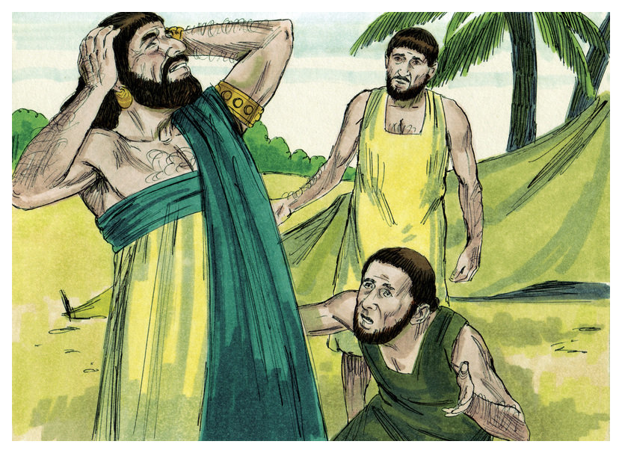

Slide 17
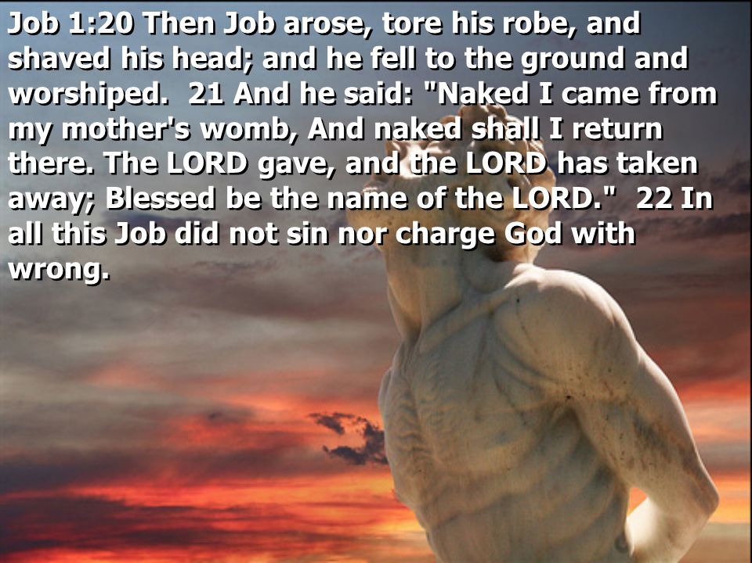

Slide 18
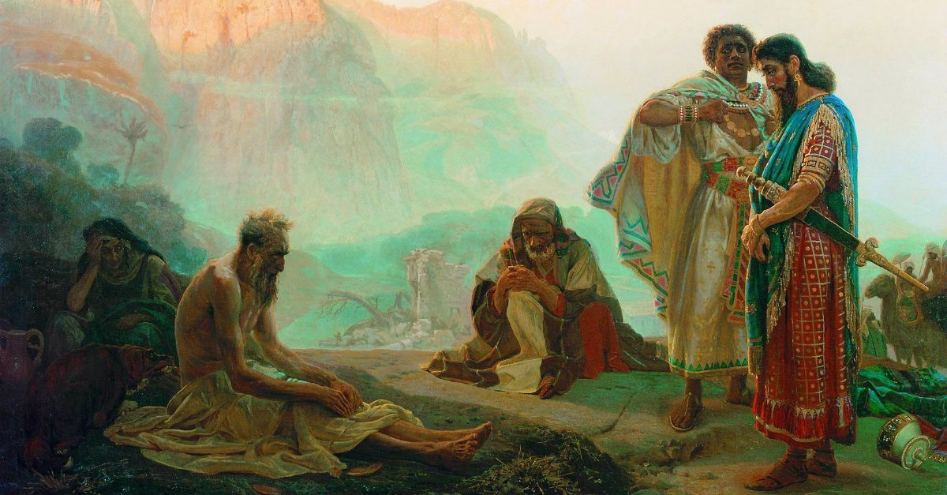

Slide 19
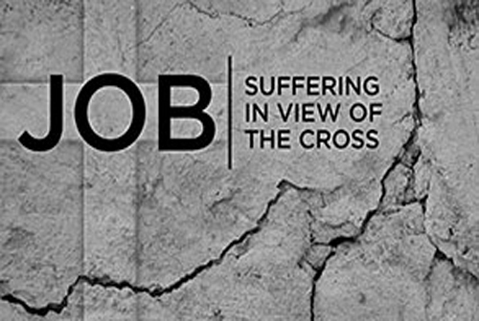

Slide 20
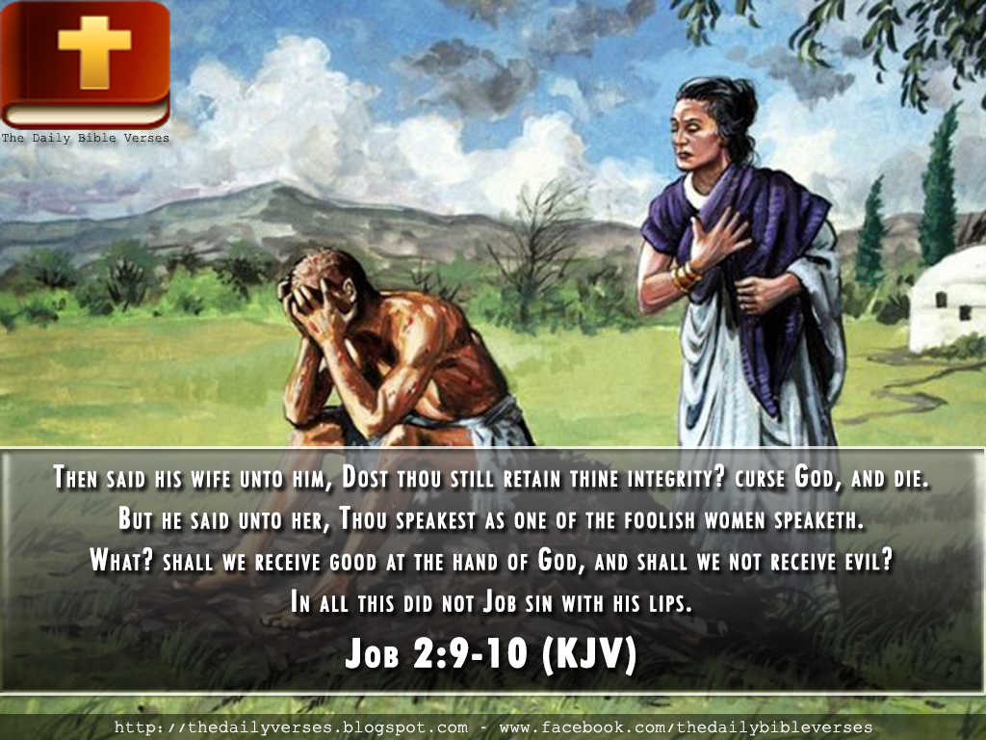

Slide 21
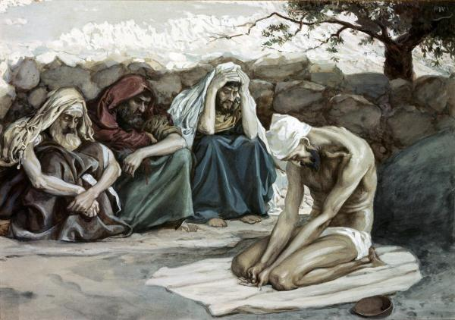

Slide 22
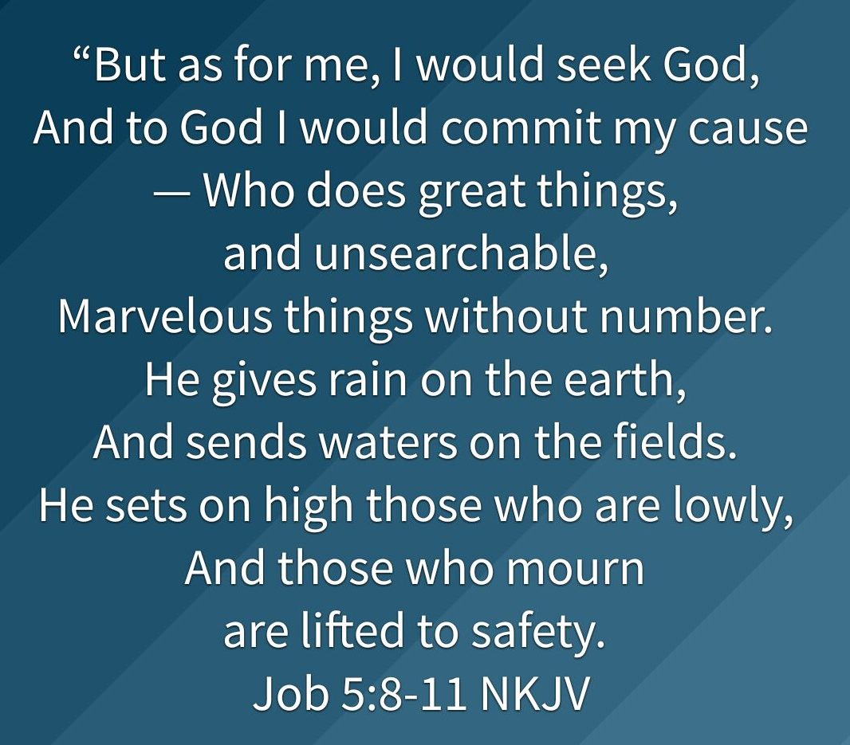

Slide 23
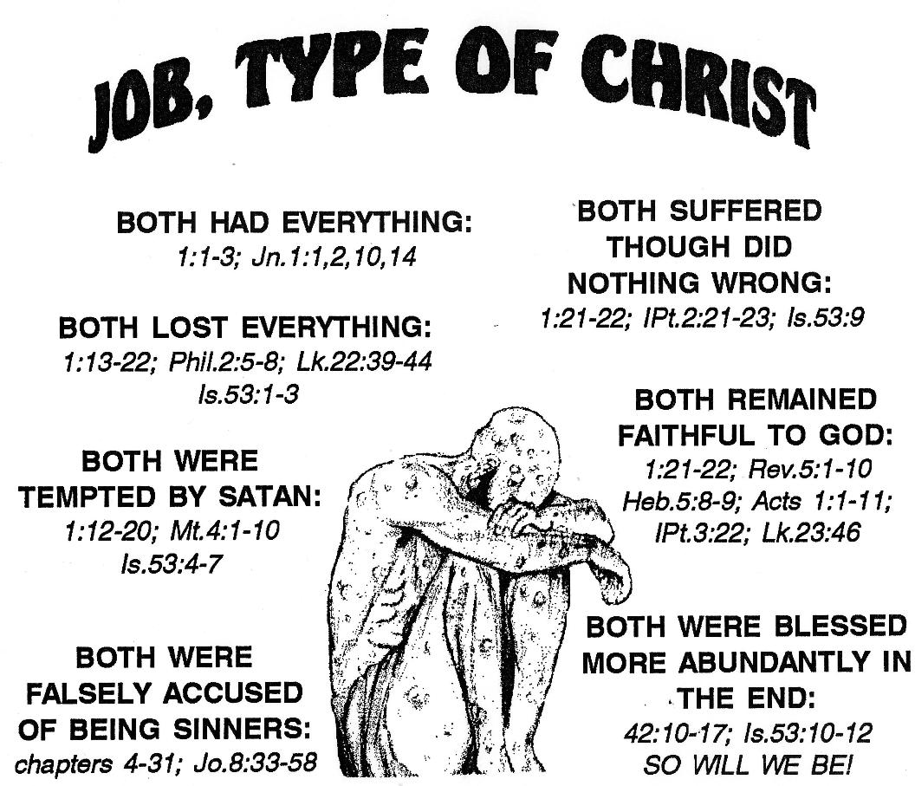

Slide 24
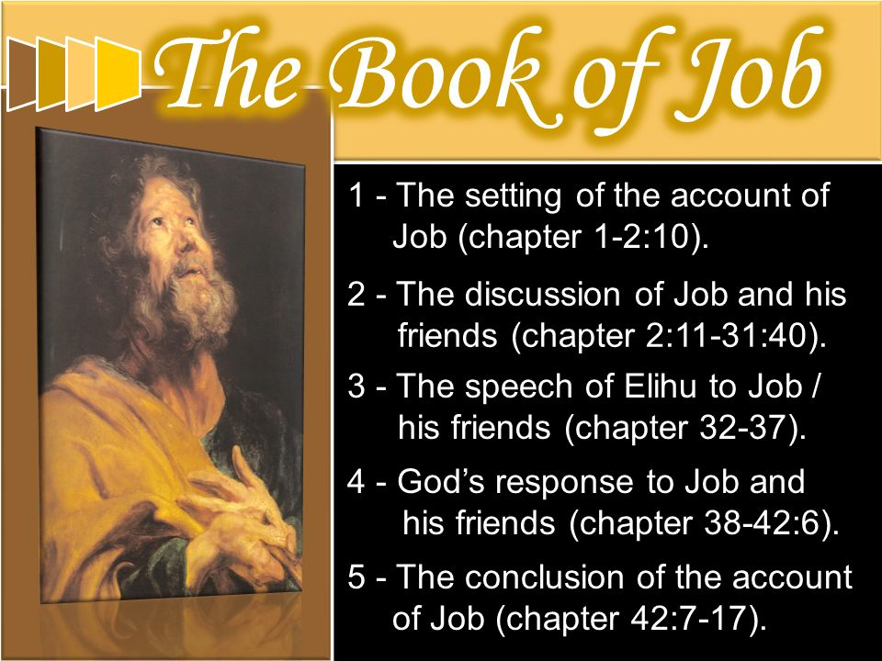

Slide 25
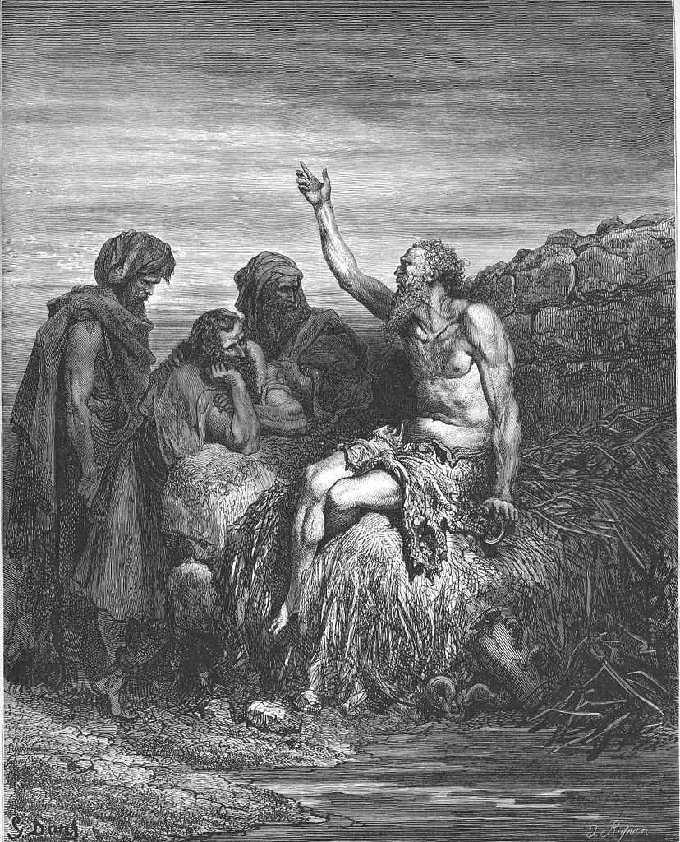

Slide 26
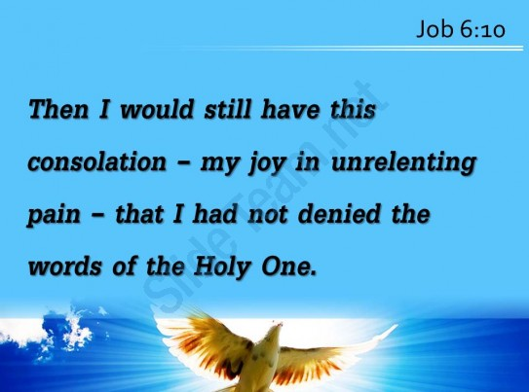

Slide 27
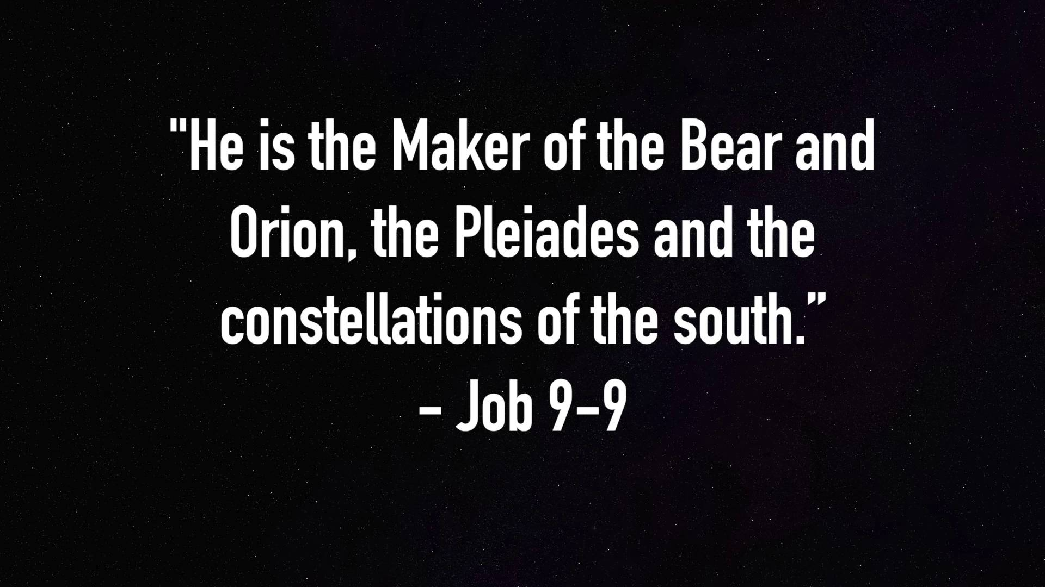

Slide 28
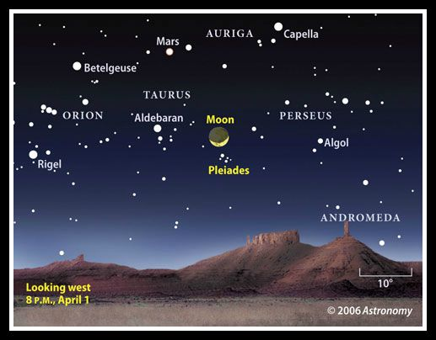

Slide 29
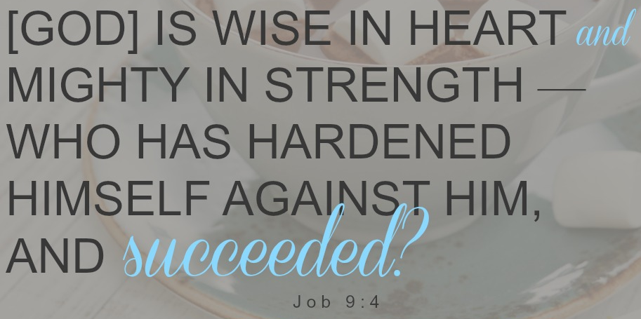

Slide 30
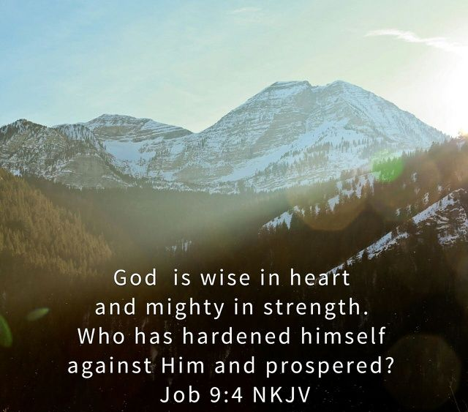

Slide 31
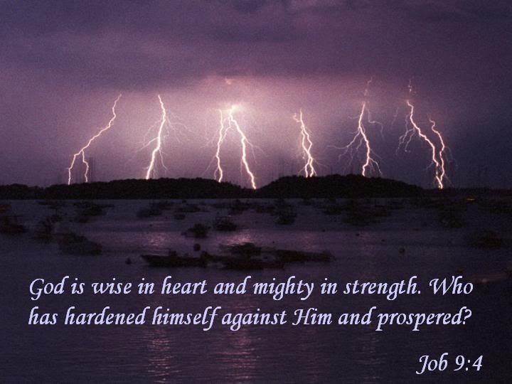

Slide 32
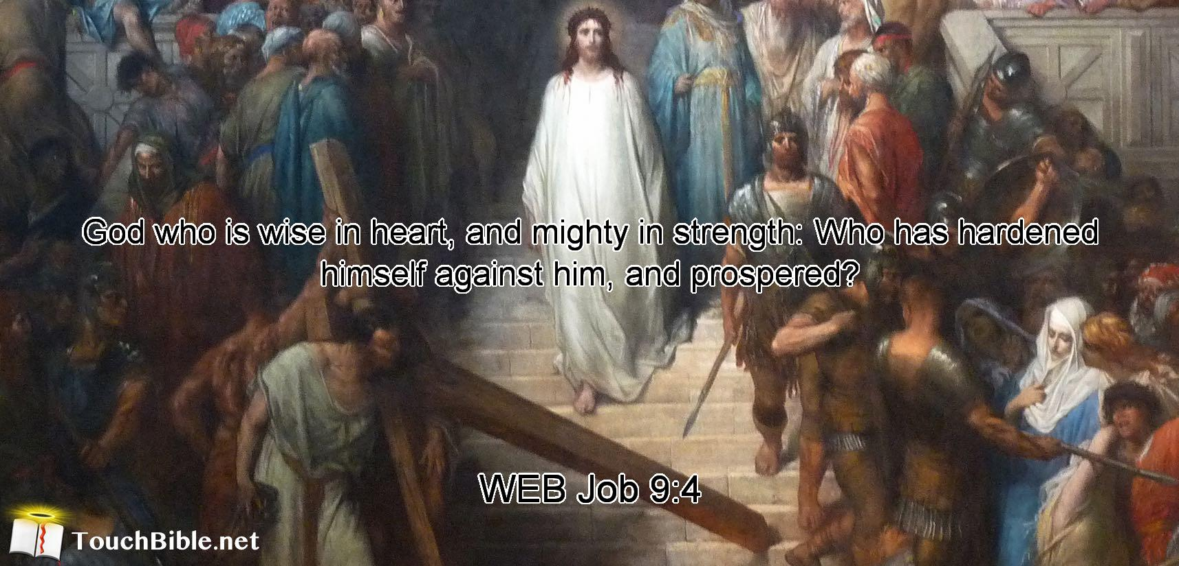

Slide 33
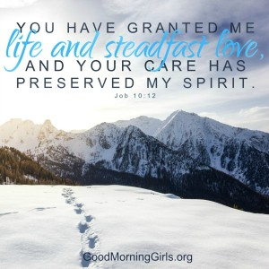

Slide 34
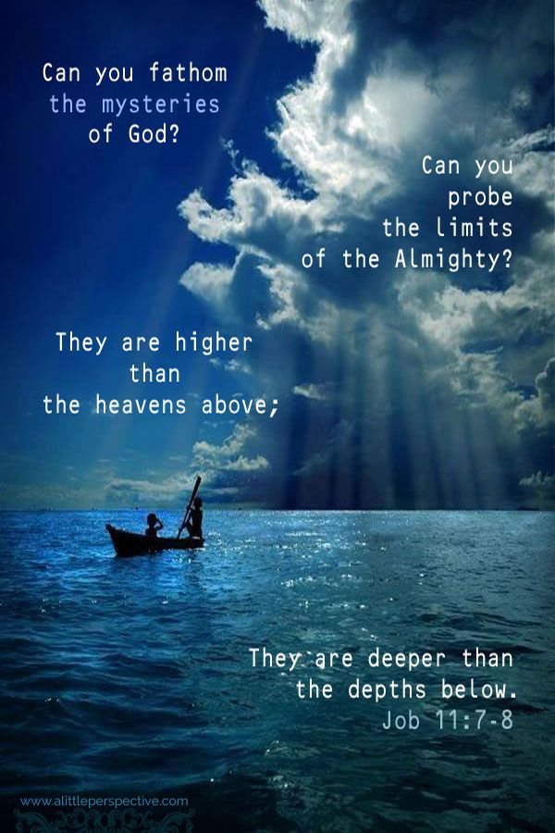

Slide 35
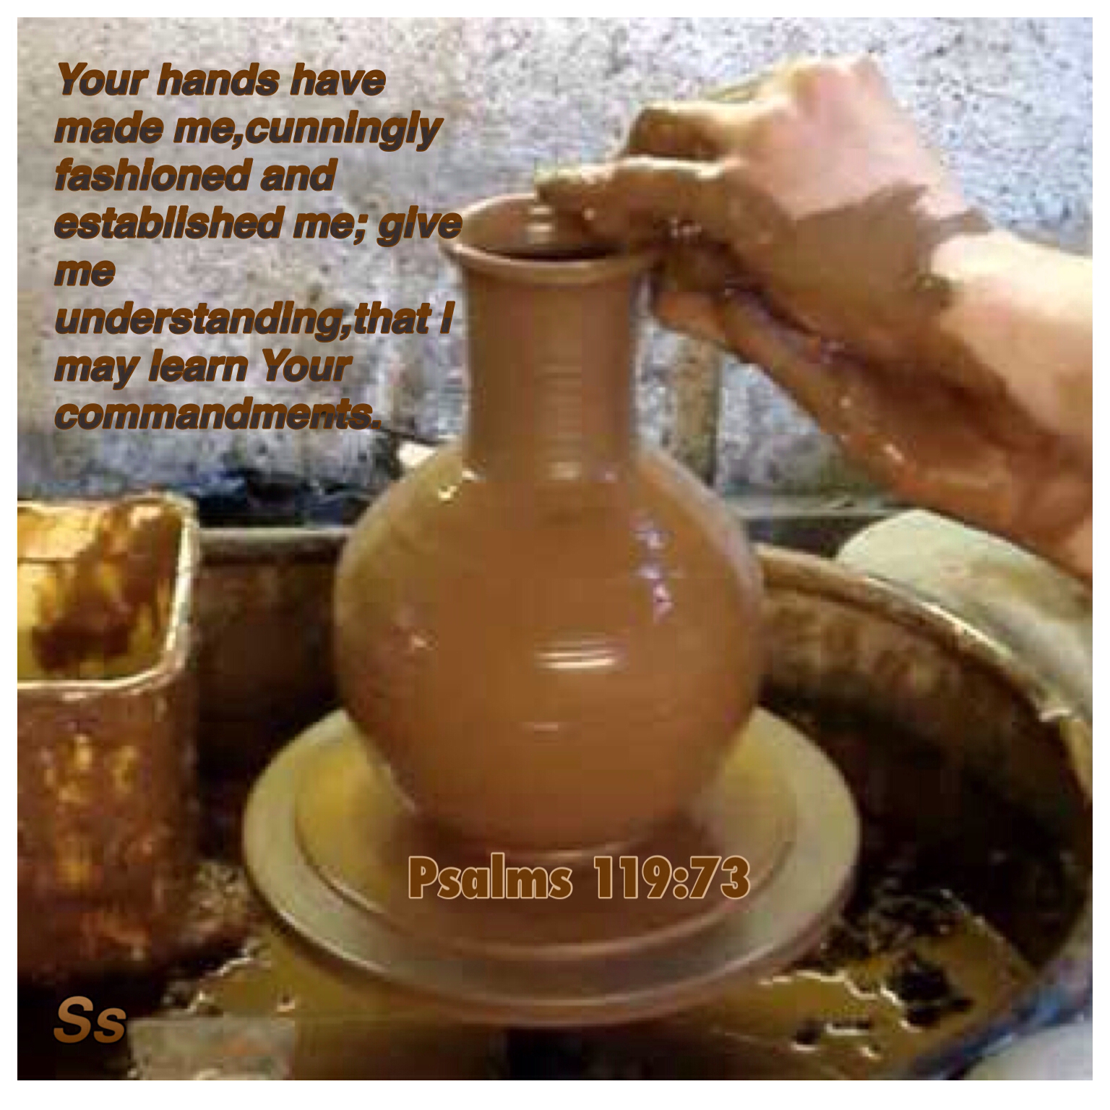

Slide 36


Slide 37
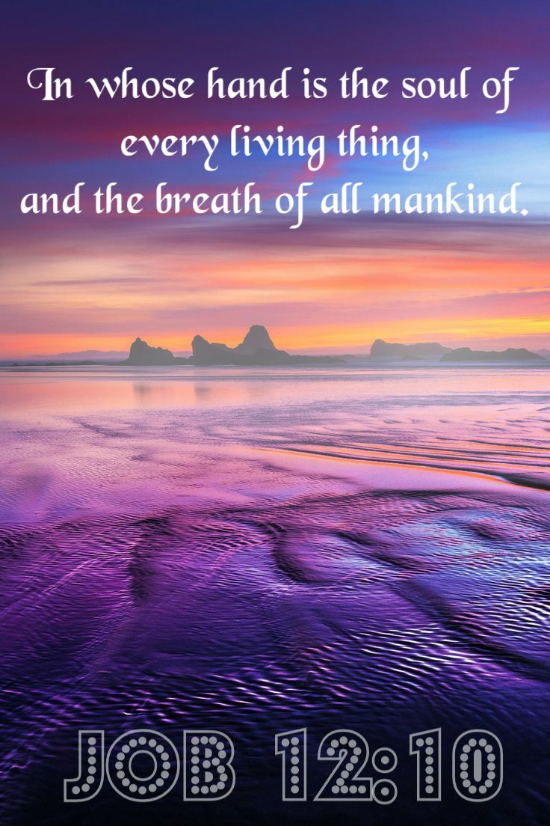

Slide 38
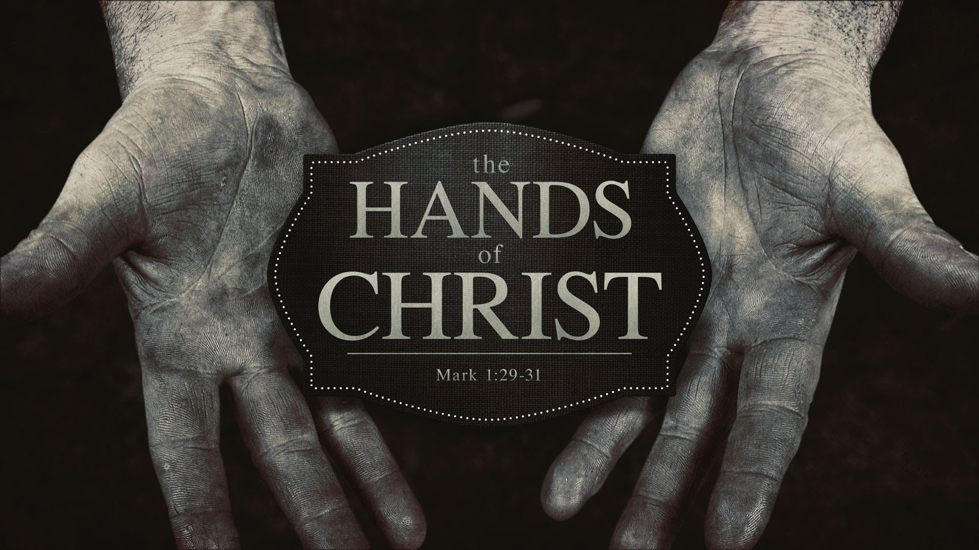

Slide 39
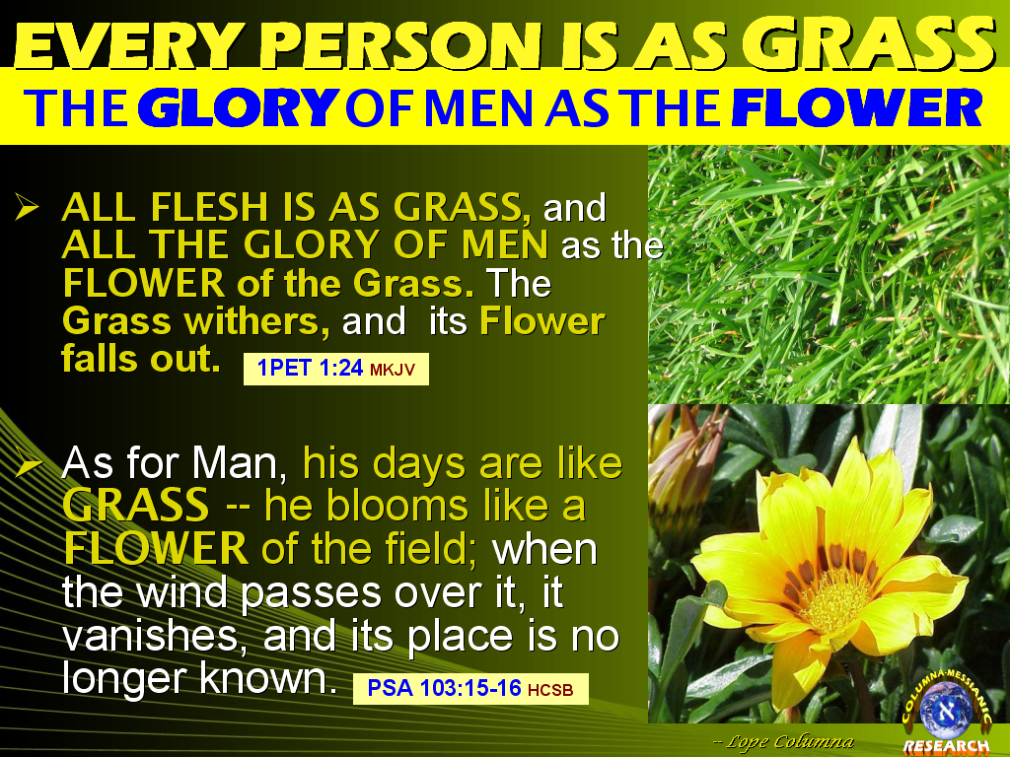

Slide 40
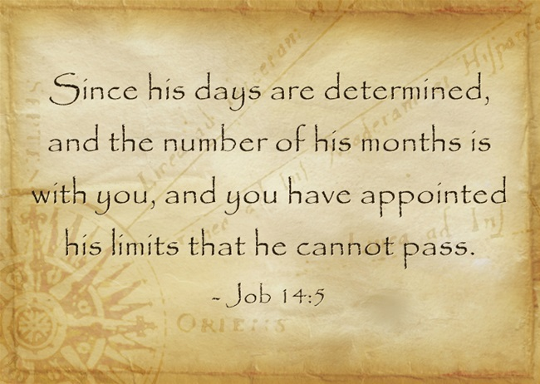

Slide 41
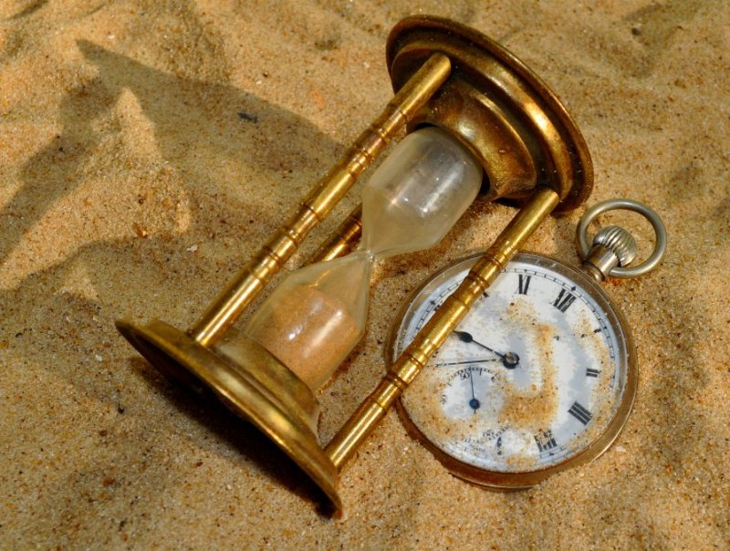

Slide 42
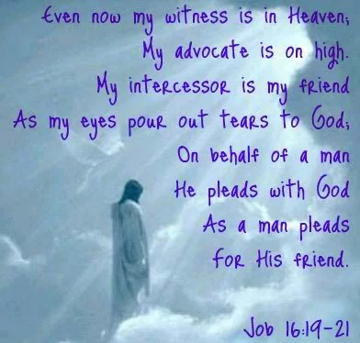

Slide 43
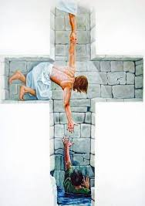

Slide 44
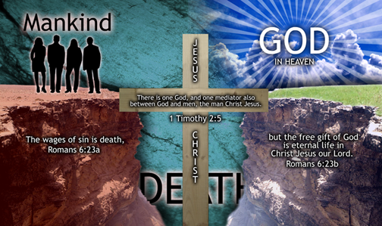

Slide 45
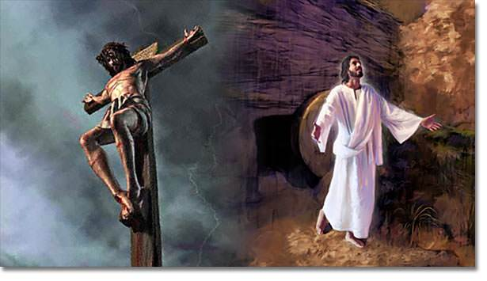

Slide 46
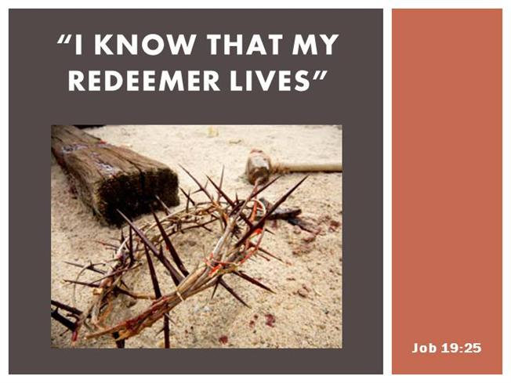

Slide 47
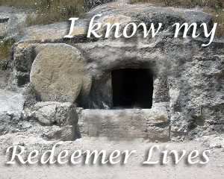

Slide 48
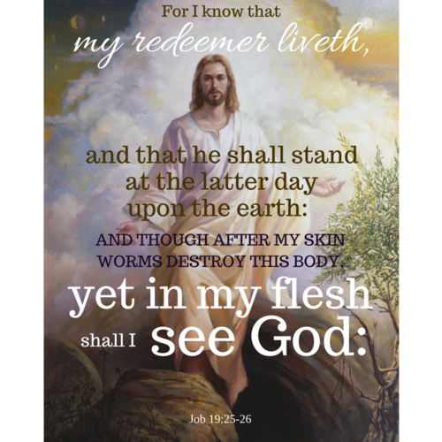

Slide 49
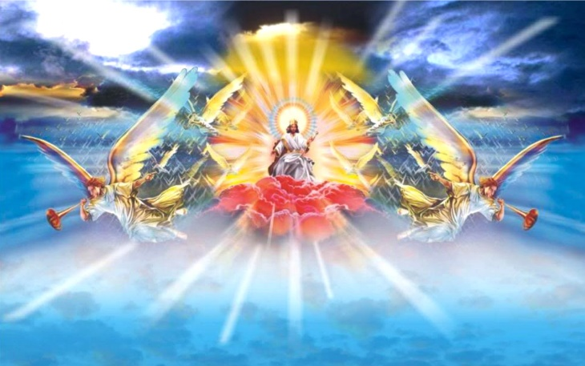

Slide 50
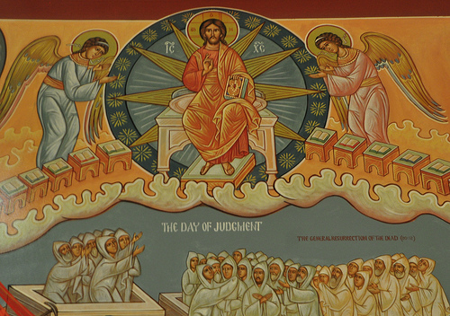

Slide 51
