Slide 1
Trinity Lutheran Church
Norman, Oklahoma – www.tlcnorman.org
The Epistle of James
Theme:
“The Testing of Your Faith”
Date: 2-5-23
Lesson: 3 - Chapter 1:5-12

Slide 2
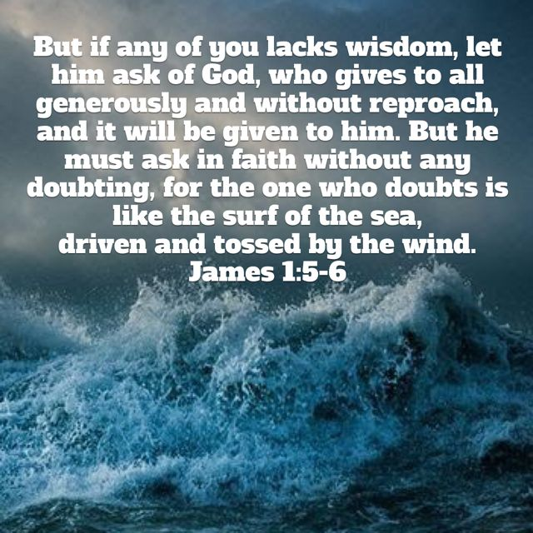

Slide 3
TEXT and STUDY NOTES
(5) If any of you lacks wisdom,
let him ask God, who gives generously to all without reproach, and it will be given him.
(6) But let him ask in faith, with no doubting,
for the one who doubts is like a wave of the sea that is driven and tossed by the wind.
(7) For that person must not suppose that he will receive anything from the Lord;
(8) he is a double-minded man, unstable in all his ways.
(1 Ki 3:9-12; Ps 51:6; 119:113;
Prov 1:2-4; 2:3-6,10-15; 4:5-9; 9:10-12;
Dan 1:17; 2:21;
Mt 7:7; 21:21; Mk 11:24; Lk 11:9-13; 16:13;
Eph 4:14; 1 Pet 2:14; 3:16)

Slide 4
(9) Let the lowly brother boast in his exaltation,
(10) and the rich in his humiliation, because like a flower of the grass he will pass away.
(11) For the sun rises with its scorching heat and withers the grass; its flower falls, and its beauty perishes. So also will the rich man fade away in the midst of his pursuits.
(Job 14:2; Ps 102:4,11; 103:15,16; Is 40:6-8;
Mt 19:23-26; 20:12; 23:12; Lk 1:46-55;
1 Cor 7:31; 1 Pet 1:24)

Slide 5
(12) Blessed is the man who remains steadfast under trial, for when he has stood the test he will receive
the crown of life, which God has promised to those who love him.
(Gen 22:1; Ex 20:6; Ps 1:1;
Jer 17:7-8; Dan 12:12; Mt 5:3-12; 10:22;
1 Cor 2:9; 8:3; 9:25; 2 Tim 4:8;
1 Pet 3:14; 5:4;
Rev 1:3; 2:10; 3:11,19)

Slide 6
LUTHER’S WORKS – VOLUMES 24 & 35 - “Doubt vs. Faith”
“How can one conclude with certainty that God is gracious to us and pleased with us? To be sure, not by and of yourself, but solely because of Christ’s words “Unless you abide in Me”; for “as the branch cannot bear fruit of itself, unless it abides in the vine, neither can you, unless you abide in Me” (John 15:4).
Therefore we must not look at ourselves to see what we are and what we do, whether we are worthy and our works are sufficient. Therefore it is impossible for them ever to conclude with certainty that their calling and life are acceptable to God. They are doomed to eternal doubt; and the more they work and torment themselves in an effort to please God, the greater their uncertainty becomes, until finally it culminates in despair. This is the inevitable lot of all who rely on themselves and their deeds.
See to it that here you exercise and strengthen your faith, so that when you are sorrowful or when your sins press you and you go to the sacrament, you do so with a hearty desire for this sacrament and for what it signifies. Then do not doubt that you have what the sacrament signifies, that is, be certain that Christ and all his saints are coming to you with all their virtues, sufferings, and mercies, to live, work, suffer, and die with you, and that they desire to be wholly yours, having all things in common with you.

Slide 7
If you will exercise and strengthen this faith, then you will experience what a rich, joyous, and bountiful wedding feast your God has prepared for you upon the altar. Then you will understand what the great feast of King Ahasuerus signifies [Esther 1:5]; and you will see what that wedding feast is for which God slew his oxen and fat calves, as it is written in the gospel [Matt. 22:2–4]. Then your heart will become truly free and confident, strong and courageous against all enemies [Ps. 23:5].
For who will fear any calamity if he is sure that Christ and all his saints are with him and have all things, evil or good, in common with him? So we read in Acts 2[:46] that the disciples of Christ broke this bread and ate with great gladness of heart. Since, then, this work is so great that the smallness of our souls would not dare to desire it, to say nothing of hoping for it or expecting it, therefore it is necessary and profitable to go often to the sacrament, to exercise and strengthen this faith on which the whole thing depends and for the sake of which it was instituted.
For if you doubt, you do God the greatest dishonor and make him out to be a faithless liar; if you cannot believe, then pray for faith, as was said earlier in the other treatise.”.

Slide 8
LIFE APPLICATION
If we do ask God
(who gives generously to all without reproach, and it will be given to us)
how can we ask in faith, with no doubting?

Slide 9
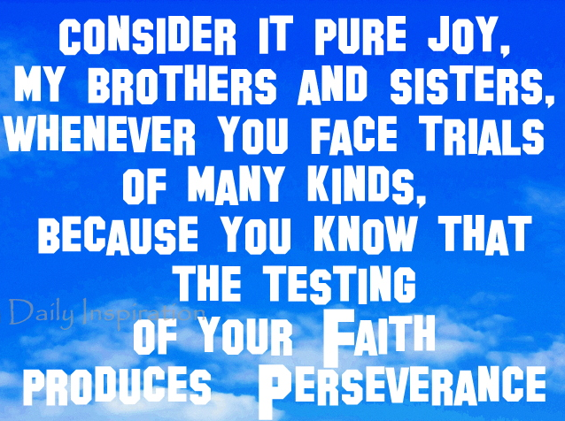

Slide 10
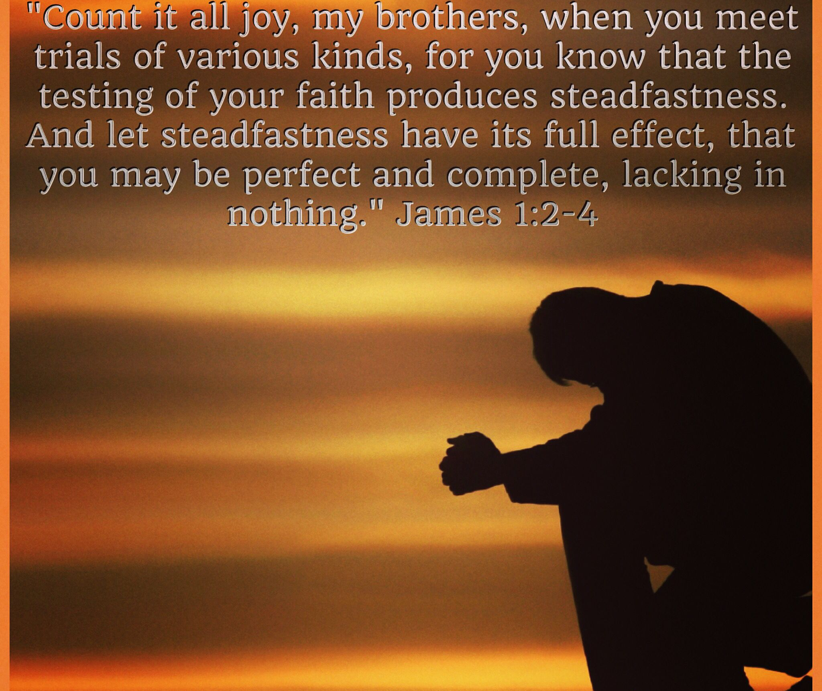

Slide 11
