Slide 1
Trinity Lutheran Church Norman, Oklahoma – www.tlcnorman.org The Epistle of James Theme:
“The Testing of Your Faith” Date: 3-19-23 Lesson: 9 - Chapter 1:21-27

Slide 3
(21) Therefore put away all filthiness and rampant wickedness and receive with meekness the implanted Word, which is able to save your souls.
(Mt 13:19-23; Rom 13:12;
1 Cor 15:2; Eph 1:13; 4:22; Col 3:8)

Slide 4
(22) But be doers of the Word, and not hearers only, deceiving yourselves.
(23) For if anyone is a hearer of the Word and not a doer,
he is like a man who looks intently at his natural face in a mirror.
(24) For he looks at himself and goes away and at once forgets what he was like.
(25) But the one who looks into the perfect law, the law of liberty, and perseveres, being no hearer who forgets but a doer who acts, he will be blessed in his doing.
(Ps 1:1,2; 19:7; 119;92-94; Mt 7:21-27; Lk 6:46-49; 11:28; 8:21; Jn 8:32; 13:17;
Rom 2:13; 8:2; Gal 2:4; 5:1,13; 1 Pet 2:16; 2 Pet 2:19)

Slide 5
(26) If anyone thinks he is religious and does not bridle his tongue but deceives his heart,
this person's religion is worthless.
(27) Religion that is pure and undefiled before God, the Father, is this:
to visit orphans and widows in their affliction,
and to keep oneself unstained from the world.
(Dt. 10:18; 14:29; 16:11; 24:19; Job 31:16-21;
Ps 34:13; 39:1; 141:3; 146:9;
Is 1:17-23; Jer 22:16; Hos 14:3; Mt 25:36;
Lk 7:11-17; Ac 26:5; Rom 12:2; 1 Tim 5:22;
1 Pet 3:10; 2 Pet 1:4; 2:20; 3;14;
1 Jn 2:15; 5:18)

Slide 6
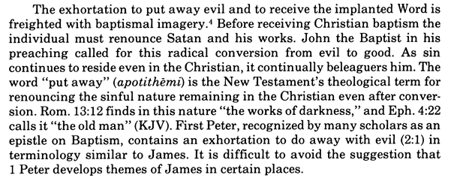
Commentary on James – “The Epistle of Faith” – Dr. David Scaer – CPH

Slide 7
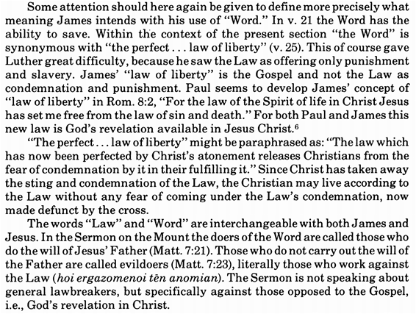

Slide 8
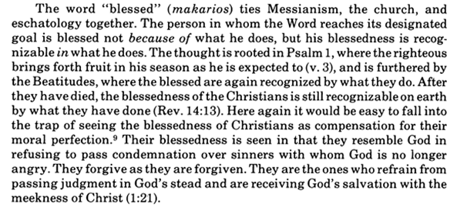

Slide 9
LIFE APPLICATION
“Receive with meekness the implanted Word, which is able to save your souls.
Be doers of the Word, and not hearers only, deceiving yourselves.
What are the means by which we receive the implanted Word?
How are we then empowered to be doers of the Word?

Slide 18
