Slide 1
Trinity Lutheran Church Norman, Oklahoma – www.tlcnorman.org The Epistle of James Theme:
“The Testing of Your Faith” Date: 2-19-23 Lesson: 5 - Chapter 1:12

Slide 3
TEXT and STUDY NOTES
(12) Blessed is the man who remains steadfast under trial, for when he has stood the test he will receive
the crown of life, which God has promised to those who love him.
(Gen 22:1; Ex 20:6; Ps 1:1;
Jer 17:7-8; Dan 12:12; Mt 5:3-12; 10:22;
1 Cor 2:9; 8:3; 9:25; 2 Tim 4:8;
1 Pet 3:14; 5:4;
Rev 1:3; 2:10; 3:11,19)

Slide 4
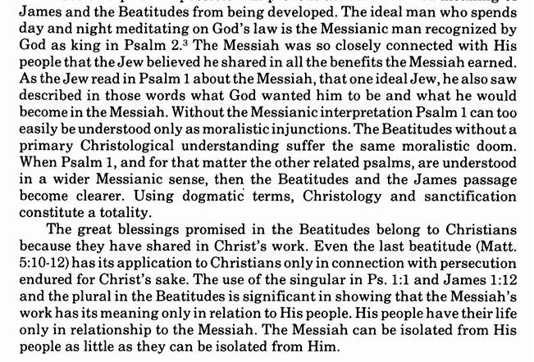
Commentary on James – “The Epistle of Faith” – Dr. David Scaer – CPH

Slide 5
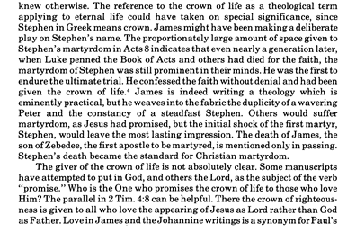

Slide 7
LIFE APPLICATION
Blessed is the man
who remains steadfast under trial,
for when he has stood the test
he will receive
the crown of life,
which God has promised
to those who love him.
What does this say to you
about the purpose for your life
here on earth
in view of your future life in heaven?

