Slide 1
Trinity Lutheran Church Norman, Oklahoma – www.tlcnorman.org The Epistle of James Theme:
“The Testing of Your Faith” Date: 2-11-24 Lesson: 42 - Chapter 5:19,20

Slide 3
TEXT AND STUDY NOTES
(19) My brothers, if anyone among you wanders from the truth and someone brings him back,
(Ps 51:13; Dan 12:3; Mal 2:6;
Matt 9:12,13; 18:15-20;
Mark 2:16,17; Luke 1:16; 5:31,32;
Gal 6:1)

Slide 5
(20) let him know that whoever brings back a sinner from his wandering will save his soul from death and will cover a multitude of sins.
(Neh 4:5; Ps 32:1; 85:2; 119:10,21;
Prov 5:6; 10:12; Zech 10:2;
Luke 7:36-50;
Rom 11:11-16; Heb 9:24-29;
1 Pet 4:7-10)

Slide 7
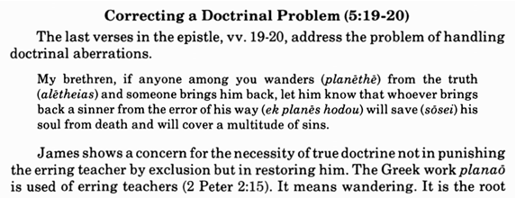
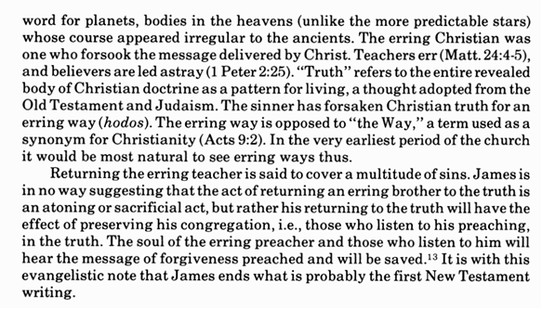

Slide 9
1. “If anyone among you wanders from the truth and someone brings him back.”
How can this best be done?
2. “Whoever brings back a sinner from his wandering
will save his soul from death and will cover a multitude of sins.”
What are the ways in which people will wander?

Slide 10
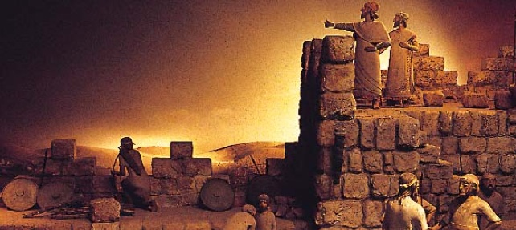
NEW BIBLE STUDY – STARTS 2-18-24
The Book of Haggai -
Theme:
“Prioritize Our Lives – Work Together!’

Slide 27
