Slide 1
Trinity Lutheran Church Norman, Oklahoma – www.tlcnorman.org The Epistle of James Theme:
“The Testing of Your Faith” Date: 2-4-24 Lesson: 41 - Chapter 5:17,18

Slide 2
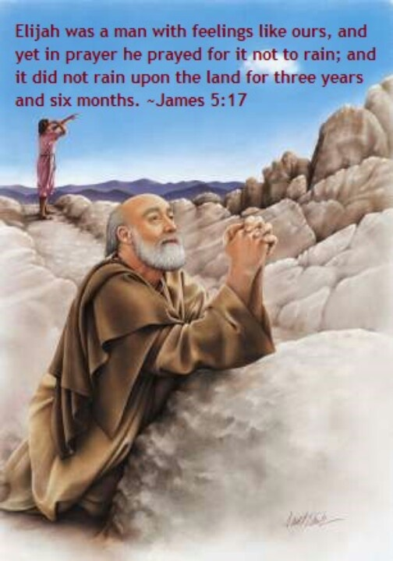

Slide 3
TEXT AND STUDY NOTES
(17) Elijah was a man with a nature like ours, and he prayed fervently that it might not rain, and for three years and six months it did not rain on the earth.
(1 Kings 17:1,7,14; 18:1,37-46;
Lk 4:24-26;
Acts 12:1-17; 14:15; 18:24-28;
Rom 12:9-12; 2 Cor 8:16,17,22,23)

Slide 4
(18) Then he prayed again, and heaven gave rain, and the earth bore its fruit.
(Jonah 2:1-10; Job 5:8-10;
Ps 72:6; 147:8;
Is 45:8; 55:10,11; Joel 2:23;
Zech 10:1;
Mt 5:44-47;
Acts 10:1,2; Heb 6:7; Rev 11:1-8)

Slide 5
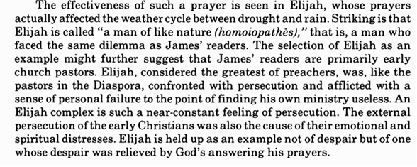

Slide 6
Explain the
“balance of prayer”:
-On the one hand pray fervently to God
– On the other hand pray that God’s will be done

Slide 23
