Slide 1
Trinity Lutheran Church Norman, Oklahoma – www.tlcnorman.org The Epistle of James Theme:
“The Testing of Your Faith” Date: 1-28-24 Lesson: 40 - Chapter 5:16a

Slide 3
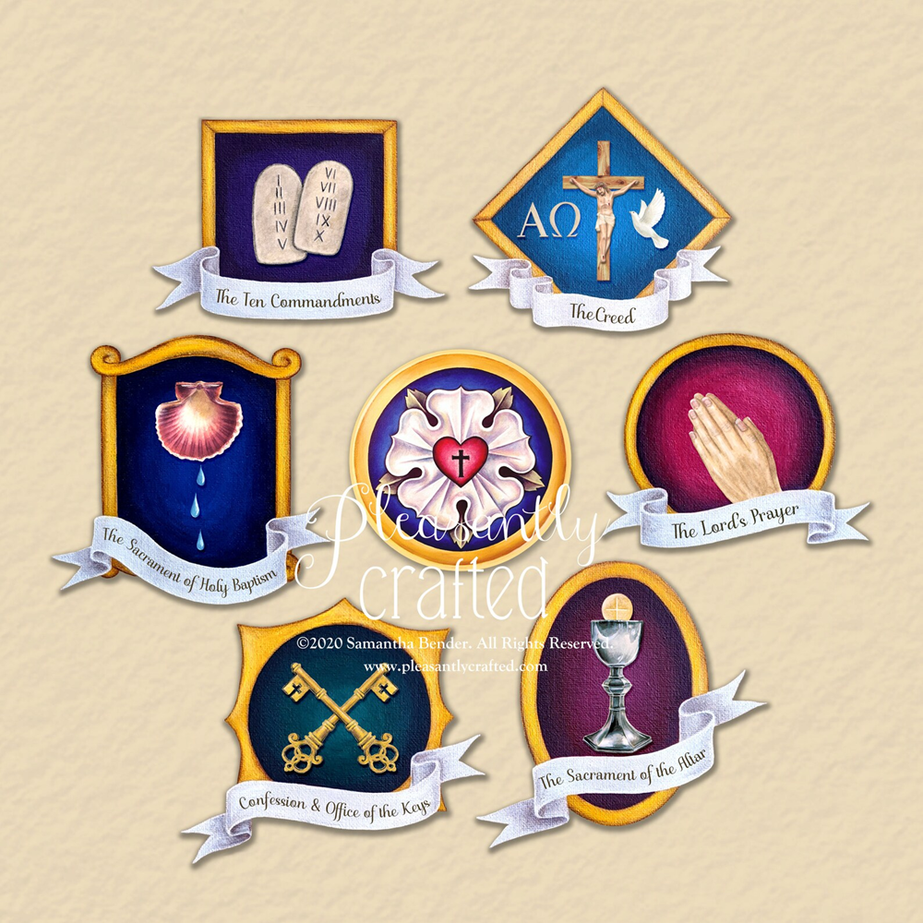

Slide 4
TEXT AND STUDY NOTES
(16a) Therefore, confess your sins to one another and pray for one another,
that you may be healed.
(1 Ki 13:6; 17:22; 2 Ki 4:33; 19:15-20; Job 42:8; Prov 15:29; Ps 145:18;
Mt 3:6; 7:7; Mk 1:5; Jn 9:31;
Ac 19:18; Heb 12:13; 1 Pet 2:24)

Slide 5
2 Sam 12:1-13 Nathan and David – confession and absolution from the prophet
Mt 16:13-19 Peter and the Church - confession and absolution from the apostles
Mt 18:15-20 The Church and its members - confession and absolution from the congregation
Jn 20:19-23 The Pastors and the flock - confession and absolution from the pastors
1 Jn 1:8-2:2 The Lord and his believers - confession and absolution from God

Slide 6
THE POINT:
All Christians are priests by virtue of our baptism
– the priesthood of all believers
Christ gives his authority to the whole Christian Church
- the office of the keys
Called and ordained pastors administer the keys publicly on behalf of the congregation – the office of the ministry
Forgiveness of sins is conveyed to us through the Word of God which comes to us through preaching, teaching, baptizing, absolving and communing,
so that it come to us personally - connected to water, bread and wine.

Slide 7
Luther’s Small Catechism
and Commentary on James – “The Epistle of Faith”
– Dr. David Scaer – CPH
How Christians should be taught to confess
What is Confession?
Confession has two parts. First, that we confess our sins, and second, that we receive absolution, that is, forgiveness, from the pastor as from God Himself, not doubting, but firmly believing that by it our sins are forgiven before God in heaven.
What sins should we confess?
Before God we should plead guilty of all sins, even those we are not aware of, as we do in the Lord’s Prayer; but before the pastor we should confess only those sins which we know and feel in our hearts.
Which are these?
Consider your place in life according to the Ten Commandments: Are you a father, mother, son, daughter, husband, wife, or worker? Have you been disobedient, unfaithful, or lazy? Have you been hot-tempered, rude, or quarrelsome? Have you hurt someone by your words or deeds? Have you stolen, been negligent, wasted anything, or done any harm?

Slide 8
Explanation of Confession
A Short Form of Confession
[Luther intended the following form to serve only as an example of private confession for Christians of his time. For a contemporary form of individual confession, see Lutheran Worship, pp. 310–11; see Lutheran Service Book, pp. 292–93.]
The penitent says:
Dear confessor, I ask you please to hear my confession and to pronounce forgiveness in order to fulfill God’s will.
I, a poor sinner, plead guilty before God of all sins. In particular I confess before you that as a servant, maid, etc., I, sad to say, serve my master unfaithfully, for in this and that I have not done what I was told to do. I have made him angry and caused him to curse. I have been negligent and allowed damage to be done. I have also been offensive in words and deeds. I have quarreled with my peers. I have grumbled about the lady of the house and cursed her. I am sorry for all of this and I ask for grace. I want to do better.
A master or lady of the house may say:
In particular I confess before you that I have not faithfully guided my children, servants, and wife to the glory of God. I have cursed. I have set a bad example by indecent words and deeds. I have hurt my neighbor and spoken evil of him. I have overcharged, sold inferior merchandise, and given less than was paid for.
[Let the penitent confess whatever else he has done against God’s commandments and his own position.]

Slide 9
If, however, someone does not find himself burdened with these or greater sins, he should not trouble himself or search for or invent other sins, and thereby make confession a torture. Instead, he should mention one or two that he knows: In particular I confess that I have cursed; I have used improper words; I have neglected this or that, etc. Let that be enough.
But if you know of none at all (which hardly seems possible), then mention none in particular, but receive the forgiveness upon the general confession which you make to God before the confessor.
Then the confessor shall say:
God be merciful to you and strengthen your faith. Amen.
Furthermore:
Do you believe that my forgiveness is God’s forgiveness? Yes, dear confessor.
Then let him say:
Let it be done for you as you believe. And I, by the command of our Lord Jesus Christ, forgive you your sins in the name of the Father and of the Son and of the Holy Spirit. Amen. Go in peace.
A confessor will know additional passages with which to comfort and to strengthen the faith of those who have great burdens of conscience or are sorrowful and distressed. This is intended only as a general form of confession.

Slide 10
What is the Office of the Keys?
The Office of the Keys is that special authority which Christ has given to His church on earth to forgive the sins of repentant sinners, but to withhold forgiveness from the unrepentant as long as they do not repent.
Where is this written?
This is what St. John the Evangelist writes in chapter twenty: The Lord Jesus breathed on His disciples and said, “Receive the Holy Spirit. If you forgive anyone his sins, they are forgiven; if you do not forgive them, they are not forgiven.” (John 20:22–23)
What do you believe according to these words?
I believe that when the called ministers of Christ deal with us by His divine command, in particular when they exclude openly unrepentant sinners from the Christian congregation and absolve those who repent of their sins and want to do better, this is just as valid and certain, even in heaven, as if Christ our dear Lord dealt with us Himself.

Slide 12
LIFE APPLICATION
The Roman Catholic Church teaches the Keys are only given to the Pope – from Peter – apostolic succession.
The Lutheran Church teaches that the Keys are given to the whole Church – from Christ.
Explain the many ramifications of this difference in doctrine and practice.

Slide 29
