Slide 1
Trinity Lutheran Church Norman, Oklahoma – www.tlcnorman.org The Epistle of James Theme:
“The Testing of Your Faith” Date: 12-3-23 Lesson: 35 - Chapter 5:10-12

Slide 3
TEXT AND STUDY NOTES
(10) As an example of suffering and patience,
brothers, take the prophets who spoke
in the name of the Lord.
(11) Behold, we consider those blessed who remained steadfast.
You have heard of the steadfastness of Job, and you have seen the purpose of the Lord,
how the Lord is compassionate and merciful.
(Ex 34:6; Nu 14:18; 2 Chr 36:16;
Job 1:20-22; 2:9,10; 3; 12:1-3; 13:15; 16:1-3; 21:4;
Ps 103:8;
Mt 5:10-12; 23:34; Ac 7:52;
Heb 10:36; 11:32-38)

Slide 4
(12) But above all, my brothers, do not swear, either by heaven or by earth or by any other oath, but let your “yes” be yes and your “no” be no, so that you may not fall under condemnation.
(Lev 19:12;
Mt 5:33-37; 23:16-22)

Slide 5
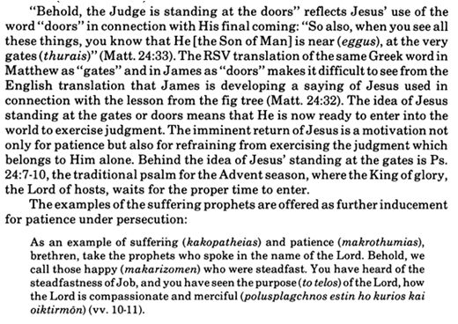
Commentary on James – “The Epistle of Faith”
– Dr. David Scaer – CPH

Slide 6
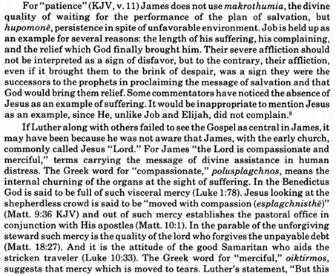

Slide 7
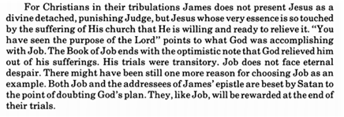

Slide 8
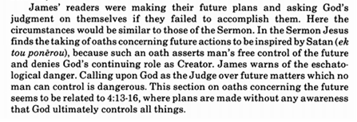

Slide 9
LIFE APPLICATION
“Those blessed who remained steadfast.
You have heard of the steadfastness of Job, and you have seen the purpose of the Lord,
how the Lord is compassionate and merciful.”
Since the Lord has been merciful to us,
what are the ways we are merciful to others and remain steadfast in the purposes of the Lord?

Slide 26
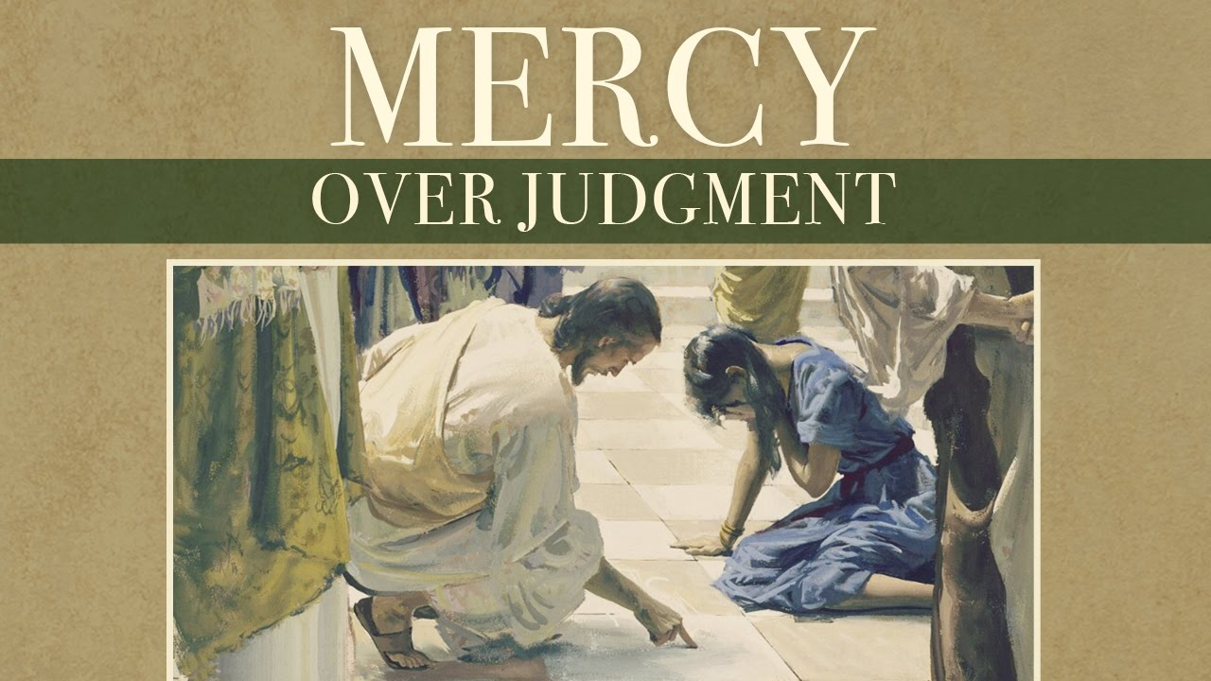

Slide 45
