Slide 1
Trinity Lutheran Church Norman, Oklahoma – www.tlcnorman.org The Epistle of James Theme:
“The Testing of Your Faith” Date: 11-26-23 Lesson: 35 - Chapter 5:7-12

Slide 3
TEXT AND STUDY NOTES
(7) Be patient, therefore, brothers,
until the coming of the Lord.
See how the farmer waits for the precious
fruit of the earth,
being patient about it,
until it receives the early and the late rains.
(8) You also, be patient. Establish your hearts, for the coming of the Lord is at hand.
(Dt 11:14; Ps 10:17; Jer 5:24; Hos 6:3; Joel 2:23,24;
Lk 21:19; Rom 13:11; 1 Cor 1:7; Gal 6:9;
1 Th 3:13; 2 Th 2:1)

Slide 4
(9) Do not grumble against one another, brothers,
so that you may not be judged; behold, the Judge is standing at the door.
(Ps 94:2;
Mt 7:1; 24:33; Mk 13:32-39;
Rom 13:12; 1 Cor 4:5;
Heb 10:25,37; 1 Pet 4:5-7;
Rev 22:12,20)

Slide 5
(10) As an example of suffering and patience,
brothers, take the prophets who spoke in the name of the Lord.
(11) Behold, we consider those blessed who remained steadfast.
You have heard of the steadfastness of Job, and you have seen the purpose of the Lord,
how the Lord is compassionate and merciful.
(Ex 34:6; Nu 14:18; 2 Chr 36:16; Job 1:20-22; 2:9,10; 3; 12:1-3; 13:15; 16:1-3; 21:4; Ps 103:8;
Mt 5:10-12; 23:34; Ac 7:52;
Heb 10:36; 11:32-38)

Slide 6
(12) But above all, my brothers, do not swear, either by heaven or by earth or by any other oath, but let your “yes” be yes and your “no” be no, so that you may not fall under condemnation.
(Lev 19:12;
Mt 5:33-37; 23:16-22)

Slide 7
Commentary on James – “The Epistle of Faith”
– Dr. David Scaer – CPH

Slide 8
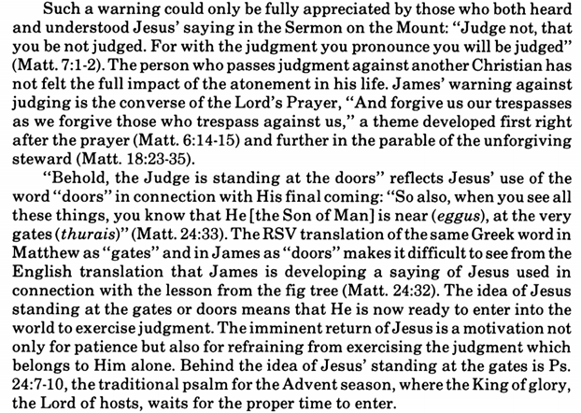

Slide 10
LIFE APPLICATION
“Be patient, therefore, brothers,
until the coming of the Lord.
Establish your hearts,
for the coming of the Lord is at hand.”
His return is at hand,
but why must we still be patient?

