Slide 1
Trinity Lutheran Church Norman, Oklahoma – www.tlcnorman.org The Epistle of James Theme:
“The Testing of Your Faith” Date: 11-19-23 Lesson: 34 - Chapter 5:5,6

Slide 3
TEXT AND STUDY NOTES
(5) You have lived on the earth in luxury
and in self-indulgence.
You have fattened your hearts in a day of slaughter.
(6) You have condemned; you have murdered the righteous person. He does not resist you.
(Ezek 16:19; Am 6:1; Jer 12:3; 25:34;
Mt 10:41; 13:43; 25:37,46; 27:13-26; Mark 15:1-15; Lk 1:6; 2:25; 16:19-31; 23:50;
John 18:33-40; 19:1-22; Ac 3:13, 14; 7:52; 22:14;
Rom 1:17; 5:7,8, 19;
Gal 3:11; 1 Tim 5:6; Heb 10:38;
1 Pet 3:12; 2 Pet 2:13; 1 Jn 3:7; Rev 19:8)

Slide 4
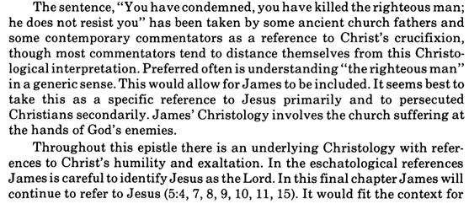
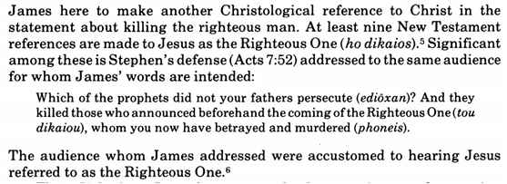
Commentary on James – “The Epistle of Faith”
– Dr. David Scaer – CPH

Slide 5
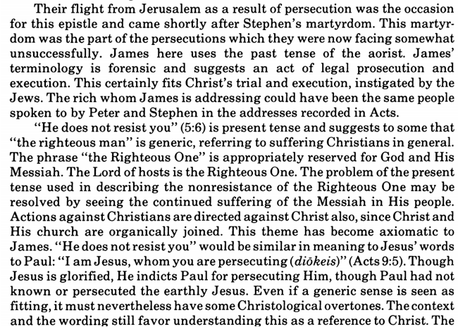

Slide 6
LIFE APPLICATION
The world condemned and murdered the righteous person,
Jesus Christ, who did not resist them.
How today will the world condemn and murder the righteous persons,
Christians, who do not resist them?

Slide 23
