Slide 1
Trinity Lutheran Church Norman, Oklahoma – www.tlcnorman.org The Epistle of James Theme:
“The Testing of Your Faith” Date: 11-12-23 Lesson: 33 - Chapter 5:4

Slide 3
(4) Behold, the wages of the laborers who mowed your fields, which you kept back by fraud, are crying out against you, and the cries of the harvesters have reached the ears of the Lord of hosts.
(Gen 2:1-3; 17:1; Lev 19:13;
Dt. 24:15; 1 Sam 1:3;
Is 5:9; 6:1-7; Jer 22:13; Zech 13:2;
Mal 1:14; 3:1-6; Rom 9:29)

Slide 4
The name “LORD of hosts” occurs some 261 times in the Old Testament Scriptures. God is called the “LORD of hosts” in 1 Samuel 1:3. The word LORD, capitalized, refers to Yahweh, the self-existent, redemptive God. The word “hosts” is a translation of the Hebrew word Sabaoth, meaning “armies”—a reference to the angelic armies of heaven. Thus, another way of saying “LORD of hosts” is “God of the armies of heaven.”
This name for God appears at the close of the period of the judges. In the same sentence as “LORD of hosts” is a reference to Shiloh, where the Ark of the Covenant was kept. The Ark symbolized Yahweh’s rulership, among other things, for He sits enthroned above the cherubim (1 Samuel 4:4; Psalm 99:1). The ”LORD of hosts” reaffirms that God is the true Leader of Israel’s armies, in spite of the low spiritual condition of the nation of Israel at the time of the judges. In 1 Samuel 17:45, as part of his pre-fight verbal sparring with Goliath, David invokes this name of God. In doing so, David was claiming that God is the universal ruler over every force whether in heaven or on earth.
Soon after David’s defeat of Goliath, Israel would enter the international scene. It was necessary for the nation to realize that Yahweh was King even of the many other mighty nations. This kingship of the LORD of hosts is vividly expressed in Psalm 24:10: “Who is this King of glory? The LORD of hosts, he is the King of glory!” He is the glorious King of Israel, and Zechariah 14:9 tells us that He will be King of the world, over all the kingdoms of the earth (cf. Isaiah 37:16).
Eventually, Yahweh of armies will put down all rebellion (Isaiah 24:21–23) and establish His Kingdom from Mt. Zion (Isaiah 31:4–5; 34:12). As the LORD of hosts, God is the all-powerful Ruler over the entire universe. All power and authority are His. He alone intervenes to provide victory for His people. He alone brings world peace. At the same time, He is available to hear the prayers of His people (Psalm 80:19). There is no other God like this.
The LORD of hosts has the grace to always be there for the one who comes to Him through faith in the Lord Jesus Christ. The King of glory, who commands the armies of heaven and who will eventually defeat all His enemies in this world, is none other than Jesus Christ. He is the LORD of hosts (Revelation 19:11–20).

Slide 5
Commentary on James – “The Epistle of Faith”
– Dr. David Scaer – CPH

Slide 6
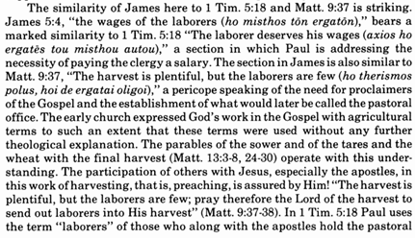

Slide 7
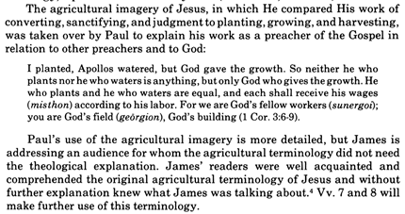

Slide 8
LIFE APPLICATION
“The cries of the harvesters have reached the ears of the Lord of hosts.”
Nothing escapes the ears of God. How is this both terrifying and comforting?

Slide 25
