Slide 1
Trinity Lutheran Church Norman, Oklahoma – www.tlcnorman.org The Epistle of James Theme:
“The Testing of Your Faith” Date: 11-5-23 Lesson: 32 - Chapter 5:1-6

Slide 3
TEXT AND STUDY NOTES
( 5:1) Come now, you rich,
weep and howl for the miseries that are coming upon you.
(2) Your riches have rotted and your garments are moth-eaten.
(3) Your gold and silver have corroded, and their corrosion will be evidence against you and will eat your flesh like fire. You have laid up treasure in the last days.
(Job 13:28; Ps 39:11; Is 13-23: Jer 46-51; Ezek 25-32; Am 1:3-2:16; 8:9-10; Zeph 2:4-15;
Mt 6:19,20; Lk 6:24; 12:21,33; Rom 2:5; 1 Tim 6:9; Heb 1:2; 1 Pet 1:20)

Slide 4
(4) Behold, the wages of the laborers who mowed your fields, which you kept back by fraud, are crying out against you, and the cries of the harvesters have reached the ears of the Lord of hosts.
(Gen 17:1; Lev 19:13; Dt. 24:15;
1 Sam 1:3; Is 5:9; Jer 22:13; Zech 13:2; Mal 3:5; Rom 9:29)

Slide 5
(5) You have lived on the earth in luxury and in self-indulgence.
You have fattened your hearts in a day of slaughter.
(6) You have condemned;
you have murdered the righteous person. He does not resist you.
(Ezek 16:19; Am 6:1; Jer 12:3; 25:34;
Lk 16:19-31; Ac 3:14; 7:52; 22:14; Rom 5:19; 1 Tim 5:6; Heb 10:38; 2 Pet 2:13)

Slide 6
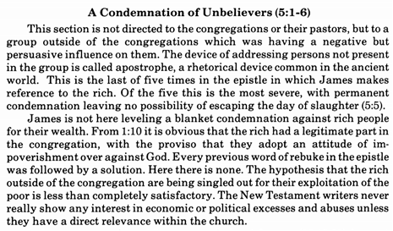
Commentary on James – “The Epistle of Faith”
– Dr. David Scaer – CPH

Slide 7
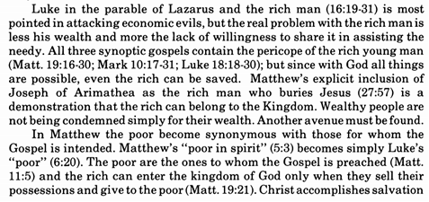
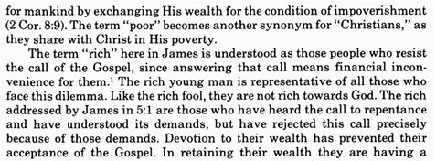

Slide 8
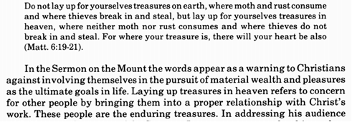
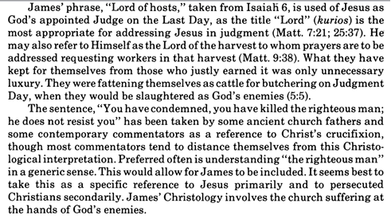

Slide 9
LIFE APPLICATION
“The cries of the harvesters have reached the ears of the Lord of hosts.”
Nothing escapes the ears of God. How is this both terrifying and comforting?

Slide 26
