Slide 1
Trinity Lutheran Church Norman, Oklahoma – www.tlcnorman.org The Epistle of James Theme:
“The Testing of Your Faith” Date: 10-29-23 Lesson: 31 - Chapter 4:16-17

Slide 3
TEXT AND STUDY NOTES
(16) As it is, you boast in your arrogance.
All such boasting is evil.
(17) So whoever knows the right thing to do and fails to do it, for him it is sin.
(Mt 25:31-45; Lk 12:47,48; Jn 9:41;
1 Cor 4:18-21; 5:1-13; 13:4;
2 Tim 3:1-7; 2 Pet 2:21)

Slide 4
NEXT WEEK – We will begin the last chapter of the epistle:
( 5:1) Come now, you rich,
weep and howl for the miseries that are coming upon you.
(2) Your riches have rotted and your garments are moth-eaten.
(3) Your gold and silver have corroded, and their corrosion will be evidence against you and will eat your flesh like fire. You have laid up treasure in the last days.
(4) Behold, the wages of the laborers who mowed your fields, which you kept back by fraud, are crying out against you, and the cries of the harvesters have reached the ears of the Lord of hosts.
(5) You have lived on the earth in luxury and in self-indulgence.
You have fattened your hearts in a day of slaughter.
(6) You have condemned;
you have murdered the righteous person.
He does not resist you.

Slide 5
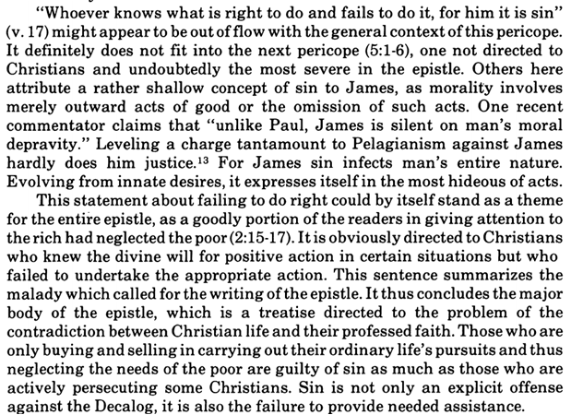
Commentary on James – “The Epistle of Faith”
– Dr. David Scaer – CPH

Slide 7
LIFE APPLICATION
So whoever knows the right thing to do and fails to do it, for him it is sin.
These are described as “sins of omission.”
Why do we often dismiss these sins and downplay them as insignificant?

Slide 24
