Slide 1
Trinity Lutheran Church Norman, Oklahoma – www.tlcnorman.org The Epistle of James Theme:
“The Testing of Your Faith” Date: 10-15-23 Lesson: 29 - Chapter 4:11-17

Slide 3
TEXT AND STUDY NOTES
Do not speak evil against one another, brothers.
The one who speaks against a brother or judges his brother, speaks evil against the law and judges the law.
But if you judge the law, you are not a doer of the law but a judge.
(12) There is only one lawgiver and judge, he who is able to save and to destroy.
But who are you to judge your neighbor?
(Ex 20:16; Lev 19:16; Ps 15:3; 50:19,20; 101:5;
Prov 6:16,19; Is 33:22;
Mt 7:1; 10:28; Rom 1:30; 14:4; 2 Cor 12:20;
Gal 6:1,2; 1 Pet 2:1)

Slide 4
(13) Come now, you who say,
"Today or tomorrow we will go into such and such a town and spend a year there and trade and make a profit"—
(14) yet you do not know what tomorrow will bring.
What is your life?
For you are a mist that appears for a little time and then vanishes.
(15) Instead you ought to say, "If the Lord wills, we will live and do this or that."
(Job 7:7; Ps 39:5; 102:3; 144:4; Prov 27:1; Is 2:22;
Mt 6:10; Mk 3:35; Lk 12:18-20; 22:42;
Acts 18:21; 21:14; Rom 8:27; 2 Cor 8:5;
Eph 5:17; 6:6; Col 4:12; 1 Thess 4:3; 5:18;
Heb 10:36; 1 Pet 2:15; 4:2; 1 John 2:17; 5:14;15)

Slide 5
(16) As it is, you boast in your arrogance.
All such boasting is evil.
(17) So whoever knows the right thing to do and fails to do it, for him it is sin.
(Lk 12:47,48; Jn 9:41;
1 Cor 5:6; 2 Pet 2:21)

Slide 6
Commentary on James – “The Epistle of Faith”
– Dr. David Scaer – CPH

Slide 7
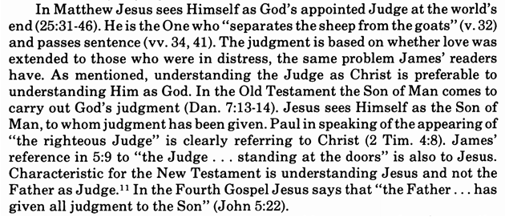

Slide 9
LIFE APPLICATION
Since we stand under the Law,
not above the Law,
how does this shape our relationships to others
and to the Lord?

