Slide 1
Trinity Lutheran Church Norman, Oklahoma – www.tlcnorman.org The Epistle of James Theme:
“The Testing of Your Faith” Date: 10-8-23 Lesson: 28 - Chapter 4:7-10

Slide 3
TEXT AND STUDY NOTES
(7) Submit yourselves therefore to God.
Resist the devil, and he will flee from you.
(8) Draw near to God, and he will draw near to you.
Cleanse your hands, you sinners, and purify your hearts,
you double-minded.
(9) Be wretched and mourn and weep.
Let your laughter be turned to mourning and
your joy to gloom.
(10) Humble yourselves before the Lord,
and he will exalt you.
(Ex 30:17-21; Dt 4:7; Job 5:11;
Ps 24:3-4; 51:17; 73:28; 119:113,169,170;
Is 1:16; 57:14-16;
Jer 4:14; Mic 1:8,9; 2:4; Joel 1:5,12; Zech 1:3; Mal 3:7;
Mt 5:4; Lk 1:52; 6:25; 15:20 18:14; Eph 4:27; 6:11-18;
Heb 7:19; 1 Pet 5:6-9)

Slide 4
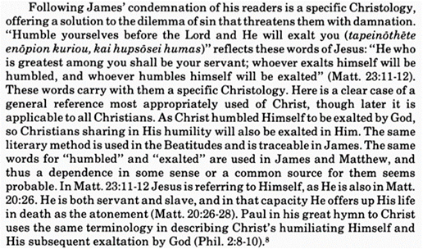
Commentary on James – “The Epistle of Faith”
– Dr. David Scaer – CPH

Slide 5
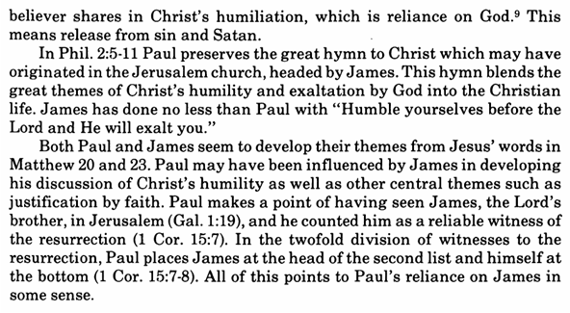

Slide 6
LIFE APPLICATION
– Note all the imperatives:
Submit - Resist
Draw Near - Cleanse - Purify
Be Wretched - Mourn - Weep
Laughter - Mourning- Joy – Gloom - Humble

