Slide 1
Trinity Lutheran Church Norman, Oklahoma – www.tlcnorman.org The Epistle of James Theme:
“The Testing of Your Faith” Date: 9-24-23 Lesson: 27 - Chapter 4:4-10

Slide 3
TEXT AND STUDY NOTES
(4) You adulterous people! Do you not know that friendship with the world is enmity with God? Therefore whoever wishes to be a friend of the world makes himself an enemy of God. (5) Or do you suppose it is to no purpose that the Scripture says, "He yearns jealously over the spirit that
he has made to dwell in us"?
(6) But he gives more grace. Therefore it says,
"God opposes the proud, but gives grace to the humble."
(Gen 2:7; Ex 20:5; Prov 3:34; Is 54:5-8; 57:3;
Jer 2:2; 3:20; 31:32; Hos 2:2-5; 3:1; 9:1;
Mt 6:24; 23:12; Jn 15:19; Rom 8:7; 1 Cor 6:19; 2 Cor 6:16; Gal 5:17; 1 Pet 5:5; 1 Jn 2:15)

Slide 4
(7) Submit yourselves therefore to God.
Resist the devil, and he will flee from you.
(8) Draw near to God, and he will draw near to you.
Cleanse your hands, you sinners, and purify your hearts,
you double-minded.
(9) Be wretched and mourn and weep.
Let your laughter be turned to mourning and
your joy to gloom.
(10) Humble yourselves before the Lord,
and he will exalt you.
(Ex 30:17-21; Dt 4:7; Job 5:11;
Ps 24:3-4; 51:17; 73:28; 119:113,169,170;
Is 1:16; 57:14-16;
Jer 4:14; Mic 1:8,9; 2:4; Joel 1:5,12; Zech 1:3; Mal 3:7;
Mt 5:4; Lk 1:52; 6:25; 15:20 18:14; Eph 4:27; 6:11-18;
Heb 7:19; 1 Pet 5:6-9)

Slide 5
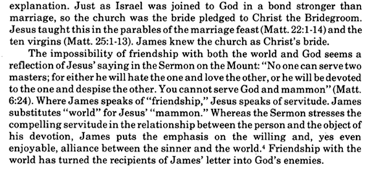
Commentary on James – “The Epistle of Faith”
– Dr. David Scaer - CPH

Slide 6
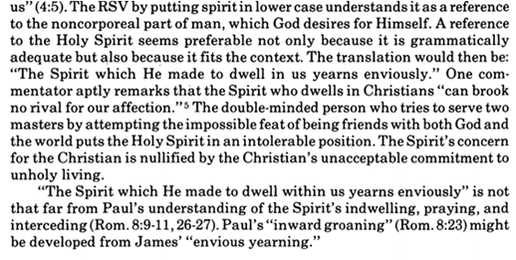

Slide 7
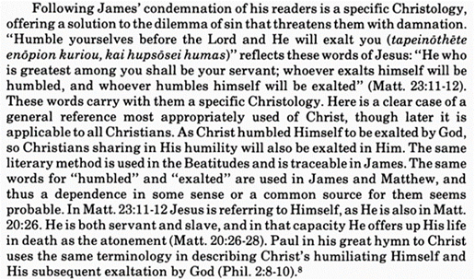

Slide 8
LIFE APPLICATION
“Do you not know that friendship with the world is enmity with God?
Therefore whoever wishes to be a friend of the world makes himself
an enemy of God.”
What are examples of being friends with the world or friends with God?

