Slide 1
Trinity Lutheran Church Norman, Oklahoma – www.tlcnorman.org The Epistle of James Theme:
“The Testing of Your Faith” Date: 8-27-23 Lesson: 24 - Chapter 3:13-18

Slide 3
TEXT AND STUDY NOTES
Who is wise and understanding
among you?
By his good conduct let him show his works in the meekness of wisdom.
(Dt 1:13-15; Mt 5:5; Eph 5:15;
1 Pet 2:12)

Slide 4
(14) But if you have bitter jealousy and selfish ambition in your hearts,
do not boast and be false to the truth.
(15) This is not the wisdom that comes down from above, but is earthly, unspiritual, demonic.
(1 Ki 22:22; Prov 2:1-9; Acts 5:17;
Rom 2:8; 13:13; 1 Cor 2:6-16; 3:3;
2 Cor 12:20; Eph 4:31; 2 Thess 2:9,10;
1 Tim 4:1; Rev 2:24)

Slide 5
(16) For where jealousy and selfish ambition exist,
there will be disorder and every vile practice.
(Mk 7:20-23; 1 Cor 14:33; Gal 5:20,21)

Slide 6
(17) But the wisdom from above is first pure, then peaceable, gentle,
open to reason,
full of mercy and good fruits,
impartial and sincere.
(18) And a harvest of righteousness is sown in peace by those who make peace.
(Prov 11:18; Is 32:17; Hos 10:12; Amos 6:12; Mt 5:9; Lk 6:36;
Rom 12:9; 14:19; 1 Cor 2:6,7; Gal 6:7,8; Php 1:11,17; 2:3; Heb 12:11)

Slide 7
Commentary on James – “The Epistle of Faith”
– Dr. David Scaer - CPH

Slide 8
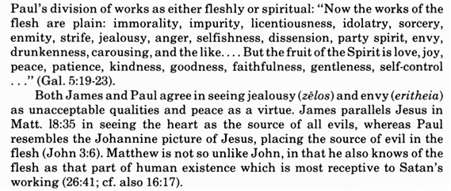
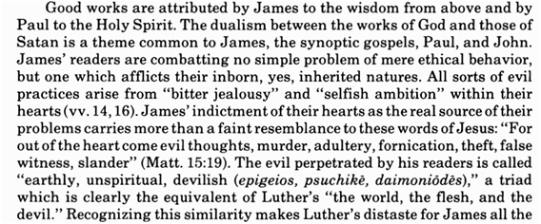

Slide 9
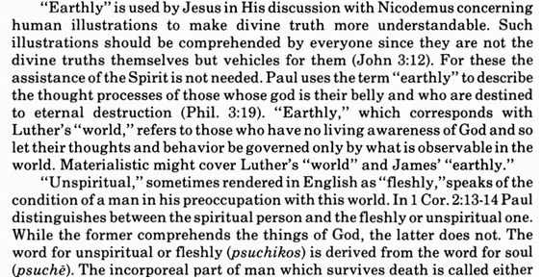

Slide 10
LIFE APPLICATION
Describe the difference between worldly wisdom
and the wisdom that comes down from above.

Slide 27
