Slide 1
Trinity Lutheran Church Norman, Oklahoma – www.tlcnorman.org The Epistle of James Theme:
“The Testing of Your Faith” Date: 8-20-23 Lesson: 23 - Chapter 3:7-10

Slide 3
TEXT AND STUDY NOTES
(7) For every kind of beast and bird, of reptile and sea creature,
can be tamed and
has been tamed by mankind,
(8) but no human being
can tame the tongue.
It is a restless evil, full of deadly poison.
(Gen 1:26-31; Ps 140:3; Eccl 10:11;
Mark 7:33-37; Rom 3:13-19; Col 3:8)

Slide 4
(9) With it we bless
our Lord and Father,
and with it we curse people who are made in the likeness of God.
(10) From the same mouth come blessing and cursing.
My brothers,
these things ought not to be so.
(Acts 2:25-28; Rom 10:8-10; 14:11;
Eph 6:19; Php 2:9-11; 1 Cor 11:7;
1 Pet 3:8-11)

Slide 6
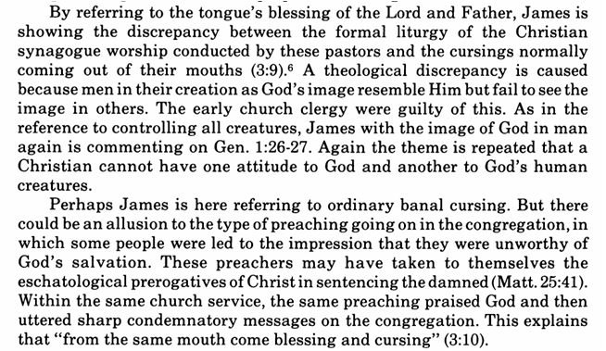

Slide 8
LIFE APPLICATION
“With it we bless our Lord and Father,
and with it we curse people who are made in the likeness of God.
From the same mouth come blessing and cursing.
My brothers, these things ought not to be so.”
Consider the beauty of the confession the creeds,
singing the hymns, psalms and liturgy
each Sunday together with our own mouths and the mouths of others!

Slide 25
