Slide 1
Trinity Lutheran Church Norman, Oklahoma – www.tlcnorman.org The Epistle of James Theme:
“The Testing of Your Faith” Date: 8-13-23 Lesson: 22 - Chapter 3:1-10

Slide 3
TEXT AND STUDY NOTES
Not many of you should become
teachers, my brothers,
for you know that we who teach will be judged with greater strictness.
(2) For we all stumble in many ways,
and if anyone does not stumble in what he says,
he is a perfect man, able also to bridle his whole body.
(1 Ki 8:46; Ps 39:1; Prov 10:19; 20:9; Eccl 7:20;
Mt 12:37; 23:1-33; Lk 11:45,46,52;
Ac 13:1; Rom 2:20,21; 3:9-20;
1 Cor 12:28-29; Gal 1:8,9; Eph 4:11;
1 Tim 1:7; 3:1-6; Titus 1:7-9; 1 Pet 3:10; 1 Jn 1:8)

Slide 4
(3) If we put bits into the mouths of horses so that they obey us, we guide their whole bodies as well.
(4) Look at the ships also:
though they are so large and are driven by strong winds,
they are guided by a very small rudder
wherever the will of the pilot directs.
(5) So also the tongue is a small member,
yet it boasts of great things.
How great a forest is set ablaze by such a small fire!
(6) And the tongue is a fire, a world of unrighteousness.
The tongue is set among our members, staining the whole body,
setting on fire the entire course of life, and set on fire by hell.
(Ps 12:3,4; 32:9; 57:4; 73:8,9; 120:2-4; Prov 16:27;
Mt 5:22; 15:11-19; Mk 7:14-23; Lk 16:23; Jn 8:44)

Slide 5
(7) For every kind of beast and bird, of reptile and sea creature,
can be tamed and has been tamed by mankind,
(8) but no human being can tame the tongue. It is a restless evil, full of deadly poison.
(Ps 140:3; Eccl 10:11; Rom 3:13)

Slide 6
(9) With it we bless
our Lord and Father,
and with it we curse people who are made in the likeness of God.
(10) From the same mouth come blessing and cursing.
My brothers,
these things ought not to be so.
(Gen 1:26-28; 1 Cor 11:7)

Slide 7
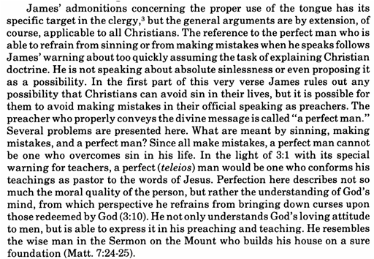

Slide 9
LIFE APPLICATION
“So also the tongue is a small member, yet it boasts of great things.
How great a forest is set ablaze by such a small fire!”
Why do our tongues cause
both tragedy and blessing?

