Slide 1
Trinity Lutheran Church Norman, Oklahoma – www.tlcnorman.org The Epistle of James Theme:
“The Testing of Your Faith” Date: 7-23-23 Lesson: 20 - Chapter 2:24-26

Slide 4
TEXT AND STUDY NOTES
(24) You see that a person is justified by works
and not by faith alone.
(25) And in the same way was not also Rahab the prostitute justified by works when she received the messengers and sent them out by another way?
(Josh 2:1-27; Mt 1:5; Heb 11:31)
For as the body apart from the spirit is dead,
so also faith apart from works is dead.
(Gen 2:7; Eccl 12:7;
Mt 27:50; Mk 14:38; Lk 23:46; Jn 19:30;
Acts 7:55-60;
Php 1:23,24; Heb 12:23)

Slide 5
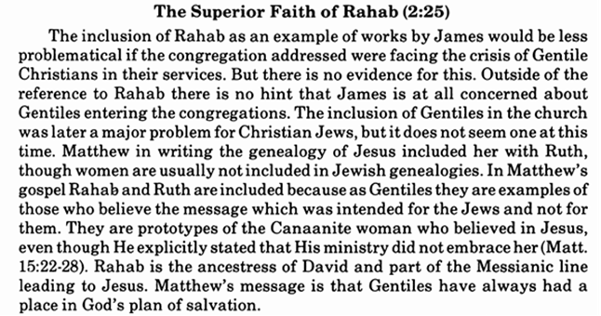
Commentary on James – “The Epistle of Faith” – Dr. David Scaer - CPH

Slide 6
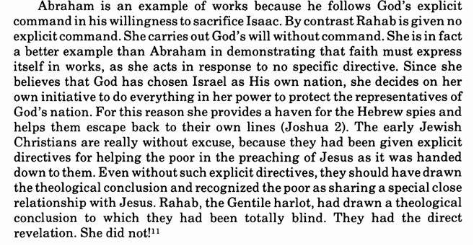

Slide 8
LIFE APPLICATION
“For as the body apart
from the spirit is dead,
so also faith apart from works is dead.”
You and I are body and soul
at the same time.
You and I have faith and do good works
at the same time.
Explain how this affects your daily vocation?

Slide 25
