Slide 1
Trinity Lutheran Church Norman, Oklahoma – www.tlcnorman.org The Epistle of James Theme:
“The Testing of Your Faith” Date: 7-16-23 Lesson: 19 - Chapter 2:21-26

Slide 3
TEXT AND STUDY NOTES
(21) Was not Abraham our father justified by works when he offered up his son Isaac on the altar? (22) You see that faith was active along with his works, and faith was completed by his works;
(23) and the Scripture was fulfilled that says, "Abraham believed God, and it was counted to him as righteousness“
-- and he was called a friend of God.
(Gen 15:6; 22:9-12; 2 Chr 20:7; Is 41:8; Mt 11:19; 12:33-37;
Rom 4:3; Gal 2:15,16; 3:6; 5:6; 1 Th 1:3; Heb 11:17)
(24) You see that a person is justified by works and not by faith alone.
(25) And in the same way was not also Rahab the prostitute justified by works when she received the messengers
and sent them out by another way?
(26) For as the body apart from the spirit is dead, so also faith apart from works is dead.
(Gen 2:7; Josh 2:1-22; Mt 1:5; Heb 11:31)

Slide 4
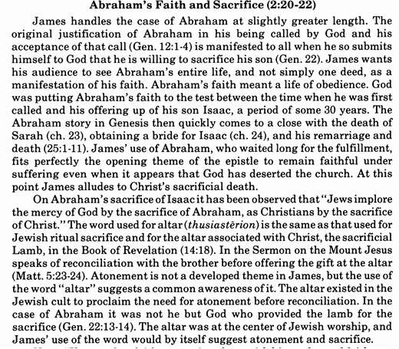
Commentary on James – “The Epistle of Faith” – Dr. David Scaer - CPH

Slide 5
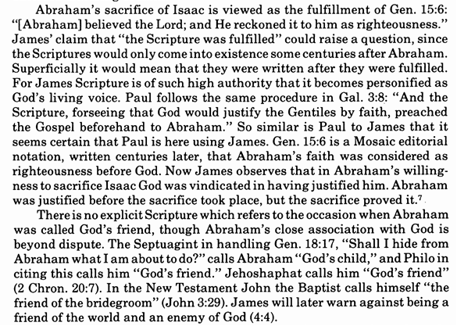

Slide 7
LIFE APPLICATION
How are belief,
faith
and works
interrelated?

Slide 24
