Slide 1
Trinity Lutheran Church Norman, Oklahoma – www.tlcnorman.org The Epistle of James Theme:
“The Testing of Your Faith” Date: 7-9-23 Lesson: 18 - Chapter 2:18-26

Slide 3
TEXT AND STUDY NOTES
(18) But someone will say, "You have faith and I have works." Show me your faith apart from your works, and I will show you my faith by my works.
(Mt 7:16,17; Rom 3:28; 4:6; Gal 5:6; Heb 11:33)
(19) You believe that God is one; you do well. Even the demons believe--and shudder!
(20) Do you want to be shown, you foolish person, that faith apart from works is useless?
(Dt 6:4; Mt 8:29; Mk 1:24; 5:7; 12:29; Lk 4:33,34;
Ac 16:17; 19:15;
Rom 2:17-24; 1 Cor 8:4-6; Eph 4:6)

Slide 4
(21) Was not Abraham our father justified by works when he offered up his son Isaac on the altar? (22) You see that faith was active along with his works, and faith was completed by his works;
(23) and the Scripture was fulfilled that says, "Abraham believed God, and it was counted to him as righteousness“
-- and he was called a friend of God.
(Gen 15:6; 22:9-12; 2 Chr 20:7; Is 41:8; Mt 11:19; 12:33-37;
Rom 4:3; Gal 2:15,16; 3:6; 5:6; 1 Th 1:3; Heb 11:17)
(24) You see that a person is justified by works and not by faith alone.
(25) And in the same way was not also Rahab the prostitute justified by works when she received the messengers
and sent them out by another way?
(26) For as the body apart from the spirit is dead, so also faith apart from works is dead.
(Gen 2:7; Josh 2:1-22; Mt 1:5; Heb 11:31)

Slide 5
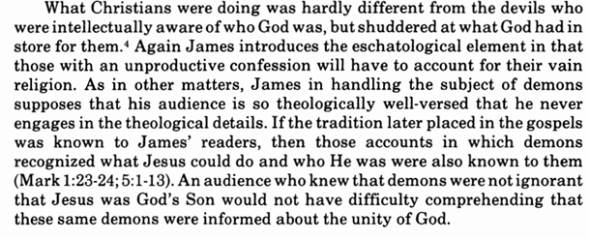
Commentary on James – “The Epistle of Faith” – Dr. David Scaer - CPH

Slide 6
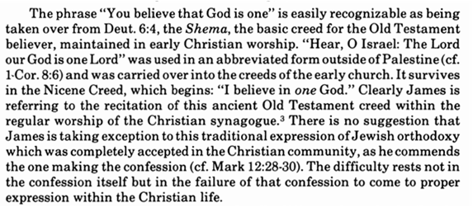

Slide 7
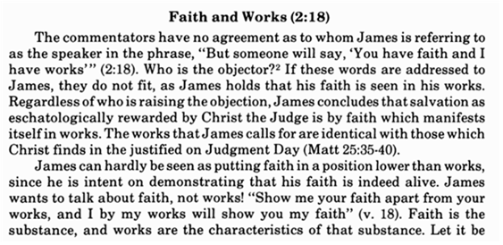
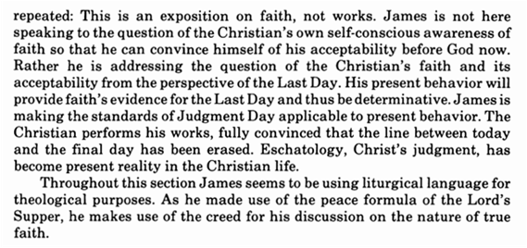

Slide 8
LIFE APPLICATION
Note: Martin Luther had difficulties with the words of James here. He thought that James was contradicting Paul in saying that a person is justified not only by faith, but also by works. But since Scripture interprets Scripture, the simple way to understand this is that James is indicating that true faith WILL always be followed by good works, and THAT is what saving faith is. A good tree WILL always bear good fruit.
So someone who claims to have faith, but has no good works – really doesn’t have faith at all.
How would you explain this to someone based on the distinction between justification and sanctification?

Slide 25
