Slide 1
Trinity Lutheran Church Norman, Oklahoma – www.tlcnorman.org The Epistle of James Theme:
“The Testing of Your Faith” Date: 6-4-23 Lesson: 16 - Chapter 2:10-17

Slide 2
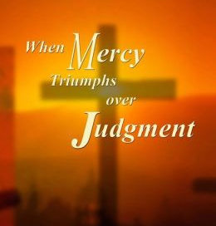

Slide 3
TEXT AND STUDY NOTES
(10) For whoever keeps the whole law but fails
in one point has become accountable for all of it.
(11) For he who said, "Do not commit adultery,"
also said, "Do not murder." If you do not commit adultery but do murder, you have become a transgressor of the law.
(12) So speak and so act as those who are to be judged
under the law of liberty.
(13) For judgment is without mercy
to one who has shown no mercy.
Mercy triumphs over judgment.
(Ex 20:13,14; Dt 5:17,18; 27:26; 28:15;
Job 22:6-11; Ps 18:25,26; Prov 21:3,13; Ezek 25:11-14;
Mt 5:7,18,19; 6:14,15; 9:13; 12:7; 16:27; 18:21-35; 23:23;
Lk 6:37,38; Jn 5:24;
1 Cor 3:12-15; 2 Cor 5:10; Gal 3:10; 5:3; Rev 22:12)

Slide 4
(14) What good is it, my brothers, if someone says he has faith but does not have works?
Can that faith save him?
(15) If a brother or sister is poorly clothed and lacking in daily food,
(16) and one of you says to them,
"Go in peace, be warmed and filled,"
without giving them the things needed for the body, what good is that?
(17) So also faith by itself, if it does not have works, is dead.
(Job 31:19; Mt 7:26; 23:1-6; 25:35; Lk 3:11;
Gal 5:6; 1 Jn 3:17,18)

Slide 5
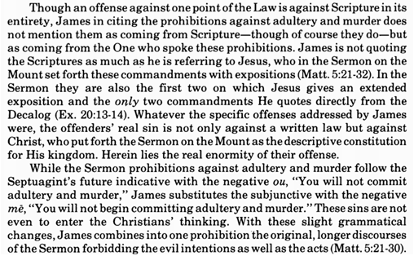
Commentary on James – “The Epistle of Faith” – Dr. David Scaer - CPH

Slide 6
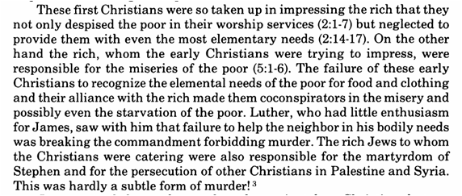

Slide 7
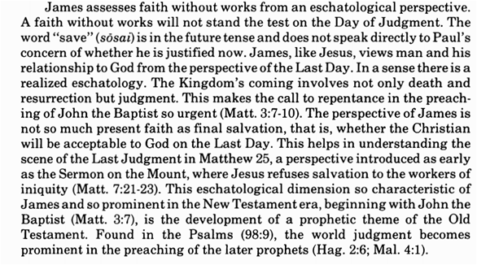

Slide 8
LIFE APPLICATION
1. LAW:
“For whoever keeps the whole law but fails
in one point has become accountable for all of it.”
(Breaking of one commandment has a domino effect on all ten commandments)
2. GOSPEL:
“Mercy triumphs over judgment.”
(Mercy is personified in our Lord Jesus Christ – the Merciful One)
3. JUSTIFICATION AND SANCTIFICATION JOINED TOGETHER:
“So also faith by itself, if it does not have works, is dead.”
(A good tree will always bear good fruit)
How do we in preaching, teaching and living, properly then,
distinguish these three crucial truths from the Bible,
that show us how God carefully deals with each one of us?

Slide 25
