Slide 1
Trinity Lutheran Church Norman, Oklahoma – www.tlcnorman.org The Epistle of James Theme:
“The Testing of Your Faith” Date: 4-16-23 Lesson: 12 - Chapter 1:26-27

Slide 3
(26) If anyone thinks he is religious and does not bridle his tongue but deceives his heart,
this person's religion is worthless.
(27) Religion that is pure and undefiled before God, the Father, is this:
to visit orphans and widows in their affliction,
and to keep oneself unstained from the world.
(Dt. 10:18; 14:29; 16:11; 24:19; Job 31:16-21;
Ps 34:13; 39:1; 141:3; 146:9;
Is 1:17-23; Jer 22:16; Hos 14:3;
Mt 25:36; Mark 12:38-44; Lk 4:25-27; 7:11-17; 18:1-8;
Ac 9:39-43; Rom 12:2; 1 Tim 5:3-16; 6:12-16;
1 Pet 3:10; 2 Pet 1:4; 2:20; 3:10-14; 1 Jn 2:15; 5:18)

Slide 4
LUTHER ON TRUE RELIGION – VOLUME 24
“Faith must lay hold of this, must be founded on it, and must take comfort from it in times of temptation, when the devil and man’s own conscience argue with him as follows: “Listen. What kind of Christian are you? Where is your righteousness? Do you not see and feel that you are a sinner? How, then will you pass muster before God?” Here again he must base his words on this verse and say: “I know very well, and I am sorry to say, that I am a sinner and that in me there is no righteousness that will be valid before God. And I must and will not look for or know of such righteousness in myself, for with it I could never come before God. But in this verse I hear Christ say that my righteousness consists in His going to the Father and in His ascension into heaven.
There my righteousness has been deposited, and there the devil will surely have to let it remain; for he will not make Christ a sinner or reprove or find fault with His righteousness. If I am a sinner and my life does not pass muster before God, and if I find no righteousness in myself, I have another treasure, which is the righteousness of which I boast and on which I rely. This is Christ’s going to the Father, which He has presented to me as a gift.” What does this righteousness lack, or what flaw can you find in it? You surely do not see or feel anything of it, do you? Answer: “Indeed, Christ Himself defines and describes righteousness by saying that I will not feel it but must take hold of it by faith in Christ’s Word ‘you will see Me no more.’ But why would I need faith if I could perceive and feel this righteousness in myself?”
Therefore learn this verse well, in order that on the basis of it you may be able to distinguish clearly between Christ’s righteousness and anything else that is called righteousness. For here you learn that the righteousness of which Christ is speaking is not our work or doing, but that it is His going to the Father or His ascension. It is clear and obvious, of course, that there is a wide gulf between the two types of righteousness.

Slide 5
Our work surely is not Christ, and His going is not our doing or work. For what did I or any other man contribute to His going to the Father, that is, to His suffering and death, His resurrection, and His sitting at the right hand of God? This “going to the Father” certainly is not my obedience and good works not even the works done in accordance with the Ten Commandments, much less my self-chosen worship and human works, monasticism, pilgrimages, self-made exercises in religion, etc. Even if one cannot comprehend the meaning of the words “going to the Father,” still one can at least hear and understand that this is not and cannot be our work or doing but is given to Christ alone and is placed entirely on His Person…
It is true of course that we must improve our conduct and change our way of life, do good and shun evil; but a better life of this kind will not accomplish what Christ’s going to the Father is to accomplish, namely, our justification before God and our salvation. The lives and the works of all the saints and the capabilities of all men are far too weak and too few to accomplish this; for everything they do is surely nothing more than earthly, transitory activity, which must terminate with us and remain here below.
And although the works and deeds believers perform in conformity with God’s commandments are pleasing to God and will also be rewarded by Him both in time and in eternity, still they cannot bring us to God or be the righteousness that delivers from sin and death. No, there is no other consolation than Christ’s going to the Father. This is our chief possession and inheritance, our ultimate trust and eternal righteousness.”

Slide 6
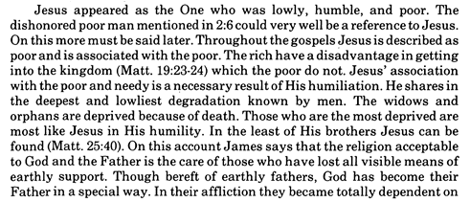
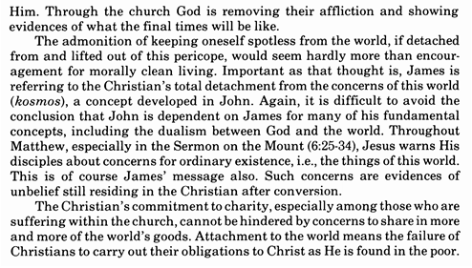
Commentary on James – “The Epistle of Faith”
– Dr. David Scaer – CPH

Slide 7
LIFE APPLICATION
1. If we desire to be truly religious,
how do we bridle our tongues?
2. If our religion is pure and undefiled
before God, the Father,
what are the ways to visit orphans and widows in their affliction?
3. Why must we keep ourselves unstained from the world?

Slide 16
