Slide 1
Trinity Lutheran Church Norman, Oklahoma – www.tlcnorman.org The Epistle of James Theme:
“The Testing of Your Faith” Date: 4-2-23 Lesson: 11 - Chapter 1:26-27

Slide 3
(26) If anyone thinks he is religious and does not bridle his tongue but deceives his heart,
this person's religion is worthless.
(27) Religion that is pure and undefiled before God, the Father, is this:
to visit orphans and widows in their affliction,
and to keep oneself unstained from the world.
(Dt. 10:18; 14:29; 16:11; 24:19; Job 31:16-21;
Ps 34:13; 39:1; 141:3; 146:9;
Is 1:17-23; Jer 22:16; Hos 14:3;
Mt 25:36; Mark 12:38-44; Lk 4:25-27; 7:11-17; 18:1-8;
Ac 9:39-43; Rom 12:2; 1 Tim 5:3-16; 6:12-16;
1 Pet 3:10; 2 Pet 1:4; 2:20; 3:10-14; 1 Jn 2:15; 5:18)

Slide 4
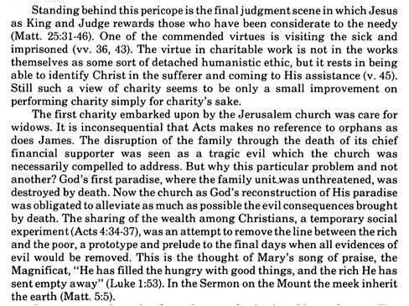
Commentary on James – “The Epistle of Faith”
– Dr. David Scaer – CPH

Slide 5
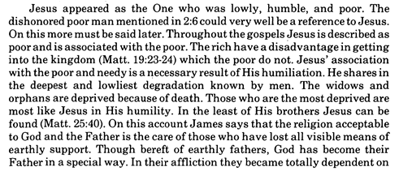
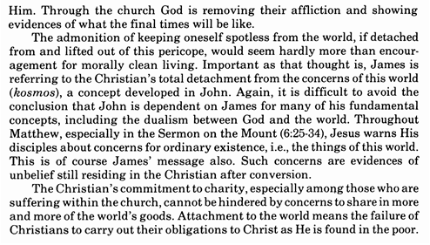

Slide 6
LIFE APPLICATION
1. If we desire to be truly religious,
how do we bridle our tongues?
2. If our religion is pure and undefiled
before God, the Father,
what are the ways to visit orphans and widows in their affliction?
3. Why must we keep ourselves unstained from the world?

