Slide 1
Trinity Lutheran Church Norman, Oklahoma – www.tlcnorman.org Israel –
Whose Land Is It? Date: 12-31-23

Slide 2
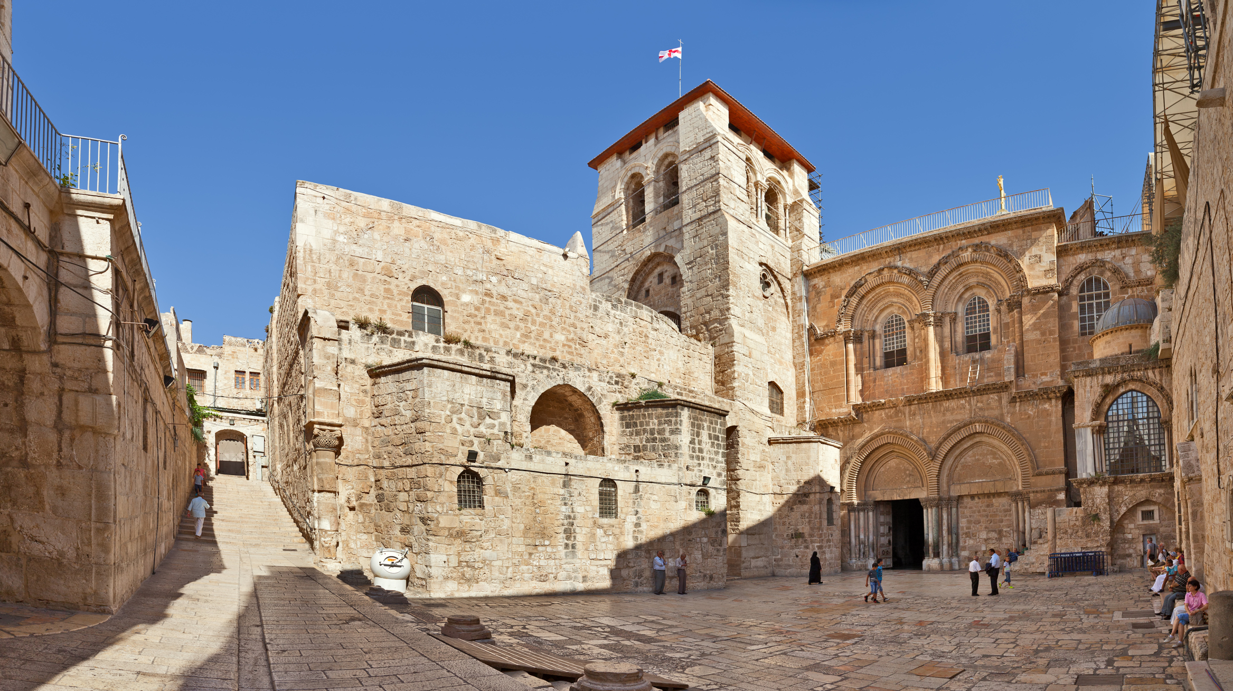
The Church of the Holy Sepulchre – Jerusalem, Israel

Slide 7
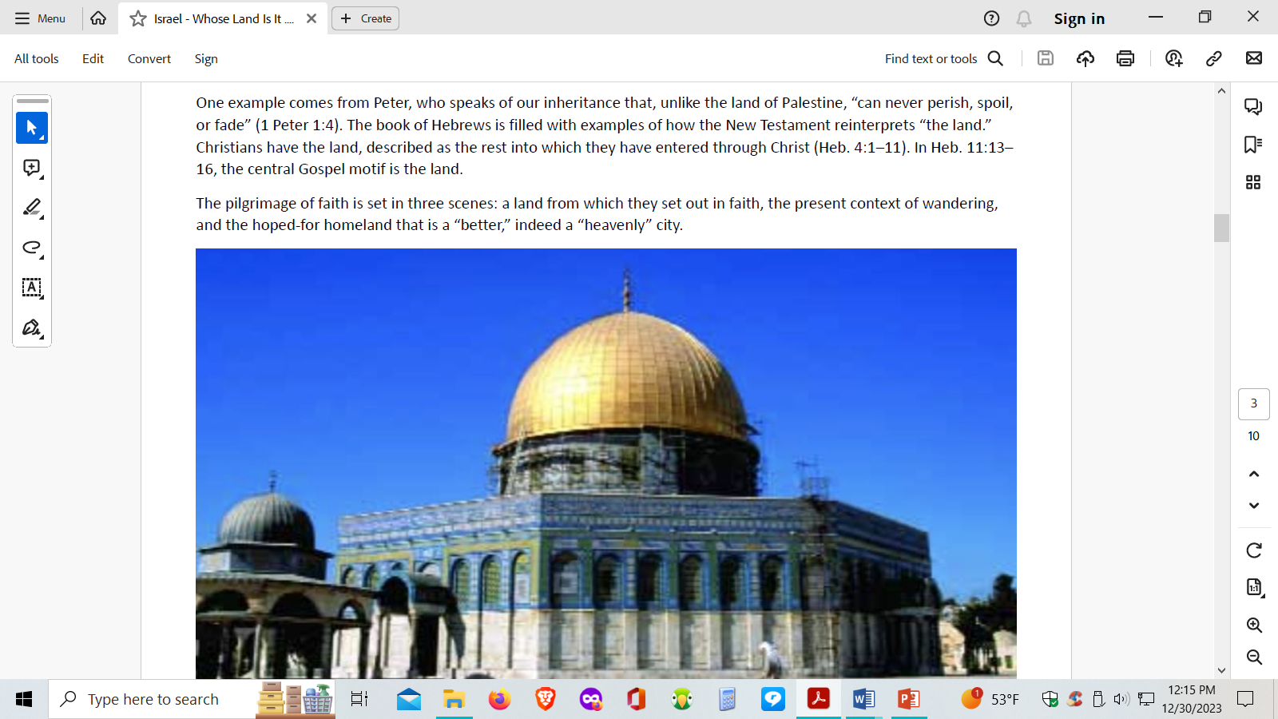

Slide 9
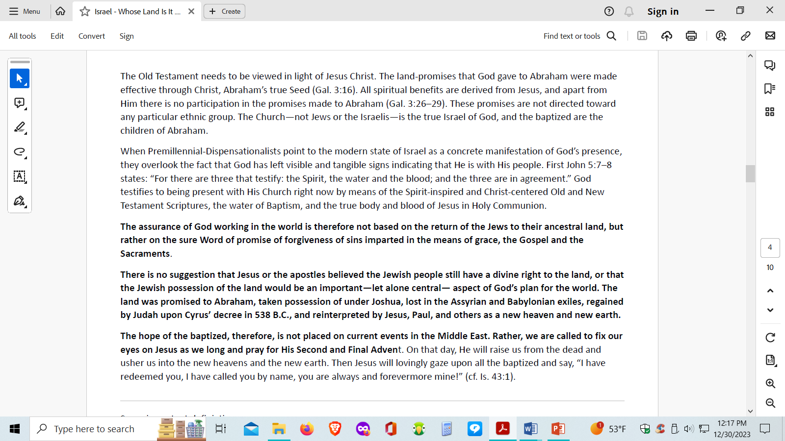

Slide 13
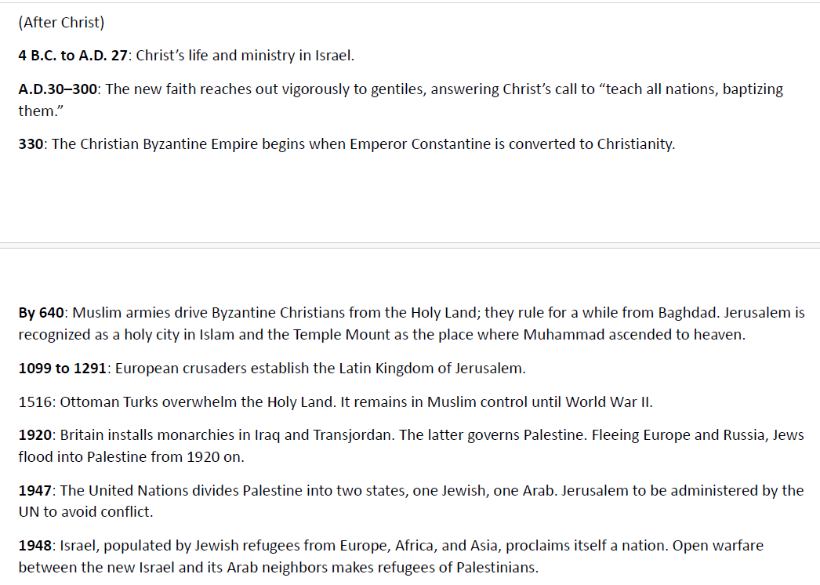

Slide 18
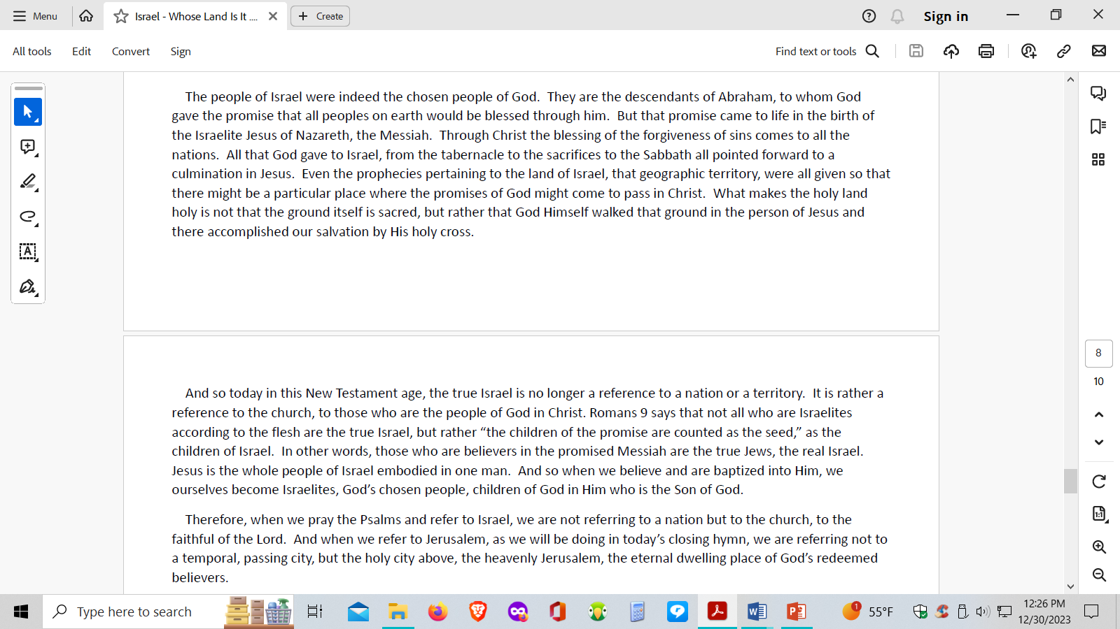

Slide 19
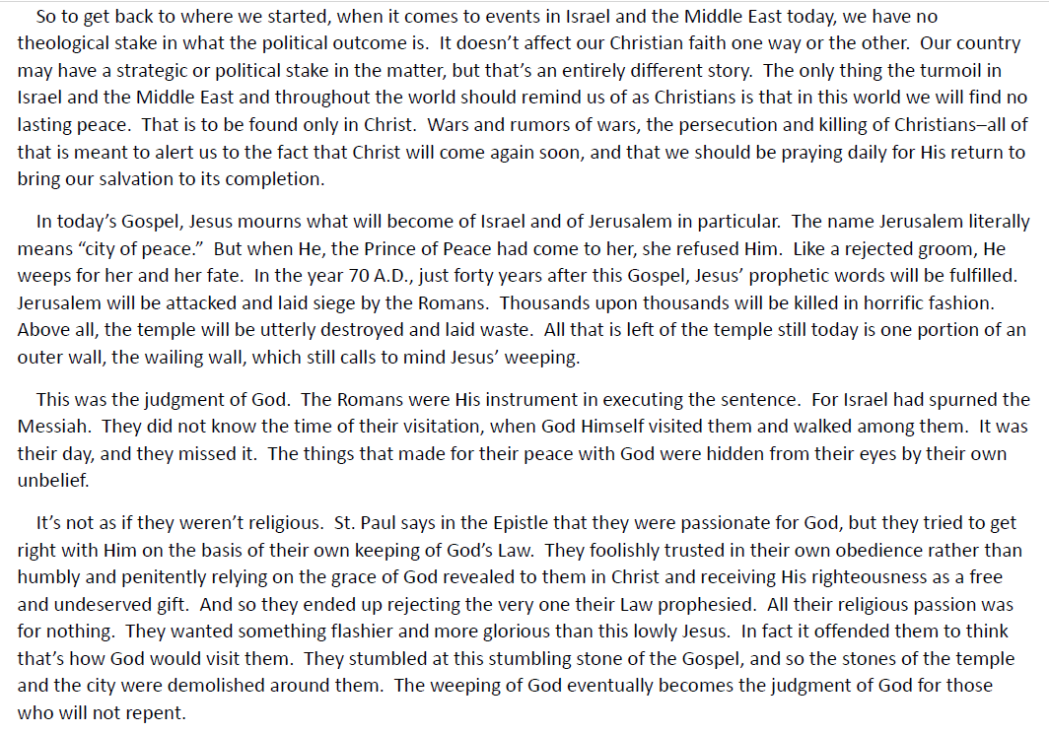

Slide 22
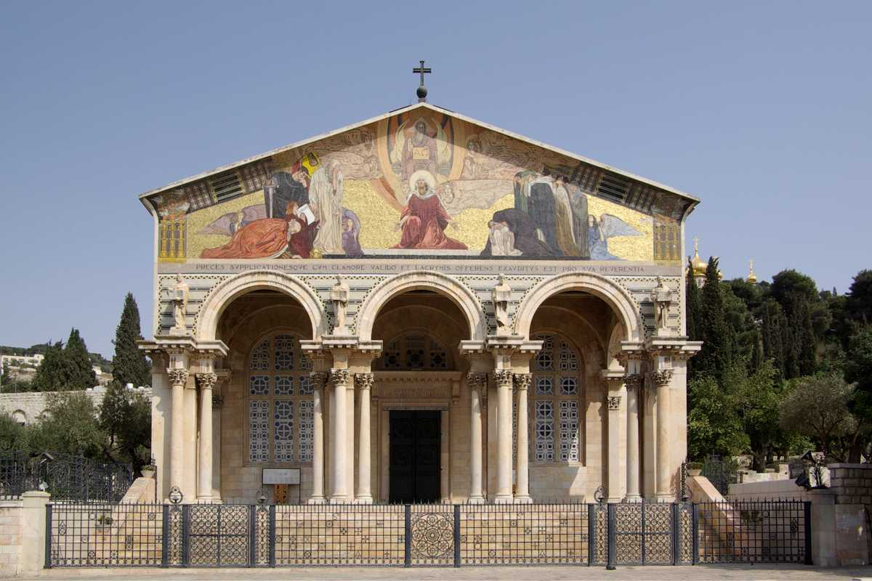
The Church of All Nations – The Garden of Gethsemane – Jerusalem, Israel

