Slide 1
“Prioritize Our Lives
Work Together”
The Book of Haggai
Making Disciples for Life
Pastor David Nehrenz
Trinity Lutheran Church Norman, OK.
Date: 2-25-24 Lesson: 2
“My Spirit remains in your midst.
Fear not.”
MISSION PRIORITY #1
“Plant, sustain and revitalize
Lutheran churches”

Slide 2
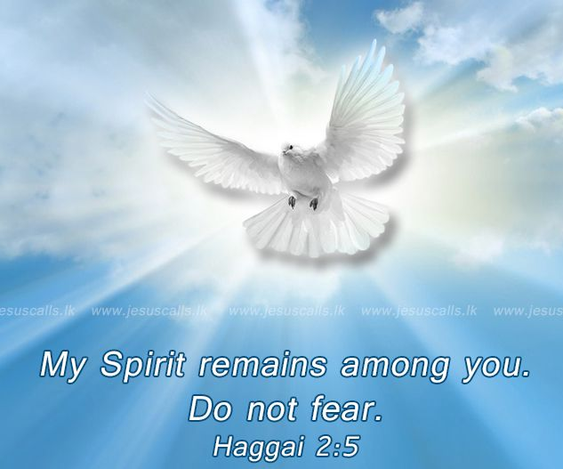

Slide 3
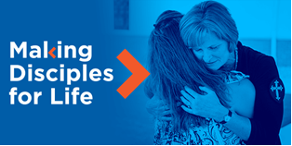

Slide 4


Slide 5
A. THE TEXT (Haggai 2:1-5)
In the seventh month, on the twenty-first day of the month, the word of the Lord came by the hand of Haggai the prophet, (2) "Speak now to Zerubbabel the son of Shealtiel, governor of Judah, and to Joshua the son of Jehozadak, the high priest, and to all the remnant of the people, and say, (3) 'Who is left among you who saw this house in its former glory? How do you see it now? Is it not as nothing in your eyes?
(4) Yet now be strong, O Zerubbabel, declares the Lord. Be strong, O Joshua, son of Jehozadak, the high priest. Be strong, all you people of the land, declares the Lord. Work, for I am with you, declares the Lord of hosts, (5) according to the covenant that I made with you when you came out of Egypt. My Spirit remains in your midst. Fear not.

Slide 6
B. THE KEY PEOPLE and THE HISTORICAL BACKGROUND
1. Darius the king – Hystaspis ruler of Persia (522-486 B.C.)
2. Haggai the prophet (Ezr 5:1-2; 6:14)
3. Zerubbabel the son of Shealtiel, governor of Judah – Sheshbazzar (Ezr 1:8)
4. Joshua the son of Jehozadak, the high priest (taken captive by Nebuchadnezzar in 1 Chr 6:15)
5. The remnant of the people
6. The last day of the Feast of Tabernacles- 21st day of the 7th month = Oct. 17, 520 B.C.
7. From 333-330 B.C. Alexander the Great would defeat the Persians, nations rise and fall.

Slide 7
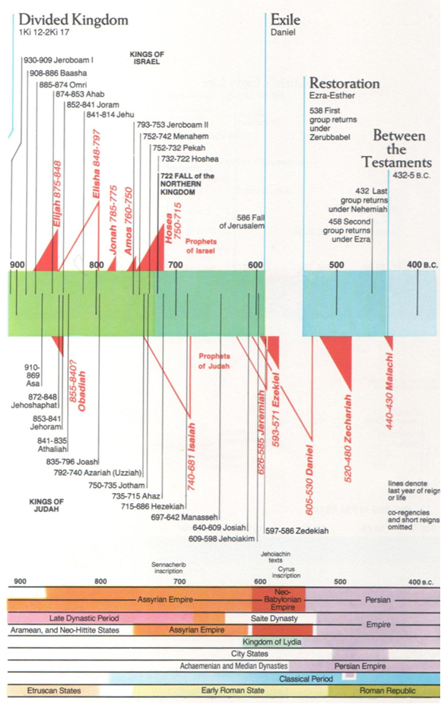

Slide 8
C. THE STUDY NOTES
1. This house in its former glory – Solomon had dedicated the original temple during this same Feast
Some of the older exiles like Haggai had seen Solomon’s temple before it was destroyed 66 years earlier
by the Babylonians. This rebuilt temple will not be able to match the glory of the original one
(Ezr 3:12)
2. Be strong, I am with you, declares the Lord of hosts
(Josh 1:6,7,9,18; 1 Chr 28:20; 1 Cor 16:13; Eph 6:10)
3. The covenant that I made with you when you came out of Egypt.
(Gen 6:18; Ex 19:5,6; 25:8; 29:46)
4. My Spirit remains in your midst. Fear not.
(Nu 11:16,17,25; Is 41:10; 63:11; Zech 4:6; Mt 10:31; Lk 12:32; Rev 1:17)

Slide 9
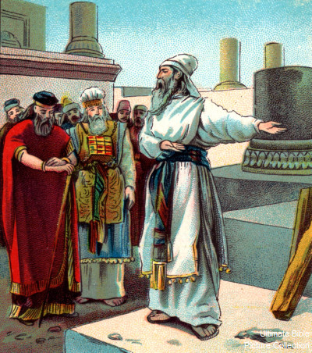

Slide 10
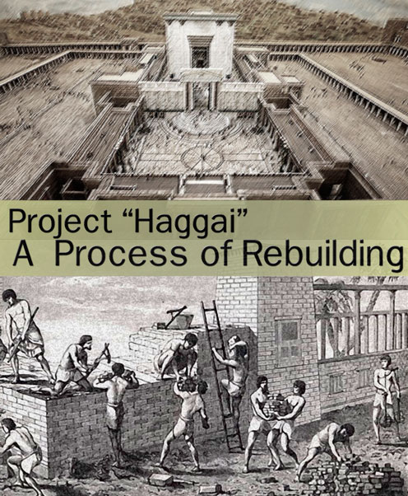

Slide 11
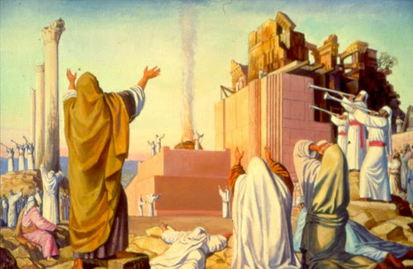

Slide 12
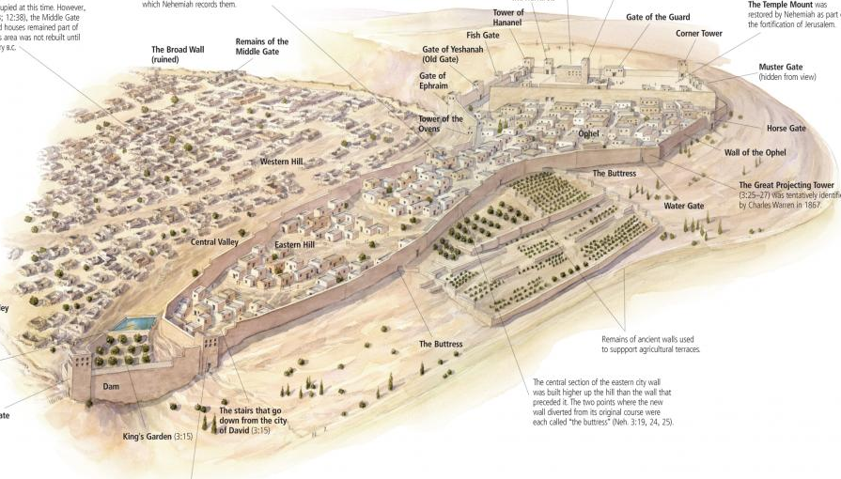

Slide 13
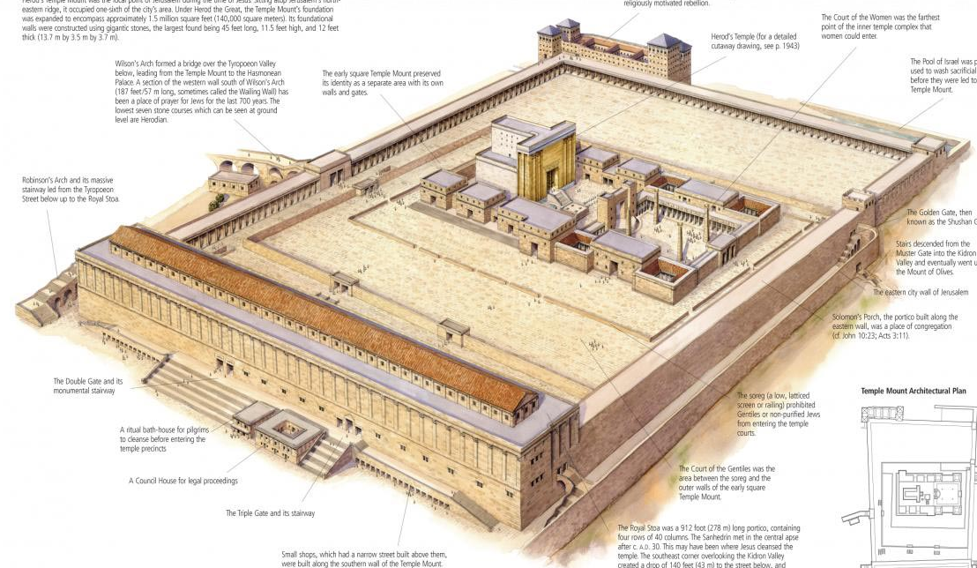

Slide 14
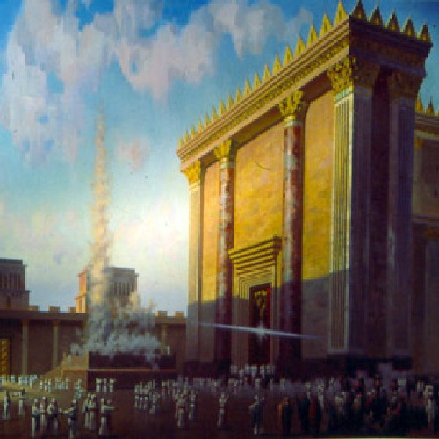

Slide 15
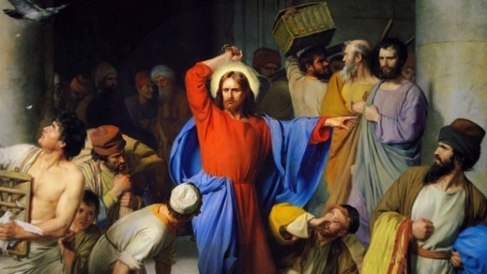

Slide 16
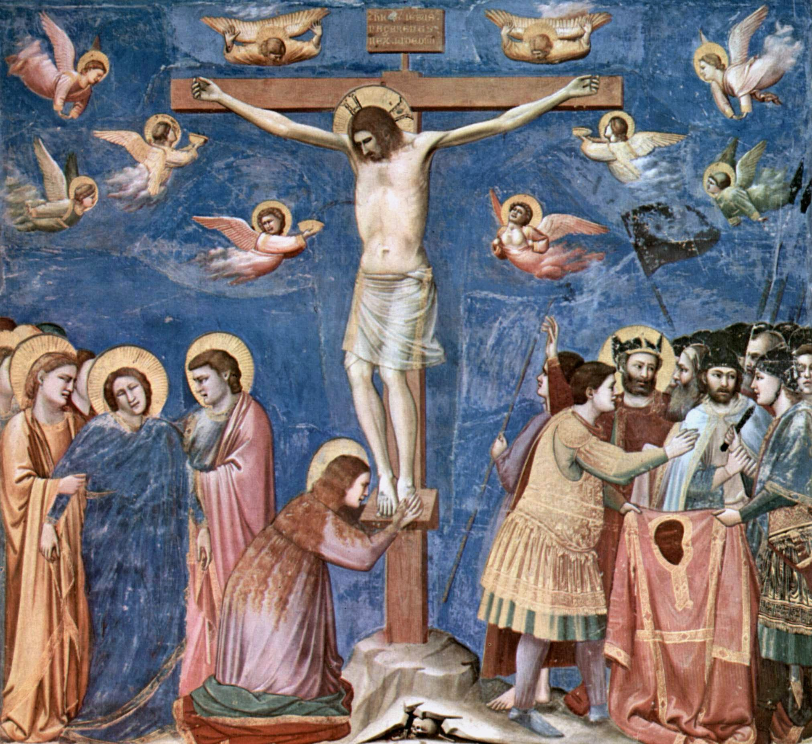

Slide 17
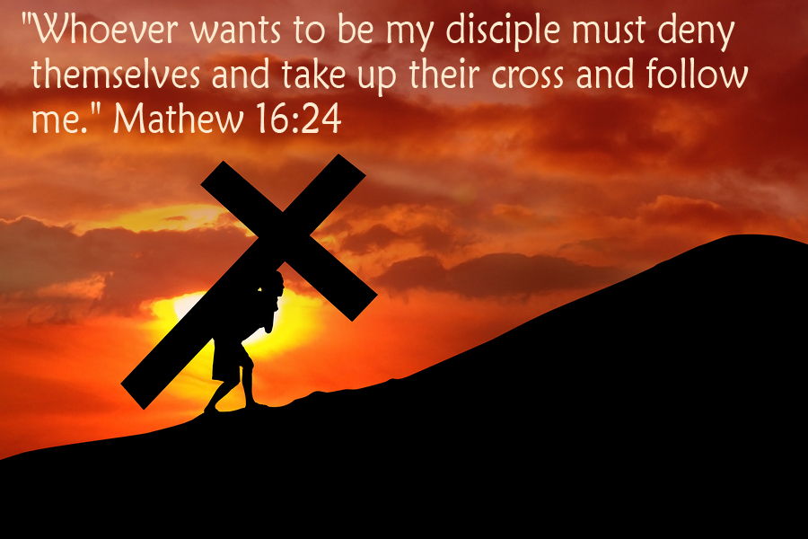

Slide 18
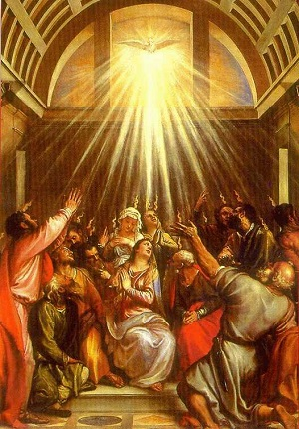

Slide 19
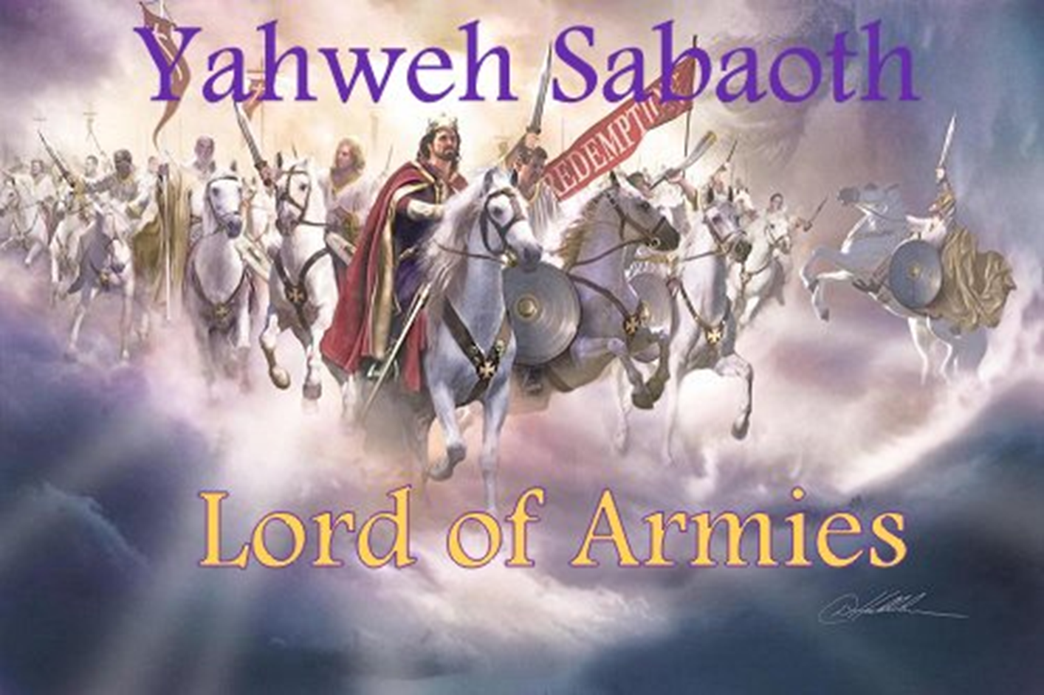

Slide 20
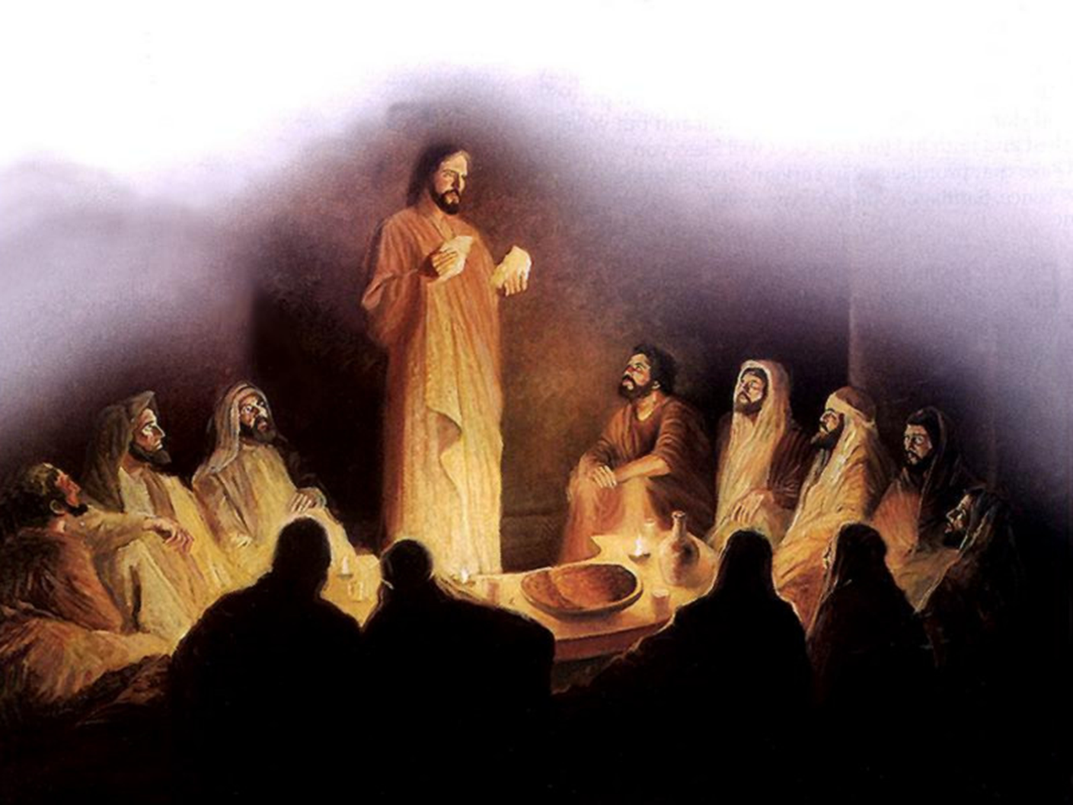

Slide 21
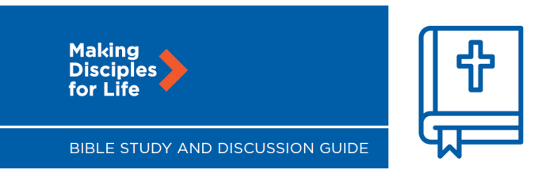

Slide 22

D. MISSION PRIORITY #1 Plant, sustain and revitalize Lutheran churches
What does this mean?
Congregations, where the Gospel is purely preached and the Sacraments of Christ are rightly administered, are vital to the task of Making Disciples for Life. Called to faith in Christ by the Holy Spirit, congregations are assemblies of believers in Christ Jesus that are known by tangible gifts from God that create and sustain disci­ples and by which the church is known to the world. Luther pointed to seven such “marks” of the church:
The faithful preaching and teaching of God’s Word;
Holy Baptism;
Holy Absolution;
Holy Communion;
Called and ordained pastors;
Public thanksgiving; and
Faithful suffering under the cross of Christ.

Slide 23
By these same gifts, congregations reach out to those who do not know Christ to bring them into the fellowship of saving faith, where they faithfully and regularly receive Jesus in Word and Sacrament so that they might serve their neighbor with the love of Christ in their vocations.
God’s Word plants, sustains and revitalizes congregations and each disciple of Jesus in faith in Christ and love for others. Congregations confess and live under the redemptive work of Christ for sinful humanity and for all of God’s creation, embracing God’s design for men and women, marriage and family, the sanctity of human life, and the sacrificial service of the Christian toward one’s neighbor and the world around them.
Christian congregations and their members share in the sweet communion of God’s love and forgiveness in Christ as they forgive one another, pray for each other and the world, study God’s Word together, offer themselves in acts of mercy and charity to a fallen world, and suffer joyously under the cross with fervent faith in Christ and the glorious hope of the resurrection from the dead. All of this is believed, confessed and shared for the expansion of the kingdom of God when and where our Lord pleases.
Scripture reference: Acts 14:21–28

Slide 24
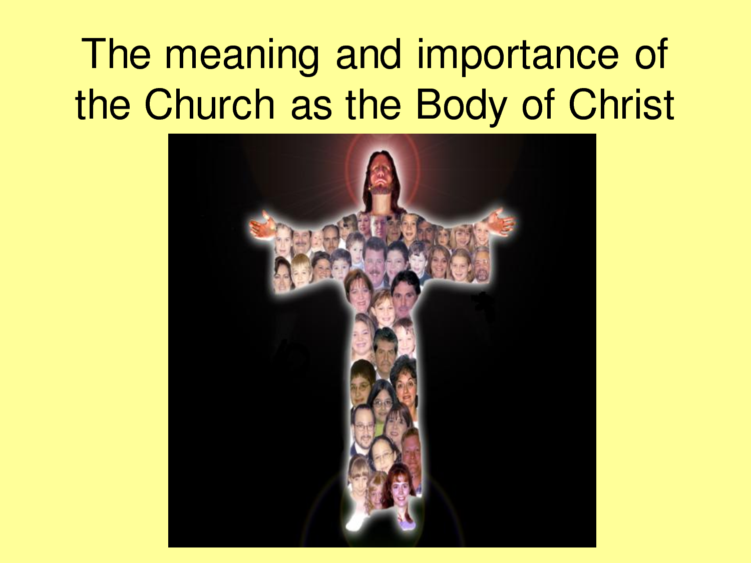

Slide 25
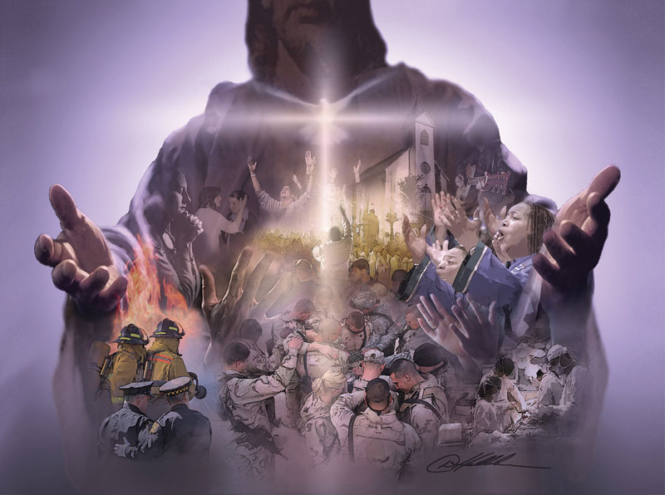

Slide 26
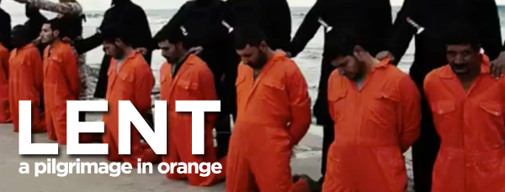

Slide 27
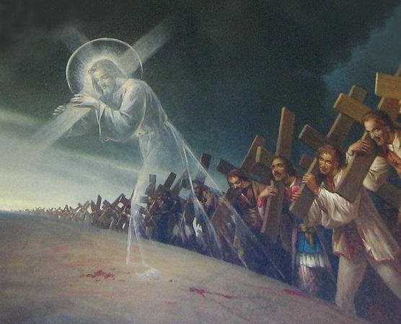

Slide 32

NEXT WEEK 3-3-24 LESSON 3
“The latter glory of this house shall be greater than the former”
(Haggai 2:6-9)
SEVEN MISSION PRIORITIES
MISSION PRIORITY #2
Support and expand theological education

