Slide 1
Trinity Lutheran Church Norman, Oklahoma – www.tlcnorman.org The Book of Galatians Theme: “The True Gospel You Have Received” Date:12-11-22 Lesson: 36 - Chapter 6:16-17

Slide 3
(16) And as for all who walk by this rule,
peace and mercy be upon them,
and upon the Israel of God.
(17) From now on let no one cause me trouble,
for I bear on my body the marks of Jesus.
(Ps 125:5; 128:6; Is 44:5; Rom 2:29; 4:12; 9:6-8;
1 Cor 10:18; Php 3:3)
Note: “the New Israel” = the Christian Church made up of Jews and Gentiles. It is not a reference to the modern state of Israel. The confusion among Christians on that issue has brought endless dispensational theories and endtimes’ speculation through millennialism. We reject all of that as false teaching which completely obscures the proper proclamation of the Law and the Gospel
– justification by grace through faith.

Slide 4
The marks of Jesus on Paul:
In the ancient world, slaves were branded on their skin to mark to whom they belonged and identified who was their master. Paul was indeed marked as a slave of Jesus:
Stoning (Ac 14:19); beatings (Ac 16:22; 2 Cor 11:23-25);
illness (2 Cor 1:5; 12:7; Gal 4:13,14);
servant of Christ (2 Cor 4:8-10; Php 3:10)
The Roman Catholic superstitious and pietistic description of these marks is called “the stigmata.”
This meant that special holy saints miraculously had appear the same “marks” that were on Jesus, meaning nails scars on their hands and feet. This was then a sign of the holiness of that person, who could become an intercessor for a believer. This is nowhere taught in Scripture. Lutherans reject these manmade means of grace in relics and holy bones as having salvific power. The only true means of grace flow from the certain Word of God in preaching, teaching, baptism, absolution and holy communion.

Slide 5
(18) The grace of our Lord Jesus Christ be with your spirit, brothers.
Amen.
A shortened form of the apostolic benediction
(Rom 16:20; Php 4:23; 2 Tim 4:22; Phm 25)

Slide 6
Luther’s Commentary – Vol. 27
16. Peace and mercy be upon all who walk by this rule, upon the Israel of God.
“Walk” (στοιχήσουσιν) is the same verb (στοιχω̂μεν) that is used above (5:25). “Walk,” that is, go, by this rule. By what rule? It is this rule, that they are new creatures in Christ, that they shine with the true righteousness and holiness which come from faith, and that they do not deceive themselves and others with the hypocritical righteousness and holiness which come from the Law. Upon the latter there will be wrath and tribulation, but upon the former will rest peace and mercy.
Paul adds the words “upon the Israel of God.” He distinguishes this Israel from the Israel after the flesh, just as in 1 Cor. 10:18 he speaks of those who are the Israel of the flesh, not the Israel of God. Therefore peace is upon Gentiles and Jews, provided that they go by the rule of faith and the spirit.

Slide 7
17. Henceforth let no man trouble me, for I bear on my body the marks of Jesus.
In the Greek text we read: “Henceforth let no one cause me toil.” …It is as if he were saying: “What I have said is right and true; but if anyone more ready to quarrel than to be instructed is unwilling to agree to the truth and is looking for something to say in reply, let him know that he does not deserve an answer.”
Thus he writes to the Corinthians: “But if anyone seems to be quarrelsome, we have no such custom; nor does the church of God” (cf. 1 Cor. 11:16). I like this latter sense because St. Augustine also teaches that those who are quarrelsome should be abandoned; and he himself, in his books The City of God, makes the announcement that he is unwilling to give any further answer to totally meaningless loquacity. Thus the apostle, too, casts aside those who are eager for a quarrel, lest he toil in vain with them; for they yield no fruit but only cause toil.
Although “marks”—in Latin this word means signs that are stamped on—may be taken here as referring to the sufferings of Paul, nevertheless—because Paul likes to make use of military allegories and metaphors—he certainly understands them in the sense of the distinctive tokens of the Christian life, which are the crucifixion and subjection of the flesh.

Slide 8
In addition, they are the fruits of the spirit. For just as slaves bear the distinctive tokens, the arms, and the colors of their masters, so Paul and every Christian carries in his own body the cross of his lusts and vices—not indeed in the way in which it is customary nowadays to picture on a wall or in paintings and books the distinctive tokens of Christ assembled on a shield.
No, every Christian carries this cross in the body—and in my own body, not in someone else’s. What good will it do if you carry even in gold and precious stone, not only the distinctive tokens but also the very nails, yes, the very wounds and blood of Christ, and never express the living image in your body? Moreover, circumcision and the works required by human laws are the marks of Moses and of popes and of Caesars. These alone are looked at now, and they are of such infinite variety that the emperor, together with all his nobles, hardly has so many kinds of distinctive marks.

Slide 9
LIFE APPLICATION
For all who walk by this rule, peace and mercy be upon them.
What is the rule we walk by?
Describe the distinction between peace and mercy.

Slide 11
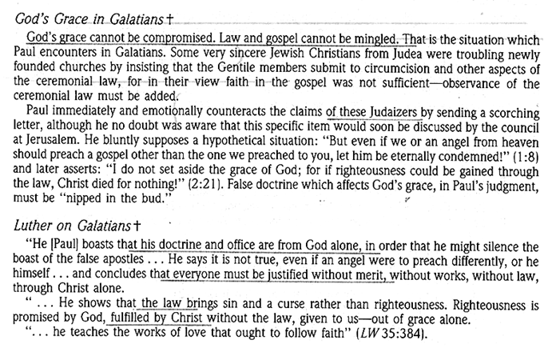

Slide 12
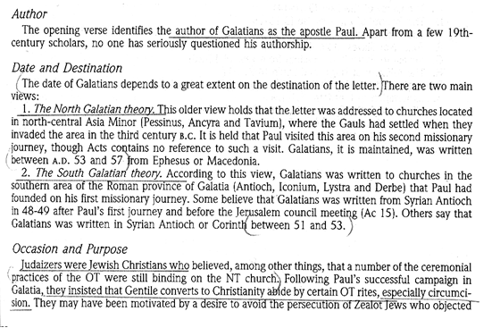

Slide 62
