Slide 1
Trinity Lutheran Church Norman, Oklahoma – www.tlcnorman.org The Book of Galatians Theme: “The True Gospel You Have Received” Date: 10-2-22 Lesson: 27 - Chapter 5:9-12

Slide 2
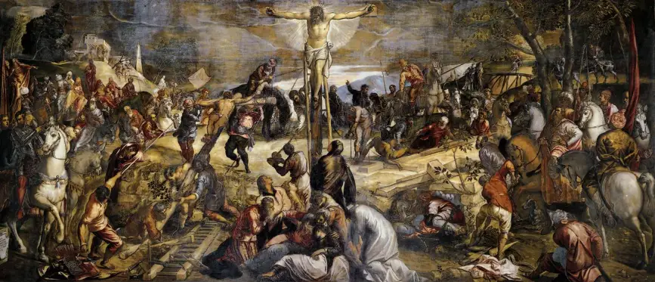

Slide 3
(9) A little leaven leavens the whole lump. (10) I have confidence in the Lord that you will take no other view than mine, and the one who is troubling you will bear the penalty, whoever he is. (11) But if I, brothers, still preach circumcision, why am I still being persecuted? In that case the offense of the cross has been removed. (12) I wish those who unsettle you would emasculate themselves!
(Mt 13:33; Mk 6:1-3; 8:15; Lk 2:34; Jn 6:60-64;
Rom 8:28; 9:32,33; 11:19; 1 Cor 1:23; 5:6; 2 Cor 2:3; Php 3:2,15; 1 Pet 2:4-10)

Slide 4
11. But if I, brethren, still preach circumcision, why am I still persecuted?
In that case the stumbling block of the cross has been removed.
“But now, because I preach the Gospel of Christ and the righteousness of faith, together with the abrogation of the Law and of circumcision, I suffer persecution. On the other hand, in order not to have to bear the cross and the bitter hatred of the Jewish people, the false apostles preach circumcision; in this way they curry the favor of the Jews and keep them as their friends.” Similarly he says in the sixth chapter (v. 12): “They would compel you to be circumcised, etc.” In addition, they would like to bring it about that there be no dispute at all, but only peace and harmony, between Gentiles and Jews. But it is impossible for this to happen except at the cost of the doctrine of faith, which is the doctrine of the cross and is full of stumbling blocks.
Therefore when Paul says: “If I still preach circumcision, why am I still persecuted? In that case the stumbling block of the cross has been removed,” he wants to show that it would be an absurdity and a disgrace if the stumbling block of the cross were to end. He speaks the same way in 1 Cor. 1:17: “Christ sent me to preach the Gospel, not with eloquent wisdom, lest the cross of Christ be emptied of its power.” It is as though he were saying: “I would not be willing to remove the stumbling block and the cross of Christ.” Here someone may say: “Christians must be quite insane if they expose themselves to dangers voluntarily. For all they accomplish with their preaching is to gain for themselves the anger and hatred of the world and to create stumbling blocks.
And that, as the saying goes, is laboring in vain and simply looking for trouble.”﻿³⁷﻿ “This fact,” says Paul, “does not offend or bother us at all; it only makes us courageous and optimistic about the success and growth of the church, which flourishes and grows under persecution.” For Christ, the Head and the Bridegroom of the church, must “rule in the midst of His foes” (Ps. 110:2). On the other hand, when the cross and the raging of tyrants and heretics have been removed, and the stumbling blocks have come to an end, and when the devil “guards his own palace, and his goods are in peace” (Luke 11:21), this is a sure sign that the pure teaching of the Word has been taken away.

Slide 5
On the other hand, the world regards it as a sure sign that the Gospel is a heretical and seditious doctrine when it sees that the preaching of the Gospel is followed by great upheavals, disturbances, offenses, sects, etc
The term “stumbling block of the cross” may be understood either actively or passively. The cross immediately follows the teaching of the Word, in accordance with the statement of Ps. 116:10: “I believed; therefore I have spoken. But I am greatly afflicted.” Now the cross of Christians is ignominious and merciless persecution; therefore it is a great stumbling block. To begin with, they suffer as though they were the vilest scoundrels. The prophet Isaiah predicted this about Christ Himself (53:12): “He was numbered with the transgressors.”
Thus the cross and death of the godly are filled with stumbling blocks. “Do not let that bother you,” says Paul, “the inhuman treatment and the continuance of the cross and of the stumbling block, but rather let it encourage you; for as long as these things continue, the Christian cause is doing very well.”
Christ also comforts His followers in this way in Matt. 5:11–12: “Blessed are you when men revile you and persecute you and utter all kinds of evil against you falsely on My account. Rejoice and be glad, for your reward is great in heaven; for so men persecuted the prophets who were before you.” The church will not permit this joy to be taken away from it. In short, the church must suffer persecution because it teaches the Gospel purely.

Slide 6
The Gospel proclaims the mercy and the glory of God; it discloses the wickedness and the wiles of the devil, portraying him in his true colors and taking away his mask of divine majesty, by which he has made an impression on the whole world. That is, it shows that all the forms of worship, religious ways of life, and monastic orders invented by men, as well as the traditions about celibacy, special foods, etc., by which men think they can gain the forgiveness of sins and justification, are all ungodly things and “doctrines of demons” (1 Tim. 4:1).
Thus there is nothing that vexes the devil more than the proclamation of the Gospel; for this takes away from him the mask of God and shows him up for what he is, not God but the devil. Therefore it is unavoidable that when the Gospel flourishes, the stumbling block of the cross will follow; otherwise it is sure that the devil has not really been attacked but has only been gently caressed. If he is really attacked, he does not remain quiet but begins to raise a terrible disturbance and to create havoc everywhere.
Therefore if Christians want to keep the Word, they must not be offended or frightened when they see the devil breaking his reins and running wild, or the whole world in tumult, or tyrants in a rage, or sects arising. But they should know for a certainty that these are signs, not of terror but of joy, as Christ interpreted them when He said (Matt. 5:12): “Rejoice and be glad.”
Therefore may the stumbling block of the cross never be taken away, which is what would happen if we were to preach what the ruler of this world (John 14:30) and his members would like to hear, namely, the righteousness of works; then we would have the devil friendly to us, the world on our side, and the pope and the princes kindly disposed toward us. But because we illumine the blessings and the glory of Christ, they persecute us and rob us of our goods and our very lives.”

Slide 7
LIFE APPLICATION
How is the Gospel proclamation still an offense (stumbling block) to people today
when they hear about the cross of Christ?

Slide 9
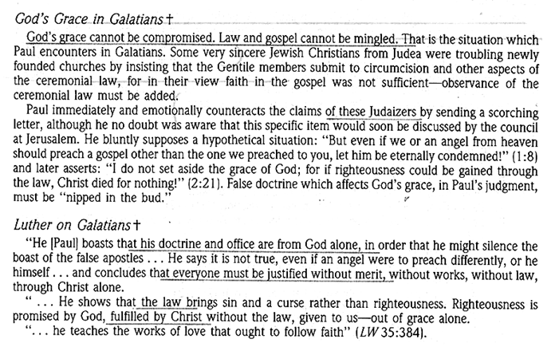

Slide 10
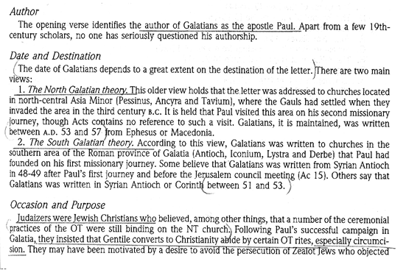

Slide 60
