Slide 1
Trinity Lutheran Church Norman, Oklahoma – www.tlcnorman.org The Book of Galatians Theme: “The True Gospel You Have Received” Date: 9-25-22 Lesson: 26 - Chapter 5:1-12

Slide 3
(1) For freedom Christ has set us free; stand firm therefore, and do not submit again to a yoke of slavery. (2) Look: I, Paul, say to you that if you accept circumcision, Christ will be of no advantage to you. (3) I testify again to every man who accepts circumcision that he is obligated to keep the whole law. (4) You are severed from Christ, you who would be justified by the law; you have fallen away from grace.
(Mt 23:4; Jn 8:32; Ac 15:1,10,11;
Rom 2:25; 3:28; 7:4; 1 Cor 16:13;
Heb 12:15; Jas 2:10; 2 Pet 3:17)

Slide 4
(5) For through the Spirit, by faith, we ourselves eagerly wait for the hope of righteousness. (6) For in Christ Jesus neither circumcision nor uncircumcision counts for anything, but only faith working through love. (7) You were running well. Who hindered you from obeying the truth? (8) This persuasion is not from him who calls you.
(Rom 8:23,24; 16:3; 1 Cor 7:19; 9:24; Php 2:16; 1 Th 1:3; Jas 2:18-22)

Slide 5
(9) A little leaven leavens the whole lump. (10) I have confidence in the Lord that you will take no other view than mine, and the one who is troubling you will bear the penalty, whoever he is. (11) But if I, brothers, still preach circumcision, why am I still being persecuted? In that case the offense of the cross has been removed. (12) I wish those who unsettle you would emasculate themselves!
(Mt 13:33; Mk 8:15; Lk 2:34;
Rom 8:28; 9:32,33; 1 Cor 1:23; 5:6; 2 Cor 2:3; Php 3:2,15)

Slide 6
Luther’s Commentary – Vol. 27
6. For in Christ Jesus neither circumcision nor uncircumcision is of any avail, but faith working through love.
What is this? Do not those who receive circumcision keep God’s commandment? Did He not give this commandment through Moses and Abraham? I have said above that those who are circumcised in the flesh without the circumcision of the heart are uncircumcised in the sight of God, although it is true that the Jews of necessity had to keep the ceremonial requirements of the Law until Christ came. For the promise to Abraham and the Law of Moses were in force until Christ came, as Moses clearly says in Deut. 18:15 that they should listen to the Prophet whom God was going to raise up, just as they listened to Moses himself. Accordingly, Moses did not want to be listened to after the coming of this Prophet, who is Christ, as the apostle Peter, in Acts 3:23, cites this same passage against the Jews.
And when God gave Abraham the commandment of circumcision, He surely wanted this to remain in force only until the appearance of the promised blessing. For with the coming of the Offspring with regard to whom the promise was made certainly the promise and the covenant of the promise, together with its seal, were simultaneously brought to an end. After the coming of Christ, therefore, circumcision is nothing. Nevertheless, it is a matter of indifference and permissible, just as is everything else concerning days, food, clothing, places, sacrifices, etc., even though they were of no value, even before the coming of Christ, if they were done without the inward righteousness, as Isaiah says (1:11): “What to Me is the multitude of your sacrifices?” And Micah asks (6:6): “What worthy offering shall I make to the Lord?” Thus in Heb. 9:10 it is stated that all these things were imposed until the time of reformation. But even the works of the Decalog were outside grace and must be brought to an end, in order that its works that are true in the spirit may take their place.

Slide 7
When Paul speaks of “faith working through love,” this is a clarification of his remarks that sheds light on them and gives understanding to the immature, in order that we may understand what kind of faith he is talking about so often, namely, one that is genuine and sincere, and, as he writes to Timothy (1 Tim. 1:5), is “from a good conscience and sincere faith.”
Nor am I dealing here with the frivolous questions and the disgusting opinions with which they determine that “acquired” faith is a prerequisite for “infused” faith, as if the Holy Spirit were in need of us and we were not rather in need of Him in everything. For they dream that if a boy who has just been baptized were brought up among Turks and unbelievers without a Christian teacher, he would not be able to know the things a Christian must know.
But this is nonsense, as if they did not experience before their eyes every day of what little advantage Christian teaching is to those who are not inwardly drawn by God, and, on the other hand, what great things are being done by those who are not outwardly taught as many great things as the theologians teach and are taught. It is something living, yes, life and reality, if the Spirit does the teaching. He knows, He speaks, He works all things in all. He whom God teaches is certainly no different from him whom God creates anew.

Slide 8
Therefore he who hears the Word of Christ sincerely and clings to Him in faith is at once also clothed with the Spirit of love, as Paul said above: “Did you receive the Spirit by works of the Law, or by hearing with faith?” (Gal. 3:2.)
For if you hear Christ sincerely, it is impossible for you not to love Him forthwith, since He has done and borne so much for you. If you are able to love the person who gives you a present of twenty florins or honors you with some service, how will you fail to love Him who gives up, not gold but His very self for you, receives so many wounds for you, sweats blood and sheds it, dies and endures the uttermost? But if you do not love him, it is certain that you do not listen to these things sincerely and do not truly believe that they were done for you. For the Spirit brings it about that you do this.
Very judiciously, therefore, and very significantly he speaks of “faith working through love” That is, as Erasmus shows from the Greek, a faith which is powerfully active, not one that snores once it has been “acquired” or one that is strong through miracles but one that is powerfully active through love. Just as he said earlier: “He who worked through Peter worked for me also for the Gentiles.” For the word expresses energy.

Slide 9
LIFE APPLICATION
For through the Spirit, by faith, we ourselves eagerly wait for the hope of righteousness.
Only faith working through love
counts for anything.
So then how is this exhibited in our lives?

Slide 11
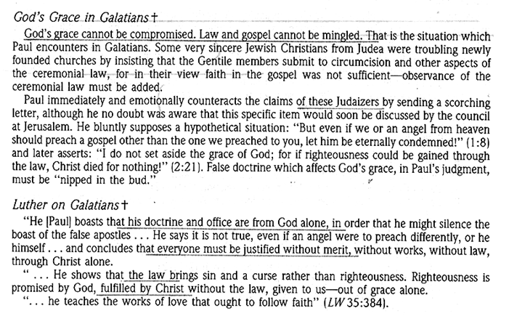

Slide 12
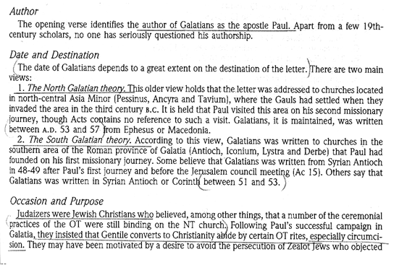

Slide 62
