Slide 1
Trinity Lutheran Church Norman, Oklahoma – www.tlcnorman.org The Book of Galatians Theme: “The True Gospel You Have Received” Date: 3-6-22 Lesson: 2 - Chapter 1:2-5

Slide 3
TEXT AND STUDY (2) and all the brothers who are with me, To the churches of Galatia: (Acts 13:14 – 14:23; 16:6; Php 4:20,21; 2 Tim 4:10; 1 Pet 1:1)

Slide 4
(3) Grace to you and peace from God our Father and the Lord Jesus Christ,
(John 14:27; 20:19; Rom 1:7; Eph 1:2)
(4) who gave himself for our sins to deliver us from the present evil age, according to the will of our God and Father,
(Mt 1:21; 20:28; Jn 1:29; 1 Cor 1:20; 15:3; 2 Cor 4:4; Eph 2:2; 6:12; 1 Pet 2:24)
(5) to whom be the glory forever and ever. Amen.
(Rom 9:5; 11:36; 16:27; Eph 3:21; 1 Tim 1:17)

Slide 5
LUTHER’S COMMENTARY
To the churches of Galatia.
“Paul had preached throughout Galatia. Although he had not entirely converted it to Christ, he still had many churches there, into which the false apostles, the devil’s ministers, had sneaked.
Thus in our time the fanatics do not come to those places where the enemies of the Gospel have the upper hand but to those where there are Christians and good people, who love the Gospel. They insinuate themselves among such people, even in the territories of the tyrants and persecutors of the Gospel. Sneaking into houses under false pretenses, they spew out their venom and undermine the faith of the common people. But why do they not rather go into the cities, countries, and territories of the papists and confess and support their doctrine there before evil princes, bishops, and theologians in the universities, as we have done by the grace of God?
These precious martyrs are not willing to take any chances but move into places where the Gospel has already established itself and where they can live without danger and in great tranquility. Thus the false apostles would not run the risk of going to Caiaphas in Jerusalem or to the emperor in Rome or to some other place where no one had ever preached before, as Paul and the others did. Instead, they came to Galatia, which had already been gained and prepared for Christ by the toil and trouble of Paul, and into Asia, into Corinth, where there were good men and Christians who were not persecuting anyone but were suffering everything quietly. There the enemies of the cross of Christ could live in great smugness, without undergoing any persecution.
Here you should learn that pious preachers have this lot in life. In addition to the persecution that they have to endure from the wicked and ungrateful world and the hard labor that they experience in planting churches, they are forced to see the quick overthrow of what they had taught for so long in its purity, at the hands of the fanatics, who thereupon lord it over them and get the upper hand. This causes more anguish for godly ministers than any persecution by tyrants.

Slide 6
Therefore let anyone who is reluctant to bear such contempt and reproach not become a minister of the Gospel; or if he is one, let him turn over his ministry to someone else. As you see, we today are despised and troubled—outwardly by tyrants, inwardly by those whom we have liberated with the Gospel, as well as by false brethren. But this is our comfort and glory: being called by God, we have a promise of eternal life, and we look for that reward which “no eye has seen, nor ear heard, nor the heart of man conceived” (1Cor. 2:9). For when Christ, the chief Shepherd, is manifested, we shall obtain the unfading crown of glory (1 Peter 5:4); and even in this world He will not let us starve.
Jerome raises an important question here: Why does Paul call “churches” those that were not churches? For Paul, he says, is writing to the Galatians, who had been led astray and turned away from Christ and from grace to Moses and the Law.﻿﻿ I reply: When Paul calls them the “churches of Galatia,” he is employing synecdoche, a very common practice in the Scriptures.﻿﻿ Writing in a similar vein to the Corinthians, he congratulates them that the grace of God was given them in Christ, that is, that they were enriched in Him with all speech and all knowledge (1 Cor. 1:4–5).
And yet many of them had been perverted by false apostles and did not believe in the resurrection of the dead, etc. So today we still call the Church of Rome holy and all its sees holy, even though they have been undermined and their ministers are ungodly. For God “rules in the midst of His foes” (Ps. 110:2), Antichrist “takes his seat in the temple of God” (2 Thess. 2:4), and Satan is present among the sons of God (Job 1:6). Even if the church is “in the midst of a crooked and perverse generation,” as Paul says to the Philippians (2:15), and even if it is surrounded by wolves and robber.”

Slide 7
LIFE APPLICATION
“Grace to you and peace from God our Father and the Lord Jesus Christ.”
What is the connection between grace and peace in our daily lives?

Slide 8
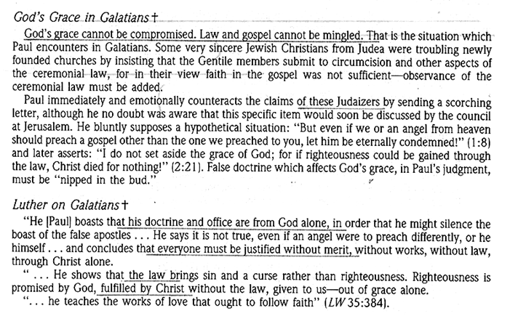

Slide 9
